Slide 1
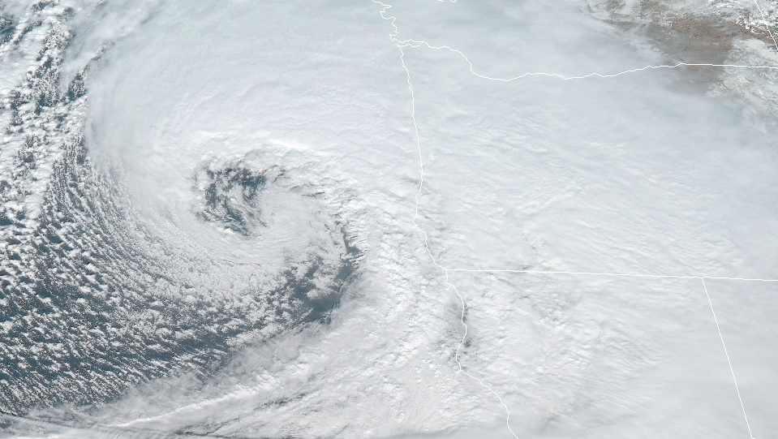
Atmospheric Oscillations:
Linear Perturbation Theory
Kinematics and Dynamics

Slide 2

Atmospheric Oscillations:
Linear Perturbation Theory
Outline of this lecture packet…
  The perturbation method
  Properties of waves
  Simple wave types
  Internal gravity (buoyancy) waves
  Gravity waves modified by rotation
  Adjustment to geostrophic balance
  Rossby waves

Slide 3
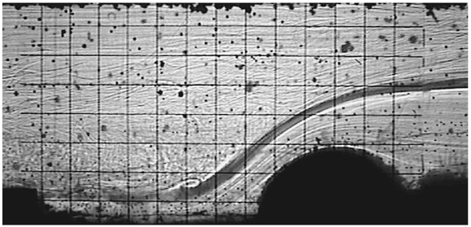
Atmospheric Oscillations:
Linear Perturbation Theory
The perturbation method
  Non-linear nature of the governing equations (and today’s computer weather forecast models) makes it difficult to gain insight into the causes of wave-like atmospheric disturbances
    Helpful to employ simplified models
Introduction
https://www.researchgate.net/figure/The-formation-of-wave-like-disturbances-behind-an-obstacle-of-radius-r-2-5-cm-a-and_fig11_319301383

Slide 4
Atmospheric Oscillations:
Linear Perturbation Theory
The perturbation method
  Useful technique for giving a qualitative analysis of atmospheric waves
    Example, inertial acceleration
Introduction

Slide 5
Atmospheric Oscillations:
Linear Perturbation Theory
The perturbation method
  Basic state variables themselves satisfy governing equations (when perturbations are zero)
  Products of perturbation are neglected
  Original equations are reduced to linear differential equations (analytic solutions exist)
    propagation speed, vertical structure, and conditions for growth or decay of the waves (will be applied to problem of baroclinic instability in the next lecture packet)
Assumptions

Slide 6
Atmospheric Oscillations:
Linear Perturbation Theory
Properties of waves
  Atmospheric waves have solutions similar to (our Physics I friend!!) the linear harmonic oscillator
Introduction

Slide 7
Atmospheric Oscillations:
Linear Perturbation Theory
Properties of waves
  the period, or time required to execute a single oscillation, is independent of the amplitude of the oscillation
Introduction

Slide 8
Atmospheric Oscillations:
Linear Perturbation Theory
Properties of waves
  Solution of the linear harmonic oscillator
Introduction

Slide 9
Atmospheric Oscillations:
Linear Perturbation Theory
Properties of waves
  Propagating waves; characterized by amplitude and phase
    Example 1D wave moving in x-direction (east-west)…
    k is wavenumber = (2π/wavelength)
    phase is constant for someone moving with the phase speed
Introduction

Slide 10
Atmospheric Oscillations:
Linear Perturbation Theory
Properties of waves
  phase is constant for someone moving with the phase speed
Introduction

Slide 11
Atmospheric Oscillations:
Linear Perturbation Theory
Properties of waves
Fourier Series (single sine wave is over-simplistic)

Slide 12
Atmospheric Oscillations:
Linear Perturbation Theory
Properties of waves
  dispersive waves - waves in which the phase speed varies with k, the various sinusoidal components of a disturbance originating at a given location are at a later time found in different places, that is, they are dispersed
  non-dispersive waves - a spatially localized disturbance consisting of a number of Fourier wave components (a wave group) will preserve its shape as it propagates in space at the phase speed of the wave
Dispersion and Group Velocity

Slide 13
Atmospheric Oscillations:
Linear Perturbation Theory
Properties of waves
  dispersive waves - shape of a wave group will not remain constant as the group propagates. Because the individual Fourier components of a wave group may either reinforce or cancel each other, depending on the relative phases of the components, the energy of the group will be concentrated in limited regions
Dispersion and Group Velocity

Slide 14
Atmospheric Oscillations:
Linear Perturbation Theory
Properties of waves
Dispersion and Group Velocity

Slide 15
Atmospheric Oscillations:
Linear Perturbation Theory
Properties of waves
  When waves are dispersive, the speed of the wave group is generally different from the average phase speed of the individual Fourier components.
    In synoptic-scale atmospheric disturbances, the group velocity exceeds the phase velocity [b]
    Surface waves in deep water (such as a ship wake) are characterized by dispersion in which individual wave crests move twice as fast as the wave group [a]
Dispersion and Group Velocity

Slide 16
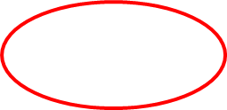
Atmospheric Oscillations:
Linear Perturbation Theory
Properties of waves
  Group velocity - velocity at which the observable disturbance (and hence the energy) propagates
  Example,
Dispersion and Group Velocity
envelope
carrier wave

Slide 17
Atmospheric Oscillations:
Linear Perturbation Theory
Properties of waves
  Group velocity (example),
Dispersion and Group Velocity

Slide 18
Atmospheric Oscillations:
Linear Perturbation Theory
Simple wave types
  Waves in fluids result from the action of restoring forces on fluid parcels that have been displaced from their equilibrium positions.
    The restoring forces, due to
      compressibility,
      gravity,
      rotation, or
      electromagnetic effects
Introduction

Slide 19
Atmospheric Oscillations:
Linear Perturbation Theory
Simple wave types
  longitudinal waves - waves in which the particle oscillations are parallel to the direction of propagation
Acoustic or Sound Waves
for propagation in the positive x direction…

Slide 20
Atmospheric Oscillations:
Linear Perturbation Theory
Simple wave types
Acoustic or Sound Waves
momentum equation, continuity equation, and thermodynamic energy equation for adiabatic motion…

Slide 21
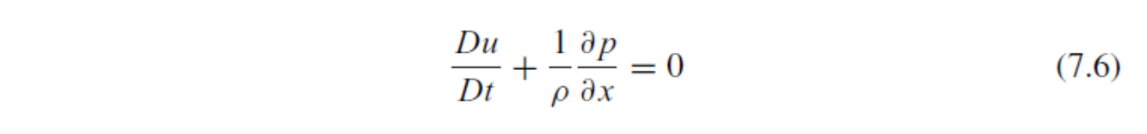
Atmospheric Oscillations:
Linear Perturbation Theory
Simple wave types
Acoustic or Sound Waves

Slide 22
Atmospheric Oscillations:
Linear Perturbation Theory
Simple wave types
Acoustic or Sound Waves

Slide 23
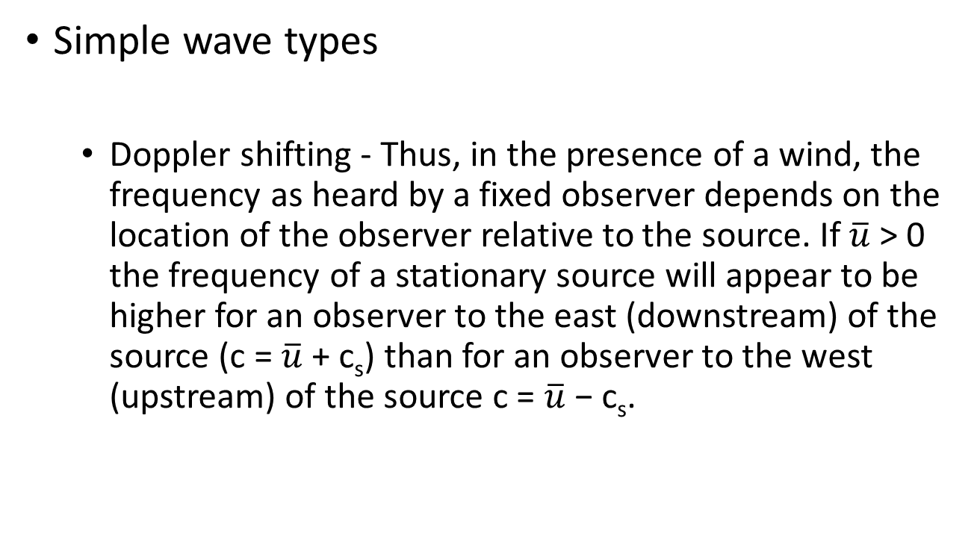
Atmospheric Oscillations:
Linear Perturbation Theory
Simple wave types
  Doppler shifting - Thus, in the presence of a wind, the frequency as heard by a fixed observer depends on the location of the observer relative to the source. If $\overline{u}$> 0 the frequency of a stationary source will appear to be higher for an observer to the east (downstream) of the source (c = $\overline{u}$ + c_{s}) than for an observer to the west (upstream) of the source c = $\overline{u}$− c_{s}.
Acoustic or Sound Waves

Slide 24
Atmospheric Oscillations:
Linear Perturbation Theory
Simple wave types
  transverse waves – waves whose particle motion oscillations are at right angles to the direction of phase propagation
Shallow Water Gravity Waves

Slide 25
Atmospheric Oscillations:
Linear Perturbation Theory
Simple wave types
  consider a fluid system consisting of two homogeneous incompressible layers of differing density (no acoustic waves)
Shallow Water Gravity Waves

Slide 26
Atmospheric Oscillations:
Linear Perturbation Theory
Simple wave types
Shallow Water Gravity Waves

Slide 27
Atmospheric Oscillations:
Linear Perturbation Theory
Simple wave types
Shallow Water Gravity Waves

Slide 28
Atmospheric Oscillations:
Linear Perturbation Theory
Simple wave types
Shallow Water Gravity Waves

Slide 29
Atmospheric Oscillations:
Linear Perturbation Theory
Simple wave types
Shallow Water Gravity Waves
Shallow water gravity waves may be generated by underwater earthquakes (tsunamis) or along interfaces within the ocean where there is a very sharp density gradient (thermocline).

Slide 30
Atmospheric Oscillations:
Linear Perturbation Theory
Internal gravity (buoyancy) waves
  …can only exist when the atmosphere is stably stratified so that a fluid parcel displaced vertically will undergo buoyancy oscillations (see Section 2.7.3). Because the buoyancy force is the restoring force responsible for gravity waves, the term buoyancy wave is actually more appropriate as a name for these waves. However, in this text we will generally use the traditional name gravity wave.
Introduction

Slide 31
Atmospheric Oscillations:
Linear Perturbation Theory
Internal gravity (buoyancy) waves
  in a fluid that has no upper boundary, such as the atmosphere, gravity waves may propagate vertically as well as horizontally
    internal waves - In vertically propagating waves the phase is a function of height [are not generally of great importance for synoptic-scale weather forecasting].
Introduction

Slide 32
Atmospheric Oscillations:
Linear Perturbation Theory
Internal gravity (buoyancy) waves
Pure Internal Gravity Waves

Slide 33
Atmospheric Oscillations:
Linear Perturbation Theory
Internal gravity (buoyancy) waves
Pure Internal Gravity Waves

Slide 34
Atmospheric Oscillations:
Linear Perturbation Theory
Internal gravity (buoyancy) waves
Pure Internal Gravity Waves

Slide 35
Atmospheric Oscillations:
Linear Perturbation Theory
Internal gravity (buoyancy) waves
Pure Internal Gravity Waves

Slide 36
Atmospheric Oscillations:
Linear Perturbation Theory
Internal gravity (buoyancy) waves
Pure Internal Gravity Waves

Slide 37
Atmospheric Oscillations:
Linear Perturbation Theory
Internal gravity (buoyancy) waves
  If we let k > 0 and m < 0, then lines of constant phase tilt eastward with increasing height as shown in Fig. 7.9 (i.e., for φ = kx+mz to remain constant as x increases, z must also increase when k > 0 and m < 0).
Pure Internal Gravity Waves

Slide 38
Atmospheric Oscillations:
Linear Perturbation Theory
Internal gravity (buoyancy) waves
  If we let k > 0 and m < 0, then lines of constant phase tilt eastward with increasing height as shown in Fig. 7.9 (i.e., for φ = kx+mz to remain constant as x increases, z must also increase when k > 0 and m < 0).
Pure Internal Gravity Waves

Slide 39
Atmospheric Oscillations:
Linear Perturbation Theory
Internal gravity (buoyancy) waves
  Thus, the vertical component of group velocity has a sign opposite to that of the vertical phase speed relative to the mean flow (downward phase propagation implies upward energy propagation).
Pure Internal Gravity Waves

Slide 40
Atmospheric Oscillations:
Linear Perturbation Theory
Internal gravity (buoyancy) waves
  Internal gravity waves thus have the remarkable property that group velocity is perpendicular to the direction of phase propagation.
  Energy propagates parallel to the wave crests and troughs, rather than perpendicular to them as in acoustic waves or shallow water gravity waves.
  Internal gravity waves generated in the troposphere may propagate upward many scale heights into the middle atmosphere, even though individual fluid parcel oscillations may be confined to vertical distances much less than a kilometer.
Pure Internal Gravity Waves

Slide 41
Atmospheric Oscillations:
Linear Perturbation Theory
Internal gravity (buoyancy) waves
  The tilt of phase lines for internal gravity waves depends only on the ratio of the intrinsic wave frequency to the buoyancy frequency, and is independent of wavelength.
Pure Internal Gravity Waves

Slide 42

Atmospheric Oscillations:
Linear Perturbation Theory
Internal gravity (buoyancy) waves
  When air with mean wind speed $\overline{u}$is forced to flow over a sinusoidal pattern of ridges under statically stable conditions, individual air parcels are alternately displaced upward and downward from their equilibrium levels and will thus undergo buoyancy oscillations as they move across the ridges
Topographic Waves

Slide 43
Atmospheric Oscillations:
Linear Perturbation Theory
Internal gravity (buoyancy) waves
  When air with mean wind speed $\overline{u}$is forced to flow over a sinusoidal pattern of ridges under statically stable conditions, individual air parcels are alternately displaced upward and downward from their equilibrium levels and will thus undergo buoyancy oscillations as they move across the ridges
Topographic Waves

Slide 44
Atmospheric Oscillations:
Linear Perturbation Theory
Internal gravity (buoyancy) waves
Topographic Waves

Slide 45
Atmospheric Oscillations:
Linear Perturbation Theory
Internal gravity (buoyancy) waves
Topographic Waves

Slide 46
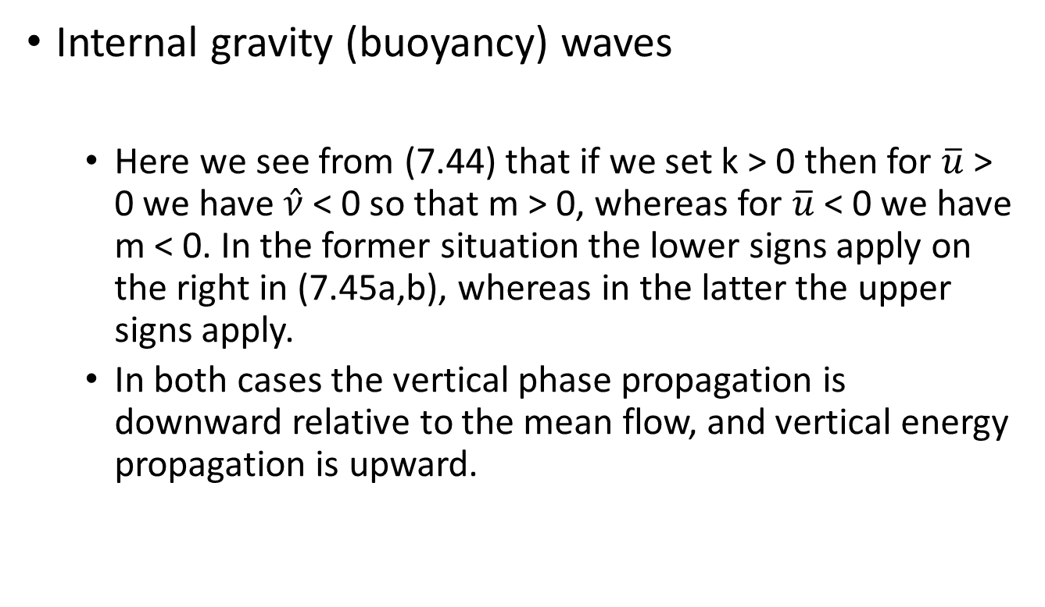
Atmospheric Oscillations:
Linear Perturbation Theory
Internal gravity (buoyancy) waves
  Here we see from (7.44) that if we set k > 0 then for $\overline{u}$ > 0 we have $\hat{ν}$< 0 so that m > 0, whereas for $\overline{u}$< 0 we have m < 0. In the former situation the lower signs apply on the right in (7.45a,b), whereas in the latter the upper signs apply.
  In both cases the vertical phase propagation is downward relative to the mean flow, and vertical energy propagation is upward.
Topographic Waves

Slide 47
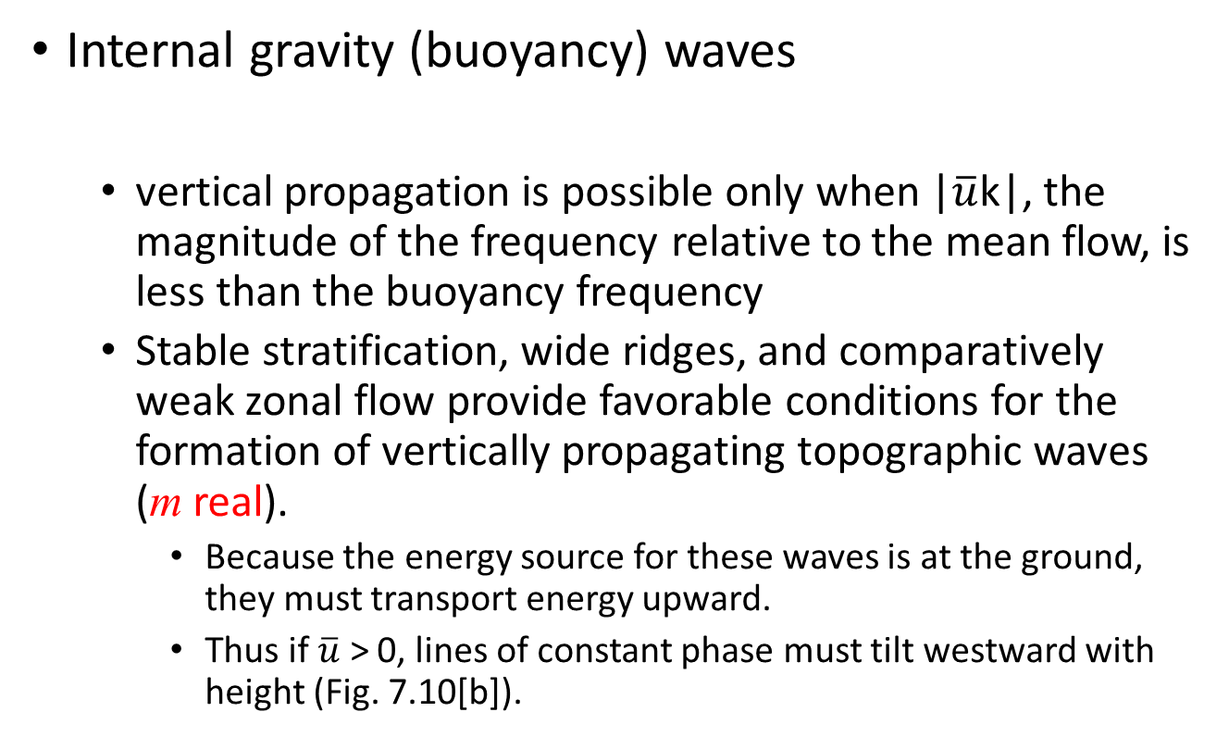
Atmospheric Oscillations:
Linear Perturbation Theory
Internal gravity (buoyancy) waves
  vertical propagation is possible only when |$\overline{u}$k|, the magnitude of the frequency relative to the mean flow, is less than the buoyancy frequency
  Stable stratification, wide ridges, and comparatively weak zonal flow provide favorable conditions for the formation of vertically propagating topographic waves (m real).
    Because the energy source for these waves is at the ground, they must transport energy upward.
    Thus if $\overline{u}$ > 0, lines of constant phase must tilt westward with height (Fig. 7.10[b]).
Topographic Waves

Slide 48
Atmospheric Oscillations:
Linear Perturbation Theory
Internal gravity (buoyancy) waves
Topographic Waves

Slide 49
Atmospheric Oscillations:
Linear Perturbation Theory
Internal gravity (buoyancy) waves
  Weak stable stratification, narrow ridges, and comparatively strong zonal flow provide favorable conditions for the formation of vertically trapped waves (m imaginary, Fig. 7.10[a]).
  In reality, both the zonal wind u and the stability parameter N generally vary with height, and ridges are usually isolated rather than periodic. A wide variety of responses are possible depending on the shape of the terrain and wind and stability profiles. Under certain conditions, large-amplitude waves can be formed, which may generate severe downslope surface winds and zones of strong clear air turbulence (Mtn Meteorology).
Topographic Waves

Slide 50
Atmospheric Oscillations:
Linear Perturbation Theory
Gravity waves modified by rotation
  Gravity waves with horizontal scales greater than a few hundred kilometers and periods greater than a few hours are hydrostatic, but they are influenced by the Coriolis effect and are characterized by parcel oscillations that are elliptical rather than straight lines as in the pure gravity wave case.
    the Coriolis effect resists horizontal parcel displacements in a rotating fluid
    the resistive force is at right angles to the horizontal parcel velocity
Introduction

Slide 51
Atmospheric Oscillations:
Linear Perturbation Theory
Gravity waves modified by rotation
  Section 3.2.3 showed that a parcel put into horizontal motion in a resting atmosphere with constant Coriolis parameter executes a circular trajectory in an anticyclonic sense.
Pure Inertial Oscillations

Slide 52
Atmospheric Oscillations:
Linear Perturbation Theory
Gravity waves modified by rotation
Pure Inertial Oscillations

Slide 53
Atmospheric Oscillations:
Linear Perturbation Theory
Gravity waves modified by rotation
Pure Inertial Oscillations

Slide 54
Atmospheric Oscillations:
Linear Perturbation Theory
Gravity waves modified by rotation
  instability results from an imbalance between the pressure gradient and inertial forces for a parcel displaced radially in an axisymmetric vortex
Pure Inertial Oscillations

Slide 55
Atmospheric Oscillations:
Linear Perturbation Theory
Gravity waves modified by rotation
  In the Northern Hemisphere, where f is positive, the flow is inertially stable provided that the absolute vorticity of the basic flow, ∂M/∂y, is positive.
  In the Southern Hemisphere, however, inertial stability requires that the absolute vorticity be negative.
  Observations show that for extratropical synoptic-scale systems the flow is always inertially stable, although near neutrality often occurs on the anticyclonic shear side of upper level jet streaks.
Pure Inertial Oscillations

Slide 56
Atmospheric Oscillations:
Linear Perturbation Theory
Gravity waves modified by rotation
  When the flow is both inertially and gravitationally stable, parcel displacements are resisted by both rotation and buoyancy. The resulting oscillations are called inertia–gravity waves.
Inertia–Gravity Waves

Slide 57
Atmospheric Oscillations:
Linear Perturbation Theory
Gravity waves modified by rotation
  consider parcel oscillations along a slantwise path in the (y, z) plane as shown in Fig. 7.11
Inertia–Gravity Waves

Slide 58
Atmospheric Oscillations:
Linear Perturbation Theory
Gravity waves modified by rotation
  Using the linearized dynamical equations [in this case, however, it is necessary to include rotation].
Inertia–Gravity Waves

Slide 59
Atmospheric Oscillations:
Linear Perturbation Theory
Gravity waves modified by rotation
Inertia–Gravity Waves

Slide 60
Atmospheric Oscillations:
Linear Perturbation Theory
Gravity waves modified by rotation
Inertia–Gravity Waves

Slide 61

Atmospheric Oscillations:
Linear Perturbation Theory
Gravity waves modified by rotation
  (7.66) indicates that for vertical propagation to be possible (m real) the frequency must satisfy the inequality | f | < |ν| $≪$ N
Inertia–Gravity Waves

Slide 62
Atmospheric Oscillations:
Linear Perturbation Theory
Gravity waves modified by rotation
Inertia–Gravity Waves

Slide 63
Atmospheric Oscillations:
Linear Perturbation Theory
Gravity waves modified by rotation
Inertia–Gravity Waves

Slide 64
Atmospheric Oscillations:
Linear Perturbation Theory
Gravity waves modified by rotation
  Equations (7.68) also show that the horizontal velocity vector turns anticyclonically with height for waves with upward energy propagation (e. g., waves with m < 0 and ν < 0).
  The anticyclonic turning of the horizontal wind with height and time is a primary method for identifying inertia–gravity oscillations in meteorological data.
Inertia–Gravity Waves

Slide 65
Atmospheric Oscillations:
Linear Perturbation Theory
Adjustment to geostrophic balance
  Chapter 6 showed that synoptic-scale motions in midlatitudes are in approximate geostrophic balance. Departures from this balance can lead to the excitation of inertia–gravity waves, which act to adjust the mass and momentum distributions so that the flow tends to return toward geostrophic balance.
Introduction

Slide 66
Atmospheric Oscillations:
Linear Perturbation Theory
Adjustment to geostrophic balance

Slide 67
Atmospheric Oscillations:
Linear Perturbation Theory
Adjustment to geostrophic balance
  This problem was first solved by Rossby in the 1930s and is often referred to as the Rossby adjustment problem.
Introduction

Slide 68
Atmospheric Oscillations:
Linear Perturbation Theory
Adjustment to geostrophic balance
  we consider an idealized shallow water system on a rotating plane with initial conditions
Example

Slide 69
Atmospheric Oscillations:
Linear Perturbation Theory
Adjustment to geostrophic balance
Example

Slide 70
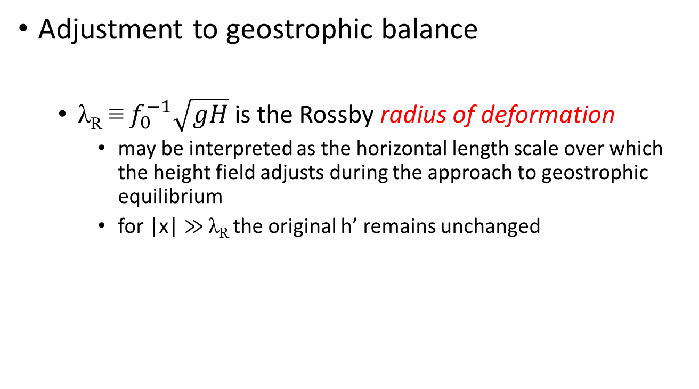
Atmospheric Oscillations:
Linear Perturbation Theory
Adjustment to geostrophic balance
  λ_{R} ≡ $f_{0}^{−1}\sqrt{gH}$ is the Rossby radius of deformation
    may be interpreted as the horizontal length scale over which the height field adjusts during the approach to geostrophic equilibrium
    for |x| $≫$ λ_{R} the original h’ remains unchanged
Example

Slide 71
Atmospheric Oscillations:
Linear Perturbation Theory
Adjustment to geostrophic balance
Example

Slide 72

Atmospheric Oscillations:
Linear Perturbation Theory
Adjustment to geostrophic balance
  Non-rotating case ( λ_{R} => $∞$ ); infinite energy release
  Rotating case…kinetic energy in the steady-state per unit length is
Example; amount of energy dispersed by gravity waves during the adjustment process

Slide 73
Atmospheric Oscillations:
Linear Perturbation Theory
Adjustment to geostrophic balance
  Rotating case…kinetic energy in the steady-state per unit length is
  a finite amount of potential energy is released, but only one-third of the potential energy released goes into the steady geostrophic mode. The remaining two-thirds is radiated away in the form of inertia–gravity waves.
Example; amount of energy dispersed by gravity waves during the adjustment process

Slide 74
Atmospheric Oscillations:
Linear Perturbation Theory
Adjustment to geostrophic balance
  it is difficult to extract the potential energy of a rotating fluid
  conservation of potential vorticity allows one to determine the steady-state geostrophically adjusted velocity and height fields without carrying out a time integration
  the length scale for the steady solution is the Rossby radius [λ_{R}]
Summary

Slide 75
Atmospheric Oscillations:
Linear Perturbation Theory
Adjustment to geostrophic balance
  Operational NWP - under some conditions the adjustment process may effectively damp out new height data inserted at a gridpoint, as the new data will generally be unbalanced and hence will tend to adjust toward geostrophic balance with the existing wind field
Summary

Slide 76
Atmospheric Oscillations:
Linear Perturbation Theory
Rossby waves
  The wave type that is of most importance for large-scale meteorological processes is the Rossby wave, or planetary wave.
    in an inviscid barotropic fluid of constant depth (where the divergence of the horizontal velocity must vanish), the Rossby wave is an absolute vorticity-conserving motion that owes its existence to the variation of the Coriolis parameter with latitude, the so-called β-effect
    in a baroclinic atmosphere, the Rossby wave is a potential vorticity conserving motion that owes its existence to the isentropic gradient of potential vorticity
Introduction

Slide 77
Atmospheric Oscillations:
Linear Perturbation Theory
Rossby waves
Introduction

Slide 78
Atmospheric Oscillations:
Linear Perturbation Theory
Rossby waves
  if the chain of parcels is subject to a sinusoidal meridional displacement under absolute vorticity conservation, the resulting perturbation vorticity will be
    positive for a southward displacement
    negative for a northward displacement
Introduction

Slide 79
Atmospheric Oscillations:
Linear Perturbation Theory
Rossby waves
  perturbation vorticity field will induce a meridional velocity field, which advects the chain of fluid parcels southward west of the vorticity maximum and northward west of the vorticity minimum
    The pattern of vorticity maxima and minima propagates to the west [constitutes a Rossby wave]
Introduction

Slide 80
Atmospheric Oscillations:
Linear Perturbation Theory
Rossby waves
  Just as a positive vertical gradient of potential temperature resists vertical fluid displacements and provides the restoring force for gravity waves, the meridional gradient of absolute vorticity resists meridional displacements and provides the restoring mechanism for Rossby waves.
Introduction

Slide 81
Atmospheric Oscillations:
Linear Perturbation Theory
Rossby waves
Introduction – speed of westward propagation

Slide 82
Atmospheric Oscillations:
Linear Perturbation Theory
Rossby waves
Free Barotropic Rossby Waves

Slide 83
Atmospheric Oscillations:
Linear Perturbation Theory
Rossby waves
Free Barotropic Rossby Waves

Slide 84
Atmospheric Oscillations:
Linear Perturbation Theory
Rossby waves
Free Barotropic Rossby Waves

Slide 85
Atmospheric Oscillations:
Linear Perturbation Theory
Rossby waves
  Rossby wave zonal phase propagation is always westward relative to the mean zonal flow.
  Rossby wave phase speed depends inversely on the square of the horizontal wavenumber.
  Rossby waves are dispersive waves whose phase speeds increase rapidly with increasing wavelength.
Free Barotropic Rossby Waves

Slide 86
Atmospheric Oscillations:
Linear Perturbation Theory
Rossby waves
  advection of planetary vorticity, which tends to make disturbances retrogress, increasingly dominates over relative vorticity advection as the wavelength of a disturbance increases
    For a typical midlatitude synoptic-scale disturbance, with similar meridional and zonal scales (l ≈ k) and zonal wavelength of order 6000 km, the Rossby wave speed relative to the zonal flow calculated from (7.92) is approximately −8 m s⁻¹
    synoptic-scale Rossby waves usually move eastward because the mean zonal wind is generally westerly and greater than 8 m s⁻¹
Free Barotropic Rossby Waves – Review 6.2.2

Slide 87
Atmospheric Oscillations:
Linear Perturbation Theory
Rossby waves
  For longer wavelengths the westward Rossby wave phase speed may be large enough to balance the eastward advection by the mean zonal wind so that the resulting disturbance is stationary relative to the surface of the earth.
Free Barotropic Rossby Waves

Slide 88
Atmospheric Oscillations:
Linear Perturbation Theory
Rossby waves
  zonal group velocity for a Rossby wave may be either eastward or westward relative to the mean flow, depending on the ratio of the zonal and meridional wave numbers
  stationary Rossby modes and synoptic-scale Rossby waves have zonal group velocities that are eastward relative to the ground
  Rossby phase speed is eastward relative to the ground, but is slower than the zonal group velocity
    => forecasting implications for downstream development
Free Barotropic Rossby Waves – Group Velocity

Slide 89
Atmospheric Oscillations:
Linear Perturbation Theory
Rossby waves
  Planetary scale-free oscillations, although they can be detected by careful observational studies, generally have rather weak amplitudes.
    Presumably this is because the forcing is quite weak at the large phase speeds characteristic of most such waves.
Free Barotropic Rossby Waves – Group Velocity

Slide 90
Atmospheric Oscillations:
Linear Perturbation Theory
Rossby waves
  forced stationary Rossby modes are of primary importance for understanding the planetary scale circulation pattern
  may be forced by longitudinally dependent diabatic heating patterns or by flow over topography
  Of particular importance for the Northern Hemisphere extratropical circulation are stationary Rossby modes forced by flow over the Rockies and the Himalayas (Section 4.3)
Forced Topographic Rossby Waves

Slide 91
Atmospheric Oscillations:
Linear Perturbation Theory
Rossby waves
  barotropic potential vorticity equation for a homogeneous fluid of variable depth (4.26)
Forced Topographic Rossby Waves

Slide 92
Atmospheric Oscillations:
Linear Perturbation Theory
Rossby waves
Forced Topographic Rossby Waves

Slide 93
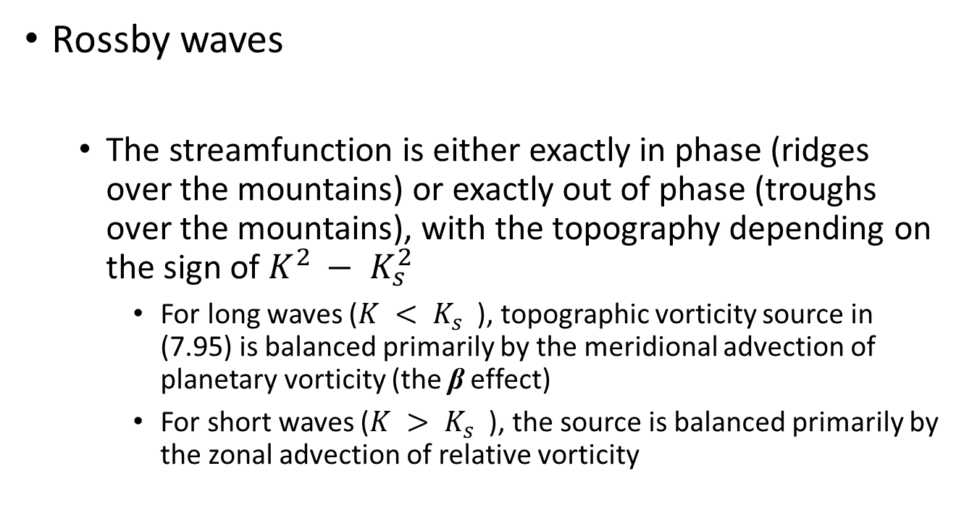
Atmospheric Oscillations:
Linear Perturbation Theory
Rossby waves
  The streamfunction is either exactly in phase (ridges over the mountains) or exactly out of phase (troughs over the mountains), with the topography depending on the sign of $K^{2 }− K_{s}^{2}$
    For long waves ($K^{ }< K_{s}^{}$), topographic vorticity source in (7.95) is balanced primarily by the meridional advection of planetary vorticity (the β effect)
    For short waves ($K^{ }> K_{s}^{}$), the source is balanced primarily by the zonal advection of relative vorticity
Forced Topographic Rossby Waves

Slide 94
Atmospheric Oscillations:
Linear Perturbation Theory
Rossby waves
  Charney and Eliassen (1949) used the topographic Rossby wave model to explain the winter mean longitudinal distribution of 500-hPa heights in Northern Hemisphere midlatitudes
Forced Topographic Rossby Waves

Slide 95
Atmospheric Oscillations:
Linear Perturbation Theory
Rossby waves
  Charney and Eliassen (1949)
Forced Topographic Rossby Waves

Slide 96
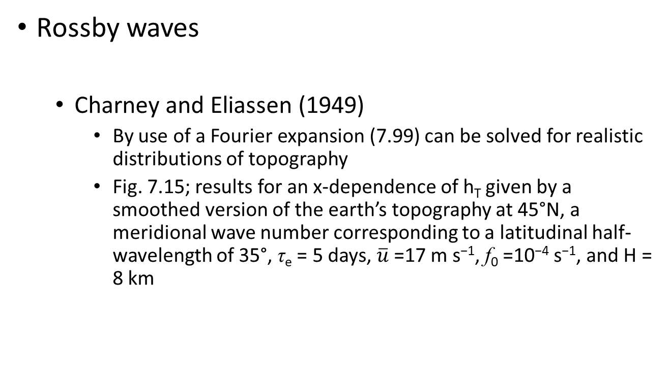
Atmospheric Oscillations:
Linear Perturbation Theory
Rossby waves
  Charney and Eliassen (1949)
    By use of a Fourier expansion (7.99) can be solved for realistic distributions of topography
    Fig. 7.15; results for an x-dependence of h_{T} given by a smoothed version of the earth’s topography at 45°N, a meridional wave number corresponding to a latitudinal half-wavelength of 35°, τ_{e} = 5 days, $\overline{u}$=17 m s⁻¹, f₀ =10⁻⁴ s⁻¹, and H = 8 km
Forced Topographic Rossby Waves

Slide 97
Atmospheric Oscillations:
Linear Perturbation Theory
Rossby waves
Forced Topographic Rossby Waves
Top
Bottom

Slide 98
Atmospheric Oscillations:
Linear Perturbation Theory
Rossby waves
  Charney and Eliassen (1949)
    Despite its simplicity, the Charney–Eliassen model does a remarkable job of reproducing the observed 500-hPa stationary wave pattern in Northern Hemisphere midlatitudes.
Forced Topographic Rossby Waves

