Slide 1
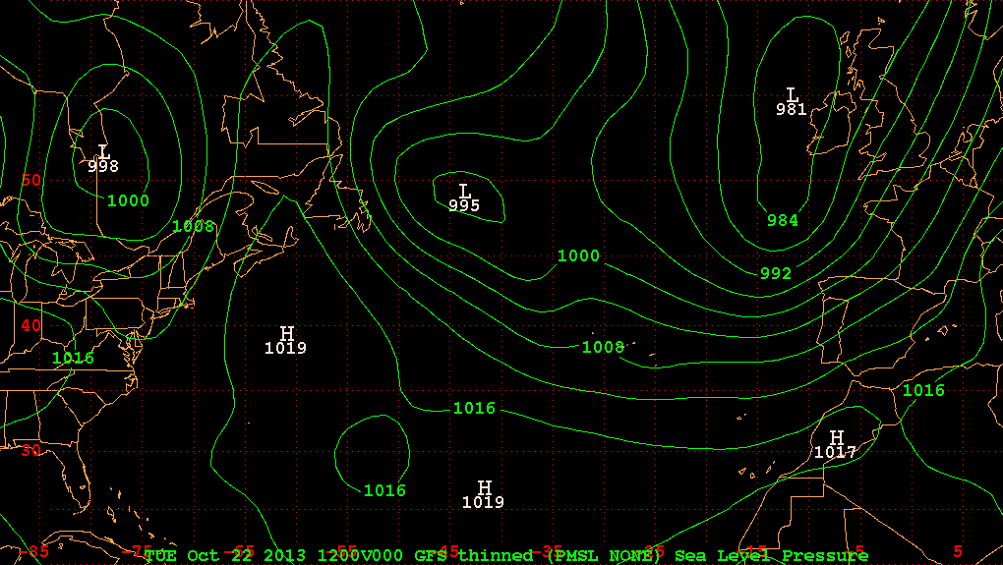
8:00 am EDT 22 Oct 2013 (Tuesday)

Slide 2
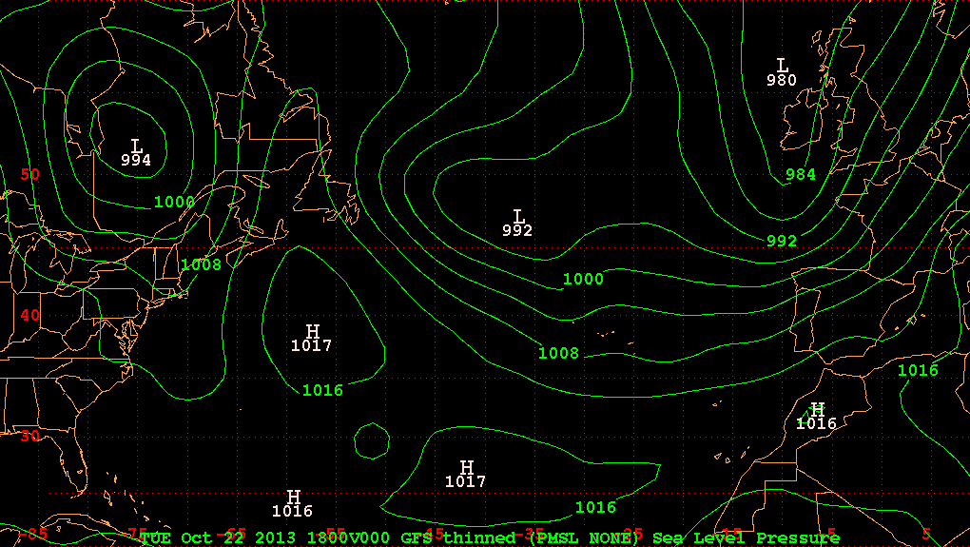
2:00 pm EDT 22 Oct 2013 (Tuesday)

Slide 3
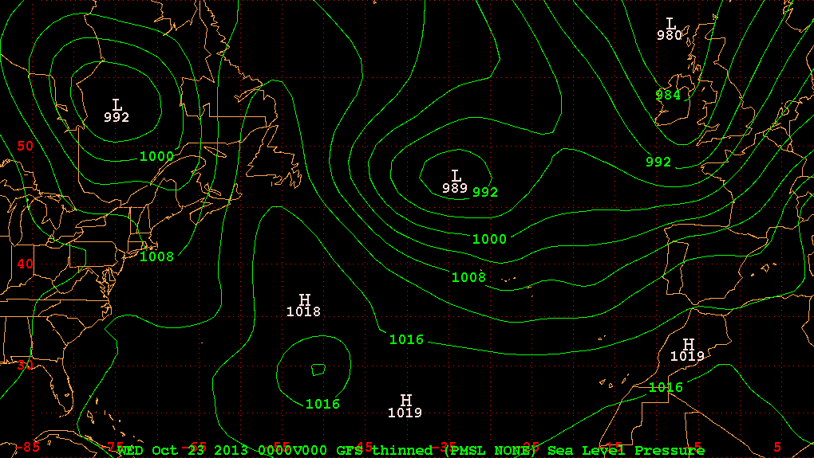
8:00 pm EDT 22 Oct 2013 (Tuesday)

Slide 4
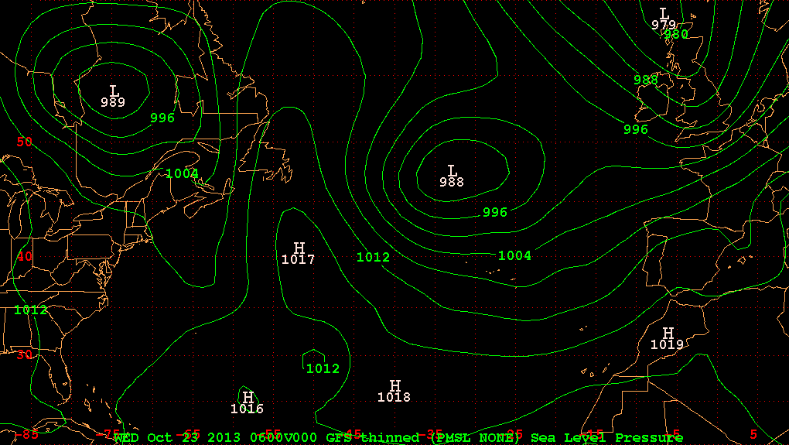
2:00 am EDT 23 Oct 2013 (Wednesday)

Slide 5
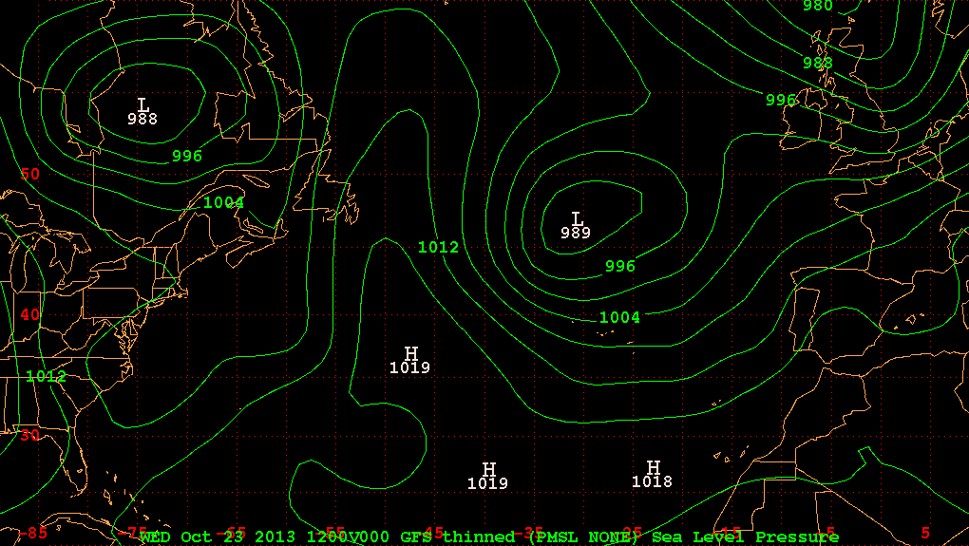
8:00 am EDT 23 Oct 2013 (Wednesday)

Slide 6
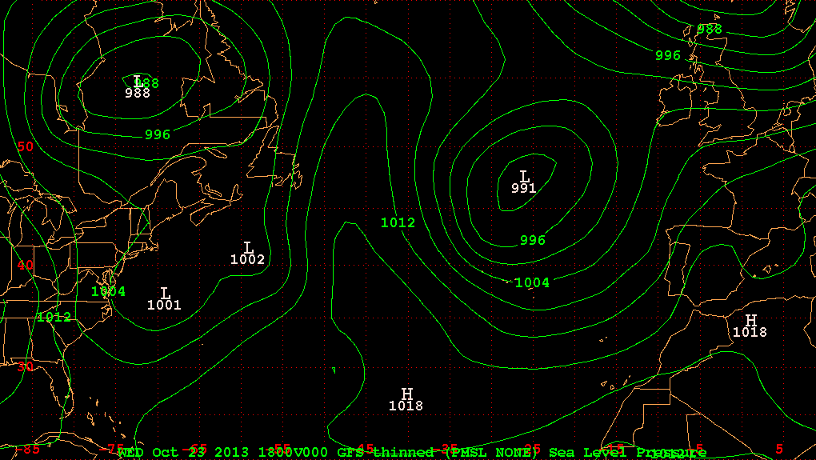
2:00 pm EDT 23 Oct 2013 (Wednesday)

Slide 7
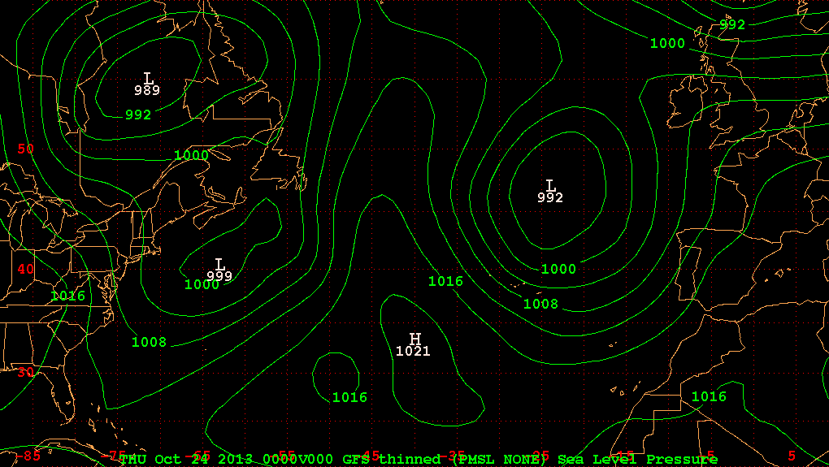
8:00 pm EDT 23 Oct 2013 (Wednesday)

Slide 8
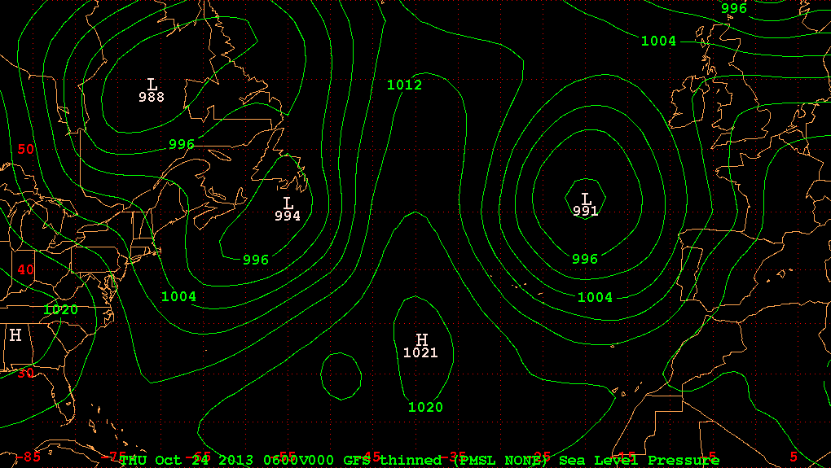
2:00 am EDT 24 Oct 2013 (Thursday)

Slide 9
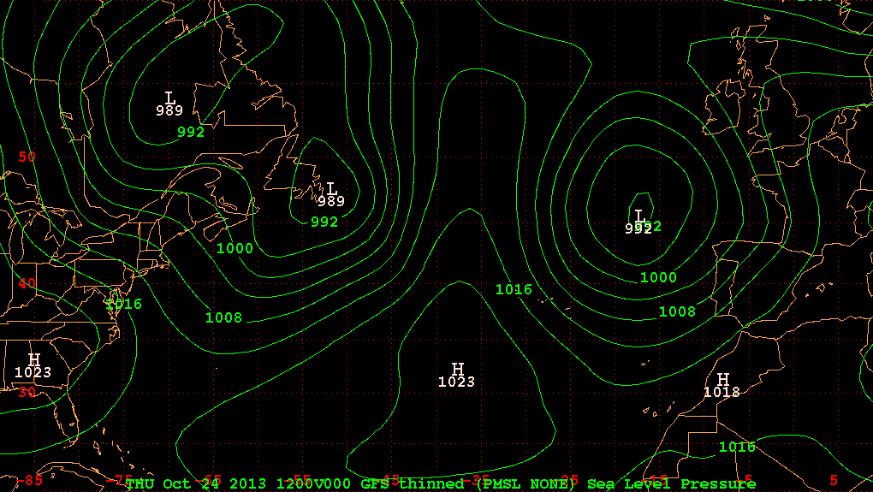
8:00 am EDT 24 Oct 2013 (Thursday)

Slide 10
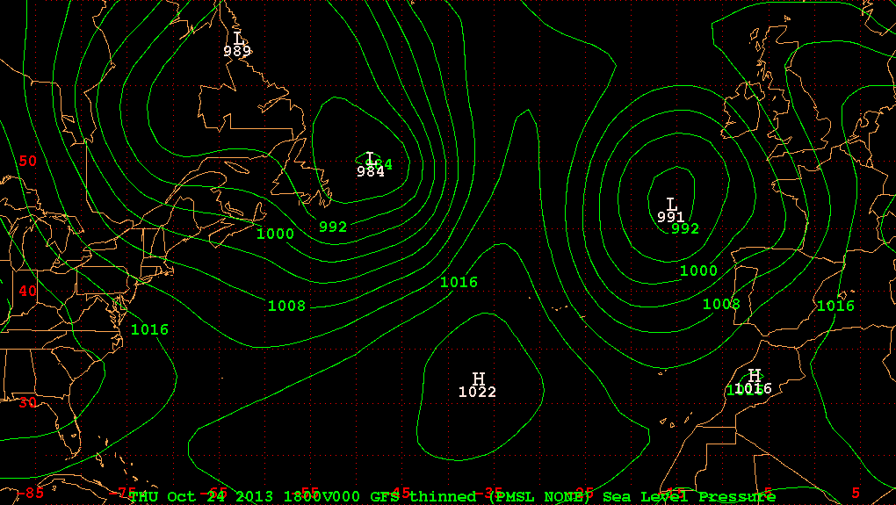
2:00 pm EDT 24 Oct 2013 (Thursday)

Slide 11
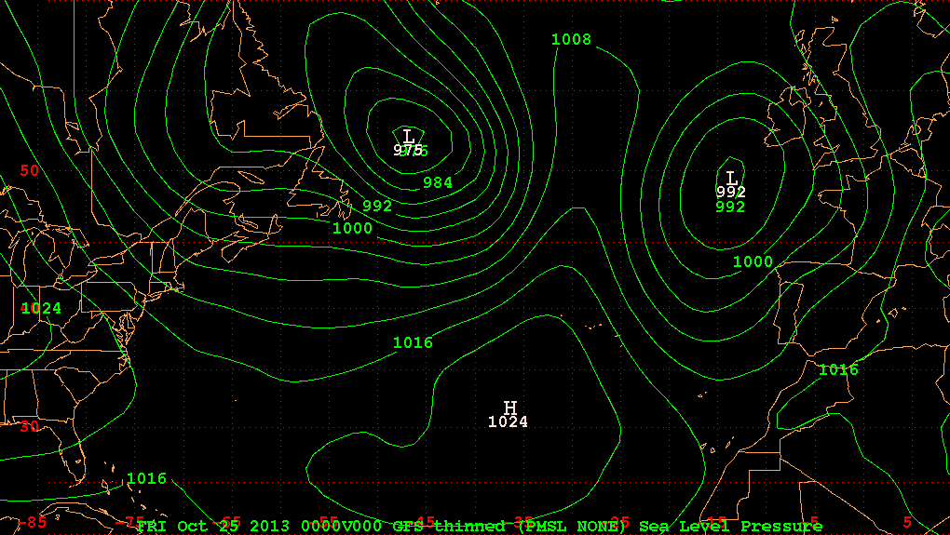
8:00 pm EDT 24 Oct 2013 (Thursday)

Slide 12
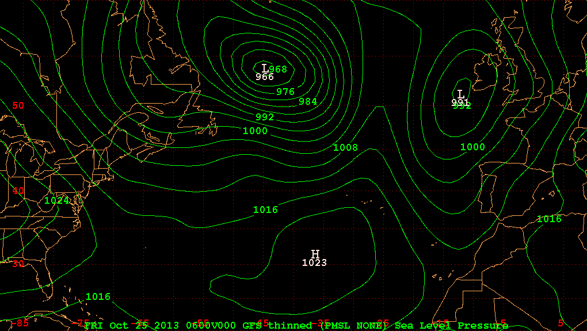
2:00 am EDT 25 Oct 2013 (Friday)

Slide 13
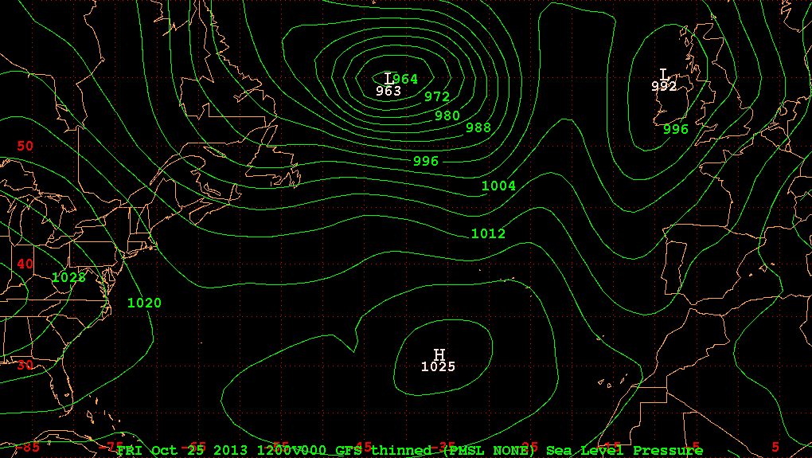
8:00 am EDT 25 Oct 2013 (Friday)

Slide 14
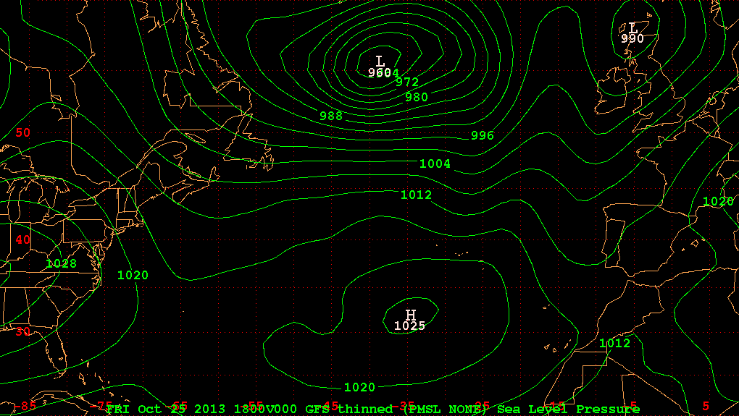
2:00 pm EDT 25 Oct 2013 (Friday)

Slide 15
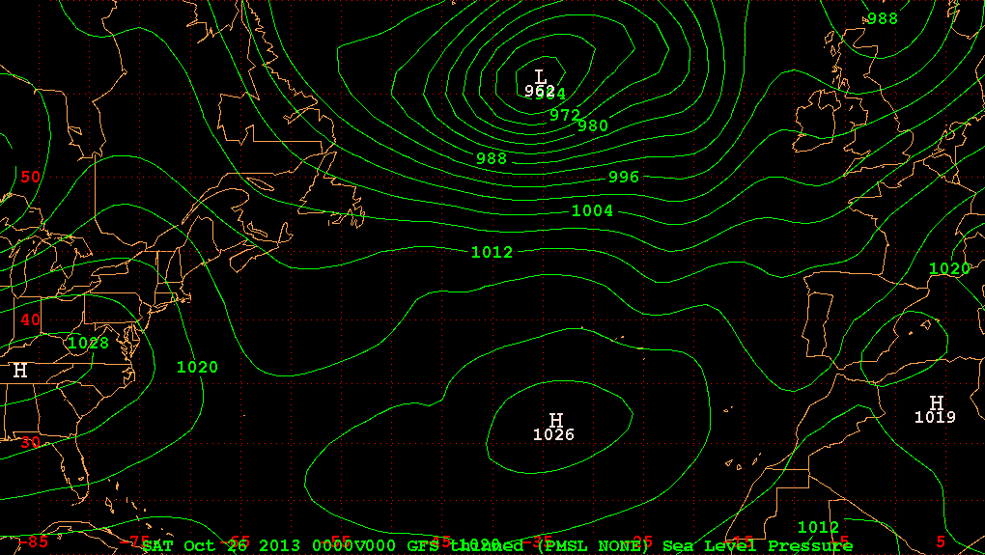
8:00 pm EDT 25 Oct 2013 (Friday)

Slide 16
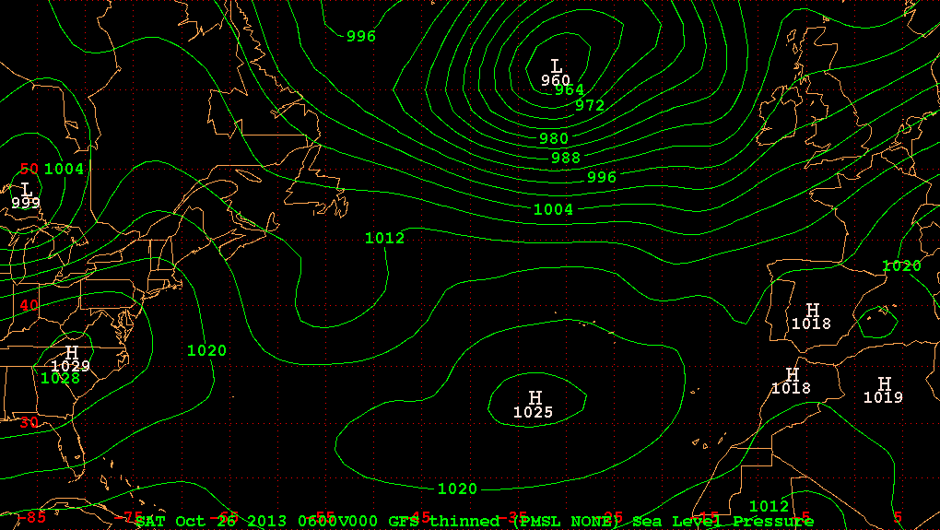
2:00 am EDT 26 Oct 2013 (Saturday)

Slide 17
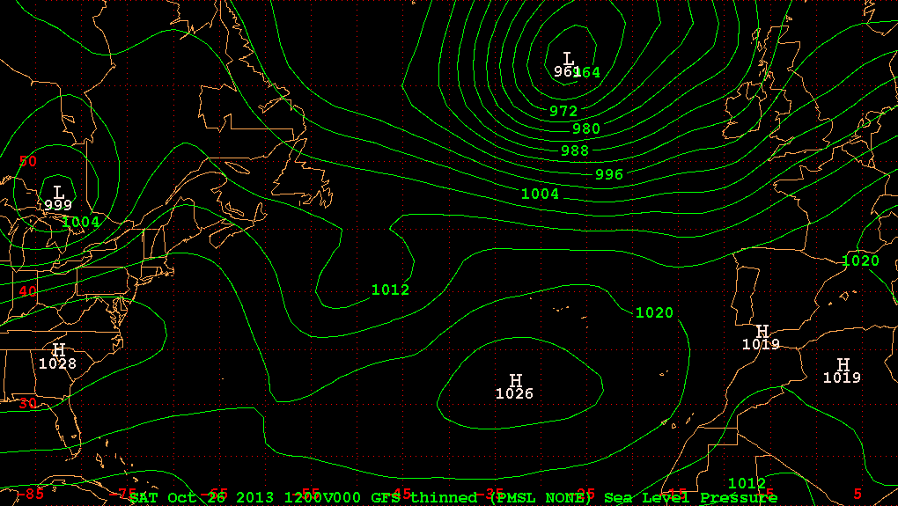
8:00 am EDT 26 Oct 2013 (Saturday)

Slide 18
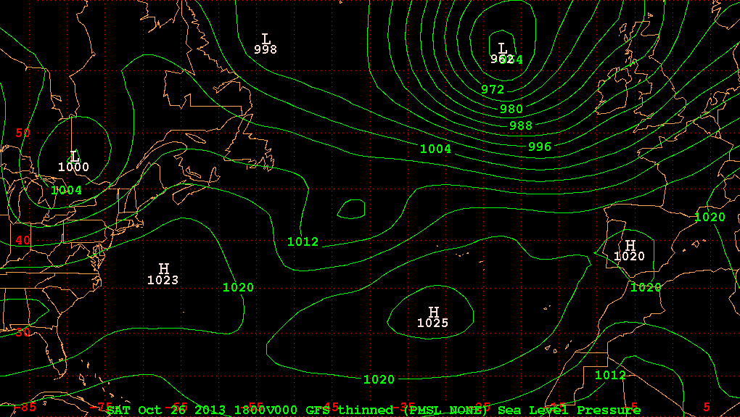
2:00 pm EDT 26 Oct 2013 (Saturday)

Slide 19
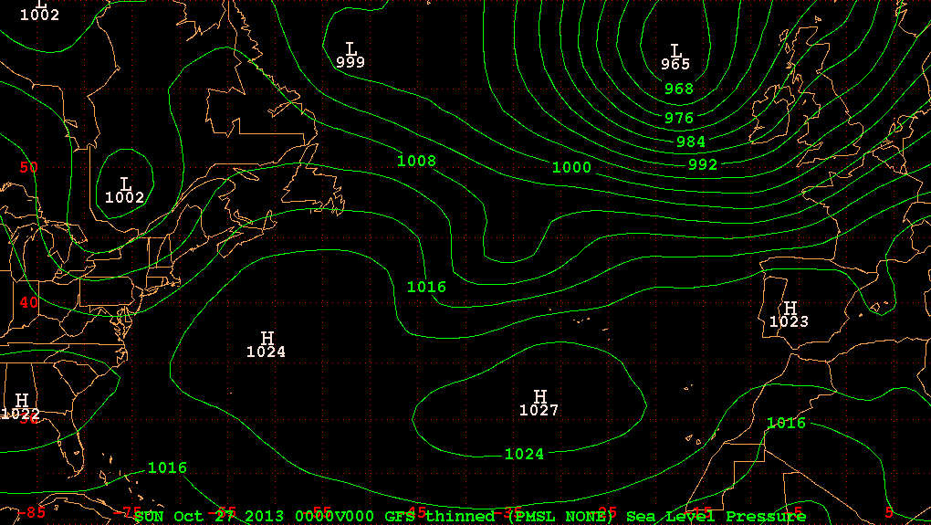
8:00 pm EDT 26 Oct 2013 (Saturday)

Slide 20
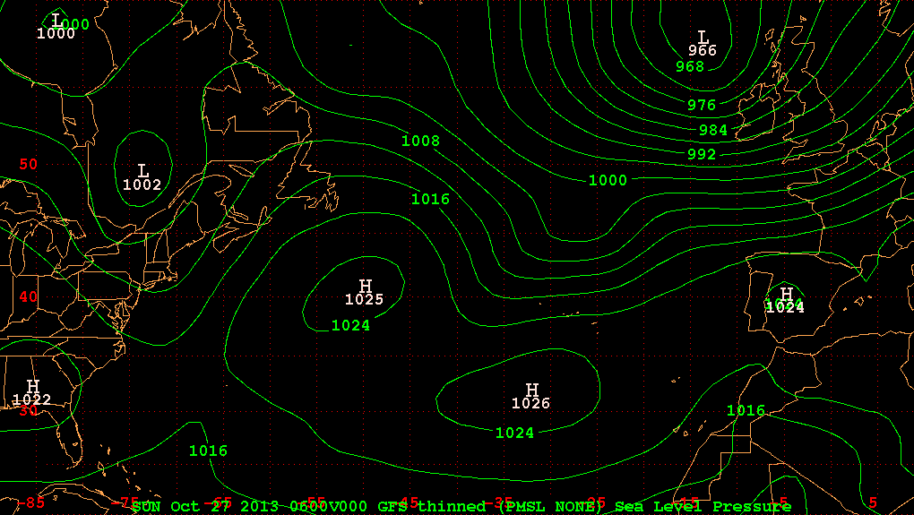
2:00 am EDT 27 Oct 2013 (Sunday)

Slide 21
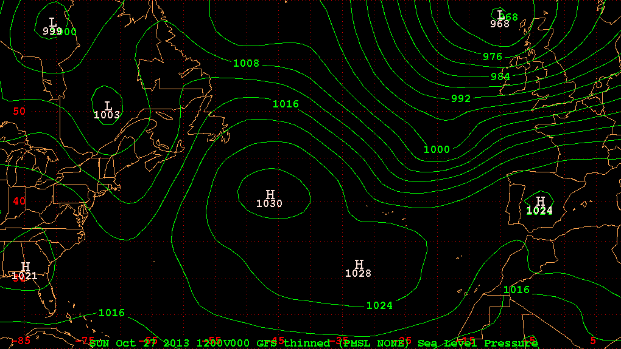
8:00 am EDT 27 Oct 2013 (Sunday)

Slide 22
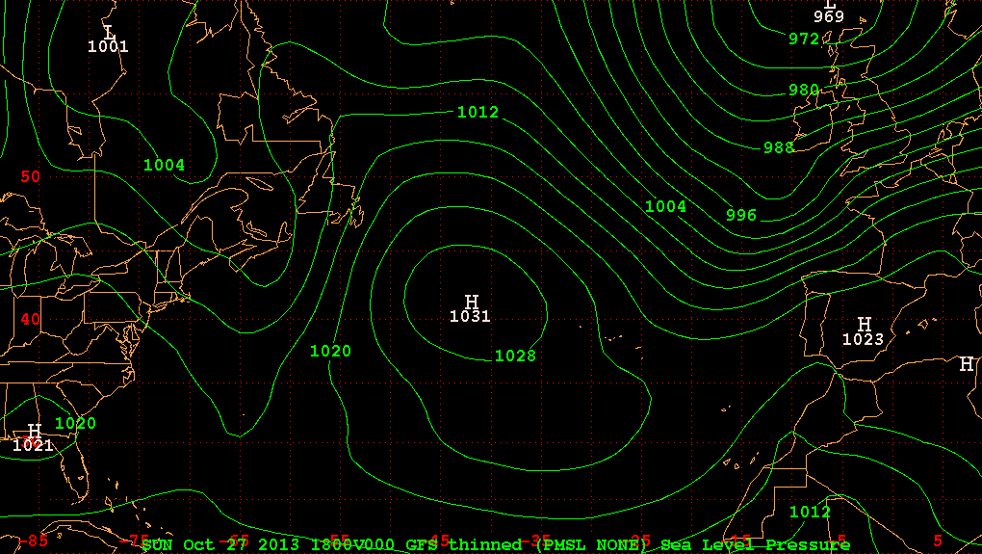
2:00 pm EDT 27 Oct 2013 (Sunday)

Slide 23
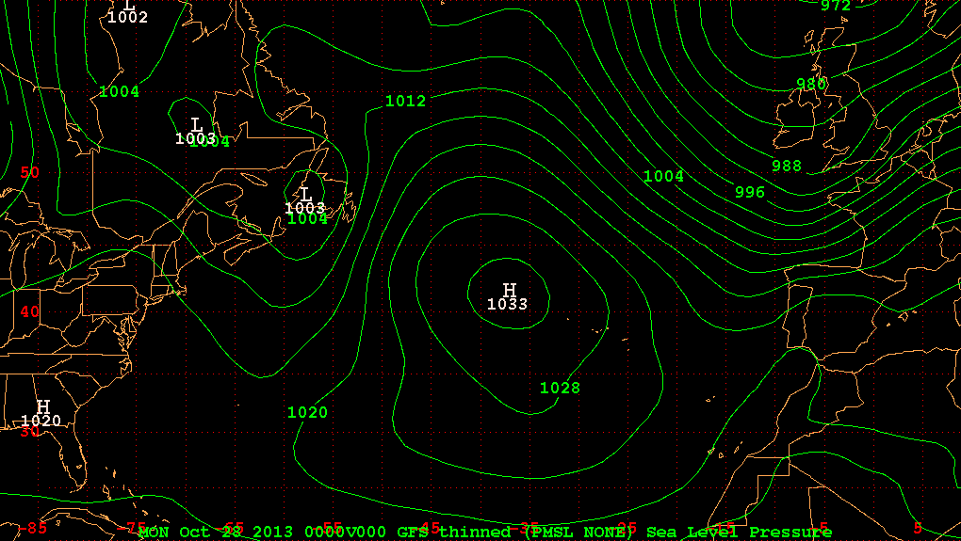
8:00 pm EDT 27 Oct 2013 (Sunday)

Slide 24
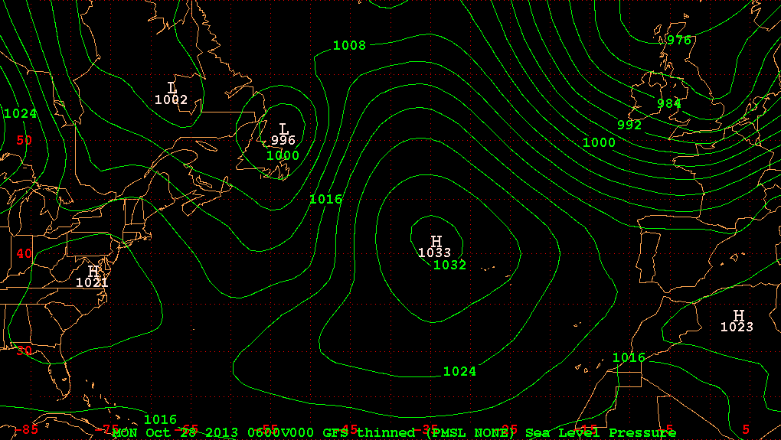
2:00 am EDT 28 Oct 2013 (Monday)

Slide 25
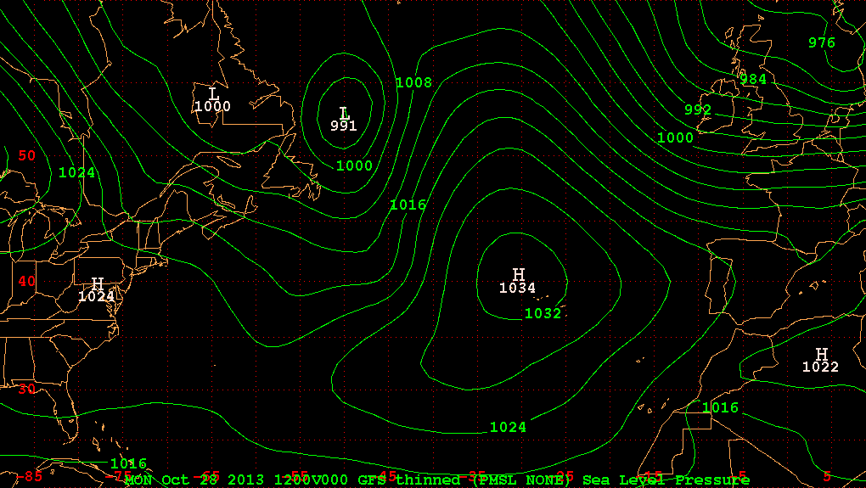
8:00 am EDT 28 Oct 2013 (Monday)

Slide 26
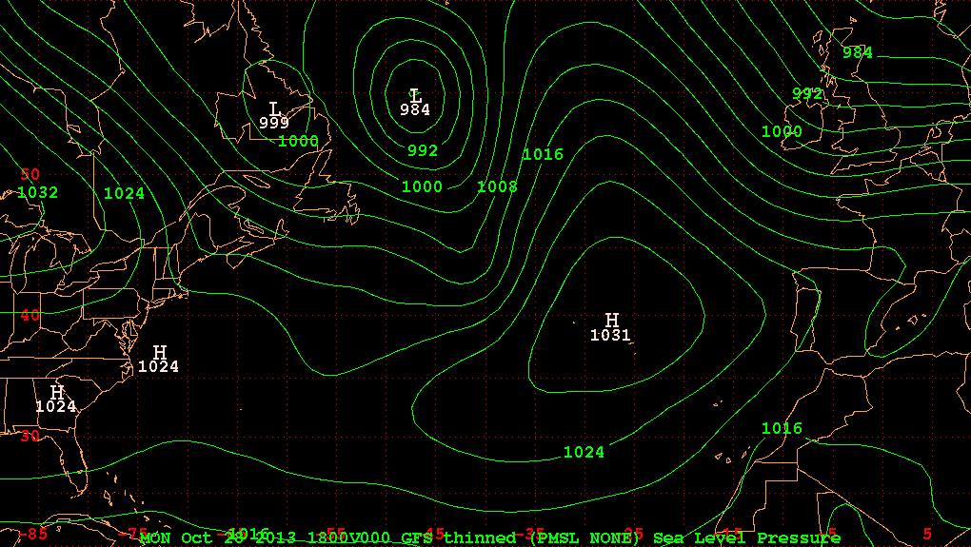
2:00 pm EDT 28 Oct 2013 (Monday)

