Slide 1
01 April 2025 Map Discussion
Asheville, North Carolina
Douglas Miller

Slide 2
Conditions at Asheville, NC
Mon. (pm) – Tues. (am) [31 Mar – 01 Apr]
Maximum Temperature = 70ºF
Minimum Temperature = 44ºF
Wind speed & direction (1800 UTC) = 7 mph from the south
24-h Precipitation = 0.09 inches

Slide 3
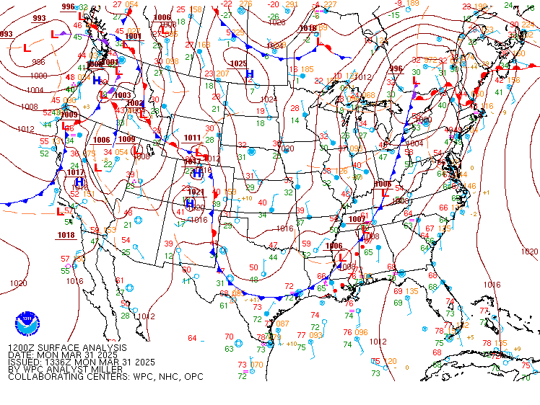
Within the past 24 hours
Sea level pressure – 1200 UTC 31 Mar 2025

Slide 4
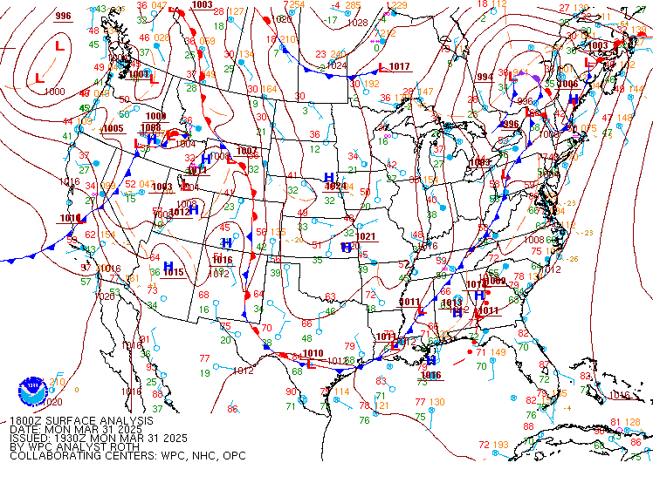
Within the past 24 hours
Sea level pressure – 1800 UTC 31 Mar 2025

Slide 5
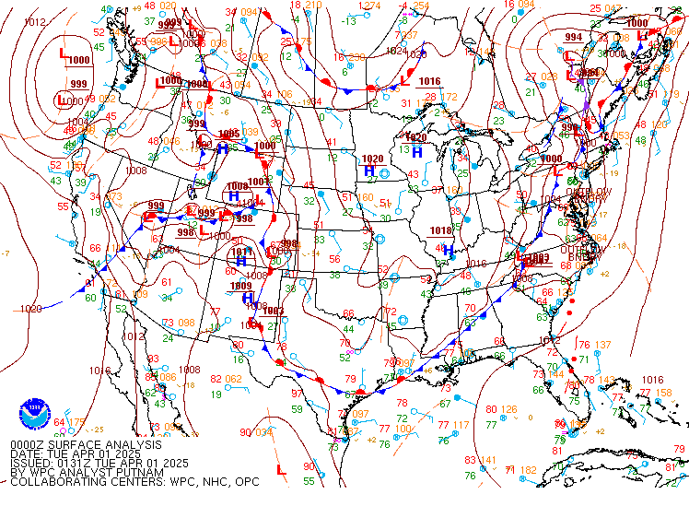
Within the past 24 hours
Sea level pressure – 0000 UTC 01 Apr 2025

Slide 6
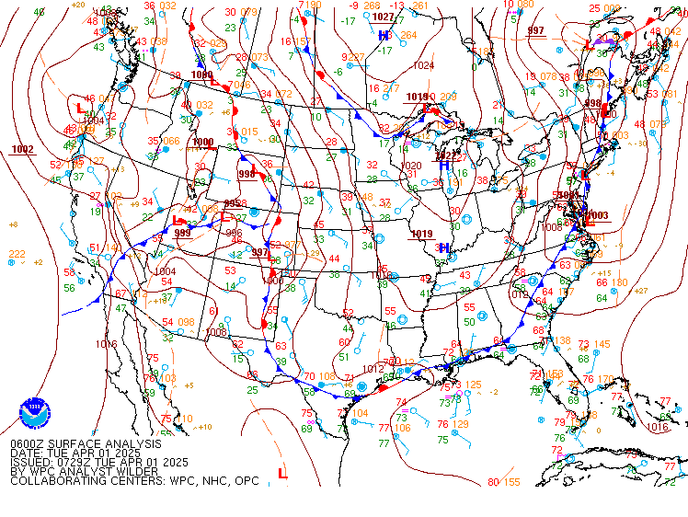
Within the past 24 hours
Sea level pressure – 0600 UTC 01 Apr 2025

Slide 7
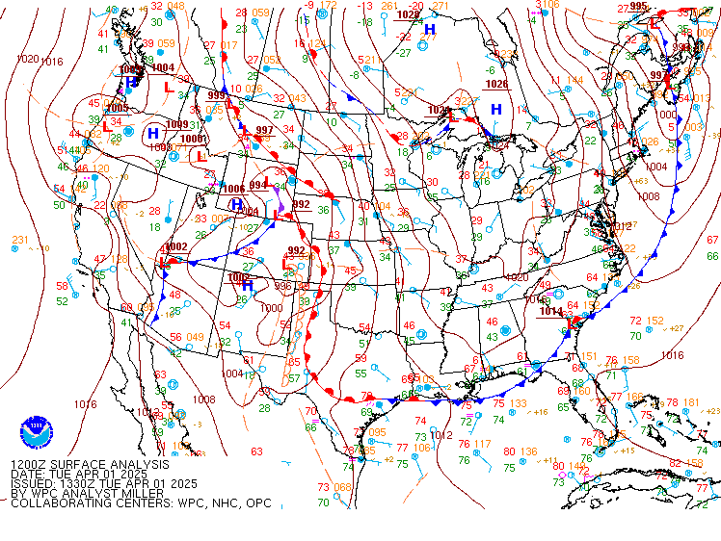
Within the past 24 hours
Sea level pressure – 1200 UTC 01 Apr 2025

Slide 8
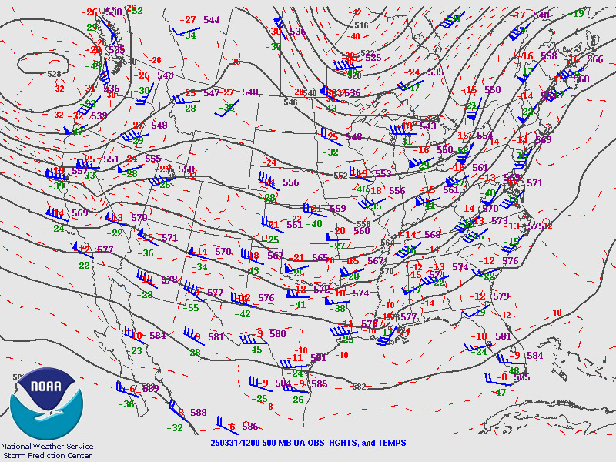
Within the past 24 hours
Halfway up through the troposphere (500 mb)
1200 UTC 31 Mar 2025

Slide 9
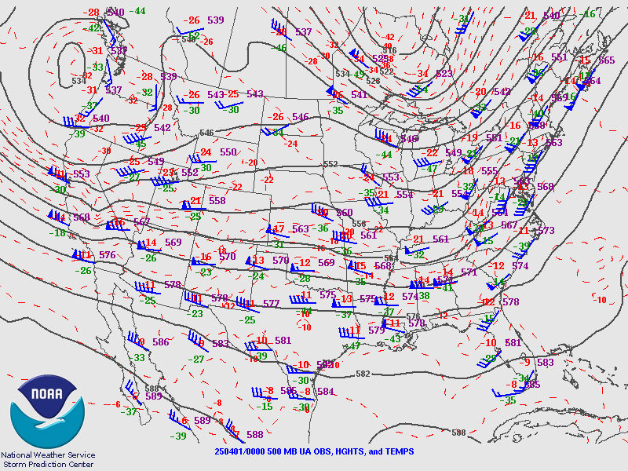
Within the past 24 hours
Halfway up through the troposphere (500 mb)
0000 UTC 01 Apr 2025

Slide 10
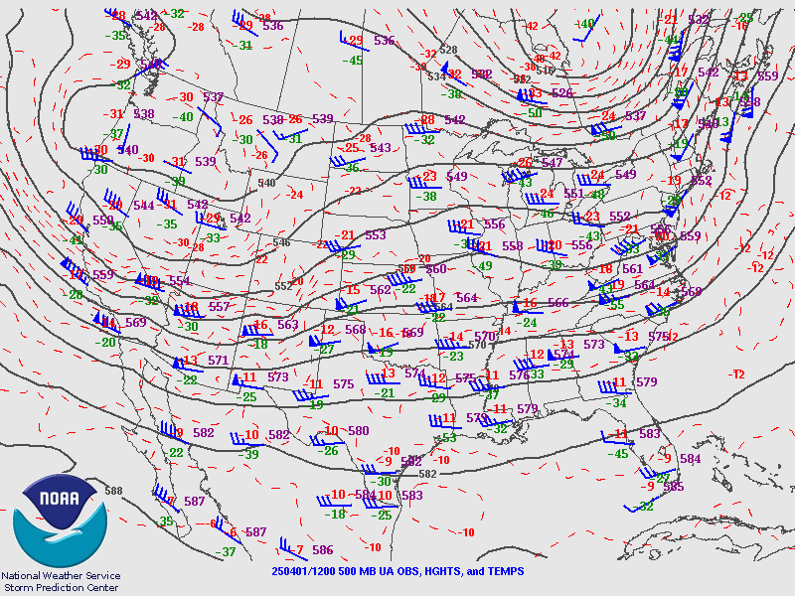
Within the past 24 hours
Halfway up through the troposphere (500 mb)
1200 UTC 01 Apr 2025

Slide 11
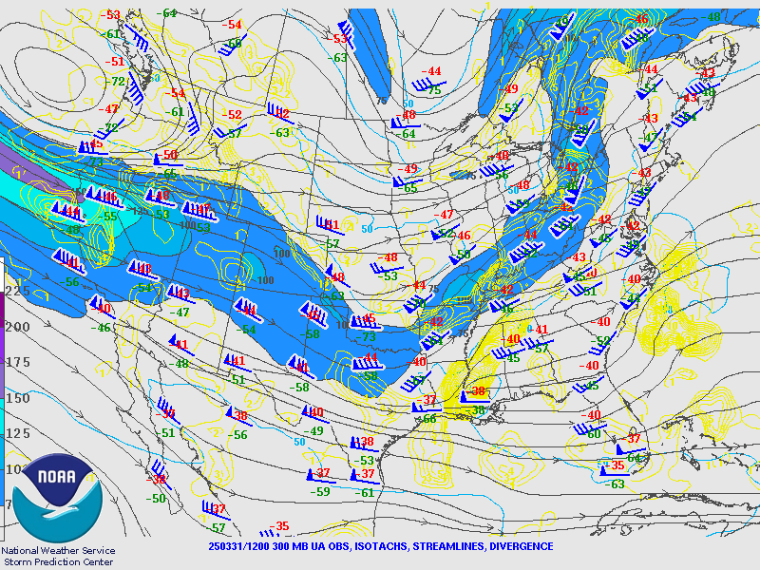
Within the past 24 hours
At the tropopause (300 mb)
1200 UTC 31 Mar 2025

Slide 12
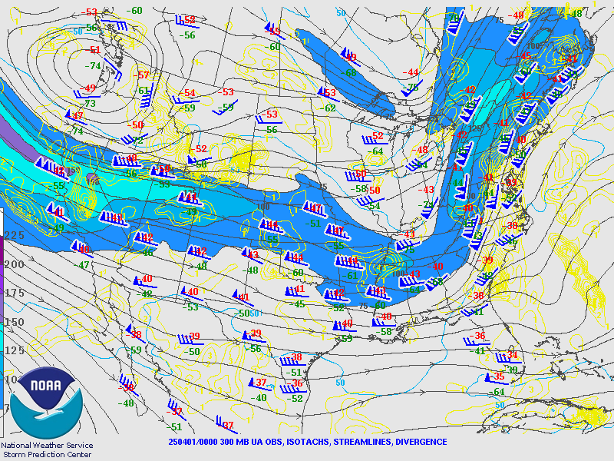
Within the past 24 hours
At the tropopause (300 mb)
0000 UTC 01 Apr 2025

Slide 13
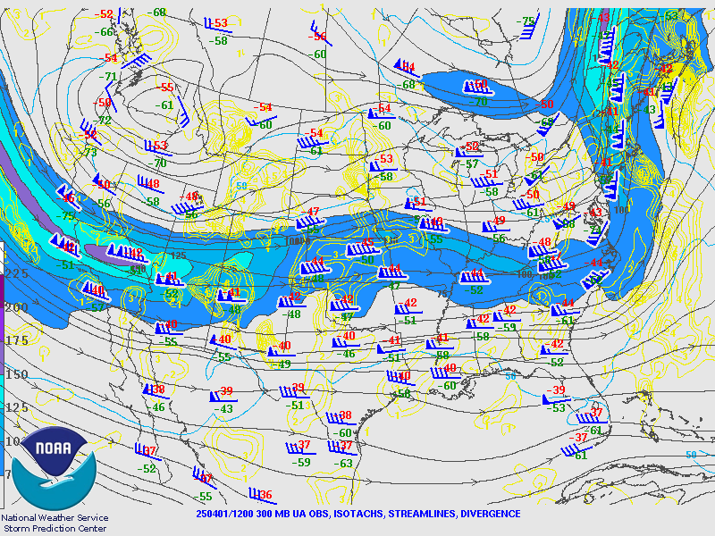
Within the past 24 hours
At the tropopause (300 mb)
1200 UTC 01 Apr 2025

Slide 14
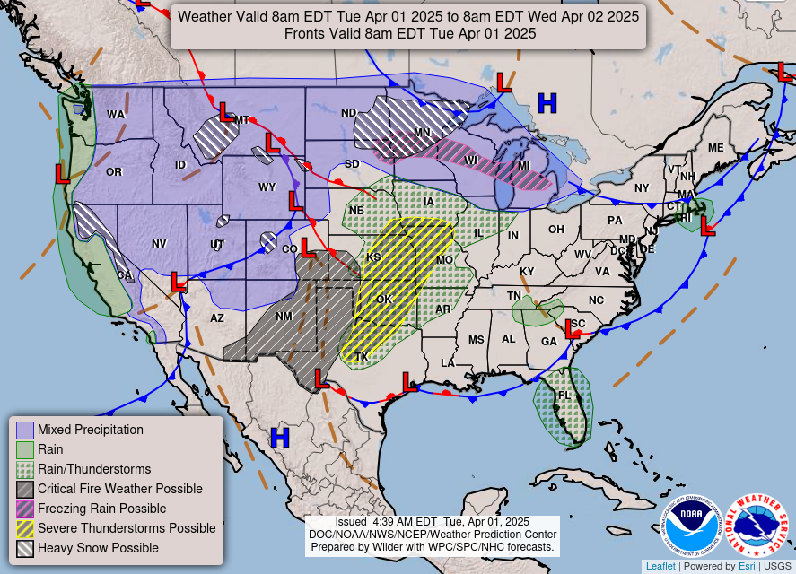
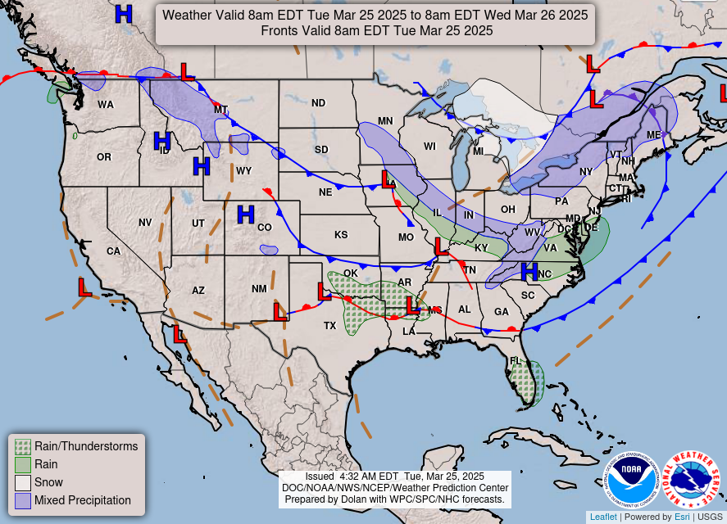
https://www.wpc.ncep.noaa.gov/NationalForecastChart/staticmaps/noaad1.png

Slide 15
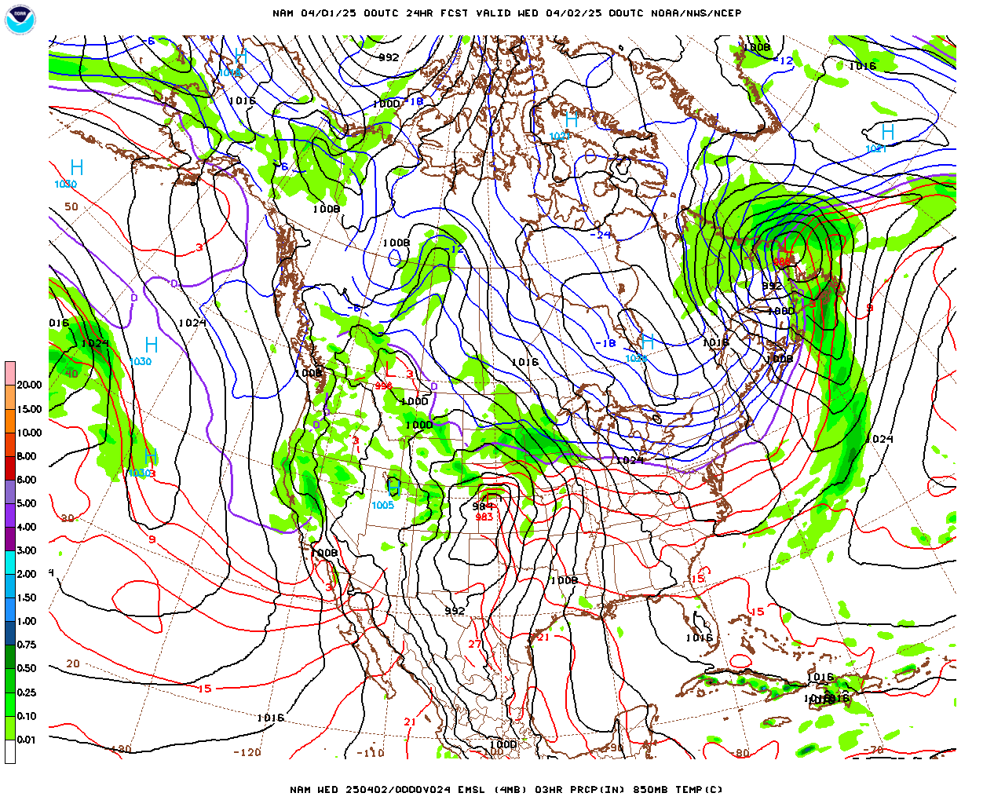
Over the next 48 hours
Sea level pressure
0000 UTC 02 Apr 2025

Slide 16
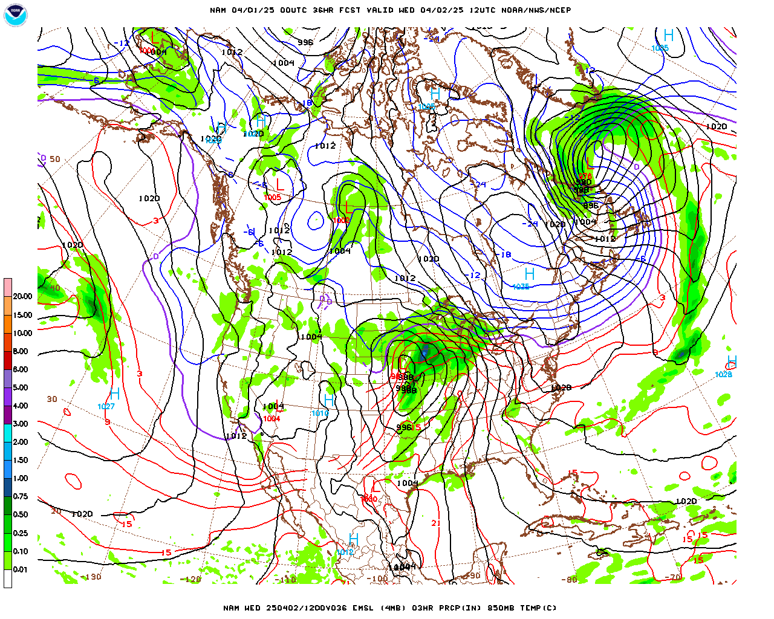
Over the next 48 hours
Sea level pressure
1200 UTC 02 Apr 2025

Slide 17
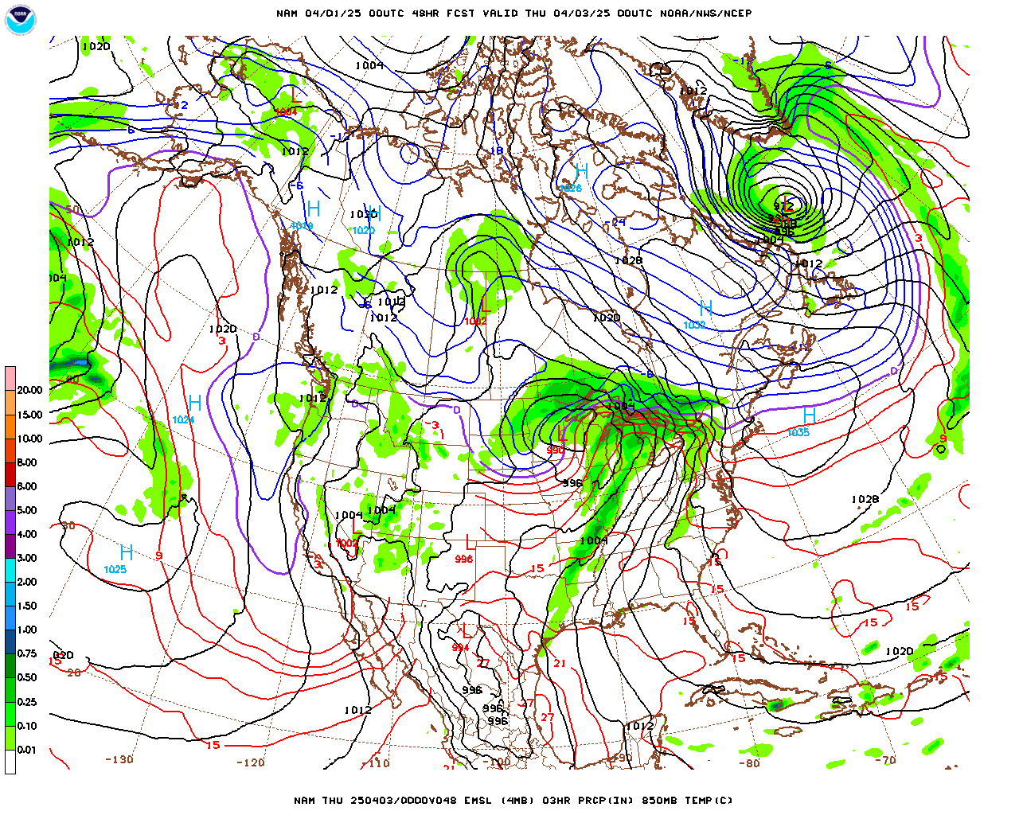
Over the next 48 hours
Sea level pressure
0000 UTC 03 Apr 2025

Slide 18
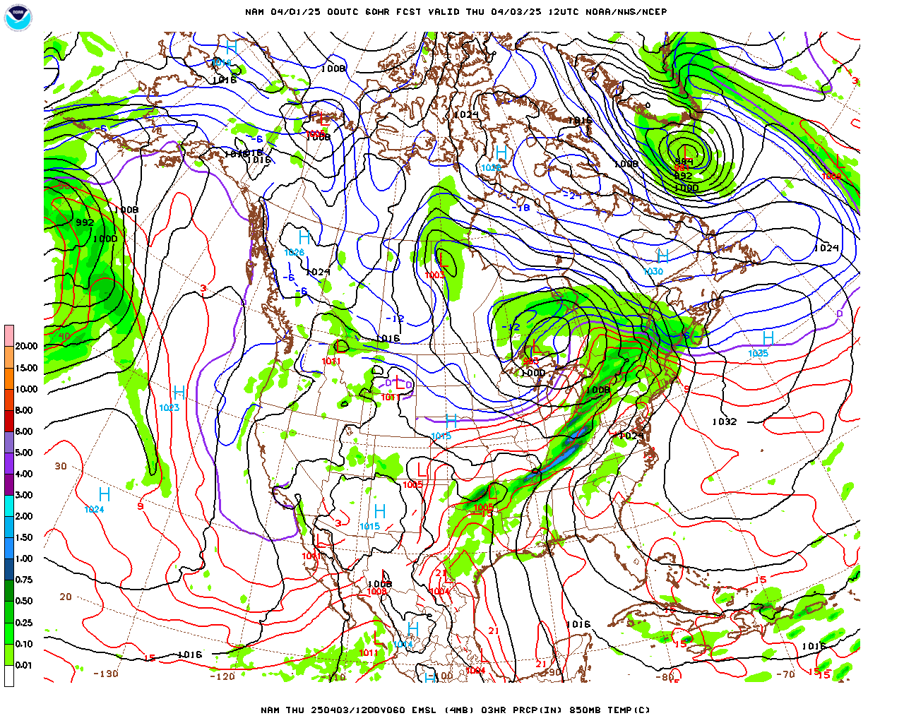
Over the next 48 hours
Sea level pressure
1200 UTC 03 Apr 2025

Slide 19
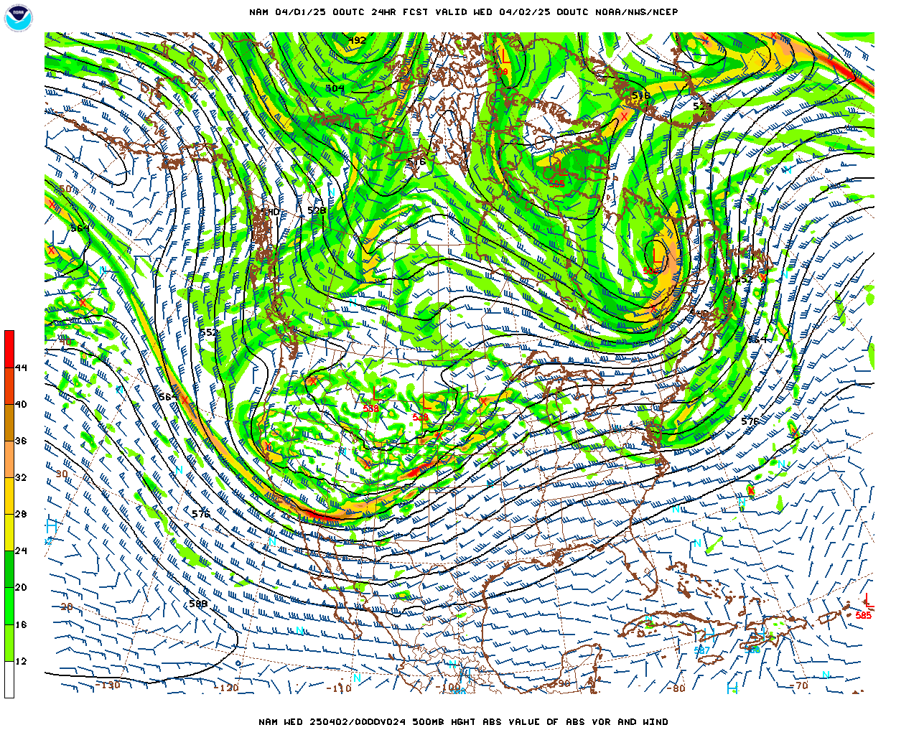
Over the next 48 hours
500 mb level
0000 UTC 02 Apr 2025

Slide 20
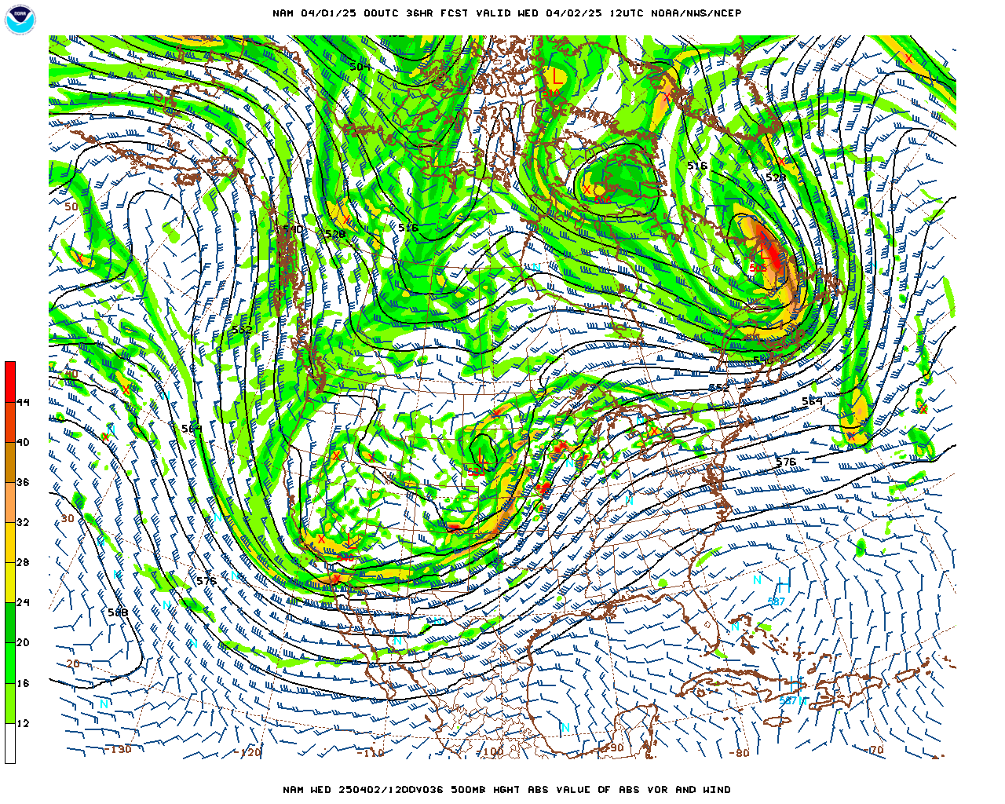
Over the next 48 hours
500 mb level
1200 UTC 02 Apr 2025

Slide 21
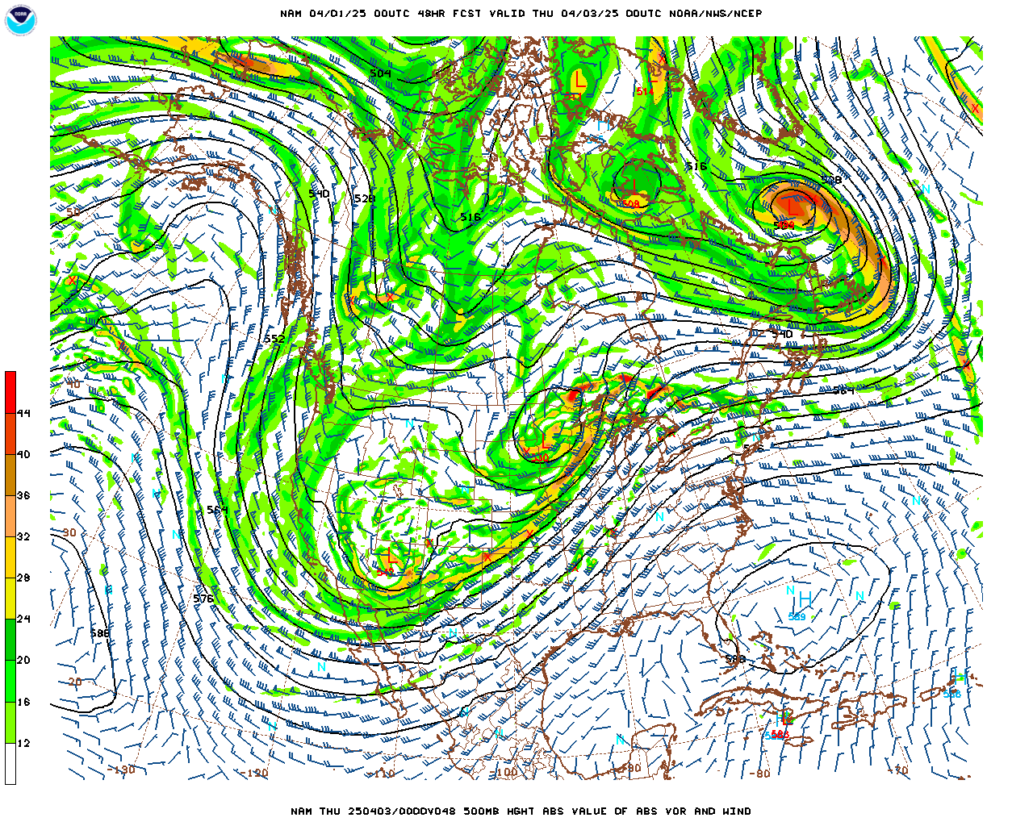
Over the next 48 hours
500 mb level
0000 UTC 03 Apr 2025

Slide 22
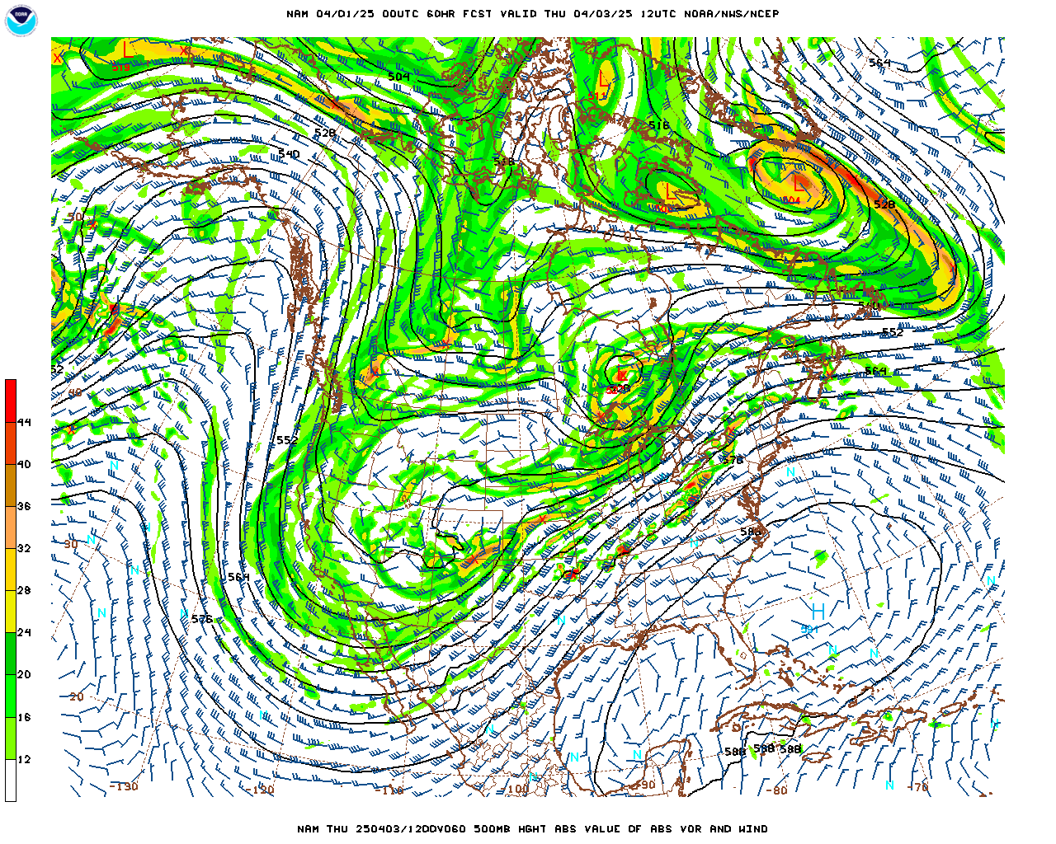
Over the next 48 hours
500 mb level
1200 UTC 03 Apr 2025

Slide 23
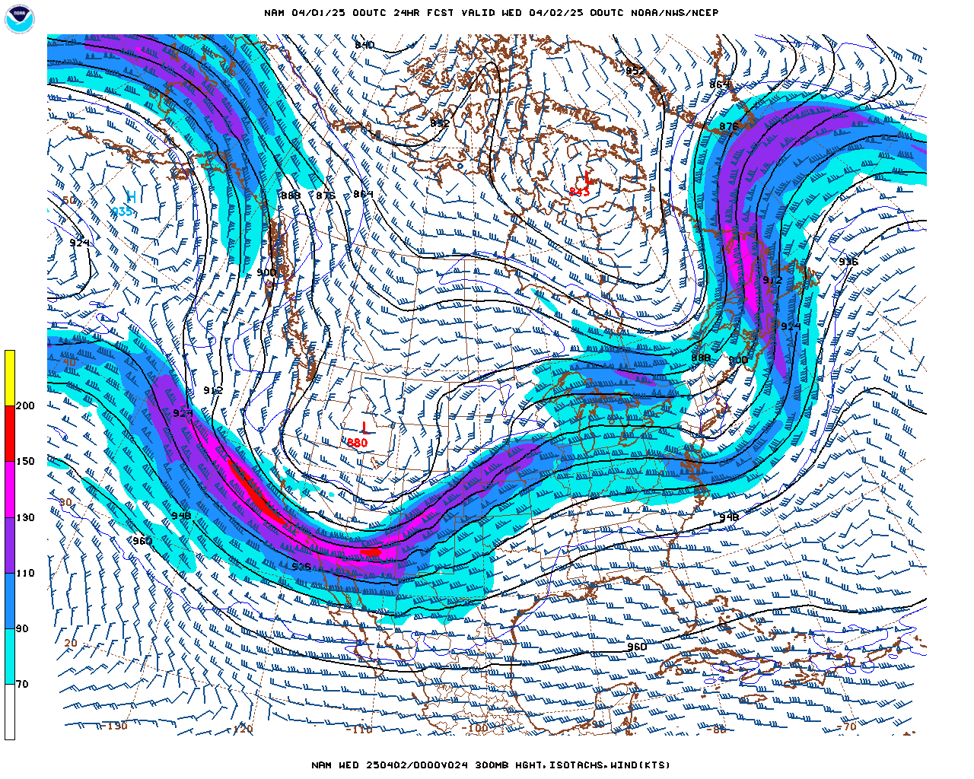
Over the next 48 hours
300 mb level
0000 UTC 02 Apr 2025

Slide 24
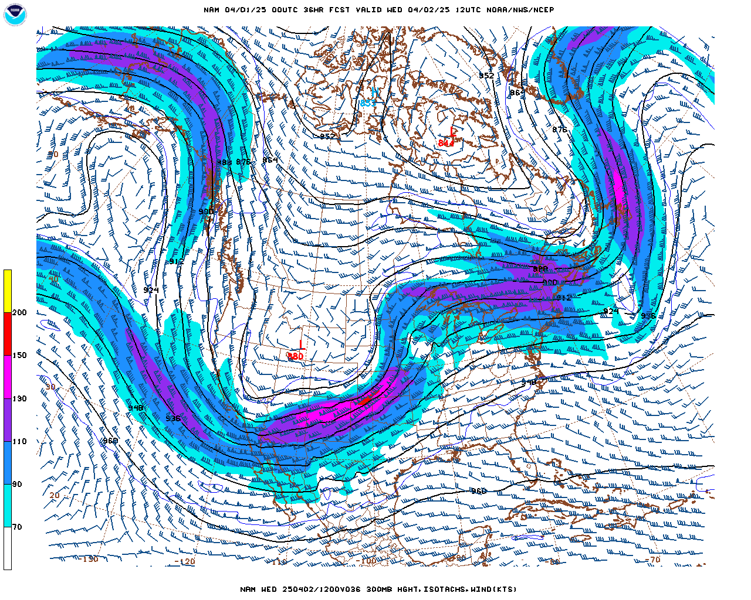
Over the next 48 hours
300 mb level
1200 UTC 02 Apr 2025

Slide 25
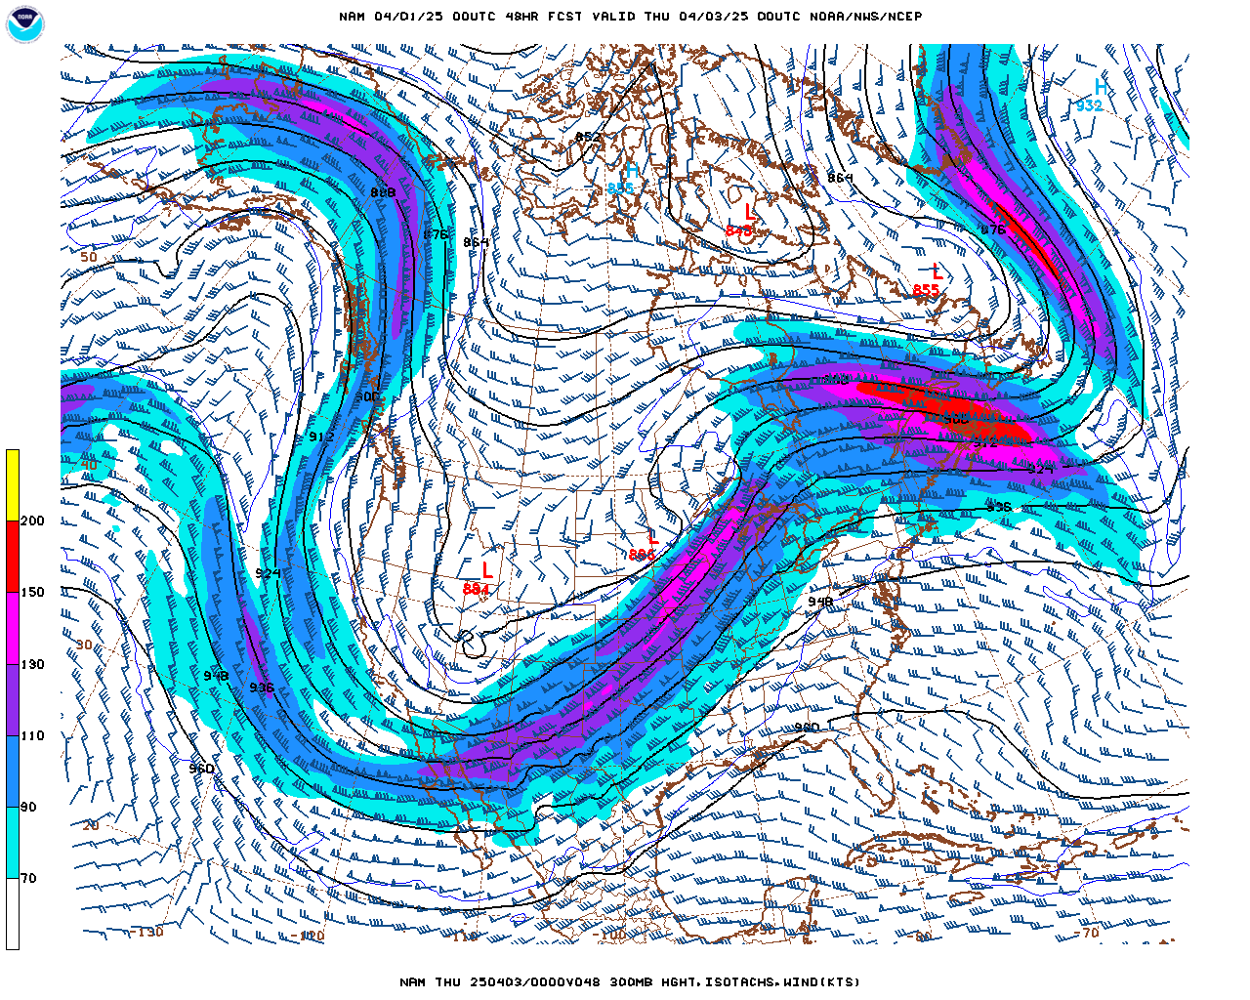
Over the next 48 hours
300 mb level
0000 UTC 03 Apr 2025

Slide 26
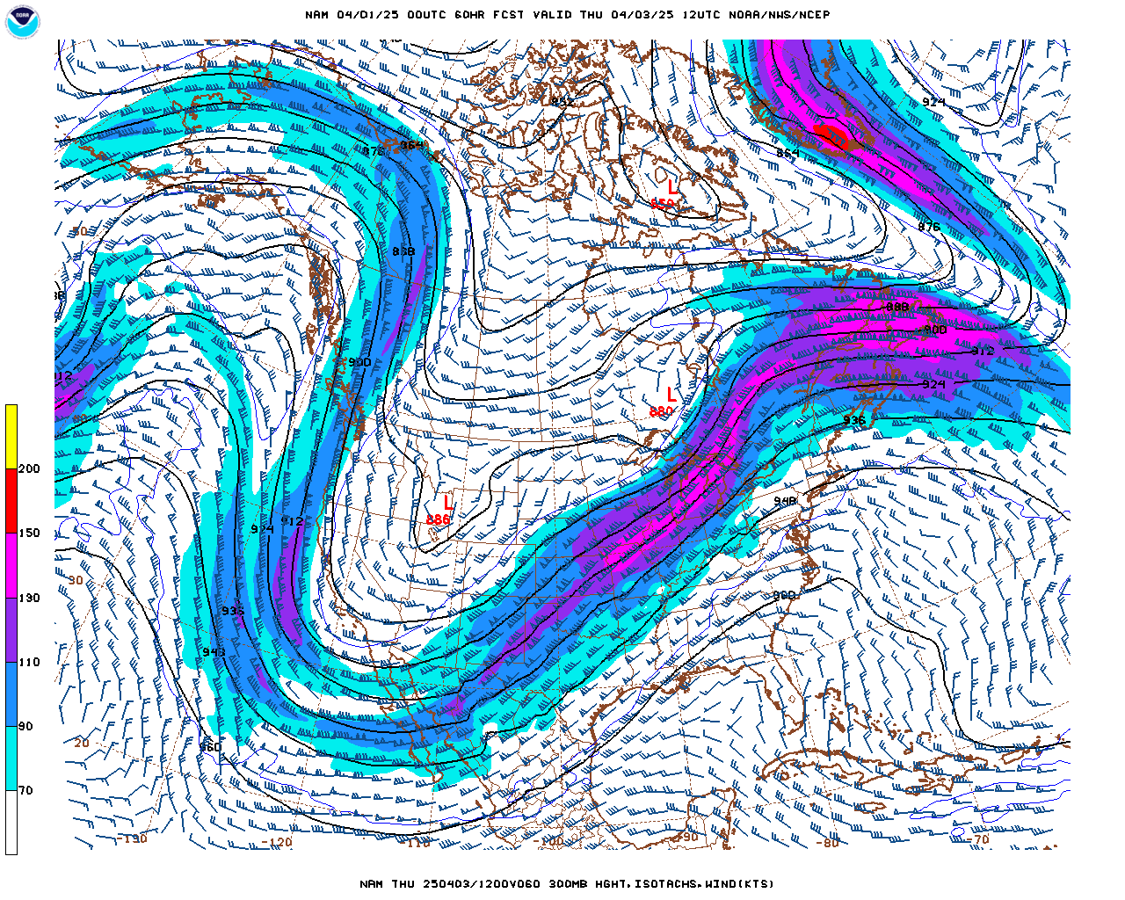
Over the next 48 hours
300 mb level
1200 UTC 03 Apr 2025

Slide 27
Forecast for Asheville, NC
Tues. (pm) – Wed. (am) [01 – 02 Apr]
Maximum Temperature = 72ºF
Minimum Temperature = 49ºF
Wind speed & direction (1800 UTC) = 2 mph from the southwest
Precipitation = 0.00 inches

Slide 28
Forecast for Asheville, NC
Wed. (pm) – Thur. (am) [02 – 03 Apr]
Maximum Temperature = 64ºF
Minimum Temperature = 58ºF
Wind speed & direction (1800 UTC) = 10 mph from the southeast
Precipitation = 0.10 inches

