Slide 1
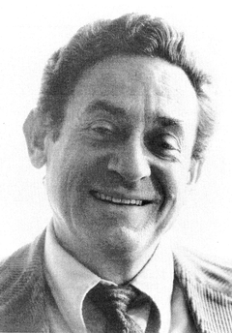
Applied NWP
[1.2] “Once the initialization problem was resolved in the 1960s, models based on the primitive equations gradually supplanted those based on the filtered equations.” (D&VK Chapters 8, 13)
Charney
http://books.nap.edu/html/biomems/jcharney.html

Slide 2
Applied NWP
REVIEW…
The humid atmosphere is governed by a system of seven equations and seven unknowns…
…our governing equations.

Slide 3
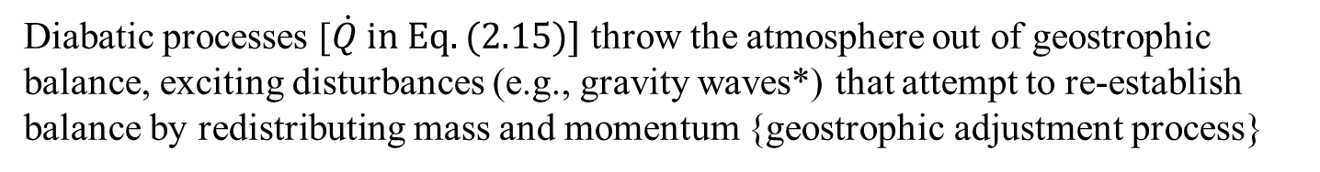
Applied NWP
REVIEW…
Synoptic-scale atmospheric disturbances in the mid-latitudes are in approximate geostrophic (quasi-geostrophic) balance

Slide 4
Applied NWP
We’ll start gradually with a ‘simpler’ model based on a smaller and less complex set of primitive equations (shallow-water or barotropic primitive equations)
  Constant density
  Hydrostatic

Slide 5
Applied NWP
barotropic primitive equations (PEs)
momentum equations
continuity equation

Slide 6
Applied NWP
barotropic primitive equations (PEs)
Barotropic PE and PE models support the development and propagation of gravity waves required to bring the synoptic-scale atmosphere back to geostrophic balance → these models can simulate the geostrophic adjustment process

Slide 7
Applied NWP
Waves [8.3]
  Review Section 8.3.1
  Phase speed (8.10), phase velocity (8.11), and group velocity (8.12)
The energy of a wave moves at the group velocity.

Slide 8
Applied NWP
Waves [8.3]
  If the phase speed of the waves does not depend on the wave number, then all of the waves, regardless of wave number, travel at the same speed (nondispersive)
    A signal comprised of nondispersive waves will maintain its shape with time
  If the phase speed of the waves does depend on the wave number, then waves of different wave numbers will travel at different speeds (dispersive)
    The signal shape will change with time

Slide 9
Applied NWP
Waves [8.3]
  For linear waves in an atmosphere having an embedded background flow…
The energy of a wave moves at the group velocity.

Slide 10
Applied NWP
Barotropic gravity waves [8.4]
  Need to understand their dispersion properties since they are so important for the geostrophic adjustment process
  Linearized versions of Eqs. (8.1)-(8.3)
Where it has been assumed that (1) the density difference of the two layers is large (use gravity instead of reduced gravity) and (2) the background flow is zero (effects can be added later in the linearized system).

Slide 11
Applied NWP
Barotropic gravity waves [8.4]
  Dispersion relation for linear barotropic inertio-gravity waves
{ f }
{ g }
Dispersive → different waves (wave numbers) travel at different speeds

Slide 12
Applied NWP
Barotropic gravity waves [8.4]
  Rossby radius of deformation→ distance traveled by a gravity wave during one angular inertial period { = 1/ f }. For a barotropic fluid,
An atmospheric circulation whose characteristic length is << λ_{R} , the earth’s rotation can be ignored as it is not important for the dynamics of the circulation.

Slide 13
Applied NWP
Barotropic gravity waves [8.4]
  Extension to a fluid having multiple layers
    An n-layered fluid would have n modes of oscillation; a single barotropic mode and n – 1 baroclinic modes.
      Each mode has its own equivalent depth {H_{e(i)}}, wave speed, and radius of deformation
      Baroclinic mode wave speeds are much smaller than the barotropic mode wave speed which, from Eq. (8.34), indicates that the effects of the Earth’s rotation may be more important for small-scale baroclinic disturbances and negligible for the barotropic circulation of the same size (identical “K”)
    Has many applications in both atmospheric and oceanic modeling
An atmospheric circulation whose characteristic length is << λ_{R} , the earth’s rotation can be ignored as it is not important for the dynamics of the circulation.

Slide 14
Applied NWP
Why stagger the horizontal grids in our PE models [8.5]-[8.6]?
  Since gravity waves are important for the geostrophic adjustment process, we need to evaluate how well these waves can be simulated on our horizontal (2D) grid. Dispersion relations for Eqs. (8.19)-(8.21) {sl#7 of this LP} using the form of differential-difference equations,

Slide 15
Applied NWP
Why stagger the horizontal grids in our PE models [8.5]-[8.6]?
  True dispersion relation – barotropic inertio-gravity waves…

Slide 16
Applied NWP
Why stagger the horizontal grids in our PE models [8.5]-[8.6]?
  Unstaggered 2D grid (Arakawa A grid)
True dispersion relation – barotropic inertio-gravity waves…

Slide 17
Applied NWP
Why stagger the horizontal grids in our PE models [8.5]-[8.6]?
  Staggered 2D grid (Arakawa B grid)
True dispersion relation – barotropic inertio-gravity waves…

Slide 18
Applied NWP
Why stagger the horizontal grids in our PE models [8.5]-[8.6]?
  Staggered 2D grid (Arakawa C grid)
True dispersion relation – barotropic inertio-gravity waves…

Slide 19
Applied NWP
Why stagger the horizontal grids in our PE models [8.5]-[8.6]?
  Staggered 2D grid (Arakawa D grid)
True dispersion relation – barotropic inertio-gravity waves…

Slide 20
Applied NWP
Why stagger the horizontal grids in our PE models [8.5]-[8.6]?
  Staggered 2D grid (Arakawa E grid)
True dispersion relation – barotropic inertio-gravity waves…

Slide 21
Applied NWP
Why stagger the horizontal grids in our PE models [8.5]-[8.6]?
Relatively stable atmosphere

Slide 22
Applied NWP
Why stagger the horizontal grids in our PE models [8.5]-[8.6]?
  Purely “zonal” propagation, B and C grids have the best dispersion properties
  For “northeasterly” propagation, C grid has the best dispersion properties
  D grid has the worst dispersion properties in both examples
  Note rotational symmetry of B and E grids {B grid-plot in top panel of Fig. 8.10 is identical to E grid-plot of bottom panel}
C grid is very commonly used in numerical models of the atmosphere or ocean.

Slide 23
Applied NWP
Why stagger the horizontal grids in our PE models [8.5]-[8.6]?
Lower stability atmosphere

Slide 24
Applied NWP
Why stagger the horizontal grids in our PE models [8.5]-[8.6]?
  Purely “zonal” propagation, B and E grids have the best dispersion properties
  For “northeasterly” propagation, E grid has the best dispersion properties
  D grid has the worst dispersion properties in both examples
  Note rotational symmetry of B and E grids {B grid-plot in top panel of Fig. 8.10 is identical to E grid-plot of bottom panel}
B and E grids are also used, particularly for mesoscale models in highly baroclinic environments, in which the Rossby radius of deformation is small.

Slide 25
Applied NWP
Numerical Stability of Barotropic PE models [8.7]
  Leapfrog time-differencing scheme on the A, B, C, and E grids
    Idealized stability condition
    A, B/E, and C Grid stability conditions

Slide 26
Applied NWP
Numerical Stability of Barotropic PE models [8.7]
  C grid has the most stringent stability criterion
  A grid has the least stringent stability criterion
  Using Adams-Bashforth Scheme (rather than the leapfrog scheme)…
    B/E grids have the most stringent stability condition
    C grid has the least stringent stability condition
Effects of Coriolis term-

Slide 27
Applied NWP
REVIEW…
The humid atmosphere is governed by a system of seven equations and seven unknowns…
…our governing equations.

Slide 28
Applied NWP
Primitive equations model choices [Chapter 13]
  Nonhydrostatic v. hydrostatic models
  Compressible, anelastic, or incompressible continuity equation
  Choices are determined by [13.1]
  scale of phenomena to be modeled
  computational performance requirements

Slide 29
Applied NWP
= requires parameterization
[dominated by subgrid-scale
phenomena]
Primitive equations [13.2]

Slide 30
Applied NWP
Vertical pressure balance [13.3]
  Eliminate acoustic waves (see LP#2) using the hydrostatic equation (Eq. 13.8),
  allows for a longer time interval (Δt) to be used
  vertical motion must be diagnosed from another equation

Slide 31
Applied NWP
Vertical pressure balance [13.3]
  As horizontal scale of phenomena approaches its depth, nonhydrostatic vertical momentum equation (Eq. 13.3) must be used
  split total pressure and density into base state and perturbation part

Slide 32
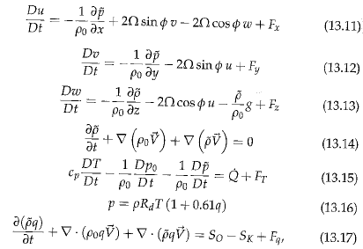
Applied NWP
Vertical pressure balance [13.3]

Slide 33
Applied NWP
Vertical pressure balance [13.3]
  Nonhydrostatic models require a fairly short time interval (Δt, more iterations per forecast hour) due to the presence and propagation of acoustic waves in both the vertical and horizontal directions

Slide 34
Applied NWP
The Continuity Equation [13.4]
  Fully compressible models; through rearrangement of Eq. 13.15, with some scale analysis, we find
  which becomes the predictive equation for temperature. Eq. 13.17 is used to predict humidity, Eqs 13.11-13.14 are used to predict u, v, w, Eq. 13.16 is used to diagnose perturbation pressure.

Slide 35
Applied NWP
The Continuity Equation [13.4]
  Anelastic models; use anelastic continuity equation,
  which eliminates acoustic waves, but gives the added complexity that pressure cannot be diagnosed without solving the computationally intensive elliptic equation,

Slide 36
Applied NWP
The Continuity Equation [13.4]
  Anelastic models; hence, the longer time interval (and fewer iterations per forecast hour) allowed by the anelastic approximation is offset by the time required to numerically solve the elliptic equation at every time step in order to diagnose the pressure

Slide 37
Applied NWP
A real-live primitive equations model example – WRF Version 3 [http://www2.mmm.ucar.edu/wrf/users/docs/arw_v3.pdf]

Slide 38
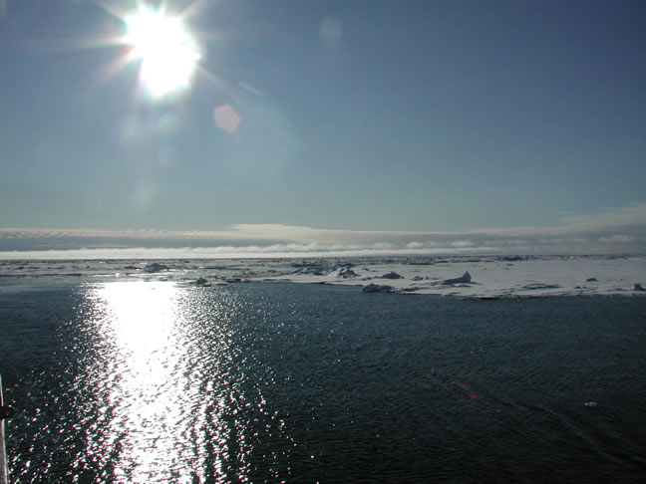
Applied NWP
And now for another activity…
WRFV3 Treasure Hunt
http://psc.apl.washington.edu/HLD/
Activity- code word- Thatisheavy

