Slide 1
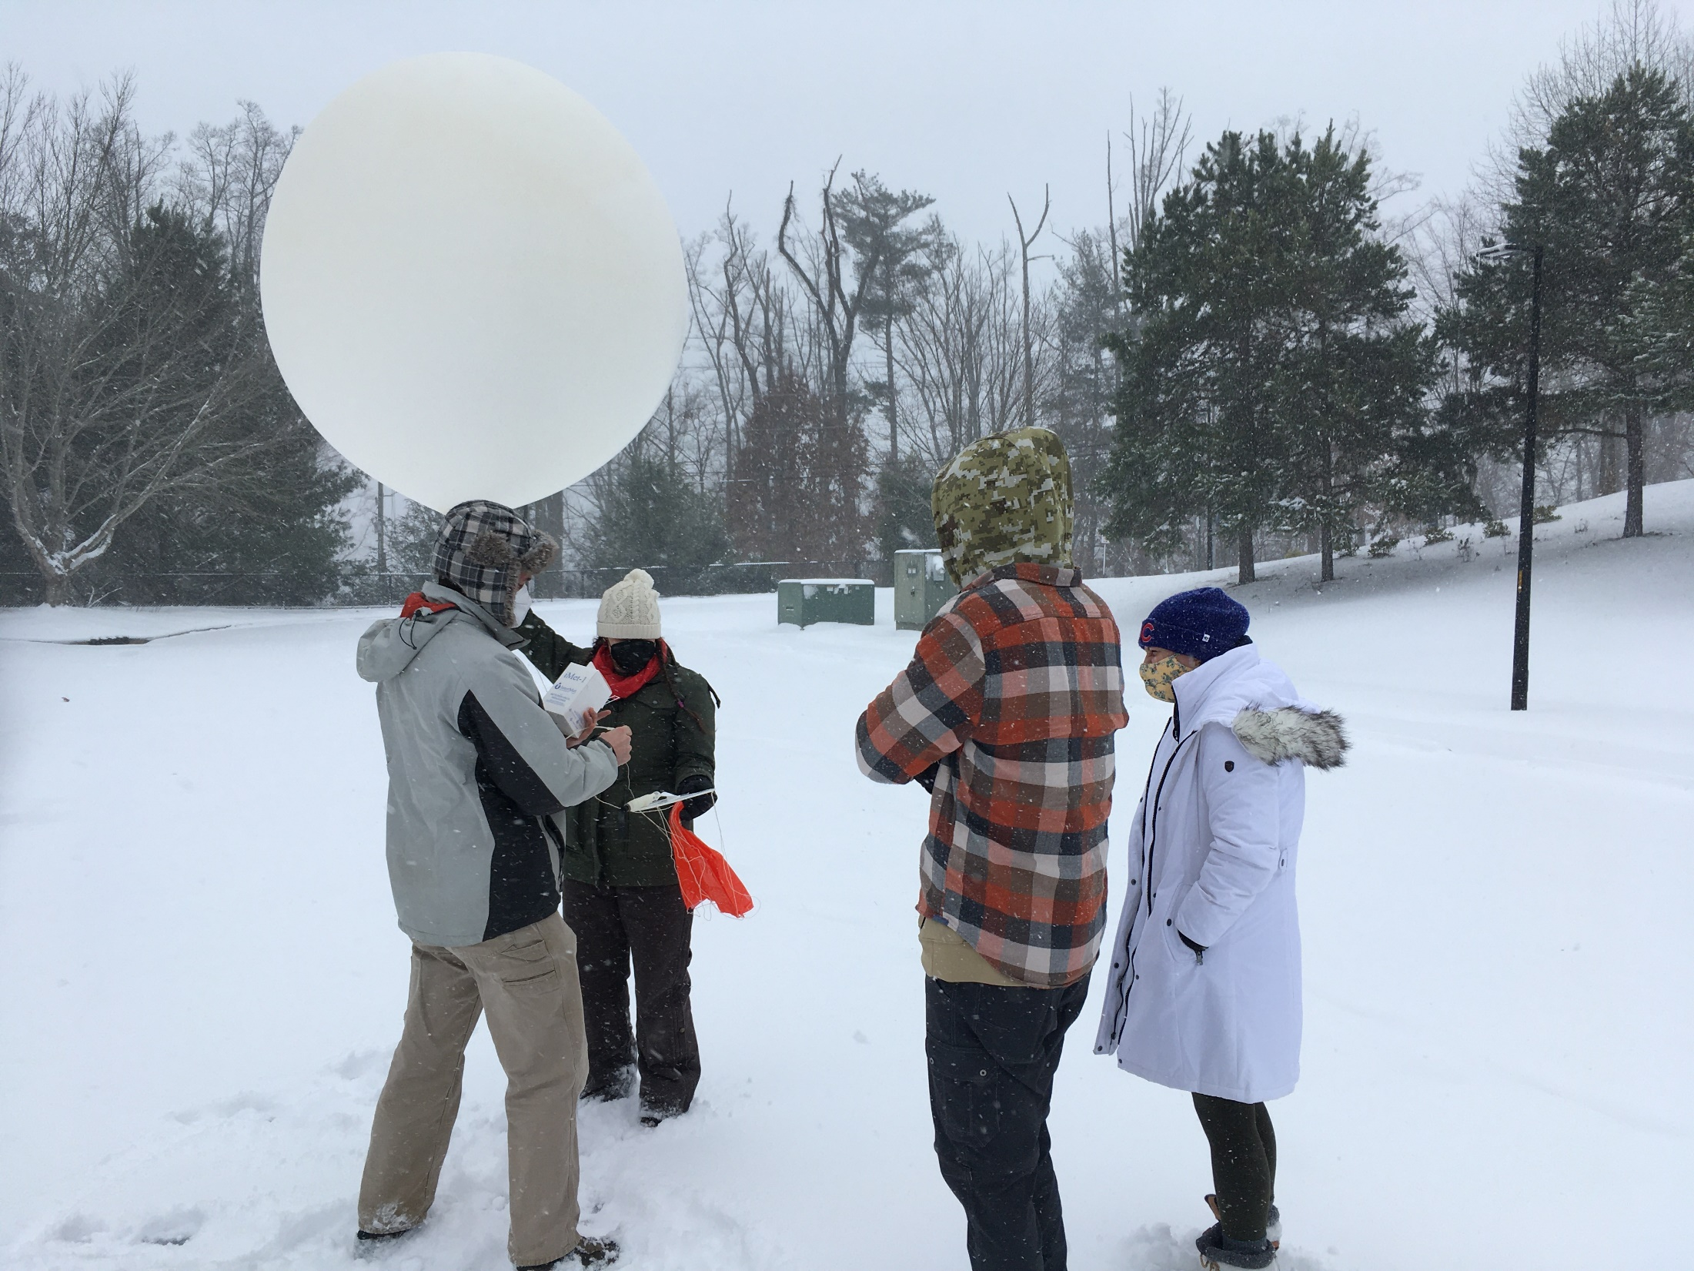
16 January 2022 snowstorm

Slide 2
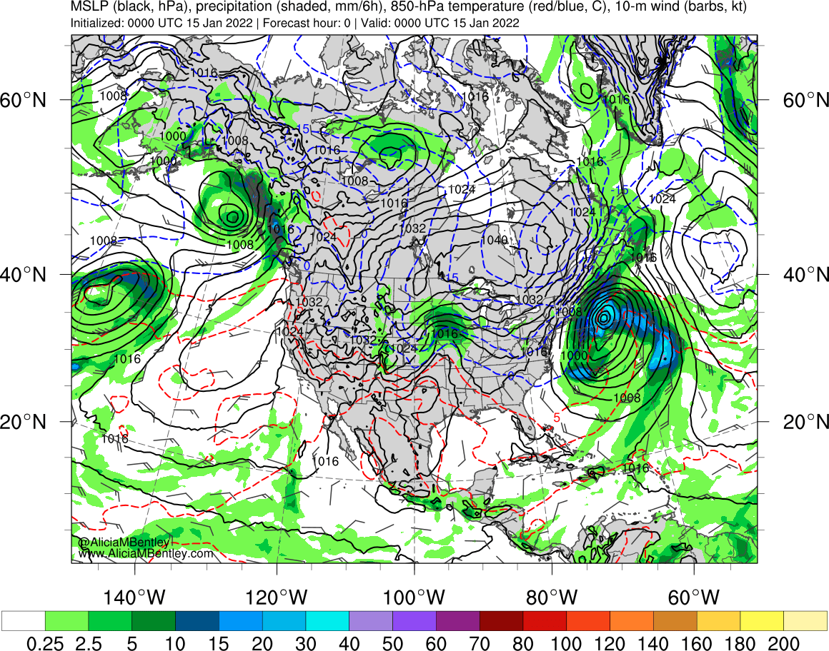

Slide 3
R Grumm; 14 January 2022
Forecasts of the potential East Coast Winter storm of 16-17 January 2022 have tended, in the Global models, for significant west of the cyclone track. It has had, at times in the NAEFS, -4 sigma u-wind anomalies too. A lot of easterly flow, a good characteristic of bigger snow storms and historic storms. Also a potential source of warmer air aloft.
The GFS has been fairly consistent for days with heavy snow at my location, many runs showing 9 to 14 inches at 10:!. The EC, GDPS, and UK too have been snowy.
However, at 18Z 13 January this storm came into the realm of the NAM. And the NAM has been screaming lower snowfall totals, just a few inches and a lot of sleet and freezing rain.

Slide 4
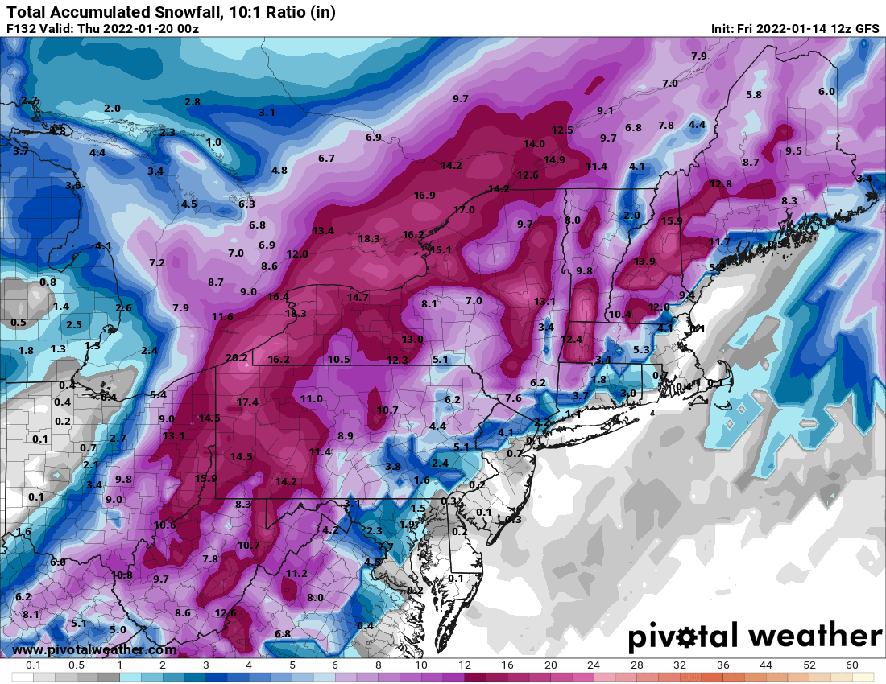
GFS

Slide 5
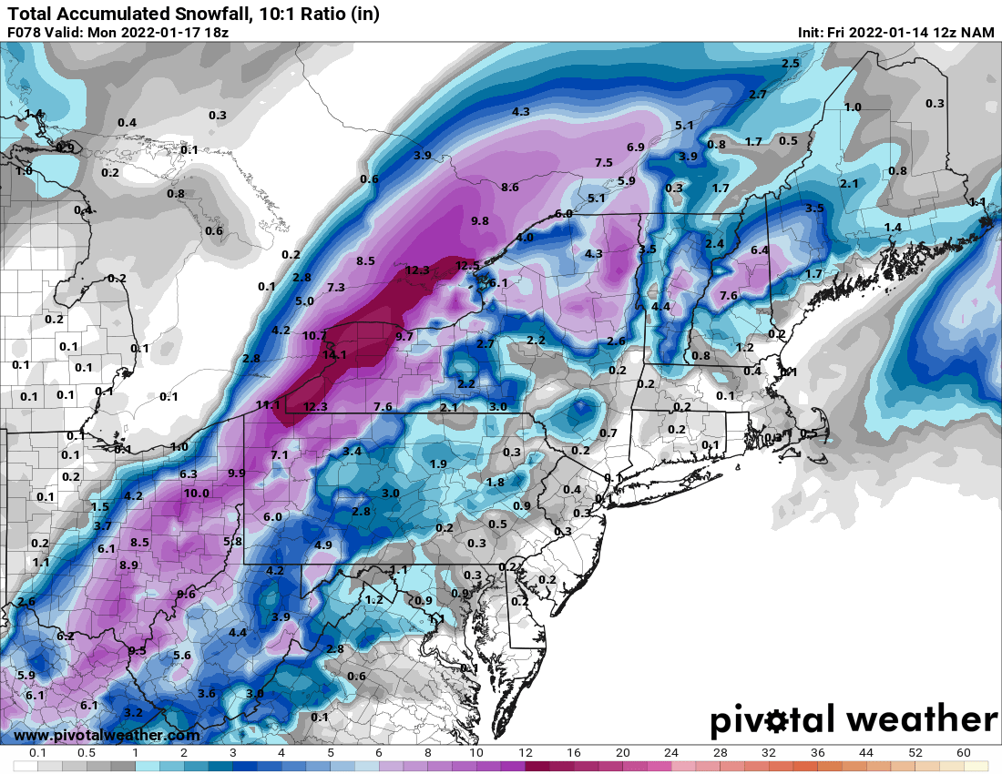
NAM

Slide 6
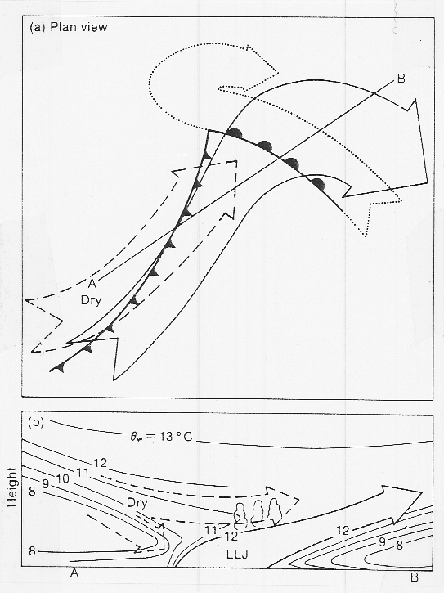

Slide 7
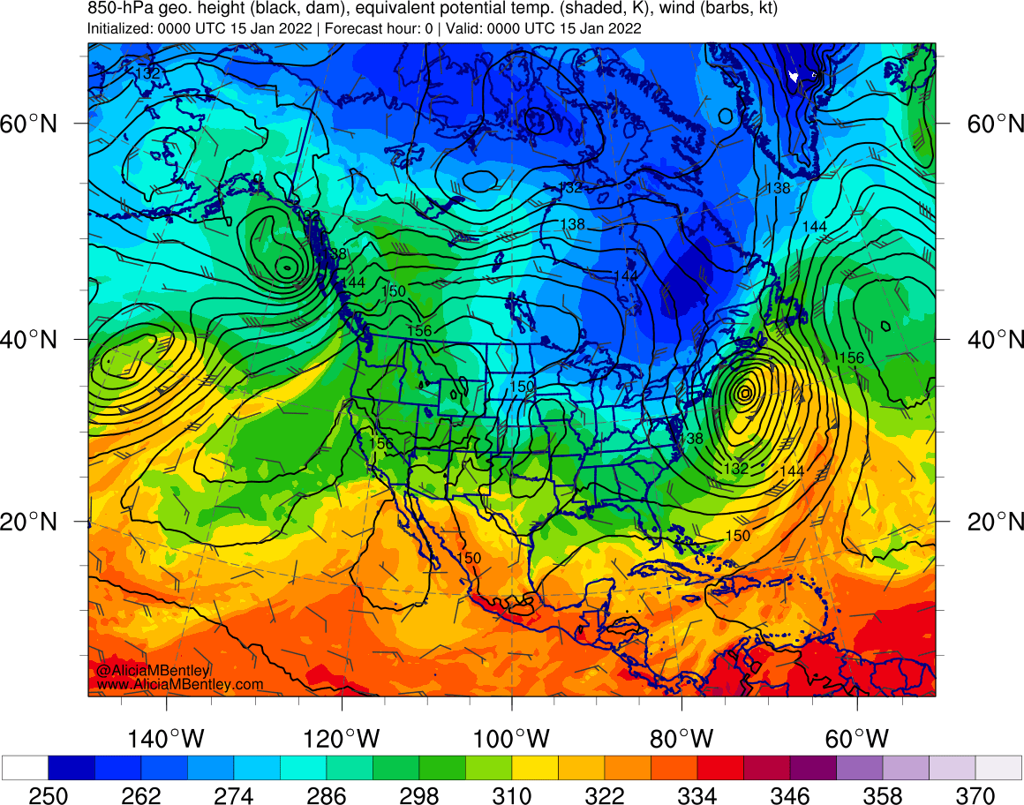

Slide 8
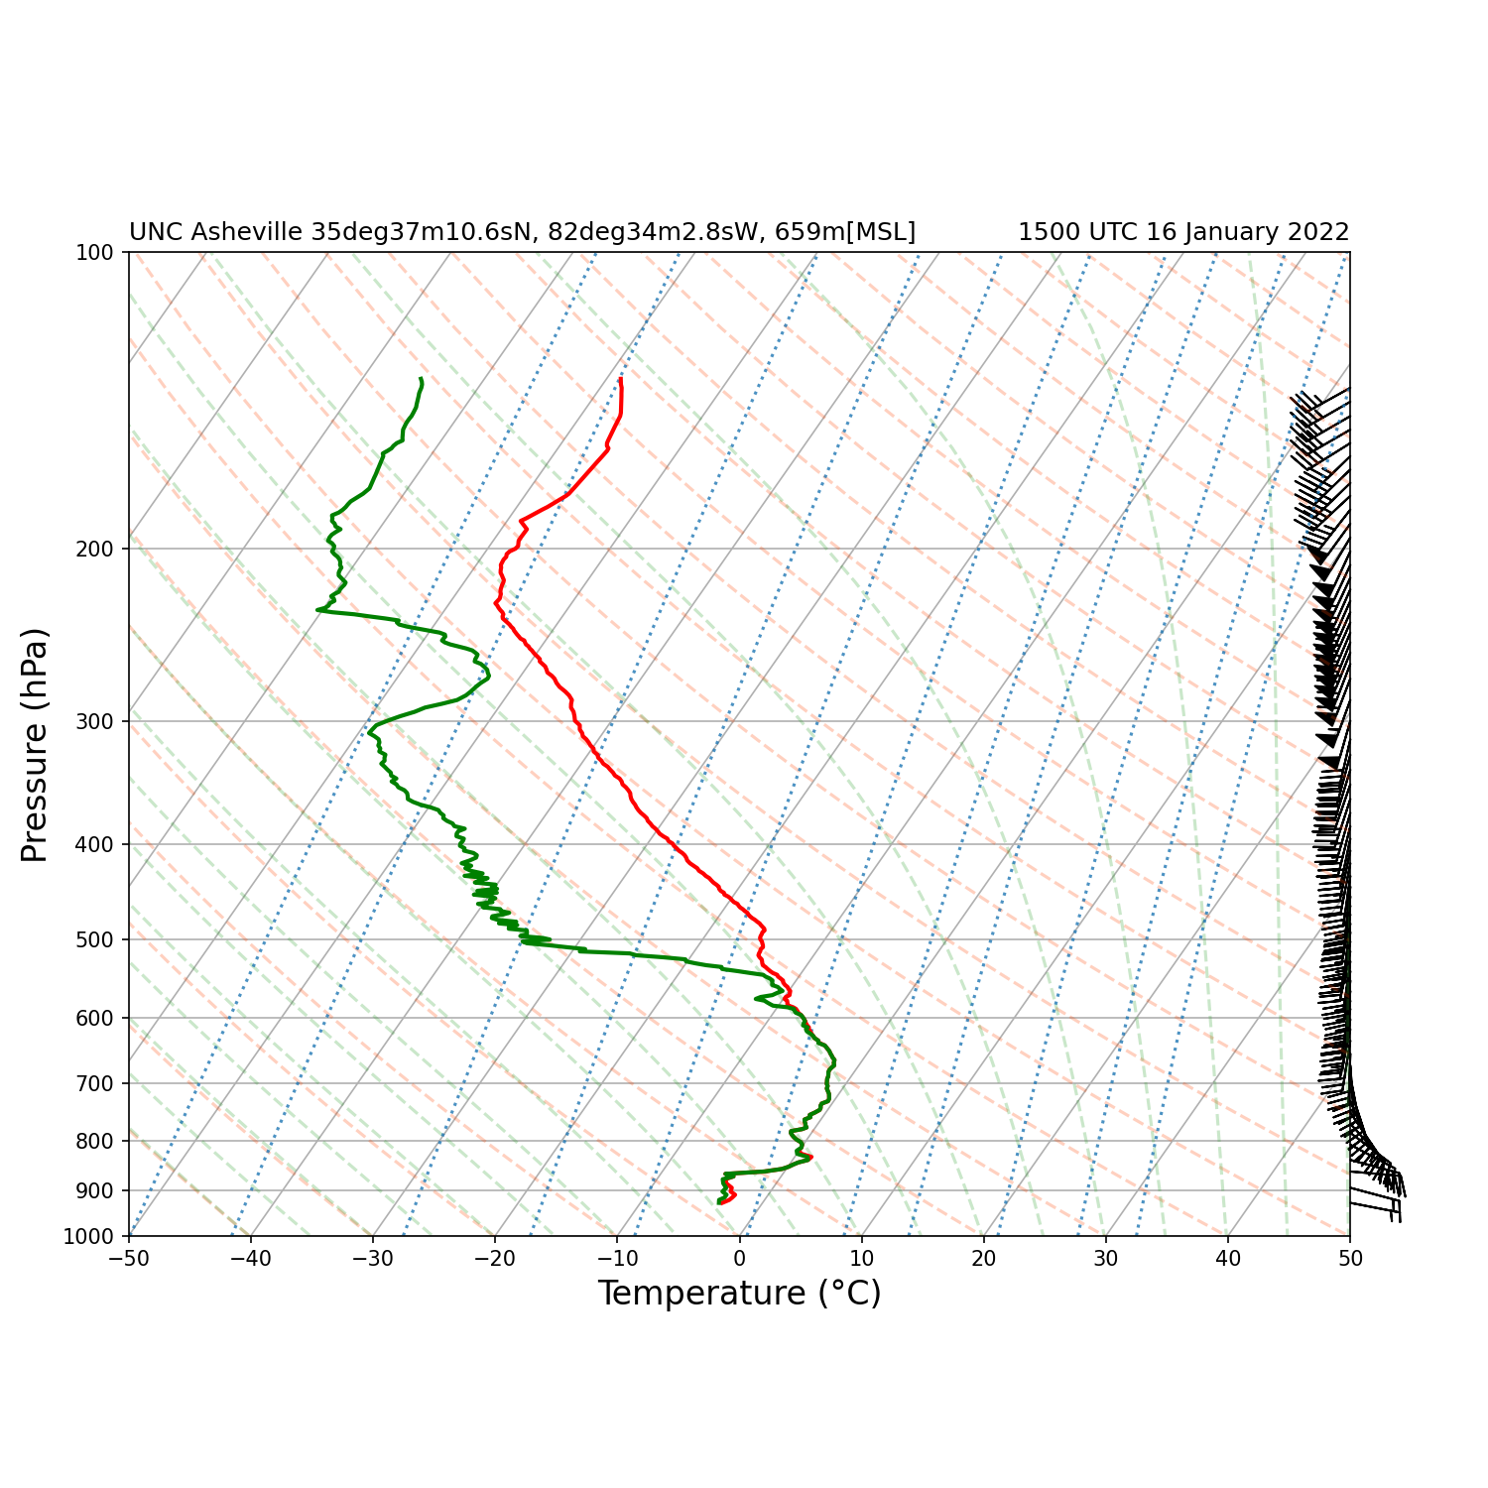

Slide 9
