Slide 1
Applied NWP
We’re going to tear apart the computer weather forecast model, “THE BLACK BOX”, and look at its guts…(B&VK Chapter 10, Kalnay Chapter 4, Krish. and Boun. Chapters 6-9)
The Black Box
“…some of the most important components of any atmospheric model are the subgrid-scale parameterization schemes for clouds, precipitation, radiation, and exchanges of momentum, heat, and moisture fluxes with the surface of the Earth.” [D&VK, p. 163]
Go to: https://www.meted.ucar.edu/nwp/model_physics/ for more information

Slide 2
Applied NWP
REVIEW…
Governing Equations
  Note how the forecast (prognostic) variables (u, v, w, T, p, ρ, and q) are interrelated in the governing equations. For now, let us focus a discussion on the First Law of Thermodynamics…

Slide 3
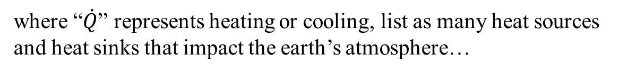
Applied NWP
First Law of Thermodynamics
where “$\dot{Q}$” represents heating or cooling, list as many heat sources
and heat sinks that impact the earth’s atmosphere…

Slide 4
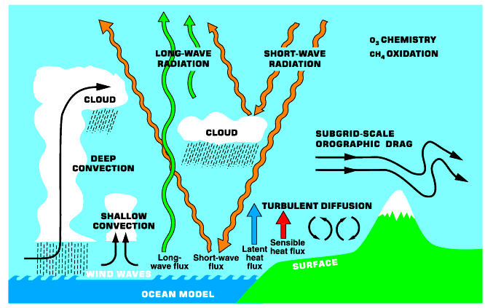
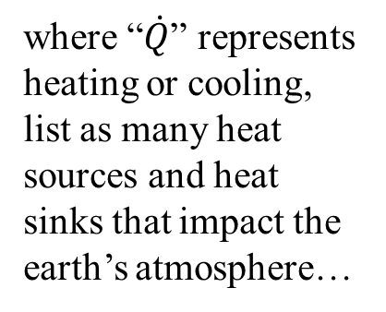
Applied NWP
First Law of Thermodynamics
(ECMWF)
where “$\dot{Q}$” represents heating or cooling, list as many heat sources and heat sinks that impact the earth’s atmosphere…

Slide 5
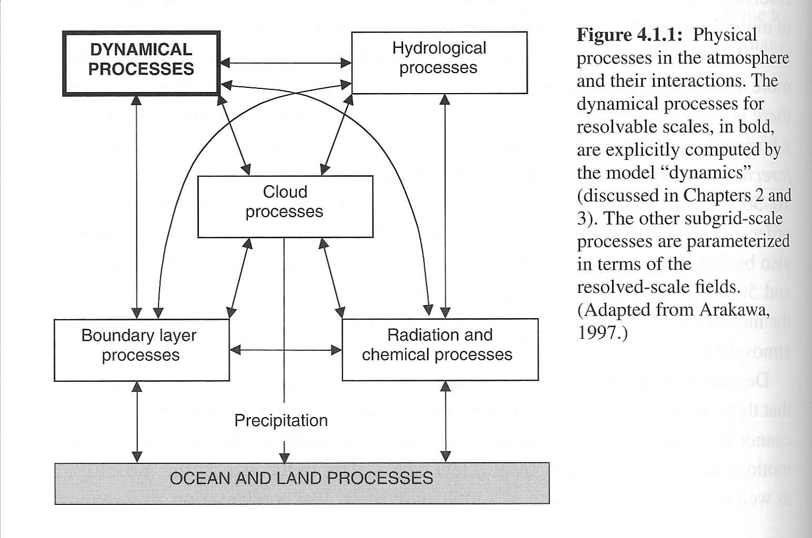
Applied NWP
Each of these heat sources and sinks needs to be accounted for in our computer weather forecast model if we are to have any chance at making an accurate forecast.

Slide 6
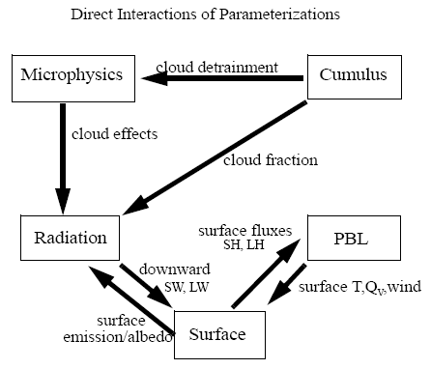
Applied NWP
MM5
Each of these heat source and sink processes need to interact in order for our computer weather forecast model to make an accurate forecast.
http://www.mmm.ucar.edu/mm5/documents/tutorial-v3-notes.html

Slide 7
Applied NWP
Problem; we have limited computer resources and limited time to get our operational computer weather forecast out to the field
Solution; cut “appropriate” corners

Slide 8
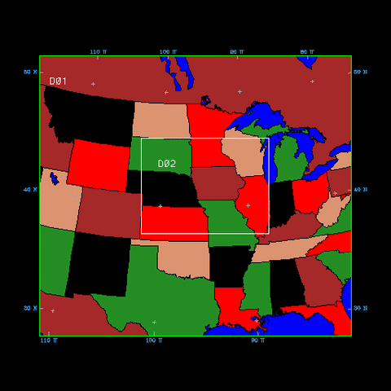
Applied NWP
How do we cut “appropriate” corners?
  Degrade resolution
  Simplify model physics
  Run the model for a limited region and time
http://mesonet.agron.iastate.edu/~mm5/resource/domain.gif

Slide 9
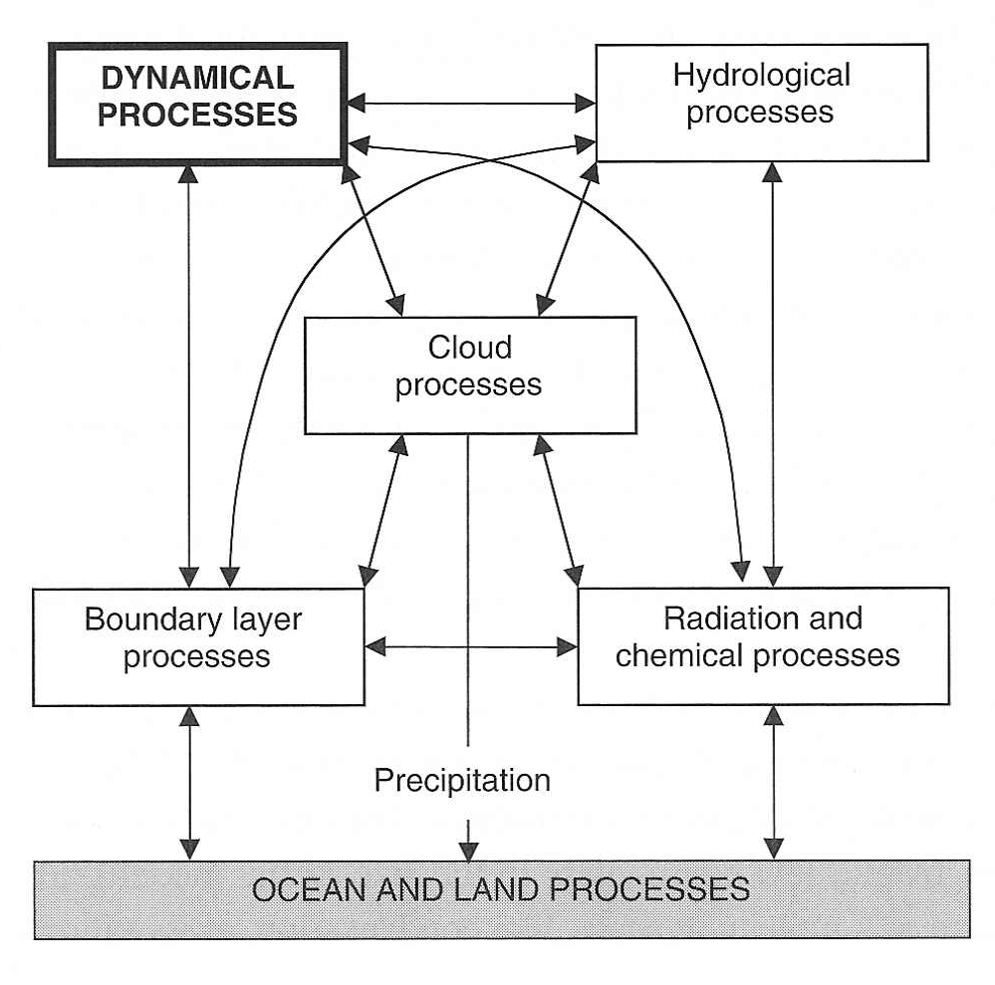
Applied NWP
By degrading resolution, we admit that there are many important processes* and scales of motion in the atmosphere that cannot be explicitly resolved with present (or future) models
*designated as “subgrid-scale processes”

Slide 10
Applied NWP
Subgrid-scale processes depend on and affect the larger-scale (resolved) dynamical processes
Activity- code word- Happenstance
(indirectly affects dynamical processes)

Slide 11
Applied NWP
To reproduce the interaction of the grid and subgrid-scale processes, the subgrid-scale phenomena are “parameterized”
  their effect is formulated in terms of the resolved fields

Slide 12
Applied NWP
What do subgrid-scale processes look like*?
turbulent moisture transport
molecular scale
grid-scale (resolved) advection
subgrid-scale processes
Equation (13.7)
*after Reynolds averaging [10.2]

Slide 13
Applied NWP
What do subgrid-scale processes look like*?
turbulent moisture transport
molecular scale
Turbulent fluxes might be
isotropic
anisotropic
=> Typical for vertical turbulent fluxes to be much greater in the vertical than in the horizontal (anisotropic)
subgrid-scale processes
*after Reynolds averaging [10.2]

Slide 14
Applied NWP
What do subgrid-scale processes look like?
turbulent moisture transport
molecular scale
Closure [10.2.3]
turbulent flux terms add new unknowns…need additional equations to form a closed system…new equations must relate grid (time averaged) variables to the turbulent flux (perturbation) terms…EXAMPLE…
subgrid-scale processes
local closure scheme =>
first-order closure scheme =>

Slide 15
Applied NWP
Computer weather model “guts”
  Resolved processes (dynamics of the model)
  Parameterized processes (model physics)

Slide 16
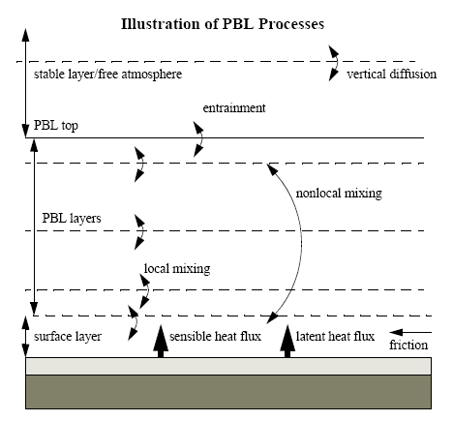
Applied NWP
Subgrid-scale processes; boundary layer processes
  How is momentum, heat, and moisture transported between the surface and the free atmosphere?
http://www.mmm.ucar.edu/mm5/documents/tutorial-v3-notes.html

Slide 17
Applied NWP
Boundary layer processes; turbulent transport and the vertical turbulence flux term…
  Neglect (zeroth order closure)
  Parameterize in terms of grid-scale variables (first order closure)
  Add prognostic equations for the turbulent fluxes (second order closure)
http://www.mmm.ucar.edu/mm5/documents/tutorial-v3-notes.html
[e.g. ]

Slide 18
Applied NWP
Boundary layer processes; turbulent transport and the vertical turbulence flux term is partly a function of
  BL stability
  Clear/cloudy sky conditions
  BL height

Slide 19
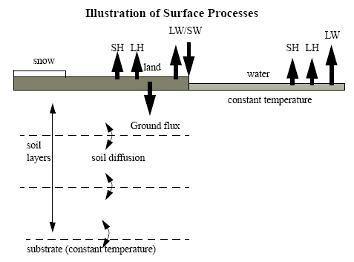
Applied NWP
Subgrid-scale processes; ocean and land processes
http://www.mmm.ucar.edu/mm5/documents/tutorial-v3-notes.html

Slide 20

Applied NWP
comparison/contrast- clear sky
sfc param. | land sfc | water sfc
temperature
roughness
moisture
albedo
http://www.amazon.com/

Slide 21
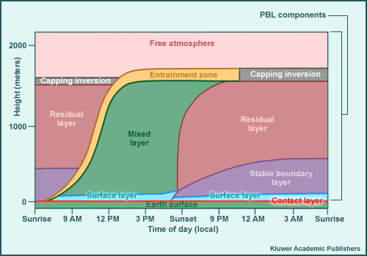
Applied NWP
comparison/contrast- clear sky
http://www.meted.ucar.edu/nwp/pcu1/ic4/frameset.htm

Slide 22
Applied NWP
comparison/contrast- cloudy sky
sfc param. | land sfc | water sfc
temperature
roughness
moisture
albedo
http://www.amazon.com/

Slide 23
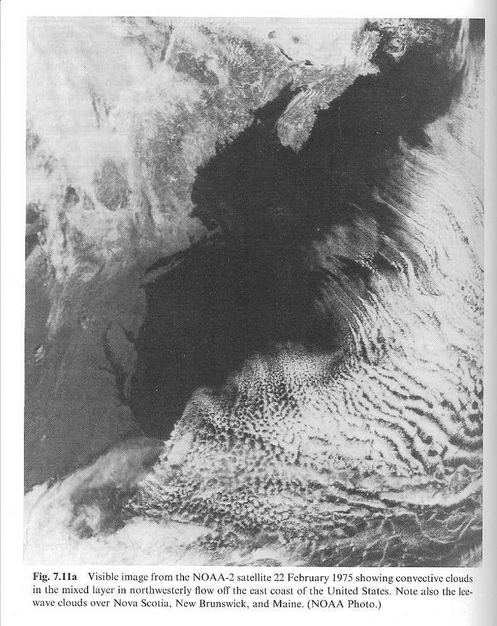
Applied NWP
VIS satellite image
What does this picture say about the surface fluxes and the planetary boundary layer?
Would our computer weather forecast model be able to predict this event accurately?
Wallace and Hobbs

Slide 24
Applied NWP
Ocean and land processes; surface fluxes a function of
  Air-surface temperature contrast
  Near surface wind speed
  Air-surface moisture contrast

Slide 25
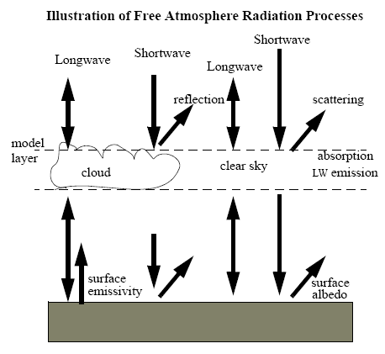
Applied NWP
Subgrid-scale processes; radiation (and chemical) processes
  Uneven heating of the earth’s surface “drives” our weather
  Important to calculate radiative transfer in the atmosphere accurately
http://www.mmm.ucar.edu/mm5/documents/tutorial-v3-notes.html

Slide 26
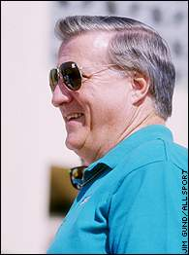
Applied NWP
Subgrid-scale processes; radiation processes
  One could spend all the computer resources and simulation time on radiation processes alone!
http://espn.go.com/page2/s/list/readers/greedy/owners.html

Slide 27
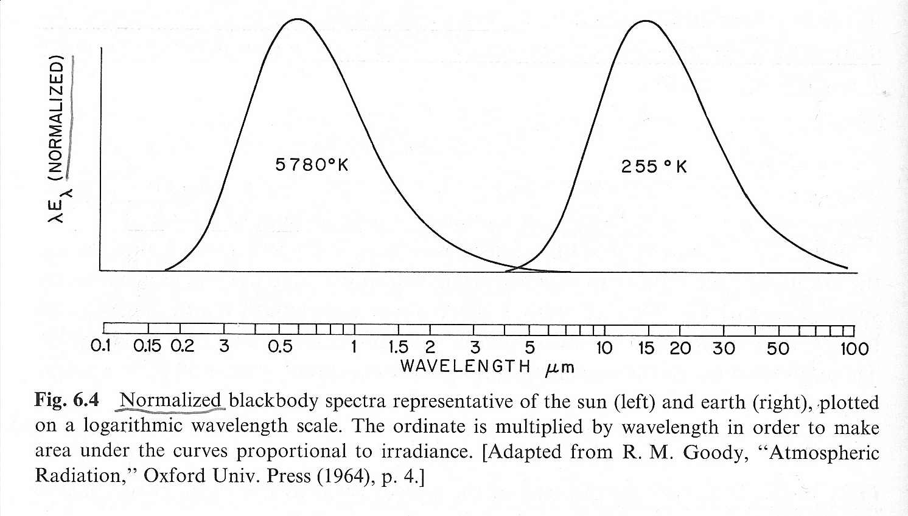
Applied NWP
Subgrid-scale processes; radiation processes
  solar radiation (due to the temperature of the sun) is concentrated in the visible and near-IR parts of the spectrum
  planetary radiation and that of their atmospheres is largely confined to the IR
Wallace and Hobbs
that allows scientists to deal separately with the radiative transfer problems of the earth and of the sun

Slide 28
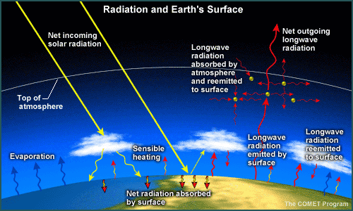
Applied NWP
Subgrid-scale processes; radiation processes- longwave radiation, common assumptions…
[Krish. & Boun., p. 195]
http://www.meted.ucar.edu/nwp/pcu1/ic4/frameset.htm
Clouds are considered as an infinite isothermal atmosphere which radiates as a black body
The earth’s surface is considered as a blackbody
The atmosphere is considered as a stratification of horizontally homogeneous plane-parallel layers
Scattering by air molecules is neglected and atmosphere is isotropic

Slide 29
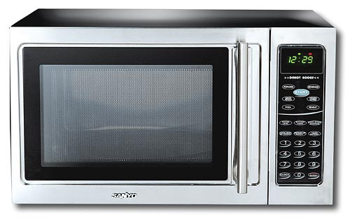
Applied NWP
Subgrid-scale processes; radiation processes- longwave radiation (cont.)
  Absorption and emission by air molecules (CO₂, H₂0, and O₃) and clouds
http://www.bestbuy.com/

Slide 30
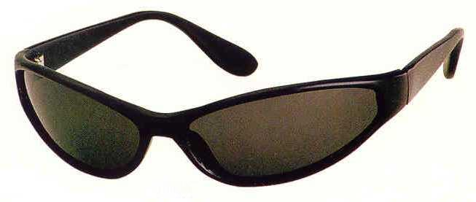
Applied NWP
Subgrid-scale processes; radiation processes- shortwave radiation
  Absorption by air molecules (O₃ and H₂0) and scattering by clouds
http://www.meted.ucar.edu/nwp/pcu1/ic4/frameset.htm
http://www.onlinereadingglasses.co.uk/uvsunglasses.html

Slide 31
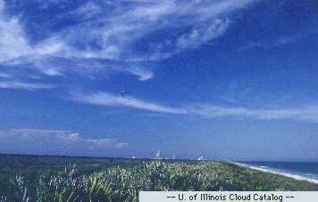
Applied NWP
Subgrid-scale processes; radiation processes- clouds are important for both LW and SW radiation
http://ww2010.atmos.uiuc.edu/(Gh)/guides/mtr/cld/cldtyp/hgh/crs.rxml

Slide 32
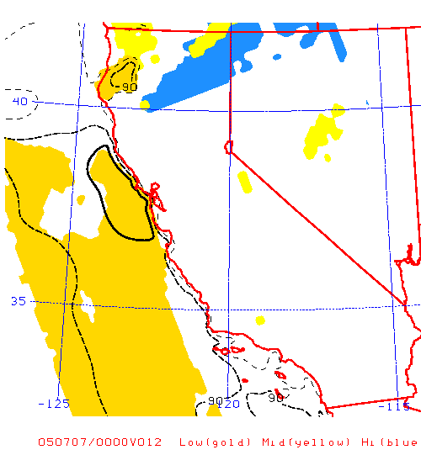
Applied NWP
Subgrid-scale processes; radiation processes- clouds
  Information used by radiation schemes to characterize clouds is based on mean relative humidity within a low, middle, and high layer of the model atmosphere
http://wx.met.nps.navy.mil/~hale/MM5/

Slide 33
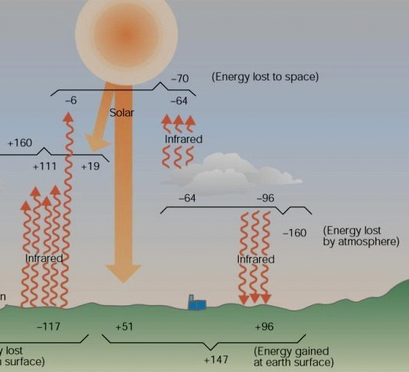
Applied NWP
Subgrid-scale processes; radiation processes

Slide 34
Applied NWP
Without subgrid-scale parameterization schemes, model forecasts of…
  Large-scale flow becomes unrealistic in one to two days
  Storm-scale development becomes unrealistic in less than an hour
500 mb Geopotential Height (m)

Slide 35
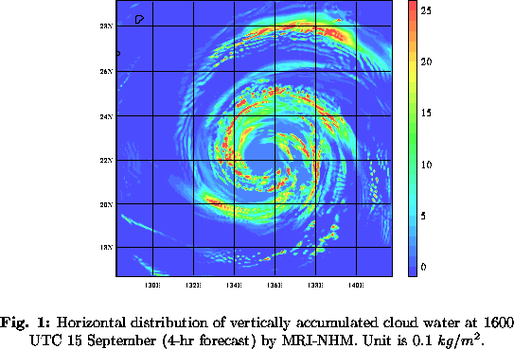
Applied NWP
What happens if an important physical process that occurs in the real atmosphere on a scale unresolved by the model is not parameterized?
http://www.mri-jma.go.jp/Project/mrinpd/APPE/srnwp99/murata.html
NOODLES!! – Say what?

Slide 36
Applied NWP
What happens if an important physical process that occurs in the real atmosphere on a scale unresolved by the model is not parameterized? In some simulations…
  Potential temperature decreases with height
  Equivalent potential temperature decreases with height
  → “noodles” develop in which unrealistic narrow columns of rising and sinking air coexist side by side

Slide 37
Applied NWP
What happens if an important physical process that occurs in the real atmosphere on a scale unresolved by the model is not parameterized?
  Potential temperature decreases with height
    Dry convective adjustment; atmospheric column is instantaneously adjusted to an adiabatic or very slightly stable profile
  Equivalent potential temperature decreases with height
    Moist convective adjustment; unrealistic
    Cumulus parameterization schemes

Slide 38
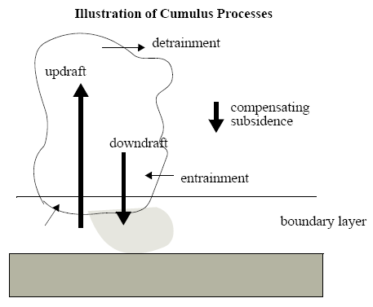
Applied NWP
Subgrid-scale processes; cloud processes
  Spatio-temporal scale of cumulus clouds is ~ two orders of magnitude less than the synoptic scale
  Organization of convection has a significant influence on large-scale motion through heat, momentum, and moisture exchanges
  (Krish. and Boun., p. 150)
http://www.mmm.ucar.edu/mm5/documents/tutorial-v3-notes.html
Go to: http://www.meted.ucar.edu/nwp/model_precipandclouds/navmenu.php and look under
“Convective Parameterization” for more information

Slide 39
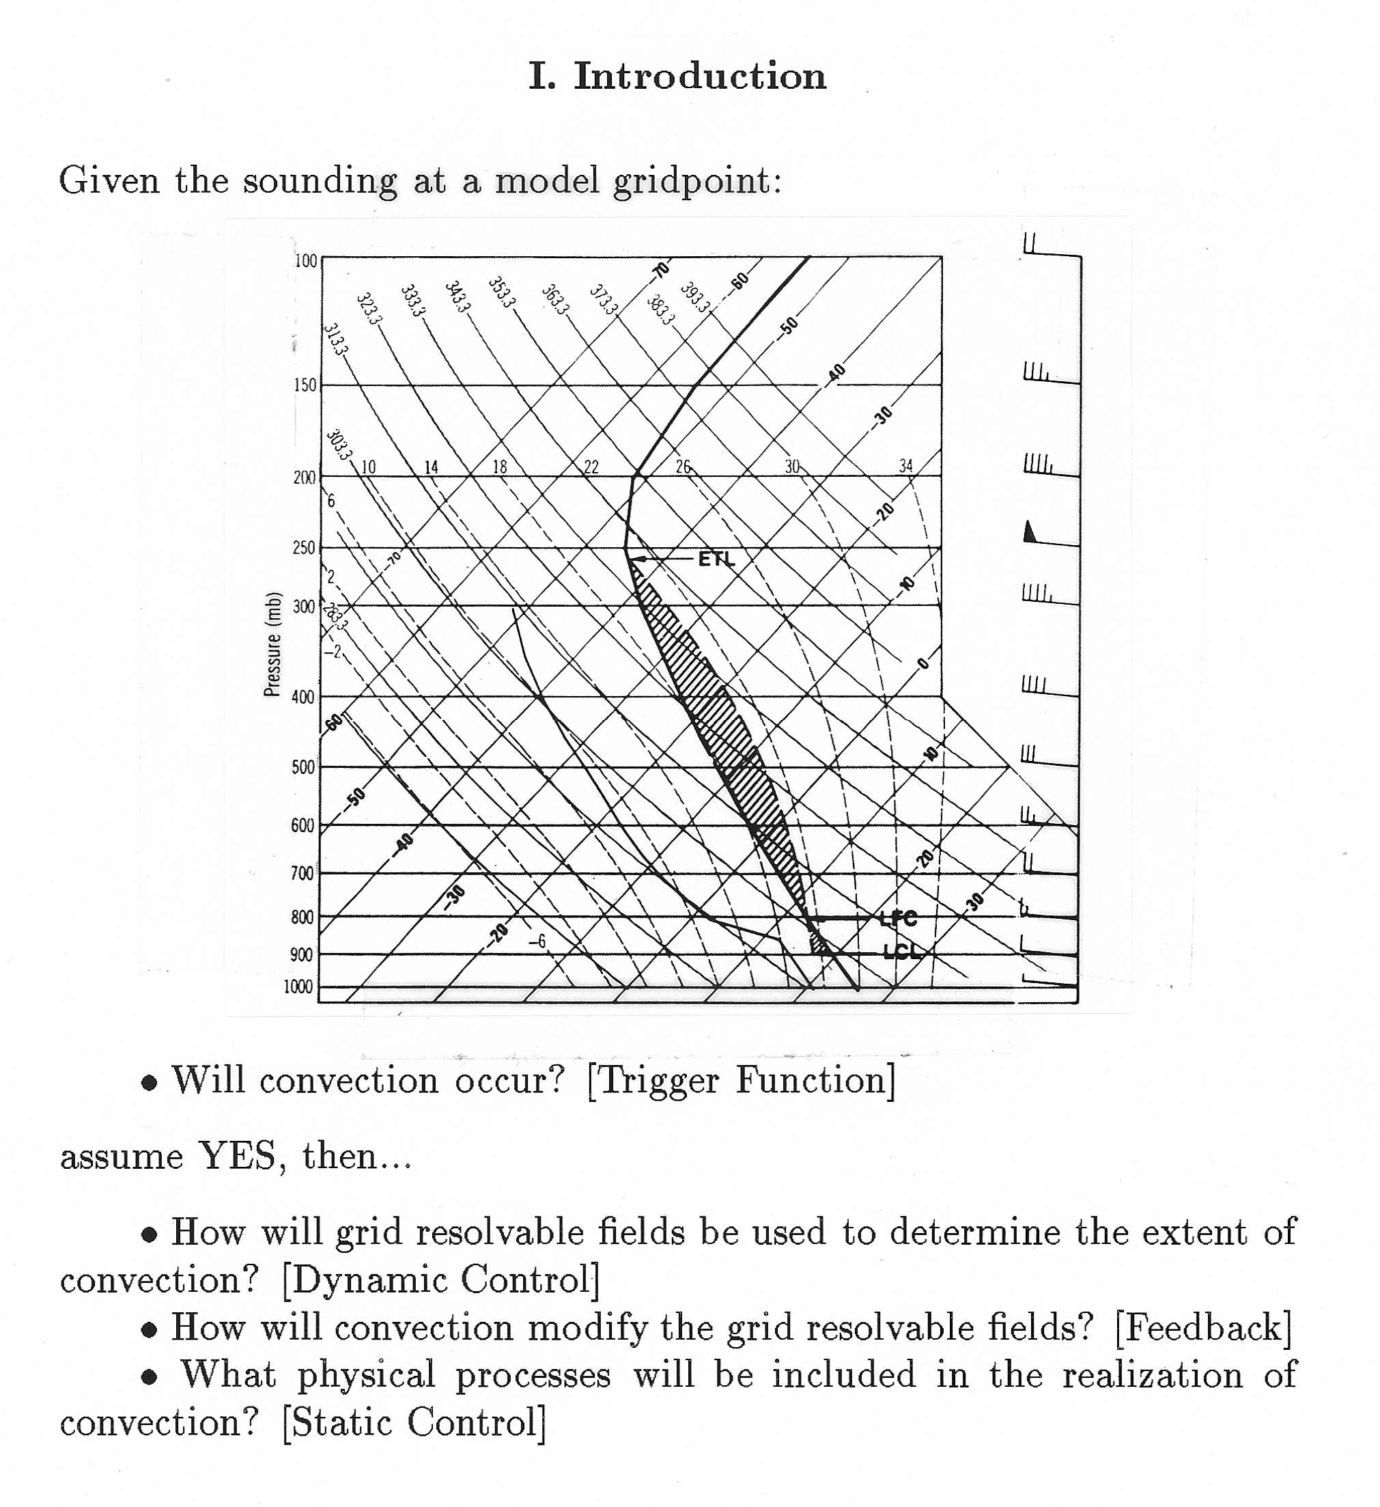
Applied NWP
Cloud processes; the “guts”
  Trigger mechanism
  Dynamic control
  Feedback
  Static control (cloud model)
“Grell et al. (1991), Monthly Weather Review
Vol. 119, 5-31” is a good reference

Slide 40
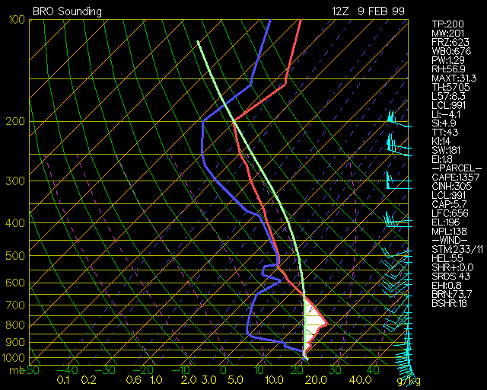
Applied NWP
Cloud processes; the “guts”- trigger mechanism
  Given convective inhibition, will heating, moistening, or large-scale flow field be able to overcome stable layer?
http://twister.sbs.ohio-state.edu/helpdocs/cinh.html
Go to: http://www.meted.ucar.edu/nwp/model_precipandclouds/navmenu.php and look under
“Convective Parameterization” for more information

Slide 41
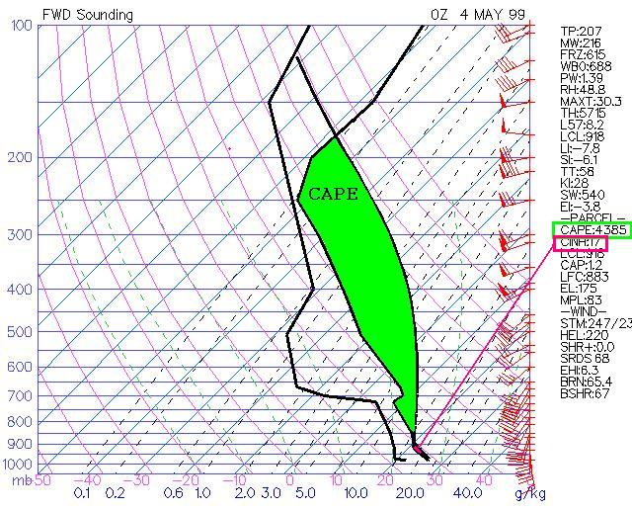
Applied NWP
Cloud processes; the “guts”-dynamic control
  Once convection is initiated, how intense will it be?
    Some schemes assume convection intensity is related to the amount of convective available potential energy (CAPE)
http://www.scalialab.com/classpages/304/Skew T Log P Diagrams.ppt

Slide 42
Applied NWP
Cloud processes; the “guts”-feedback
  Heat, momentum, and moisture of the large-scale (grid scale) fields is modified by the subgrid-scale convection
  Accomplished by the warming at mid- levels and drying at low- levels by the CPS
http://www.mmm.ucar.edu/mm5/documents/tutorial-v3-notes.html

Slide 43
Applied NWP
Cloud processes; the “guts”-static control (cloud model)
  Degree of sophistication depends on computer resources
    Updrafts?
    Downdrafts?
    Entrainment?
    Detrainment?
http://www.mmm.ucar.edu/mm5/documents/tutorial-v3-notes.html

Slide 44
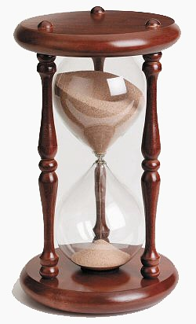
Applied NWP
Cloud processes; the “guts” (cont.)
  Because convective instability must be overturned on short time scales, the convective parameterization scheme (CPS) gets first “crack” at the available moisture
http://www.theclockdepot.com/hourglass_and_sandtimers.html

Slide 45
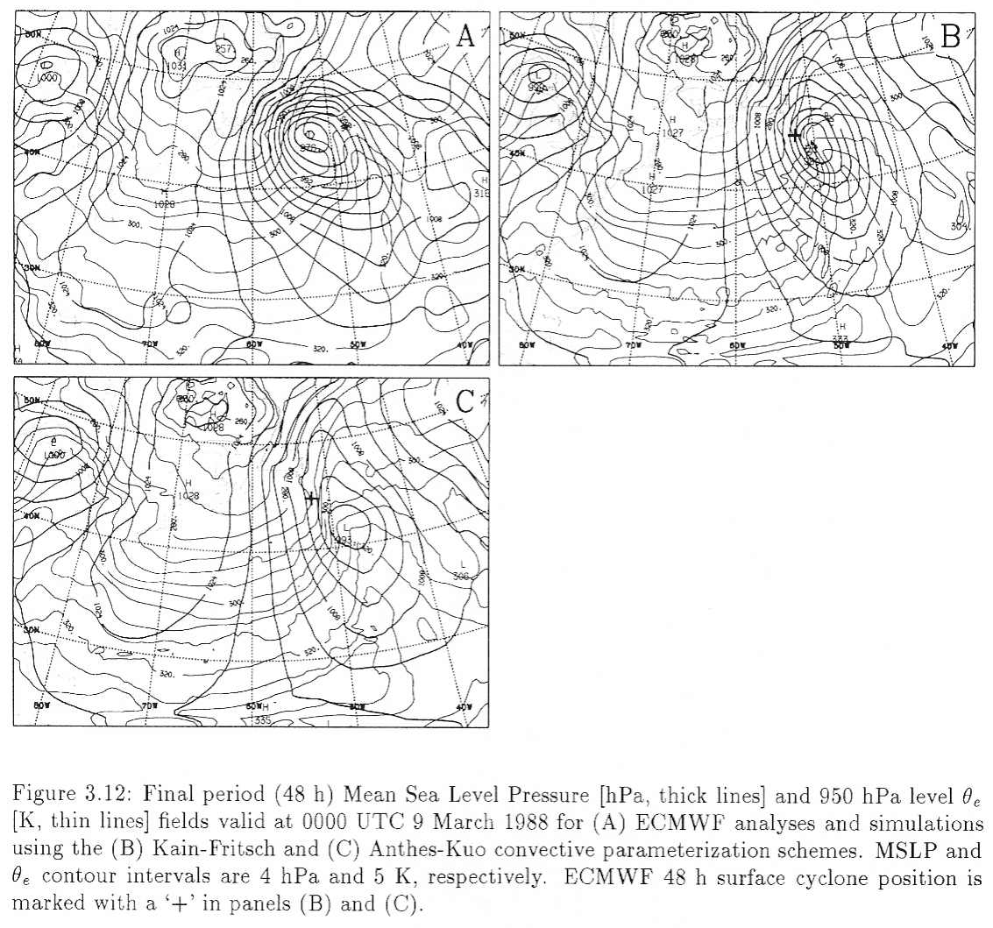
Applied NWP
Cloud processes; the “guts” (cont.)
  A resulting cyclone forecast can be dependent on the type of CPS used in the model

Slide 46
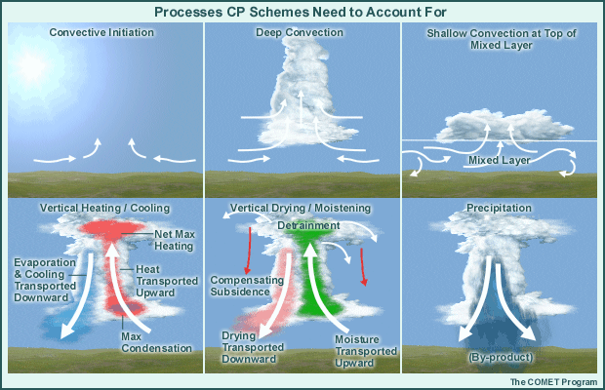
Applied NWP
Subgrid-scale processes; cloud processes
http://www.meted.ucar.edu/nwp/pcu1/ic3/frameset.htm

Slide 47
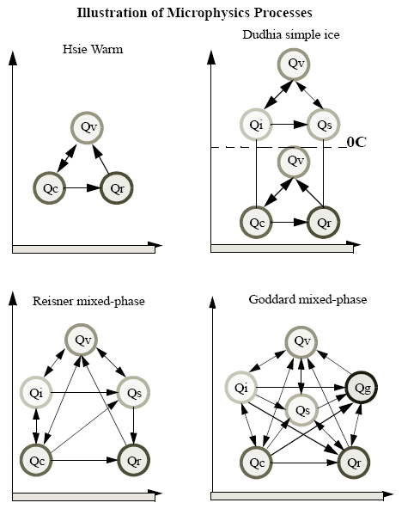
Applied NWP
Subgrid-scale processes; hydrological processes
  Large-scale clouds, small-scale processes (cloud microphysics)
    Vapor (Qv)
    Cloud liquid water (Qc)
    Rain water (Qr)
    Cloud ice (Qi)
    Snow (Qs)
    Graupel (Qg)
http://www.mmm.ucar.edu/mm5/documents/tutorial-v3-notes.html

Slide 48
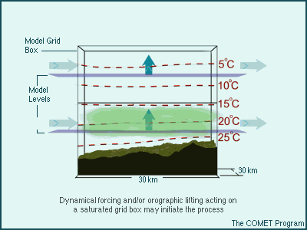
Applied NWP
Subgrid-scale processes; hydrological processes
  clouds and precipitation forced by grid-scale motions cannot be predicted in complete detail and must include at least some parameterization
http://www.meted.ucar.edu/nwp/pcu1/ic3/frameset.htm

Slide 49
Applied NWP
Subgrid-scale processes; hydrological processes
  The development of clouds and precipitation in the PCP scheme results in latent heating from condensation (indicated by the red area in the animation), which changes the grid-scale wind, temperature, and moisture fields (feedback)
http://www.meted.ucar.edu/nwp/pcu1/ic3/frameset.htm

Slide 50
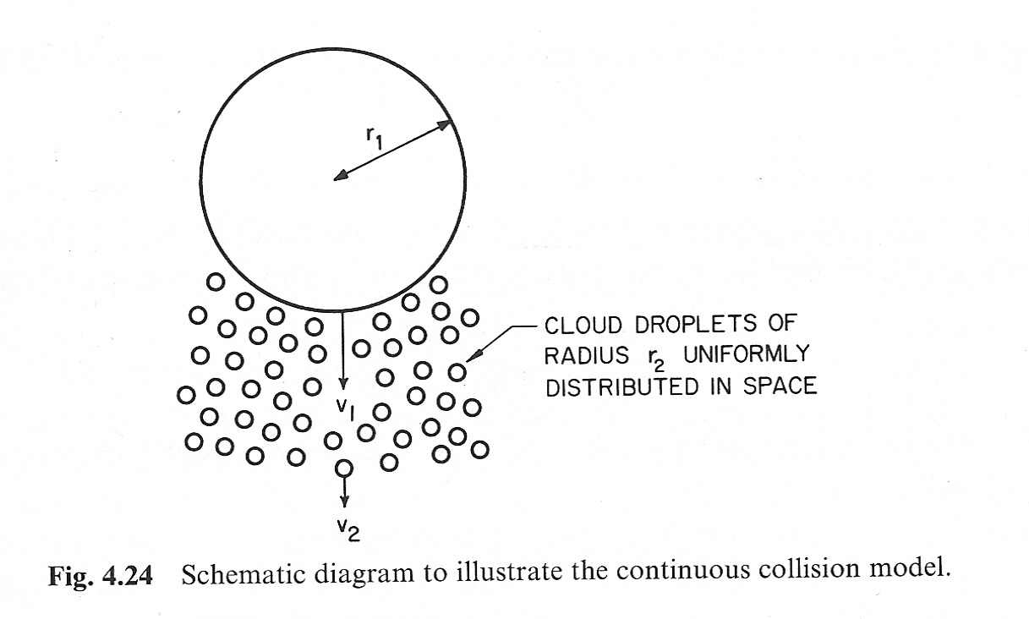
Applied NWP
Subgrid-scale processes; hydrological processes
  Precipitation-sized particles generally form due to collisions
    Requires assumptions about particle size distribution
    Marshall-Palmer size distribution is often assumed
Wallace and Hobbs
J.S. Marshall and W.M. Palmer, 1948: The distribution of
raindrops with size, Journal of Meteorology, Vol. 5 ,
pp. 165-166.

Slide 51
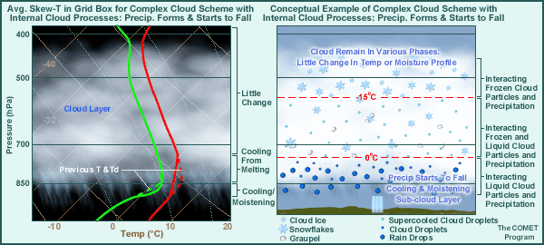
Applied NWP
Hydrological processes; some related factors
  Cloud-top IR cooling
  Entrainment at cloud edge
  Sub-cloud layer cooling and moistening
Go to: http://www.meted.ucar.edu/nwp/model_precipandclouds/navmenu.php and look under
“Precipitation Microphysics” for more information

Slide 52

Applied NWP
Subgrid-scale processes; hydrological processes
http://www.its.caltech.edu/~atomic/snowcrystals/snowstore/040122b088-570.jpg
Activity- code word- Happenstance2

Slide 53

Applied NWP
The “gray” zone (4-10 km)…
  Processes that occur at scales not much smaller than the model grid size
  Resolved scales and unresolved scales (to be parameterized) are not well separated
http://www.carlisle.army.mil/ssi/pubs/display.cfm/hurl/PubID=412

Slide 54
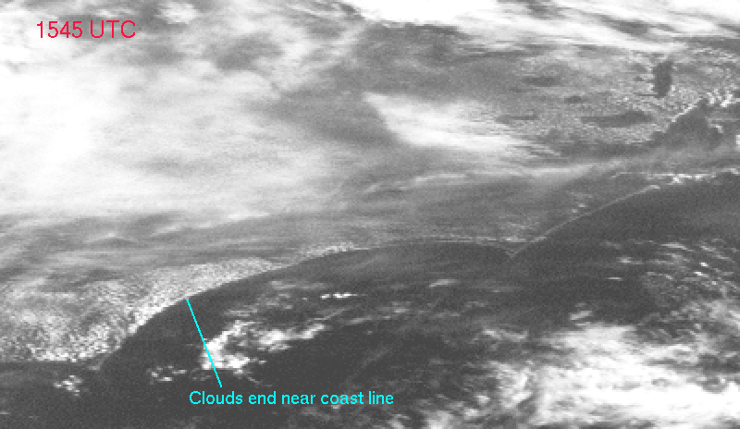
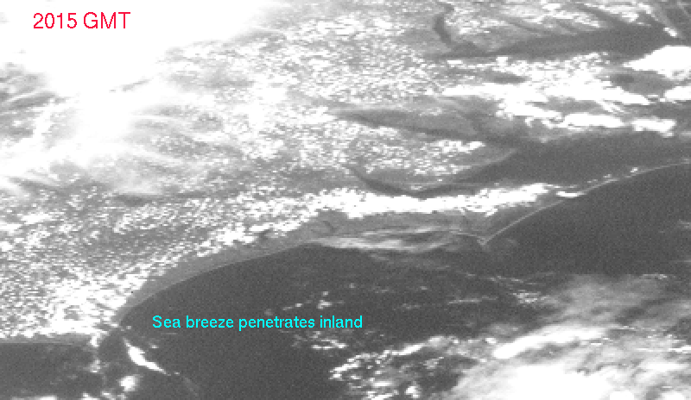
Applied NWP
The “gray” zone; examples
  Sea-breeze (1-20 km)
  Heated mountain slopes
  Cumulus convection (10 km)
2015 UTC
http://cimss.ssec.wisc.edu/wxwise/seabrz.html

Slide 55
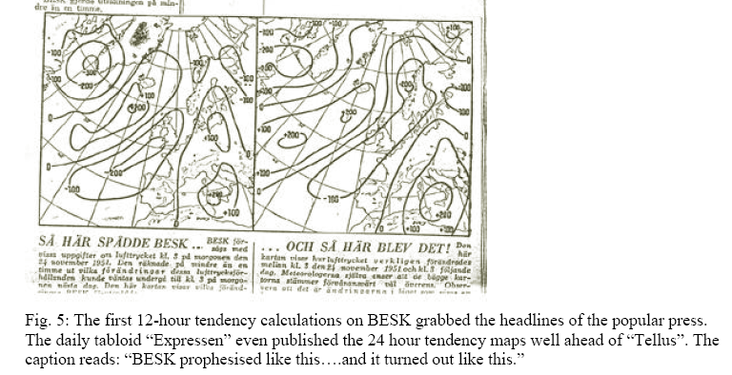
Applied NWP
In the “old days”, computer weather model forecasts performed remarkably well
  No sophisticated physics (e.g. dry atms.)
  Highly simplified governing equations
Why?
http://www.weather.org.uk/reference/files/NWP_HISTORY_small.pdf

Slide 56
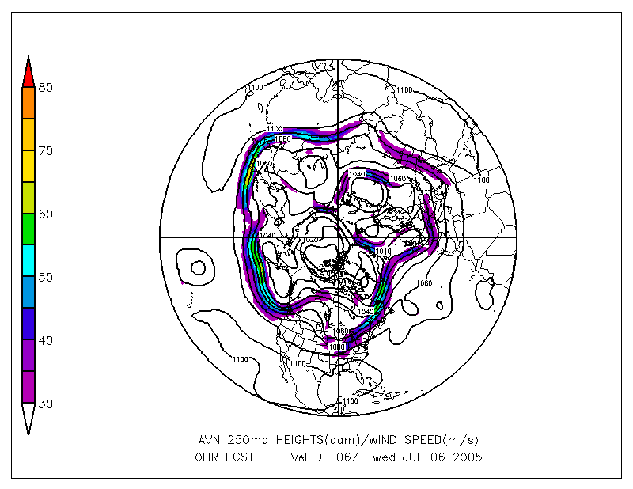
Applied NWP
Why “old” simple computer weather model forecasts performed remarkably well
  Synoptic-scale and larger waves (planetary) are reasonably well observed and understood
http://www.cdc.noaa.gov/map/images/avn/250_wnd_anl.avn.gif

Slide 57
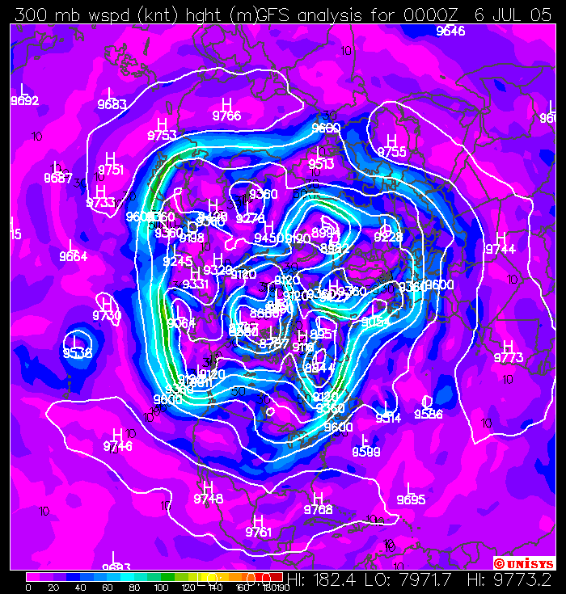
Applied NWP
Why “old” simple computer weather model forecasts performed remarkably well
  Simple weather models generally perform well in weather regimes dominated by the synoptic and planetary scales (cold seasons)
http://weather.unisys.com/upper_air/ua_nhem_300.html

Slide 58
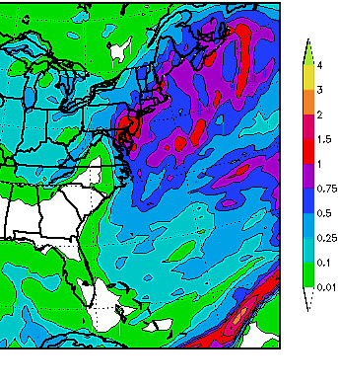
Applied NWP
Computer weather model forecast problems occur when
  Small-scale features play an important role
  Small-scale features are not well observed and often not well understood
30 December 2000 East Coast Snowstorm
http://www.meted.ucar.edu/nwp/pcu3/cases/301200/index.htm

Slide 59

Applied NWP
In summary, the computer weather forecast game- a balance between
  Computer resources
  Model physics
  to make acceptably accurate predictions
http://www.mattelscrabble.com/en/adults/index.html

