Slide 1
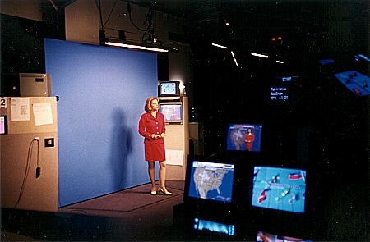
Introduction
What goes into making a good weather forecast?
http://www.hprcc.unl.edu/nebraska/TWC98-1.html

Slide 2
Introduction
What goes into making a good weather forecast?
Glitz?
Glamour?
Graphics?
Something else beginning with ‘G’?
http://www.hprcc.unl.edu/nebraska/TWC98-1.html

Slide 3
Introduction
What if as an operational forecaster you relied on the “Farmers’ Almanac as your sole source of forecast information?
http://www.farmersalmanac.com/preview/preview.html

Slide 4
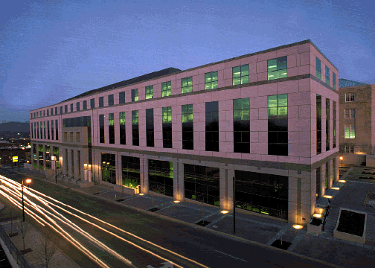
Introduction
What if you relied on climatology as your sole source of forecast information?
http://www.ozonelayer.noaa.gov/action/ncdc.htm

Slide 5
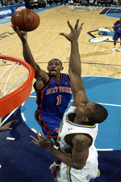
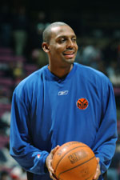
Introduction
What if you relied on (“Penny”) persistence as your sole source of forecast information?
http://www.pennyhardaway.net/fans.php

Slide 6
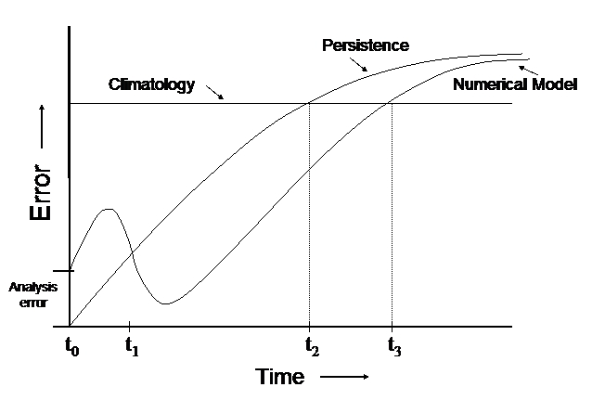
Introduction
Forecast plot of error due to climatology, persistence, and a numerical weather prediction model…
Kuypers (1999)

Slide 7
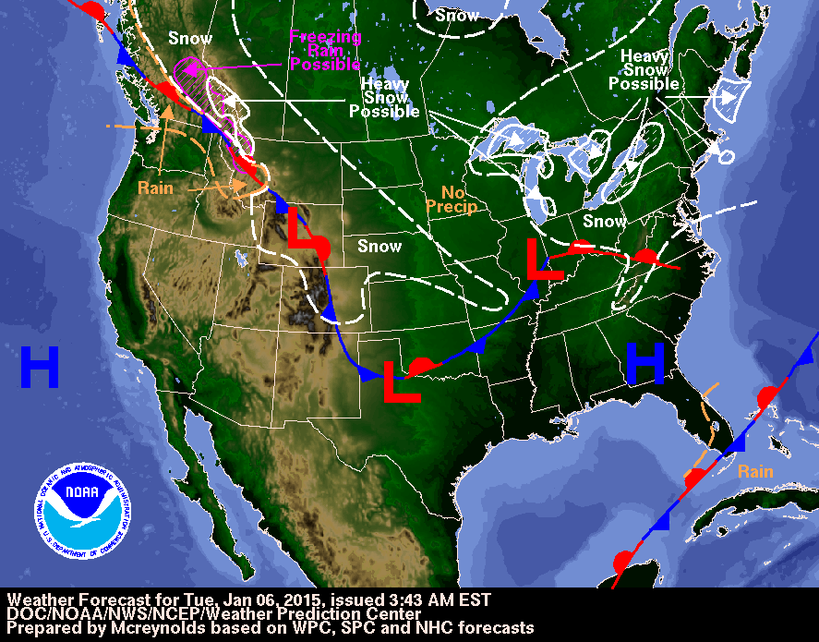
Introduction
What goes into making a good weather forecast?
http://www.hpc.ncep.noaa.gov/national_forecast/natfcst.php

Slide 8
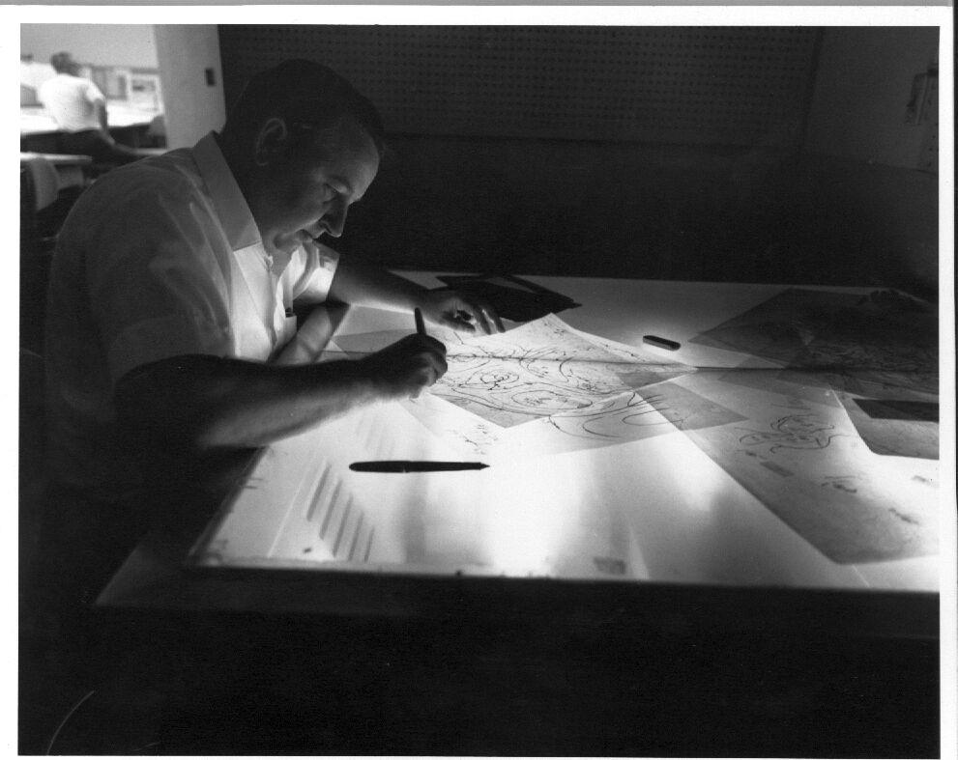
Introduction
Imagine you are a forecaster at the Weather Prediction Center…
The primary functions of the WPC:
Quantitative Precipitation Forecasts (QPF)
Mesoscale Precipitation Discussions
Winter Weather Forecasts
Short Term Forecasts
Medium-Range (Days 3-7) Public Forecasts
Alaska Medium-Range (Days 4-8) Public Forecasts
Numerical Model Diagnostics and Interpretation
Surface Analysis
Tropical Cyclone Forecasts
International Desks
http://www.hpc.ncep.noaa.gov/html/DrawTable.html
http://www.hpc.ncep.noaa.gov/html/about2.shtml

Slide 9
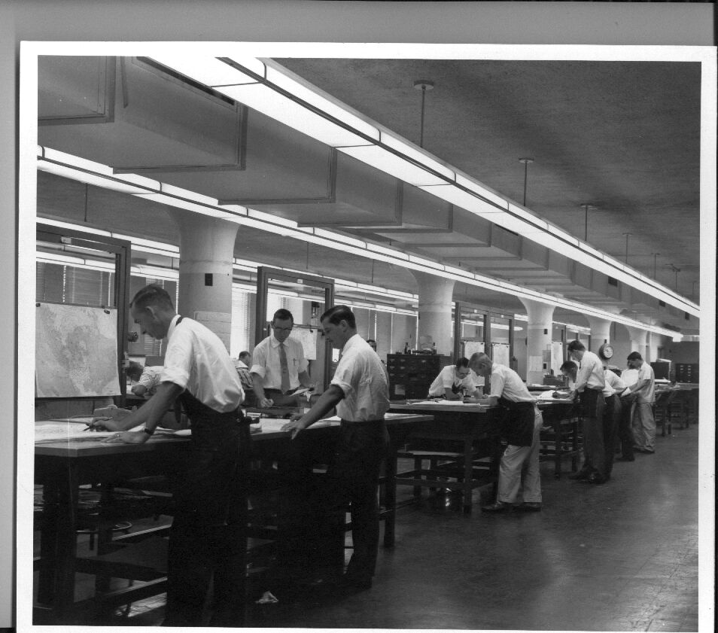
Introduction
How might making a one day forecast differ from making a medium range (3-7 day) forecast?
http://www.hpc.ncep.noaa.gov/html/OldAnalysis.html

Slide 10
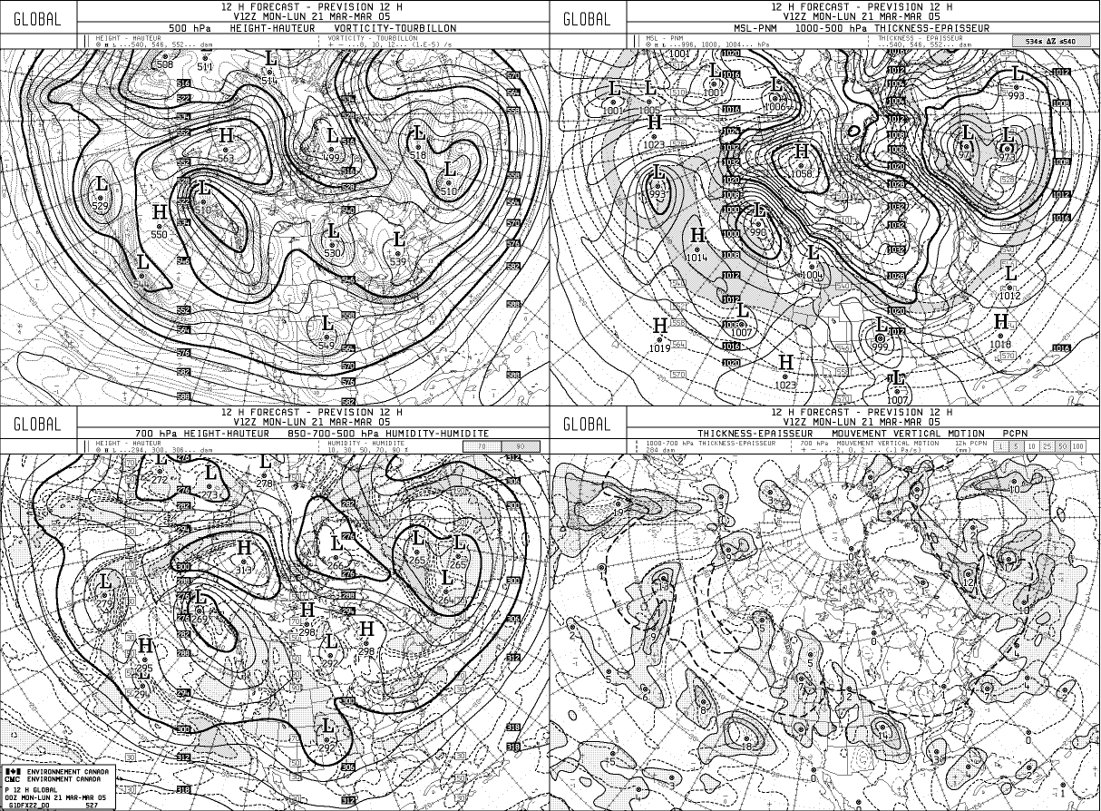
Introduction
What goes into making a good one day (short-term) weather forecast?
“The first step in making the best forecast that the science permits requires a thorough high quality diagnosis. Successful short range forecasts are more the result of good diagnosis than of prognosis.” (Snellman)
http://umanitoba.ca/faculties/environment/envirogeog/weather/nwpmodule/global_12hr.gif

Slide 11
Introduction
What goes into making a good one day (short-term) weather forecast?
“I read and listen to forecast discussions now where the total focus is on the models. The debate is mostly aimed at the absurd exercise of trying to decide which is the `model of the day.’ The fact is that there is essentially nothing in the way of systematic procedures to decide the question reliably of which model to believe on any given day, in spite of most forecasters spending an inordinate amount of time trying to do so. Rather than using their time to diagnose atmospheric processes, forecasters often waste hours of their precious time in a futile effort to choose a model in which to believe. Models definitely have a role in science. That has never been a doubt, in my mind. What is troubling is the current overemphasis on modeling and the lack of interest evident in data and diagnosis of observations. The situation represents an imbalance among the triad of components in a healthy science: (1) theory, (2) observations, and (3) modeling. It has been discussed elsewhere that our science makes its most rapid advances when all these components of a successful science are in balance.” (Doswell)
http://umanitoba.ca/faculties/environment/envirogeog/weather/nwpmodule/nwp_march21-2005.htm#Meteorological%20Cancer

Slide 12
Introduction
What is “meteorological cancer”?
Meteorological cancer is defined as the increasing tendency of forecasters to abdicate practicing meteorological science and becoming more and more just a conduit of information generated by computers (Snellman, 1977)
http://www.wes.hpc.mil/index.htm

Slide 13
Introduction
“To set the stage for my remarks, I would like you to recall the difference between a thermometer and a thermostat. A thermometer senses and adjusts to its environment; a thermostat, first senses its environment and then adjusts the latter to the conditions for which it was set.”(Snellman, 1991)
http://www.nwas.org/members/snellman.html

Slide 14
Introduction
“The ability to issue forecasts with details of time and intensity of severe weather as well as ordinary day-to-day weather changes will be great fun as well as more helpful to users. This increased job satisfaction, and being the best that you can be, will take place only if forecasters are given time to be a scientist (thermostat) and not just a communicator (thermometer).”(Snellman, 1991)
http://www.nwas.org/members/snellman.html

Slide 15
Introduction
What goes into making a good 3-7 day (medium range) weather forecast?
http://umanitoba.ca/faculties/environment/envirogeog/weather/nwpmodule/global_12hr.gif

Slide 16
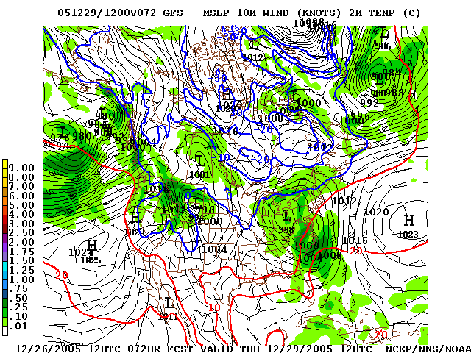
Introduction
What goes into making a good 3-7 day (medium range) weather forecast?
Beyond the ability of humans to integrate the equations of motion in their heads
Requires numerical guidance
http://www.nco.ncep.noaa.gov/pmb/nwprod/analysis/namer/gfs/12/images/gfs_ten_072s.gif

Slide 17
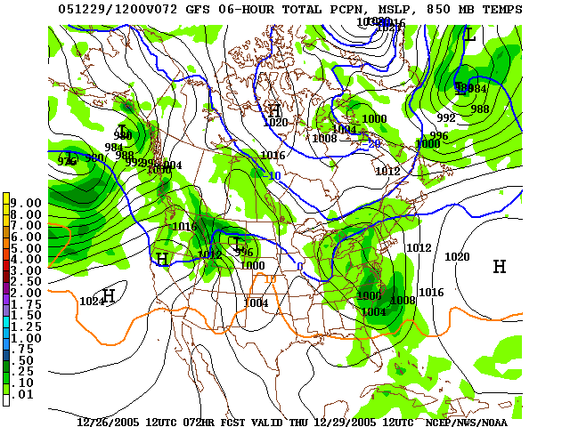
Introduction
Good numerical guidance depends on two things
Computer model is a realistic representation of the atmosphere
Initial conditions are known accurately
http://www.nco.ncep.noaa.gov/pmb/nwprod/analysis/namer/gfs/12/images/gfs_p06_072s.gif

Slide 18
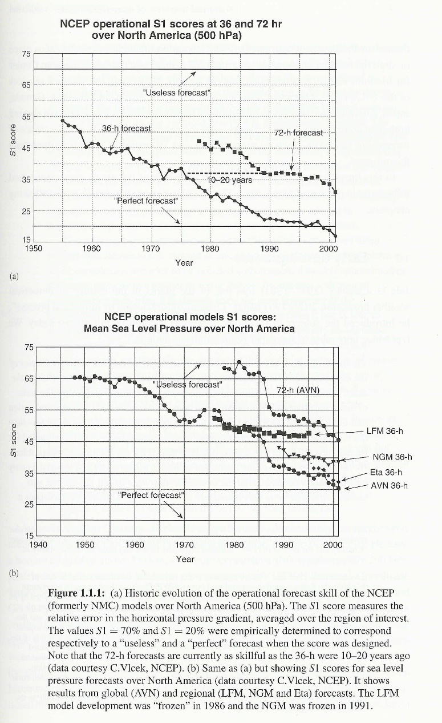
Introduction
Numerical guidance skill ,S1 score [Kalnay]
70% = useless
20% or less, perfect

Slide 19
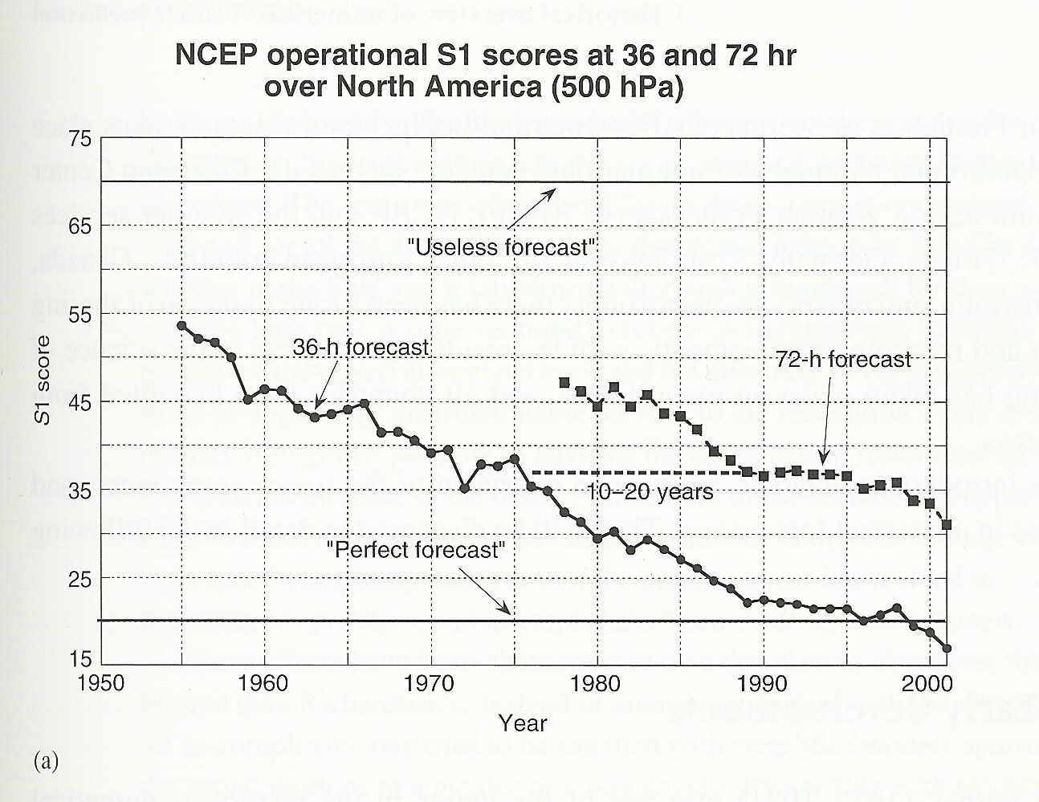
Introduction
Improvement in numerical guidance skill over past 40 years
Increased power of supercomputers
Improved representation of small-scale processes in the models
Improved methods of data assimilation
Increased availability of data

Slide 20
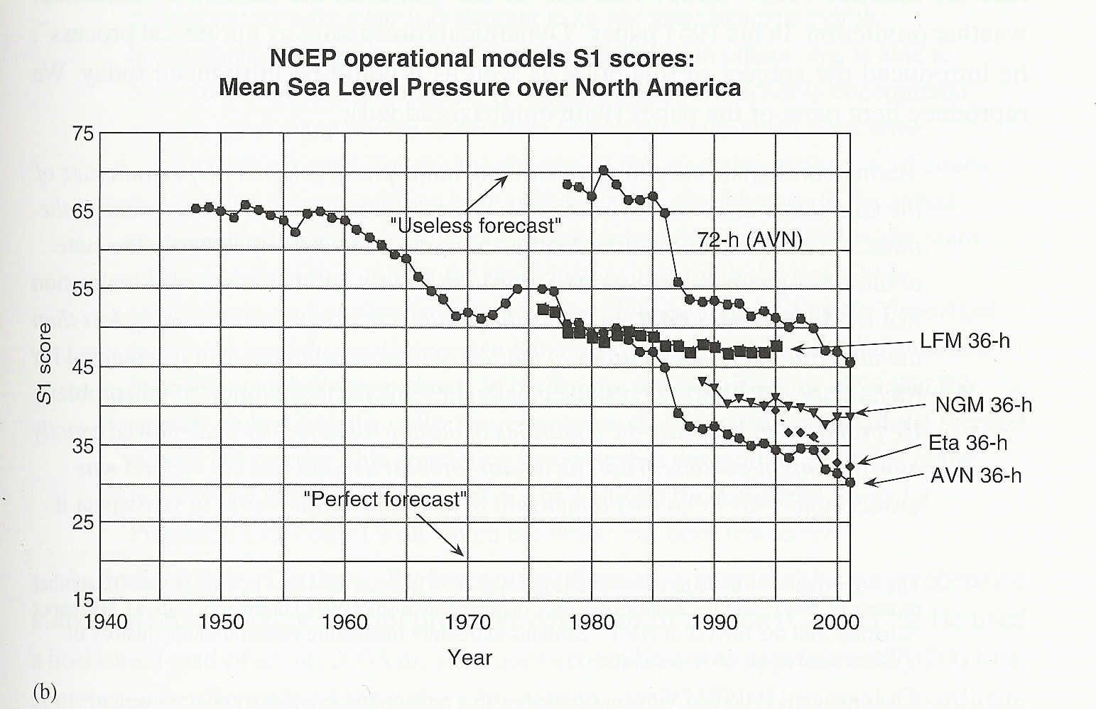
Introduction
Improvement in numerical guidance skill over past 40 years
Increased power of supercomputers
Improved representation of small-scale processes in the models
Improved methods of data assimilation
Increased availability of data

Slide 21
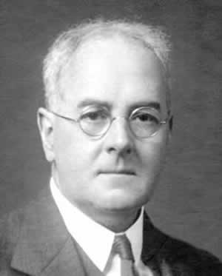
Introduction
Numerical guidance, the early years [D&VK, Chapter 1]
Lewis Fry Richardson and many others
http://www.wmo.int/pages/publications/bulletin_en/archive/59_2_en/59_2_lynch_en.html

Slide 22
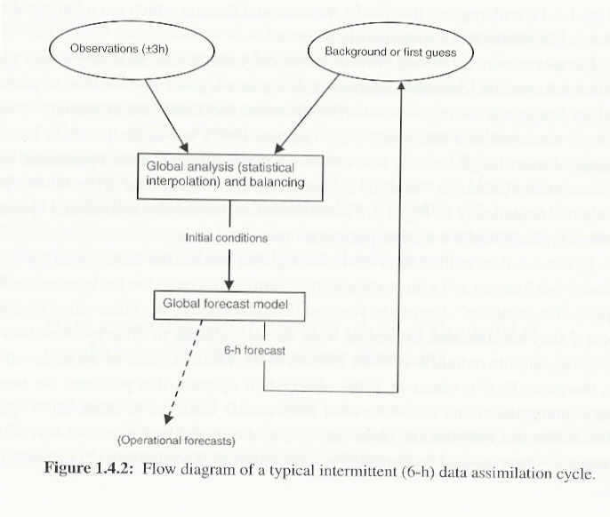
Introduction
Numerical guidance, the “big picture”
Data assimilation (pre-process)
Observations
Background (first guess)
Numerical model (NWP)
Forecast (post-process)
Validation

Slide 23
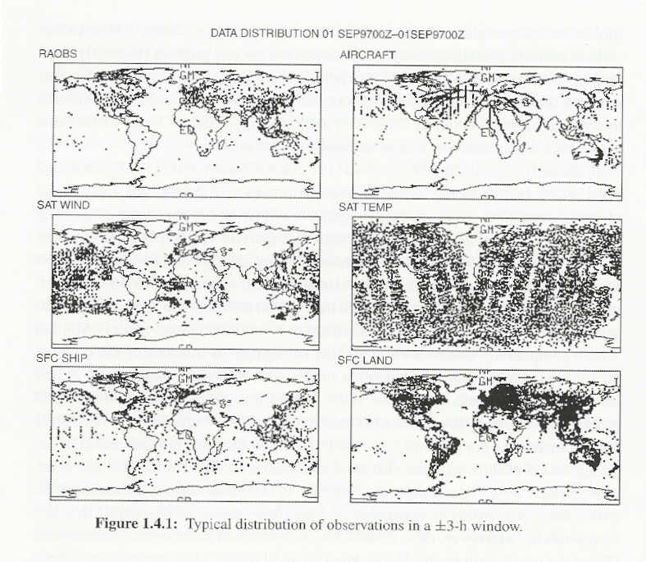
Introduction
Numerical guidance, the “big picture”; Data assimilation (D&VK Ch. 12, Kalnay Ch. 5)
Getting an accurate picture of the initial conditions
We “can’t handle the truth”!!
Methods; SCM, OI, 3D-Var, KF, 4D-Var

Slide 24
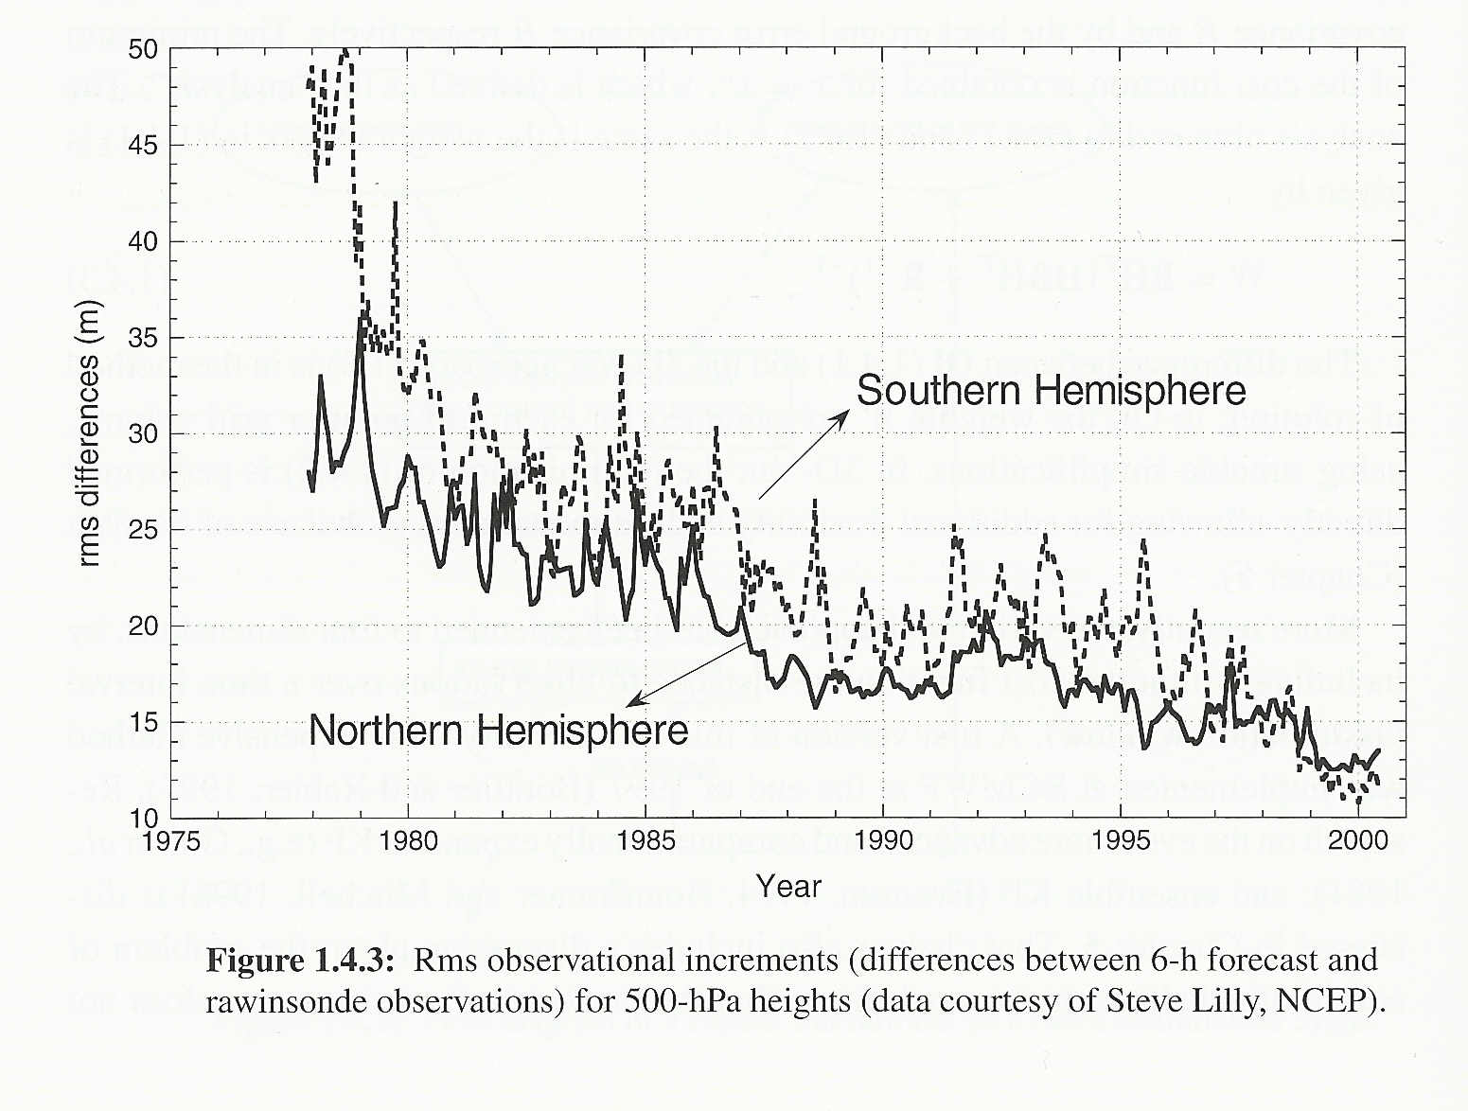
Introduction
Numerical guidance, the “big picture”; Data assimilation (cont.)
4DDA
NH RMS differences
SH RMS differences

Slide 25
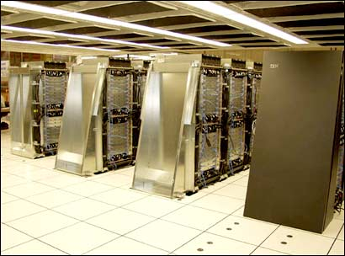
Introduction
Numerical guidance, the “big picture”; Numerical model (D&VK Chapters 3-11)
RHS- model “physics”
http://inhome.rediff.com/money/2005/jun/23super.htm

Slide 26
Introduction
Numerical guidance, the “big picture”; Numerical model (D&VK Chapters 3-11)
Global models [long-term fcsts]
ECMWF
NCEP; GFS
NAVY; NOGAPS
Regional models [short-term fcsts]
NAM (WRF); U.S.
LFM; Japan
http://inhome.rediff.com/money/2005/jun/23super.htm

Slide 27
Introduction
Numerical guidance, the “big picture”;
Regional models [D&VK Chap. 9]
Hydrostatic
Good for horizontal grid scales of 100 km or greater
Nonhydrostatic
Requires special approach for dealing with sound waves

Slide 28
Introduction
Numerical guidance, the “big picture”; Numerical model operational centers
UKMET
France
Germany
Japan
Australia
Canada
U.S.
http://inhome.rediff.com/money/2005/jun/23super.htm

Slide 29
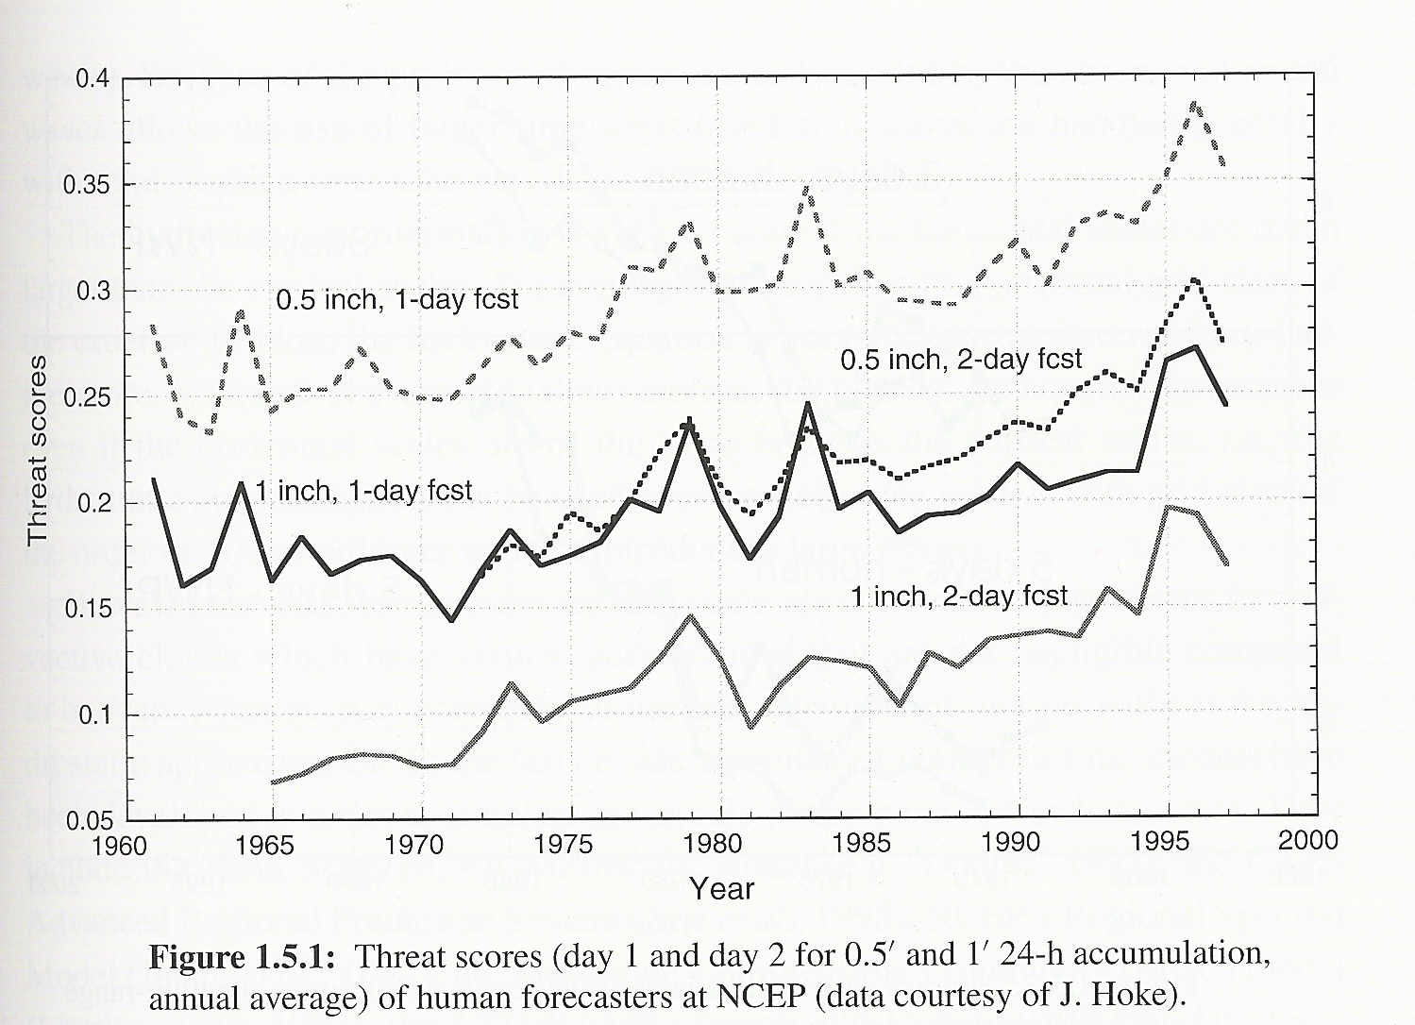
Introduction
Numerical guidance, the “big picture”; Forecast- verification & validation (D&VK Chapter 17, Kalnay 1.5)
Threat score (TS)
TS = (PΛO)/(PUO)
Current average skill in 2-d fcst is as good as the 1-d fcst in the 1970s
Reflects improvements primarily in NWP

Slide 30
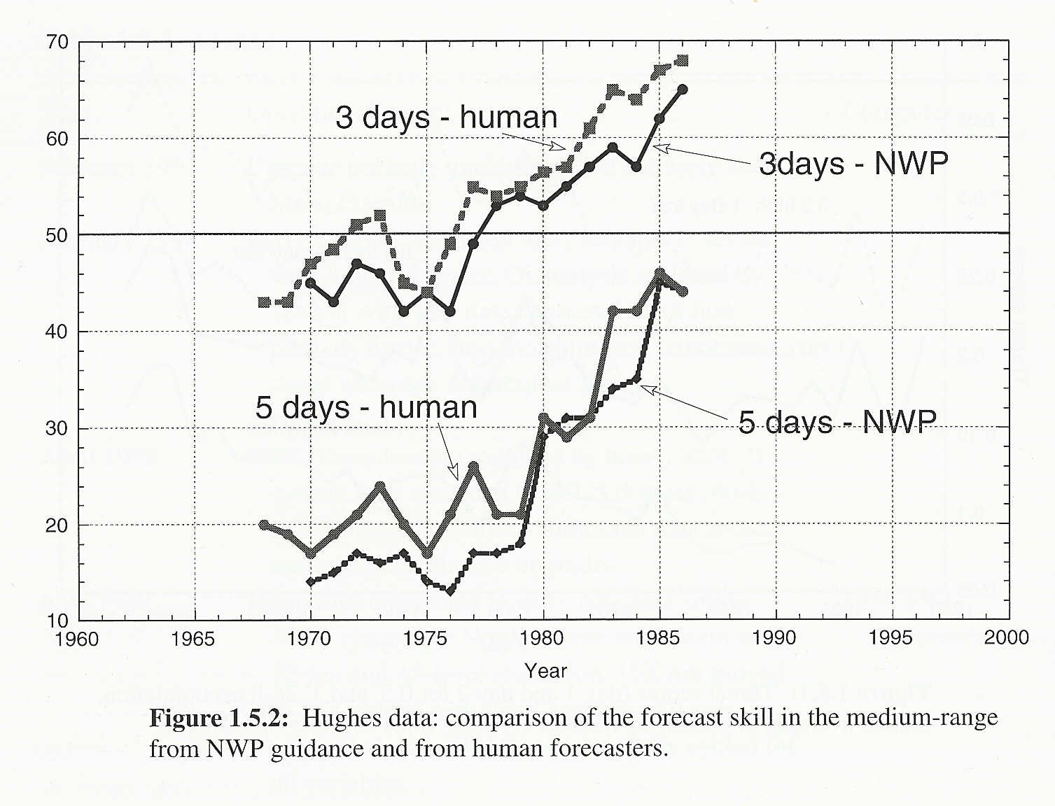
Introduction
Numerical guidance, the “big picture”; Forecast- verification (D&VK Chapter 17, Kalnay 1.5)
Relationship between human and numerical forecasts
Skill improvement rather “flat” until 1976
Improvement after 1977 for 3-day fcst
Improvement after 1980 for 5-day fcst
Humans more skillful than computers

Slide 31
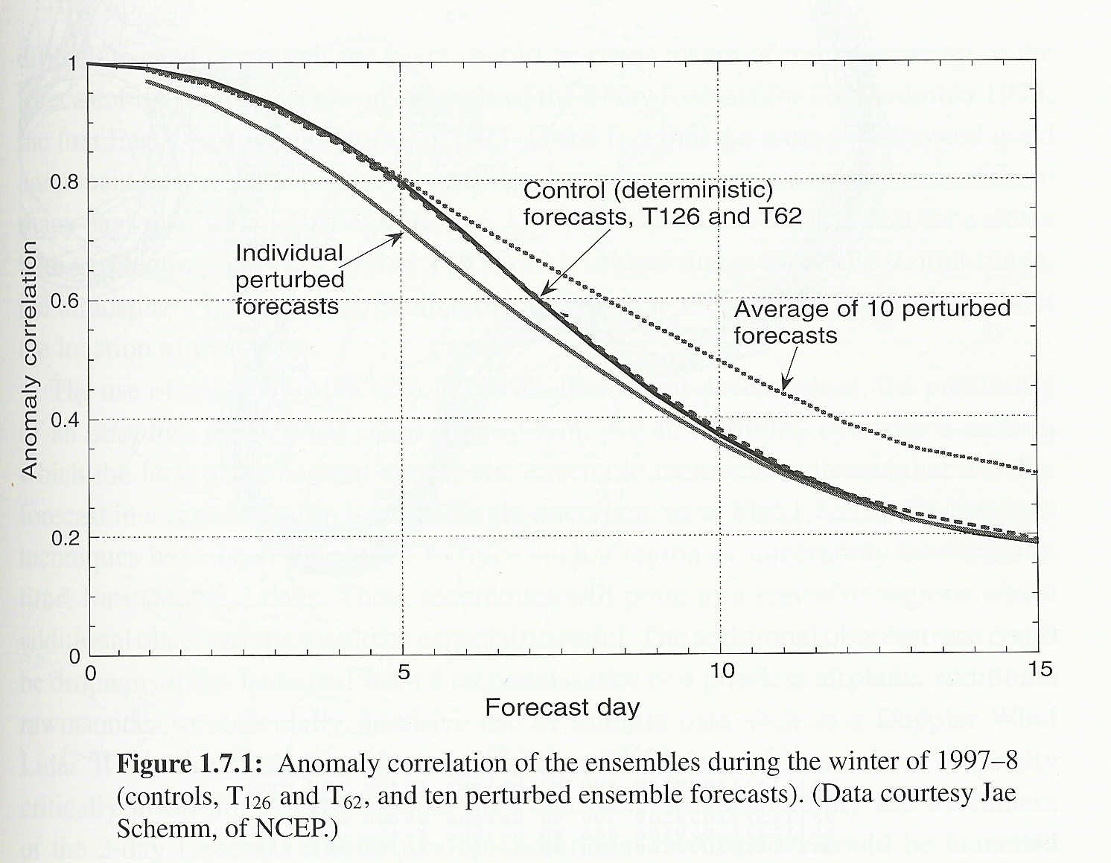
Introduction
Long-term numerical guidance, (D&VK Chapter 17 , Kalnay 1.7)
Even with perfect models and observations, the chaotic nature of the atmosphere forces a limit of predictability of ~ 2 weeks
Impetus for ensemble forecasting techniques
Provide ensemble average forecast that beyond first few days is more accurate than individual forecasts
Provide forecasters with estimate of reliability of forecast

Slide 32
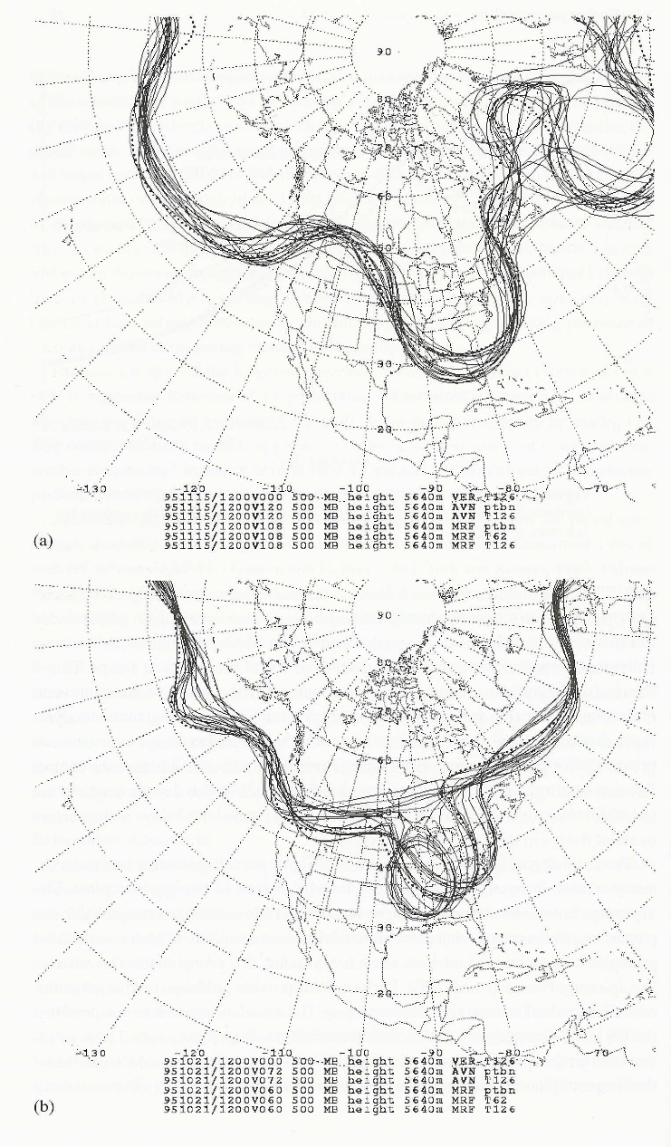
Introduction
Long-term numerical guidance, (D&VK Chapter 17, Kalnay 1.7), examples
High predictability; Nov 1995
East Coast winter storm, 5-day fcst
Low predictability; Oct 1995
2.5-day fcst for developing storm

Slide 33
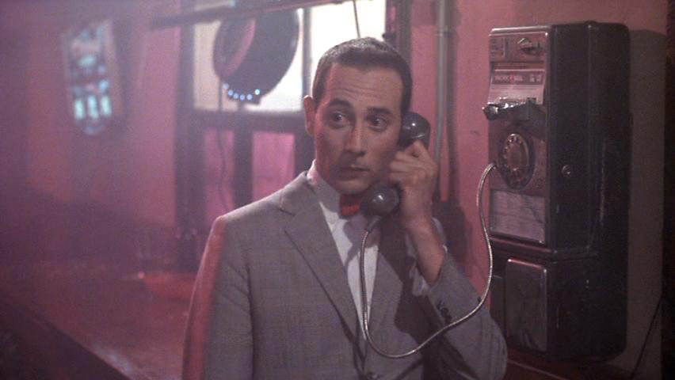
Introduction
The future,
How “low” can we go?
Mesoscale predictability limits?
Adaptive observations?
Best use of ensemble forecasts?
Coupled models?
Atmos/ocean/hydro/land
Public health applications?
Commercial applications?
http://www.davisdvd.com/misc/bin/0000.html

Slide 34
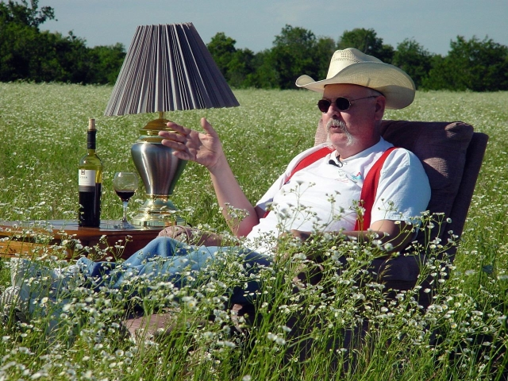
ATMS 373 – Applied NWP
What does it take to be a good forecaster?
http://www.flame.org/~cdoswell/forecasting/Forecaster_Qualities.html

