Slide 1
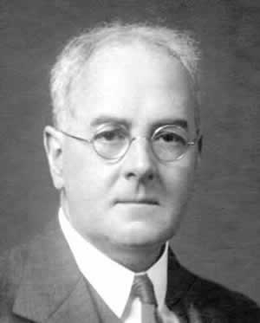
Applied NWP
[1.2] “…up until the 1960s, Richardson’s model initialization problem was circumvented by using a modified set of the primitive equations…” (D&VK Chapters 6-7)
Review LP#2 (slides #21-end)
http://www.wmo.int/pages/publications/bulletin_en/archive/59_2_en/59_2_lynch_en.html

Slide 2
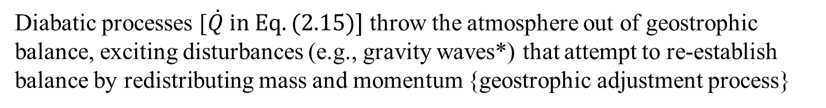
Applied NWP
REVIEW…
Synoptic-scale atmospheric disturbances in the mid-latitudes are in approximate geostrophic (quasi-geostrophic) balance
Diabatic processes [$\dot{Q} in Eq. (2.15)]$ throw the atmosphere out of geostrophic balance, exciting disturbances (e.g., gravity waves*) that attempt to re-establish balance by redistributing mass and momentum {geostrophic adjustment process}
*[unrealistically high amplitude gravity waves and their overbearing pressure tendency likely caused Richardson’s poor numerical forecast since they overwhelmed the pressure tendency signal of the synoptic-scale weather features of interest]

Slide 3
Applied NWP
Quasi-geostrophic vorticity equation…
(1)
(2)
(3)
Vorticity at a fixed location (e.g., AVL) can change only due to (1) advection of relative vorticity by the geostrophic wind, (2) advection of planetary vorticity by the geostrophic wind, and (3) divergence of the ageostrophic wind.

Slide 4

Applied NWP
Quasi-geostrophic (QG) vorticity equation…
(1)
(2)
Following an air (Polly) parcel, relative vorticity can only change via (1) advection of planetary vorticity or through (2) divergence.

Slide 5
Applied NWP
For a barotropic atmosphere [6.4], QG vorticity equation in isobaric vertical coordinates is
s = surface
In a barotropic atmosphere, there is no thermal wind and no vertical wind shear → velocity (and vorticity) is the same at all levels

Slide 6
Applied NWP
For a barotropic atmosphere [6.4], QG vorticity equation in isobaric vertical coordinates is
s = surface
Alternate version of Eq. (6.11) having streamfunction (e.g., geopotential height) as the sole dependent variable [6.7],
J = Jacobian operator, LP#3 sl#16

Slide 7
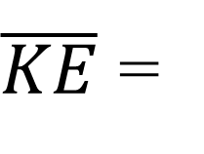
Applied NWP
When constructing a model for a barotropic atmosphere [6.7], care must be taken to design a model such that
  mean vorticity
  mean enstrophy
  mean kinetic energy
  (domain-invariant properties) are conserved
$\overline{KE}$ =

Slide 8
Applied NWP
For an equivalent-barotropic atmosphere [6.5], QG vorticity equation in isobaric vertical coordinates is
In an equivalent barotropic atmosphere, thickness contours are everywhere parallel to geopotential height contours on isobaric maps (e.g., 500 hPa, 700 hPa)
Eq. (6.20) is valid only at the level-of-nondivergence, typically in the 600-500 hPa layer. Thus, equivalent-barotropic QG models are normally assumed to represent conditions at 500 hPa.

Slide 9
Applied NWP
A model for an equivalent-barotropic atmosphere [6.5]
is incapable of forecasting cyclogenesis due to baroclinic instability, which requires (1) a vertical wind shear and (2) a lag between the thickness (temperature) wave and the geopotential wave → development of multiple-level filtered equation models [6.8]…

Slide 10
Applied NWP
Baroclinic filtered-equation models [6.8]
QG vorticity equation
QG thermodynamic energy equation
(1)
(2)
(3)
Terms on LHS are (1) local temperature tendency, (2) horizontal thermal advection, and (3) combined vertical thermal advection and adiabatic heating/cooling. Term on RHS represents diabatic heating/cooling (e.g., radiation, latent and sensible heating/cooling)

Slide 11
Applied NWP
Baroclinic filtered-equation models [6.8]
Static stability parameter

Slide 12
Applied NWP
The QG Barotropic Model [7.1-7.7]; a “cookbook” recipe for numerically solving the barotropic (Eq. (6.11) or equivalent-barotropic (Eq. 6.20) QG vorticity equation.
Fig. 7.2: Flowchart showing general algorithm for solving the barotropic model.

Slide 13
Applied NWP
The QG Barotropic Model [7.1-7.7], Step 1
Calculate initial geostrophic relative vorticity
-OR-
Eqs. (7.6) and (7.7) must be applied away from the grid boundary, unless cyclic boundary conditions are used {to be discussed later in this LP…}
Fig. 7.2: Flowchart showing general algorithm for solving the barotropic model.

Slide 14
Applied NWP
The QG Barotropic Model [7.1-7.7], Step 2
Calculate relative vorticity advection
and initial meridional geostrophic wind
Eq. (7.14) must be applied away from the grid boundary, unless cyclic boundary conditions are used {to be discussed later in this LP…}
Fig. 7.2: Flowchart showing general algorithm for solving the barotropic model.

Slide 15
Applied NWP
The QG Barotropic Model [7.1-7.7], Step 3
Use the forward time-differencing scheme to solve Eq. (7.1) for the future value of the geostrophic vorticity
Fig. 7.2: Flowchart showing general algorithm for solving the barotropic model.

Slide 16
Applied NWP
The QG Barotropic Model [7.1-7.7], Step 4
Put “new” (n+1) geostrophic vorticity values into “old” array (n)
Fig. 7.2: Flowchart showing general algorithm for solving the barotropic model.

Slide 17
Applied NWP
The QG Barotropic Model [7.1-7.7], Step 4
Use relaxation [7.4] to calculate the inverse Laplacian for converting from geostrophic vorticity values to streamfunction
Fig. 7.2: Flowchart showing general algorithm for solving the barotropic model.

Slide 18
Applied NWP
The QG Barotropic Model [7.1-7.7], Step 4
Use relaxation [7.4] to calculate the inverse Laplacian for converting from geostrophic vorticity values to streamfunction

Slide 19
Applied NWP
The QG Barotropic Model [7.1-7.7], Step 4
Use over-relaxation [7.4] to calculate the inverse Laplacian
Fig. 7.2: Flowchart showing general algorithm for solving the barotropic model.

Slide 20
Applied NWP
The QG Barotropic Model [7.1-7.7], Rinse & repeat, except…
Fig. 7.2: Flowchart showing general algorithm for solving the barotropic model.

Slide 21
Applied NWP
The QG Barotropic Model [7.1-7.7], Step 3
Use the leapfrog time-differencing scheme to solve Eq. (7.1) for the future value of the geostrophic vorticity
Fig. 7.2: Flowchart showing general algorithm for solving the barotropic model.

Slide 22
Applied NWP
The QG Barotropic Model [7.1-7.7], Step 4
Put “old” (n) geostrophic vorticity values into “old old” array (n-1)
Put “new” (n+1) geostrophic vorticity values into “old” array (n)
Fig. 7.2: Flowchart showing general algorithm for solving the barotropic model.

Slide 23
Applied NWP
Cyclic Boundary Conditions [7.6] (a.k.a., “periodic” boundary conditions)
Fig. 7.3: : For cyclic boundary conditions the left and right boundaries of the rectangular grid are brought together to form a cylinder.
Fig. 7.4: : Grid point notation near cyclic boundary for a grid with NX grid points

Slide 24
Applied NWP
Cyclic Boundary Conditions [7.6] (a.k.a., “periodic” boundary conditions)
Fig. 7.4: : Grid point notation near cyclic boundary for a grid with NX grid points

Slide 25
Applied NWP
Terrain and equivalent-barotropic model [7.7]
Barotropic QG model with terrain
Equivalent-barotropic QG model with terrain

Slide 26
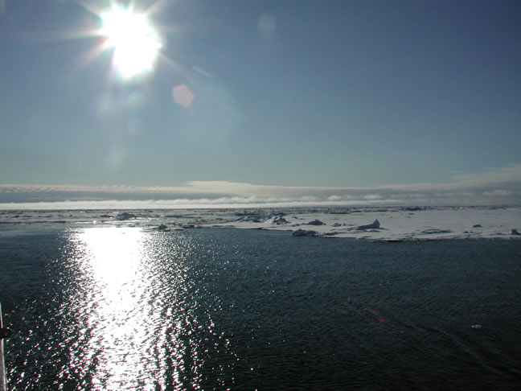
Applied NWP
And now for another activity…
http://psc.apl.washington.edu/HLD/
Activity- code word- Barodancetroupe

