Slide 1

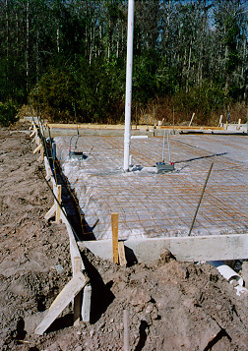
Applied NWP
What is the foundation of computer weather forecast models? (D&VK Chapter 2)
http://www.harcourtschool.com/activity/buildingahouse/buildingahouse.html

Slide 2
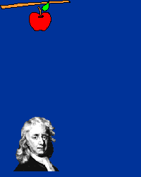
Applied NWP
Recall Newton’s 2nd Law?
http://csep10.phys.utk.edu/astr161/lect/history/newtongrav.html

Slide 3
Applied NWP
Newton’s second law and other laws form the basis for NWP…
  Newton’s second law (conservation of momentum); [2.1]
  Continuity equation (conservation of mass); [2.3, 2.4]
  Conservation of water mass; [2.5]
  First Law of Thermodynamics (conservation of energy); [2. 6]
  Equation of state (for ideal gases); [2.7, 2.9]

Slide 4
Applied NWP
…known as the “governing equations”. What do they govern?
How air parcels change and move about the globe.
→The change and movement of an infinite number of air parcels
around the globe is responsible for our weather!!

Slide 5
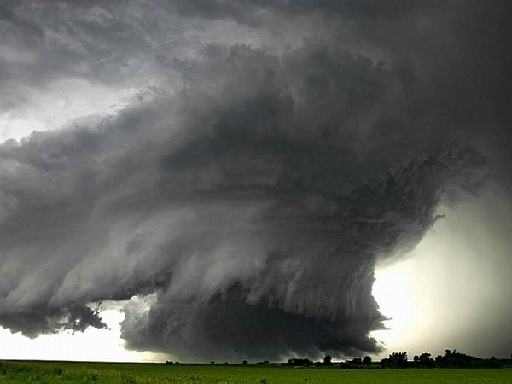

Applied NWP

Slide 6
Applied NWP
The governing equations; seven equations and seven unknowns (u, v, w, T, p, ρ, q). Solvable?

Slide 7
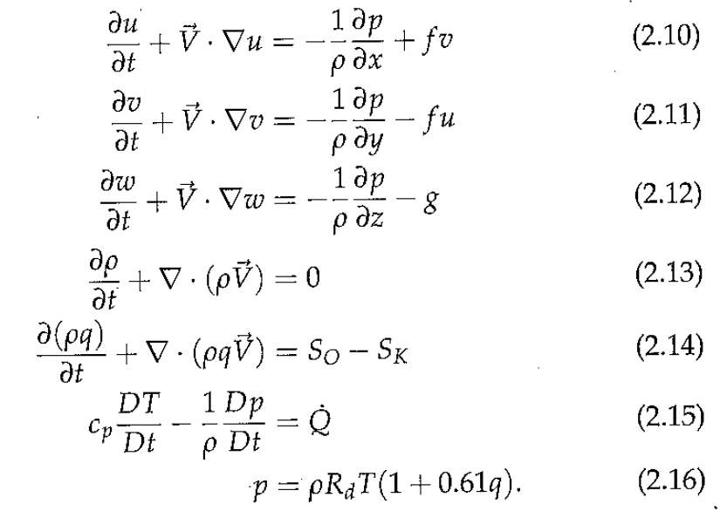
Applied NWP
How do we go from…

Slide 8
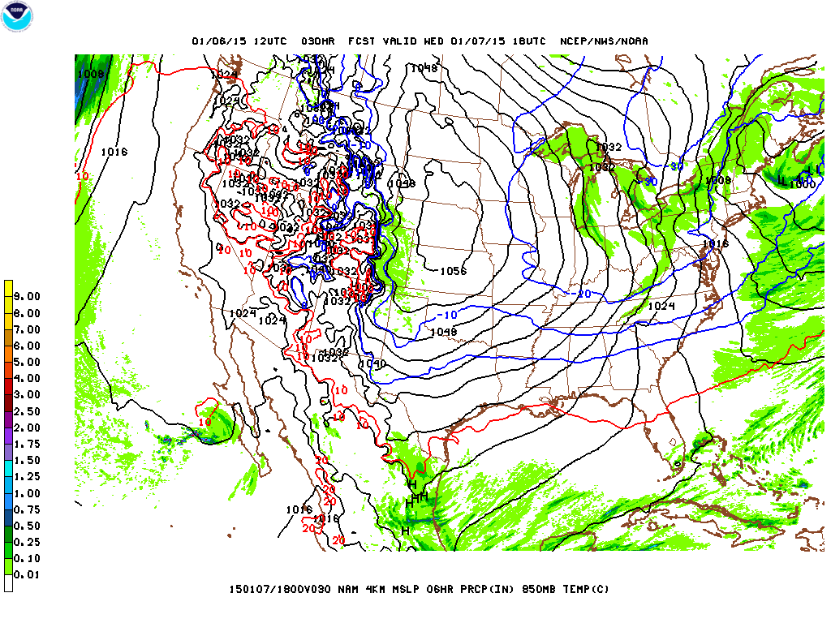
Applied NWP
…to this?
http://mag.ncep.noaa.gov/model-guidance-model-area.php#
→one of the driving purposes behind “Applied NWP”

Slide 9
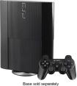
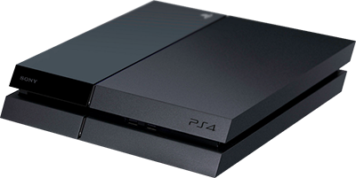
Applied NWP
We’ll start our Applied NWP journey with another question…
Why has most everyone abandoned Playstation Three…
…for PS4?

Slide 10
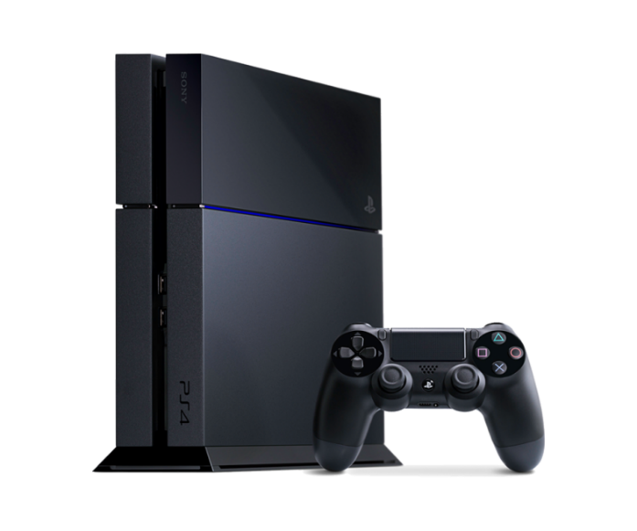
Applied NWP
And yet on the horizon looms PS5…
  What’s going on?
  Why doesn’t Sony just stick with one game console?
Technology keeps evolving from a less-than-perfect design to
one that is closer to perfection.

Slide 11
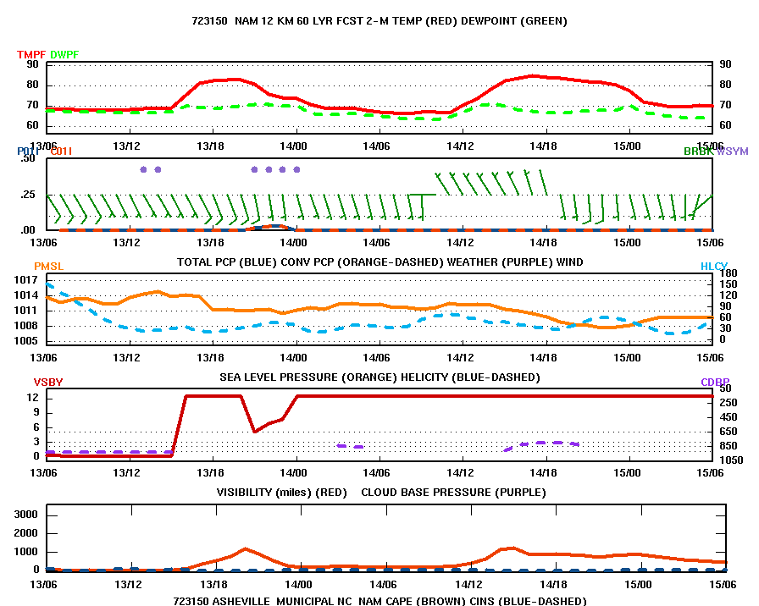
Applied NWP
The same applies for our computer forecast models…
  What’s going on?
  Why doesn’t NCEP just stick with one model?
http://www.emc.ncep.noaa.gov/mmb/nammeteograms/stations/723150.html
Technology keeps evolving from a less-than-perfect design to
one that is closer to perfection.

Slide 12
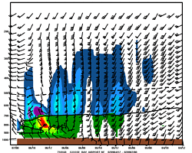
Applied NWP
Our current computer forecast models represent “the best we can do” given our current limitations* in technology.
  What limits?
    Computer horsepower
    Inability to observe everywhere at all time
*imperfect human understanding/insight
http://www.emc.ncep.noaa.gov/mmb/nammeteograms/stations/723150.html

Slide 13
Applied NWP
As a result of these limitations, we have to somehow simplify these,…
…our governing equations.
[note: friction already ‘eliminated’]

Slide 14
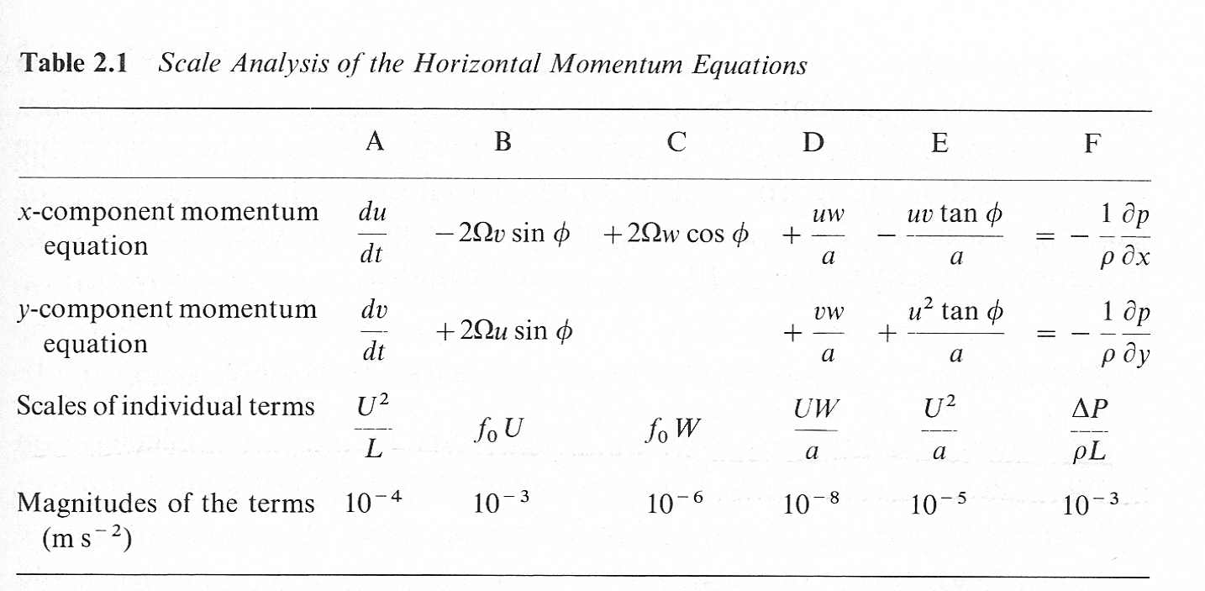
Applied NWP
Holton (2004) showed one way to simplify the momentum equations through a scale analysis…
…which, for large-scale weather patterns, leads to the expression for geostrophic balance. But what about small-scale weather?

Slide 15
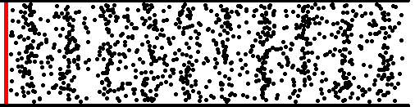
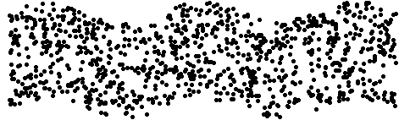
Applied NWP
In reality, we have waves present at all different scales in the atmosphere
  Sound waves (fastest)
  Gravity waves
  Mesoscale weather waves
  Synoptic-scale weather waves
  Planetary-scale weather waves (slowest)
http://www.kettering.edu/~drussell/Demos/waves/wavemotion.html

Slide 16
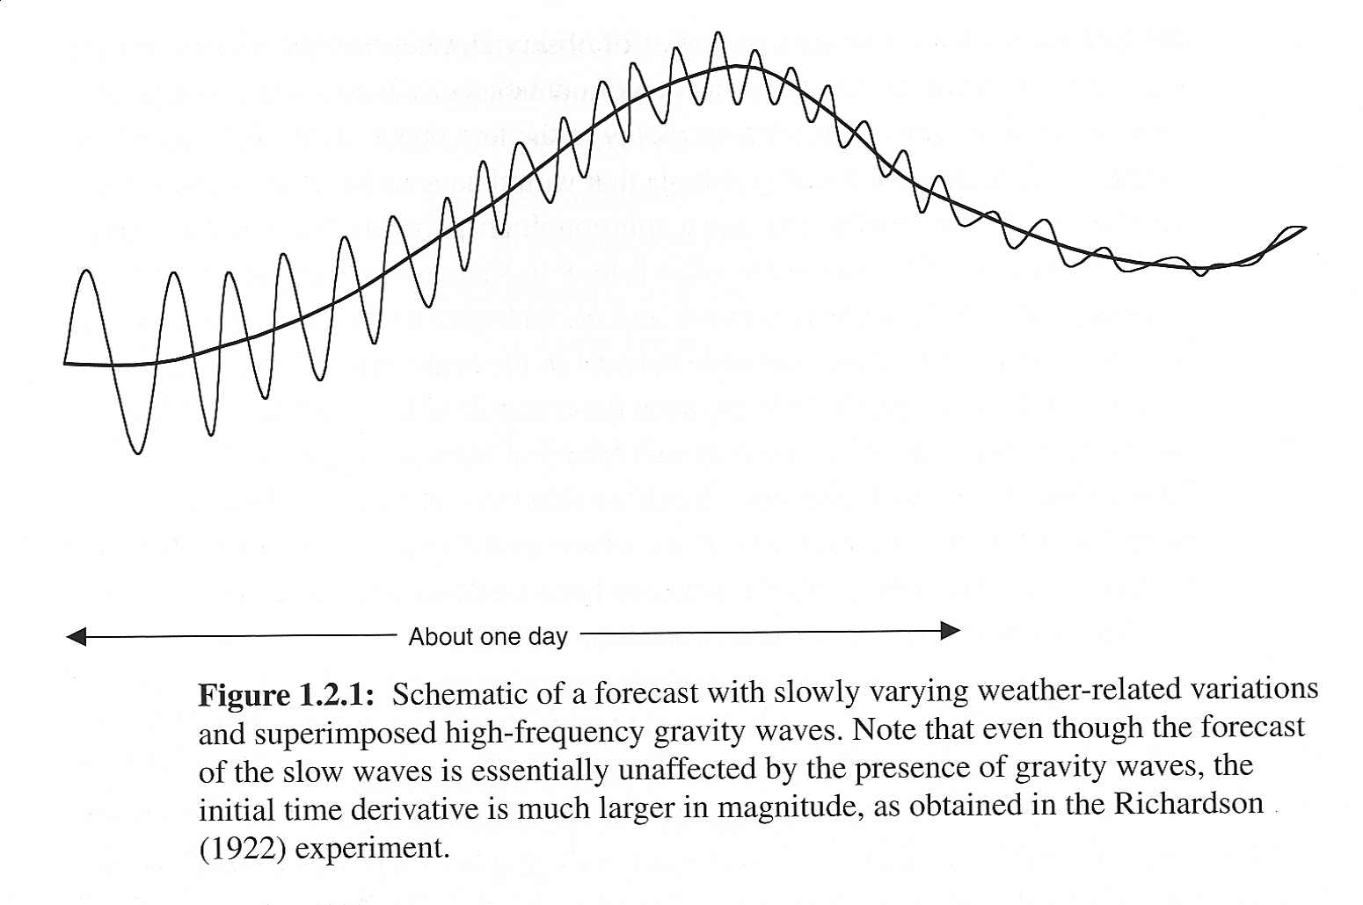
Applied NWP
The interaction of these different scales of waves can cause the “weather of interest” to be masked by the effects of the small-scale waves.

Slide 17
Applied NWP
Activity- code word- Askiloobot?

Slide 18
Applied NWP
In the previous activity, it was given that the zonal wind component (u) at AVL was a known function of two atmospheric waves
In reality, we have an infinite number of waves contributing to the observed zonal wind component at AVL (sound waves → planetary-scale waves)
What do we have to do in order to make a perfect zonal wind
component forecast at AVL?
Panic??

Slide 19
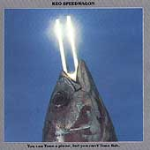
Applied NWP
In practice,
we determine the “scale of interest” (e.g. mesoscale and larger wavelengths)
we tune (scale) the governing equations for the “scale of interest”
http://www.cduniverse.com/

Slide 20
Applied NWP
We determine the “scale of interest” (e.g. mesoscale and larger wavelengths)
We tune (e.g. scale) the governing equations for the “scale of interest”
The “scale of interest” is largely determined by the current limits of technology
  Computer horsepower
  Inability to observe everywhere at all time

Slide 21
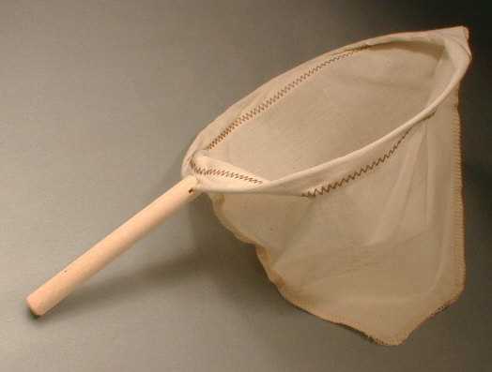
Applied NWP
How do we force our model to keep only the “scale of interest”?
  FILTER!!
http://fantes.com/images/17630coffee_filters.jpg

Slide 22
Applied NWP
We filter, in part, by making approximations to the governing equations (filtering approximations). Some examples of filtering approximations,
  Hydrostatic
  Anelastic
  Quasi-geostrophic
  Bounded model top/bottom
  No net column mass convergence
  Neutral stratification (N = 0)
  No rotation (f = 0)
  Constant Coriolis parameter (f = const)
http://fantes.com/images/17630coffee_filters.jpg

Slide 23
Applied NWP
Wave solutions from simplified forms of the governing equations [Kalnay 2.2]
  Pure sound waves
  Lamb waves
  Vertical gravitational oscillations
  Inertia oscillations
  Lamb waves in the presence of rotation and geostrophic modes
→The presence of these waves in our model has the potential to
mask the “weather of interest”.

Slide 24
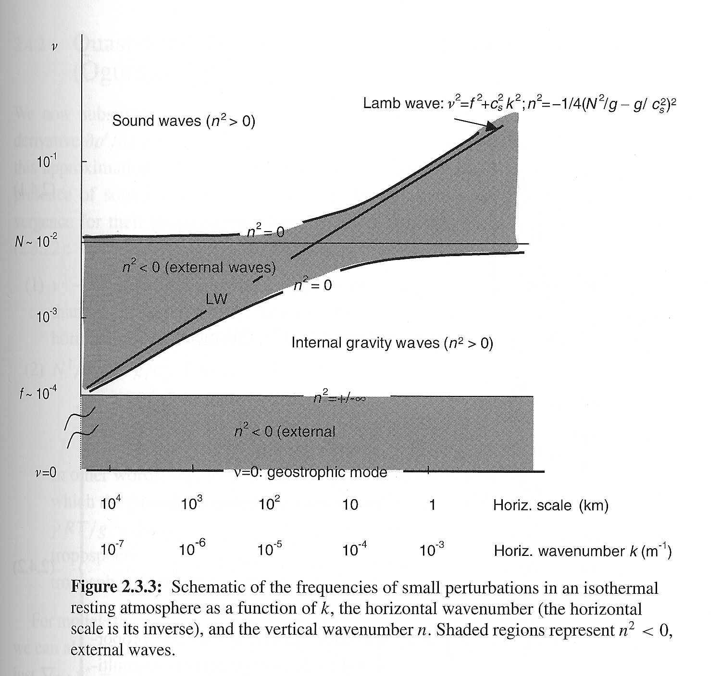
Applied NWP
For a simple (isothermal) atmosphere, the solution of the governing equations gives a frequency dispersion relationship shown in Fig. 2.3.3
Isothermal Atms. Example

Slide 25
Applied NWP
Unshaded regions shown in Fig. 2.3.3 are internal waves that propagate vertically as well as horizontally
Isothermal Atms. Example

Slide 26
Applied NWP
Shaded regions shown in Fig. 2.3.3 are external waves that propagate only in the horizontal
Isothermal Atms. Example

Slide 27
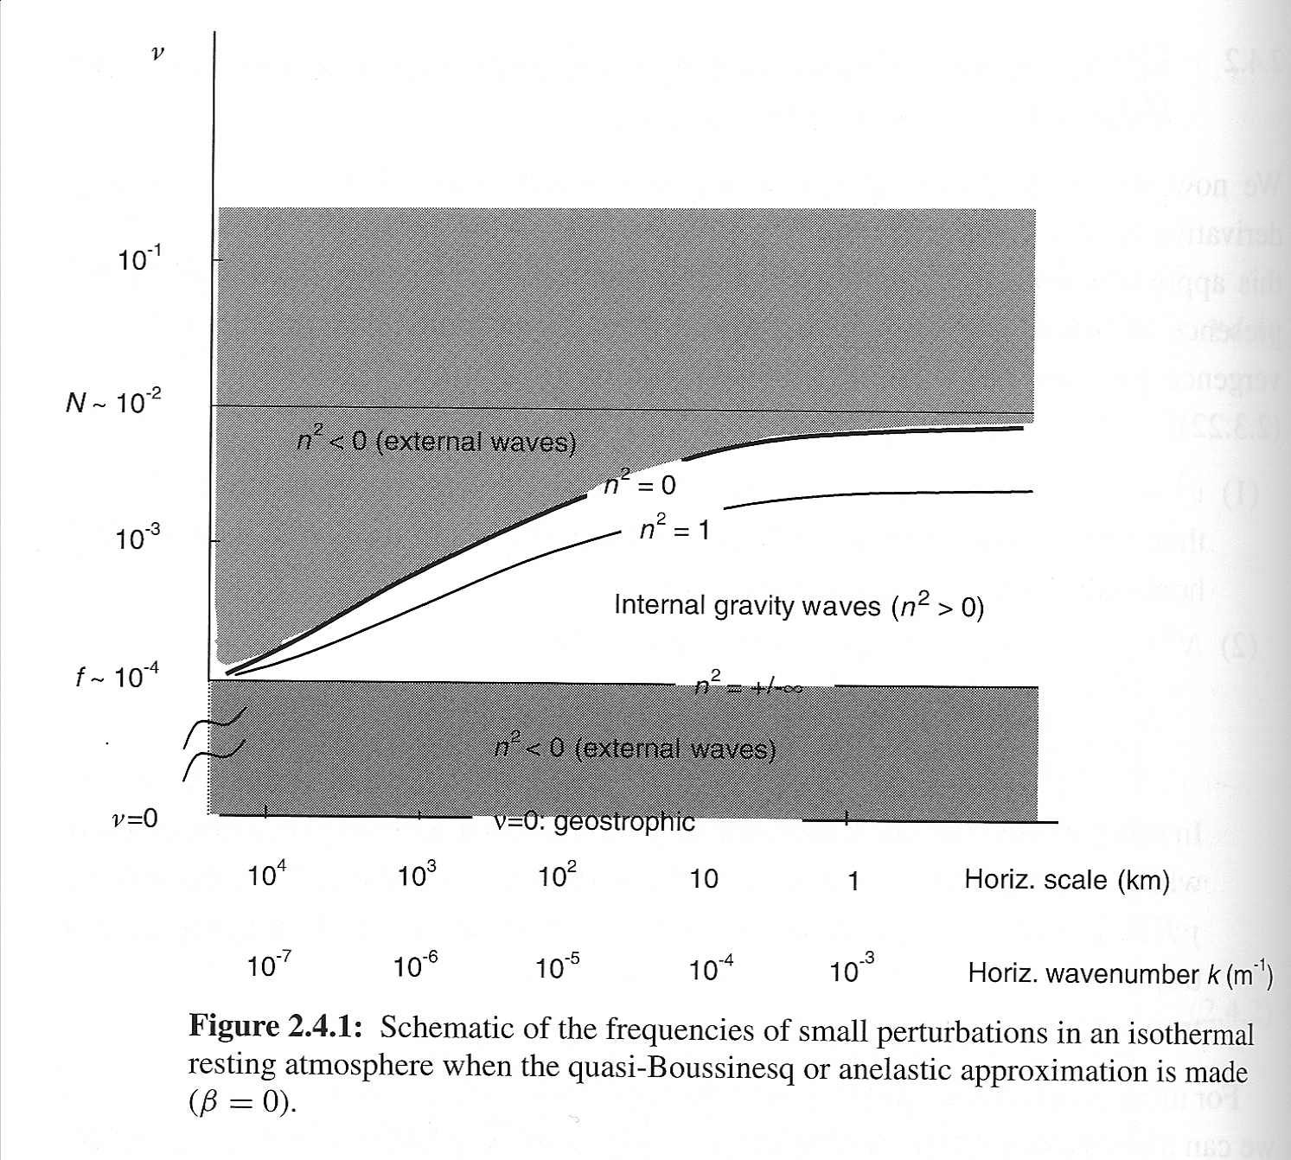
Applied NWP
Note how the solution to the governing equations changes when the anelastic approximation is made…
Isothermal Atms. Example

Slide 28
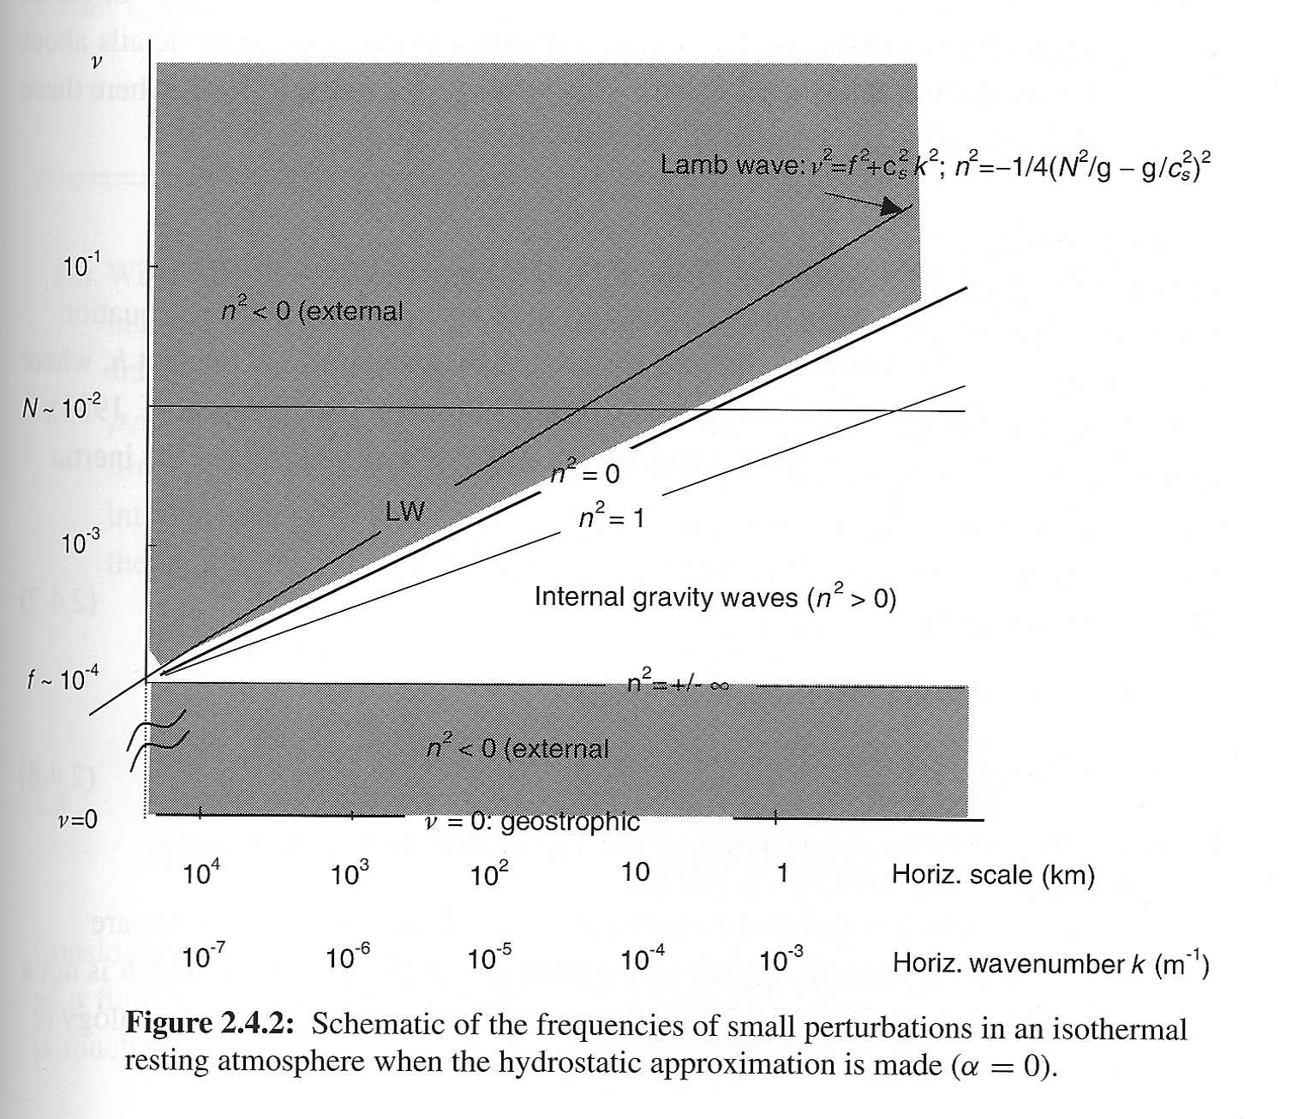
Applied NWP
Note how the solution to the governing equations changes when the hydrostatic approximation is made…
Isothermal Atms. Example

Slide 29
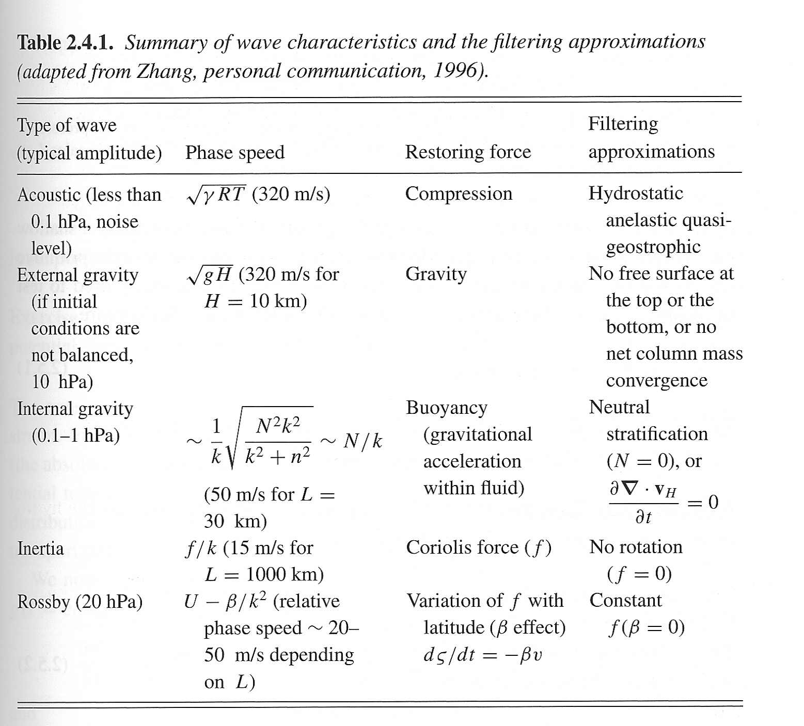
Applied NWP

Slide 30
Applied NWP
Some filtering would eliminate our “weather of interest”, so we cannot implement every type of filter. Hence, we’ll always have to deal with “noise” in our model forecasts that is due to the presence of fast-moving waves (there’s another way we deal with these, more on this later).
  Hydrostatic
  Anelastic
  Quasi-geostrophic
  Bounded model top/bottom
  No net column mass convergence
  Neutral stratification (N = 0)
  No rotation (f = 0)
  Constant Coriolis parameter (f = const)
http://fantes.com/images/17630coffee_filters.jpg

Slide 31
Applied NWP
“When we neglect the time derivative of one of the equations of motion, we convert it from a prognostic equation into a diagnostic equation, and eliminate with it one type of solution.”
“Physically, we eliminate a restoring force that supports a certain type of wave.”
0, sound-wave-be-gone
continuity equation
anelastic (filtering) approximation [Eq. 2.18]

Slide 32
Applied NWP
“…filtering was introduced by Charney et al. (1950) in order to eliminate the problem of gravity waves (which requires a small time step) whose high frequencies produced a huge time derivative in Richardson’s computation, masking the time derivative of the actual weather signal.”

