Slide 1
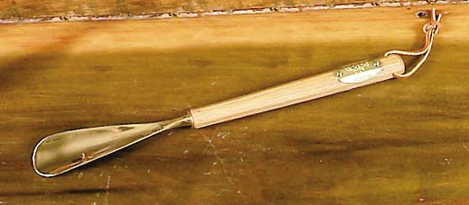
Applied NWP
How do we “shoehorn” the governing equations into the computer weather forecast model? (D&VK Chapters 3-4, Kalnay 3.1-3.3.5 & 2.6, Krish.& Bounoua Chap. 2)
http://www.thetiecoon.com/sh3.html
Go to: http://www.meted.ucar.edu/nwp/pcu1/ic2/index.htm for more information

Slide 2
Applied NWP
REVIEW…
As a result of computer limitations, we have to somehow simplify these,…
…our governing equations.

Slide 3
Applied NWP
Understanding how we “shoehorn” a simplified version of our governing equations into our computer weather forecast model…
…requires a mathematics review.

Slide 4
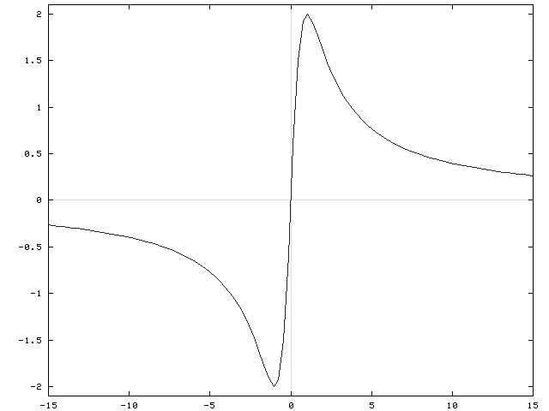
Applied NWP
Derivatives
Taylor Series Expansions
Partial Differential Equations (PDEs)
f (x)
http://www.math.ucdavis.edu/~kouba/CalcOneDIRECTORY/graphingdirectory/Graphing.html
x →

Slide 5
Applied NWP
DERIVATIVES*
  at (x, f (x)) the slope m of the graph of y = f (x) is equal to the slope of its tangent line at (x, f(x)), and is determined by the formula
  provided the limit exists.
f (x)
x →
*(Larson and Hostetler, 1982, p.101)

Slide 6
Applied NWP
DERIVATIVES*
  The limit
  is called the derivative of f at x (provided the limit exists).
f (x)
x →
*(Larson and Hostetler, 1982, p.101)

Slide 7
Applied NWP
DERIVATIVES
zonal wind from east
or west?
u(x)
EX: Let,
zonal wind from east
or west?
x →
Activity- code word- Mimetroupe

Slide 8
Applied NWP
DERIVATIVES
  In our previous activity we used an expression for the zonal wind component that was a continuous function [we knew u(x) at every ‘x’ location]
  Is this realistic in practice?
x →

Slide 9
Applied NWP
DERIVATIVES
  No!
  Due to computer limitations, we can only represent the atmosphere in our model at regularly-spaced intervals (grid points)
  Δx does NOT approach 0
o
o
o
o
o
o
o
x →

Slide 10

Applied NWP
Taylor Expansion
  Knowing the atmosphere in our model at regularly-spaced intervals (grid points separated by a distance “Δx”) forces us to obtain derivatives of u(x) using finite differences
o
o
o
o
o
o
o
x →
To the board!!→
http://www.surfboardcollectors.com/

Slide 11
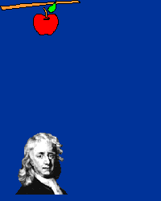
Applied NWP
And now for another activity…
http://csep10.phys.utk.edu/astr161/lect/history/newtongrav.html
Activity- code word- Mimetroupe2

Slide 12
Applied NWP
Up to now we have been assuming that the zonal wind component [u] has only been a function of the “x” (east-west) direction
Clearly this is an oversimplification [bummer!]
In reality, u is a function of x, y, and z, [u(x,y,z)] so that the change of u in the x, y, and z directions are represented by a partial derivative…
[example given is for the gradient of u, which IS a vector]

Slide 13
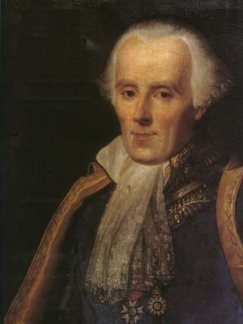
Applied NWP
A common mathematical operator in meteorology is the horizontal Laplacian:
(which is NOT a vector)
http://www-groups.dcs.st-and.ac.uk/~history/Mathematicians/Laplace.html

Slide 14
Applied NWP
Finite difference forms of the horizontal Laplacian, using Taylor’s expansion of the functions u(x+/−h, y+/−h) about (x,y), where h is the horizontal grid point spacing:
(second order accuracy)

Slide 15
Applied NWP
Finite difference forms of the horizontal Laplacian, using Taylor’s expansion of the functions u(x+/−h, y+/−h) about (x,y), where h is the horizontal grid point spacing:
(fourth order accuracy)

Slide 16
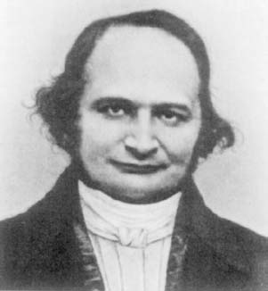
Applied NWP
Another common mathematical operator in meteorology is the horizontal Jacobian:
(which is NOT a vector)
http://www-groups.dcs.st-and.ac.uk/~history/Mathematicians/Jacobi.html

Slide 17
Applied NWP
The horizontal Jacobian is often associated with equations having conserved quantities. Application of finite differencing to such equations can introduce errors that lead to non-conserved quantities. Caution must be made so that errors introduced by the differencing method will not alter the conservation principles.
Barotropic absolute vorticity equation, where ψ is the geostrophic streamfunction and variables ξ_{a} and ξ represent the absolute and relative vorticity, respectively.

Slide 18
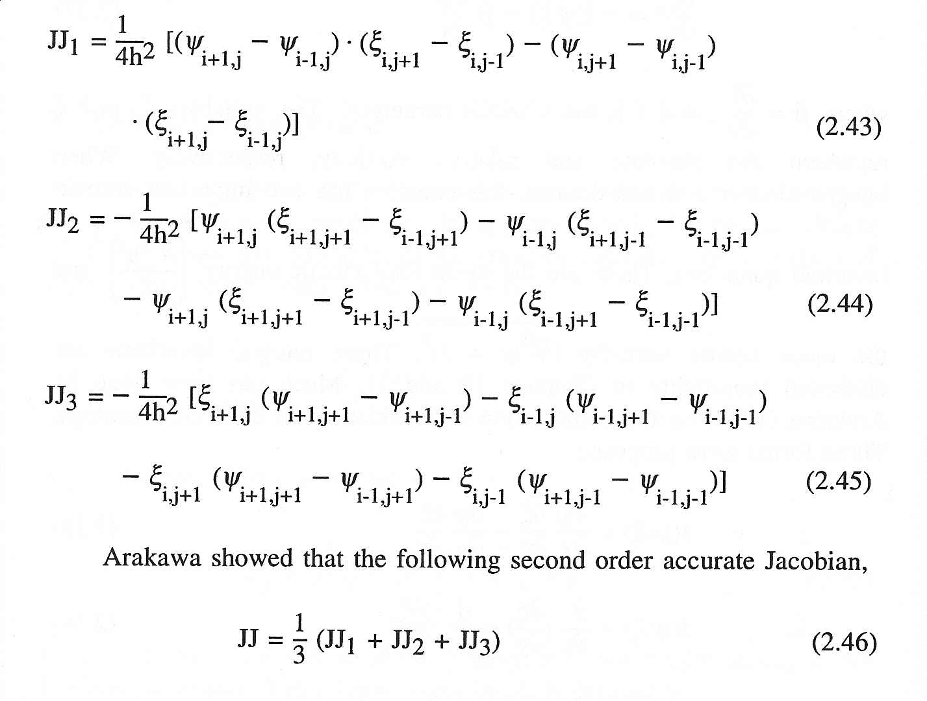
Applied NWP
Arakawa (1966) horizontal Jacobian of second order accuracy:
[D&VK Section 7.3]
Krishnamurti and Bounoua (1996)

Slide 19
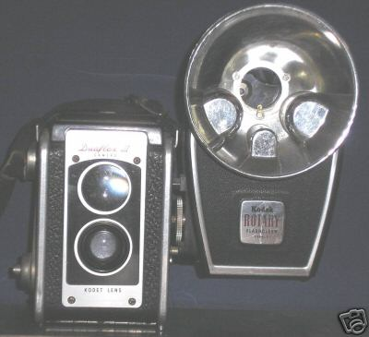
Applied NWP
Spatial derivatives give us a view into the atmospheric structure at a snapshot in time
But we want to know “What will be the structure tomorrow?”
Time derivatives!!!
http://www.ebay.com/

Slide 20
Applied NWP
Let’s start out with a “simple” linear equation:
[D&VK Eq. (4.3)]
Before getting into the numerics, what is this zonal momentum equation telling us?
(think Newton)→

Slide 21

Applied NWP
Assume that “c” is a constant and that:
where A, k, and ω are also constant. Given this information, what must be the value of “c”?
[D&VK Eq. (4.4), also, see Euler’s formula; Eq. (4.12)]
To the board!!→

Slide 22
Applied NWP
Given this form of the zonal wind component, what do we know about the behavior of the amplitude of the zonal wind?
Activity- code word- Mimetroupe3

Slide 23
Applied NWP
If we were to find that, after implementing our new finite difference scheme, the amplitude of the zonal wind was found to change with time, what might we conclude?
UGH!! Something is WRONG!!

Slide 24
Applied NWP
[D&VK Eq. (4.8)]
Stability of the numerical scheme for this simple linear equation is defined as,
  Stable if |λ| < 1
  Neutral if |λ | = 1
  Unstable if |λ | > 1, where λ is an amplification factor

Slide 25
Applied NWP
A brief aside, if
then,
more on the amplification factor a little later…

Slide 26
Applied NWP
Partial differential equations (PDEs)
  Second order linear PDEs are classified into three types depending on the sign of β ² – αγ. Equations are hyperbolic, parabolic or elliptic if the sign is positive, zero, or negative, respectively.

Slide 27
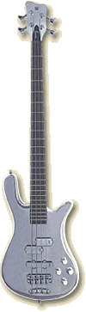
Applied NWP
Examples
  Wave equation (hyperbolic)
  vibrating string
http://www.warwickbass.com/basses/streamer_ct.html
http://www.cs.princeton.edu/~mj/string.html
http://colos1.fri.uni-lj.si/~colos/COLOS/EXAMPLES/XDJ/VSTRING/Vstring.html

Slide 28
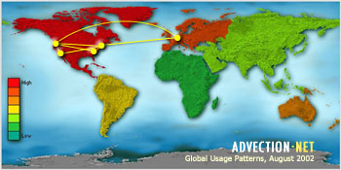
Applied NWP
Examples
  Advection equation (first order PDE, hyperbolic)
http://www.advection.net/

Slide 29
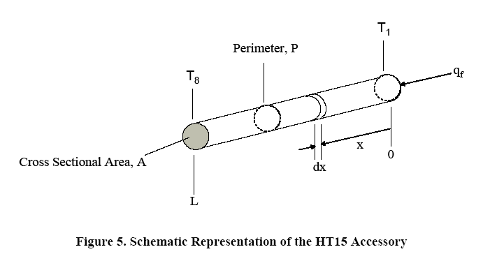
Applied NWP
Examples
  Diffusion equation (parabolic)
  heated rod
http://heatex.mit.edu/HeatexWeb/ExtendedSurfaceHeatTransfer.pdf

Slide 30
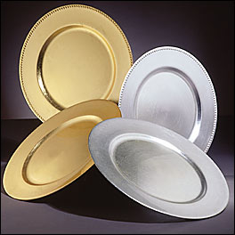
Applied NWP
Examples
  Laplace’s or Poisson’s equations (elliptic)
  steady state temperature of a plate
http://www.galasource.com/prodDetail.cfm/20170,Gold%20Beaded%20Lacquer%20Charger%2012%22,MX2

Slide 31
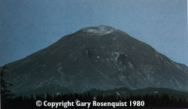
Applied NWP
Well-posed problem
  Must specify proper initial conditions and boundary conditions
    Too few→ solution will NOT be unique
    Too many→ no solution
    “just right”→ accurate solution if specified at the right place and time
http://pubs.usgs.gov/publications/msh/catastrophic.html

Slide 32
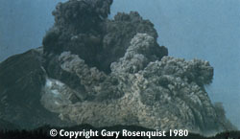
Applied NWP
Ill-posed problem
  Small errors in the initial/boundary conditions will produce huge errors in the solution
    Computer weather forecast model will “blow up”
http://pubs.usgs.gov/publications/msh/catastrophic.html

Slide 33
Applied NWP
One method of solving simple PDEs is the method of separation of variables, but unfortunately in most cases it is not possible to use it
hence the need for numerical models!
http://heatex.mit.edu/HeatexWeb/ExtendedSurfaceHeatTransfer.pdf

Slide 34
Applied NWP
Hyperbolic and parabolic PDEs are initial value or marching problems
The solution is obtained by using the known initial values and marching or advancing in time
wave or advection equation, a hyperbolic
equation
diffusion equation, a parabolic equation

Slide 35
Applied NWP
Example
  Forward-in-time, backward-in-space (upstream) scheme of the finite difference equation (FDE)
  of the wave or advection equation
PDE
[f-i-t, b-i-s scheme]
[D&VK Eq. (4.6)]

Slide 36
Applied NWP
Two questions must be asked
  Is the FDE consistent with the PDE?
  Will the solution of the FDE converge to the PDE solution as Δx→0 and Δt→0?
PDE

Slide 37

Applied NWP
Two questions must be asked
  Is the FDE consistent with the PDE?
  Will the solution of the FDE converge to the PDE solution as Δx→0 and Δt→0?
FDE is consistent with PDE if, in limit Δx→0 and Δt→0 the FDE coincides with the PDE
How to verify this?
Substitute U by u in the FDE
Evaluate all terms using a Taylor series expansion centered on point (i, n)
Subtract PDE from FDE
To the board!!→

Slide 38
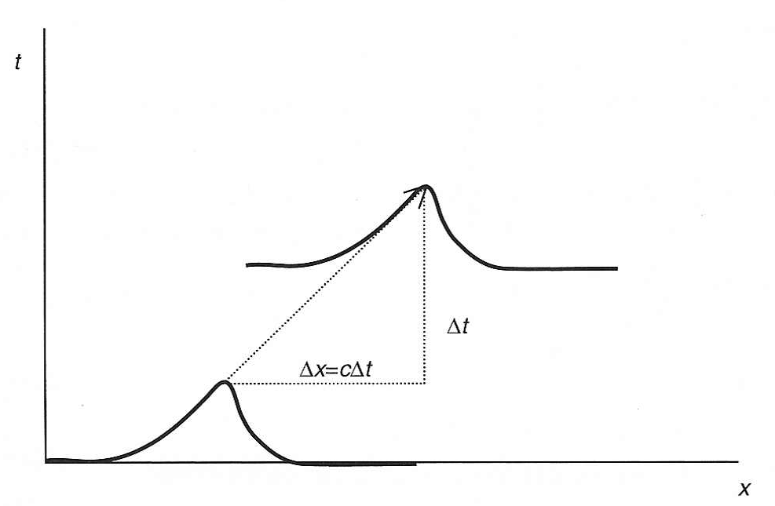
Applied NWP
Two questions must be asked
  Is the FDE consistent with the PDE?
  Will the solution of the FDE converge to the PDE solution as Δx→0 and Δt→0?
[Kalnay]
Before addressing the second question, we must explore the concept of computational stability

Slide 39
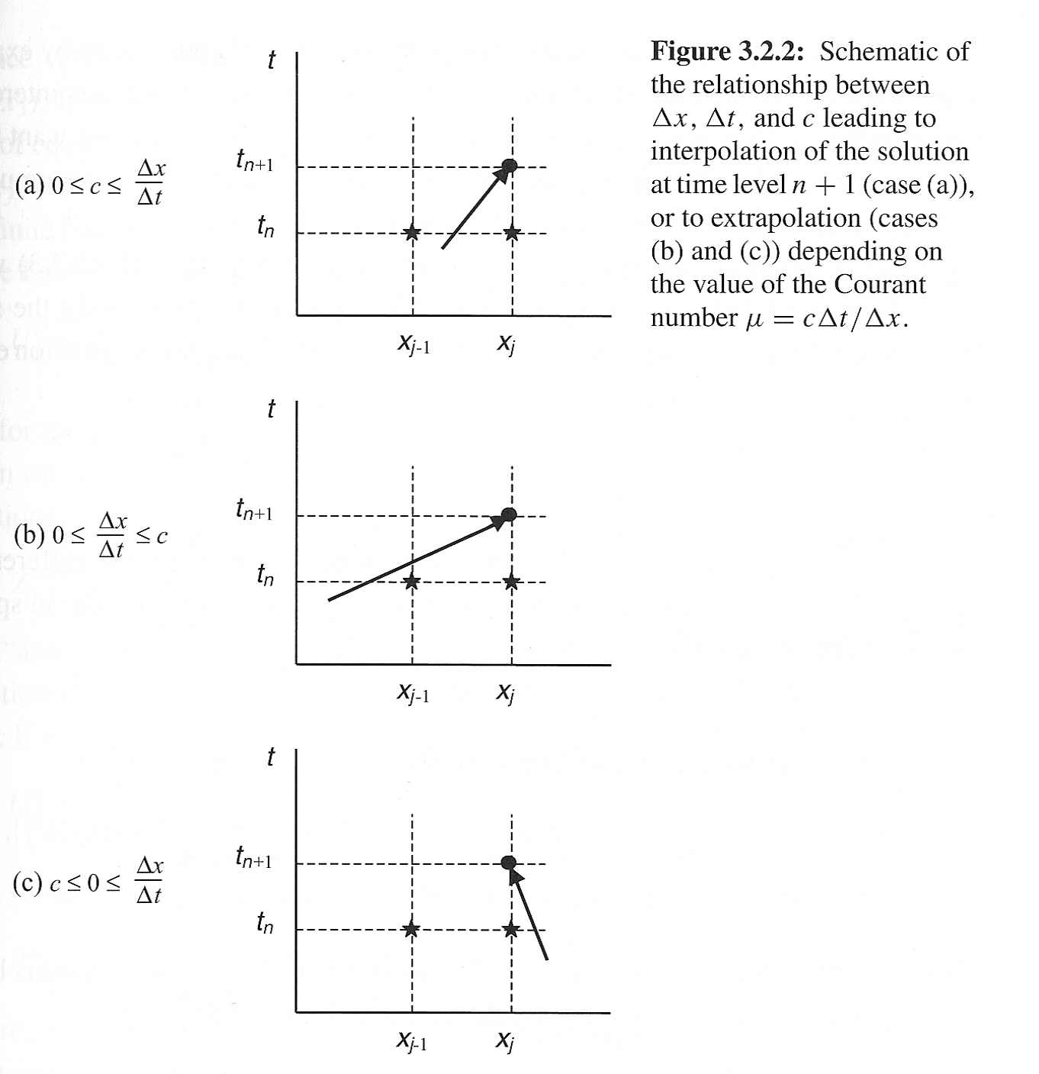

Applied NWP
Computational stability
  U_{i}^{n+1} is interpolated from U_{i}^{n} and U^{n}_{i-1} in (a)
  U_{i}^{n+1} is extrapolated from U_{i}^{n} and U^{n}_{i-1} in (b) and (c)
Activity- code word- Mimetroupe3

Slide 40
Applied NWP
Computational stability
Courant-Friedrichs-Lewy (CFL) condition of the f-i-t, b-i-s scheme

Slide 41
Applied NWP
Computational stability*
Courant-Friedrichs-Lewy (CFL) condition of the f-i-t, b-i-s scheme
*an FDE is computationally stable if
the solution of the FDE at a fixed time
t = nΔt remains bounded as Δt→0.

Slide 42
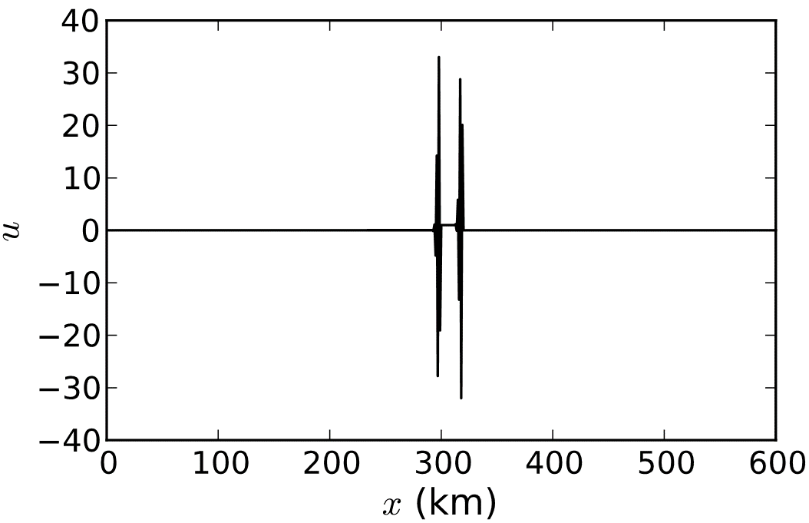
Applied NWP
Computational stability analysis [works for ‘simpler’ Finite Difference Equations (FDEs)] (p. 44)
  Substitute a solution of form Eq. (4.8) into FDE
  Rearrange the resulting equation to solve for the amplification factor, λ
  Analyze the conditions under which the magnitude of the amplification factor, |λ|, exceeds a value of one (for instability) or is less than one (for stability)

Slide 43

Applied NWP
Lax-Richtmyer theorem
  Given a properly posed linear initial value problem, and a finite difference scheme that satisfies the consistency condition, then the stability of the FDE is the necessary and sufficient condition for convergence.
http://www.convergence2004.org/
→We want to make sure that if Δt, Δx are small, then the errors u( i Δx, n Δt) – U_{i}^{n}
(accumulated or global truncation errors at a finite time) are acceptably small.

Slide 44
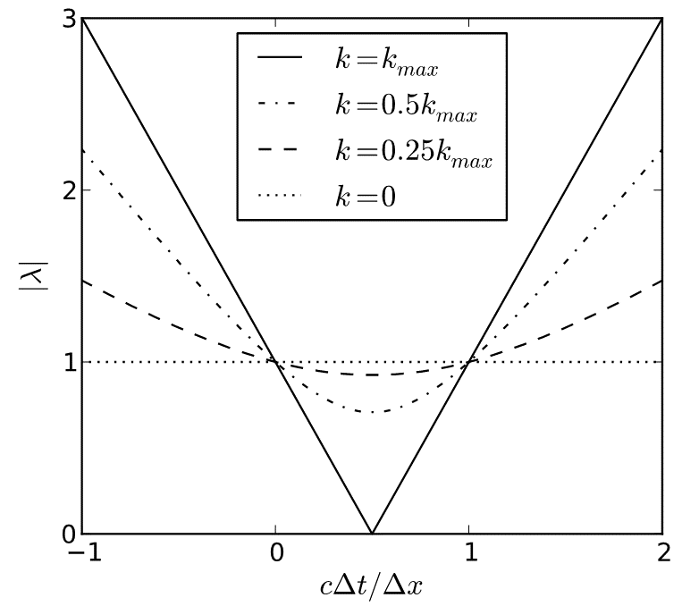
Applied NWP
PDE

Slide 45
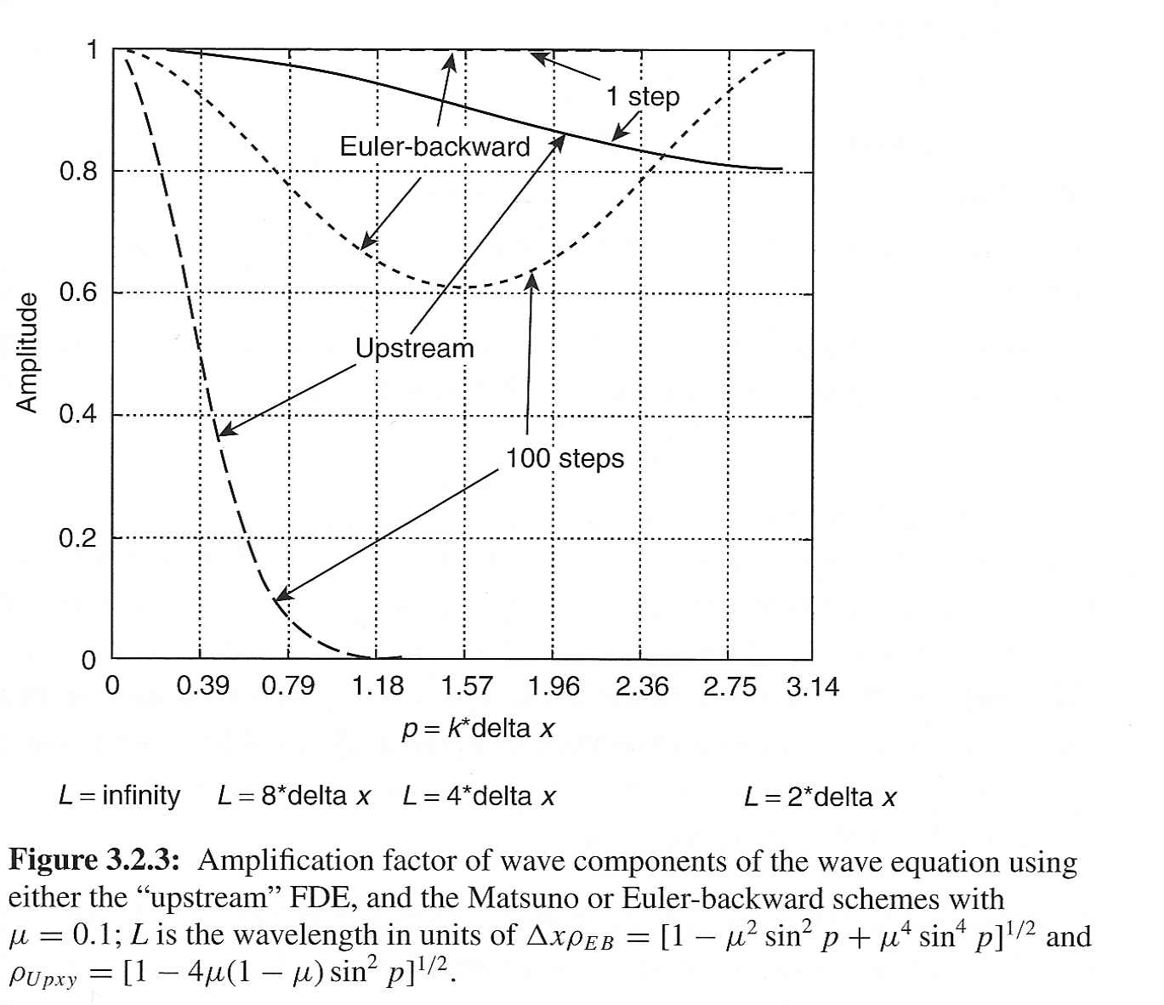

Applied NWP
Up to now we have been concerned with |λ| > 1
However, |λ| << 1 can be a problem within a computer weather forecast model, as well

Slide 46
Applied NWP
The amplification factor λ indicates how much the amplitude of each wavenumber will decrease or increase with each time step.
The f-i-t, b-i-s scheme decreases the
amplitude of all wave components
It is a very dissipative FDE (it has
strong “numerical diffusion”)

Slide 47
Applied NWP
Other time scheme examples…
  Matsuno (Euler-backward) scheme [p. 291]
  Leapfrog scheme [p.47]

Slide 48

Applied NWP
Leapfrog scheme; two solutions
  “legitimate” weather mode (physical mode)
  computational mode*
  *Arises because the leapfrog scheme has two amplification factors (two solutions) [Eq. (4.30), p. 49]
http://www.leapfrog.com/
f-i-s
c-i-s
b-i-s

Slide 49
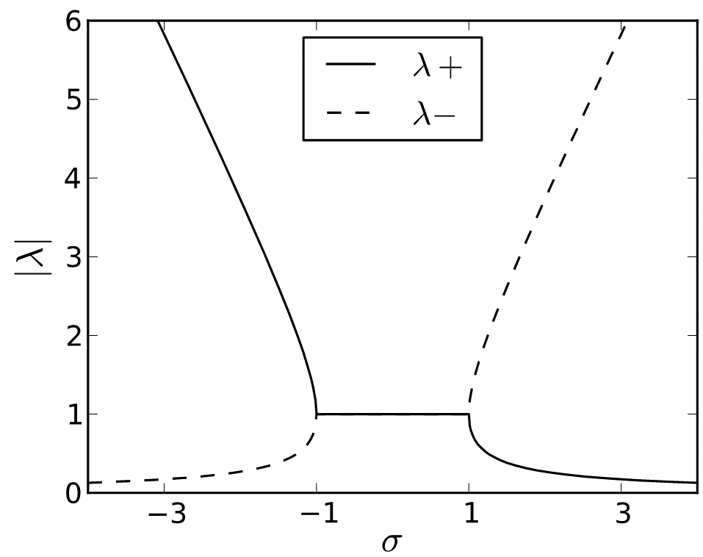
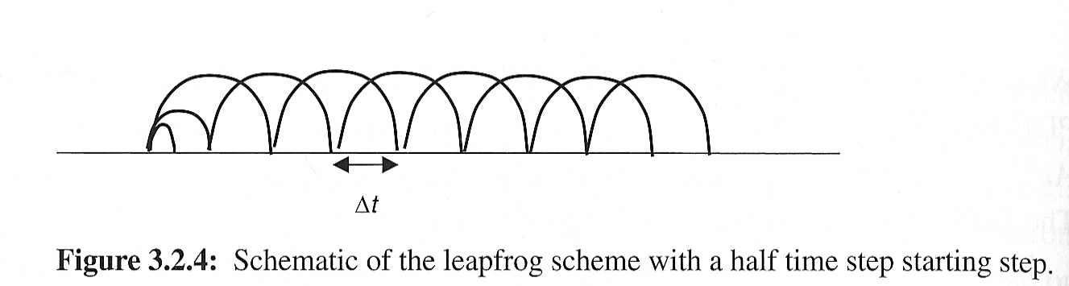
Applied NWP
c-i-s
Leapfrog scheme; two unique problems
  needs a special initial step to get to the first time level (n=1) from the initial conditions (n=0) before it can get started
  for non-linear examples, it has a tendency to increase the amplitude of the computational mode with time
A time filter (e.g. Asselin-Roberts) is applied to solve
problem #2

Slide 50
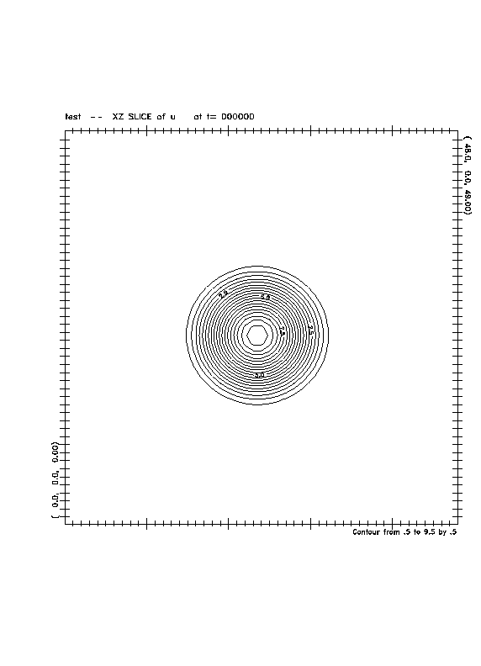
Applied NWP
http://www.atmos.ucla.edu/~fovell/AS180/dispersion.html
Leapfrog scheme; two unique problems
  needs a special initial step to get to the first time level (n=1) from the initial conditions (n=0) before it can get started
  for non-linear examples, it has a tendency to increase the amplitude of the computational mode with time
A time filter (e.g. Asselin-Roberts) is applied to solve
problem #2 [p. 53-56]

Slide 51
Applied NWP
Leapfrog scheme; two solutions
  “legitimate” weather mode (physical mode)
  computational mode
c-i-s

Slide 52
Applied NWP
(Leapfrog)
PDE

Slide 53
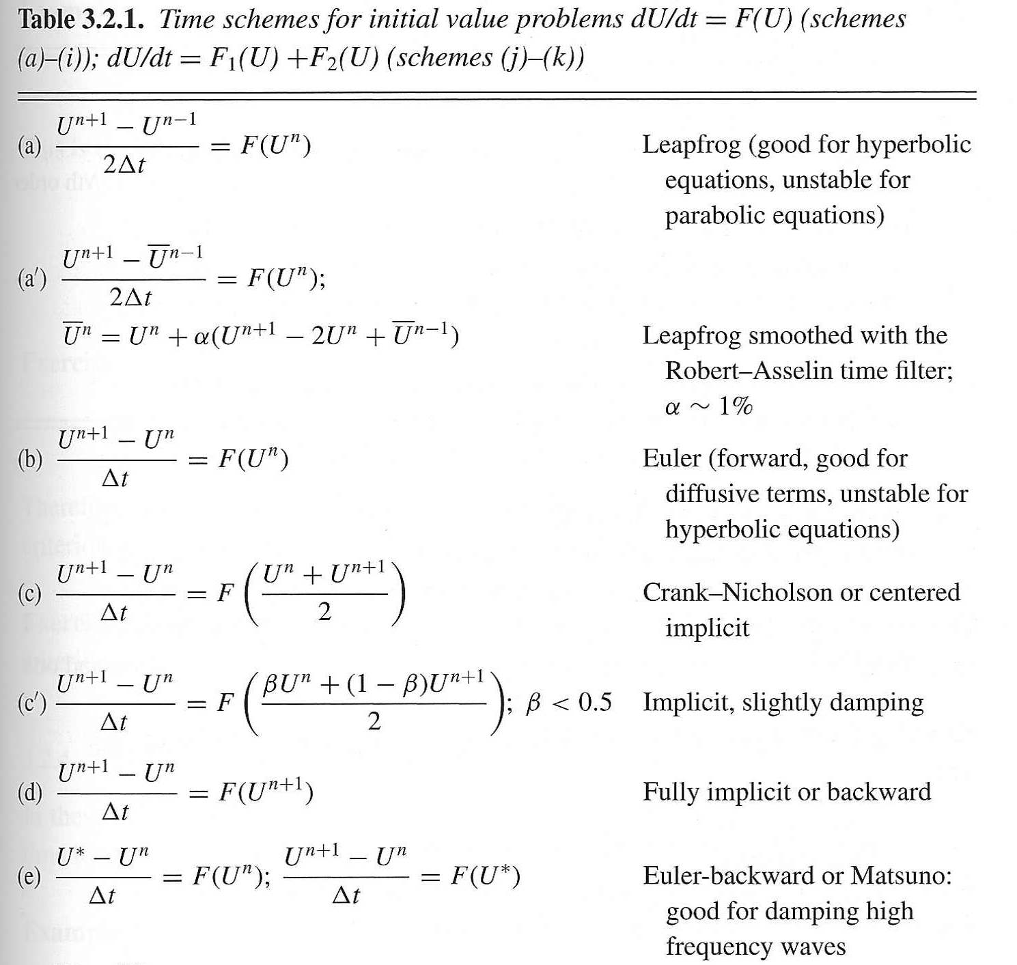
Applied NWP
Other time scheme examples…

Slide 54
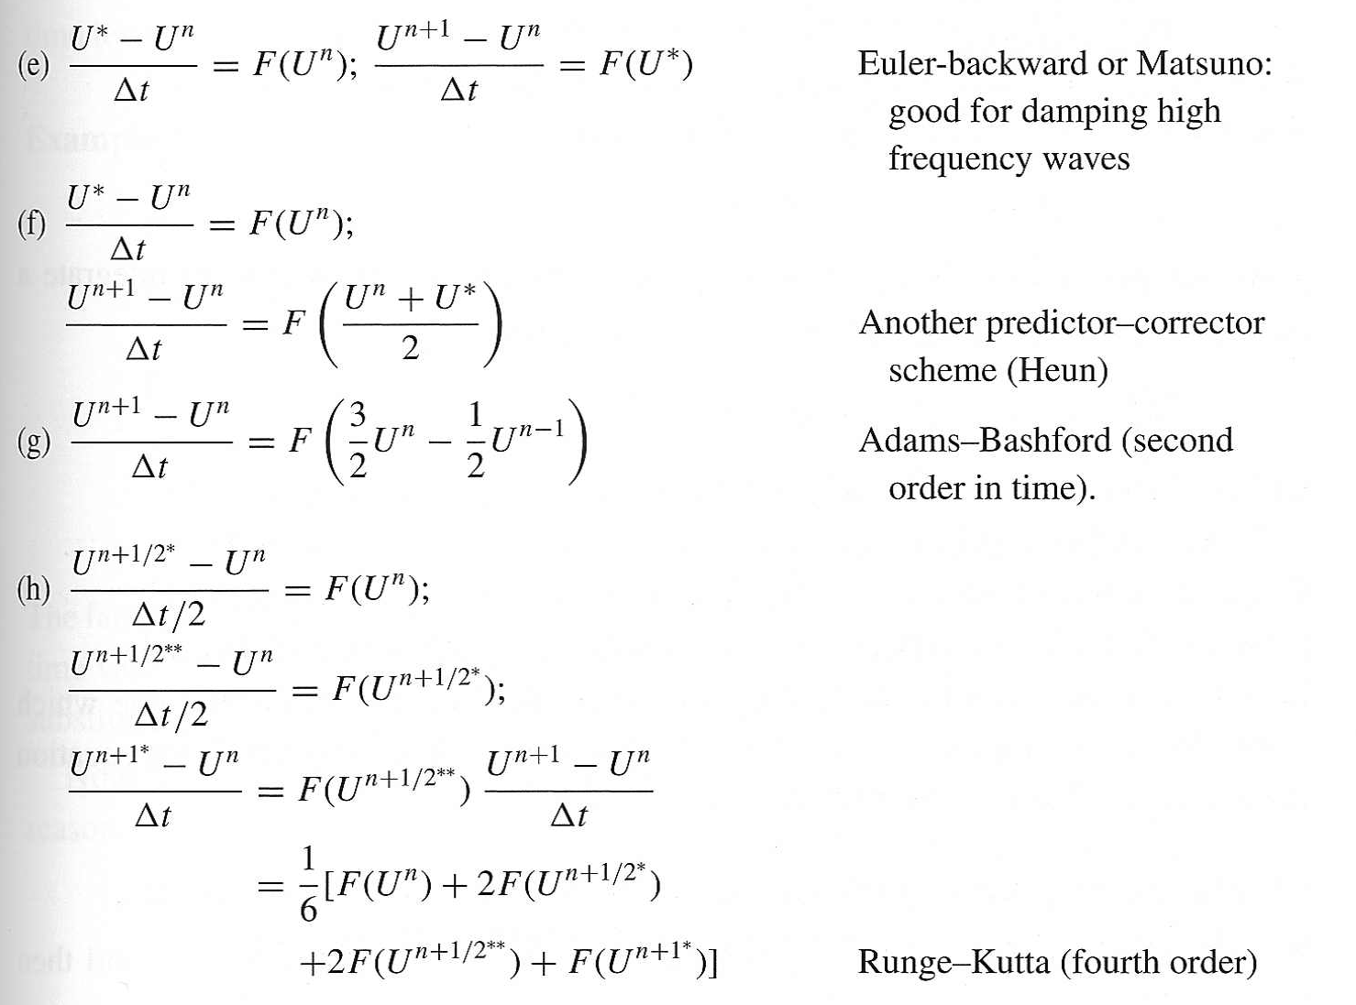
Applied NWP
Other time scheme examples…

Slide 55
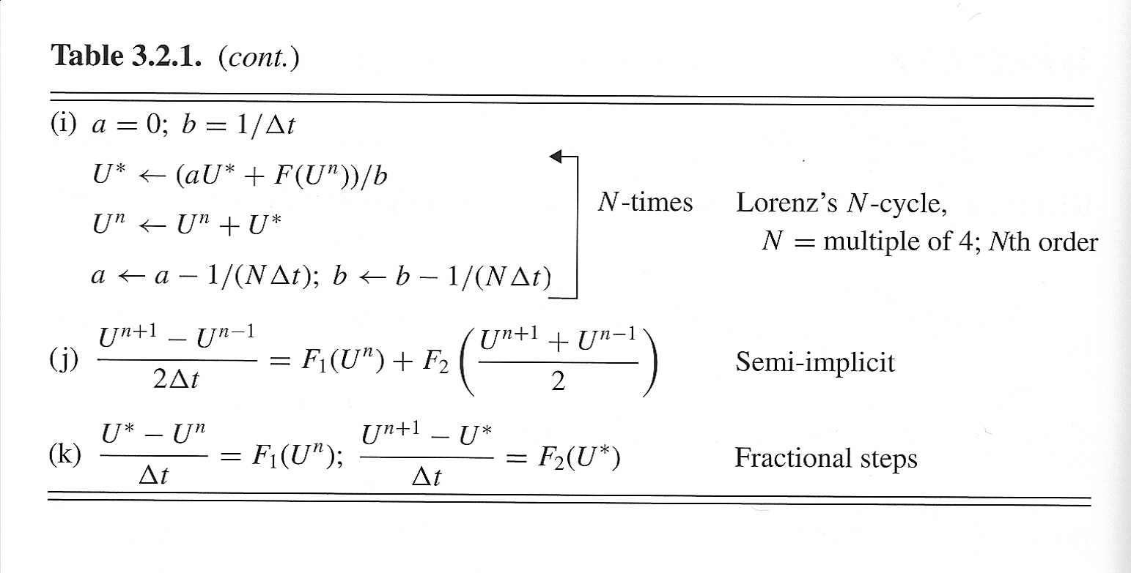
Applied NWP
Other time scheme examples…

Slide 56
Applied NWP
Implicit time schemes
  The advection or diffusion terms are written in terms of the new time level variables
PDE

Slide 57
Applied NWP
Implicit time schemes
  Why implicit time schemes?
  They allow for time steps much larger than those required by the CFL condition
PDE
(also damp the amplitude of the fast
moving gravity waves)

Slide 58
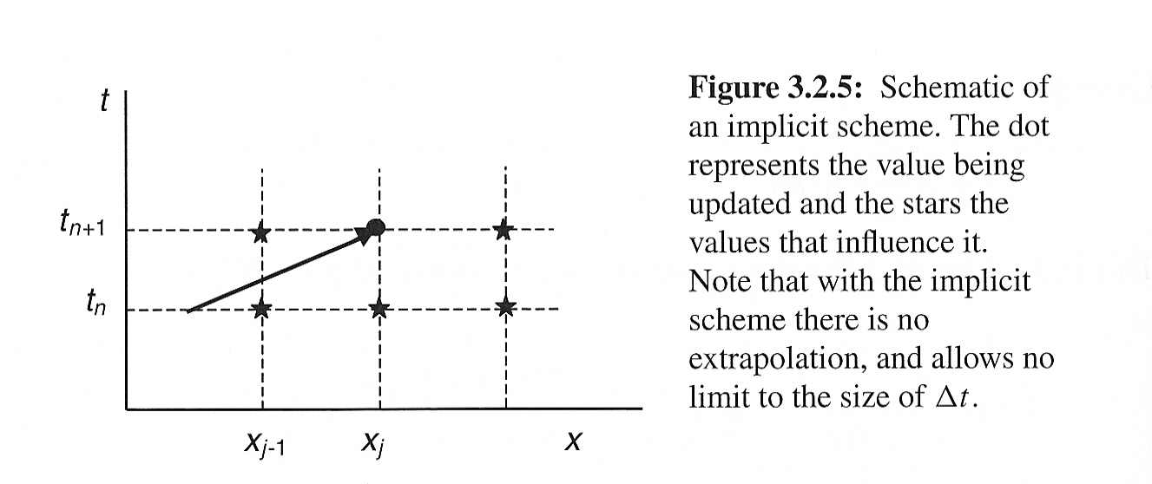
Applied NWP
Implicit time schemes
  Amplification factor;
If we choose α such that it is less than or equal to 0.5, the amplification factor is
guaranteed to be less than or equal to 1.0 → when the weight of the “new” time
values is the same as the weight of the “old” time values, there is no restriction on
the size that Δt can take!

Slide 59
Applied NWP
Implicit time schemes
  a point at the new time level is influenced by all the values at the new level, which avoids extrapolation, and therefore is absolutely stable
  if α is less than 0.5, the implicit time scheme becomes a damping scheme

Slide 60
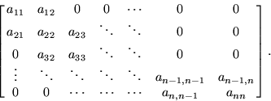
Applied NWP
Implicit time schemes
  A great disadvantage!!
  Since U ^{n+1} appears on the left- and right-hand sides of the FDE, the solution for U ^{n+1} in general requires the solution of a system of equations (added computational cost compared to explicit schemes)
http://mathworld.wolfram.com/TridiagonalMatrix.html

Slide 61
Applied NWP
tridiagonal matrix
Implicit time schemes
  A great disadvantage!!
  Solution requires either
  matrix inversion relatively fast if equations can be reduced to a tridiagonal matrix
  the relaxation method for a large number of grid points
http://mathworld.wolfram.com/TridiagonalMatrix.html

Slide 62
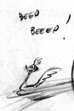
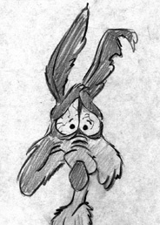
Applied NWP
Semi-implicit time schemes
  Fast and slow moving waves are separated
  Low frequency (slow) modes→explicit t.s.
  High frequency (fast) modes→implicit t.s.
The semi-implicit schemes were developed to
slow down the fast (“unweather-like”) modes
[e.g. gravity waves and sound waves].
http://looneytunes.warnerbros.com/web/stars/stars_wile.jsp

Slide 63
Applied NWP
Semi-implicit time schemes
  Slowing down the fast modes forces them to satisfy the CFL (von Neumann) stability criterion
  Another approach→ the use of fractional steps with fast mode terms integrated with small time steps
http://looneytunes.warnerbros.com/web/stars/stars_wile.jsp

Slide 64
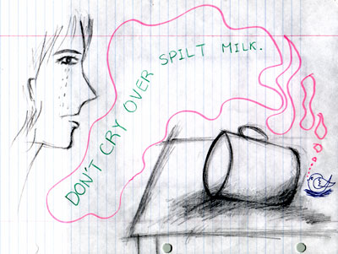
Applied NWP
Truncation errors
  Space [D&VK 3.3, 3.4]
  Time [D&VK 3.5]
  Space truncation errors tend to dominate the total forecast errors.
  For “weather waves” the time step used are much smaller than would be required to physically resolve the wave frequency.
http://humanities.byu.edu/elc/student/idioms/proverbs/cry_over_spilled_milk.html

Slide 65
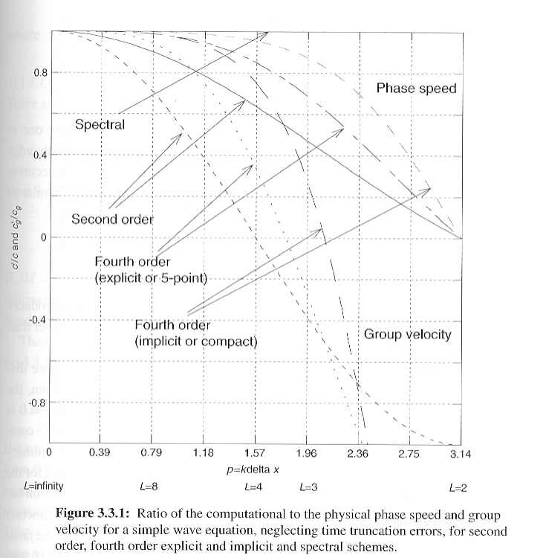
Applied NWP
Space truncation errors
Let c’ be the computational phase speed and c be the true (physical) phase speed of an atmospheric wave…

Slide 66
Applied NWP
Space truncation errors
  c’ is zero for smallest possible wavelength (L=2Δx), they don’t move at all!
  fourth order schemes are more accurate for longer waves

Slide 67
Applied NWP
Space truncation errors
Let c_{g}’ be the computational group velocity (energy propagation) and c_{g} be the true (physical) group velocity of an atmospheric wave…

Slide 68
Applied NWP
Space truncation errors
  c_{g}’ moves in the opposite direction for smallest possible wavelength (L=2Δx) to the real group velocity
  fourth order schemes are more accurate for longer waves

Slide 69
Applied NWP
(c > 0)
Space truncation errors
  As a result of the negative computational group velocity, space- centered FDEs of the wave equation tend to leave a trail of short-wave computational noise upstream of where the real perturbations should be

Slide 70
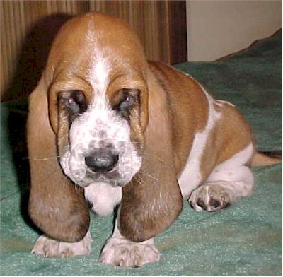
Applied NWP
Space truncation errors
  Is the problem hopeless?
Two approaches to try to fix the phase speed
and group velocity issues with short-waves:
→Galerkin [D&VK Chapter 11]
→spectral [D&VK Chapter 11]
space representations
http://www.vahhala.com/img/chase.jpg
[these are common approaches for global atmospheric models (e.g., GFS, NOGAPS)]

Slide 71
Applied NWP
Minimizing the Computational Mode (4.5)
  Asselin-Roberts time filter
  ϒ = filter factor, 0.05 < ϒ < 0.2

Slide 72

Applied NWP
Minimizing the Computational Mode (4.5)
  Asselin-Roberts time filter
    Degrades accuracy of FD scheme
    Alters stability (CFL) condition, with a larger filter factor placing more restrictions on the stability condition
Fig. 4.7

Slide 73
Applied NWP
Adams-Bashforth Scheme (4.6) – applied to the linearized advection eqtn…

Slide 74
Applied NWP
Adams-Bashforth Scheme (4.6) – applied to the linearized advection eqtn…
  Computational modes highly damped
  No time filtering required

Slide 75
Applied NWP
Computational stability for the FDE of the parabolic diffusion equation (4.7)
PDE
*
*needed when using f-i-t scheme to avoid a sign-flipping solution

Slide 76
Applied NWP
Operator splitting (4.8)
PDE
compute advection contribution only in 3 of 4 time steps…
compute advection & diffusion contributions every fourth time step…
[error discussion in Appendix D]

Slide 77
Applied NWP
PDE
CFL Condition in 2D (4.9)
shorter features can be resolved in the diagonal direction→requires a shorter time interval to meet stability requirements

Slide 78
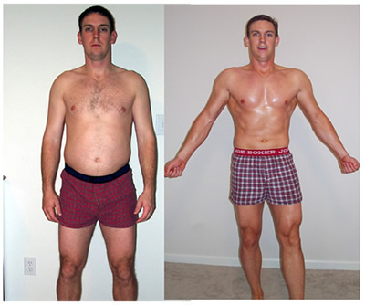

Applied NWP
Vertical coordinates
  When our model uses a vertical coordinate other than “z”, we need to transform the model variables
  [D&VK 2.4 {p. 13-18}]
http://www.bpurcell.org/bfl/before-after-pics.jpg
To the board!!→

Slide 79
Applied NWP
Vertical coordinates; Pressure coordinates
  Useful when assuming a hydrostatic atmosphere (simplify governing equations)
http://www.eumetcal.org/euromet/english/nwp/n6300/n6300071.htm

Slide 80
Applied NWP
Vertical coordinates; Pressure coordinates
  Simplify governing equations

Slide 81
Applied NWP
Vertical coordinates; Pressure coordinates
  The surface boundary condition is complicated
    Pressure surfaces intersect the ground
    Surface pressure is always changing
http://www.eumetcal.org/euromet/english/nwp/n6300/n6300071.htm

Slide 82
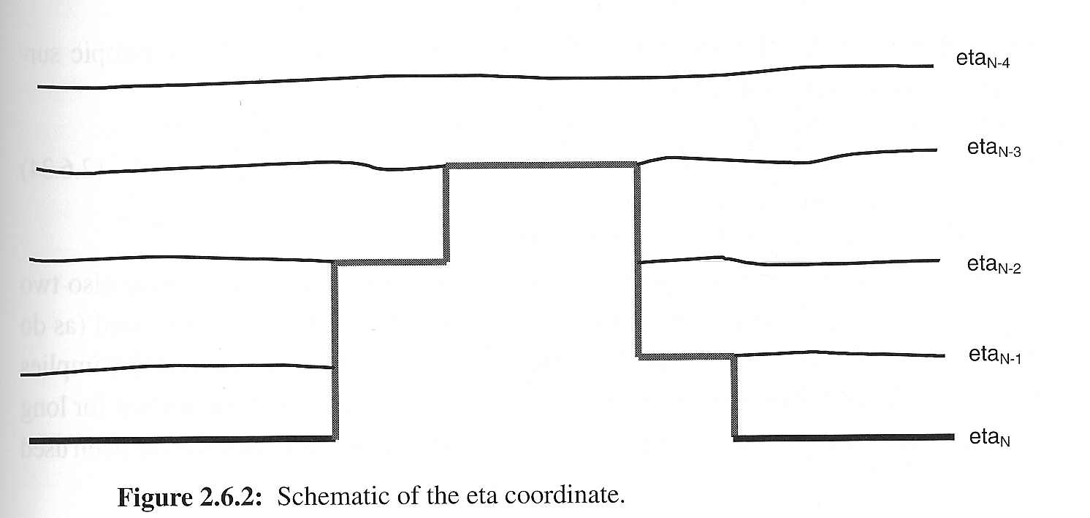
Applied NWP
Vertical coordinates; Sigma and eta coordinates
  Simplifies lower boundary condition

Slide 83
Applied NWP
Vertical coordinates; Sigma and eta coordinates
  Simplifies lower boundary condition

Slide 84
Applied NWP
Vertical coordinates; Sigma and eta coordinates
  The pressure gradient becomes the difference between two terms
  If sigma surfaces are steep, the first term may not have the information that went into the FD calculation of the second term

Slide 85
Applied NWP
Vertical coordinates; Sigma and eta coordinates
  The eta coordinate (using a step-mountain coordinate) is meant to eliminate the serious two term difference error sometimes associated with the sigma vertical coordinates

Slide 86
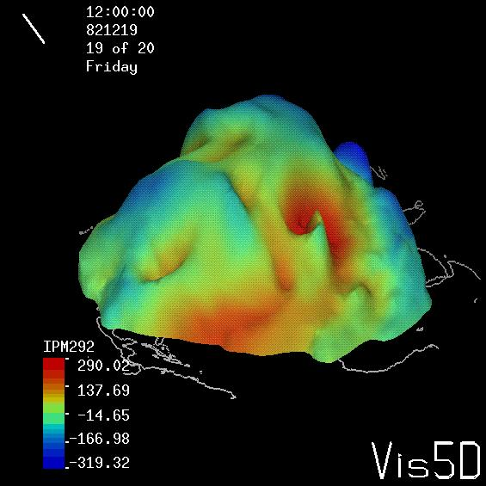
Applied NWP
Vertical coordinates; Isentropic coordinates
  Utilizes fact that on the synoptic scale, motions are adiabatic (potential temperature is conserved)
  Hence, vertical motion on a ‘θ’ surface is approximately zero
http://www.ssec.wisc.edu/theta/analysis.html
http://www.eumetcal.org/euromet/english/nwp/n6300/n6300081.htm

Slide 87
Applied NWP
Vertical coordinates; Isentropic coordinates
  Governing equations
Continuity eqtn
Hydrostatic eqtn

Slide 88
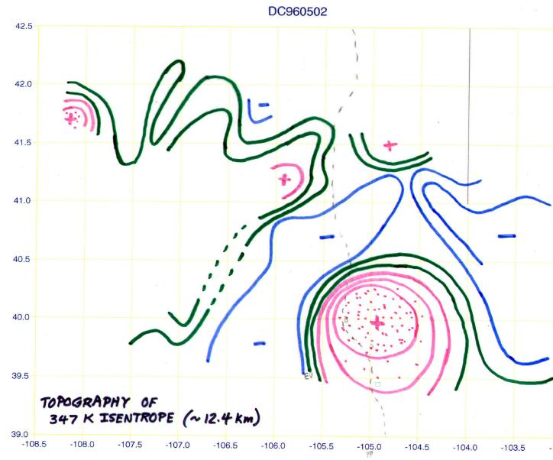
Applied NWP
Vertical coordinates; Isentropic coordinates
  Disadvantages
    Isentropic surfaces intersect the ground (difficult to enforce strict conservation of mass)
    Only statically stable solutions are allowed (there are situations where this is not true)
    In regions of low static stability, vertical resolution of isentropic coordinates can be poor
http://reductionism.net.seanic.net/bgary.mtp/topography/

Slide 89
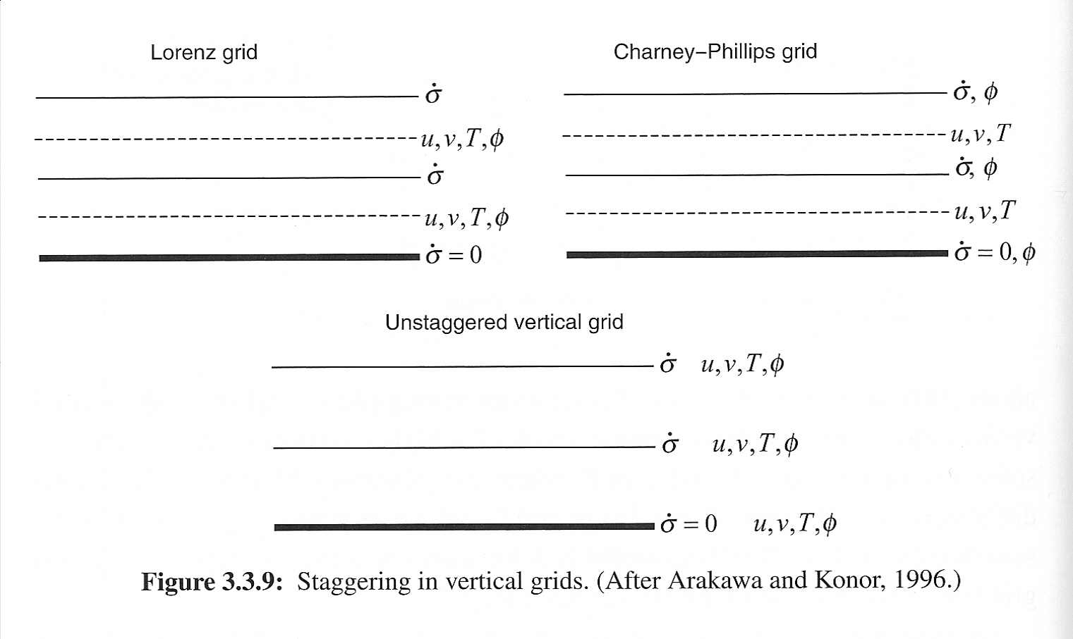
Applied NWP
Staggered vertical grids
  Vertical velocity ( ) typically defined at the boundary of layers
  Prognostic variables defined in the center of the layer

Slide 90
Applied NWP
Staggered vertical grids; Lorenz grid
  Allows the development of a spurious computational mode

Slide 91
Applied NWP
Staggered vertical grids; Charney-Phillips grid
  Absence of a spurious computational mode

Slide 92
Applied NWP
Staggered vertical grids; Unstaggered grid
  Allows a simple implementation of higher order differences in the vertical
  Computational modes present in the forecast

