Slide 1
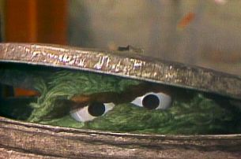
Applied NWP
We’ll look at the “garbage in – garbage out” principle as it applies to the computer weather forecast model, (D&VK Chapter 12, Kalnay Chapter 5, Krish. and Boun. Chapter 5)
http://toughpigs.com/journalmuppetquiz.htm
Go to: https://www.meted.ucar.edu/training_module.php?id=704#.VRl5GOGK14k for more information

Slide 2
Applied NWP
Computer weather model forecasting – initial value problem
  Solution at time t = τ is dependent on
    Initial state at t = 0
    Integrated effects of all forcing terms applied from t = 0 to t = τ
  If the initial conditions are not accurate → little hope of obtaining an accurate forecast

Slide 3
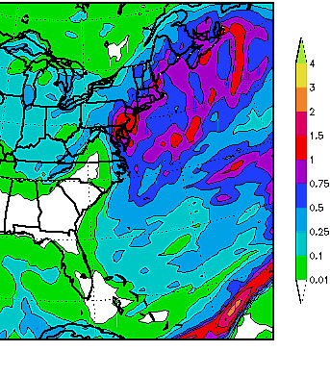
Applied NWP
REVIEW…
Computer weather model forecast problems occur when
  Small-scale features play an important role
  Small-scale features are not well observed and often not well understood
30 December 2000 East Coast Snowstorm
http://www.meted.ucar.edu/nwp/pcu3/cases/301200/index.htm

Slide 4

Applied NWP
REVIEW…
In summary, the computer weather forecast game- a balance between
  Computer resources
  Model physics
  to make acceptably accurate predictions
http://www.mattelscrabble.com/en/adults/index.html

Slide 5
Applied NWP
REVIEW…
We have to start our model with something
FDE
PDE
How do we “kick-off” our computer weather forecast model?

Slide 6
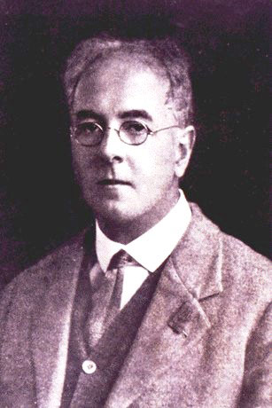
Applied NWP
In the old days…
  hand interpolations to a regular grid of available observations were performed
  these fields were manually digitized
  Very time consuming!
L.F. Richardson
http://www.metoffice.com/corporate/pressoffice/anniversary/timeline.html

Slide 7
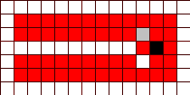
Applied NWP
Methods for automated “objective analysis*” became necessary as modeling began to “take off” in the late 1940s and early 1950s [12.1.2].
http://www.frank-buss.de/automaton/virtual/index.html
*assimilation of observations using interpolation methods based on mathematical relationships

Slide 8
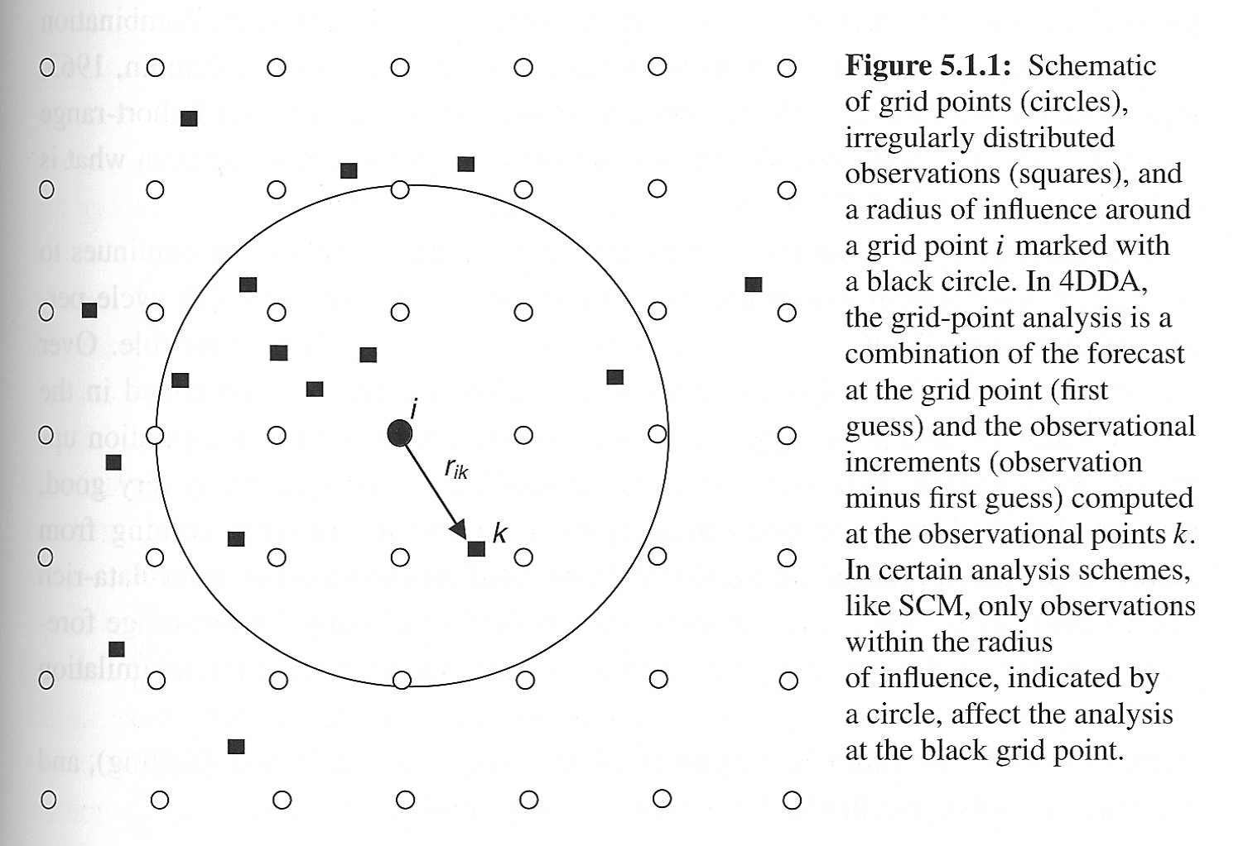
Applied NWP
1. Early techniques
  Local polynomial
    Minimize the mean square difference between the polynomial and observations close to the grid point
Activity- code word- Rex kwan do

Slide 9
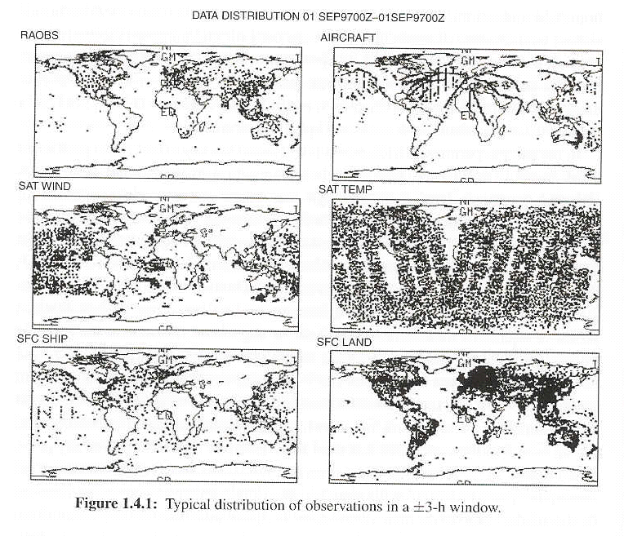
Applied NWP
Observations alone don’t provide enough information to initialize current weather forecast models…
Number of model unknowns = 10⁷
Number of observations (equations) = 10⁵
# equations < # unknowns, so the problem is underdetermined

Slide 10
Applied NWP
Observations alone don’t provide enough information to initialize current weather forecast models…
Observations have a non-uniform distribution in time and space

Slide 11
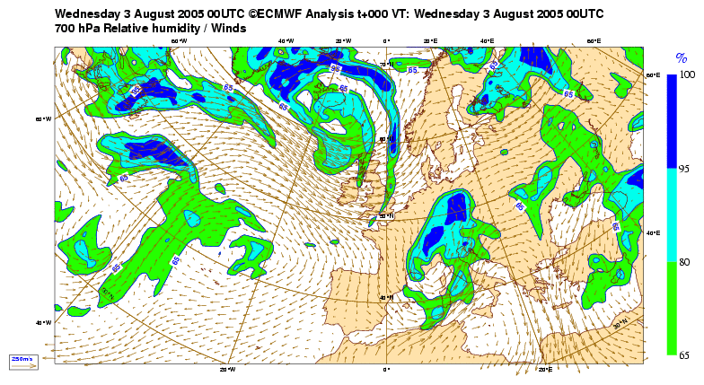
Applied NWP
Observations alone don’t provide enough information to initialize current weather forecast models…
http://www.ecmwf.int/samples/d/banner/page.html
It is necessary to have a complete first guess estimate of the state of
the atmosphere at all the model grid points, in addition to the observations
in order to generate computer weather model initial conditions

Slide 12
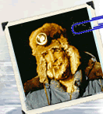
Applied NWP
First guess options
  Climatology
  Short-range model forecast
http://www.weather.nps.navy.mil/~psguest

Slide 13
Applied NWP
The data assimilation game…
  when do I believe the observations
  v.
  when do I believe the first guess (model)
  to make acceptably accurate model initial conditions?
http://www.mattelscrabble.com/en/adults/index.html

Slide 14
Applied NWP
Data assimilation (Talagrand, 1997)
  the process through which all the available information from observations is used in order to estimate as accurately as possible the state of the atmospheric flow. The available information essentially consists of the observations proper, and of the physical laws that govern the evolution of the flow. The latter are available in practice under the form of a numerical model. The existing assimilation algorithms can be described as either sequential or variational.

Slide 15

Applied NWP
The data assimilation game
  You have two social engagement options for Friday night, how do you decide which one to attend? [either/or]
…you weigh your options!
http://www.partycentral.com/

Slide 16
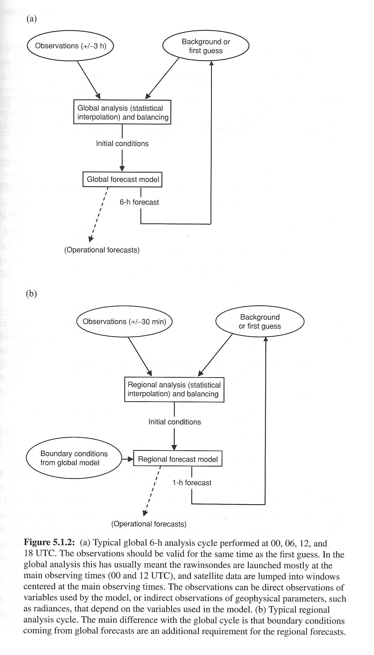
Applied NWP
First guess options – short-range model forecast
  analysis cycle- an intermittent data assimilation system which typically uses a 1- or 6-h cycle performed multiple times a day
[Kalnay 2003]

Slide 17
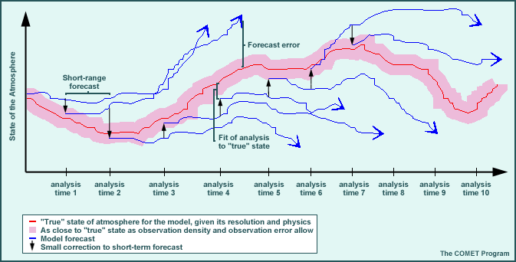
Applied NWP
http://www.meted.ucar.edu/nwp/pcu1/ic6/frameset.htm

Slide 18
Applied NWP
First guess options – short-range model forecast; analysis cycle
  Analysis is dominated by observations in data-rich regions
  Analysis is dominated by the short-range forecast in data-poor regions
[4DDA – four-dimensional data assimilation]

Slide 19
Applied NWP
2. More recent techniques
  Empirical analysis schemes
    Successive corrections method [12.3]
    Nudging [12.6]

Slide 20
Applied NWP
2. More recent techniques
  Successive corrections method
    Weights are defined using an empirical approach- usually a function of the distance between the observation and model grid point location
[a] Cressman (1959) [12.3.1]
[b] Barnes (1964, 1978) [12.3.2]

Slide 21
Applied NWP
2. More recent techniques
  Successive corrections method
    Simple
    Economical
    Provides reasonable analyses
    Related to OI when weights are chosen in a different fashion…
[a] Cressman (1959)
[b] Barnes (1964, 1978)

Slide 22
Applied NWP
2. More recent techniques
  Successive corrections method
    Disadvantages
      observational error is not accounted for when determining how observations are weighed
      weighting does not depend on the density of observations
      weighting function is not based on any physical or statistical properties of the background state or the observations
[a] Cressman (1959)
[b] Barnes (1964, 1978)

Slide 23
Applied NWP
2. More recent techniques
  Nudging (Newtonian relaxation)
  Adding to the prognostic equations a term that nudges the solution towards the observation (interpolated to the model grid)
τ_{u} should be chosen so that the nudging
term is similar in magnitude to the less
dominant terms

Slide 24
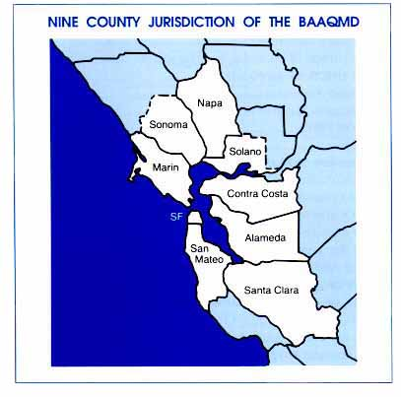
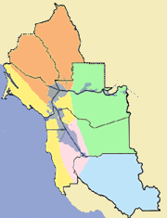
Applied NWP
2. More recent techniques
  Nudging* (Newtonian relaxation)
  *a common technique used in air quality modeling studies
http://www.baaqmd.gov/

Slide 25
Applied NWP
2. More recent techniques
  Least squares methods [12.4]
    Least squares
    Variational (cost function) approach
    Simplest sequential assimilation
    Kalman filtering

Slide 26

Applied NWP
“Truth? You can’t know the truth!!”
Where T₁ and T₂ are independent estimates of temperature
at a given location, T_{t} is the true temperature, and ε₁ and ε₂
are unknown temperature errors.
http://www.imdb.com/title/tt0081505/
→ How do we optimally combine these two pieces of information?

Slide 27
Applied NWP
2. More recent techniques
  Least squares methods [12.4]

Slide 28
Applied NWP
2. More recent techniques
  Least squares methods [12.4]
Analysis Equation

Slide 29
Applied NWP
2. More recent techniques
  Least squares methods [12.4]
Analysis Equation

Slide 30
Applied NWP
2. More recent techniques
  Least squares methods [12.4]
Analysis Equation
background error covariance matrix
observation error covariance matrix

Slide 31
Applied NWP
observation error covariance (R, p × p, p = # of obs)
R contributions:
  Instrument error (R_{instr})
  Error of representativeness (R_{repr})- the presence in the observations of subgrid-scale variability not represented in the grid-average values of the model and analysis
  Errors in the observations operator (R_{H})

Slide 32
Applied NWP
2. More recent techniques
  Least squares methods [12.4]
    Determine optimum values for elements of weight or gain matrix (K) such that analysis error is minimized**
      Optimal interpolation
      Kalman filtering
      Differ in how (B) is estimated.
background error covariance matrix
**multiple model variables, grid points, and observations result in rather large matrices → run analysis over subdomains of the grid

Slide 33
Applied NWP
background error covariance (B, n × n, n = # of pts × # of model variables)
  Determines the scale and the structure of the corrections to the background
  The most difficult error covariance to estimate, and has a crucial impact on the analysis results
  Main difference between OI, 3D-Var and Kalman filtering is how B is specified
    Assumed constant in time for OI and 3D-Var
    Is updated (forecasted) from the previous analysis time to the new analysis time in Kalman filtering
      With this change in B definition, the weight matrix becomes the Kalman gain matrix (K)

Slide 34
Applied NWP
2. More recent techniques
  Least squares methods [12.4]
    Optimal interpolation
      how (B) is estimated
      Elements are estimated based on long-term statistical comparisons between the background fields and analysis fields over many prior model runs…method is essentially static
background error covariance matrix

Slide 35
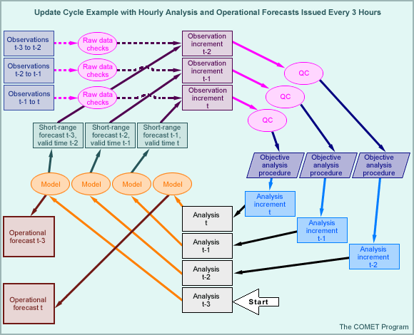
Applied NWP
2. More recent techniques
  Least squares methods [12.4]
    Kalman filtering
      how (B) is estimated
      Elements are dynamically recomputed and updated at every analysis time based on the departures between the previous analysis and previous background fields
background error covariance matrix
http://www.meted.ucar.edu/nwp/pcu1/ic6/frameset.htm

Slide 36
Applied NWP
2. More recent techniques
  Variational methods [12.5]
    Perform both the objective analysis and initialization steps at once (latter will be discussed below in slide #55)
    Roots in the calculus of variations
      Used in many branches of physics; finding the path of minimum energy for a particle to travel between two points in the presence of a potential field
      Powerful because any constraints imposed on the system can be incorporated into the formulation of the problem before it is solved

Slide 37
Applied NWP
2. More recent techniques
  3D-Var; cost function
background term
observation term
The value of x that results in the minimum value of the cost function J(x) is the optimal analysis field. Must be solved numerically using an iterative process (performed globally).

Slide 38
Applied NWP
2. More recent techniques
  3D-Var; cost function
The analysis is attained when J(x) has been minimized, in other words, when
resulting in the following [model or analysis space] formulation

Slide 39
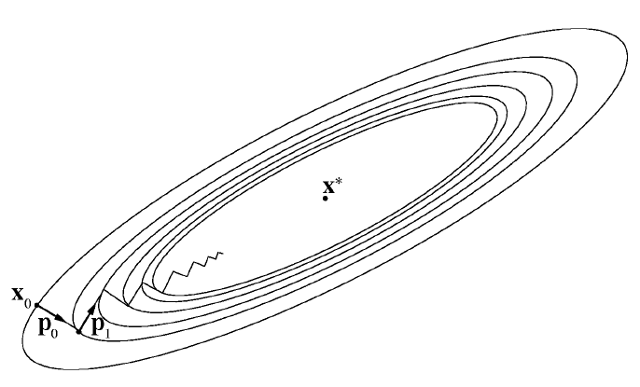
Applied NWP
Minimize J(x) by iteration, using an “adjoint” that serves to find the gradient
of J(x) in multi-dimensional space by one of the following methods…
  Steepest descent (slow, many iterations required)
  Quasi-Newton method (moderately fast)
  Conjugate gradient methods (fastest, fewest iterations)
Gradient
http://webcourse.cs.technion.ac.il/236609/Spring2003/ho/WCFiles/Tutorial%205-6.ppt

Slide 40
Applied NWP
2. More recent techniques; final comments
  OI
    requires the use of a “radius of influence” and selection of only the stations closest to the grid point being analyzed
    Background error covariance (B) matrix has to be locally approximated
    Analysis increment is limited to the subspace spanned by B
    Requires an additional step after analysis {nonlinear normal mode initialization (tbd)}

Slide 41
Applied NWP
2. More recent techniques; final comments (cont.)
  3D-Var
    All available data are used simultaneously- avoids jumpiness in the boundaries between regions that have selected different observations
    Background error covariance matrix can be defined with a more general, global approach (e.g. the “NMC method”)
    Possible to include quality control of the observations
    Possible to incorporate important nonlinear relationships between observed variables and model variables in the H operator in the minimization of the cost function (e.g., gradient and hydrostatic balance)
    Automatically returns analyzed fields that are in balance (data analysis and initialization steps are accomplished together; Fig. 12.1)
    Three-dimensional variational assimilation of radiances is possible

Slide 42
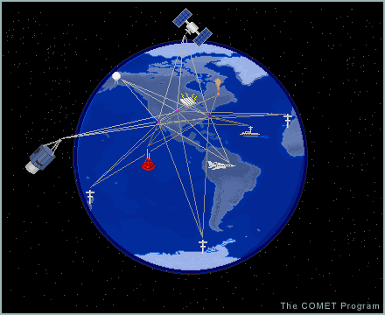
Applied NWP
Incorporating remote sensing observations in data assimilation schemes
  Satellites and radars measure quantities influenced by the variables predicted in our models (u, v, w, T, p, q)
    radiances, reflectivities, refractivities, etc.
http://www.meted.ucar.edu/nwp/pcu1/ic6/frameset.htm

Slide 43
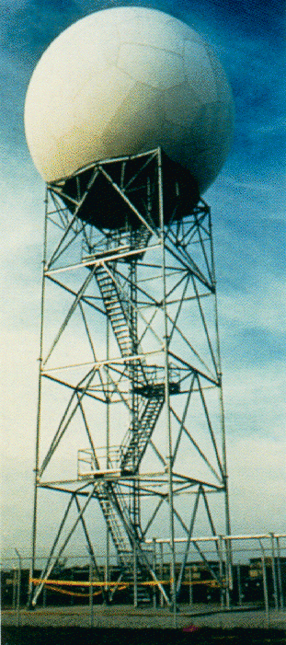
Applied NWP
Incorporating remote sensing observations in data assimilation schemes (cont.)
  We use the observation operator H(T_{b}) to obtain from the first guess gridded field a first guess of the observation
http://www.srh.noaa.gov/tlh/tlh/wsr88d.html

Slide 44
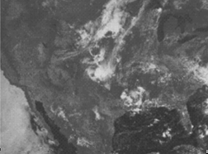
Applied NWP
  H(T_{b}) includes
    spatial interpolations from the grid point to the observation location
    Transformations based on physical laws; radiative transfer equations [T,p,q] → [T_{b}]
http://www.geog.umd.edu/eos/remote.html

Slide 45
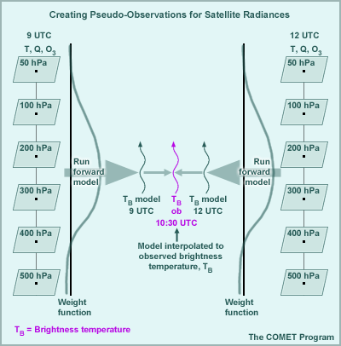
Applied NWP
http://www.meted.ucar.edu/nwp/pcu1/ic6/frameset.htm

Slide 46
Applied NWP
Remote sensing observations in data assimilation schemes (cont.), the old days…
  A “retrieval” approach was used wherein radiances would be converted into profiles that “looked” like rawinsonde observations → assimilated into models
http://www.metoffice.com/corporate/pressoffice/anniversary/timeline.html

Slide 47
Applied NWP
Remote sensing observations in data assimilation schemes (cont.), superiority of direct assimilation of radiances over the “retrieval” approach…
  There are fewer radiance observations than vertical levels of T and q in the model; the “retrieval” approach is an underdetermined problem. Therefore, it is necessary to introduce additional and less accurate statistical information into the problem to get a T and q profile from radiances
  Assigning observation error covariance (R) values for the retrieved T and q profiles is very difficult to determine

Slide 48
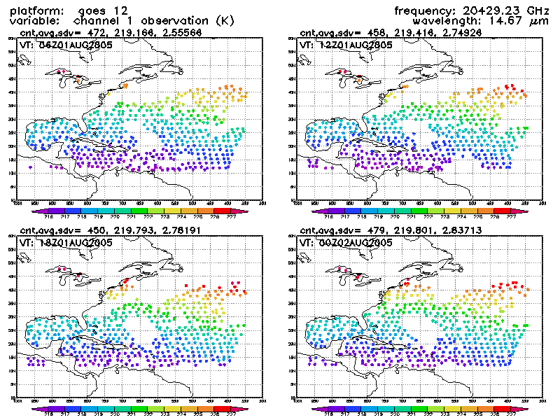
Applied NWP
The data assimilation game
  You have two social engagement options for Friday night, how do you decide which one to attend? [either/or]
http://www.emc.ncep.noaa.gov/gmb/gdas/radiance/esafford/opr/index.html

Slide 49
Applied NWP
2. More recent techniques
  Least squares methods [12.4]
    Kalman filtering
      how (B) is estimated
      Elements are dynamically recomputed and updated at every analysis time based on the departures between the previous analysis and previous background fields
background error covariance matrix
http://www.meted.ucar.edu/nwp/pcu1/ic6/frameset.htm

Slide 50
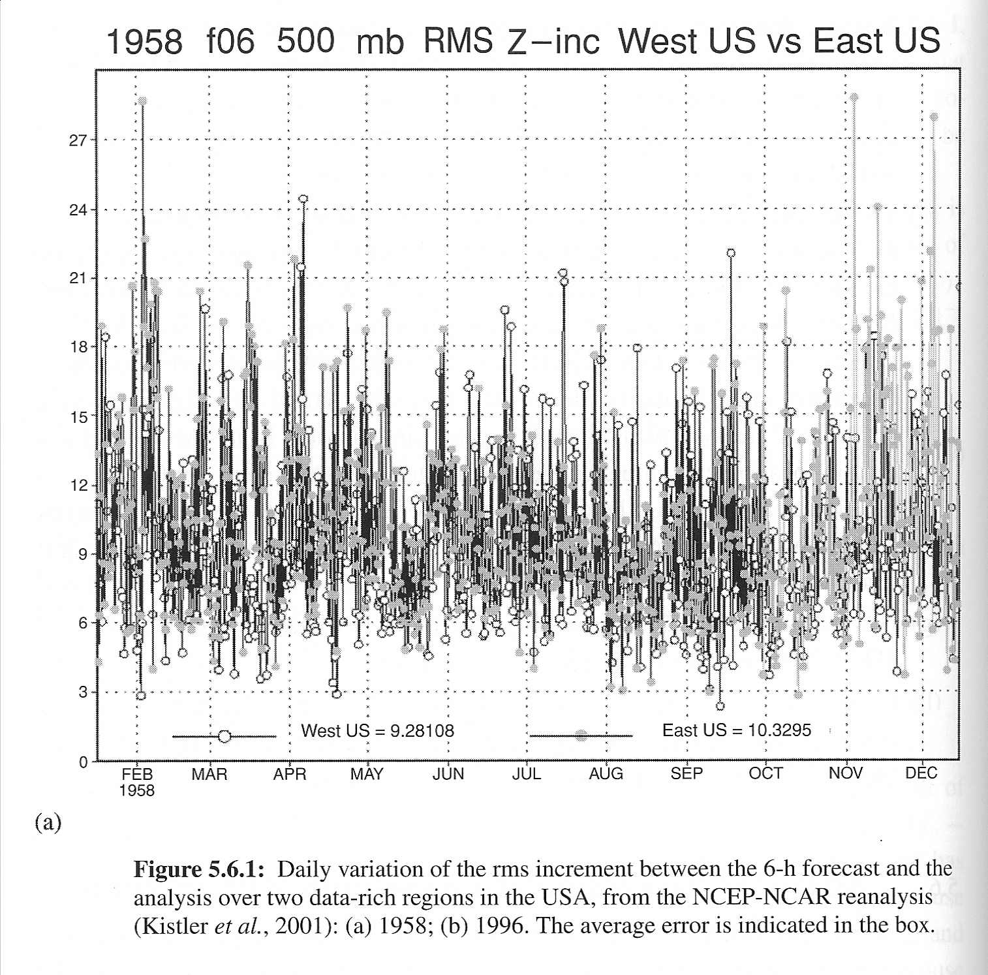
Applied NWP
6-h forecast errors for east and west US, 1958

Slide 51
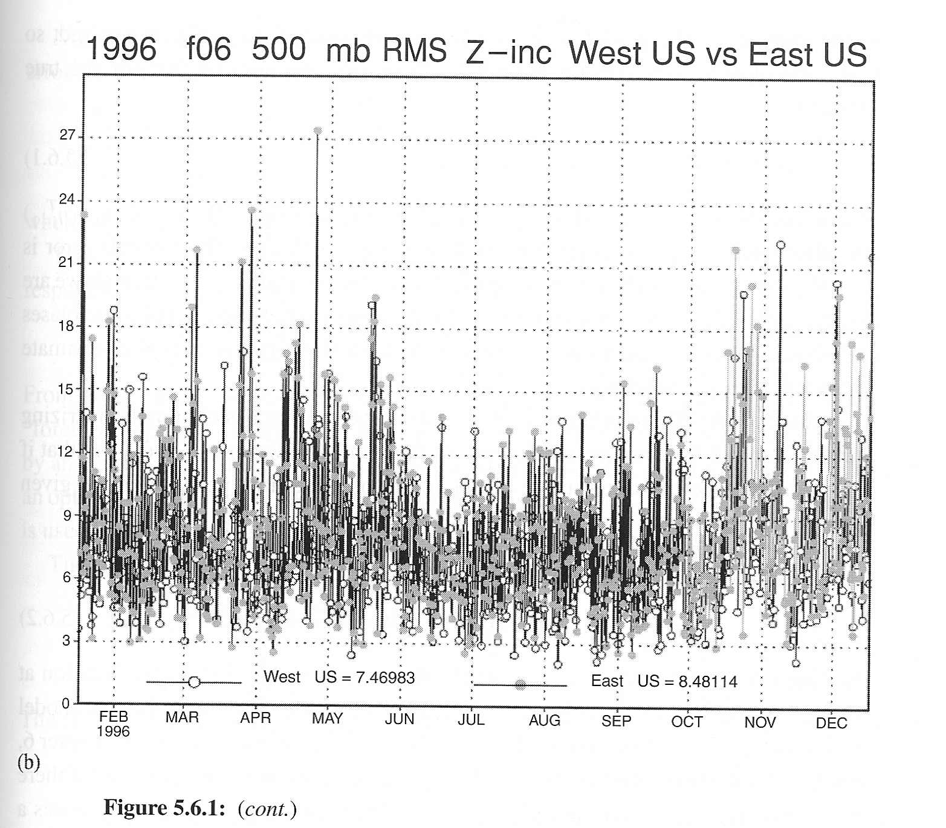
Applied NWP
6-h forecast errors for east and west US, 1996
  Differences in figures due only to changes in the observing system
  Day-to-day variability in the forecast error is about as large as the average error in both 1958 and 1996

Slide 52
Applied NWP
  Large daily forecast error is dominated (presumably) by baroclinic instabilities of synoptic time scales
  Large daily forecast error variation is ignored when the forecast error covariance (B) is assumed constant [OI, 3D-Var]

Slide 53
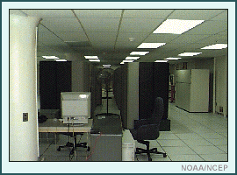
Applied NWP
3. Advanced techniques
  Kalman filtering
    Very similar to OI except- the forecast or background error covariance is advanced using the model itself (NOT constant as in OI)
    “gold standard” of data assimilation
    Computationally expensive [O(n) calcs]
http://www.meted.ucar.edu/nwp/pcu1/ic6/frameset.htm
n = # of pts × # of model variables

Slide 54
Applied NWP
3. Advanced technique; Ensemble Kalman filtering
  Cost = 10-100x(OI or 3D-Var)
  Does not require the development of a linear and adjoint model
  Does not require the linearization of the evolution of the forecast error covariance
  May provide excellent initial perturbations for ensemble forecasting

Slide 55
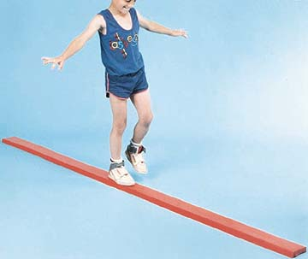
Applied NWP
Dynamical and physical balance in the initial conditions
  Geostrophic adjustment
  Normal modes initialization
  Digital filters
http://www.onlinesports.com/images/oly-ga313p-3.jpg
slide #55

Slide 56
Applied NWP
In the old days…
Richardson’s (1922) NWP experiment failed because of noisy data and the presence of fast inertia-gravity waves in the solution of the governing equations
L.F. Richardson
http://www.metoffice.com/corporate/pressoffice/anniversary/timeline.html

Slide 57
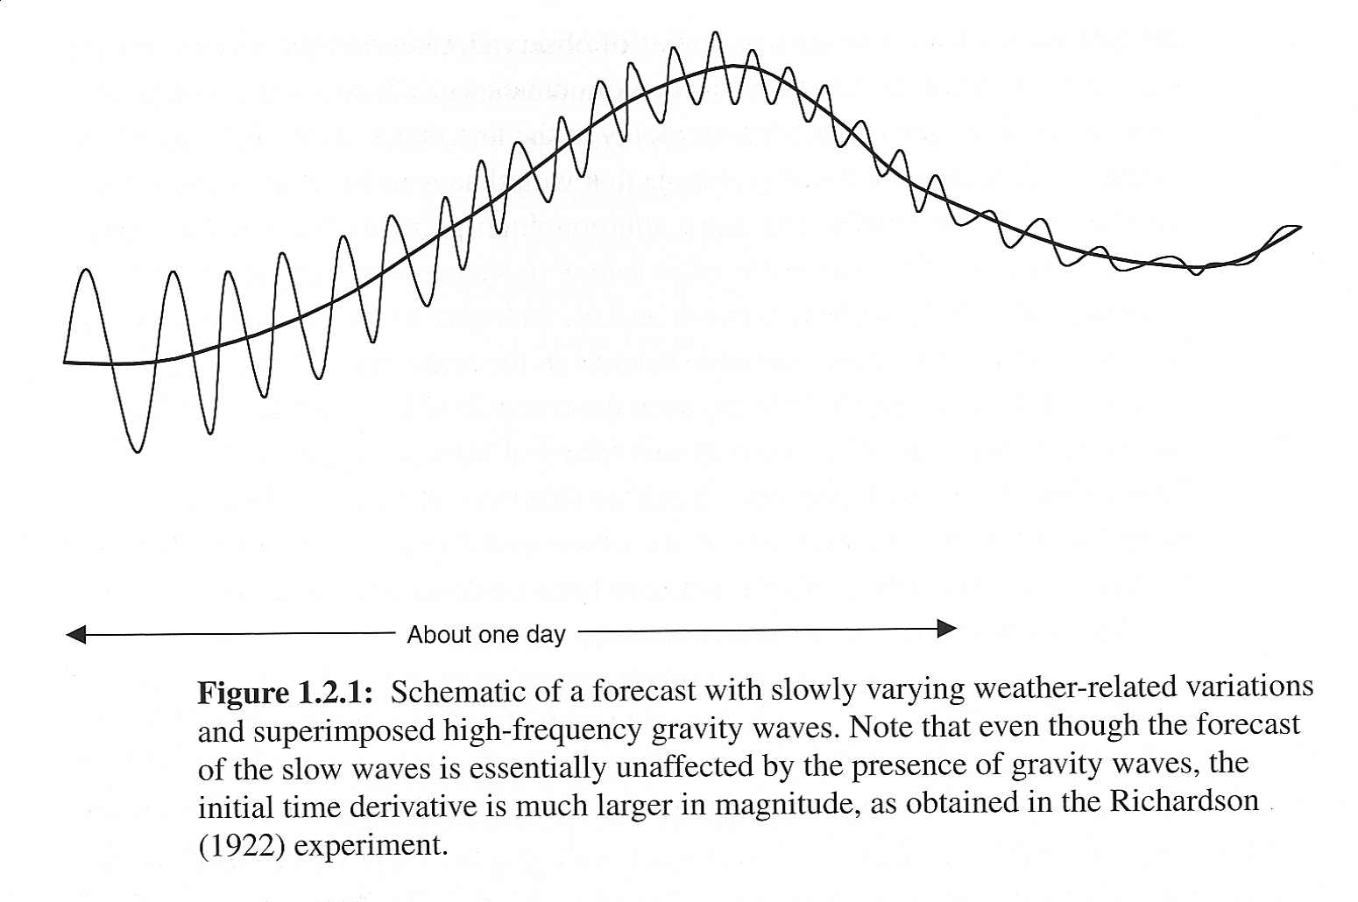
Applied NWP
Unless the amplitude of the fast waves component is made very small, the fast waves will dominate the initial tendency

Slide 58
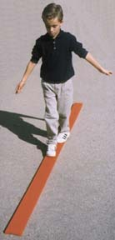
Applied NWP
If the analysis is out of balance,
  the balanced portion of the initial field will project on the quasi-geostrophic (slowly evolving “weather”) mode, and the unbalanced portion will project onto inertia-gravity waves
  all of the initial information that projects on inertia-gravity waves will be lost
It is preferable to enforce balance within the analysis as done in 3D-Var
http://www.school-tech.com/gymnastics1a.html

Slide 59
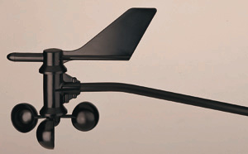
Applied NWP
Computer weather forecast model studies have shown…
  Models essentially ignore surface pressure data
    Adjusts its surface pressure to the barotropic component of the wind
  Winds tend to be more effective in providing initial conditions for an NWP model than mass data
  Temperature data are more important for shallow vertical modes
http://www.davisnet.com/productpics/big/7911.jpg

Slide 60
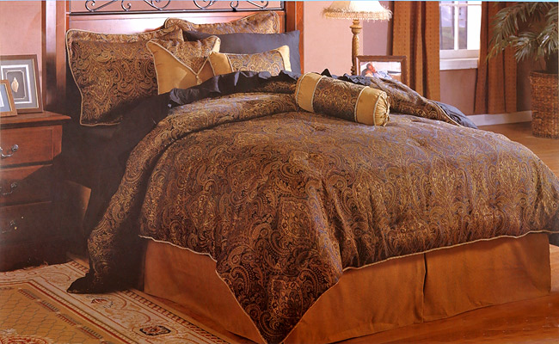
Applied NWP
Data coverage, horizontal and vertical
  Vertical profiles of winds, T, and q are more useful than single level observations
  An observing system will also contribute more to the skill of the forecasts in the absence of other observing systems (satellite impacts in NH v. SH)
http://www.shopzilla.com/

Slide 61
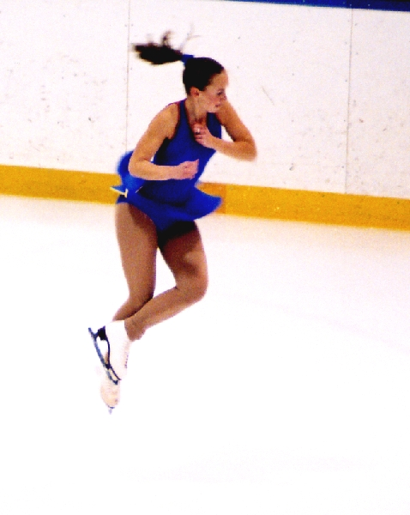
Applied NWP
Model adjustments
  Mass and wind fields
    Geostrophic balance
  Others
    Thermal balance
      Sfc air temps
    Hydrological balance
      No clouds → clouds
      Clouds → rain
  “spin-up”
    Adjustment process, which is affected by model physical parameterizations
http://www.goldengaels.com/parkinson/2004/gg02407.jpg

Slide 62
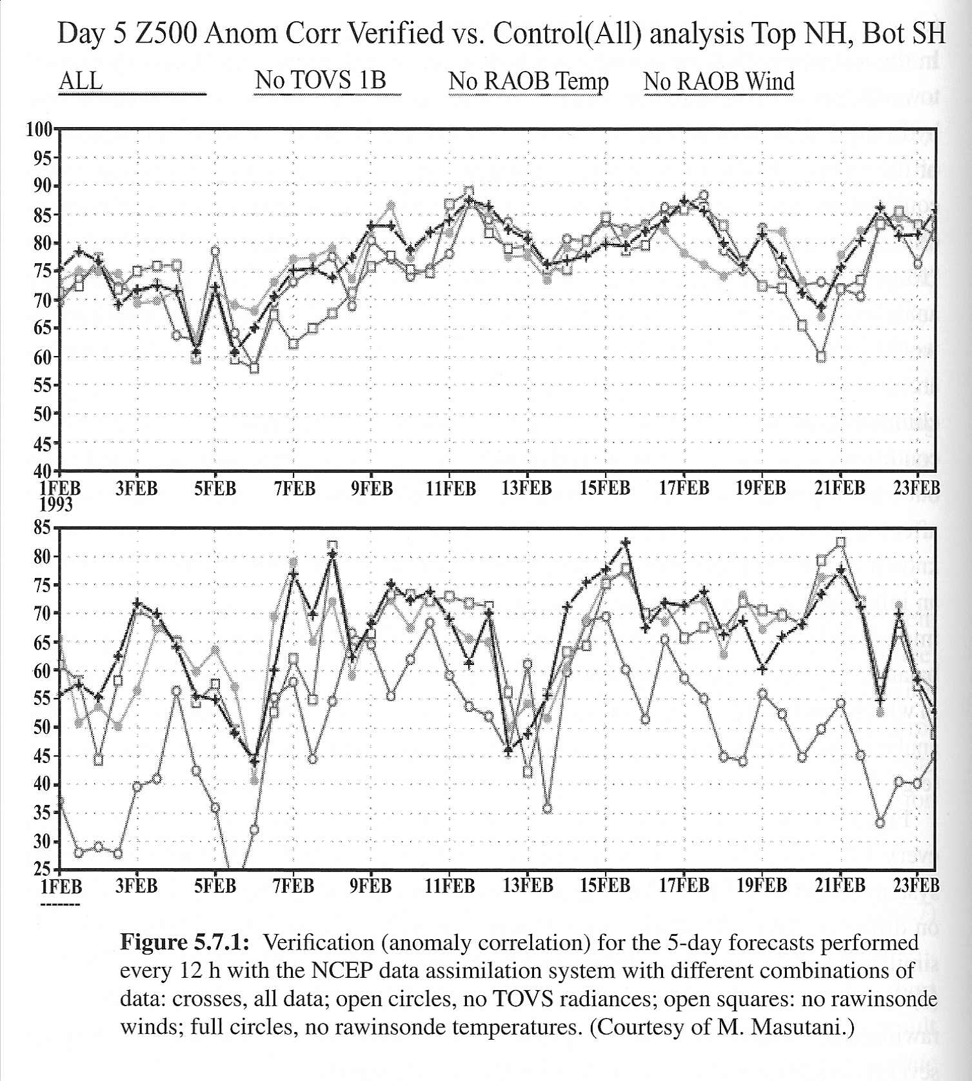
Applied NWP
Model adjustments and “spin-up”
  If assimilation assumptions were perfect, ALL experiments should have best forecasts
  Eliminating rawinsonde winds from DA has a much larger negative impact than eliminating rawinsonde temperatures for NH
  Satellite radiances have a much larger positive impact in SH than in NH

Slide 63
Applied NWP
Substantial day-to-day variability in the 5-day forecast skill
  Attributed to the changes in atmospheric predictability
    On some days the atmosphere is simply easier to predict than on others

Slide 64

Applied NWP
Normal modes initialization
  Geostrophic balance is oversimplistic
  Required after OI to reduce loss of information by inertia-gravity waves
  Becoming less popular due the emergence of 3D-Var
"Tollbooth to the Information Super Highway"
http://www.pritchettcartoons.com/toll.htm

Slide 65
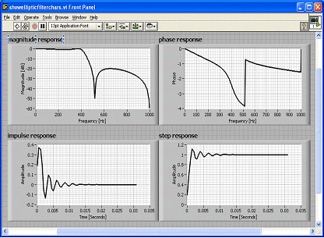
Applied NWP
Dynamic initialization using digital filters
  Old days → damping numerical scheme (e.g. Matsuno)
    “clunky”; requiring many iterations
  Digital filters
    choose filtering weights that the amplitudes of low (high) frequencies are unchanged (reduced)
http://zone.ni.com

Slide 66
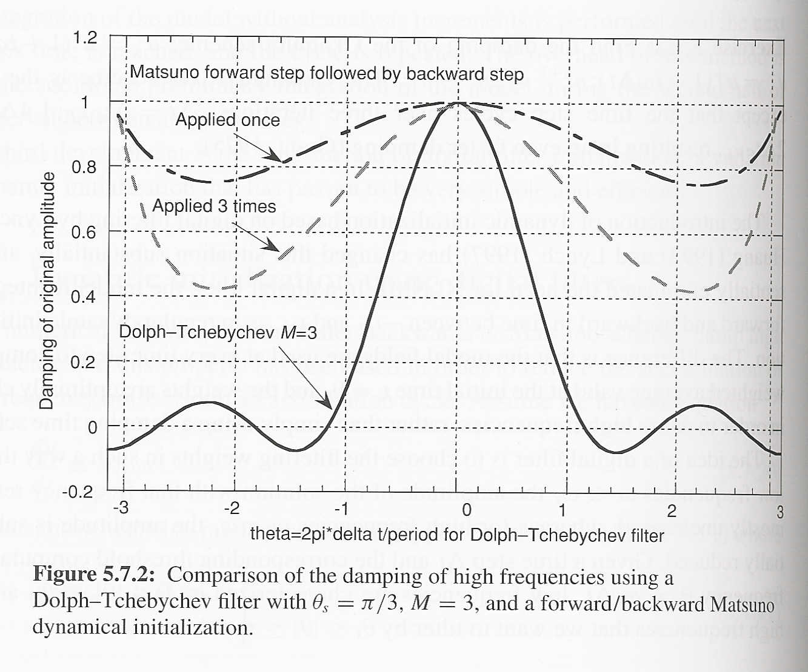
Applied NWP
Dynamic initialization using digital filters
  damping numerical scheme (e.g. Matsuno)
    “clunky”; requiring many iterations
  Digital filters
    choose filtering weights that the amplitudes of low (high) frequencies are unchanged (reduced)

Slide 67
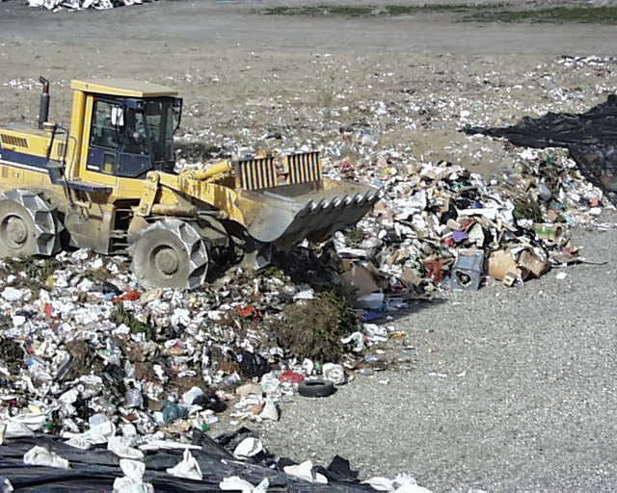
Applied NWP
Quality control of observations
  Reported observations may contain errors that are so large that they have no useful information content and should be tossed out
http://www.zerowaste.co.nz/assets/img/Howcanwehelp/PhotoGallery/landfill.jpg
How to automate the job of an observation tosser (front-end loader)?

Slide 68
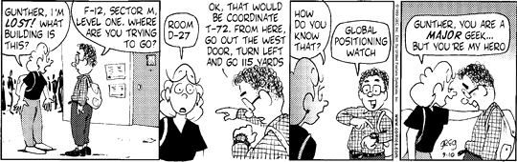
Applied NWP
Quality control of observations
  Sources of observation “garbage”
    Data entry/calculation
    Wrong date, time, location
    Uncalibrated instruments
  “when in doubt, throw it out”
http://www.edu-observatory.org/gps/gps.html

Slide 69
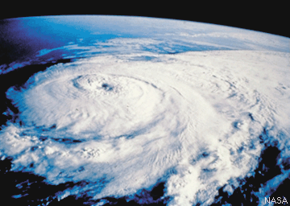
Applied NWP
Quality control of observations
  Based on a comparison between observations and some kind of expected value
    Climatology
    Nearby observation
    First guess
  How to throw out obs with large errors and keep correct errors reporting unusual states of atmosphere
http://hurricanes.noaa.gov/prepare/
[e.g. very low pressure or unusually high winds in
an area affected by a tropical cyclone]

Slide 70
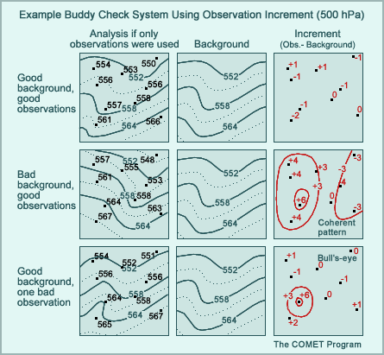
Applied NWP
Quality control of observations
  Gross error check
    compare w/ climatology
  Buddy check
    compare w/ other obs
  “OI” QC
    compare w/ analysis
  Complex QC
    Uses several checks simultaneously
    Can make corrections to observations
http://www.meted.ucar.edu/nwp/pcu1/ic6/frameset.htm

Slide 71
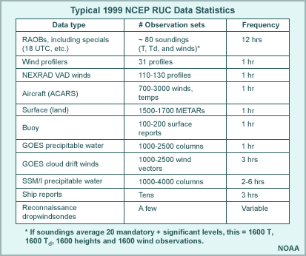
Applied NWP
Quality control of observations; NCEP Complex QC (OI-based)
  Incremental check; ob v. 6-h forecast
  Horizontal check
  Vertical check
  Hydrostatic check
  Baseline check
  Correction?
http://www.meted.ucar.edu/nwp/pcu1/ic6/frameset.htm

Slide 72
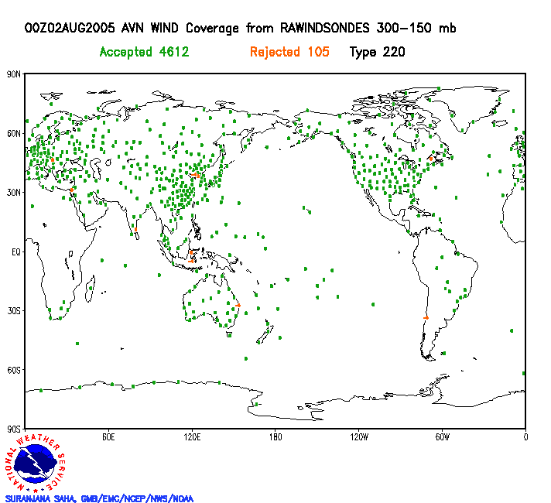
Applied NWP
http://www.emc.ncep.noaa.gov/gmb/gdas/es_conv/prhw14/index_horz.html

Slide 73
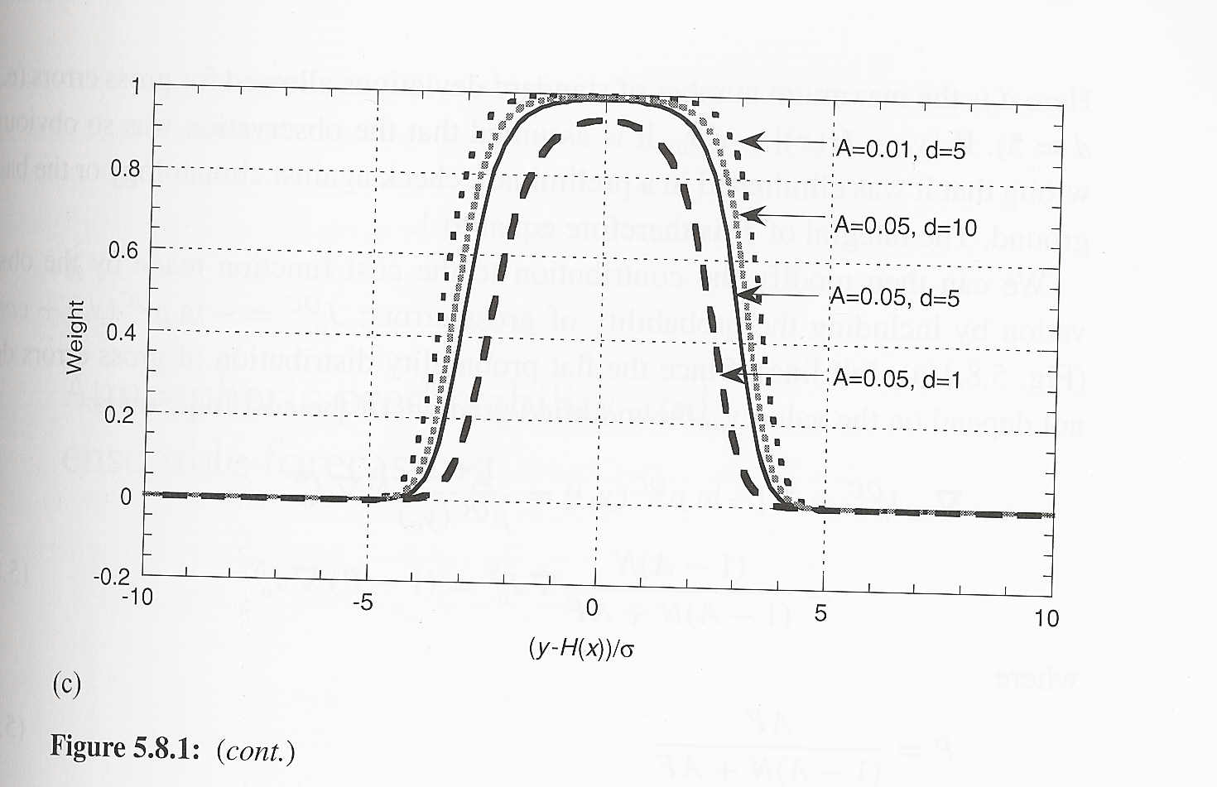
Applied NWP
Quality control of observations; variational quality control (3D- and 4D-Var)
  QC is performed as part of the analysis itself (advantage)
  Unable to correct observations like Complex QC (disadvantage)

Slide 74
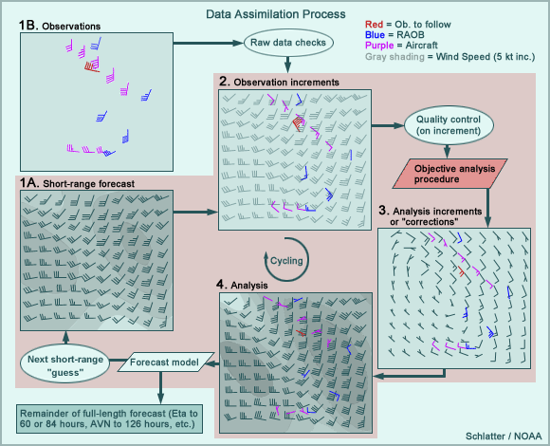
Applied NWP
Overall DA process
http://www.meted.ucar.edu/nwp/pcu1/ic6/frameset.htm

