Slide 1
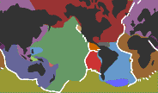
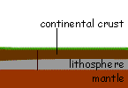
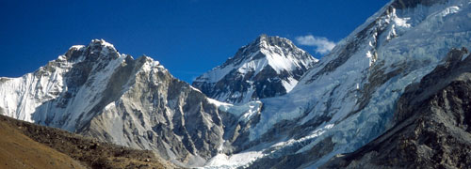
Applied NWP
Everything interesting happens at the boundaries (D&VK Chap 9., Kalnay 3.4-3.5, K&B p.70-92)
http://www.pbs.org/wgbh/aso/tryit/tectonics/crush.html
http://www.bbc.co.uk/schools/gcsebitesize/geography/platetectonics/plateboundaryrev3.shtml

Slide 2
Applied NWP
REVIEW…
Partial differential equations (PDEs)
  Second order linear PDEs are classified into three types depending on the sign of β ² – αγ. Equations are hyperbolic, parabolic or elliptic if the sign is positive, zero, or negative, respectively.

Slide 3
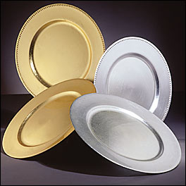
Applied NWP
REVIEW…
Examples
  Laplace’s or Poisson’s equations (elliptic)
  steady state temperature of a plate
http://www.galasource.com/prodDetail.cfm/20170,Gold%20Beaded%20Lacquer%20Charger%2012%22,MX2

Slide 4
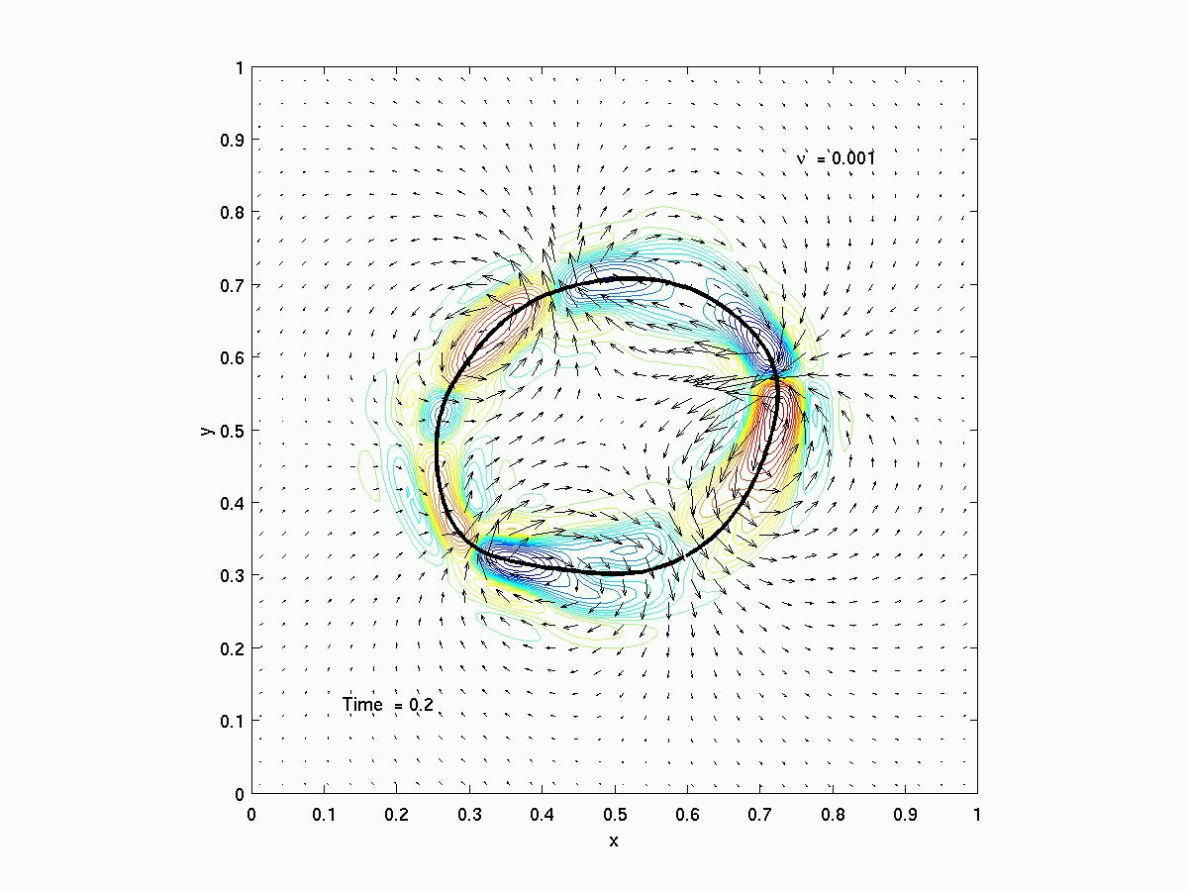
Applied NWP
In order to solve an elliptic equation, one needs to define boundary conditions
  Elliptic equations are boundary value problems
http://www.amath.unc.edu/Faculty/minion/res/blob.html

Slide 5
Applied NWP
Recall…
Examples in NWP
  Solve for streamfunction given the relative vorticity
  Solve for velocity potential given the vertical velocity
  Omega equation

Slide 6

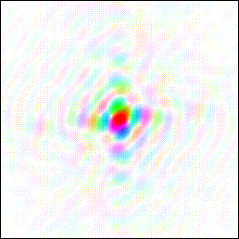
Applied NWP
Linear elliptic equations are easily solved with spectral methods (e.g. Fourier Transform Method, D&VK Appendix C)
http://www.ysbl.york.ac.uk/~cowtan/fourier/duck1.html

Slide 7
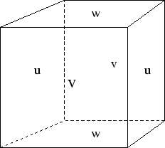
Applied NWP
Linear elliptic equations are not so easily solved using finite differences
  Methods
    Direct
    Iterative
http://mitgcm.org/pelican/online_documents/node45.html

Slide 8
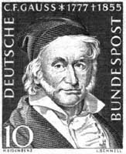
Applied NWP
Linear elliptic equation solvers on grids; direct methods
  Gaussian elimination
    Simple if the unknowns in the governing equations can be re-cast as a tridiagonal matrix
    Problems when the matrix is ill-conditioned
http://www-groups.dcs.st-and.ac.uk/~history/PictDisplay/Gauss.html

Slide 9
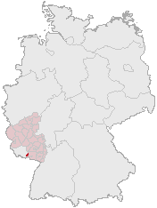
Applied NWP
Linear elliptic equation solvers on grids; iterative methods [7.4.1]
  Jacobi simultaneous relaxation method
  Gauss-Seidel (successive) relaxation method
  Successive overrelaxation method (SOR)
  others
http://de.wikipedia.org/wiki/Ludwig_Seidel
For a refresher, re-examine D&VK Section 7.4

Slide 10
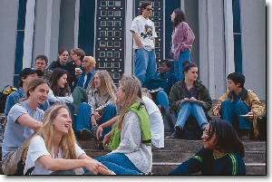
Applied NWP
Linear elliptic equation solvers on grids; iterative methods
  Discussion
    How does the iteration speed depend on the initial guess?
    How do you know if your scheme is converging?
    Will your scheme ever reach the perfect solution?
http://www.unca.edu/welcome/pictures.html

Slide 11
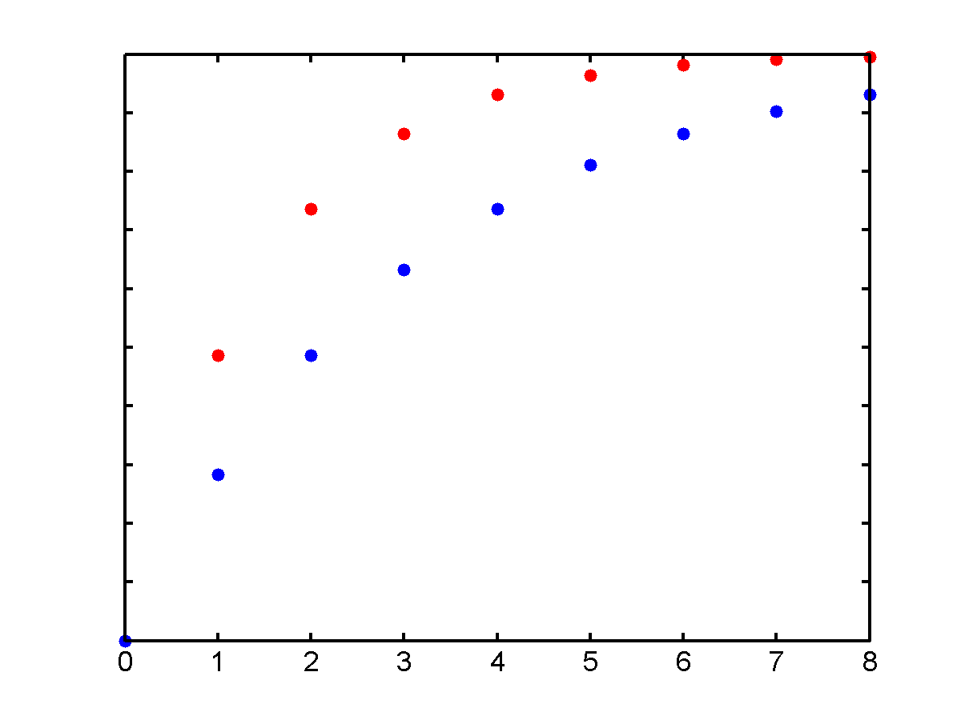
Applied NWP
Linear elliptic equation solvers on grids; iterative methods – rates of convergence*…
  Jacobi = ε
  Gauss-Seidel = 2ε
  SOR =
http://www.eee.metu.edu.tr/~skoc/iterative_methods.ppt#1
*the higher the rate, the faster the solution

Slide 12
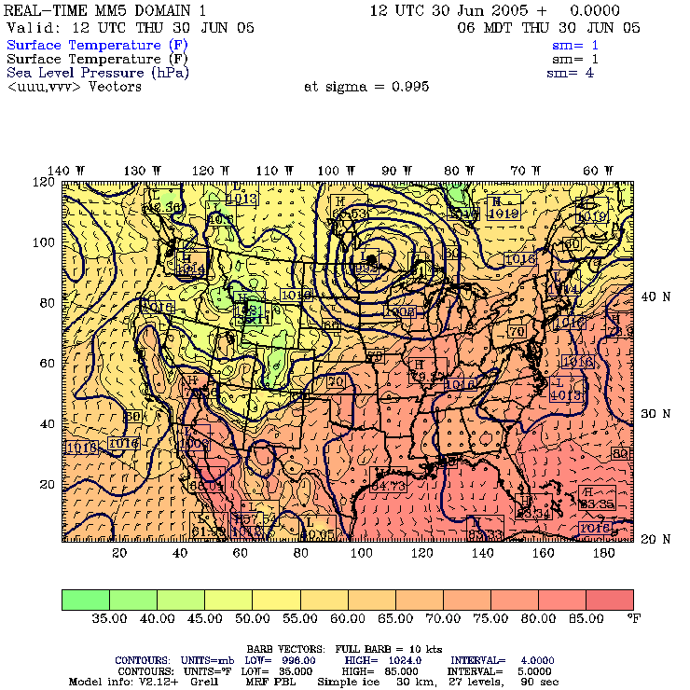
Applied NWP
Limited area models (LAMs)…
  Allows high resolution in the horizontal since it covers a limited area
  Requires the use of updated lateral boundary conditions obtained from the global model
http://rain.mmm.ucar.edu/mm5/plots/30km/2005063012/slp.hr00.gif
Go to: https://www.meted.ucar.edu/nwp/model_structure/

Slide 13
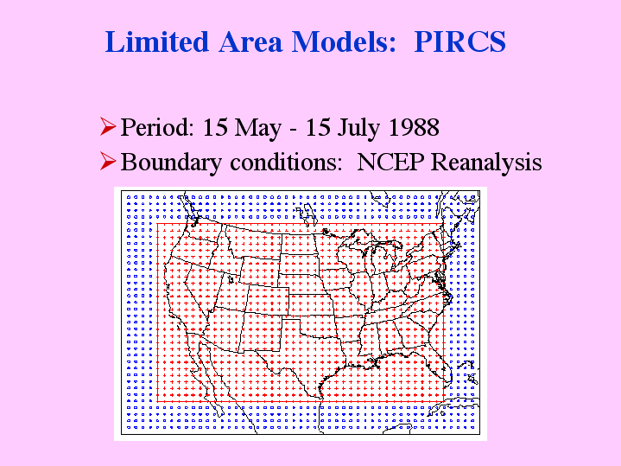
Applied NWP
Limited area models (LAMs)…
  If appropriate boundary conditions are not specified at artificial boundaries…
    fluxes of momentum, heat, moisture, and mass will reflect off of the boundary and move back into the model domain (D&VK p. 149)
http://www.pircs.iastate.edu/people/Gutowski/Presentations/STAT_LAM/sld012.htm

Slide 14
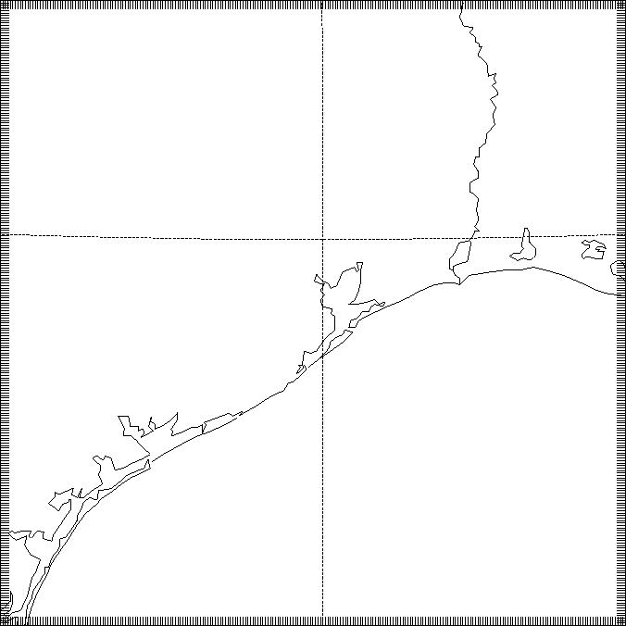
Applied NWP
Lateral boundary conditions for PDEs
  Depending on the type of equation in the computer forecast model, each boundary point can require up to three boundary conditions to solve the equation

Slide 15
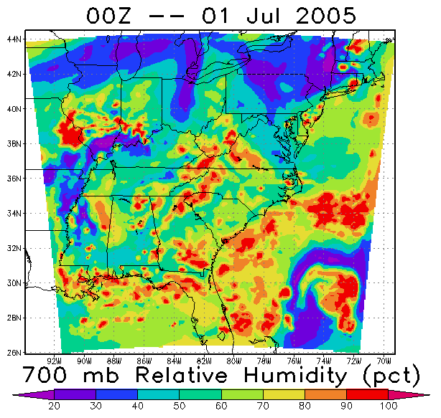
Applied NWP
Lateral boundary conditions for PDEs
  In reality, lateral boundary conditions in LAMs are over-specified*; we “get away with it” because of the presence of numerical diffusion
http://personal.uncc.edu/betherto/tellus/
*too many conditions to get a unique solution

Slide 16
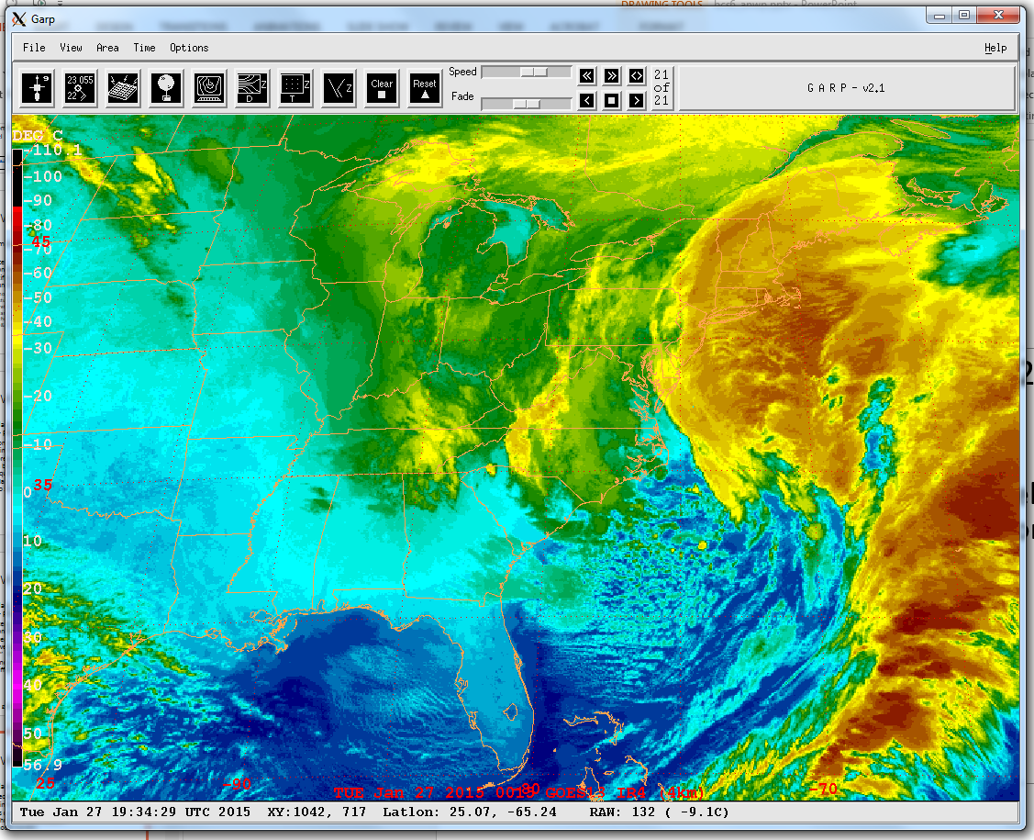
Applied NWP
Lateral boundary conditions [9.2]
  Prevent reflections
  Account for influence that disturbances outside of the model domain will have on the simulation inside the model domain

Slide 17
Applied NWP
Radiation boundary condition [9.3]
  Prevents reflection of wavelike disturbances

Slide 18
Applied NWP
Radiation boundary condition [9.3]
  Applied to a 1D barotropic primitive equation model

Slide 19
Applied NWP
Radiation boundary condition [9.3]
  Applied to a 1D barotropic primitive equation model
No advection or Coriolis force

Slide 20
Applied NWP
Radiation boundary condition [9.3]
  Applied to a 1D barotropic primitive equation model
Apply the one-way wave operators, Eqs. (9.1) & (9.2), to the u values at i = 0 and i = NX,
Activity- code word- Yo-yo-ma

Slide 21
Applied NWP
Radiation boundary condition [9.3]
  Applied to a 1D barotropic primitive equation model

Slide 22
Applied NWP
Radiation boundary condition [9.3]
  Applied to a 2D barotropic primitive equation model [9.3.3]

Slide 23
Applied NWP
Unknown wave speed [9.4]
  Boundary condition speed that estimates the speed of the waves as they approach the lateral boundaries
    modified Orlanski BC (p. 154)
“s” is determined using Eqs. (9.15) and (9.17) or (9.18)

Slide 24
Applied NWP
*Most commonly implemented at the top of an atmospheric model to avoid reflection of vertically propagating waves back downward into the model domain (D&VK, p. 157)
Absorbing (Sponge*) Layers [9.5]
  Damps any disturbances that approach the boundary
    Add artificial viscosity
    Include a Rayleigh damping term
α(x) or R(x) would be zero in the center of the domain and would gradually increase as the boundaries are approached.

Slide 25

Applied NWP
Upper boundary condition; what about the model top [sponge, D&VK p. 156-157]?
  Some challenges since our computer weather forecast model cannot extend upward to infinity
  What to do?
http://www.hatsinthebelfry.com/page/H/CTGY/top-hats&source=googletophats

Slide 26
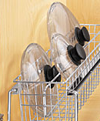
Applied NWP
Upper boundary condition, most models…
  place their top at 100 – 1 mb level
  assume a “rigid top” (a.k.a. rigid lid)
http://www.thehomemarketplace.com/category.aspx?cid=340%7C344
Important reference…
Warner, T.T., R.A. Petersen, and R.E. Treadon, 1997: A tutorial on lateral boundary conditions as a
basic and potentially serious limitation to regional numerical weather prediction.
Bull. Amer. Meteorol. Soc., 78, 2599-2617.

Slide 27
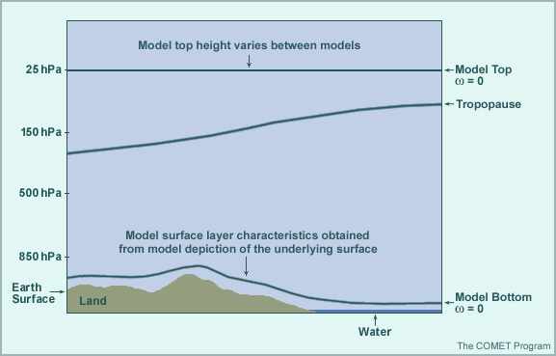
Applied NWP
Upper boundary condition; rigid lid considerations
  Can give energy reflections that introduce artificial instabilities
  Can be effective if the top of the model is sufficiently high and there is enough vertical resolution to damp the upward moving disturbances
  Can impose a radiation condition that enforces the condition that energy only propagate upwards (difficult to implement)
http://meted.ucar.edu/nwp/pcu1/ic2/5_3_1.htm

Slide 28
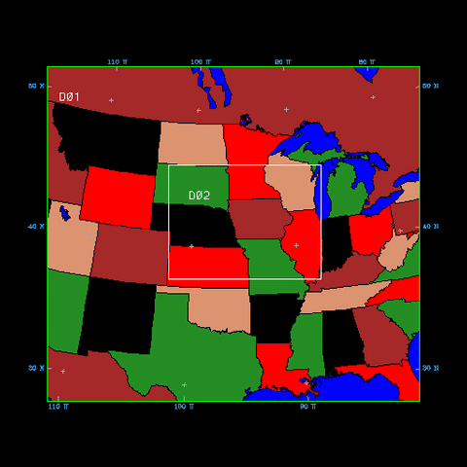
Applied NWP
Lateral boundary conditions; methods [9.6.2]
  One-way nesting
  Two-way nesting
http://mesonet.agron.iastate.edu/~mm5/resource/domain.gif

Slide 29
Applied NWP
Lateral boundary conditions; methods
  One-way nesting
  Two-way nesting
  Host model, with coarser resolution, provides information about the boundary values to the nested model, but is not affected by the high resolution model solution.
http://mesonet.agron.iastate.edu/~mm5/resource/domain.gif

Slide 30
Applied NWP
Lateral boundary conditions; one-way methods
  Pseudo-radiation boundary conditions
  Diffusive damping in a “sponge layer”
  Tendency modification scheme
  Flow relaxation scheme (most widely used)

Slide 31
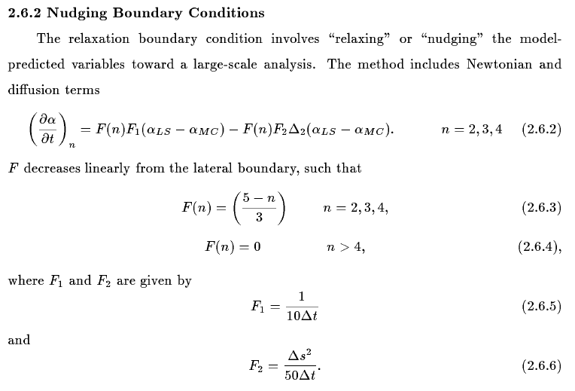
Applied NWP
Lateral boundary conditions; practical application…
http://www.mmm.ucar.edu/mm5/documents/mm5-desc-doc.html

Slide 32
Applied NWP
Lateral boundary conditions; practical application…
Activity- code word- Yo-yo-ma2

Slide 33
Applied NWP
Lateral boundary conditions; methods
  One-way nesting
  Two-way nesting
  The high resolution model solution feeds back to the host model solution
http://mesonet.agron.iastate.edu/~mm5/resource/domain.gif

Slide 34
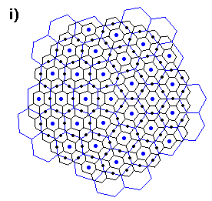
Applied NWP
Lateral boundary conditions; two-way methods
  Nested model feeds back to the host model on overlapping grid points in the boundary zone
  Use stretched coordinates in the host model so that only the region of interest is solved with high resolution [9.6.1]
http://kiwi.atmos.colostate.edu:16080/BUGS/groupPIX/ross/ross1/ross1.html

