Slide 1
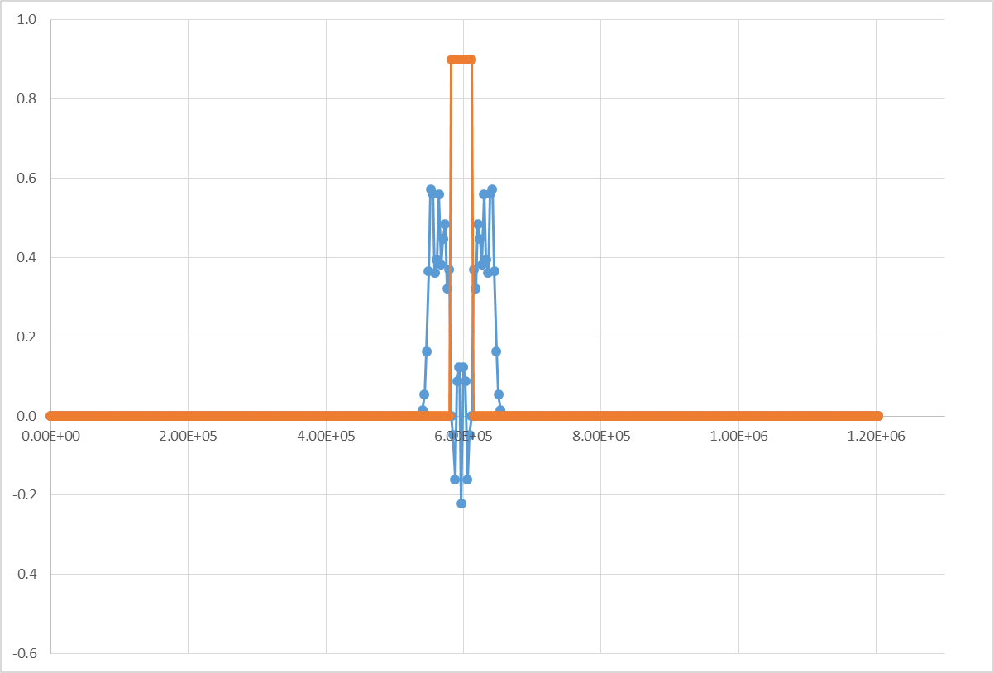
High pressure in center of domain
η
(meters)
Distance (meters)
Time = 5000 seconds (1.389 hours)

Slide 2
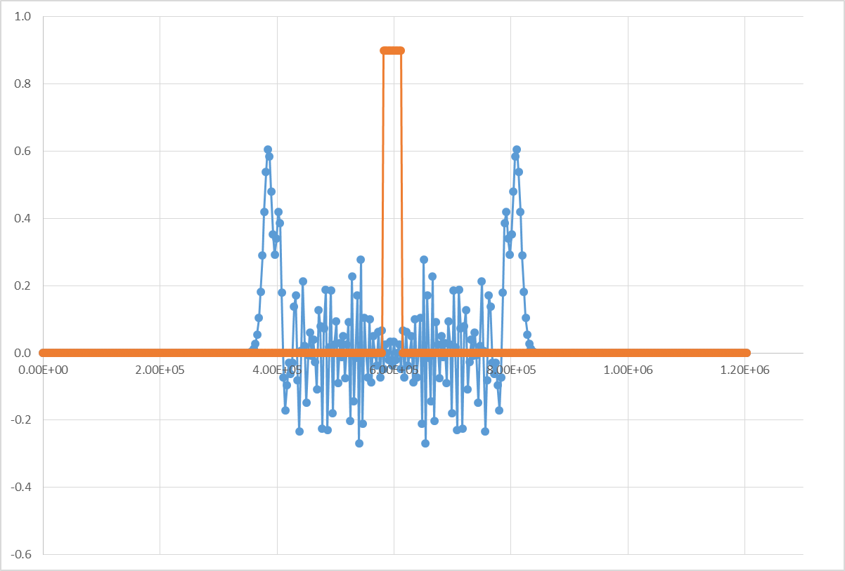
High pressure in center of domain
η
(meters)
Distance (meters)
Time = 30000 seconds (8.33 hours)

Slide 3
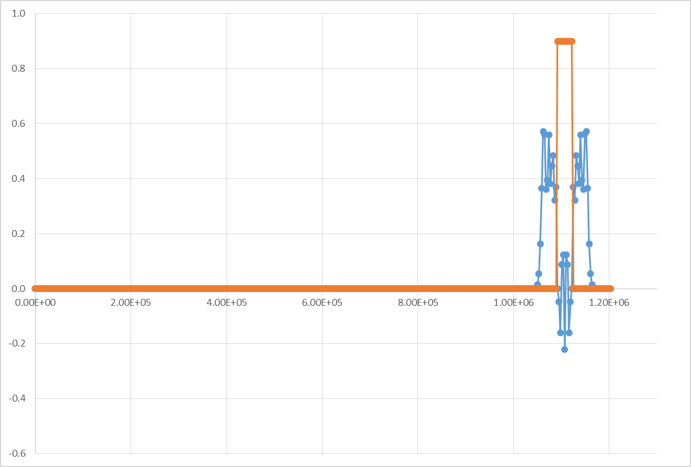
η
(meters)
Distance (meters)
Time = 5000 seconds (1.389 hours)

Slide 4
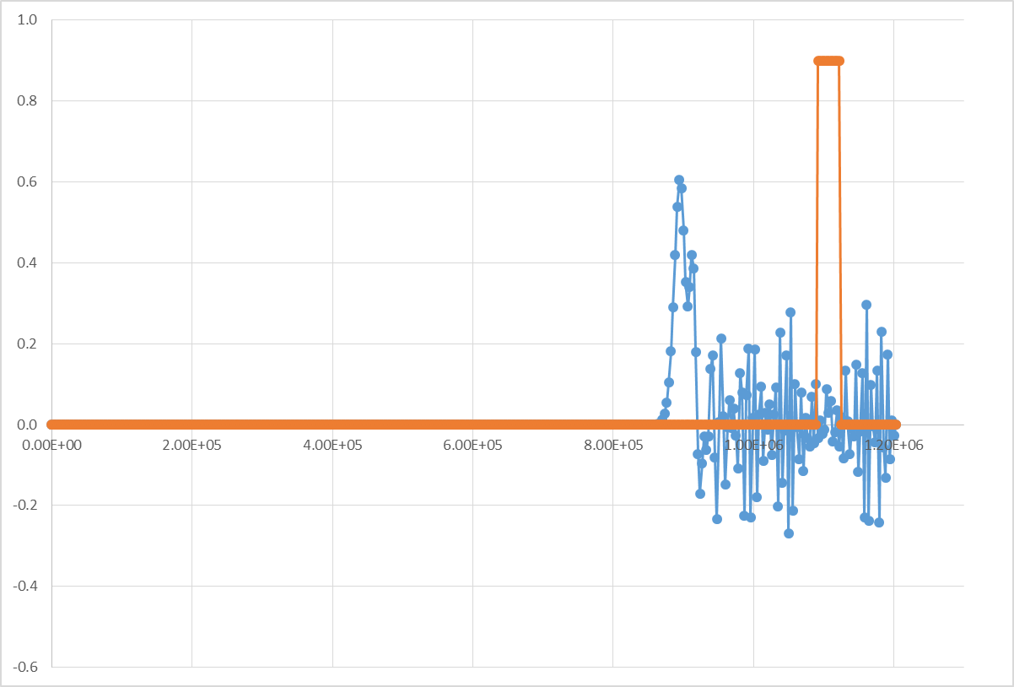
Radiation Boundary Conditions
η
(meters)
Distance (meters)
Time = 30000 seconds (8.33 hours)

Slide 5
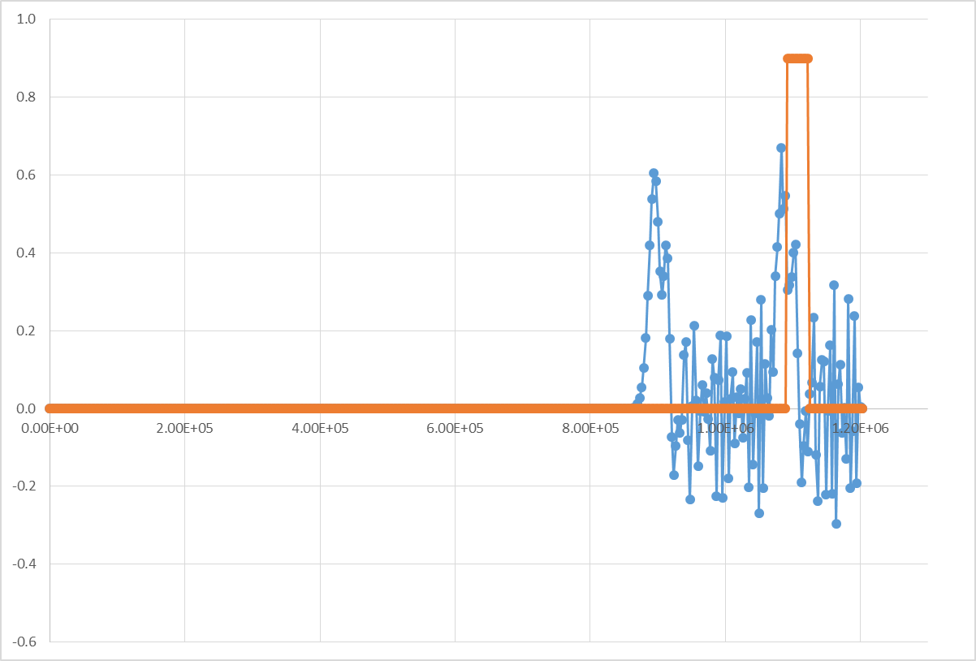
Fixed (Rigid) Boundary Conditions
η
(meters)
Distance (meters)
Time = 30000 seconds (8.33 hours)

Slide 6
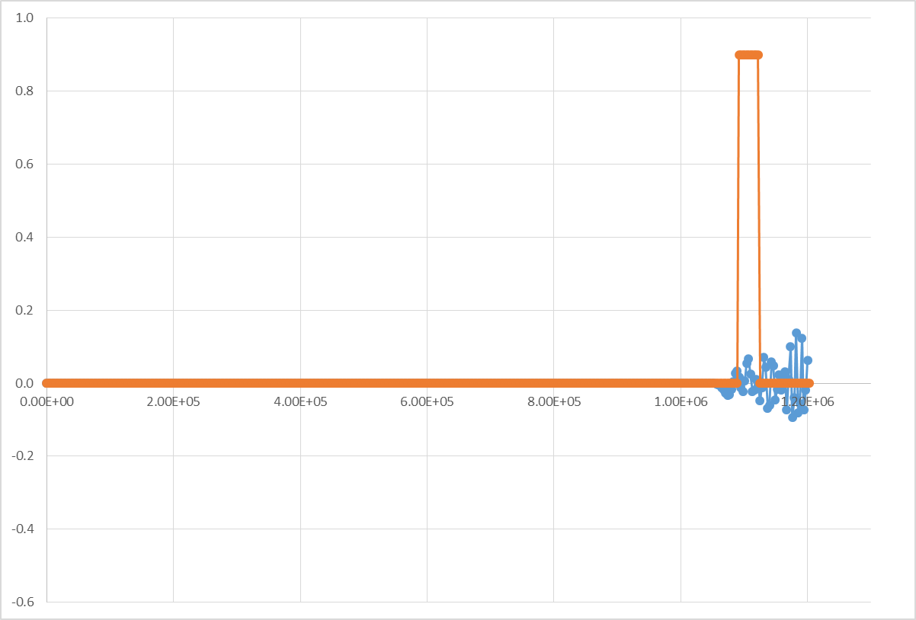
Radiation Boundary Conditions
Δη
(meters)
Distance (meters)
Time = 30000 seconds (8.33 hours)

Slide 7
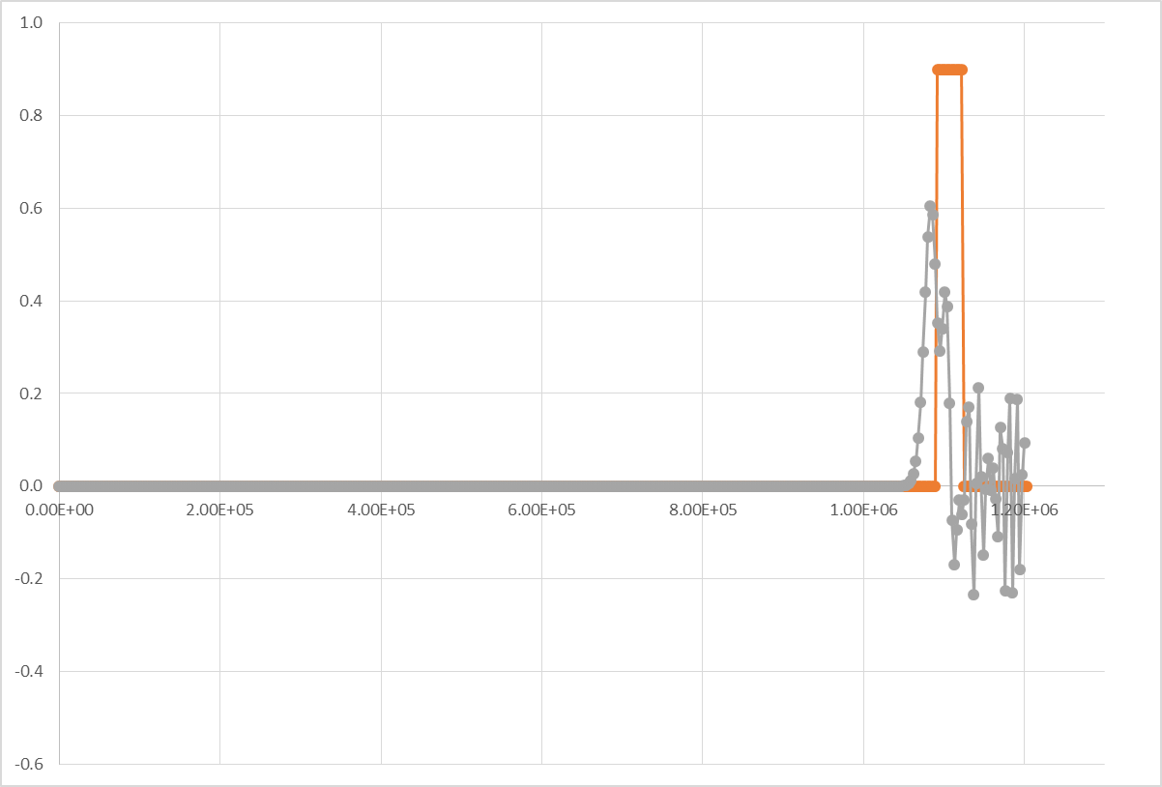
Fixed (Rigid) Boundary Conditions
Δη
(meters)
Distance (meters)
Time = 30000 seconds (8.33 hours)

