Slide 1
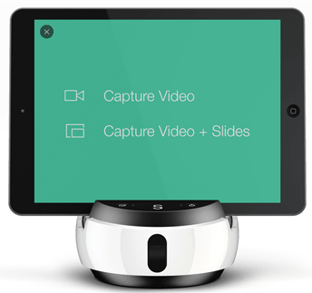
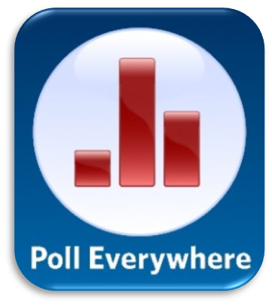
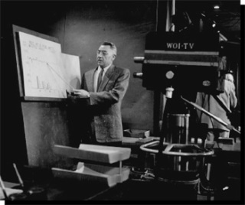
Exploration of Online Tools for Online Teaching
Dr. Alex Huang, ahuang@unca.edu, Department of Atmospheric Sciences
University of North Carolina at Asheville, One University Heights, Asheville, North Carolina 28804
ABSTRACT
Online courses have been extensively offered by most research universities in North Carolina, but the face-to-face in-class teaching is still paramount at UNC Asheville. However, the trend and need for online teaching may become a reality at UNC Asheville in the future. In order to prepare for online teaching, the presenter has been exploring online teaching resources, and beginning the development of several hybrid (blended) courses recently. It is noted that there are many free online tools that are effective for both online and in-class teaching. In this poster presentation, the presenter will introduce these online tools that are practical and useful for online presentation, collaboration, online quiz and survey. The applications of these online tools will be illustrated. Additionally, the strategies for effective online teaching will be outlined and discussed.
Communications
Online Technology
Develop and maintain an inviting atmosphere;
Have safe, secure, confidential, and respectful communication;
Have net and e-mail etiquette;
Have a consistent online presence;
Encourage engagement and collaboration between students;
Facilitate genuine interaction using forum or dashboard;
Monitor learners’ progress and inquiries with constructive comments;
Provide consistent, fair, and objective feedback and evaluations;
Plan for the unexpected interruptions; and
Create a “frequently asked questions” document that addresses potential areas of confusion or inquires.
LEARNING MANAGEMENT SYSTEM (LMS)
Moodle: A learning platform designed to provide educators, administrators and learners with a single robust, secure and integrated system to create personalized learning environments.
Blackboard: An Internet-based application which allows instructors to put class materials on the Internet. It provides a variety of tools to facilitate teaching and learning.
Canvas: A free website for hosting and creating online courses. https://canvas.instructure.com/
What is Online teaching?
Ice-breaking/Community-building Activities
PRESENTATION
Add narration to PowerPoint Presentations.
Swivl: Hardware and software for recording videos of lectures.
PowerPoint Online: Create and share PowerPoint presentations online.
OfficeMix: Free authoring add-on for PowerPoint 2013.
Sway: Free online presentation, not intuitive initially but extensive.
Google Slides: Create and collaborate with others on presentations.
Podcasting: Produce and share audios of lectures.
CuePrompter: Free online teleprompter.
Emaze: A powerful free (and paid version) online presentation tool.
Slides: An interesting free (and paid version) online presentation tool.
Prezi: A basic free (and paid version) online presentation tool.
An integrated course of information (subject, content, structure, presentations) + communication (survey, feedback, forum, social networking, simulation, problem solving, collaboration, chatting/messaging, discussion board, tutorials, case studies) + assessment (self-assessment, survey, feedback, quizzes, pre-test, post-test, formative and summative assessments) delivered completely on the web.
A learning community, an experience, an engagement, and a culture.
It is not a direct transition from face-to-face environment, it requires to rethink and reconfigure the materials and presentations. It is a continuous and conscientious effort in designing, developing, and improving an online course.
Self-introduction verbally or with a video;
Interview classmates with predefined questions and present the findings;
Using online survey to be acquainted with students and each other;
Encourage communication between students and between the instructor and students by asking questions;
Foster collaborative environment by assigning group projects;
Creative games and simulations;
Assign students to design learner-lead activities;
Create peer partnership and team activities; and
Assign students to make collaborative poster and oral presentations.
Can you Teach an Online Course? Yes, if you
VIDEO EDITING
MS Movie Maker for Windows: A free software for editing and sharing videos.
MS Photo Story for Windows: A free software for creating slide shows/videos.
Jing: A free software that lets you share images and short videos of your computer screen.
Vine: A free video sharing platform.
Youtube editor: Online video editor.
Audacity: Record and process audio files.
Free M4a to MP3 Converter: Convert video to mp3 audio.
VideoPad: A free 30-day trial video editor.
COMMUNICATION
Forum on Moodle.
Dashboard on Blackboard.
Slack: A free web-platform for team communication.
TodaysMeet: A free chat platform for students to engage in conversation and discussion.
Padlet: An online “virtual” bulletin board, where people can collaborate, reflect, share links and pictures, in a secure and shared location.
Google Hangout: A free online group video chatting software.
Skype: A free online messaging, calling, and video chatting software.
Hypothes.is: A free open platform for discussion on the web. It leverages annotation to enable sentence-level critique or note-taking on everything.
Voki: A free (and paid) service that lets you create customized speaking characters. It is great for self-introduction.
Have time;
Have a desire and compassion for online teaching;
Can plan ahead and pay attentions to details;
Can provide an easy and transparent access;
Have technical knowledge about online technology or willing to learn from the experts;
Can have ubiquitous and persistent online presence;
Can develop engaging activities and assignments and enforce the deadline;
Can provide prompt, positive, and substantive responses and feedback
Create and maintain a positive, safe, and respectful learning environment;
Can implement effective online survey and assessment; and
Can maintain and cultivate human interaction.
Structure of Online Teaching
SCREEN CAPTURING
Tinytake: To perform screen capture, record videos and share for free.
GifCAM: To capture animated GIF images from the screen.
Screencast-o-matic: A screen capture software to create video from your screen.
FILE SHARING/COLLABORATION
Google Drive: Good for sharing files.
Dropbox: Good for sharing files and it can let students upload a file to a designated folder.
SendAnywhere: A free software to send files anywhere between different devices.
Youtube: A video sharing and editing site.
Pbworks: A free (and paid version) online collaborative tool.
Use one learning management system such as Moodle, Blackboard or canvas for course management;
Have a complete and detailed syllabus: List of goals, expectations, requirements, regulations, textbooks, and assessments;
List contact information, online office hours, and communication strategies;
List a variety of activities (online presentation, lab exercises, group projects);
Each assignment is described with pre-class assignments and reading requirements;
Provide a variety of assignments (no need to grade all the assignments) including quizzes, essays, presentations, reflections;
Students are asked to provide (non-grading) frequent feedback and online survey;
Standard access and logistics for each assignment;
Define and enforce a transparent, fair, and constructive grading system; and
Pay attention to legal, ethical and academic dishonesty.
Challenges
Mission of the university
Time constraint
Instructor’s commitment
Campus supports
Students’ acceptance and reactions
Technology limitations
Value of teaching evaluation
SURVEY and FEEDBACK
Google form: Good for online survey.
Socrative: A free student response system that empowers teachers by engaging their classrooms with a series of educational exercises and games.
SurveyMonkey: A free (and paid version) online survey tool.
Poll Anywhere: A free (and paid version) web platform for surveys and quizzes.
USEFUL SOFTWARE
Irfanview: A free and powerful tool for manipulating photos and images.
VLC media player: A free and powerful video player.
WebCamImageSave.com: A free webcam image capture utility.
Paint.net: A free and powerful software for manipulating images
Unfreeze: A free simple software to create a loop of GIF files.
Ccleaner: A free utility software for memory and disk cleaning.
Students to Succeed on Online Courses, they should
Have a learning objective and life goals;
Be self-motivated and self-disciplined;
Be a person of integrity;
Be able to communicate effectively, speak up when necessary;
Be open-minded, and be willing to appreciate criticisms;
Be committed, willing to engage in discussion and assessment;
Be able to work with others;
Have good time management, create a schedule for studying;
Stay organized and complete assignments on time;
Confirm technical requirements and understand technology;
Connect with instructors early and stay in contact frequently; and
Have supports from the family and friends.
The University of Houston offered the first televised college classes in 1953.
http://infinityschoolteachers.weebly.com/history-of-online-teaching.html
Online Learning
All software, logos, and trademarks mentioned herein are the property of their respective owners and copy right protected.
http://askforeducation.com/how-the-internet-and-modern-technologies-can-help-todays-students.html

