Slide 1
Exploring Weather Linkages
Professional Development Day (27 October 2015)
Douglas K. Miller
Professor, Atmospheric Sciences Department
UNC Asheville
dmiller@unca.edu

Slide 2
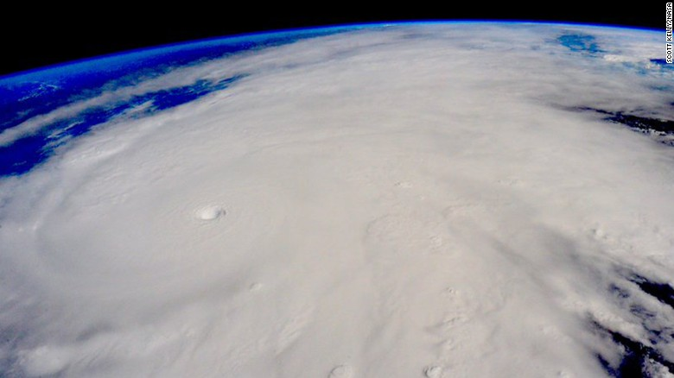
Outline
Air molecules
Air pressure
A tale of two cities
What makes the wind blow?
→ intermission ←
Fronts
Mid-latitude pressure systems
Jet streams
El Niño/La Niña
http://i2.cdn.turner.com/cnnnext/dam/assets/151023142534-hurricane-patricia-scott-kelly-exlarge-169.jpg

Slide 3
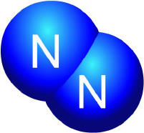
Air molecules
Lesson learned from “A Bug’s Life”
http://www.msnucleus.org/membership/html/jh/physical/periodictable/lesson4/periodic4c.html

Slide 4
Air pressure
Collectively…
http://www.msnucleus.org/membership/html/jh/physical/periodictable/lesson4/periodic4c.html

Slide 5
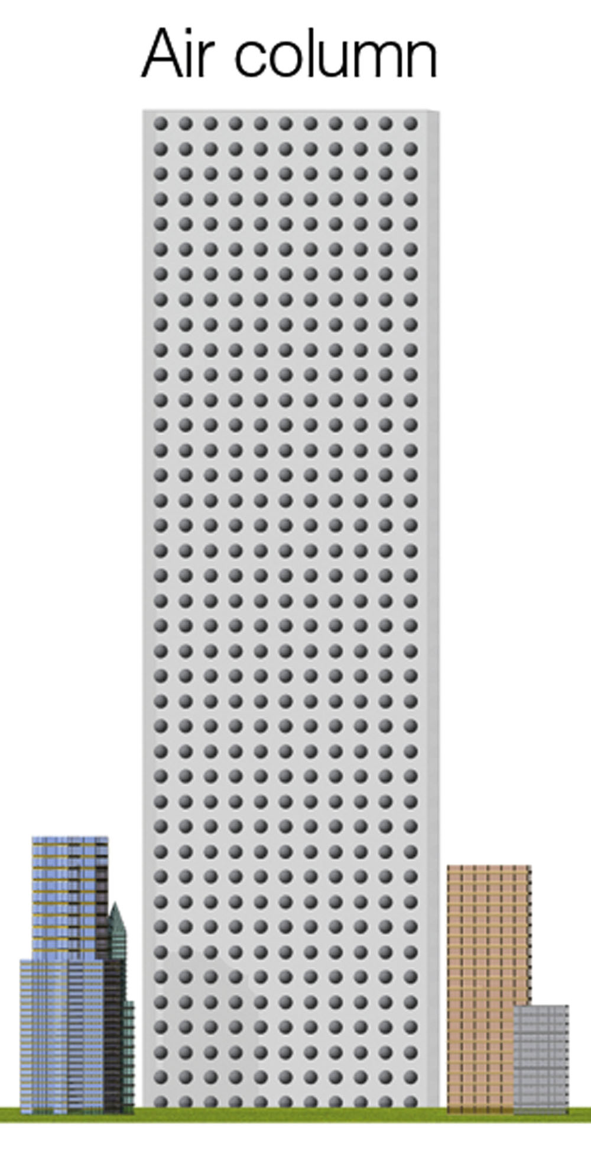
A tale of two cities
First, a closer look at air pressure…
Lecture Packet #6

Slide 6
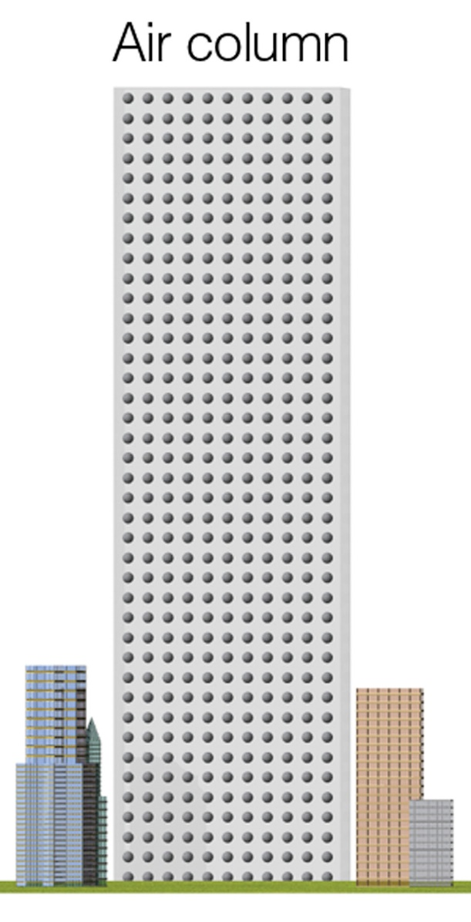
A tale of two cities
Warm air over City A
Cool air over City B
Two columns of air, initially equal temperature and height
Same air pressure
p ~ T x ρ
p is pressure
T is temperature
ρ (rho) is density
Lecture Packet #6

Slide 7
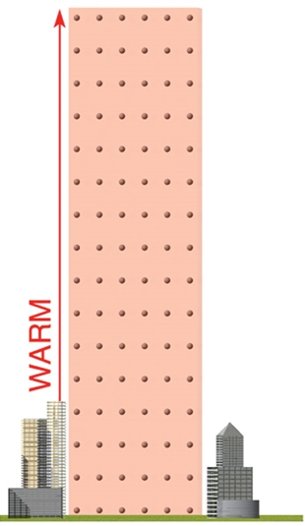
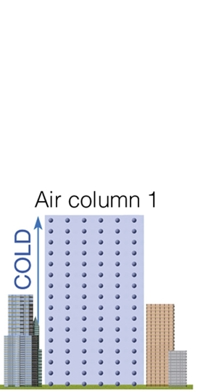
A tale of two cities
Warm air over City A
Cool air over City B
Lecture Packet #6

Slide 8
What makes the wind blow?
The higher water level creates higher fluid pressure at the bottom of tank A and a net force directed toward the lower fluid pressure at the bottom of tank B. This net force causes water to move from higher pressure toward lower pressure.
Since it is easier to visualize a tank of water than a tank of air…
Lecture Packet #6

Slide 9
What makes the wind blow?
Impact of the earth’s rotation on the wind…
N.H.
Lecture Packet #6

Slide 10
Intermission
Reflect…

Slide 11
Fronts
Air masses
Source Regions – are regions where air masses originate. In order for a huge air mass to develop uniform characteristics, its source region should be generally flat and of uniform composition with light surface winds.
The longer air remains stagnant over its source region, the more likely it will acquire properties of the surface below.
Best source regions are usually dominated by High Pressure [e.g. ice and snow covered arctic plains and subtropical oceans and desert regions.]
Lecture Packet #8

Slide 12
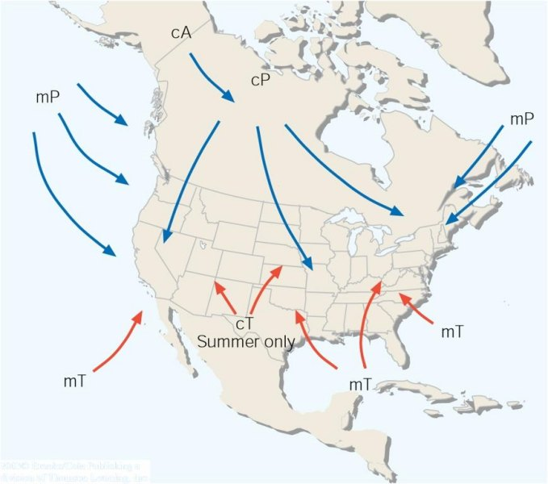
Air mass source regions and their paths.
Lecture Packet #8

Slide 13
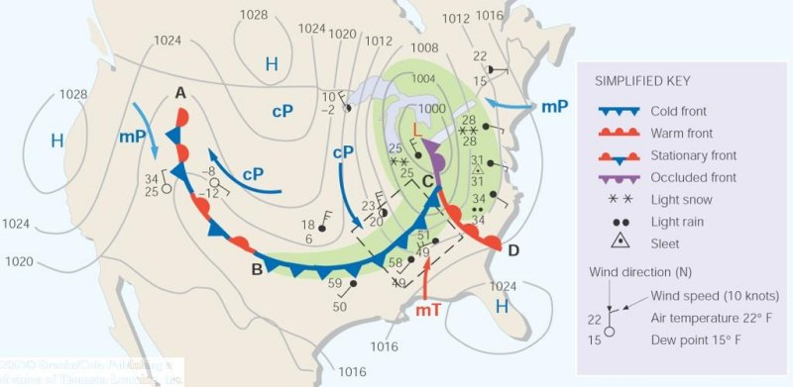
A weather map showing surface-pressure systems, air masses, fronts, and isobars (in millibars) as solid gray lines. Large arrows in color show air flow. (Green-shaded area represents precipitation.)
Lecture Packet #8

Slide 14
Fronts
[ aka frontal zone ]
cold air
warm air
T₇ < T₆ < T₅ < T₄ < T₃ < T₂ < T₁
T = air temperature

Slide 15
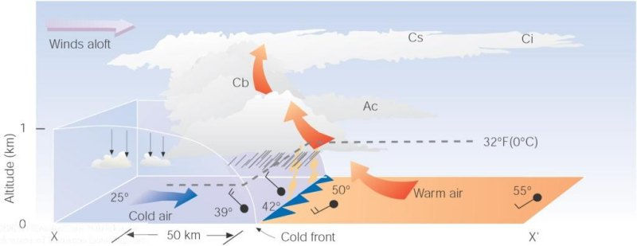
A vertical view of the weather across a cold front
Lecture Packet #8

Slide 16
A vertical view of the weather across a warm front
Lecture Packet #8

Slide 17
Fronts
Observed Structure of Fronts
Associated cloud structure
Norwegian school (Bjerknes and Solberg 1922)

Slide 18
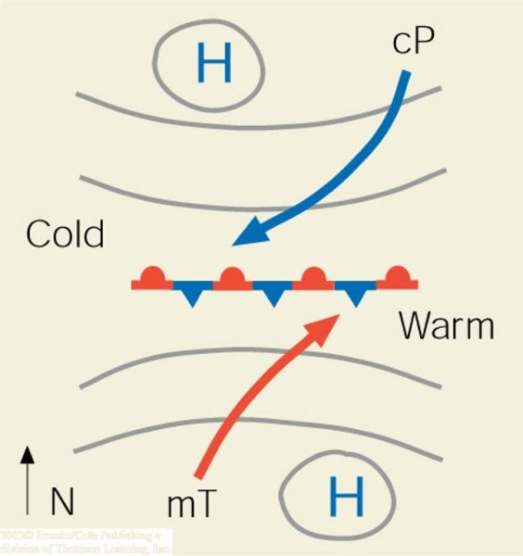
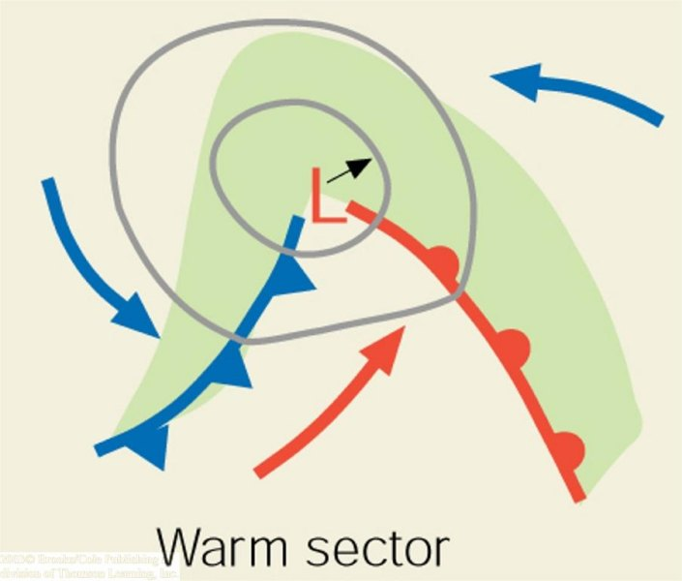
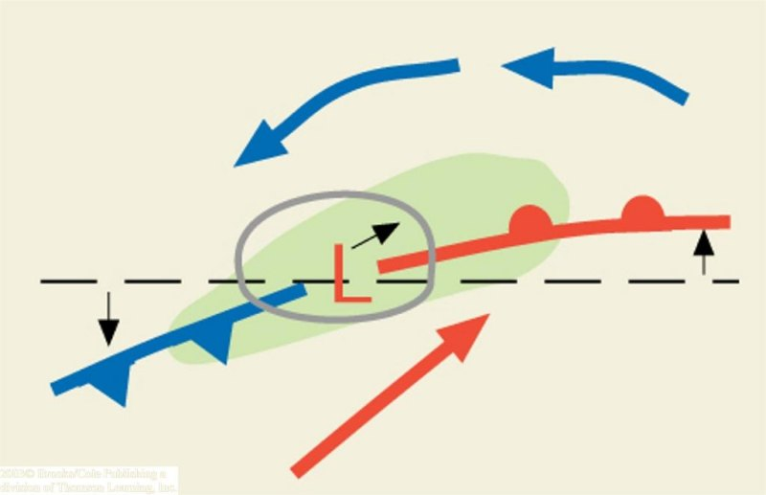
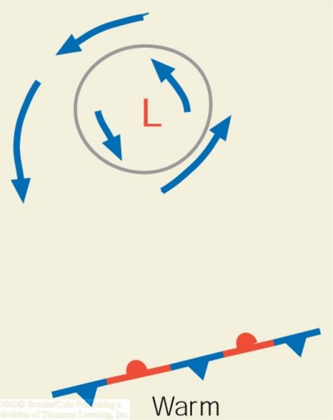
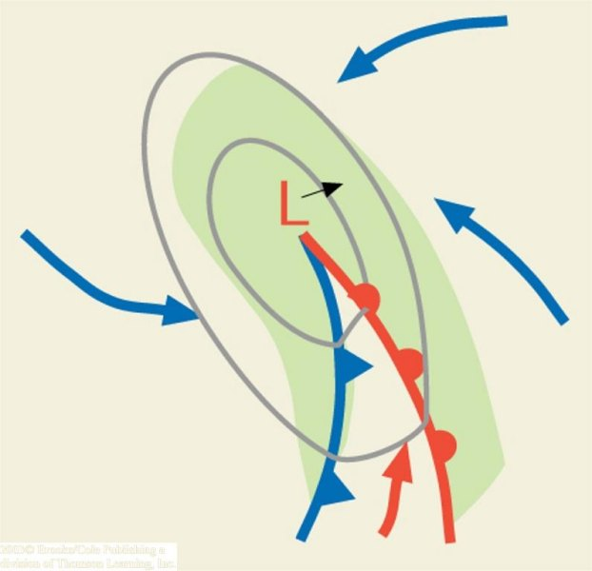
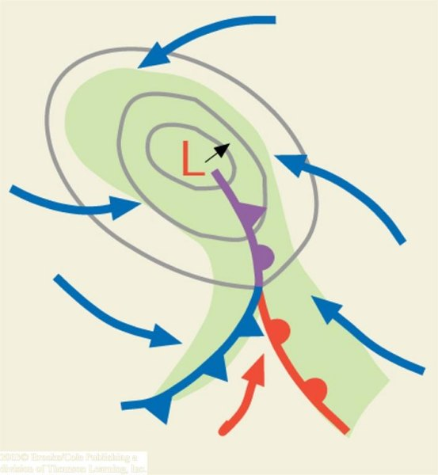
‘trigger’
cyclogenesis
(a)
(b)
(c)
N.H.
(d)
(e)
(f)
Lecture Packet #8

Slide 19
Fronts
Lecture Packet #8

Slide 20
Fronts
Lecture Packet #8

Slide 21
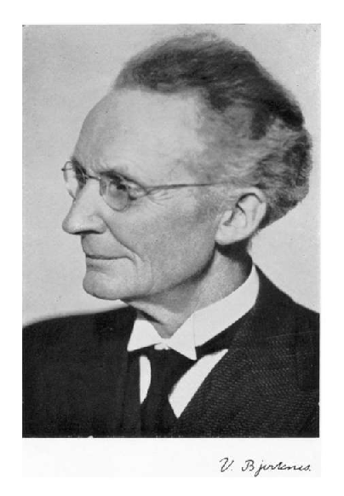
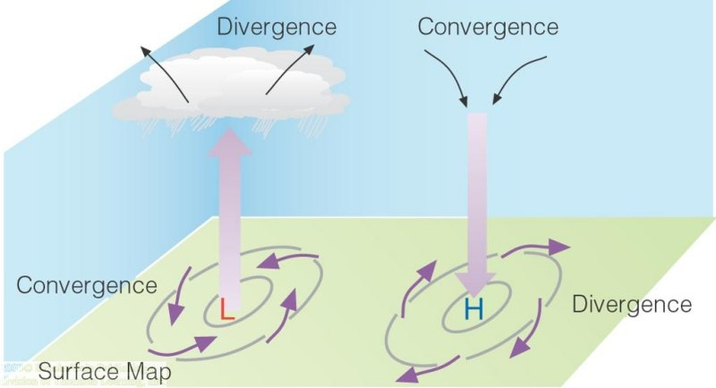
Pressure systems
Some challenges (1908)…
Surface convergence over the center of an intensifying cyclone
Vilhelm Bjerknes
Lecture Packet #6

Slide 22
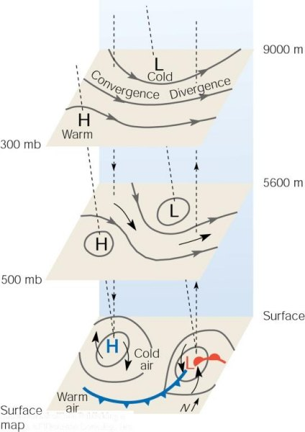
Pressure systems
Some challenges (1908)…
Surface convergence over the center of an intensifying cyclone
N.H.
Lecture Packet #8

Slide 23
Pressure systems
microscale
mesoscale
synoptic scale
planetary scale
seconds
hours
days
weeks

Slide 24
Pressure systems
Uneven heating and/or cooling at the earth’s surface creates atmospheric environments having potential energy that, in the presence of a ‘trigger’, releases the energy (instability) for conversion to kinetic energy (energy of motion)
microscale
mesoscale
synoptic scale
planetary scale
seconds
hours
days
weeks

Slide 25
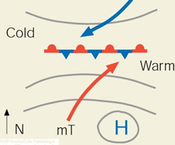
Pressure systems
Synoptic scale low pressure system (cyclone) ‘trigger’
N.H.

Slide 26
‘trigger’
cyclogenesis
(a)
(b)
(c)
N.H.
(d)
(e)
(f)
Lecture Packet #8

Slide 27
Pressure systems
Anticyclone (high pressure system)
N.H.
Lecture Packet #8

Slide 28
Jet streams
Lecture Packet #6

Slide 29
Jet streams
127 mph
http://mag.ncep.noaa.gov/model-guidance-model-area.php#

Slide 30
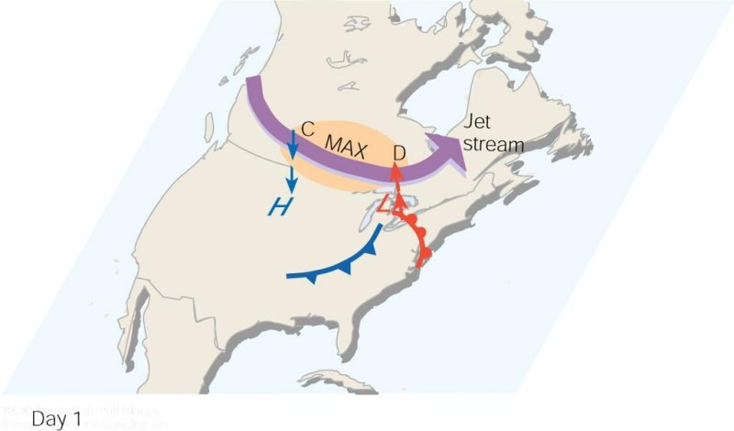
As the polar jet stream and its area of maximum winds (the jet streak, or MAX). Swings over a developing mid-latitude cyclone, an area of divergence (D) draws warm surface air upward, and an area of convergence (C) allows cold air to sink. The jet stream removes air above the surface storm, which causes surface pressures to drop and the storm to intensify.
Lecture Packet #8

Slide 31
Pressure systems
Some challenges (1908)…
Surface convergence over the center of an intensifying cyclone
Vilhelm Bjerknes
Lecture Packet #6

Slide 32
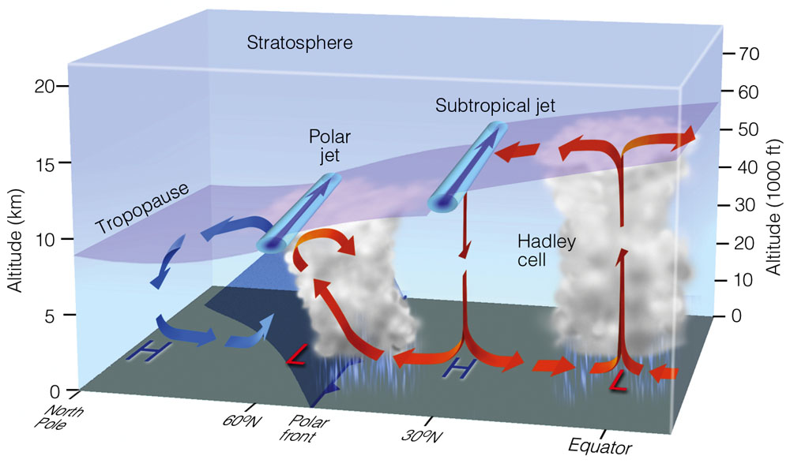
Lecture Packet #7
Notes:
Figure 7.31: Average position of the polar jet stream and the subtropical jet stream, with respect to a model of the general circulation in winter. Both jet streams are flowing from west to east.

Slide 33
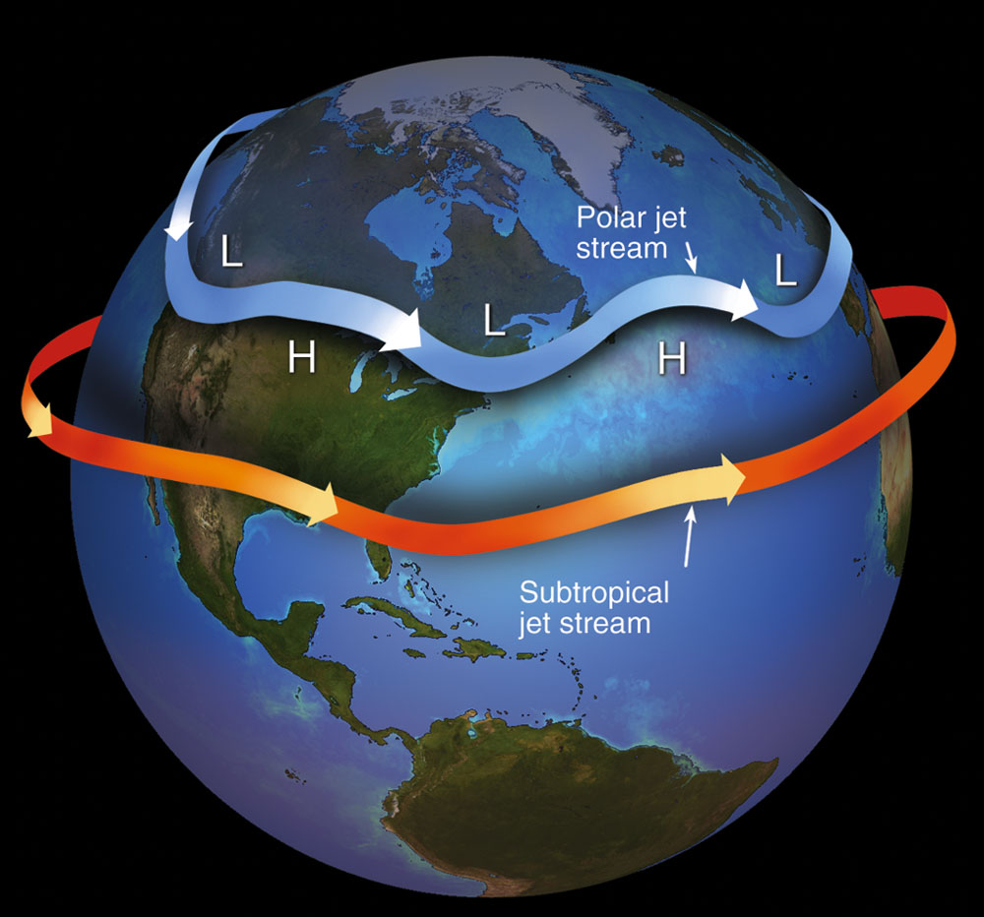
Lecture Packet #7
Notes:
Figure 7.32: Jet streams are swiftly flowing currents of air that move in a wavy west-to-east direction. The figure shows the position of the polar jet stream and subtropical jet stream in winter. Although jet streams are shown as one continuous river of air, in reality they are discontinuous, with their position varying from one day to the next.

Slide 34
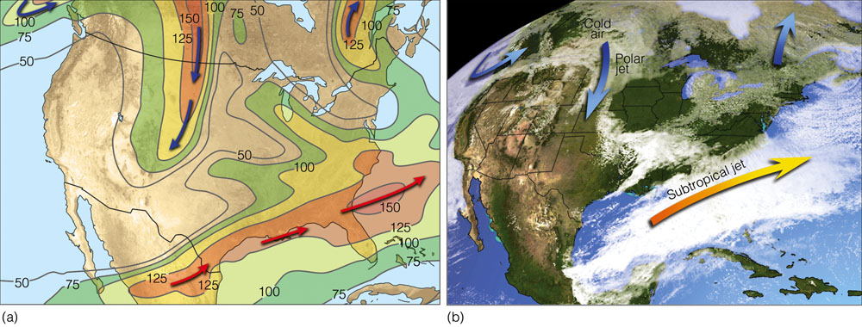
Lecture Packet #7
Notes:
Figure 7.33: (a) Position of the polar jet stream (blue arrows) and the subtropical jet stream (orange arrows) at the 300-mb level (about 9 km or 30,000 ft above sea level) on March 9, 2005. Solid lines are lines of equal wind speed (isotachs) in knots. (b) Satellite image showing clouds and positions of the jet streams for the same day.

Slide 35
El Niño/La Niña
Trade winds – blow from northeast in N. Hemi and southeast in S. Hemi
Intertropical Convergence Zone – Surface region of convergence between trades
Subtropical Highs – semipermanent high in the subtropical high pressure belt centered near 30° latitude. Bermuda high, Pacific Ridge.
Westerlies – prevailing westerly flow
Lecture Packet #7

Slide 36
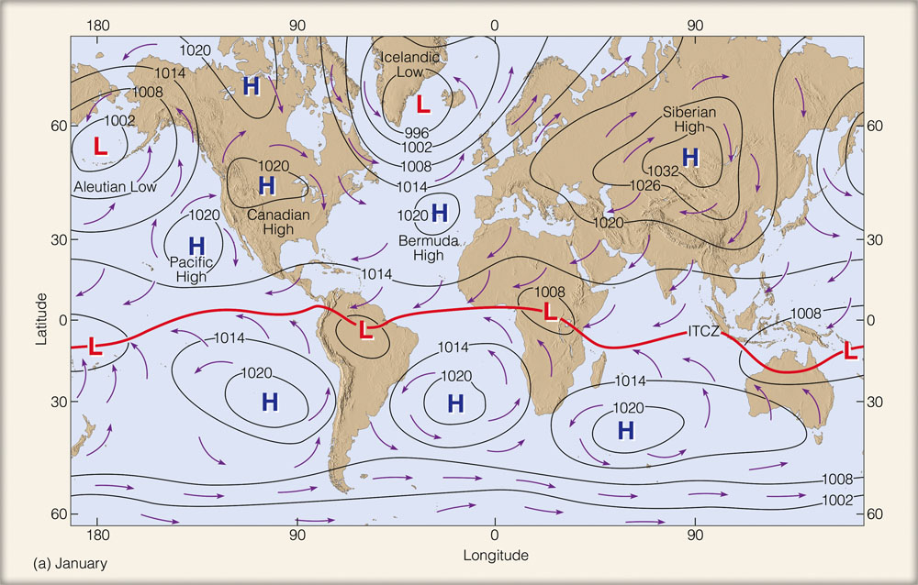
January
Lecture Packet #7
Notes:
Figure 7.27: Average sea-level pressure distribution and surface wind-flow patterns for January (a) and for July (b). The solid red line represents the position of the ITCZ.

Slide 37
Upwelling
As winds blow parallel to the west coast of North America, surface water is transported to the right (out to sea). Cold water moves up from below (upwells) to replace the surface water.
Lecture Packet #7

Slide 38
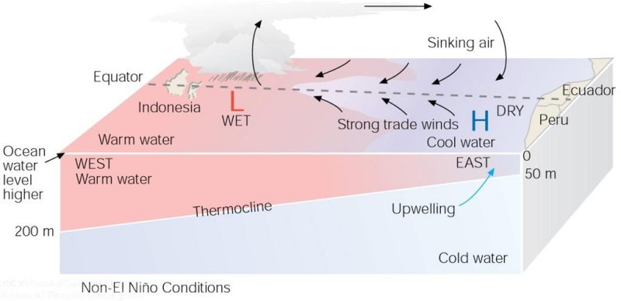
Under ordinary conditions, higher pressure over the southeastern Pacific and lower pressure near Indonesia produce easterly trade winds along the equator. These winds promote upwelling and cooler ocean water in the eastern Pacific, while warmer water prevails in the western Pacific. When the trades are exceptionally strong, water along the equator in the eastern Pacific becomes quite cool. This cool event is called La Niña.
Lecture Packet #7

Slide 39
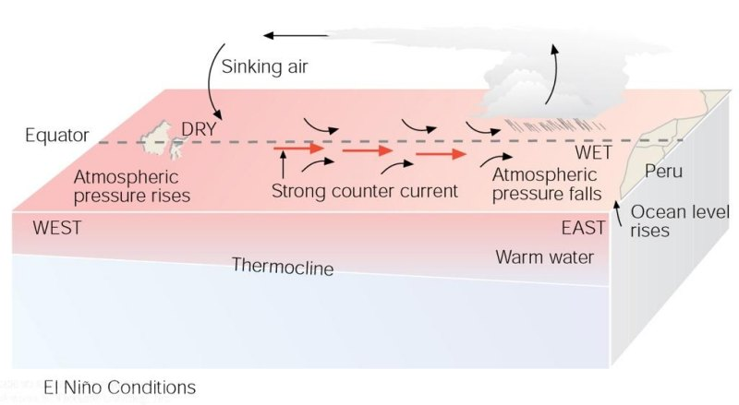
During El Niño conditions, atmospheric pressure decreases over the eastern Pacific and rises over the western Pacific. This change in pressure causes the trades to weaken or reverse direction. This situation enhances the countercurrent that carries warm water from the west over a vast region of the eastern tropical Pacific. The thermocline, which separates the warm water of the upper ocean from the cold water below, changes as the ocean conditions change from non-El Niño to El Niño.
Lecture Packet #7

Slide 40
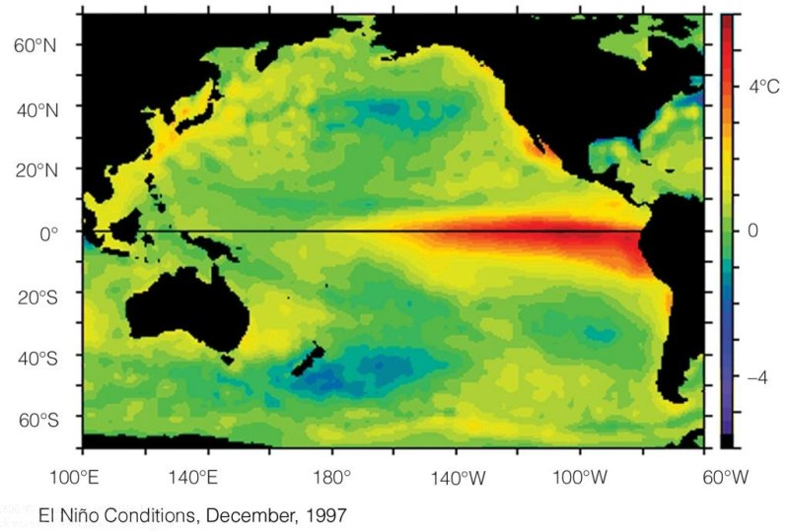
Average sea surface temperature departures from normal as measured by satellite. (a) During El Niño conditions, upwelling is greatly diminished and warmer than normal water (deep red color), extends from the coast of South America westward, across the Pacific.
Lecture Packet #7

Slide 41
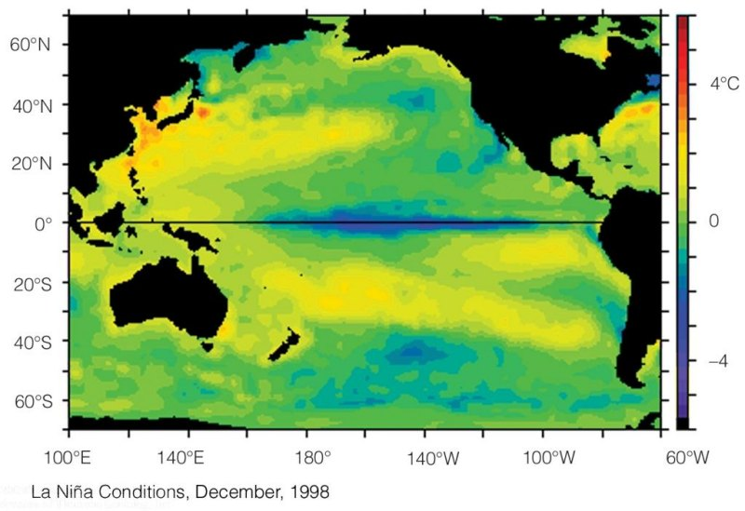
During La Niña conditions, strong trade winds promote upwelling, and cooler than normal water (dark blue color) extends over the eastern and central Pacific.

Slide 43
Useful, extra slides…
N.H.
Lecture Packet #6

Slide 44
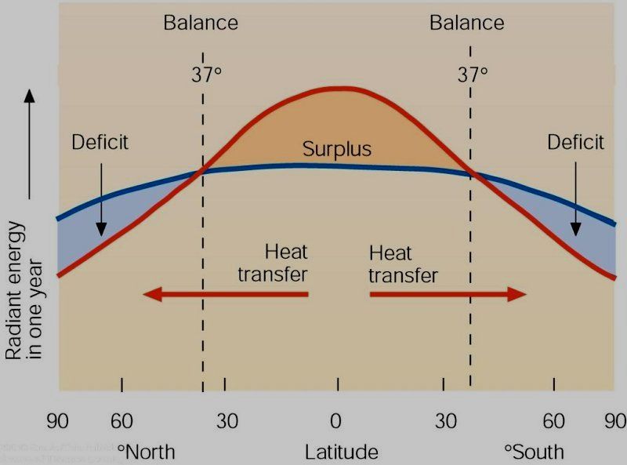
It’s all about balance
Example
microscale
mesoscale
synoptic scale
annual scale
seconds
hours
days
one year
Lecture Packet #2

