Slide 1
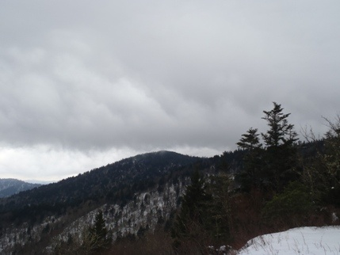
Predicting Weather Patterns in Western North Carolina
Weather-related safety issues
  Spotting the warning signs
Spotter field test
  On the Quad
Helpful weather resources
  2 to 7 days from the event
  0 to 2 days from the event
Wx resource session
  A test drive
Douglas K. Miller
Atmospheric Sciences Department
UNC Asheville

Slide 2
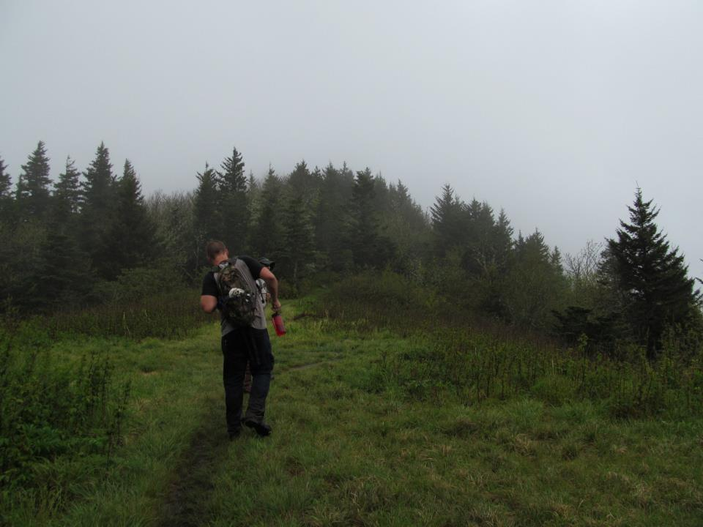
Weather-related safety issues
Hypothermia
  strong winds, cold air, damp clothing
Electrocution
  thunderstorms
Drowning
  persistent or sudden intense rainfall
Blunt force trauma
  wind-throw, slipping and falling, rock slides/ debris flows
Courtesy: Daniel Martin

Slide 3
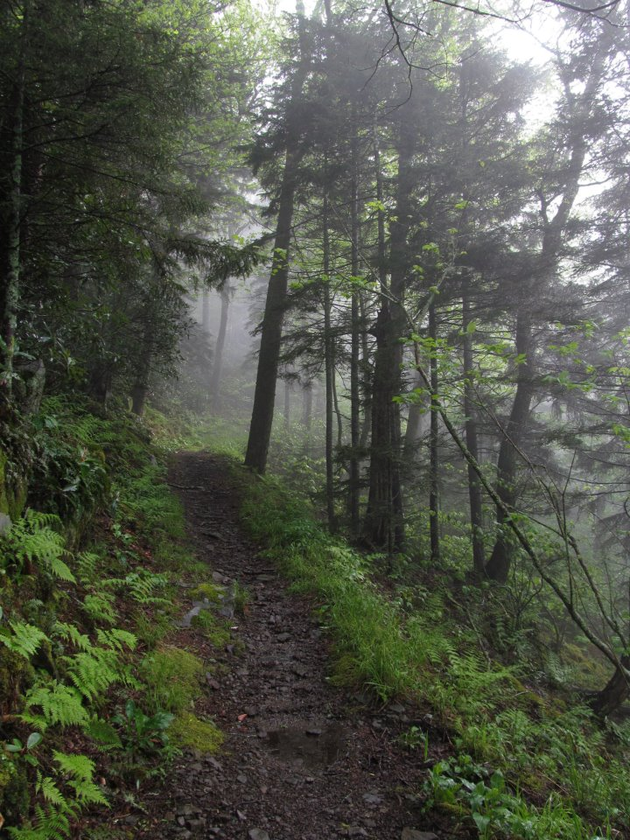
Weather-related safety issues
Nowcasting (0 – 12 h weather forecast) to avoid or anticipate weather hazards
  Sights
  Sounds
  Smells
  Sensations
Courtesy: Daniel Martin

Slide 4
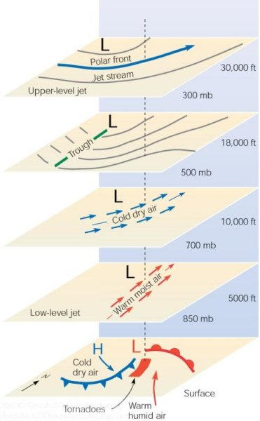
Mid-latitude cool season storm
Note: LLJ at 850 mb, cold air at
700 mb, trough at 500 mb, PFJ at
300 mb.
At the ground
(sea level)

Slide 5
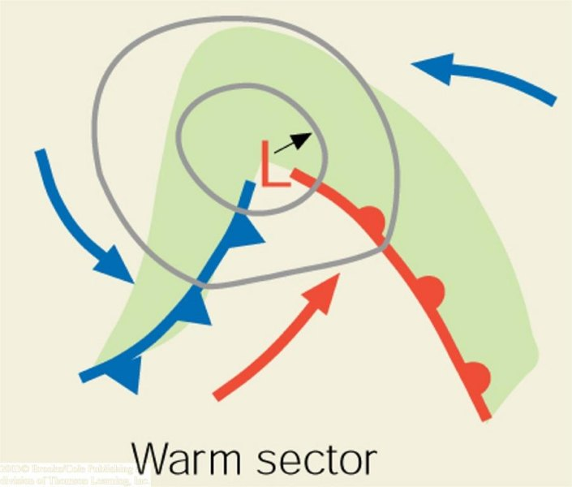
Synoptic-scale cyclone
North
At the ground
(sea level)
1243 miles
Open wave stage of the cyclone. Arrows represent general wind direction, concentric circles are isopleths of mean sea level pressure, and the green shaded region represents the precipitation region. The cold and warm fronts are indicated by the blue and red “arms”, respectively, extending from the cyclone center (designated by the red “L”).

Slide 6
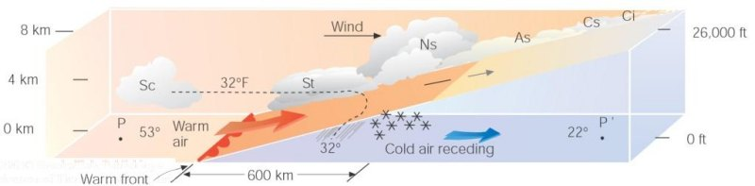
Ci = cirrus
Approaching warm front

Slide 7
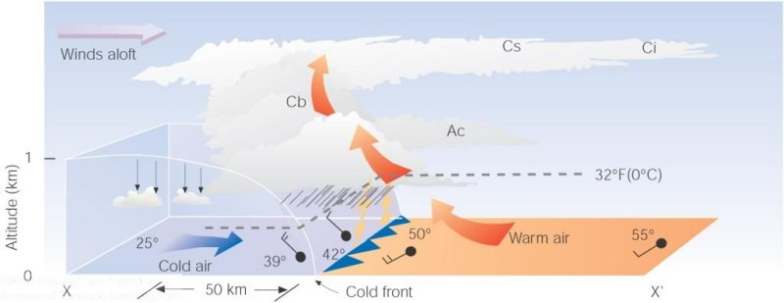
Cb = Cumulonimbus
Approaching cold front

Slide 8
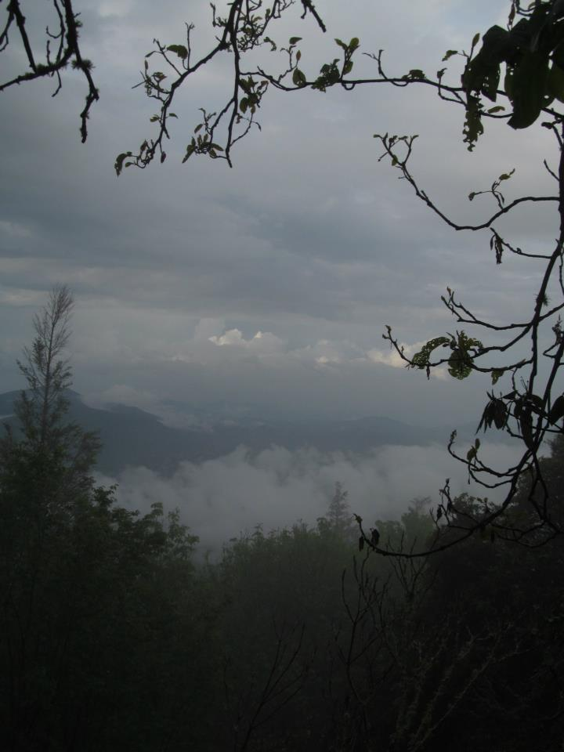
Weather-related safety issues
Nowcasting to avoid or anticipate weather hazards; sights
  Cool season
    Clouds thickening (can’t see sun) → storm approaching
    Winds and/or clouds moving toward north → storm approaching
    Winds and/or clouds shift to moving toward east or south → clearing and cool weather approaching
Courtesy: Daniel Martin

Slide 9
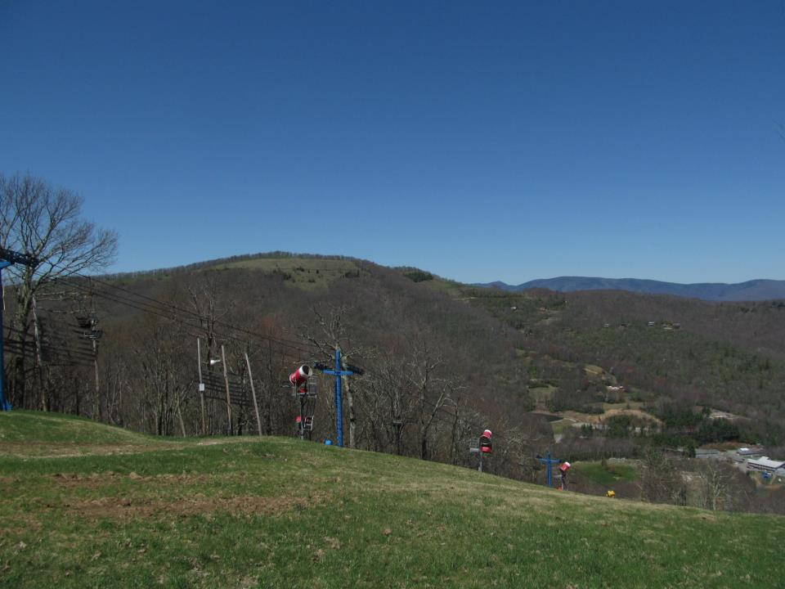
Weather-related safety issues
Nowcasting to avoid or anticipate weather hazards; sights
  Cool season
    Calm winds with…
      clouds and precipitation; in middle of storm (low pressure center)
      clear sky; in the middle of high pressure, winds may shift to blowing from the south (warming on the horizon)
Courtesy: Daniel Martin

Slide 10
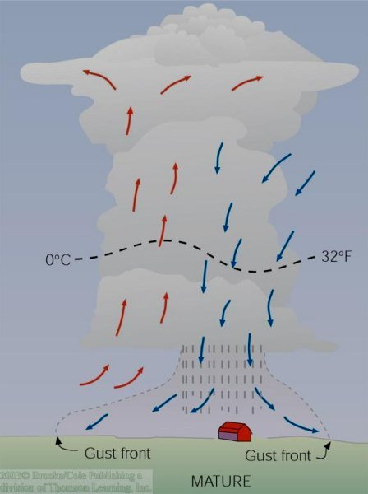
Ordinary Thunderstorm Mature Stage
The downdraft and updraft within the mature thunderstorm constitute a cell
This is the most intense stage of an ordinary thunderstorm
Lightning & thunder, hail, heavy rain possible
Often a cold downrush of air associated with the onset of precipitation – gust front

Slide 11
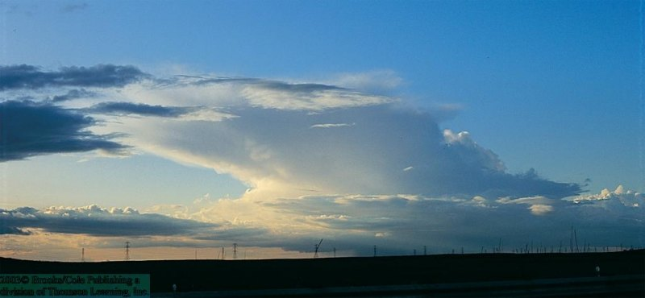
An ordinary thunderstorm in its mature stage. Note the distinctive anvil top.

Slide 12
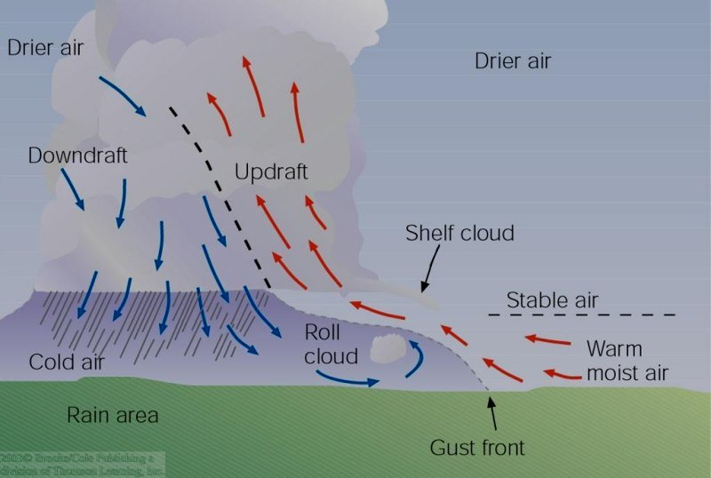
Supercell Thunderstorm
“Peaceful coexistence” of the downdraft and updraft
Lifespan is much LONGER than for the ordinary thunderstorm (as long as 6 hours, or longer)
Added lifespan makes severe weather (strong winds, large hail, and tornadoes) more likely
Most tornadoes in the U.S. are produced by supercell thunderstorms
27 April 2011 – Tuscaloosa tornado (example)

Slide 13
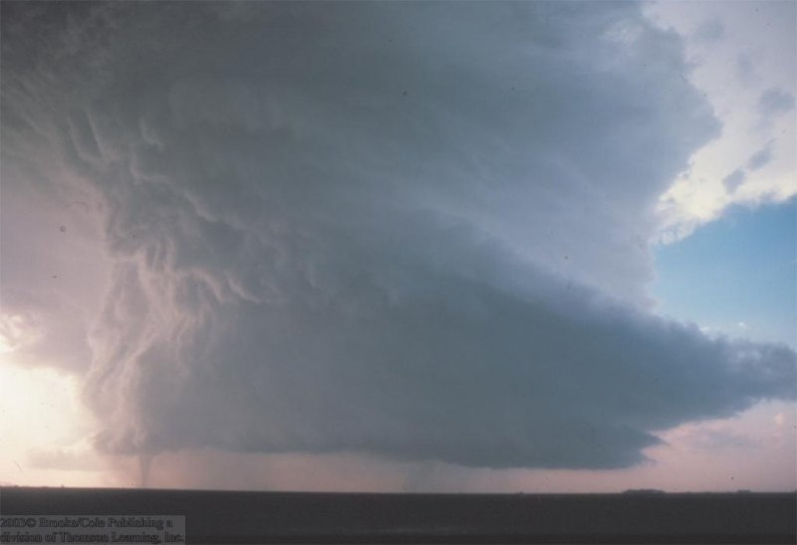
A Supercell T-storm with a tornado extending downward from its base.

Slide 14
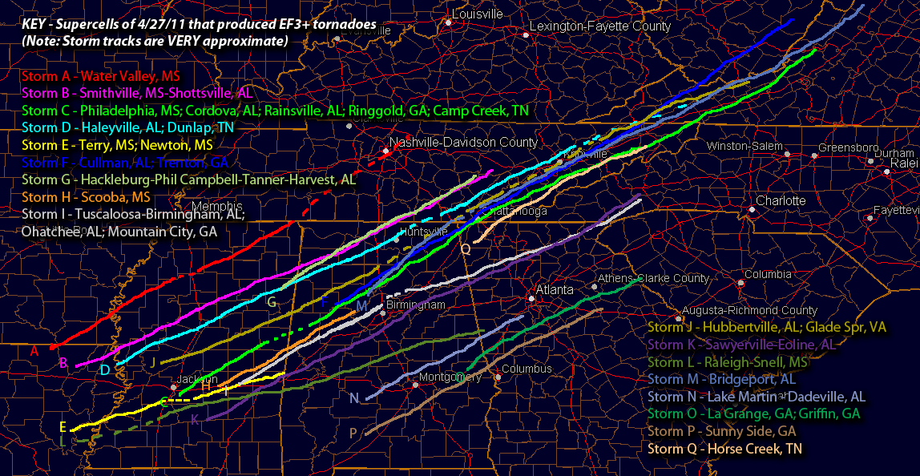
Supercell Tracks – 27 April 2011
http://www.talkweather.com/forums/index.php?/topic/56530-supercell-tracks-from-april-27-2011/

Slide 15
April 27, 2011
http://www.srh.noaa.gov/srh/ssd/mapping/

Slide 16
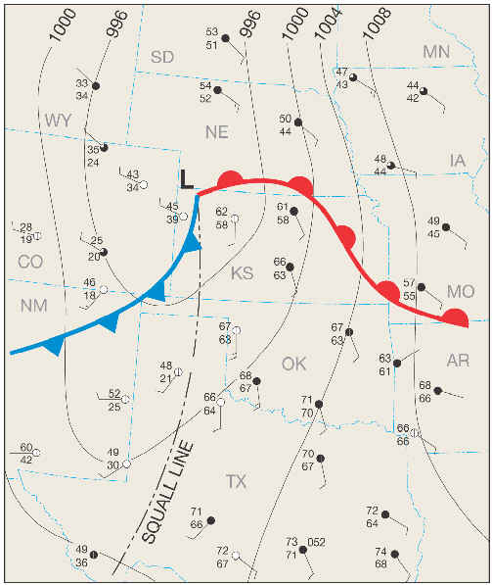
Squall Line Thunderstorm
A line of thunderstorms that often form along or ahead of a cold front associated with a synoptic-scale cyclone (2000 km or 1243 mile horizontal scale)
Most persistent and damaging squall lines occur in the spring
Can also have a long lifespan (~6 hours)
Recent studies suggest that most nighttime tornadoes are produced by squall lines
http://www.geography.hunter.cuny.edu/~tbw/wc.notes/10.thunderstorms.tornadoes/squalls_tornadoes.htm

Slide 17
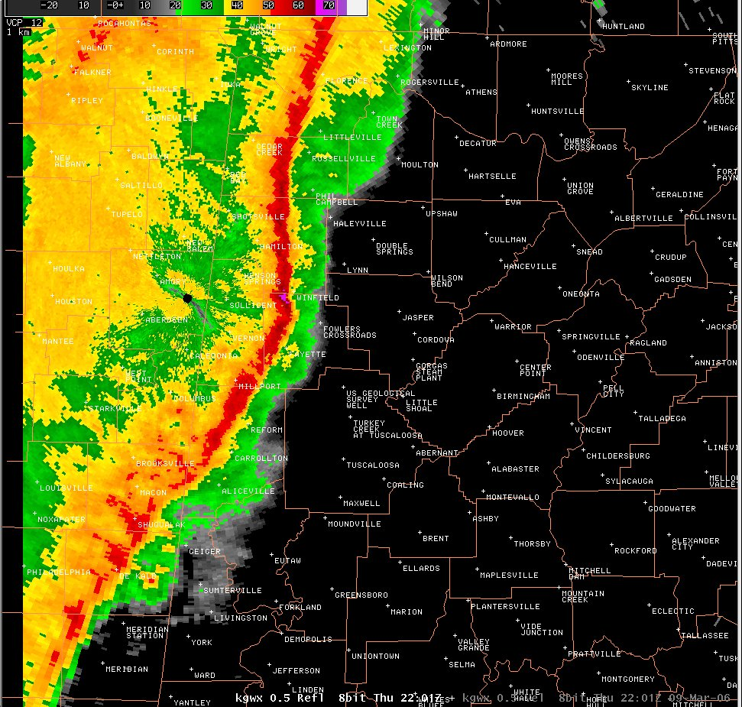
Squall Line Thunderstorm
Alabama, 9 March 2006
Tornadoes can form at the far northern and southern ends of a “bowing” squall line
http://www.srh.noaa.gov/bmx/?n=event_03092006

Slide 18
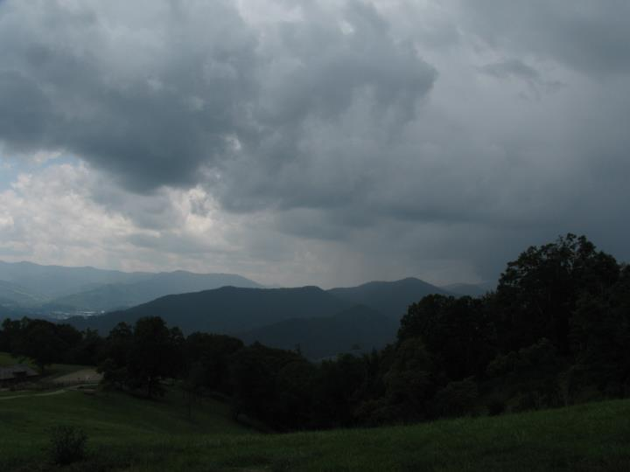
Weather-related safety issues
Nowcasting to avoid or anticipate weather hazards; sights
  Warm season
    Clouds thickening (can’t see sun) → storm approaching
    Wind speeds pick up (approaching gust front)
    Wind direction can indicate T-storm center location, but mountains & valleys complicate its interpretation
Courtesy: Daniel Martin

Slide 19
Weather-related safety issues
Nowcasting to avoid or anticipate weather hazards; sounds
  Cool season & Warm season
    Gusts (indicated by tree movement) can warn of potential wind-throw
    “Roar” warns of sustained windy period and strong gusts

Slide 20
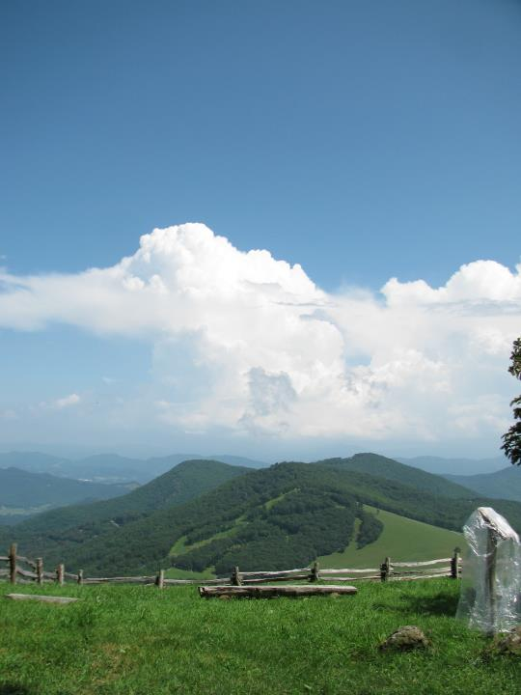
Weather-related safety issues
Nowcasting to avoid or anticipate weather hazards; sounds
  Warm season
    Thunder – indicates proximity of lightning-generating T-storm cell
Courtesy: Daniel Martin

Slide 21

T-storm Warning Signs
Watch & Listen for
  Time between
    seeing lightning flash
    hearing thunder
  [time (sec) / five = distance of T-storm in miles]

Slide 22
Lightning Safety, in the Mountains
Lightning safety, when caught outdoors
    Avoid peaks and ridges
    Do squat on an insulating material
    Do not lean back against rock walls
    Do not take shelter under tall isolated trees
    Do not take shelter in caves, shallow depressions, under large boulders, or under overhangs
“Mountain Meteorology, Fundamentals and Applications” by C. David Whiteman

Slide 23
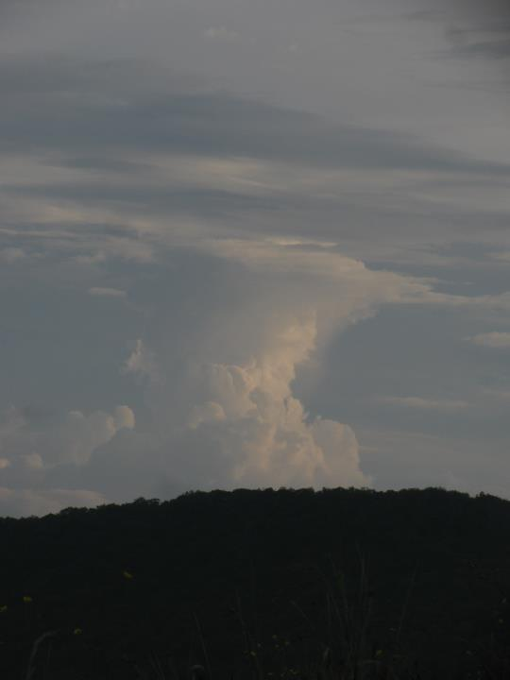
Weather-related safety issues
Nowcasting to avoid or anticipate weather hazards; smells
  Cool season and Warm season
    Air pockets in the soil collect gases from decaying matter
    Rain fills the air pockets, expelling the gases which are then carried by the winds of the storm
Courtesy: Daniel Martin

Slide 24
Weather-related safety issues
Nowcasting to avoid or anticipate weather hazards; sensations
  Cool season and Warm season
    Creaky knee?
    Achy breaky elbow?
    might be indicating a significant change in atmospheric pressure that can forewarn the approach of a storm

Slide 25
Weather-related safety issues
Nowcasting to avoid or anticipate weather hazards; undetected hazard

Slide 26
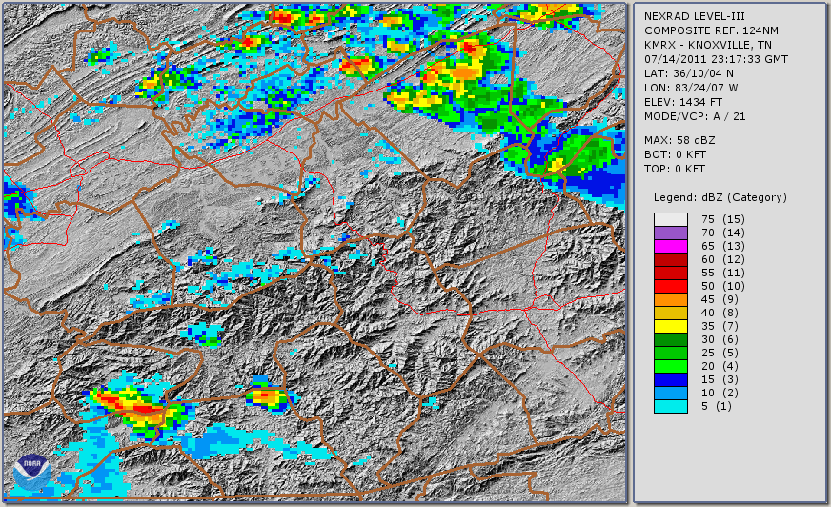
Gunter Fork Debris Flow
KMRX
  Loop period; 7:17 pm EDT 14 July – 12:03 am EDT 15 July 2011

Slide 27
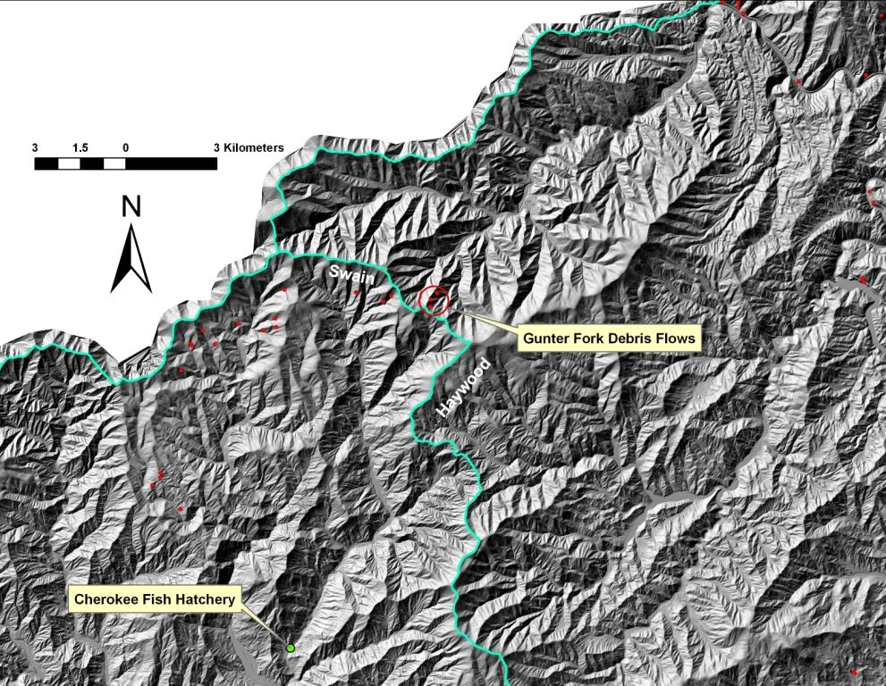
Weather-related safety issues
Nowcasting to avoid or anticipate weather hazards; undetected hazard
  Gunter Fork example
Courtesy: Rick Wooten

Slide 28
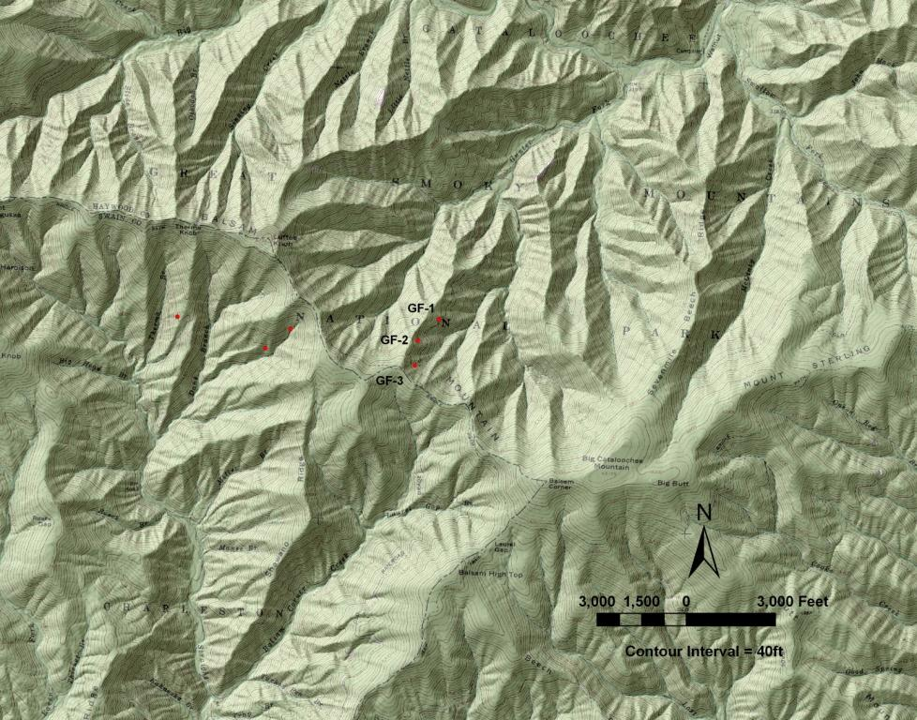
Weather-related safety issues
Nowcasting to avoid or anticipate weather hazards; undetected hazard
  Gunter Fork example
Courtesy: Rick Wooten
Big Cataloochee Mtn

Slide 29
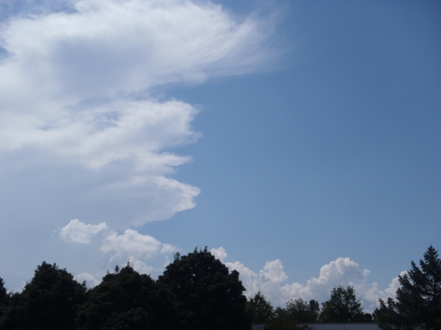
Spotter field test
Cloud thickness trend
Cloud movement
Wind speed/ direction
Weather-related sounds?
Weather-related smells?
Weather-related aches and pains?

Slide 30
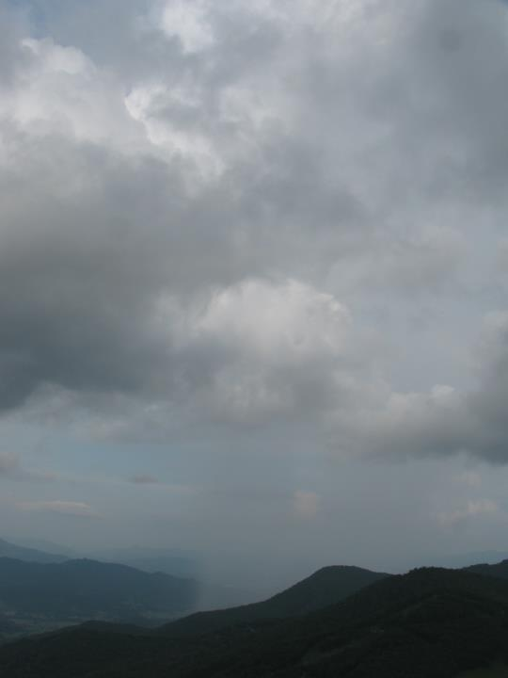
Helpful weather resources
  Lead time from the event
    2 to 7 days
    0 to 2 days
Courtesy: Daniel Martin

Slide 31

Helpful weather resources
  2 to 7 day event lead time
  Climate Prediction Center 6-10 day outlook site
    http://www.cpc.ncep.noaa.gov/products/predictions/610day/
  NCEP computer weather model site
    http://mag.ncep.noaa.gov/
  Storm Prediction Center site
    http://www.spc.noaa.gov/
  National Hurricane Center site
    http://www.nhc.noaa.gov/
  Hydrometeorological Prediction Center analysis site
    http://www.hpc.ncep.noaa.gov/
  National Weather Service forecast site
    http://www.weather.gov/

Slide 32
Helpful weather resources
  0 to 2 day event lead time
  NCEP computer weather model site
    http://mag.ncep.noaa.gov/
  Storm Prediction Center site
    http://www.spc.noaa.gov/
  National Hurricane Center site
    http://www.nhc.noaa.gov/
  Hydrometeorological Prediction Center analysis site
    http://www.hpc.ncep.noaa.gov/
  National Weather Service forecast site
    http://www.weather.gov/

Slide 33
Wx resource session
  A test drive
    activity sheet hand-out

Slide 34
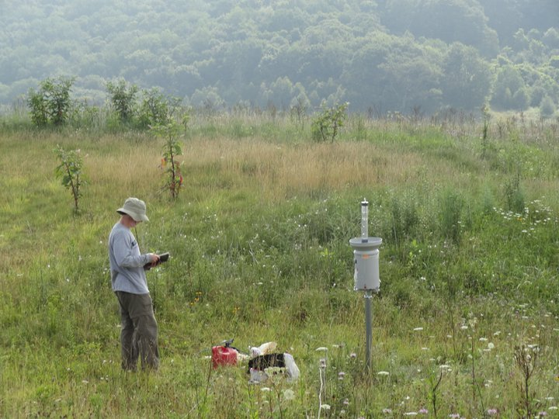
The End
Near Purchase Knob, credit: Michael Goldsbury

Slide 35
Advertising - Mountain Meteorology
Mountain meteorology – Spring 2014 semester
  Definitions
    Mountain meteorology – branch of meteorology that focuses on the weather and climate of mountainous regions
      Weather – the state of the atmosphere during a short period of time
      Climate – the average or prevailing weather of a given region over a long period of time

