Slide 1
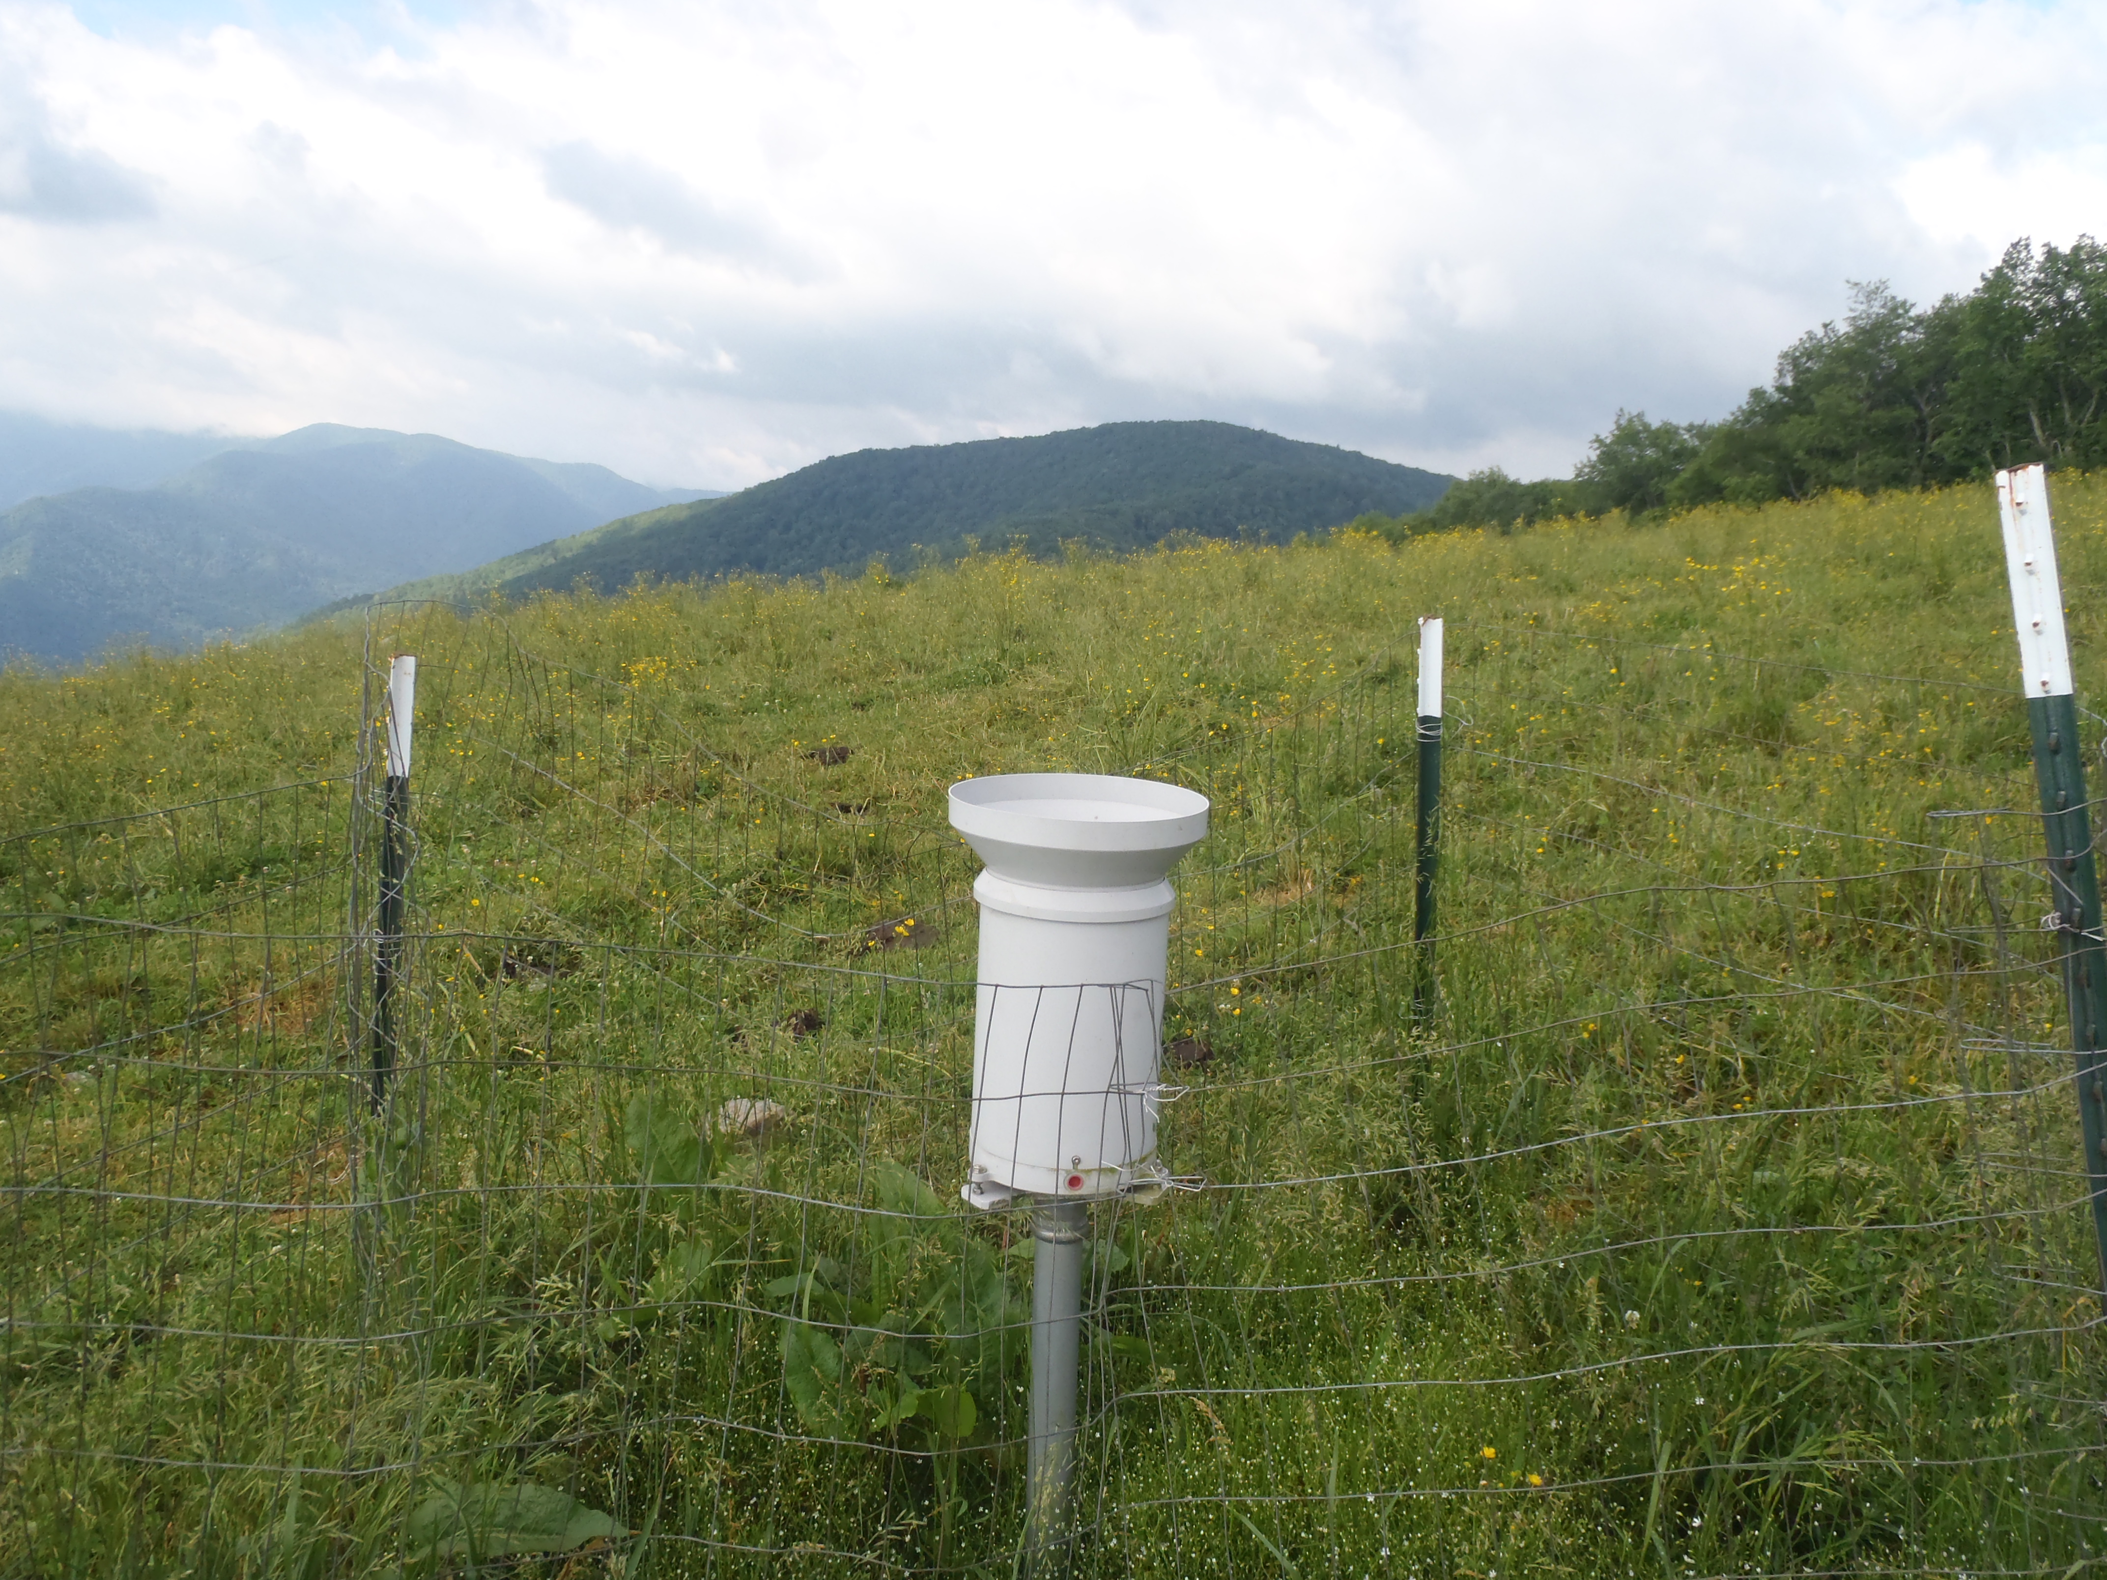


High elevation rain gauge network in the Great Smoky Mountains National Park
Douglas Miller
Atmospheric Sciences Department
UNC Asheville
Ana Barros
Civil Engineering Department
Duke University

Slide 2
Outline
High elevation rain gauge network in the Pigeon River Basin and Great Smoky Mountains National Park
  Original purpose
  What have we learned?
    Based partly on the rain gauge network
      Climatology of precipitation in the GSMNP
      ‘older’ satellite estimates of precipitation
      IPHEx – newest satellite estimates of precipitation
      Influence of atmospheric rivers in the GSMNP
  What next?
    3-yr continuation project, Scripps-NOAA/NESDIS-UNCA partnership

Slide 3

September 18, 2004
The Pigeon River
Courtesy: John Fargher, P.E.

Slide 4
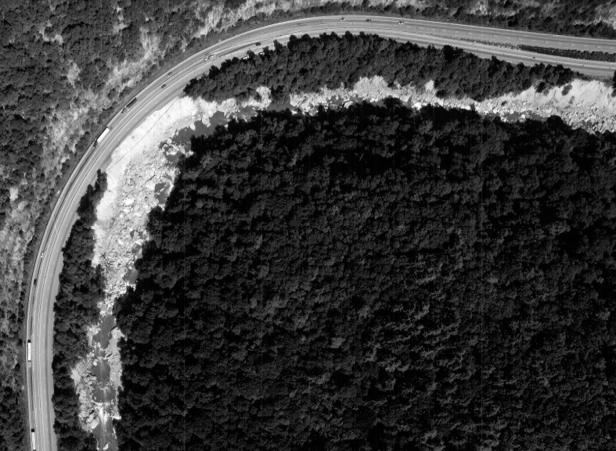
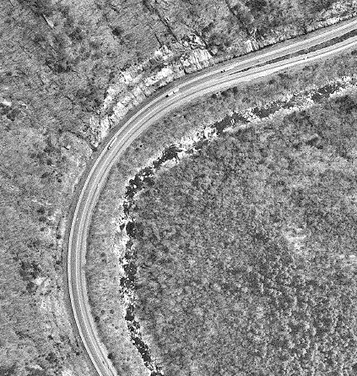
Aerial Photographs
2004
1992
Courtesy: John Fargher, P.E.

Slide 5
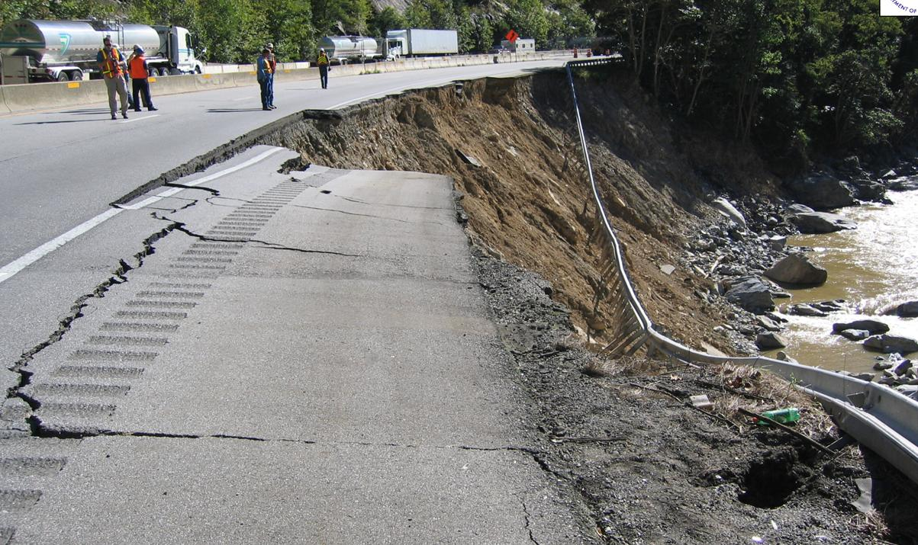
Courtesy: John Fargher, P.E.

Slide 6
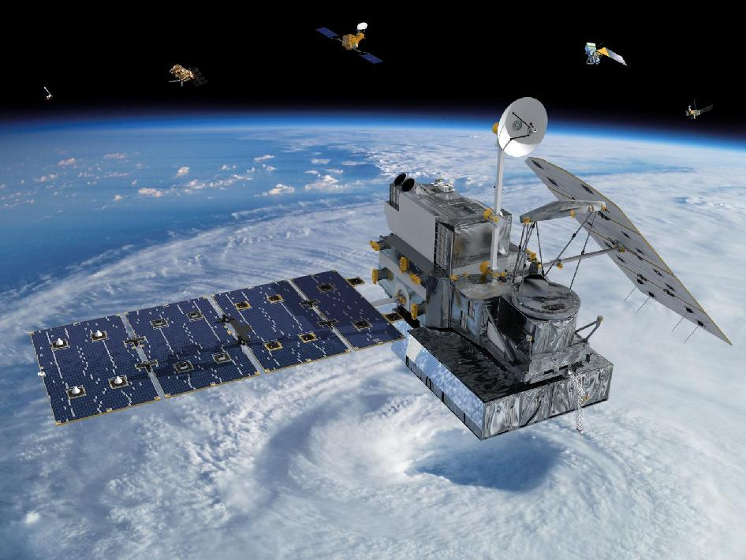
Original purpose
funded by NASA
  Provide ground validation (GV) at high elevation locations in the mid-latitudes for NASA’s Global Precipitation Mission (GPM)

Slide 7

GPM LAUNCH: 27 FEBRUARY 2014, 1:37 PM EST, TANEGASHIMA SPACE CENTER, JAPAN
Improves upon the capabilities of the Tropical Rainfall Measurement Mission (TRMM), a joint NASA-JAXA mission launched in 1997 and still in operation.
Expands coverage area from 40°N to 40°S (TRMM) to from the Arctic Circle to the Antarctic Circle.
Detect light rain and snowfall, a major source of available fresh water in some regions.
Collect information that unifies and improves data from an international constellation of existing and future satellites by mapping global precipitation every three hours.
http://www.nasa.gov/mission_pages/GPM/main/#.Ux9ynM65Hws
Wilson et al. (2014)
Notes:
TRMM stands for Tropical Rainfall Measurement Mission
TRMM revisits area on average once a day
7

Slide 8
GPM Ground Validation Program
Objectives
Provide ground and airborne precipitation datasets supporting physical validation of satellite-based precipitation retrieval algorithms
Determine the measurement uncertainty for GPM measurements to allow users of GPM data to interpret observations
Improve the retrieval algorithms used by GPM and future space-based precipitation measurement missions
Improve understanding of precipitation processes and the ground-based GV measurements themselves, which have historically been beset with difficulties
seek to advance our physical understanding of precipitation processes and assure consistency between this understanding and the representation of those physical processes in NASA GPM retrieval algorithms
Wilson et al. (2014)

Slide 9
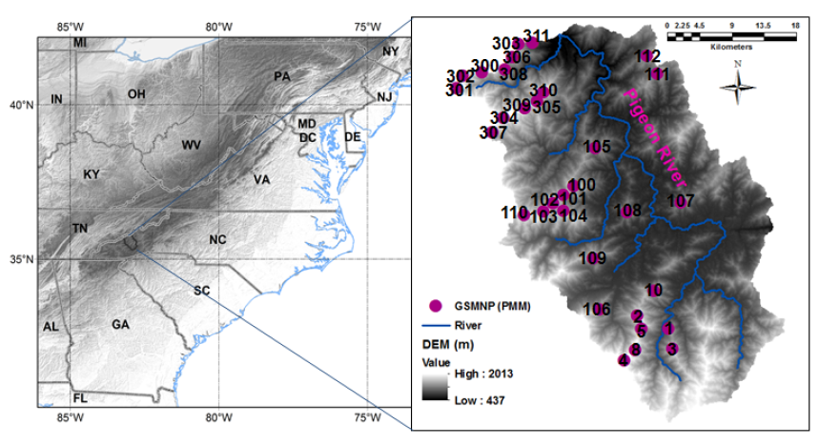
Methodology
Duke University Great Smoky Mountain Rain Gauge Network
Duan et al. (2015)
Notes:
9

Slide 10
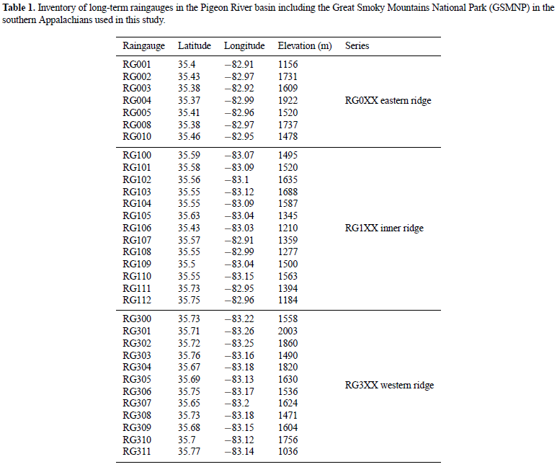
Methodology
32 gauges
Duan et al. (2015)
Notes:
10

Slide 11
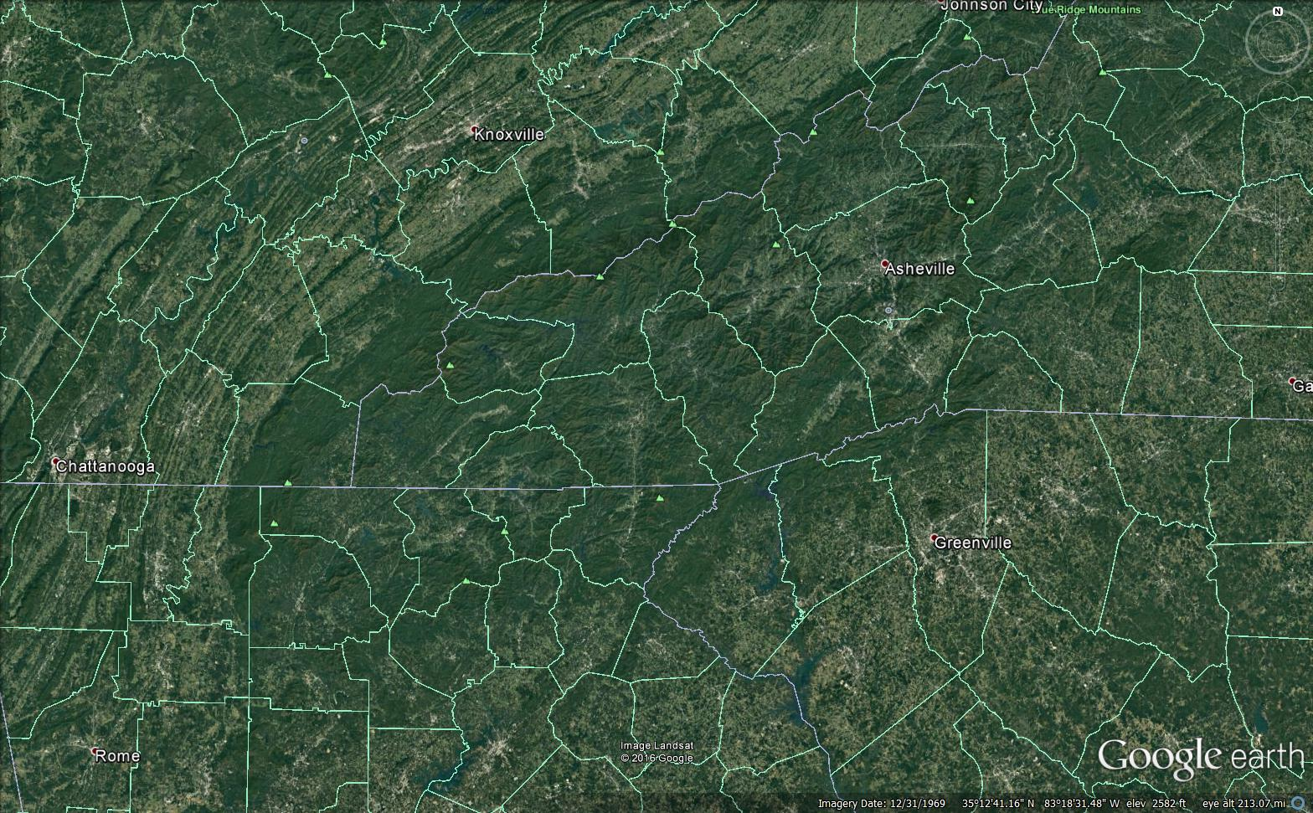
Southern Appalachians
Clingmans Dome [3]
2024 m (6643 ft)
Mt. Mitchell [1]
2037 m (6684 ft)
Mt. Guyot [4]
2018 m (6621 ft)
Pigeon River Basin (PRB)
1823 km² (704 sq mi)
Notes:
2037 m = 79130.7 Pascals (U.S. Standard Atmosphere)
Mount Craig is 2nd highest peak east of the Mississippi River
11

Slide 12
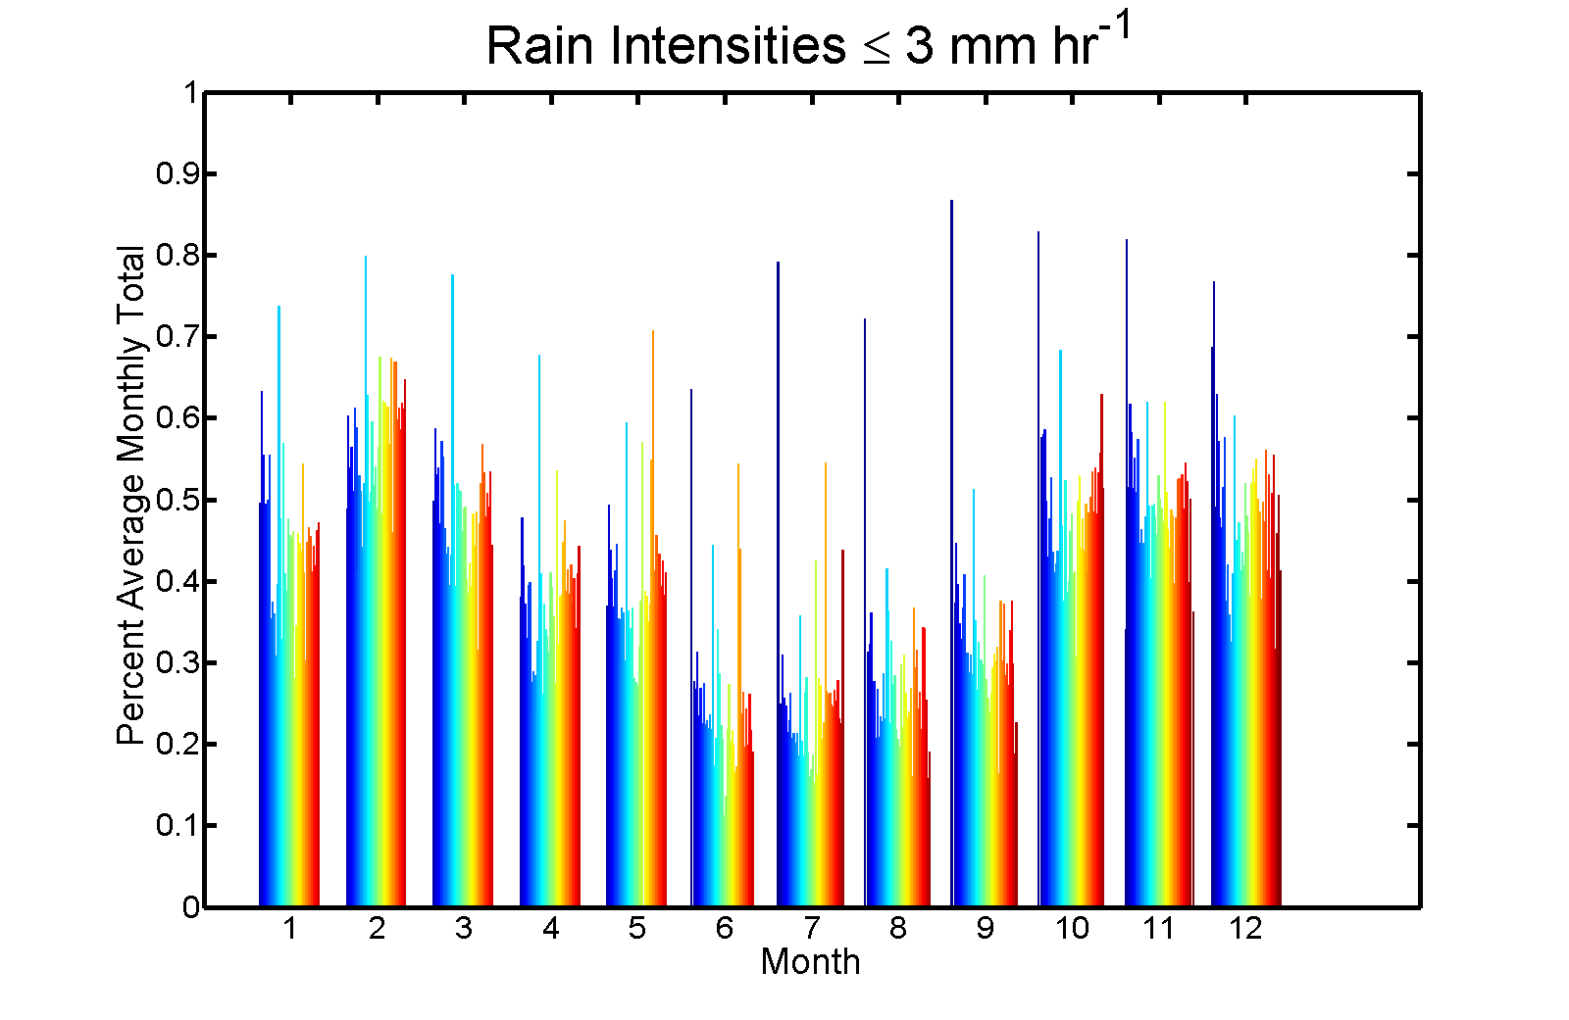
What have we learned?
light rainfall (rain rates less than 3 mm h⁻¹ at 5-min time scales) at ridgelines represents 30%–50% of total annual precipitation based on 2007–13 records
Percent Average Total
50%
25%
Month
Wilson and Barros (2014)
Notes:
Gauges PRB, seasonal cycle. Blue to red equals southeast to northwest in PRG (through winter)

Slide 13
What have we learned?
underestimation of light rainfall in mountainous regions due to the Precipitation Radar (TRMM) low sensitivity

Slide 14

Case Studies: Detailed Analysis
Explicit Raindrop Population Dynamics Model
Boundary condition
Z values BC DSD
2. Model simulates DSD evolution
throughout the column – 10 m steps
Precipitating cloud
3. Seeder-Feeder Mechanism added
LWC Fog DSD
FINDINGS
Pre existing moisture source at low levels causes orographic enhancement up to one order of magnitude through increasing coalescence efficiency
Pre-existing Fog or Low Level Cloud
Upwind
Lee
Wilson and Barros, 2014
Wilson et al. (2014)
Notes:
Initial Boundary Condition is full column then after that they just use upper boundary. The accumulation/intensity is only see. when added low level moisture.
14

Slide 15
What have we learned?
Rain gauge data has been used successfully to adaptively correct biases in the gridded Next Generation Multi-sensor QPE (Q2) data set used as input to a high-resolution physically-based hydrological model (3D-LSHM,Tao and Barros 2013) on successful quantitative flash-flood estimates for three case studies occurring in the Pigeon River Basin

Slide 16
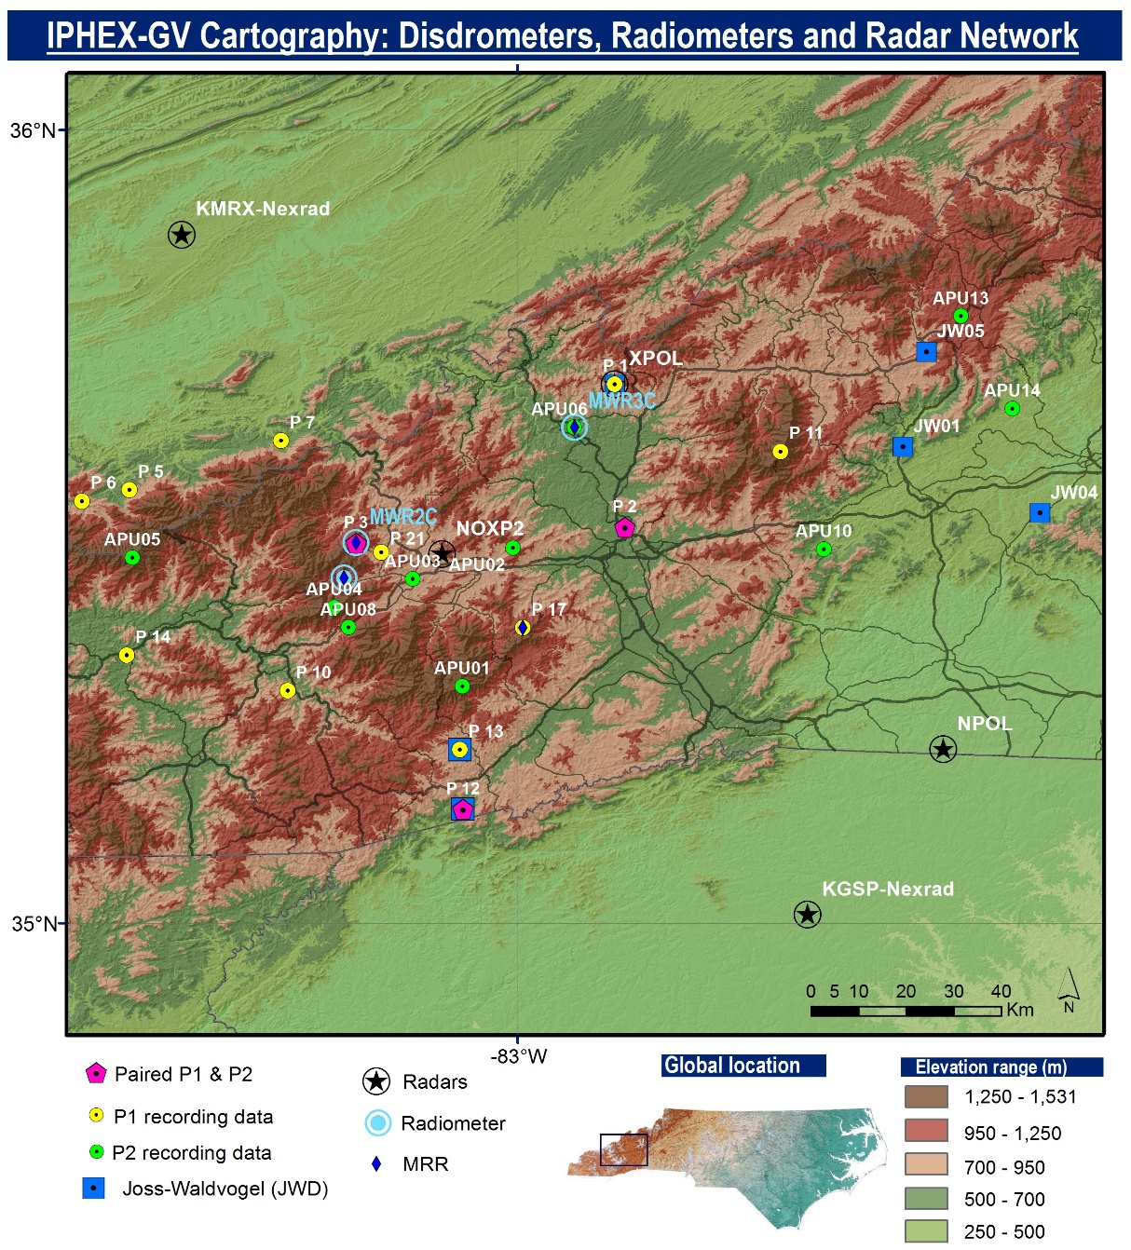
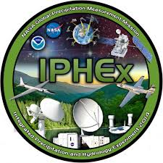
What have we learned?
IPHEx
1 May – 15 June 2014
Wilson et al. (2014)

Slide 17
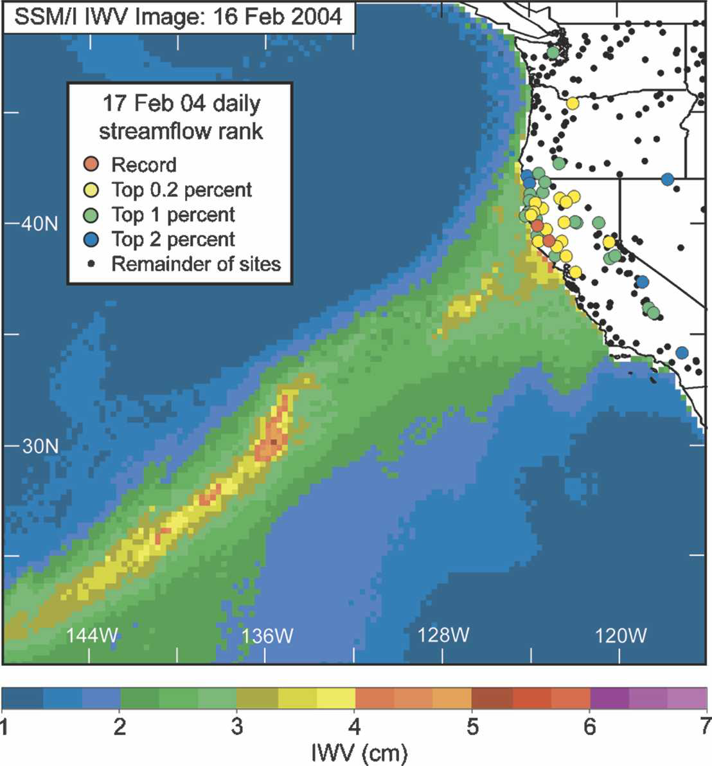
IWV = Integrated Water Vapor
Atmospheric Rivers
“narrow plumes of SSM/I IWV with values > 2 cm that were > 2000 km long and < 1000 km wide were defined as atmospheric rivers”
Neiman et al. (2008)

Slide 18
Analysis Questions
Do Atmospheric Rivers impact the southern Appalachians?
  Are they responsible for flooding events?
  Are they detectable by today’s GOES sounder observations? Will they be detectable by tomorrow’s GOES-R sounder observations?
  What atmospheric fields beyond satellite observations are useful in their detection?

Slide 19
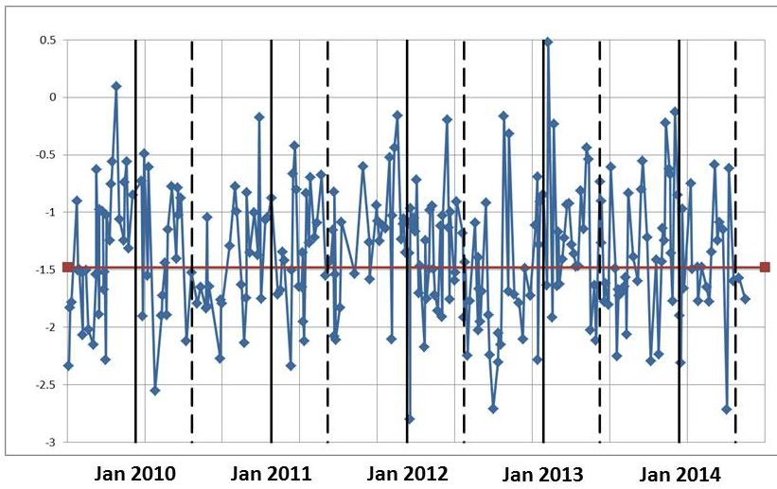
Rain Gauge Obs
1 July 2009 – 30 June 2014
Heavy
Moderate

Slide 20
(EDT)
*
*
Moderate
*
*mesoscale
Heavy

Slide 21
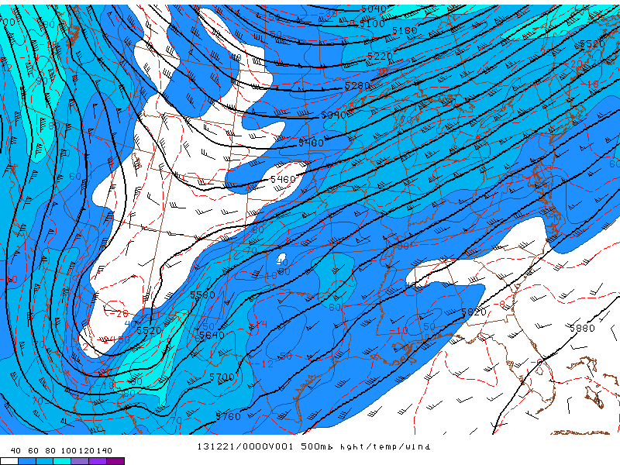
500 hPa level Geo Ht / Temp / WS
21- 24 December 2013 – UQ03
(moderate flooding)
NOAA - SPC

Slide 22
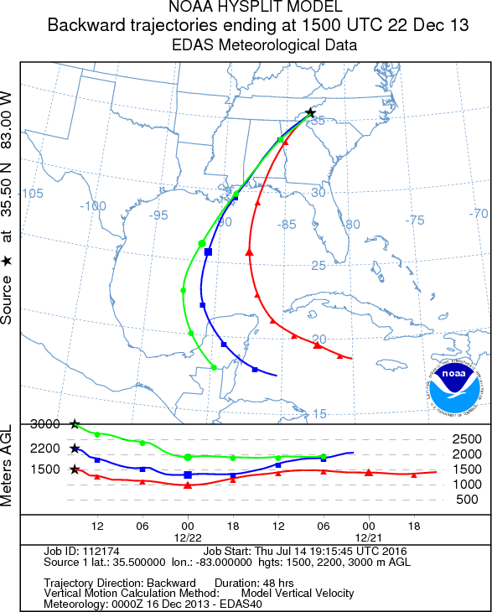

Slide 23
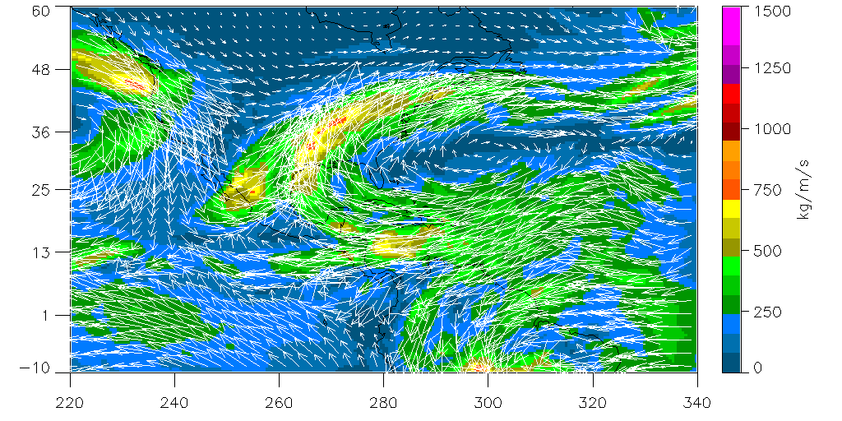
Integrated Vapor Transport
0000 UTC 21- 0600 UTC 24 December 2013 – UQ03
GFS gridded analyses
(moderate flooding)
NOAA - NOMADS

Slide 24
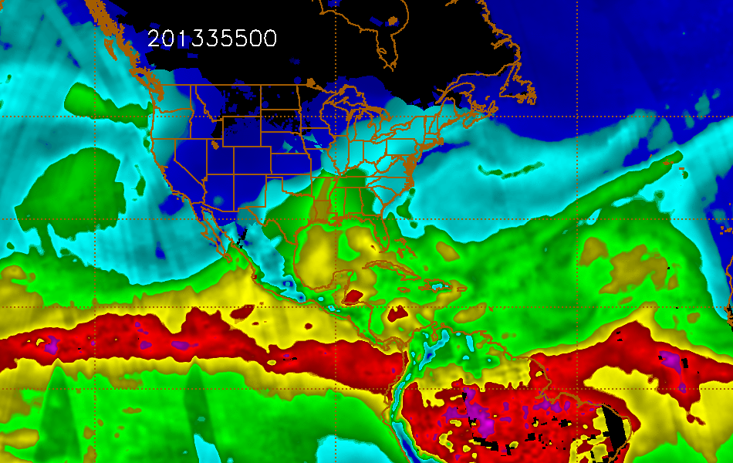

Blended IWV archives (Colorado St. Univ.)
0000 UTC 21- 2300 UTC 25 December 2013 – UQ03
(355)
(359)

Slide 25
Answers to Analysis Questions
Do Atmospheric Rivers impact the southern Appalachians? 7/15 – Moderate, 13/17 – Heavy
  Are ARs responsible for flooding events?
    Storm Data; 1/7 – Moderate, 11/13 – Heavy
    USGS River Gauge; 0/7 – Moderate, 10/13 – Heavy
  Are they detectable by today’s GOES sounder observations?
    IR cloud contamination problem
Notes:
USGS gauge at Newport, TN on Pigeon River

Slide 26
Answers to Analysis Questions
Do Atmospheric Rivers impact the southern Appalachians?
  What atmospheric fields beyond satellite observations are useful in their detection?
    favorable HYSPLIT flow/high climatological IWV values
    strong Integrated Vapor Transport (IVT)
    direction of IVT; SE to SSW is best
    long duration IVT
    strong upper level forcing & large-scale ascent

Slide 27
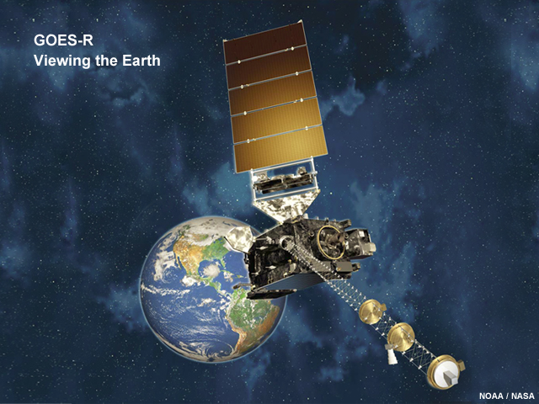
What next?
Will ARs be detectable by tomorrow’s GOES-R sounder observations?
  Current launch schedule; 4 November 2016
AR climatology as observed by the Duke GSM Rain Gauge Network
  3-yr continuation study; Scripps-NOAA/NESDIS-UNC Asheville
http://www.goes-r.gov/users/comet/goes_r/abi/print.php.htm

Slide 28
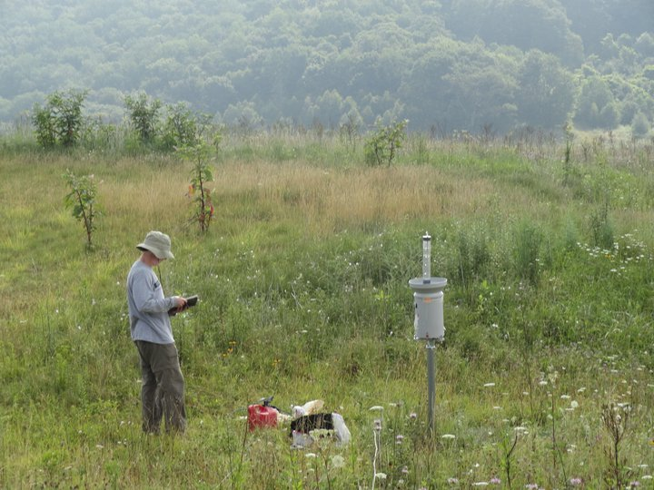
Acknowledgements
Special thanks to Paul Super, Jim Renfo, and everyone in the Great Smoky Mountains NP for your invaluable help and cooperation!
Near Purchase Knob, credit: Michael Goldsbury

