Slide 1
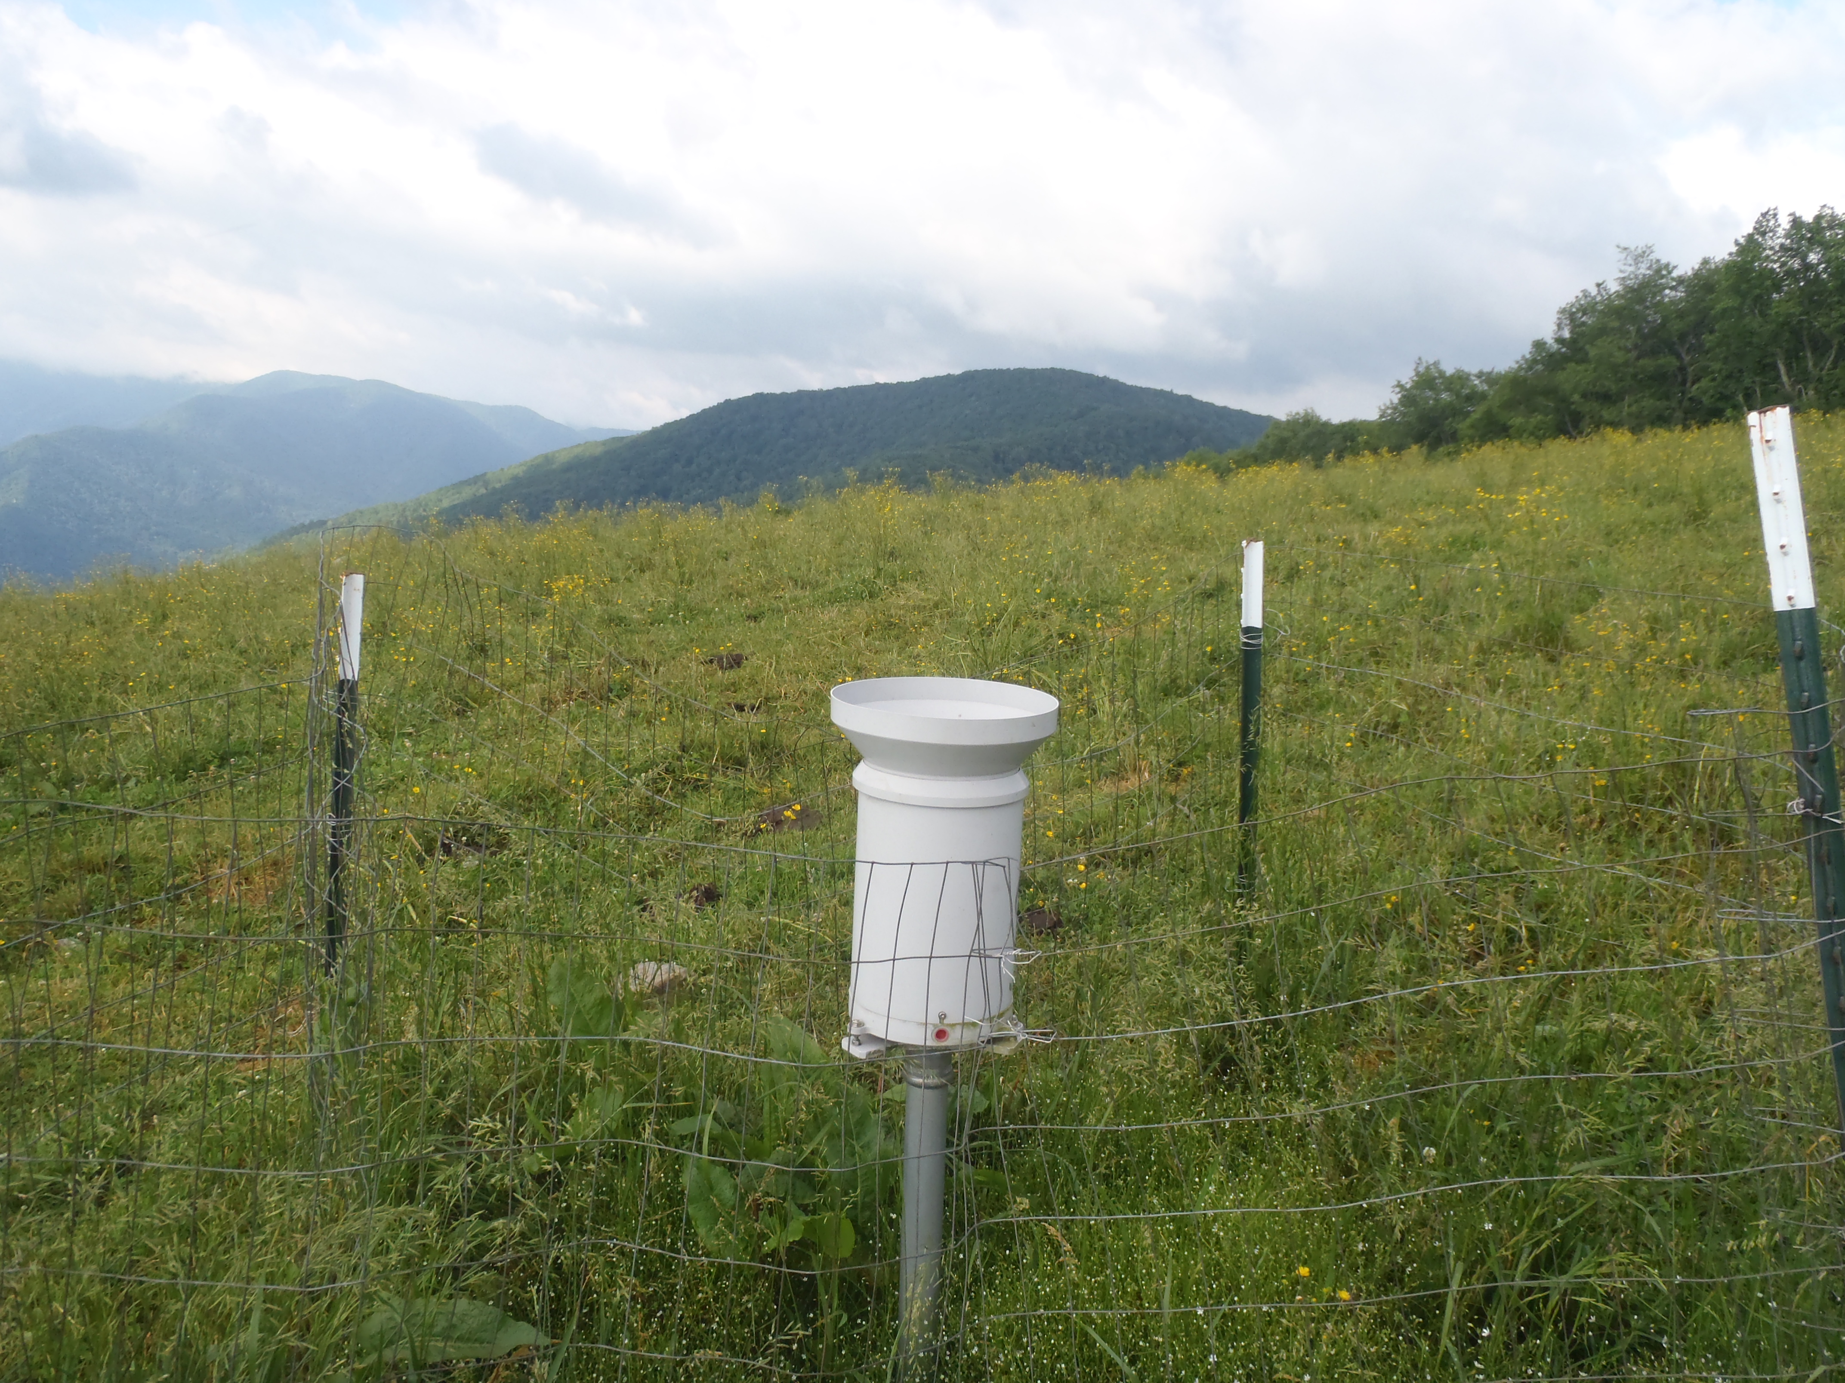


Atmospheric Rivers and the Great Smoky Mountains National Park; Fact and Fiction
Douglas Miller and Lukas Stewart
Atmospheric Sciences Department
UNC Asheville
David Hotz and Jessica Winton
National Weather Service
Morristown, TN
Ana Barros, Duke University
John Forsythe, CIRA-Colorado State University
Arastoo Pour Biazar, University of Alabama – Huntsville
Gary Wick, NOAA – ESRL

Slide 2
Outline
Atmospheric Rivers
  Background
    U.S. west coast
    southeastern U.S.
  Methodology
  Results
  Future work

Slide 3
Background
U.S. west coast

Slide 4
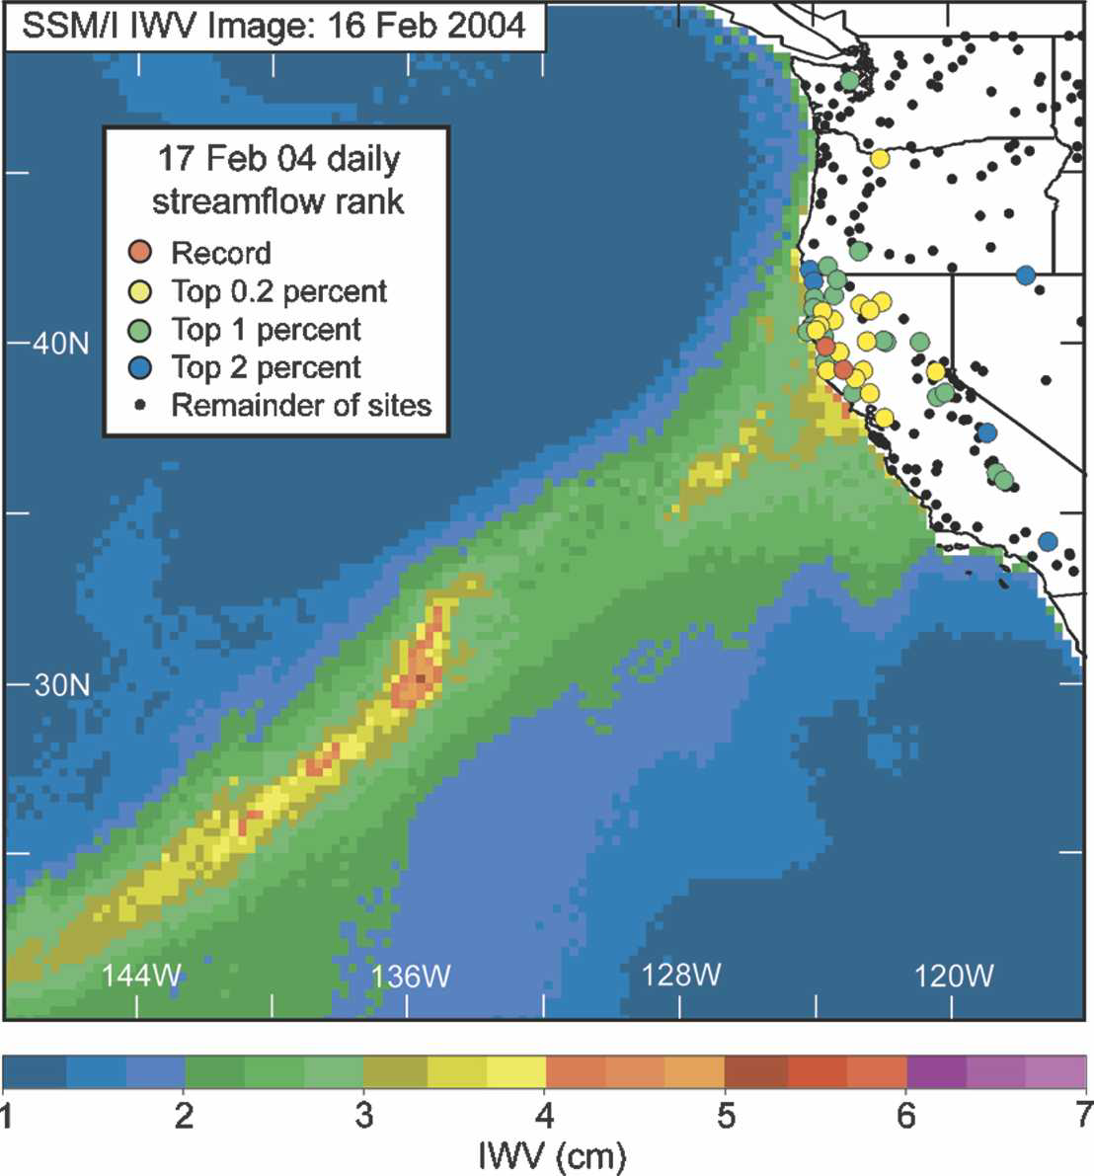
IWV = Integrated Water Vapor
“narrow plumes of SSM/I IWV with values > 2 cm that were > 2000 km long and < 1000 km wide were defined as atmospheric rivers”
Neiman et al. (2008)

Slide 5
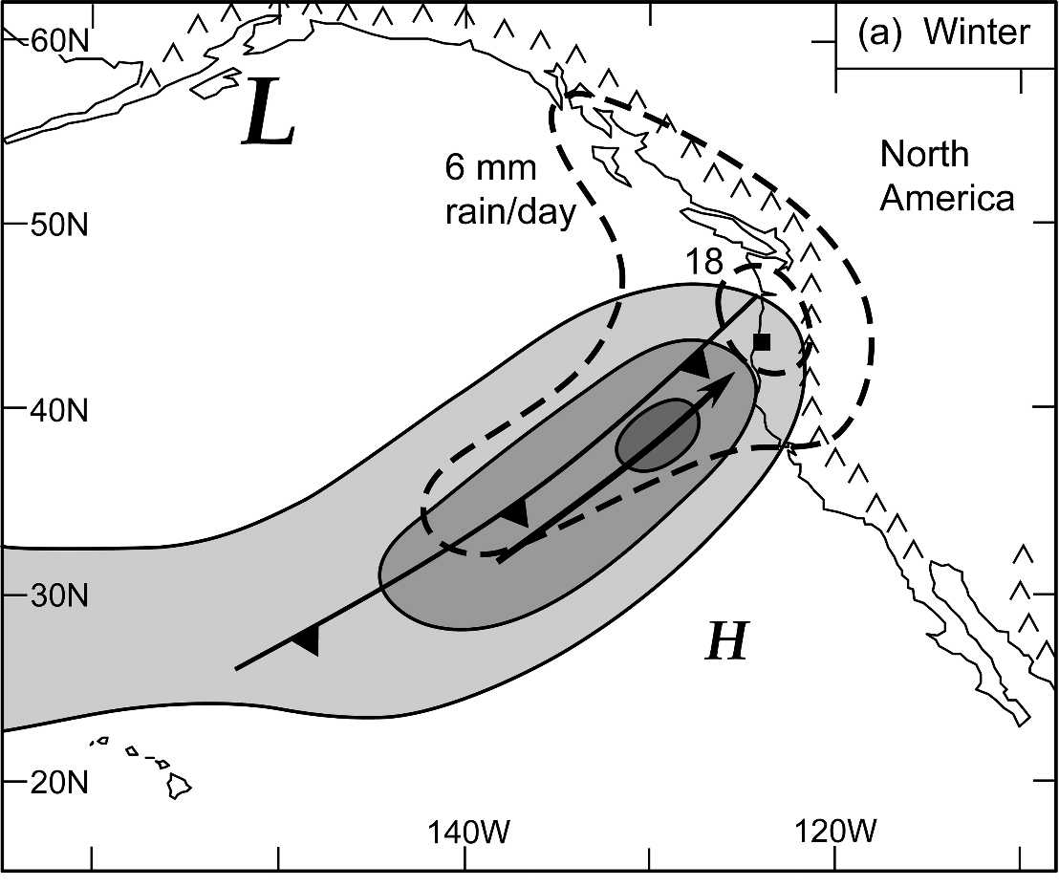
Wintertime mean plan view of IVT (solid contours; light shading: weak water vapor flux of 250–350 kg s-1 m-1, medium shading: moderate flux of 350–450 kg s-1 m-1, dark shading: strong flux 450 kg s-1 m-1), daily rainfall (dashed; mm day-1), 925-hPa cold front (standard notation) and pre-cold frontal flow direction (bold arrow), and the location of the primary cyclone and anticyclone (L and H, respectively; the size of the letters reflect their relative intensities). The black square marks the position of the composite sounding shown in (c). The primary near-coast mountains are also shown.
Neiman et al. (2008)

Slide 6


Background
  Integrated vapor transport (IVT)…
Moore et al. (2012)

Slide 7
Background
southeastern U.S.

Slide 8
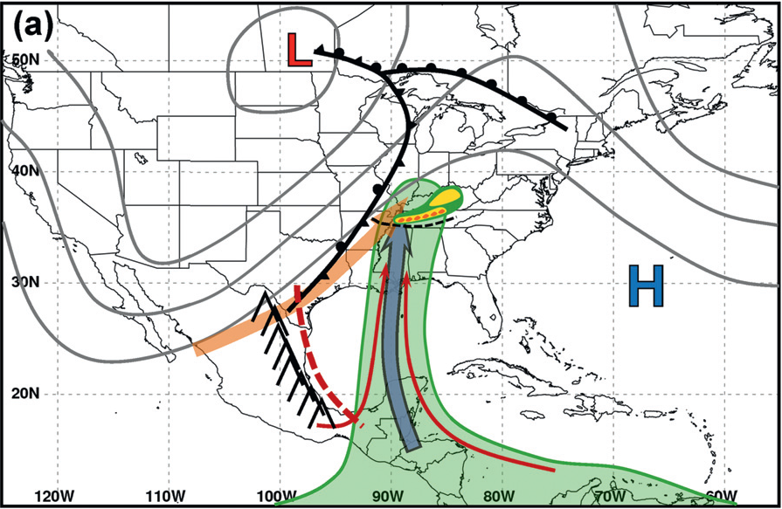
slow-moving or static supply of moisture from the tropics
1 – 2 May 2010
Moore et al. (2012)

Slide 9
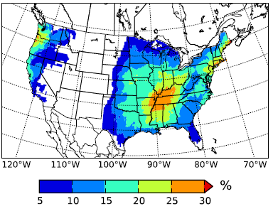
Climatology in SE U.S.
“The Appalachian Mountains are clearly visible as a low AR fraction region dividing relatively high percentages along the U.S. East Coast and the central United States.”
Lavers and Villarini (2015)

Slide 10
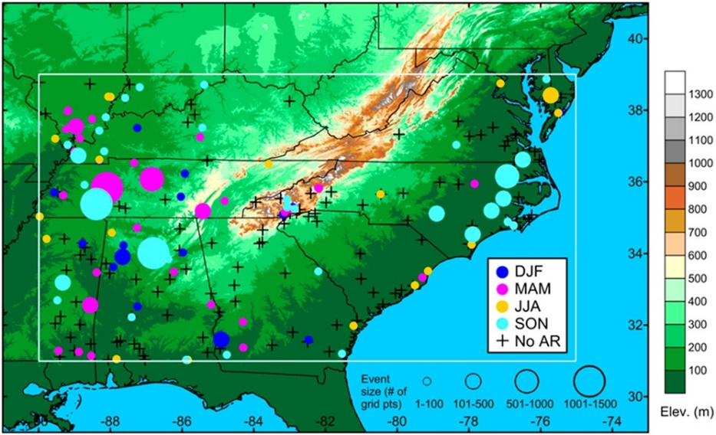
Background
S.E. U.S. (SEUS) findings…
IVT ~500 kg m⁻¹ s⁻¹ reasonable threshold for defining ARs
clear connection between ARs and heavy precipitation events in non-summer months
AR conditions in SEUS have a less direct influence on heavy precipitation relative to the U.S. west coast
Jan. 2002 – Dec. 2011
Mahoney et al. (2016)

Slide 11
Purpose
Do Atmospheric Rivers impact the southern Appalachians?
  Hypothesis
    atmospheric rivers (ARs) are primarily responsible for the highest accumulation periods observed by a high elevation gauge network in the Great Smoky Mountains National Park and these periods correspond to events having a societal hazard (flooding)

Slide 12
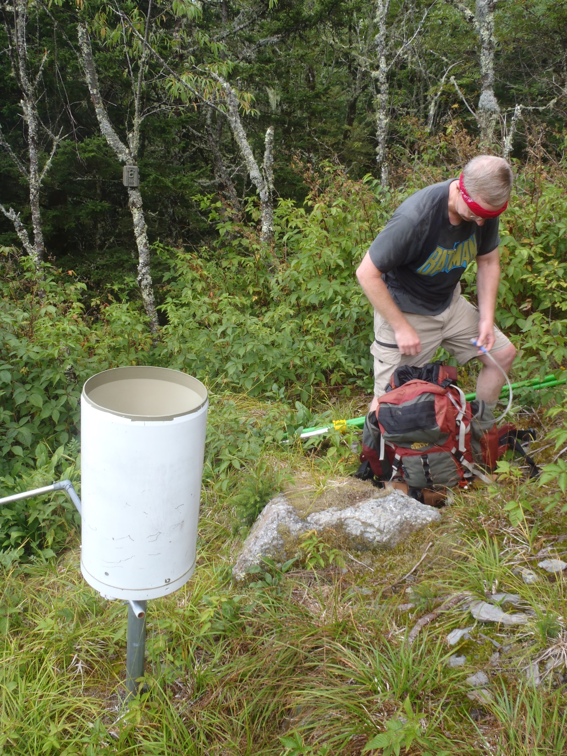
Rainfall Obs.
1 July 2009 – 30 June 2014

Slide 13
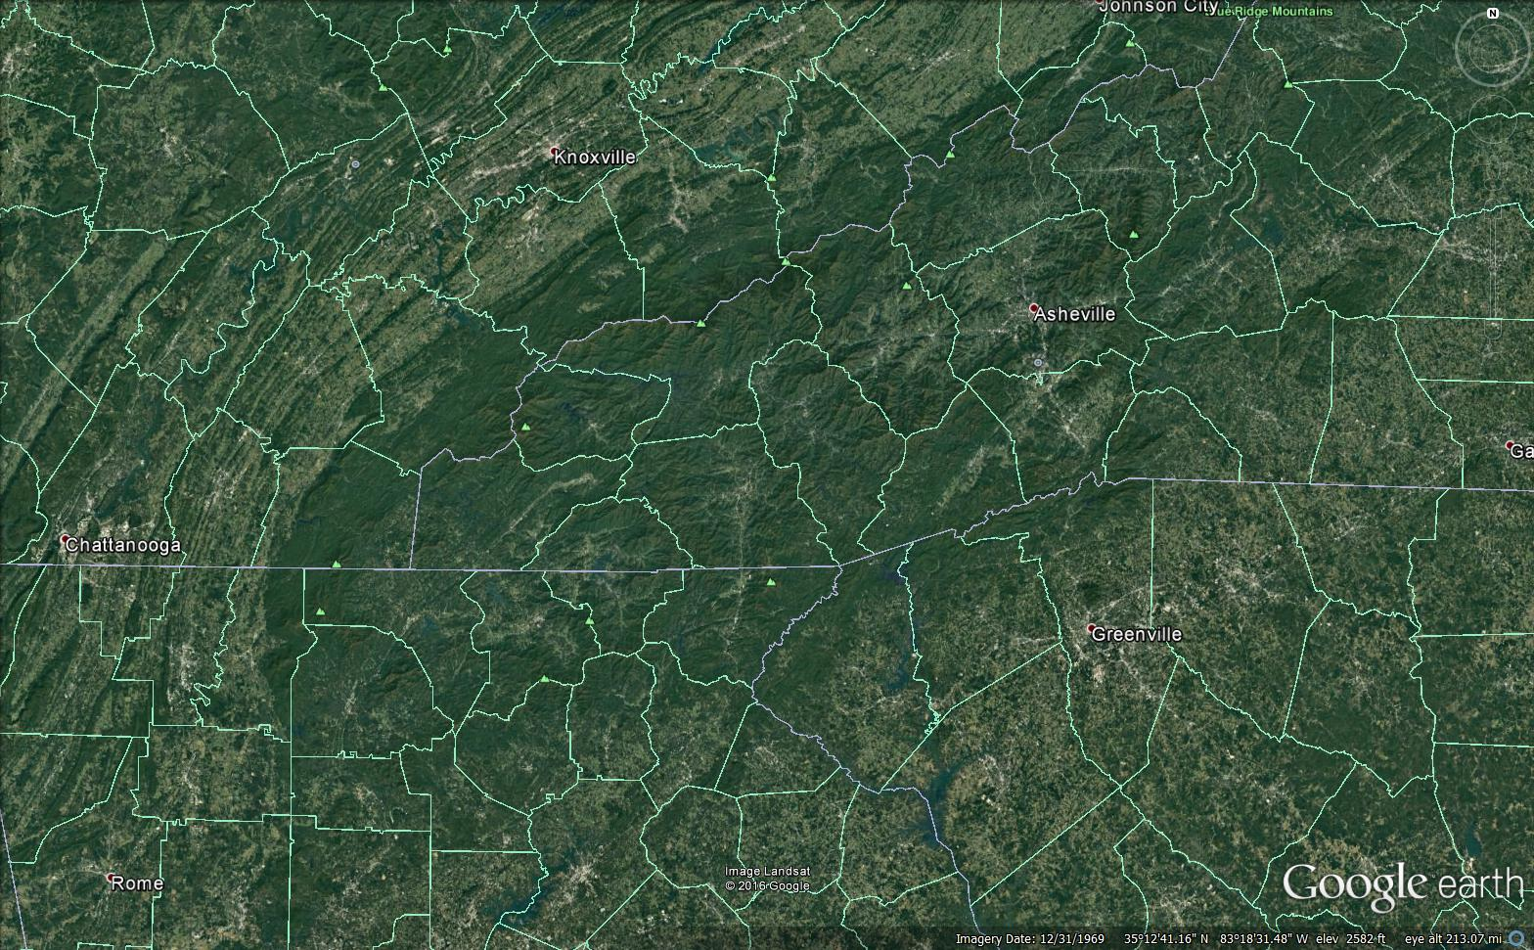
Southern Appalachians
Clingmans Dome [3]
2024 m (6643 ft)
Mt. Mitchell [1]
2037 m (6684 ft)
Mt. Guyot [4]
2018 m (6621 ft)
Pigeon River Basin (PRB)
1823 km² (704 sq mi)
Notes:
2037 m = 79130.7 Pascals (U.S. Standard Atmosphere)
Mount Craig is 2nd highest peak east of the Mississippi River
13

Slide 14
Methodology
Duke University Great Smoky Mountain Rain Gauge Network
Notes:
14

Slide 15
Methodology
32 gauges
6570 ft
3398 ft
Notes:
15

Slide 16
Methodology
Societal hazards
  minor, moderate, and major flood stage criteria were 2.4 m (8 feet) or 8.1 kcfs, 3.0 m (10 feet) or 13.1 kcfs, and 3.7 m (12 feet) or 18.6 kcfs [NWS, USGS river gauge]
  flooding, flash flooding, and heavy rainfall reports [NWS – storm event reports; Storm Data]

Slide 17
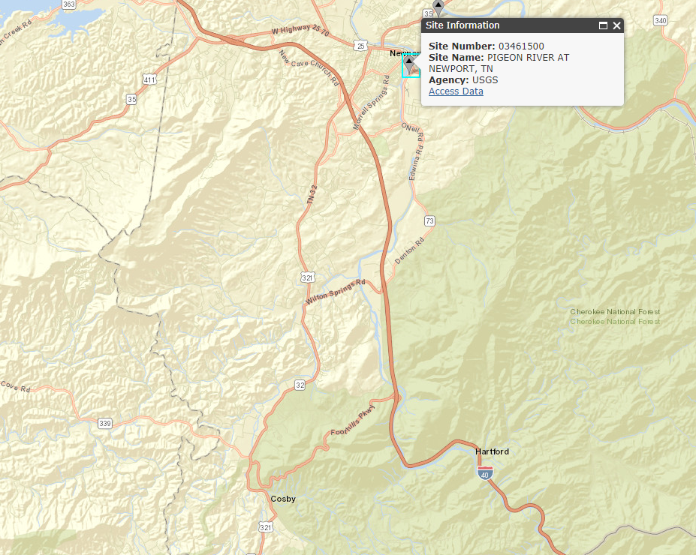
Flooding Obs.
https://maps.waterdata.usgs.gov/

Slide 18
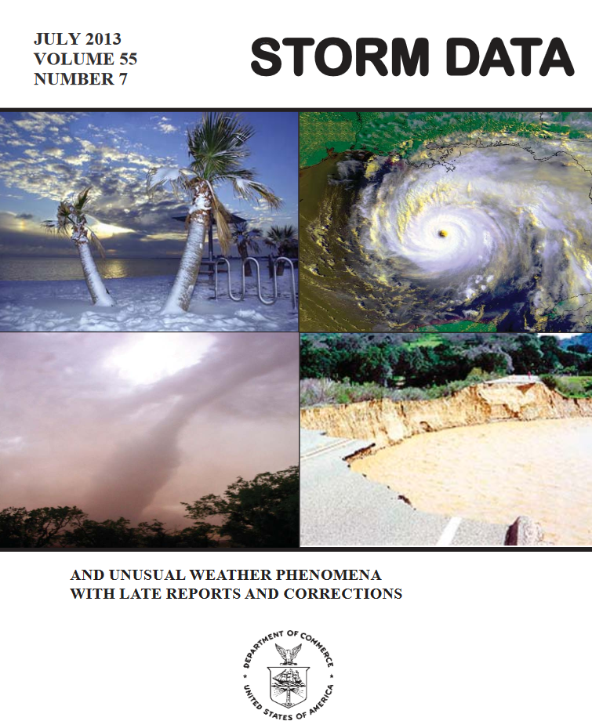
Flooding Obs.
https://www.ncdc.noaa.gov/stormevents/

Slide 19
Methodology
Atmospheric Rivers (ARs)
  Gridded atmospheric model analyses

Slide 20
ARs Data Source
GFS model analyses (every 6-h)
https://www.ncdc.noaa.gov/data-access/model-data/model-datasets/global-forcast-system-gfs

Slide 21
Methodology
Rainfall accumulation binned in 6-h periods
g #1
.
.
.
g #32
0000 UTC
0600 UTC
1200 UTC
1800 UTC
0000 UTC

Slide 22
Methodology
Rainfall events (observed by Duke GSMRGN)
  add total accumulation for all reporting gauges during 6-h period
  calculate per gauge accumulation during 6-h period [total acc./ (max. # reporting gauges)]
  event start/finish
    6-h period during which zero gauges report a tip
  event total per gauge accumulation
    Add consecutive 6-h periods of non-zero per gauge accumulation

Slide 23
Methodology
Rainfall events (observed by Duke GSMRGN)
  Rank events by event total per gauge accumulation
  Extreme (top 2.5%) rainfall events [N=28]
  Normal (middle 33%) rainfall events [N=366]

Slide 24
Methodology
Investigate systematic differences between Extreme and Normal rainfall events (“Connections”)
  Atmospheric Rivers (ARs)
  Observed flooding at Newport, TN river gauge
  Storm event reports in TN, NC along common state border

Slide 25

Results
High elevation GSM Rain Gauge Network

Slide 26
Results
All events

Slide 27
Results
All events

Slide 28
Results
Extreme events
AR – “Yes”
flooding at
Newport – “+”
storm event
report – “*”

Slide 29
Results
Extreme events

Slide 30
Results
Extreme events

Slide 31
Results - ARs
https://www.ncdc.noaa.gov/data-access/model-data/model-datasets/global-forcast-system-gfs

Slide 32
Results

Slide 33
Results

Slide 34
Results - Flooding
https://maps.waterdata.usgs.gov/

Slide 35
Results

Slide 36
Results

Slide 37
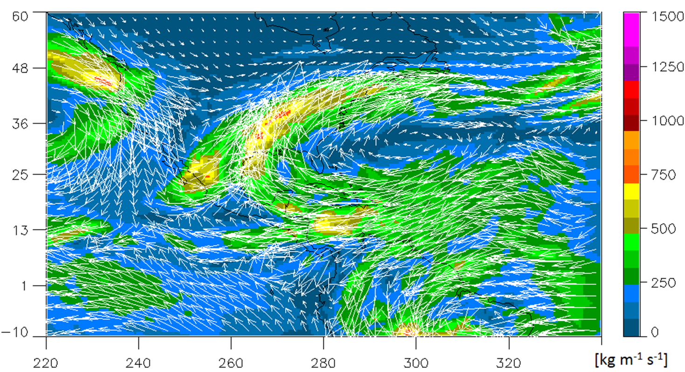

Results - Connections

Slide 38
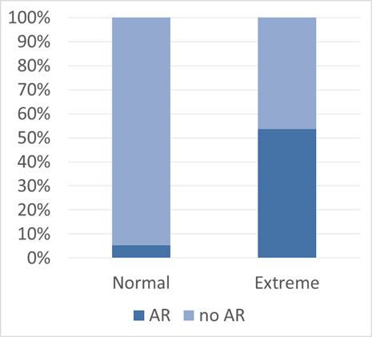
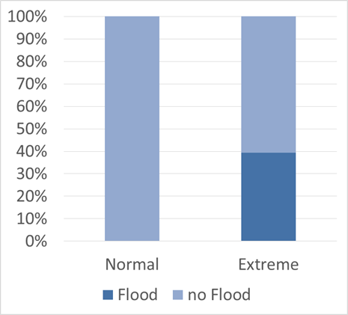
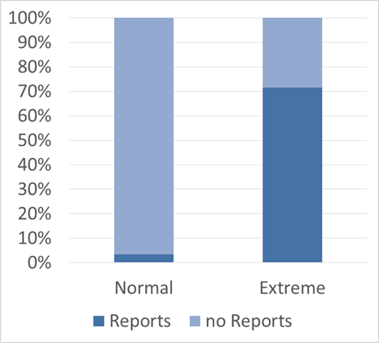
Results
Event frequency
Normal = 366 events, Extreme = 28 events

Slide 39
Results
Event frequency
Reports = 115 events, Flood = 22 events

Slide 40
Results
Event frequency
ARs = 130 events

Slide 41
Composite Mean
300 hPa Z [m]
Extreme + AR
500 hPa Z [m]
Extreme, no AR

Slide 42
Composite Mean
850 hPa Z [m]
Extreme + AR
Precipitable water [kg m⁻²]
Extreme, no AR

Slide 43
Composite Anomaly
300 hPa Z [m]
Extreme + AR
500 hPa Z [m]
Extreme, no AR

Slide 44
Composite Anomaly
850 hPa Z [m]
Extreme + AR
Precipitable water [kg m⁻²]
Extreme, no AR

Slide 45
Composite Mean IVT
Extreme + AR
Extreme, no AR

Slide 46
Analysis Questions
Do Atmospheric Rivers impact the southern Appalachians?
  Half of Extreme events are AR-influenced
    Most likely in cool season environments
      Slow-moving high amplitude atmospheric wave
        Rapidly moving humid air at low-levels (from the Gulf of Mexico)
  Extreme events having no AR-influence
    Most likely in warm season environments
      Cut-off low level cyclone southwest of southern Appalachians
        Low-level winds blow normal to mountains – orographically-enhanced precipitation

Slide 47
Analysis Questions
Do Atmospheric Rivers impact the southern Appalachians?
  12-25% ARs are associated with a societal hazard (flooding, flash flooding, heavy rainfall reports)
  Normal rainfall events with an AR, not associated with a societal hazard? [“non-threatening” ARs]

Slide 48
Heavy Rainfall Ingredients
Doswell et al. (1996)*
  Precipitation = RRate × Duration
  RRate = Efficiency × Vertical Velocity × Vapor
Duration, Efficiency, Vertical Velocity, Vapor
*Doswell, C.A., H. E. Brooks, and R. A. Maddox, 1996: Flash flood forecasting: An ingredients-based methodology. Wea. Forecasting, 11, 560-580.
Notes:
Efficiency = liquid precipitation output/vapor input

Slide 49
Analysis Questions
Do Atmospheric Rivers impact the southern Appalachians?
  ARs not associated with a societal hazard?
    Modest RRate
      Weak vertical velocity (future work)
    Low duration
      fast moving → zonal [low amplitude] atmospheric flow pattern (future work)

Slide 50
Future Work
Discover important parameter(s) defining “non-threatening” ARs
Investigate “under-performing” Extreme events [e.g., Rank #28]
  All atmospheric ‘ingredients’ look right, but event happens with no societal hazards
Duration, Efficiency, Vertical Velocity, Vapor

Slide 51
Event Rank #28
Notes:
data cgauge/
+ 'PMM-001', 'PMM-002', 'PMM-003', 'PMM-004', 'PMM-005', 'PMM-008',
+ 'PMM-010', 'PMM-100', 'PMM-101', 'PMM-102', 'PMM-103', 'PMM-104',
+ 'PMM-105', 'PMM-106', 'PMM-107', 'PMM-108', 'PMM-109', 'PMM-110',
+ 'PMM-111', 'PMM-112', 'PMM-300', 'PMM-301', 'PMM-302', 'PMM-303',
+ 'PMM-304', 'PMM-305', 'PMM-306', 'PMM-307', 'PMM-308', 'PMM-309',
+ 'PMM-310', 'PMM-311', 'PMM303S'/

Slide 52
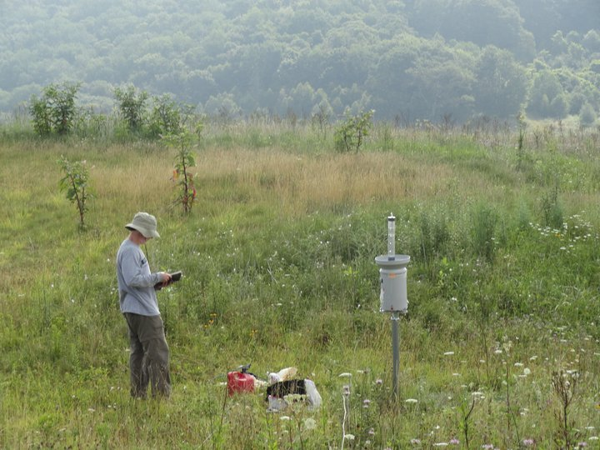
Acknowledgements
COMET GOES-R Partners Project
(UCAR Award No.: Z16-20569)
Paul Super
Near Purchase Knob, credit: Michael Goldsbury

Slide 53
Extra Results
Case study examples

Slide 54
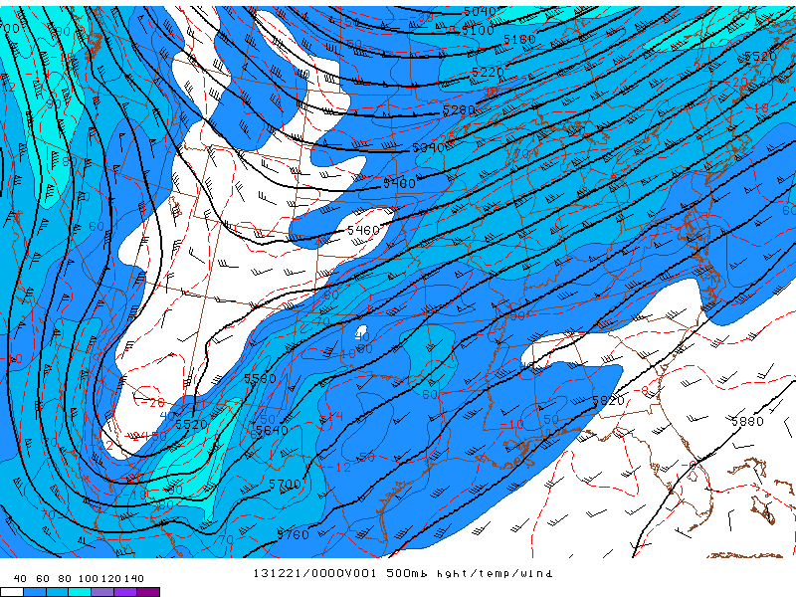
500 hPa level Geo Ht / Temp / WS
21- 24 December 2013 – #7
(moderate flooding)
NOAA - SPC

Slide 55
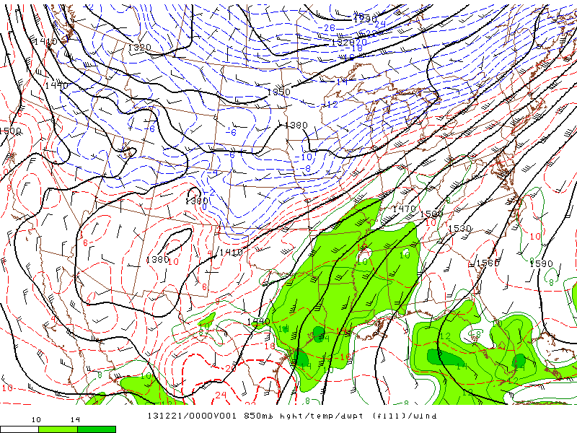
850 hPa level Geo Ht / Temp / Td
21- 24 December 2013 – #7
(moderate flooding)
NOAA - SPC

Slide 56
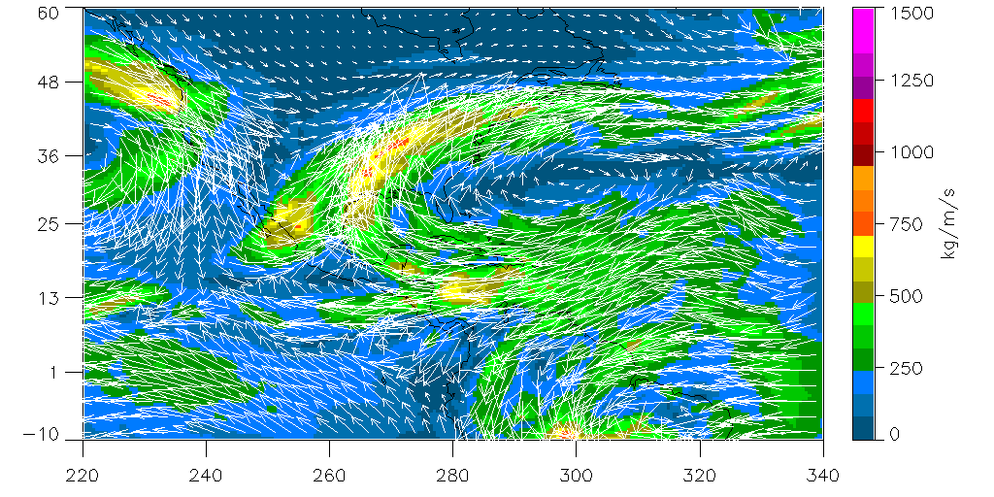
Integrated Vapor Transport
0000 UTC 21- 0600 UTC 24 December 2013 – #7
GFS gridded analyses
(moderate flooding)
NOAA - NOMADS

Slide 57
References
Carbone, R. E., J. D. Tuttle, D. A. Ahijevych, and S. B. Trier, 2002: Inferences of predictability associated with warm season precipitation episodes. J. Atmos. Sci., 59, 2033–2056.
Duan, Y., A. M. Wilson, and A. P. Barros, 2015: Scoping a field experiment: error diagnostics of TRMM precipitation radar estimates in complex terrain as a basis for IPHEx2014. Hydrology and Earth System Sciences, 19(1), 1501- 1520.
Forsythe, J. M., S. Q. Kidder, K. K. Fuell, A. LeRoy, G. J. Jedlovec, and A. S. Jones, 2015: A multisensor, blended, layered water vapor product for weather analysis and forecasting. J. Operational Meteor., 3 (5), 41-58, doi: http://dx.doi.org/10.15191/nwajom.2015.0305.
Gaffin, D. M., and D. G. Hotz, 2000: A precipitation and flood climatology with synoptic features of heavy rainfall across the southern Appalachian Mountains. Posted online. Last accessed on 29 May 2015 at http://www.srh.noaa.gov/mrx/?n=heavyrainclimo .
Geerts, B., 1998: Mesoscale convective systems in the southeast United States during 1994–1995: A survey. Wea. Forecasting, 13, 860–869.
Hansen, J. W., A. W. Hodges, and J. W. Jones, 1998: ENSO influences on agriculture in the southeastern United States. J. Clim., 11, 404–411.
Kelly, G.M., L. B. Perry, B. F. Taubman, and P. T. Soulé, 2012: Synoptic classification of 2009–2010 precipitation events in the southern Appalachian Mountains, USA. Climate Research, 55, 1-15.
Konrad, C. E., 1997: Synoptic-scale features associated with warm season heavy rainfall over the interior southeastern United States. Wea. Forecasting, 12, 557-571.
Lavers, D. A., and G. Villarini, 2015: The contribution of atmospheric rivers to precipitation in Europe and the United States. J. Hydrology, 522, 382-390.

Slide 58
References
Moore, B. J., K. M. Mahoney, E. M. Sukovich, R. Cifelli, and T. M. Hamill, 2015: Climatology and environmental characteristics of extreme precipitation events in the southeastern United States. Mon. Wea. Rev., 143, 718-741.
Moore, B. J., P. J. Neiman, F. M. Ralph, and F. E. Barthold, 2012: Physical processes associated with heavy flooding rainfall in Nashville, Tennessee, and vicinity during 1–2 May 2010: The role of an atmospheric river and mesoscale convective systems. Mon. Wea. Rev., 140, 358-378.
Neiman, P. J., F. M. Ralph, G. A. Wick, J. D. Lundquist, and M. D. Dettinger, 2008: Meteorological characteristics and overland precipitation impacts of atmospheric rivers affecting the west coast of North America based on eight years of SSM/I satellite observations. J. of Hydrometeorology, 9, 22-47.
Mahoney, K.M., D. L. Jackson, P. Neiman, M. Hughes, L. Darby, G. Wick, A. White, E. Sukovich, R. Cifelli, 2016: Understanding the role of atmospheric rivers in heavy precipitation in the southeast United States. Mon. Wea. Rev., 144, 1617-1632.
Parker, M. D., and D. A. Ahijevych, 2007: Convective episodes in the east-central United States. Mon. Weather Rev., 135, 3707–3727.
Ralph, F. M., P. J. Neiman, and G. A. Wick, 2004: Satellite and CALJET aircraft observations of atmospheric rivers over the eastern North Pacific Ocean during the winter of 1997/98. Mon. Wea. Rev., 132, 1721–1745.
Rickenbach, T. M., R. Nieto-Ferreira, C. Zarzar, and B. Nelson, 2015:A seasonal and diurnal climatology of precipitation organization in the southeastern United States. Q. J. R. Meteorol. Soc., DOI:10.1002/qj.2500.
Stevenson, S. N., and R. S. Schumacher, 2014: A 10-year survey of extreme rainfall events in the central and eastern United States using gridded multisensor precipitation analyses. Mon. Wea. Rev., 142, 3147-3162.

Slide 59
References
Tao, J., and A. P. Barros, 2013: Prospects for flash flood forecasting in mountainous regions - an investigation of Tropical Storm Fay in the southern Appalachians. J. Hydrology, 506, 69-89.
Zhu, Y., and R. E. Newell, 1998: A proposed algorithm for moisture fluxes from atmospheric rivers. Mon. Wea. Rev., 126, 725–735.

