Slide 1
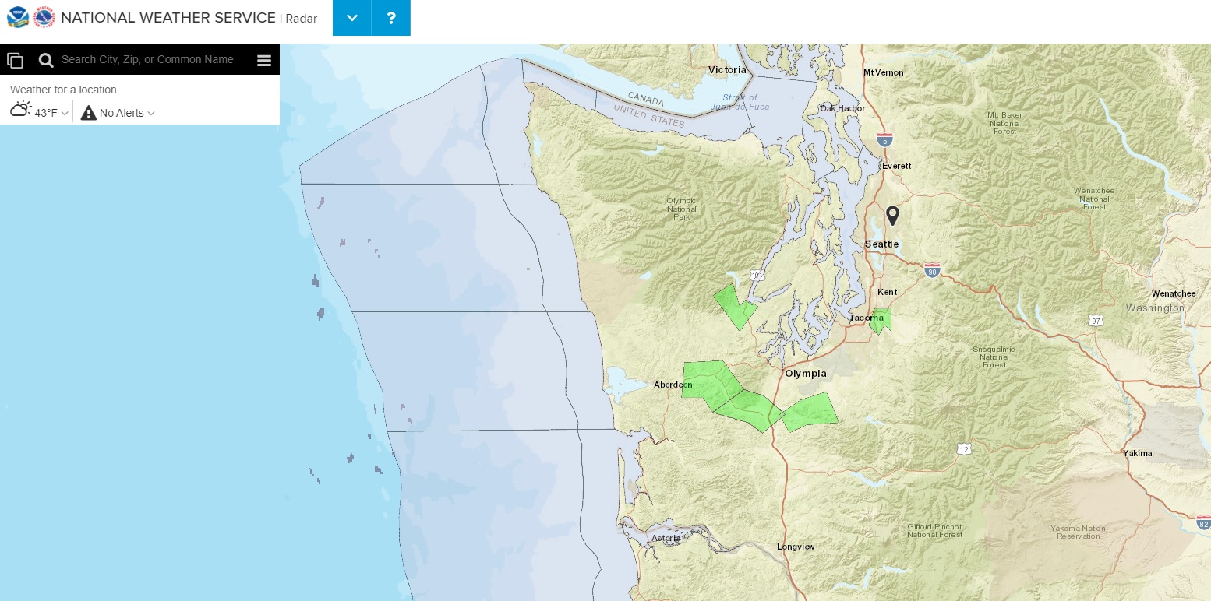
Mountain Weather – 12 January 2021;
Olympic Mountains, Washington state
+ Sequim
+ Quillayute
https://www.weather.gov/sew/

Slide 2
Olympic Mountains profile (looking west)
North
https://www.powerslidedesign.com/posters/onp_big.jpg

Slide 3
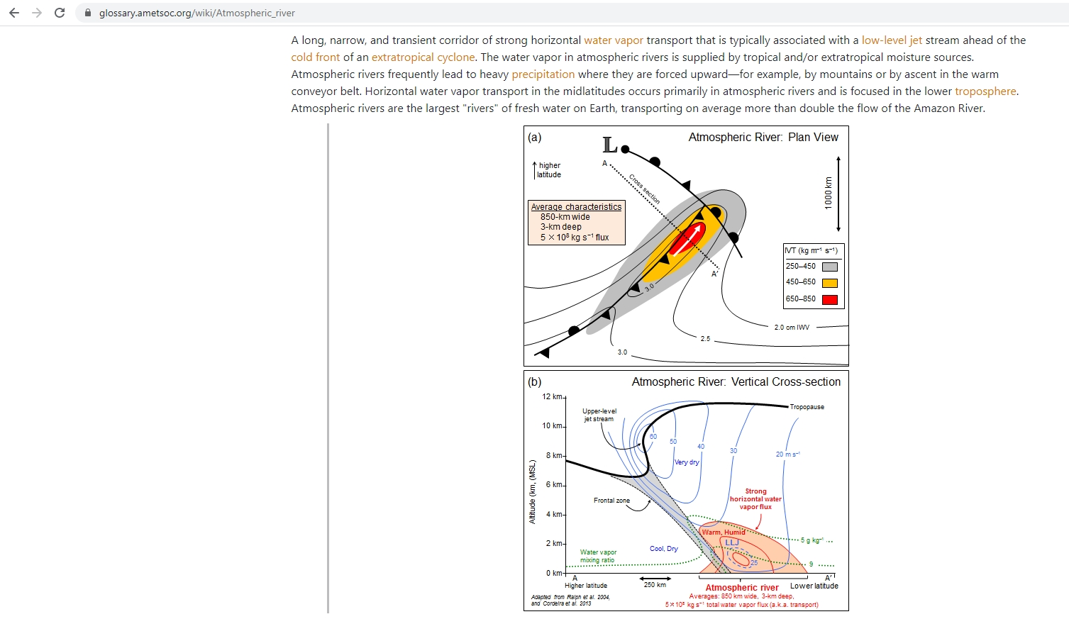
AMS Glossary – atmospheric river
https://glossary.ametsoc.org/wiki/Atmospheric_river

Slide 4
Seattle- NWS Prediction
475
FXUS66 KSEW 112238
AFDSEW
Area Forecast Discussion
National Weather Service Seattle WA
238 PM PST Mon Jan 11 2021
.SYNOPSIS...An active period of weather will bring periods of
heavy rain, mountain snow, river and coastal flooding through
Wednesday. We'll see a break in the action by Thursday followed by
more showers on Friday. High pressure will bring quieter weather
over the weekend.
&&
.SHORT TERM /TONIGHT THROUGH THURSDAY/...We're in for another
soggy/wet 48-hr period of weather across western WA due to strong
moist flow over the region. The main impacts will be periods of
heavy rain, mountain snow, river flooding, high threat for
landslides, and strong winds. In addition, we're also seeing
possible minor tidal overflow due to king tides on Tuesday.
https://mesonet.agron.iastate.edu/wx/afos/p.php?pil=AFDSEW&e=202101112238

Slide 5
Seattle- NWS Prediction
…continued
Today's system was the primer with a frontal system draped/stalled
over the region. Rainfall amounts were generally between
0.25-0.50" in the interior with up to 1.00" at the coast. The
Skokomish River is seeing a sharp rise and will likely cross flood
stage tonight. Up in the mountains, the passes are seeing snow
with easterly flow. More snow is expected overnight and into
Tuesday with heavy snow likely from Stevens Pass to Mount Baker
(with 1-2 feet expected). Snoqualmie Pass will likely see a
rain/snow mix for lesser amounts.
Tuesday will be our wettest period with rain essentially all day.
Snow levels will be rising in the mountains but east winds will
keep the Cascade passes near freezing for more snow. All other
rivers will start to see rises with heavier precipitation totals.
In addition, minor tidal overflow is possible with high tides and
anomalies close to the HAT (highest astronomical tide). This
would affect both the coast and Salish Sea.
Finally, our last surge of moisture will cover the region Tuesday
night into Wednesday. By then rivers will be cresting and several
rivers may be close to minor flooding. Snow levels will lower
Wednesday afternoon or evening to around 3000 ft for rain changing
back to snow in the mountains and Cascade passes. It'll be windy
through the Strait of Juan de Fuca Wednesday afternoon with a
strong push through the strait.
https://mesonet.agron.iastate.edu/wx/afos/p.php?pil=AFDSEW&e=202101112238

Slide 6
Seattle- NWS Prediction
…continued
All in all, through Wednesday, precipitation amounts will range
from 1-2" in the interior to 2-4" around the Olympic peninsula.
This may put more pressure on our already saturated soils which
leads to an increase threat for landslides. 33
FXUS66 KSTO 220630
AFDSTO
https://mesonet.agron.iastate.edu/wx/afos/p.php?pil=AFDSEW&e=202101112238

Slide 7
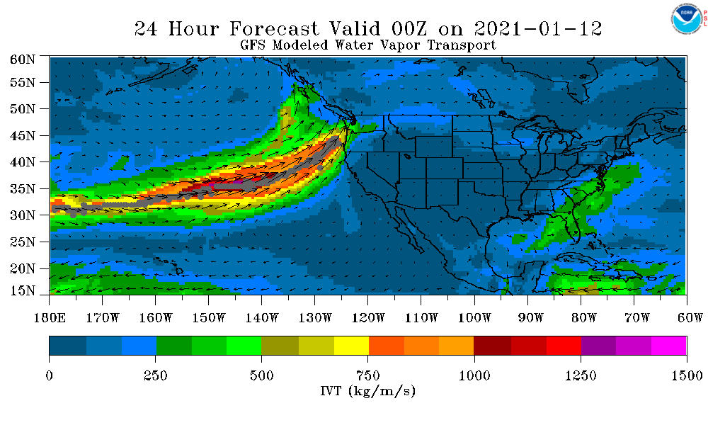
GFS Analysis – Atmospheric River ‘locator’
https://psl.noaa.gov/psd2/coastal/satres/data/html/ardt_gfs_day1.php

Slide 8
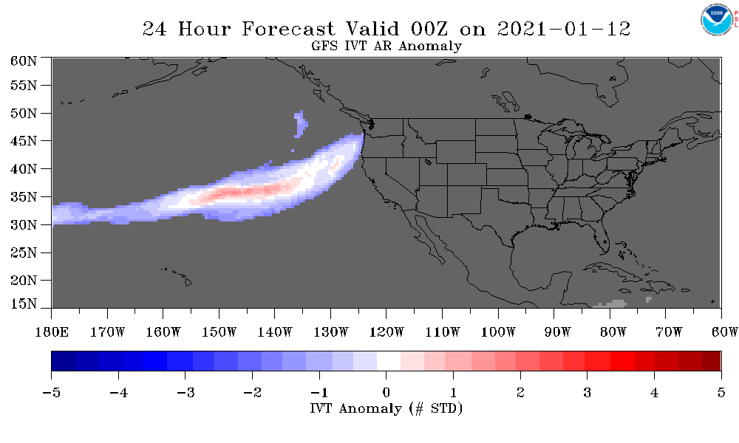
GFS Analysis – Atmospheric River anomaly
https://psl.noaa.gov/psd2/coastal/satres/data/html/ardt_gfs_day1.php

Slide 9
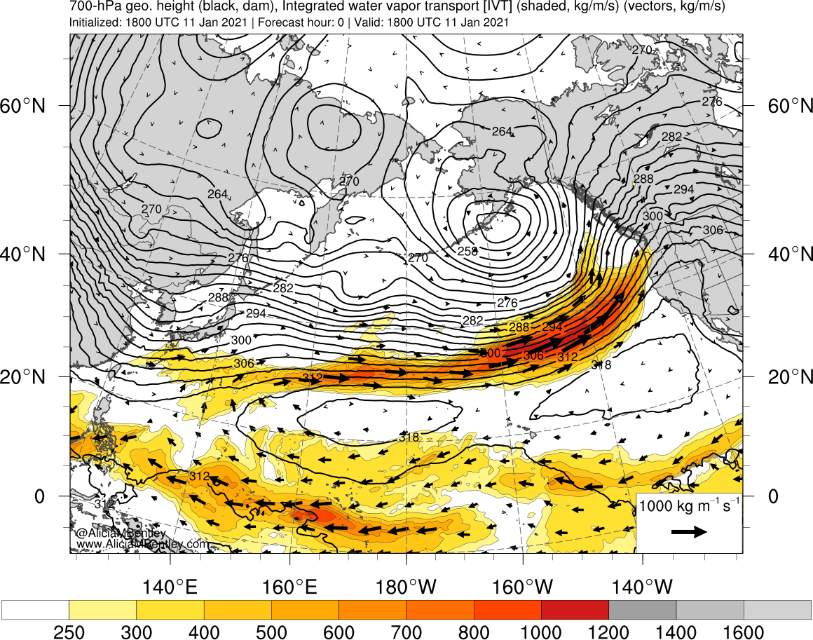
GFS computer model prediction
SLP (hPa), 3-hr Acc Precip, 1000-500 mb Thickness
27-hr forecast valid 0900 UTC 20 Jan 2011, (1:00 am PST)
http://www.atmos.albany.edu/student/abentley/realtime.html

Slide 10
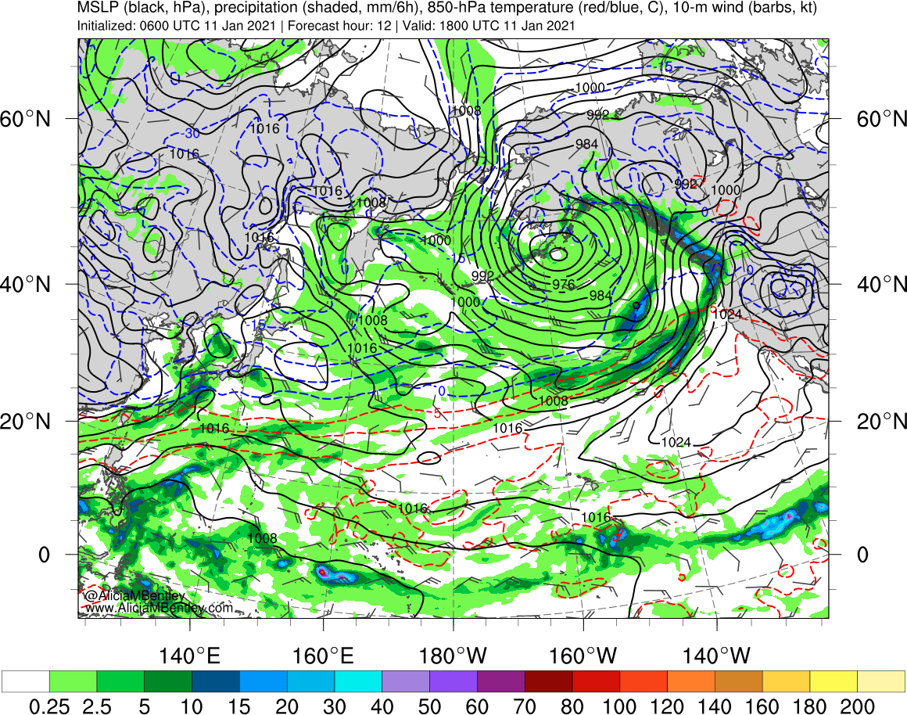
WRF – ARW computer model prediction
SLP (hPa), 3-hr Acc Precip, 1000-500 mb Thickness
27-hr forecast valid 0900 UTC 20 Jan 2011, (1:00 am PST)
http://www.atmos.albany.edu/student/abentley/realtime.html

Slide 11
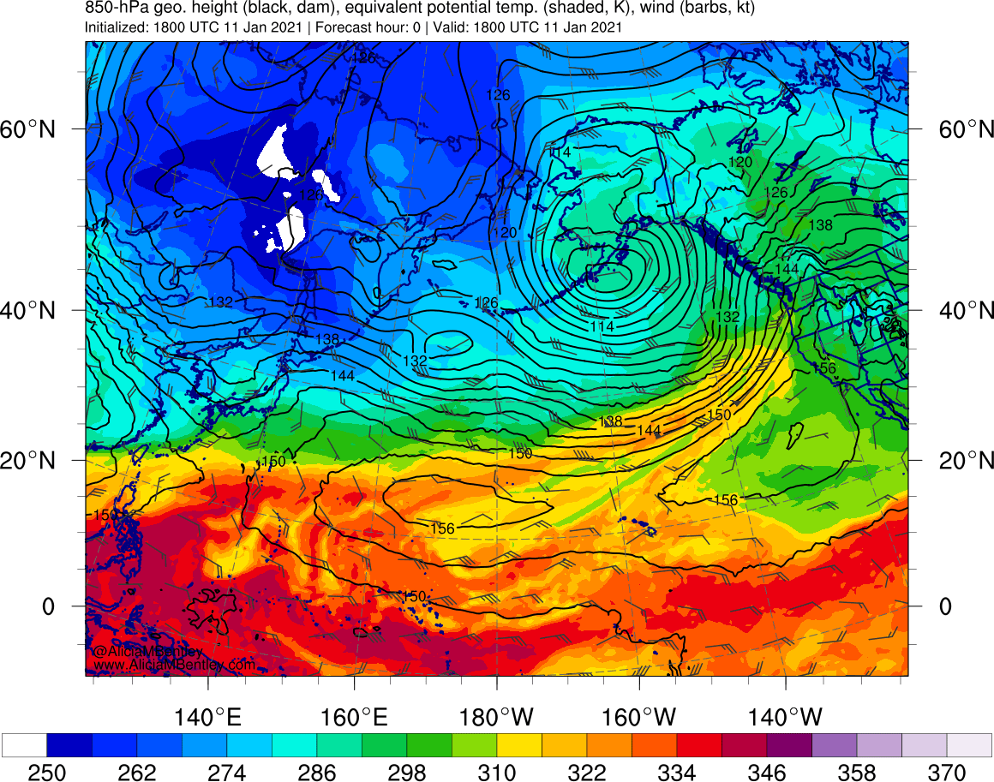
WRF – ARW computer model prediction
SLP (hPa), 3-hr Acc Precip, 1000-500 mb Thickness
27-hr forecast valid 0900 UTC 20 Jan 2011, (1:00 am PST)
http://www.atmos.albany.edu/student/abentley/realtime.html

Slide 12
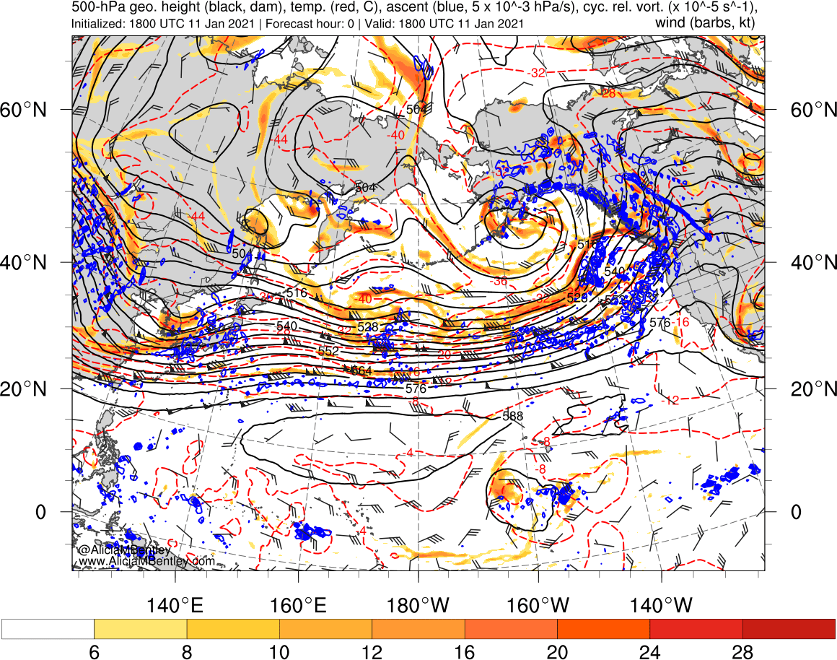
WRF – ARW computer model prediction
SLP (hPa), 3-hr Acc Precip, 1000-500 mb Thickness
27-hr forecast valid 0900 UTC 20 Jan 2011, (1:00 am PST)
http://www.atmos.albany.edu/student/abentley/realtime.html

Slide 13
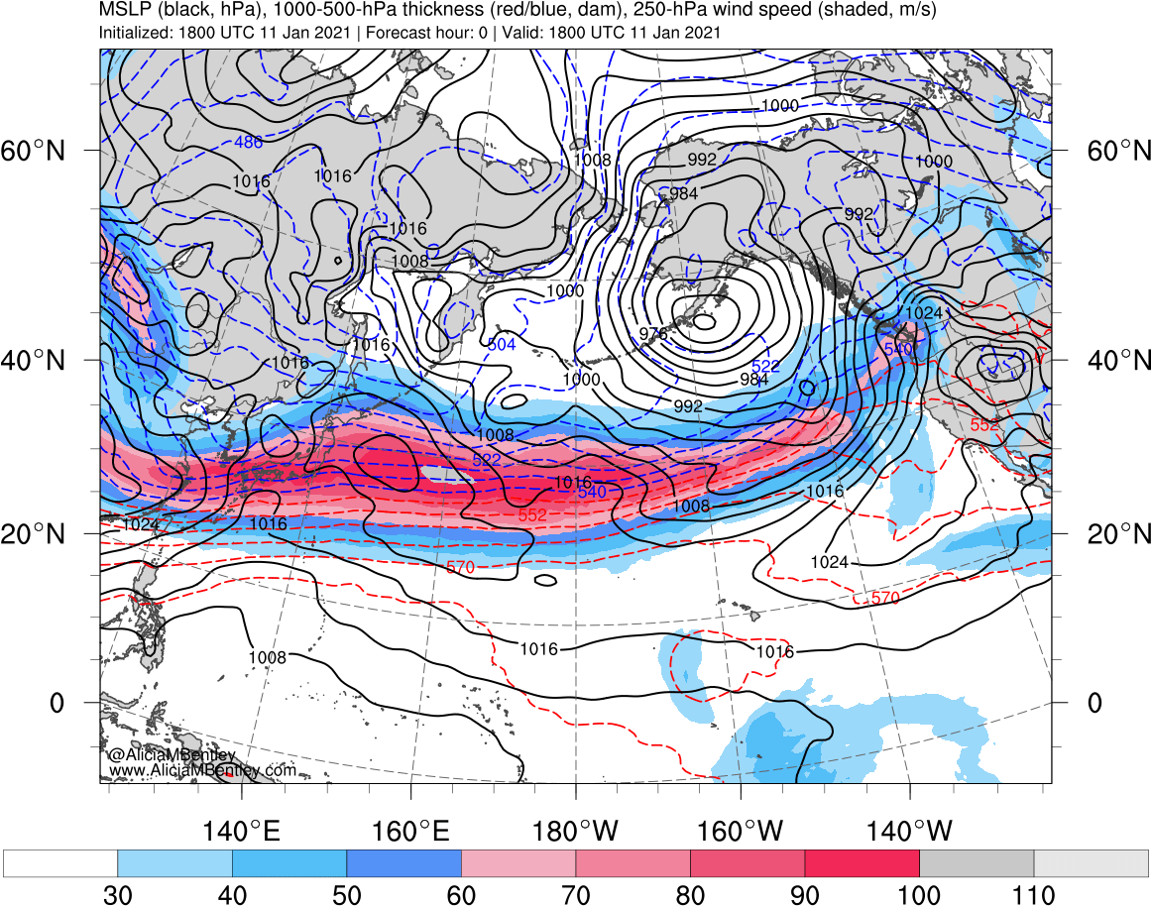
WRF – ARW computer model prediction
SLP (hPa), 3-hr Acc Precip, 1000-500 mb Thickness
27-hr forecast valid 0900 UTC 20 Jan 2011, (1:00 am PST)
http://www.atmos.albany.edu/student/abentley/realtime.html

Slide 14
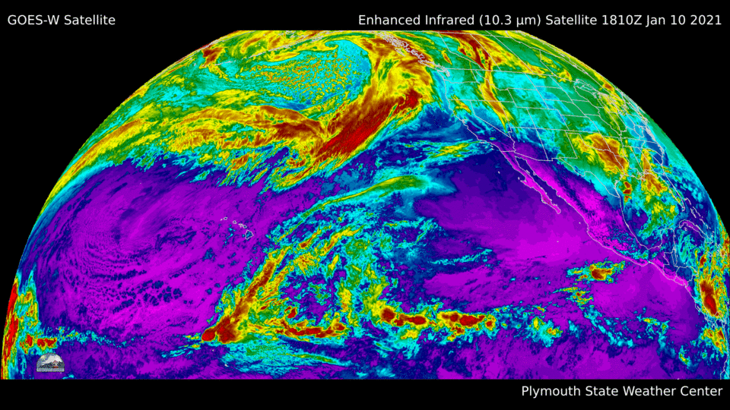
IR satellite loop
https://vortex.plymouth.edu/mapwall/goes/satellite.html#09c

Slide 15
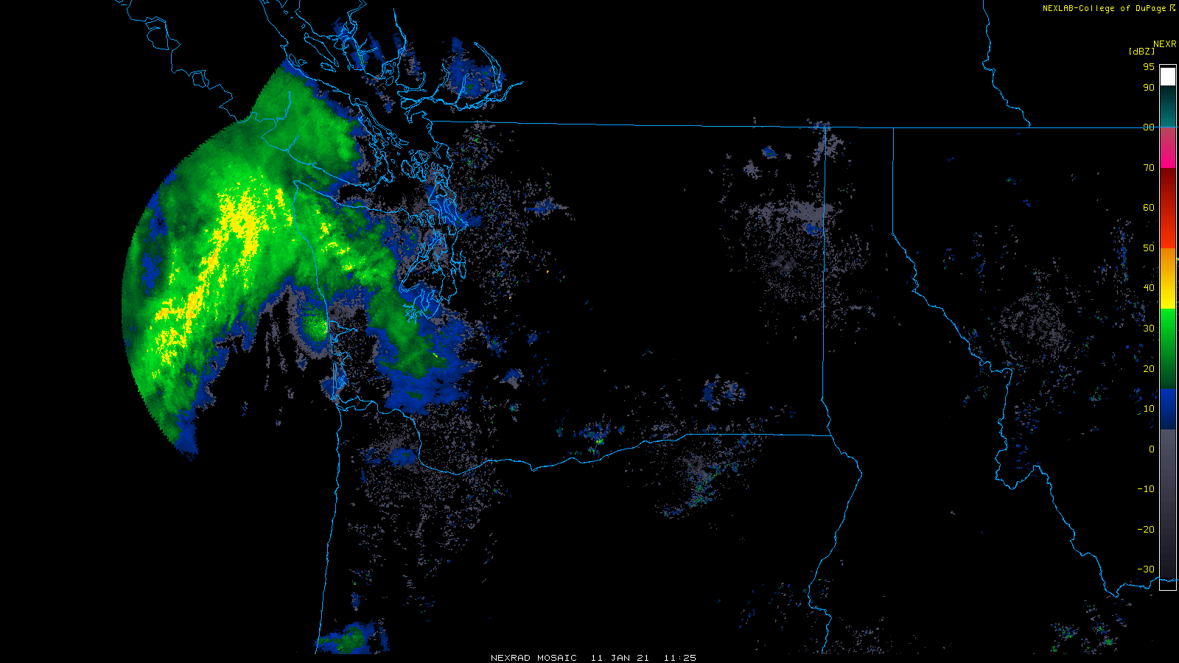
WSR88D composite - northwest
http://www2.mmm.ucar.edu/imagearchive/

Slide 16
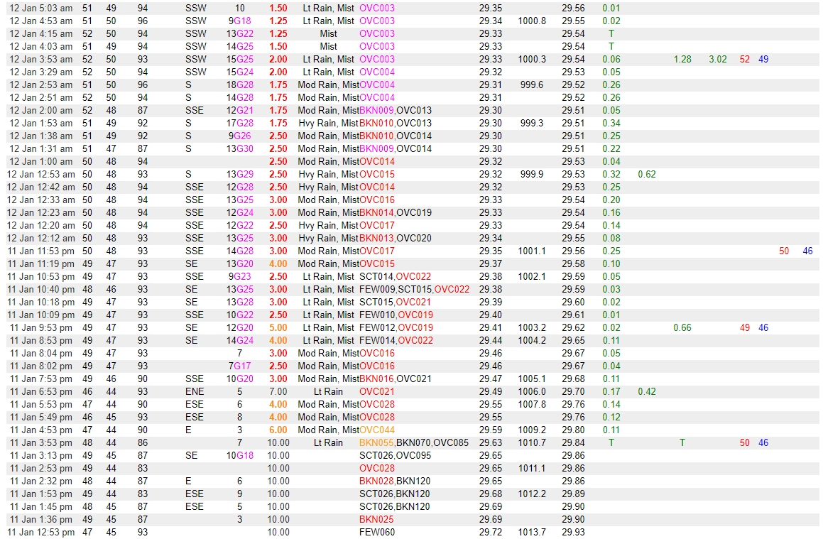
Quillayute State Airport, WA. (KUIL)
0000 UTC 12 Jan 2021
https://www.wrh.noaa.gov/mesowest/getobext.php?wfo=sew&sid=KUIL&num=72&raw=0

Slide 17
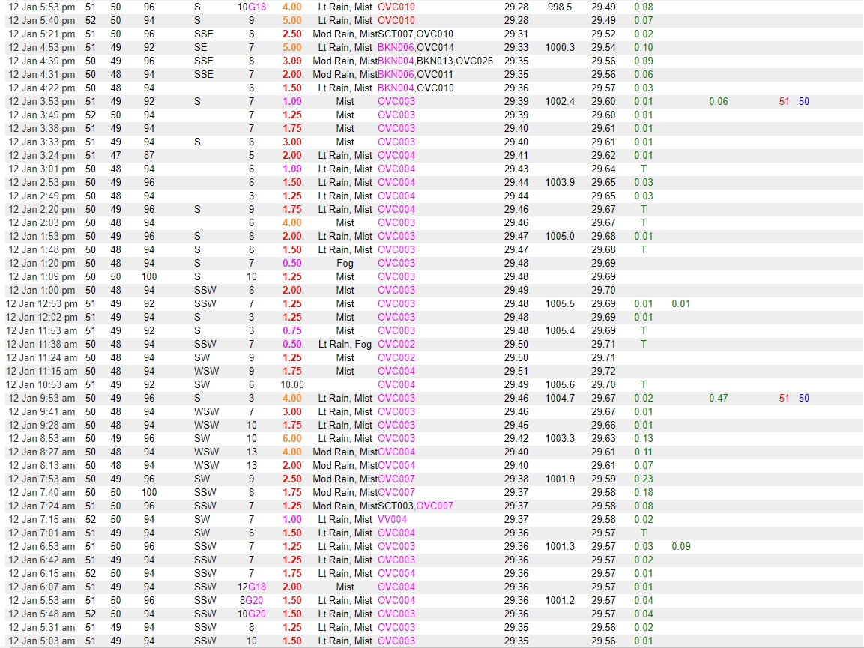
Quillayute State Airport, WA. (KUIL)
https://www.wrh.noaa.gov/mesowest/getobext.php?wfo=sew&sid=KUIL&num=72&raw=0

Slide 18
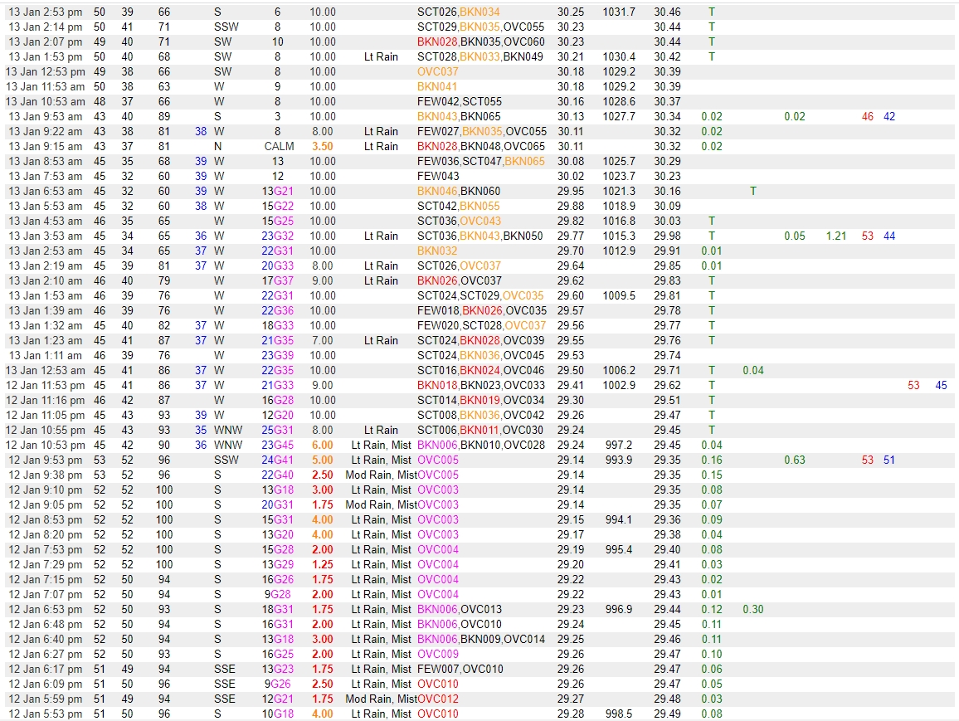
Quillayute State Airport, WA. (KUIL)
0700 UTC 13 Jan 2021
https://www.wrh.noaa.gov/mesowest/getobext.php?wfo=sew&sid=KUIL&num=72&raw=0

Slide 19
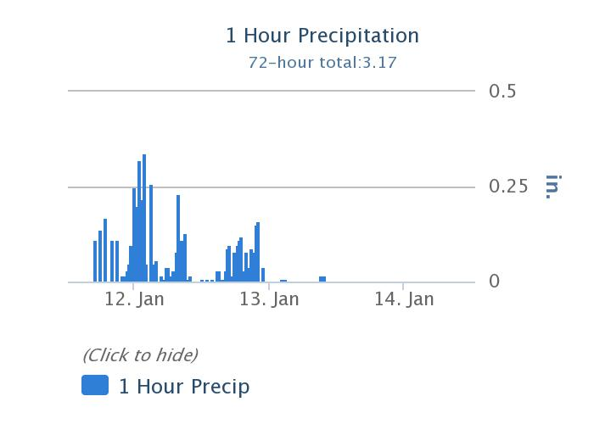
Quillayute State Airport, WA. (KUIL)
WSR88D – Sacramento (DAX)
http://vortex.plymouth.edu/myo/rad/nids.html

Slide 20
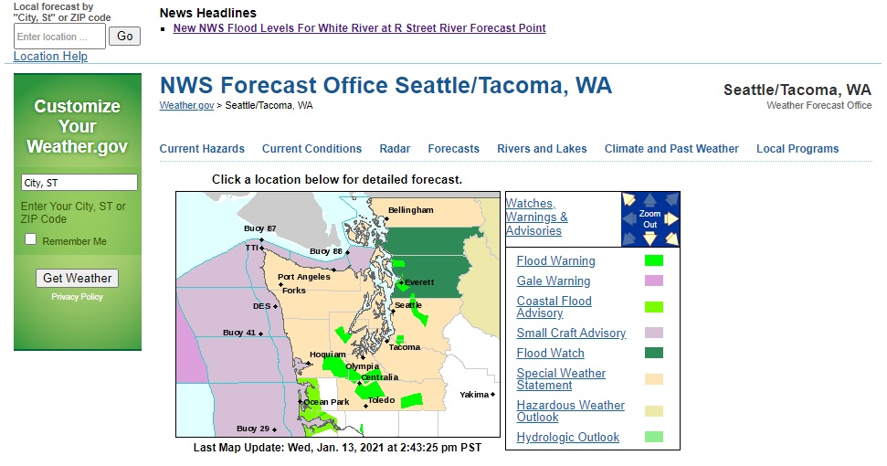
NWS – Seattle, WA web page (13 Jan 2021)
WSR88D – Sacramento (DAX)
http://vortex.plymouth.edu/myo/rad/nids.html

Slide 21
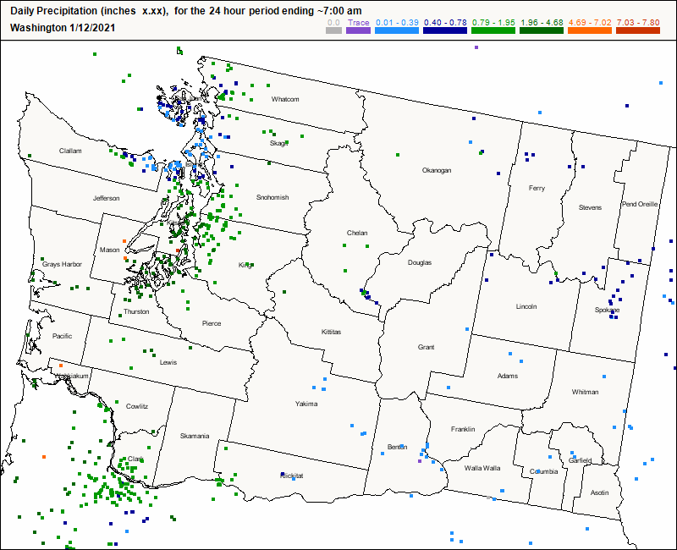
CoCoRaHS
http://www.cocorahs.org/

Slide 22
+ Sequim
+ Quillayute
https://www.weather.gov/sew/

Slide 23
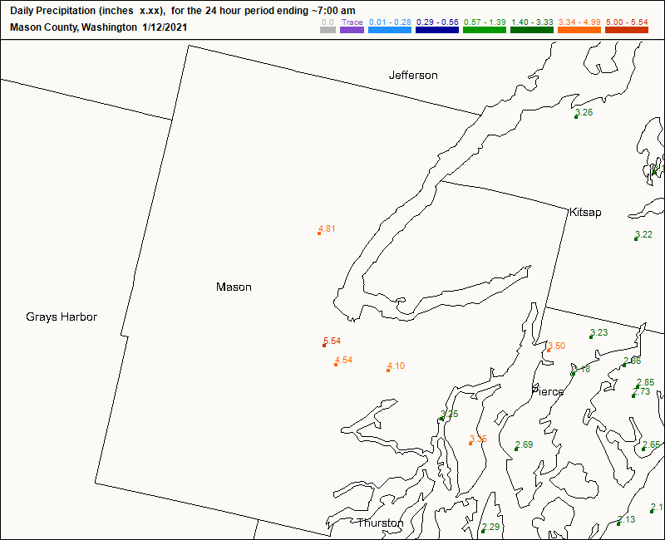
CoCoRaHS
http://www.cocorahs.org/

Slide 24
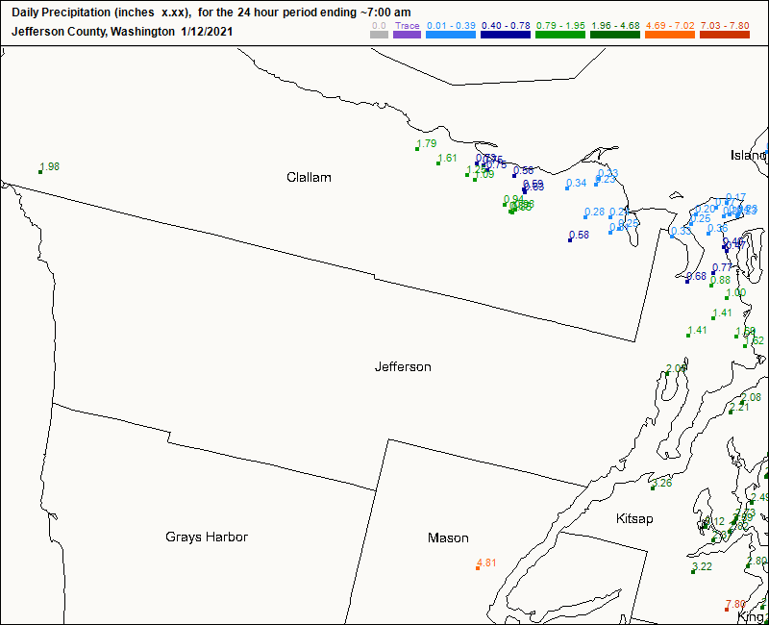
CoCoRaHS
http://www.cocorahs.org/

