Slide 1
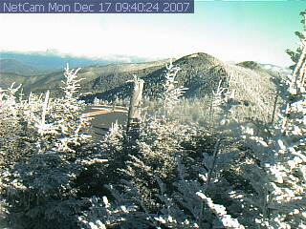
ATMS 373- Mountain Meteorology
Packet#1
What is meant by “Mountain Meteorology”?
http://www.ils.unc.edu/parkproject/webcam/webcam.html

Slide 2
ATMS 373- Mountain Meteorology
Outline
Introduction
Topics
Literature search
http://www.ils.unc.edu/parkproject/webcam/webcam.html

Slide 3
ATMS 373- Mountain Meteorology
Mountain meteorology
Definitions
Mountain meteorology – branch of meteorology that focuses on the weather and climate of mountainous regions
Weather – the state of the atmosphere during a short period of time
Climate – the average or prevailing weather of a given region over a long period of time

Slide 4
ATMS 373- Introduction
Mountain meteorology
Climate - precipitation

Slide 5
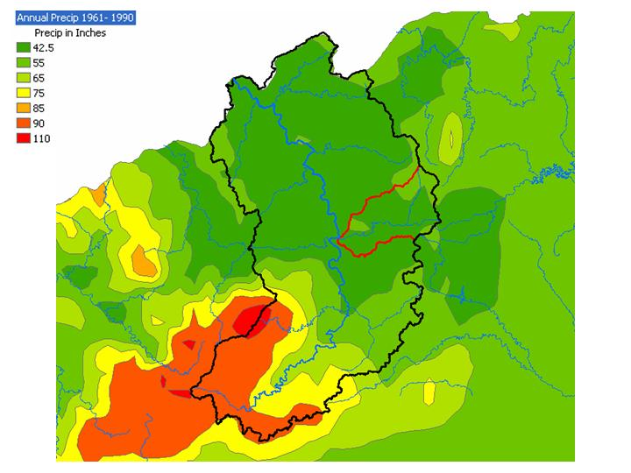
ATMS 373- Introduction
Mountain meteorology
Climate - precipitation
Courtesy: Greg Dobson

Slide 6
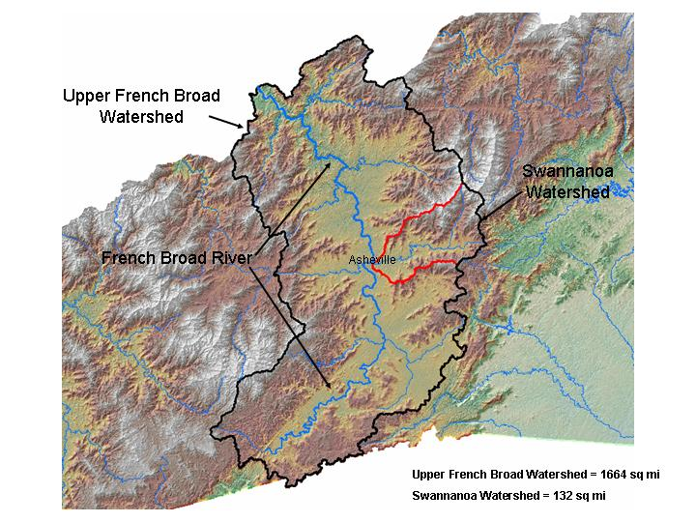
ATMS 373- Introduction
Mountain meteorology
Climate - precipitation
Courtesy: Greg Dobson

Slide 7
ATMS 373- Introduction
Mountain meteorology
Climate – precipitation
Striking contrasts in mean annual precipitation accumulations within relatively short distances
AVL v. Transylvania and Haywood Counties

Slide 8
ATMS 373- Introduction
Mountain meteorology
Climate – momentum
Mountains contribute to the “wavy” structure of our weather patterns
January (500 hPa), NH
Global three wave structure

Slide 9
Synoptic I – ATMS 410
Friction: momentum (source) sink

Slide 10
ATMS 373- Introduction
Mountain meteorology
Climate – momentum
Mountain wave drag
The effect of gravity waves that are generated in the atmosphere by flow over uneven terrain
Must be accounted for as the sink of momentum contributed by the mountains over a long period of time (general circulation models)

Slide 11
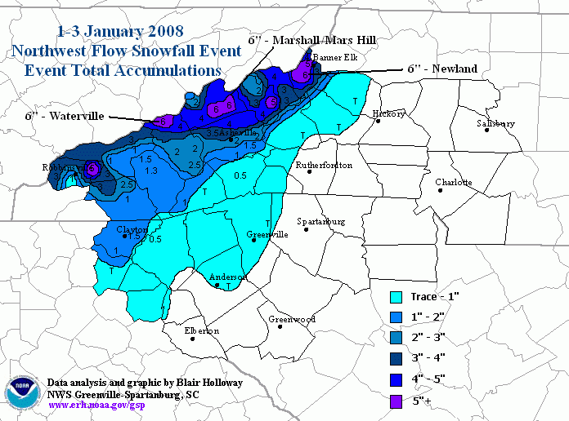
ATMS 373- Introduction
Mountain meteorology
Weather
Very localized effects
Precipitation
Temperature
Wind speeds
Wind direction
Moisture
http://www.erh.noaa.gov/gsp/localdat/NWFS_discussion_group/nwfs_discussion_group.html

Slide 12
ATMS 373- Introduction
Mountain meteorology
Weather
Snowfall

Slide 13
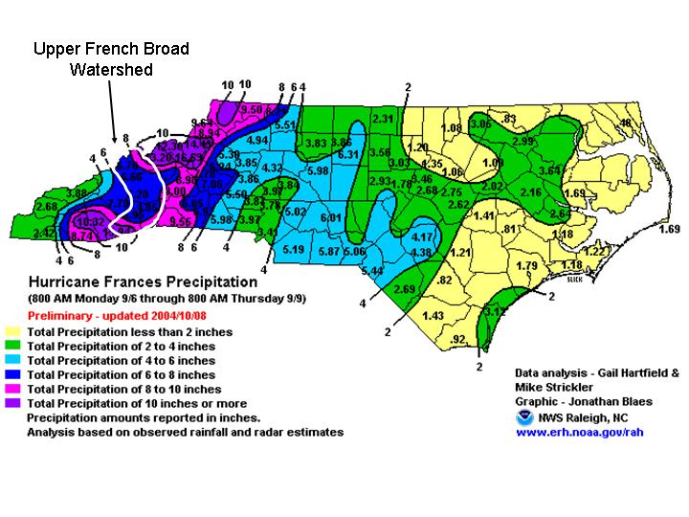
ATMS 373- Introduction
Mountain meteorology
Weather
Hurricanes

Slide 14
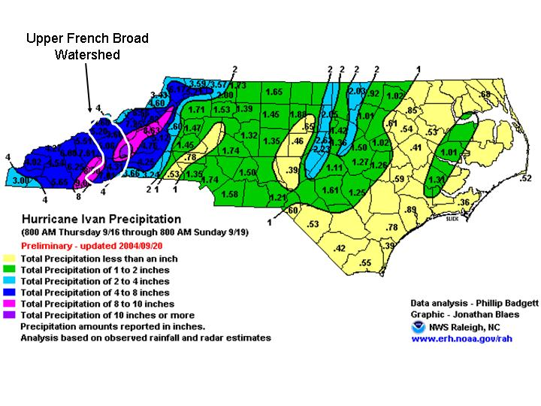
ATMS 373- Introduction
Mountain meteorology
Weather
Hurricanes

Slide 15
ATMS 373- Introduction
Mountain meteorology
Challenges in being able to understand and predict weather in the mountains
Note the “broad” nature of the accumulated precipitation maps

Slide 16
ATMS 373- Introduction
Mountain meteorology
Weather
Snowfall

Slide 17
ATMS 373- Introduction
Mountain meteorology
Climate - precipitation
Courtesy: Greg Dobson

Slide 18
ATMS 373- Introduction
Mountain meteorology
Challenges in being able to understand and predict weather in the mountains
Notice any apparent inconsistencies?
data (observations) void – lack of observations in the mountains, particularly at high elevations

Slide 19
ATMS 373- Introduction
http://www.nc-climate.ncsu.edu/cronos/map/index.php
data (observations) void – lack of observations in the mountains, particularly at high elevations

Slide 20
ATMS 373- Introduction
Mountain meteorology
A branch of “mesoscale meteorology”

Slide 21
ATMS 373- Introduction
Mesoscale meteorology
Various attempts at categorizing “mesoscale meteorology”

Slide 22
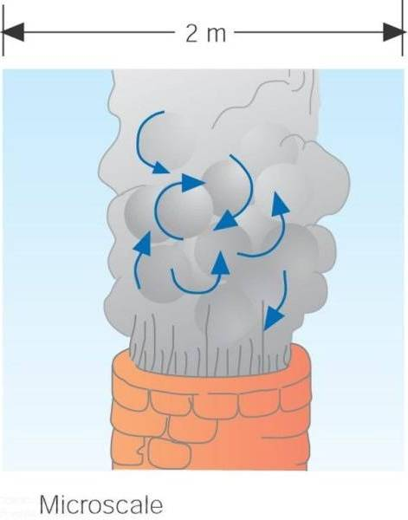
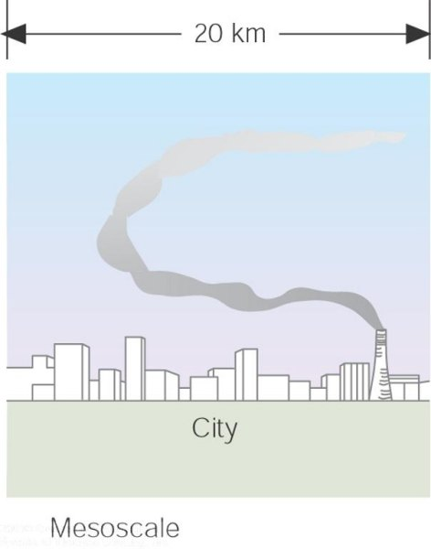
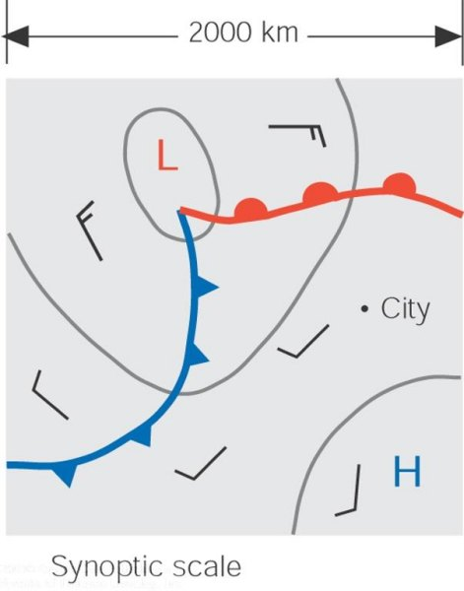
ATMS 373- Introduction
The tiny microscale motions... constitute a part of the larger mesoscale motions... which, in turn, are part of the much larger synoptic scale. Notice that as the scale becomes larger, motions observed at the smaller scale are no longer visible.

Slide 23
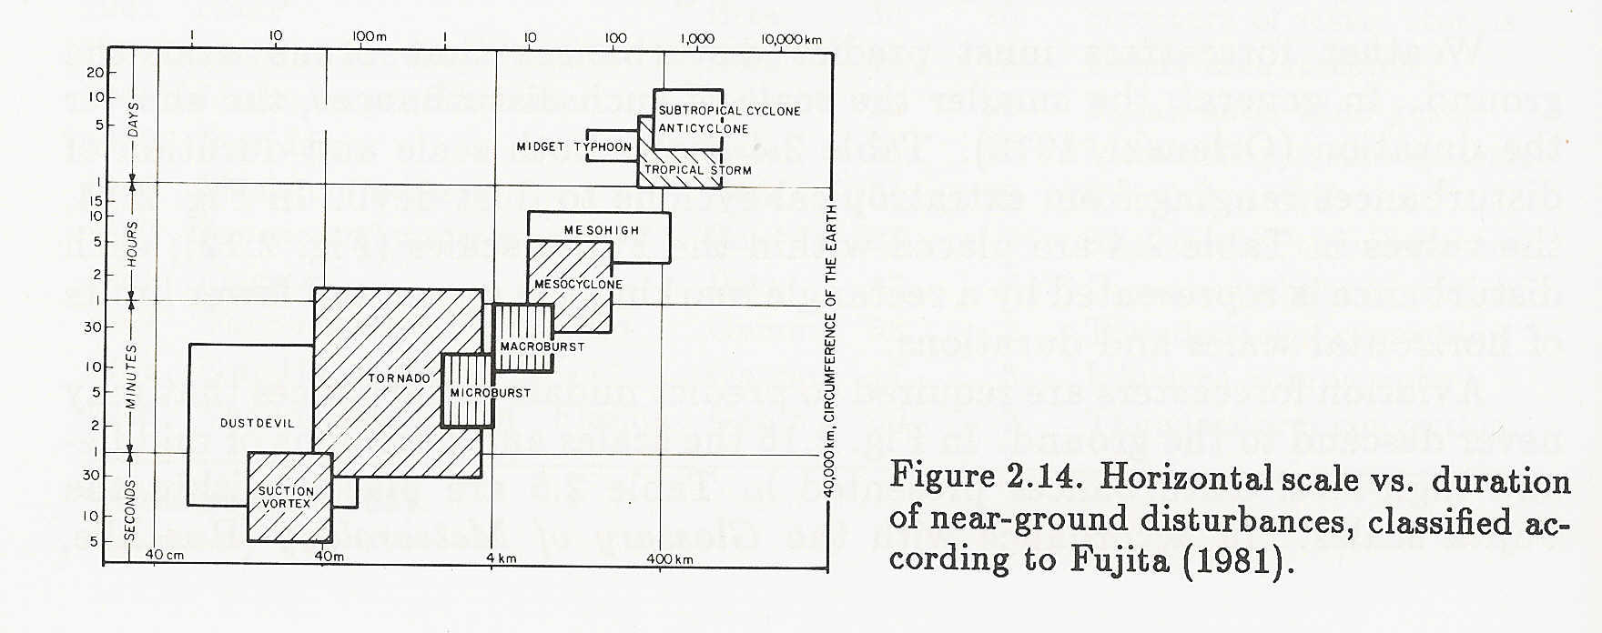
ATMS 373- Introduction
Mesoscale meteorology
near-ground disturbances
Horizontal scale is related to time scale (lifespan)

Slide 24
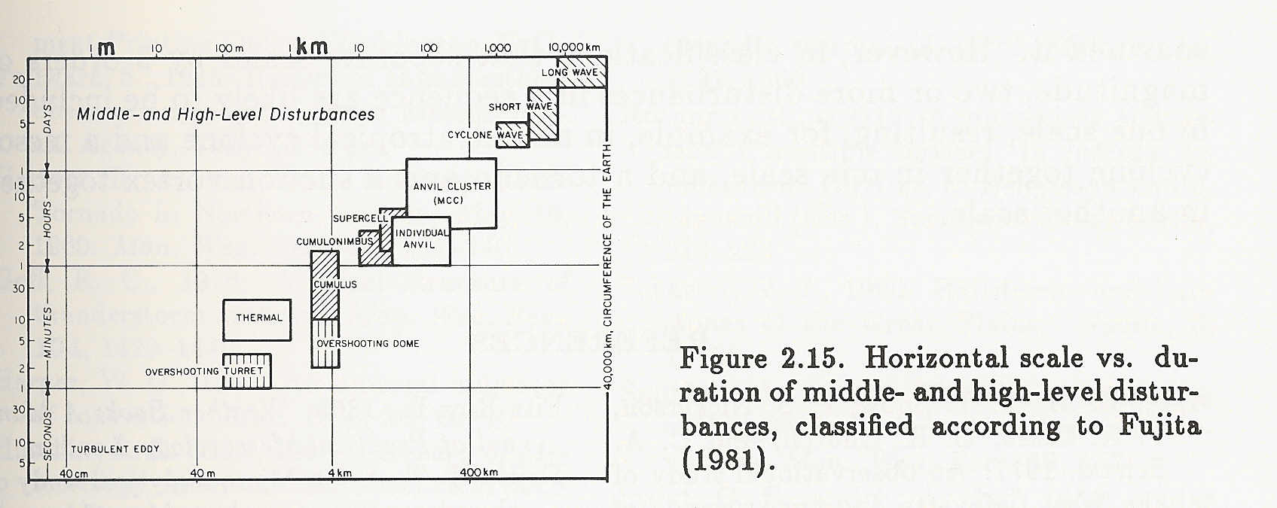
ATMS 373- Introduction
Mesoscale meteorology
upper-air disturbances
Horizontal scale is related to time scale (lifespan)

Slide 25
ATMS 373- Introduction
Mountain meteorology
Many mesoscale effects within mountain meteorology are driven by the synoptic-scale weather patterns
Applies generally to COOL season weather events

Slide 26
ATMS 373- Introduction
Mountain meteorology
Some mesoscale effects within mountain meteorology are driven primarily by very localized heating/cooling and the resulting flow channeling
Applies generally to WARM season weather events
Must have a favorable (weak) synoptic-scale weather pattern

Slide 27
ATMS 373- Mountain Meteorology
Topics
Mountain climates [LP#2]
Lee cyclogenesis (Article#1)
Clouds and fog [LP#3]
Precipitation [LP#4]
Cool season orographic storms (MetEd#1)
Impact on fronts (Article#2)
NW flow snowfall (Article#3)

Slide 28
ATMS 373- Mountain Meteorology
Topics (continued)
Terrain forced flows [LP#5] (MetEd#2)
Mountain waves (MetEd#3)
Windstorms (MetEd#3)
Gap flows (MetEd#4)
Barrier jet (MetEd#5)
Cold air damming (MetEd#6)
Coastal jet (MetEd#7)
Coastally-trapped wind reversals (MetEd#8)

Slide 29
ATMS 373- Mountain Meteorology
Topics (continued)
Diurnal mountain winds [LP#6]
Impact on convection (Article#4)
Impact on tornadoes (Article#5)

Slide 30
ATMS 373- Mountain Meteorology
Literature search
Environment Complete (on UNCA campus):
http://library.unca.edu/az.php
click on “Environment Complete” entry
“Advanced Search”
Enter Topic (key word[s])
Enter Author (last name, initials), click “Search ”
Select “Scholarly (Peer Reviewed) Journals”
Document Type: Article
Publication Type: Academic Journal

