Slide 1
Portland, Oregon Ice Storm
8-9 December 2016

Slide 2
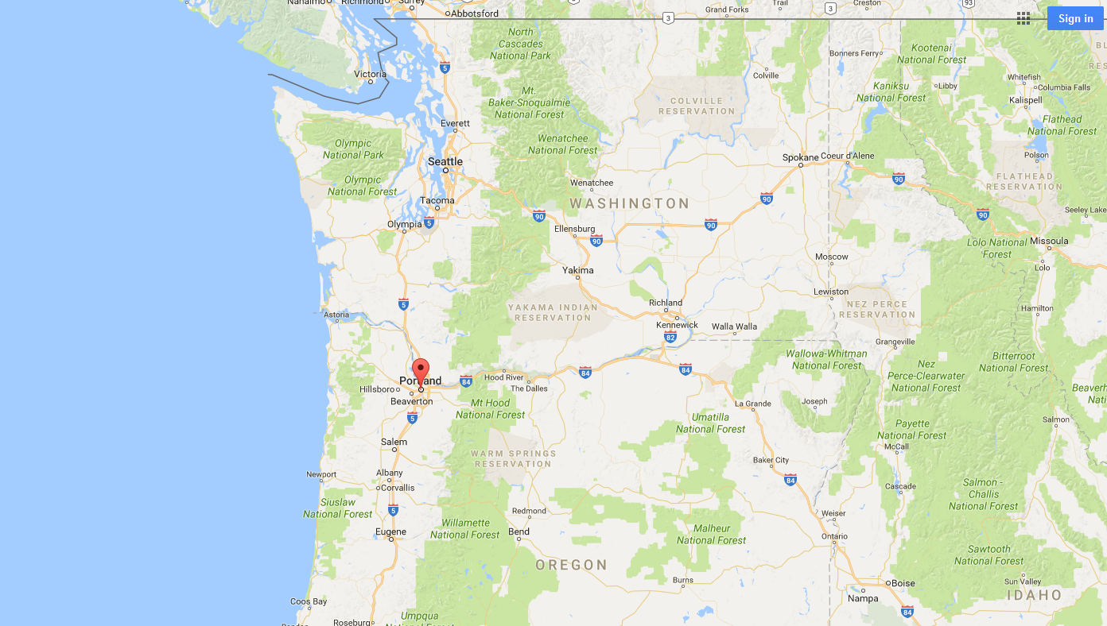

Slide 3
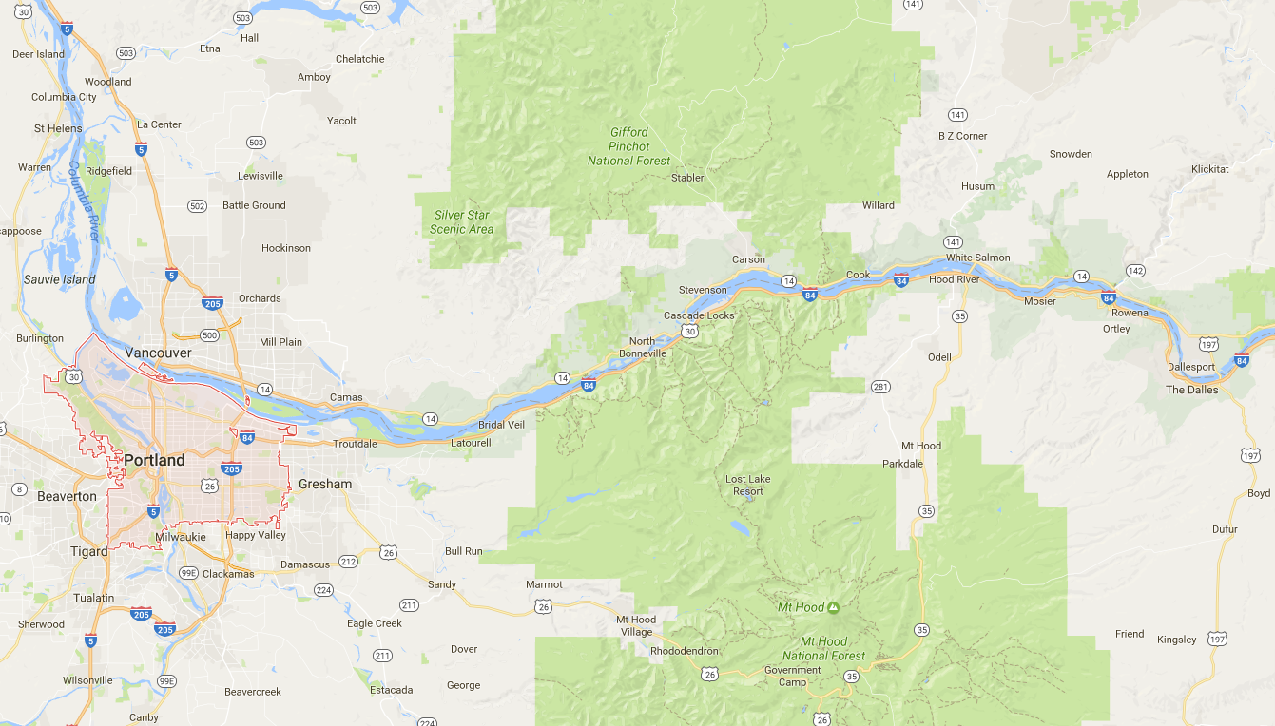

Slide 4
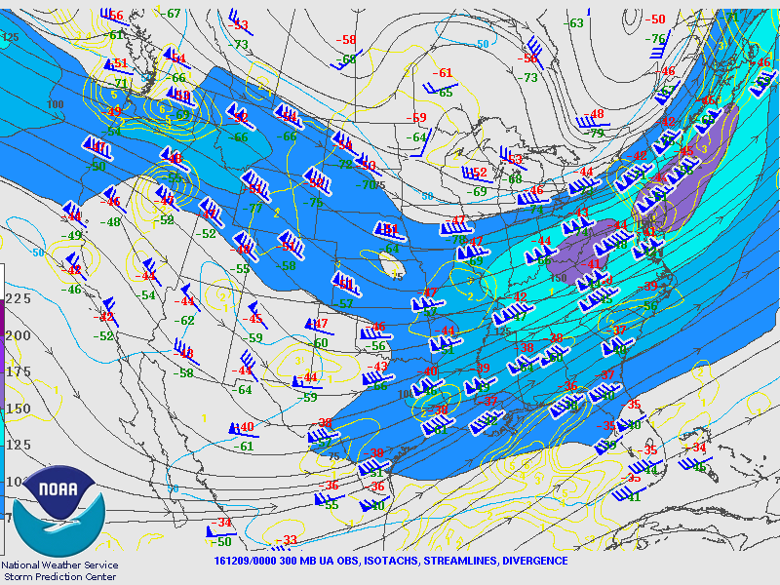
300 hPa level – 0000 UTC 9 Dec 2016

Slide 5
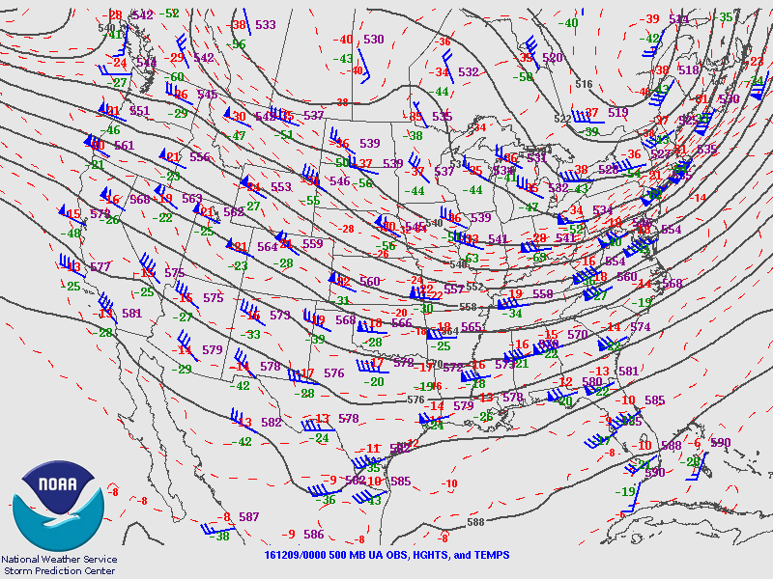
500 hPa level – 0000 UTC 9 Dec 2016

Slide 6
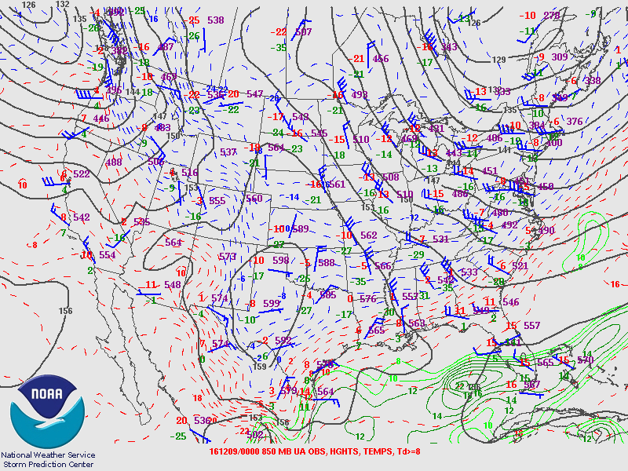
850 hPa level – 0000 UTC 9 Dec 2016

Slide 7
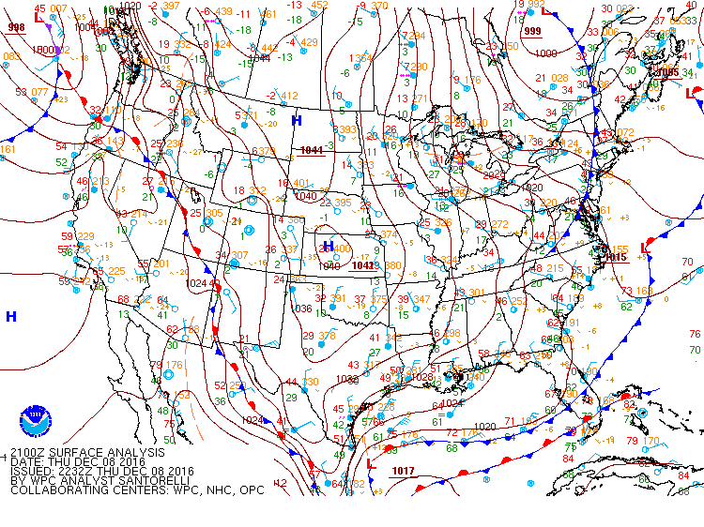
SLP– 2100 UTC 8 Dec 2016

Slide 8
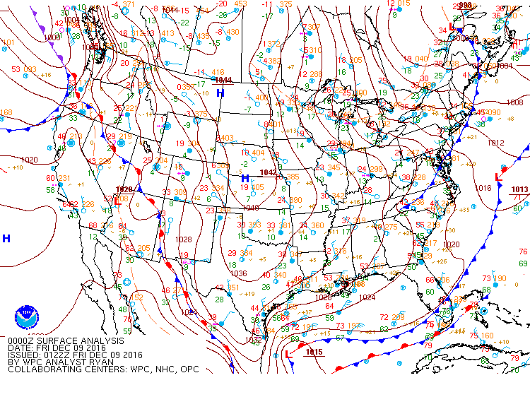
SLP– 0000 UTC 9 Dec 2016

Slide 9
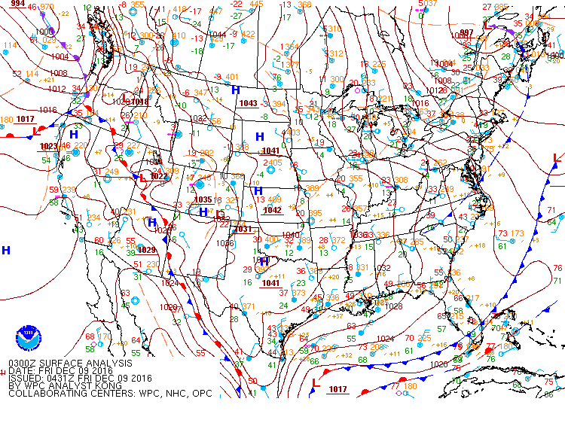
SLP– 0300 UTC 9 Dec 2016

Slide 10
http://www2.mmm.ucar.edu/imagearchive/

Slide 11
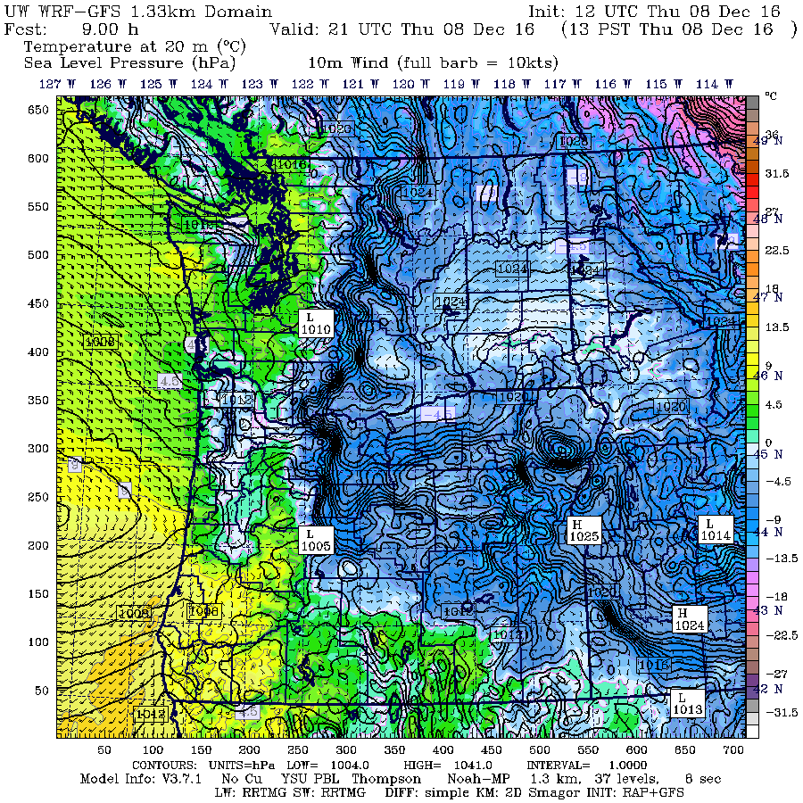

Slide 12
0000 UTC 9 December 2016
120 km
1022.8 hPa
1012.1 hPa

Slide 13
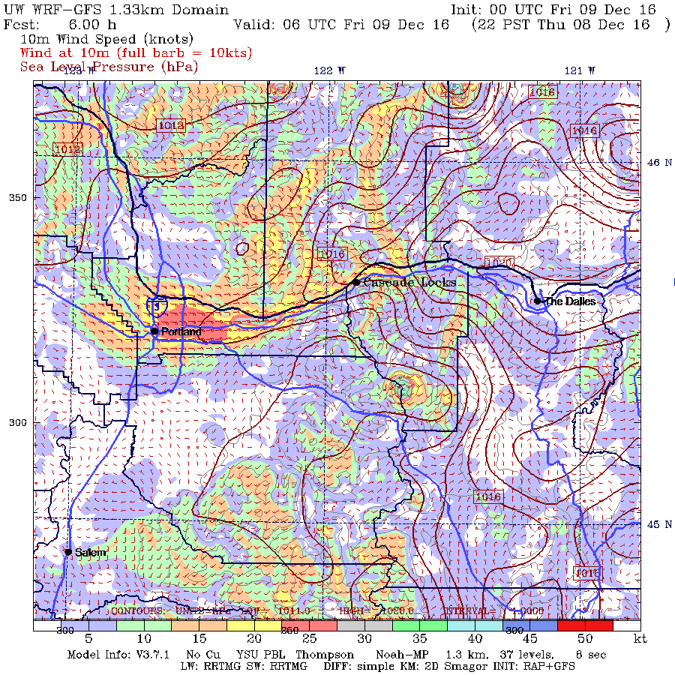

Slide 14
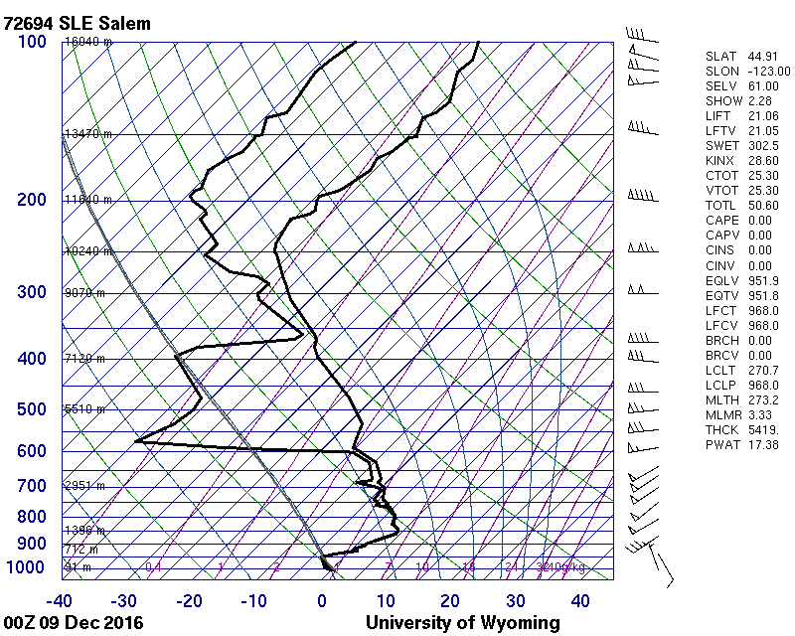

Slide 15
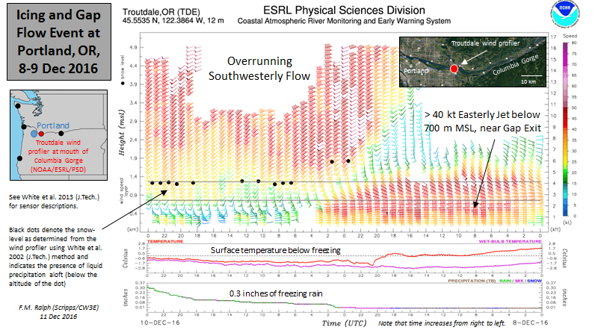

Slide 16
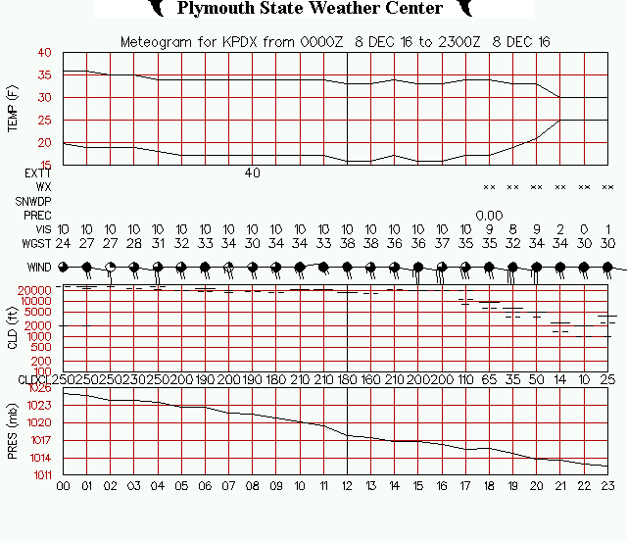

Slide 17
