Slide 1
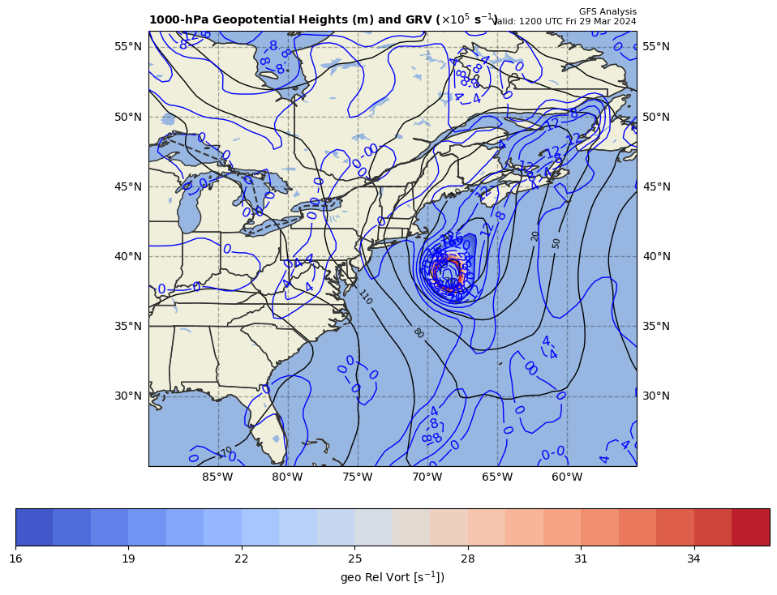
1000 hPa Z/Geo Rel Vort at t0
+

Slide 2
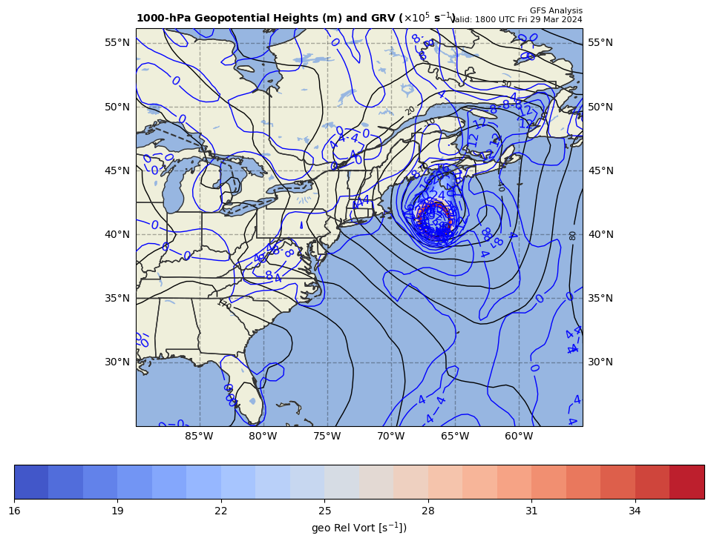
1000 hPa Z/Geo Rel Vort at t1
+
+

Slide 3
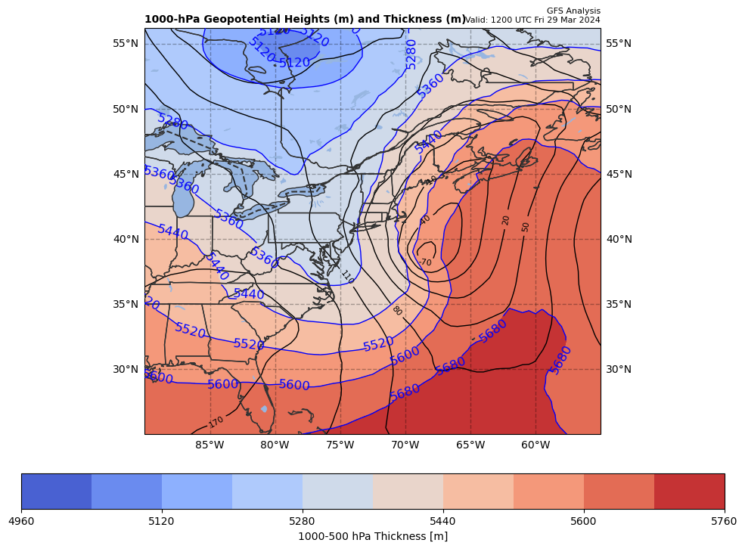
1000 hPa Z/10-5 thick (m) at t0
+

Slide 4
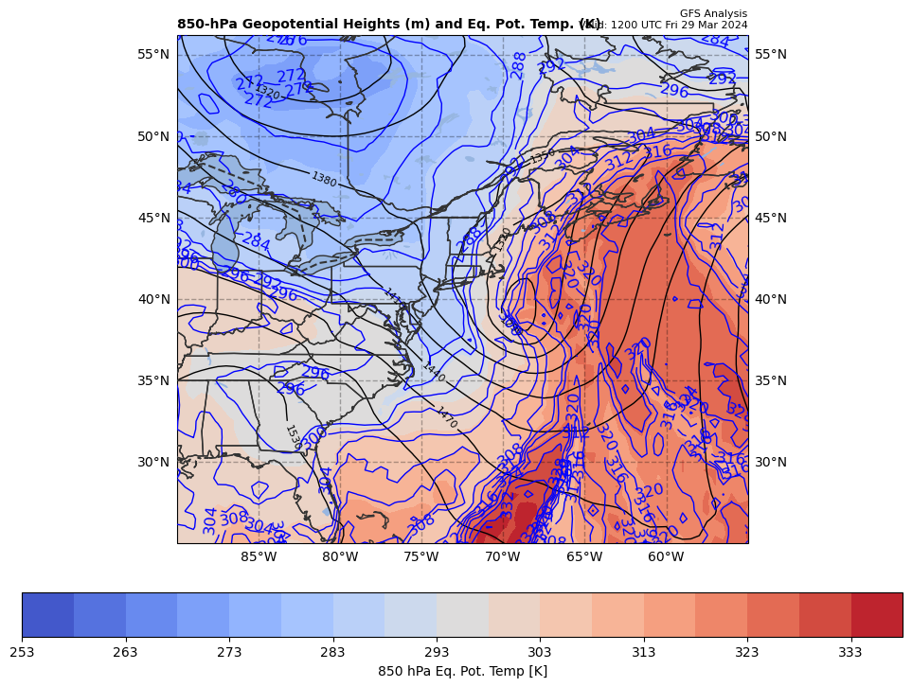
850 hPa Z, THTE at t0
+

Slide 5
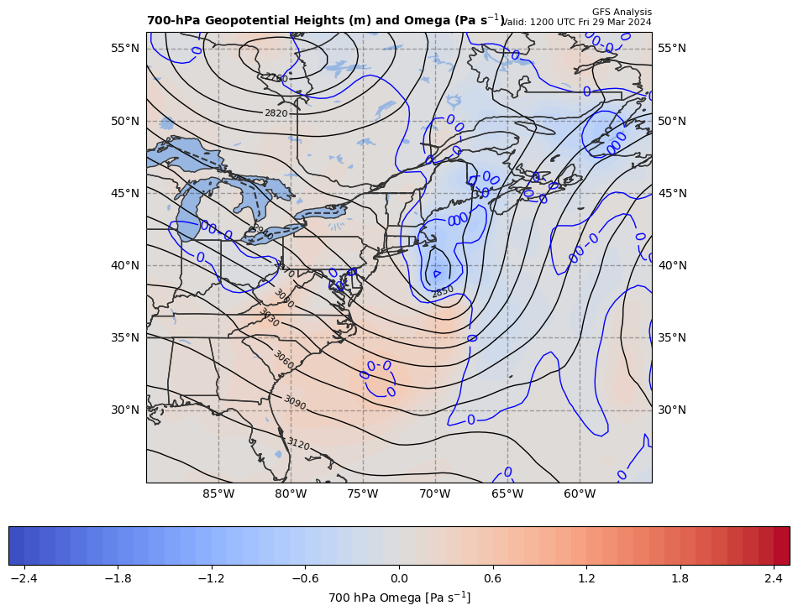
700 hPa Z & Omega at t0
+

Slide 6
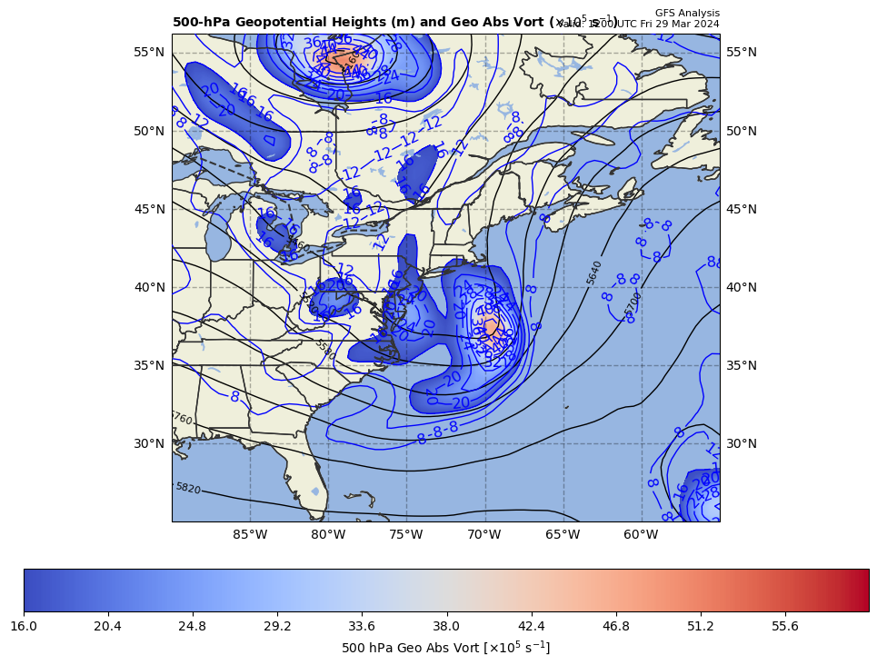
500 hPa Z, Geo Abs Vort at t0
+

Slide 7
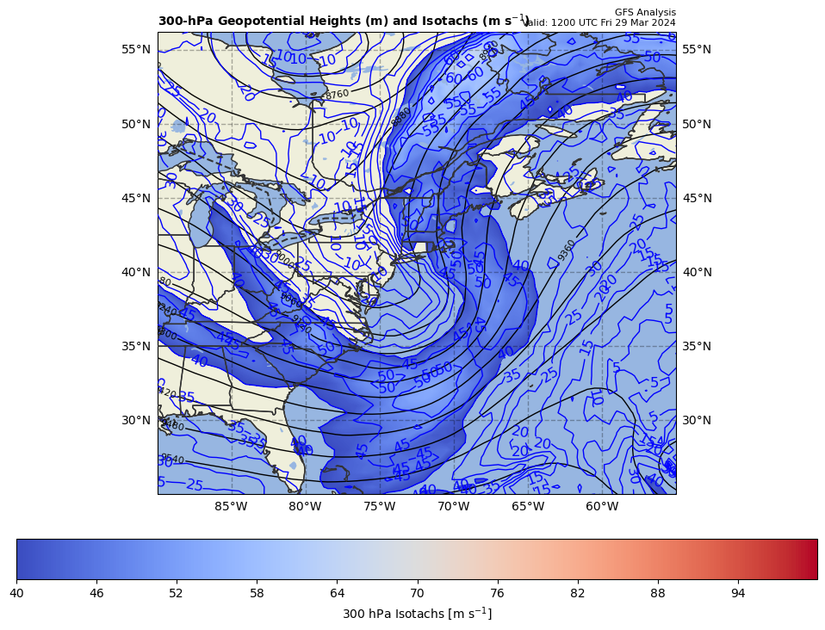
300 hPa Z, WS at t0
+

Slide 8
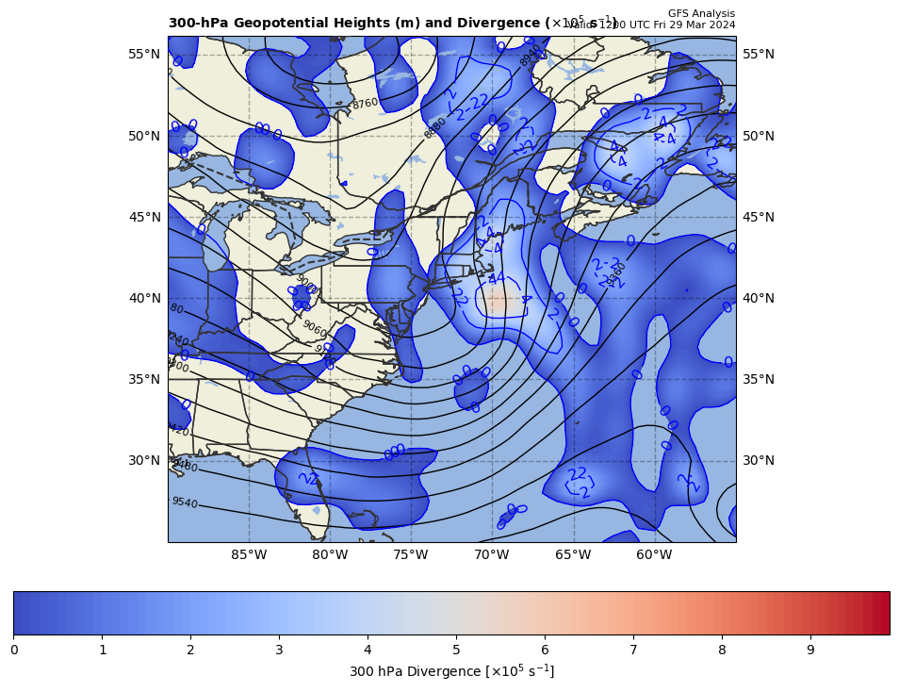
300 hPa Z, Div at t0
+

Slide 9
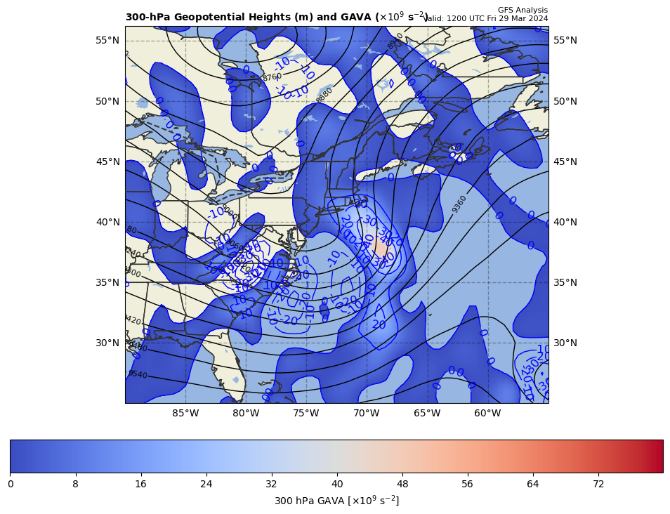
300 hPa Z, GAVA at t0
+

Slide 10
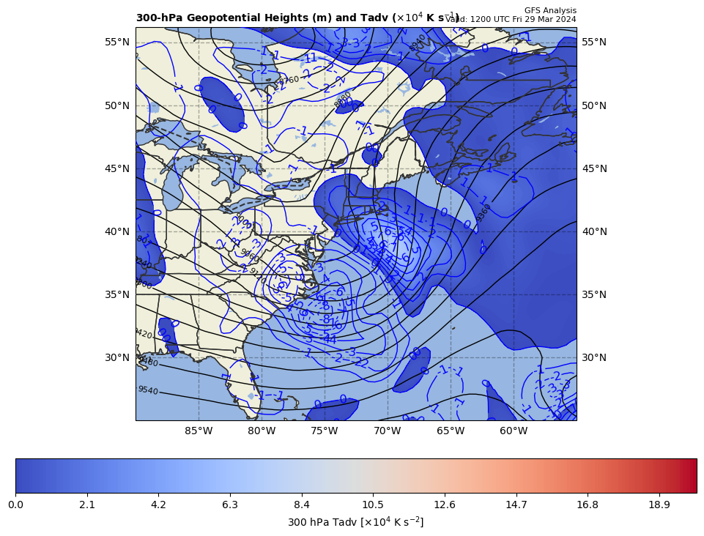
300 hPa Z, Temp Adv at t0
+

Slide 11
29 Mar 2024 case study facts:
1000 hPa cyclone center (9 pt smoother, once)
t0 = 1200 UTC 29 March 2024
Z₀ = −80.7 m at 39.00ºN, 68.50ºW
t1 = 1800 UTC 29 March 2024
Z₀ = −153.3 m at 41.00ºN, 66.50ºW
Map projection
ax.set_extent([-90,-55, 25, 55]) # case 9
cart_proj=ccrs.PlateCarree(central_longitude= -60.0) # Case 9

