Slide 1
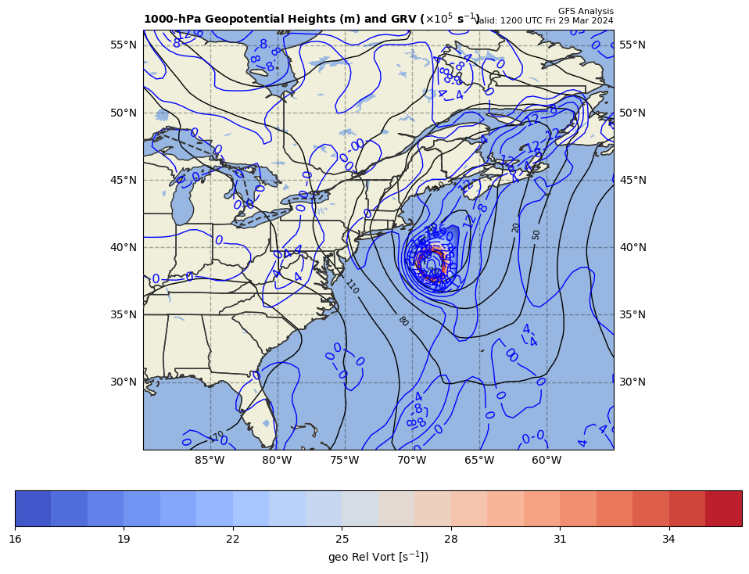
1000 hPa Z/Geo Rel Vort at t0
+

Slide 2
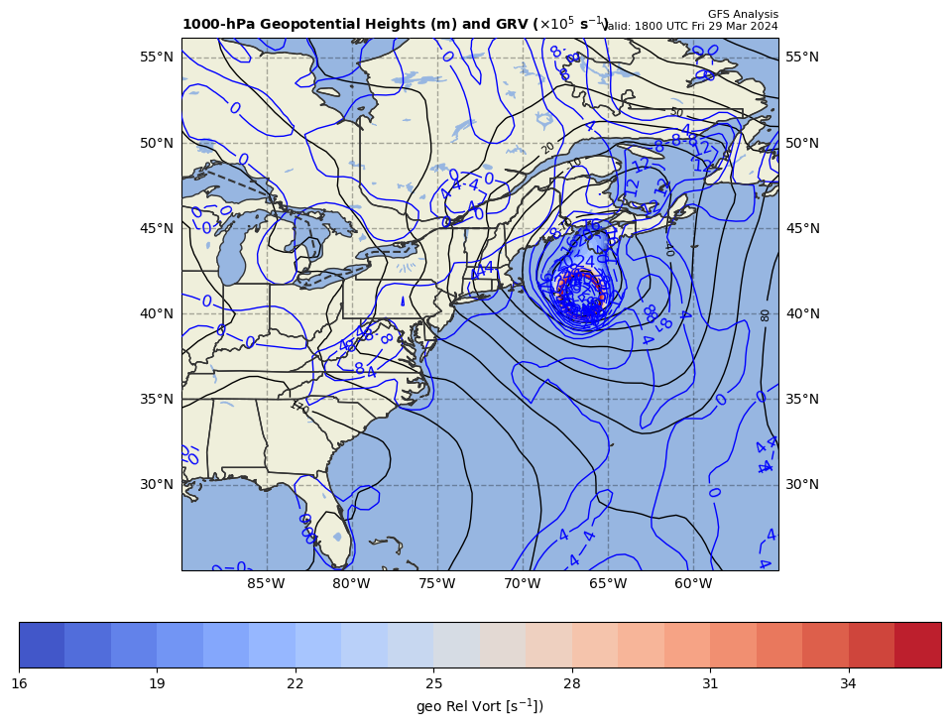
1000 hPa Z/Geo Rel Vort at t1
+
+

Slide 3
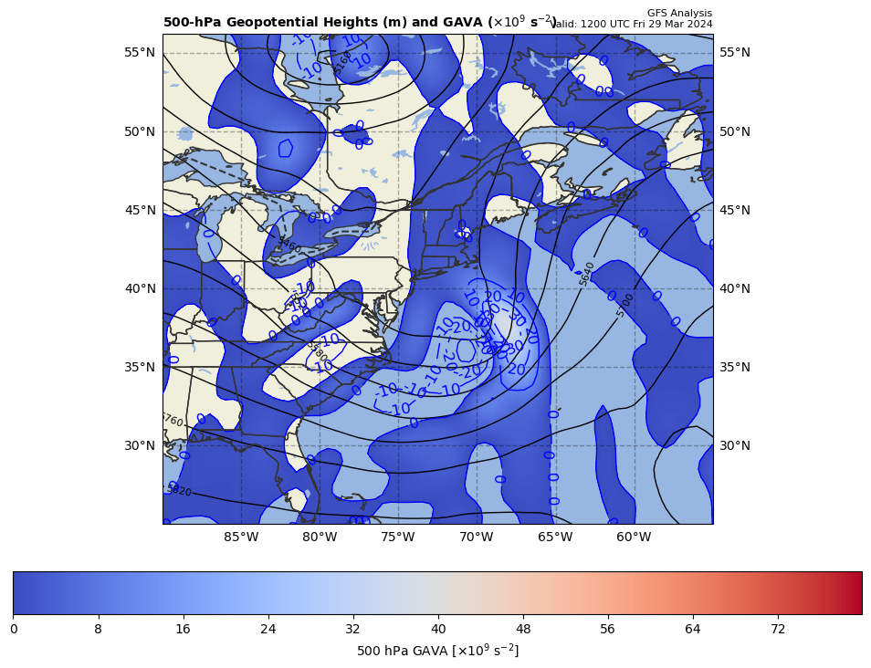
12Z GAVA (x 10⁻⁹ s⁻²); negative at 18Z position
+
−1.018392 x 10⁻⁹ s⁻²
Giving a negative GAVA contribution to cyclogenesis

Slide 4
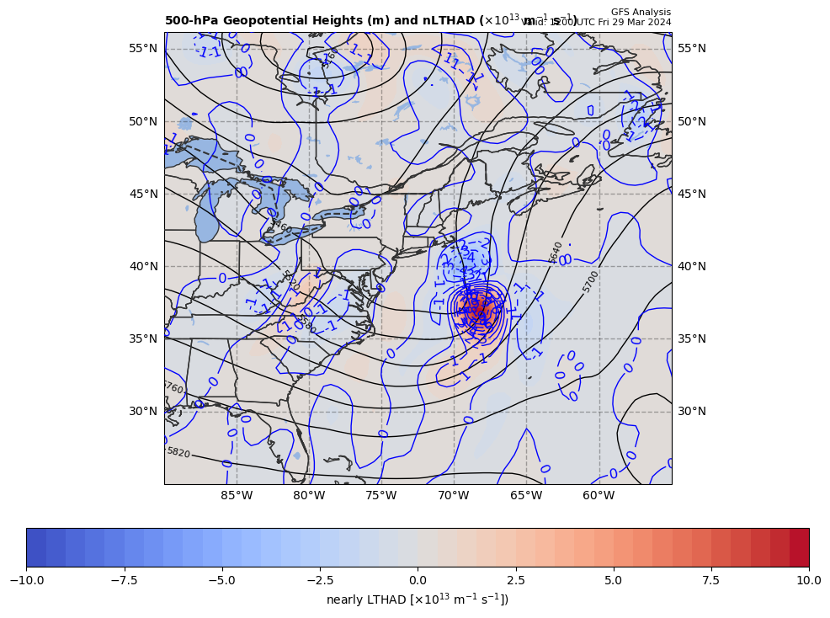
12Z nearly LTHAD (x 10⁻¹³ m⁻¹s⁻¹); negative at 18Z position
OLD WAY!!
+
-[9.81 m s⁻²/ (9.541992x10⁻⁵ s⁻¹)]*(-0.2056993x10⁻¹³ m⁻¹s⁻¹) = +2.114769 x 10⁻⁹ s⁻²
So, multiply by –g/f, giving a positive LTHAD contribution to cyclogenesis

Slide 5
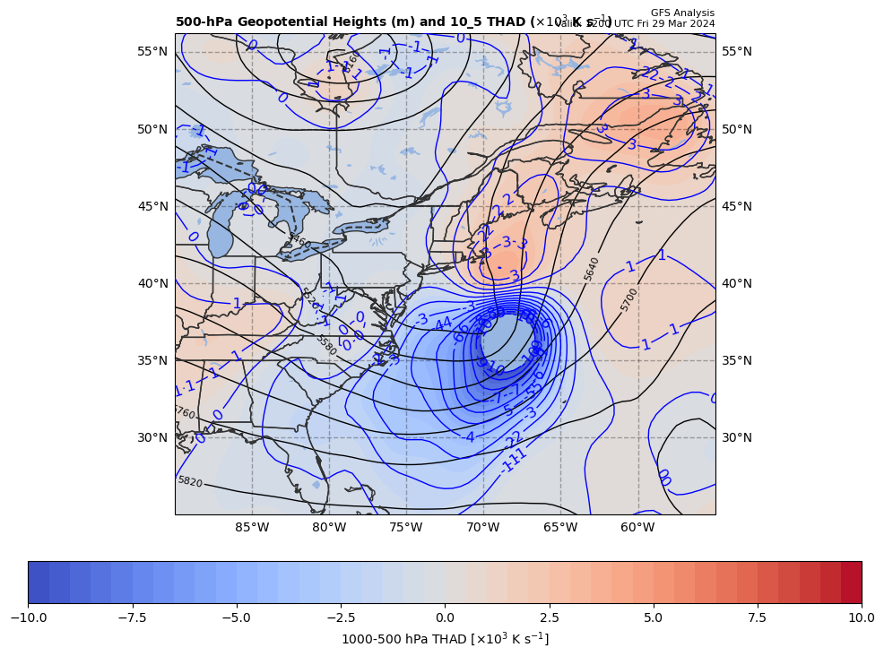
12Z nearly LTHAD (x 10⁻¹³ m⁻¹s⁻¹); negative at 18Z position
THAD field shown
NEW WAY!!
+
-[9.81 m s⁻²/ (9.541992x10⁻⁵ s⁻¹)]*(-0.2056993x10⁻¹³ m⁻¹s⁻¹) = +2.114769 x 10⁻⁹ s⁻²
So, multiply by –g/f, giving a positive LTHAD contribution to cyclogenesis

Slide 6
12Z nearly LTHAD (x 10⁻¹³ m⁻¹s⁻¹); negative at 18Z position
+2.36
+
THAD field shown
x 10⁻³ m s⁻¹
NEW WAY!!
0.5º long. = 83.77 km
+
+3.13
+
+
+
+1.99
+
+
+1.24
+
+
+0.64
-[9.81 m s⁻²/ (9.541992x10⁻⁵ s⁻¹)]*(-2.575991x10⁻¹⁴ m⁻¹s⁻¹) = +2.648344 x 10⁻⁹ s⁻²
So, multiply by –g/f, giving a positive LTHAD contribution to cyclogenesis

Slide 7
Coriolis parameter= 9.541992E-05 for Lat= 41.0
GARP-based LTHAD= 2.114769E-09
finite diff-based LTHAD= 2.648344E-09
d2tdx2, d2tdy2, xnnLTHAD= 5.486429E-14 -8.062420E-14 -2.575991E-14

Slide 8
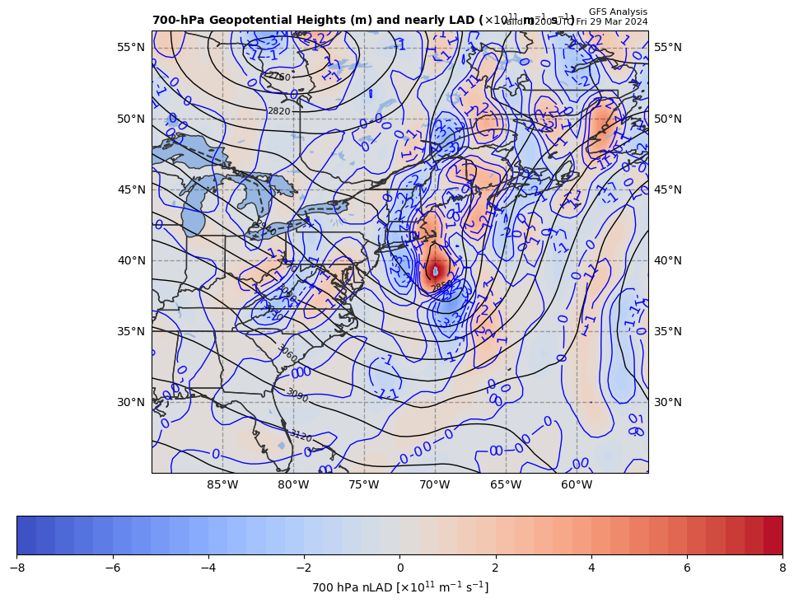
12Z nearly 700 hPa LAD (x 10⁻¹³ units); positive at 18Z position
+
+2.648344 x 10⁻⁹ s⁻² * 85% = −2.251092 x 10⁻⁹ s⁻²
So, multiply by –g/f, giving a negative LAD contribution to cyclogenesis

Slide 9
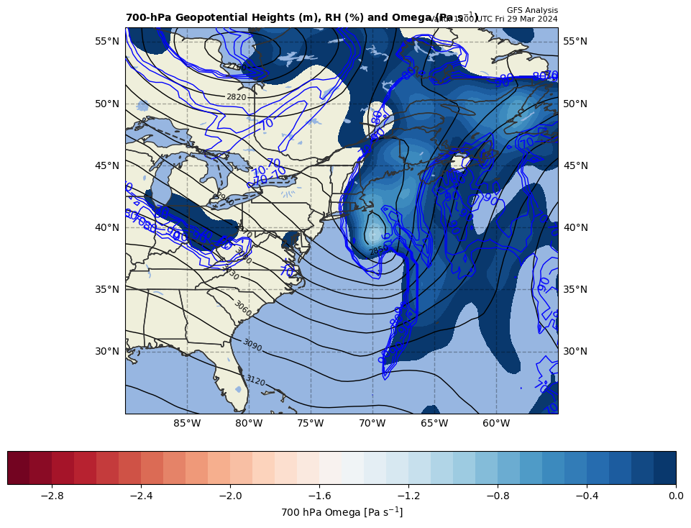
12Z nearly LDIA; latent heat release at 18Z position
+
2.251092 x 10⁻⁹ s⁻² * 70% = +1.575765 x 10⁻⁹ s⁻²
ω < 0 mb s⁻¹ & RH > 70%!!!

Slide 10
Calculations
Sum of terms on RHS = GAVA + LTHAD + LAD + LDIA
= +2.991408 x 10⁻¹⁰ s⁻²
Finite difference approximation of LHS = ∂GRV/∂t
= [(57.87 – {16.02}]) x 10⁻⁵ s⁻¹ ] / [6 h * 60 min/h * 60 s/min]
= +19.375 x 10⁻⁹ s⁻²
RHS = +0.1544 x LHS

Slide 11
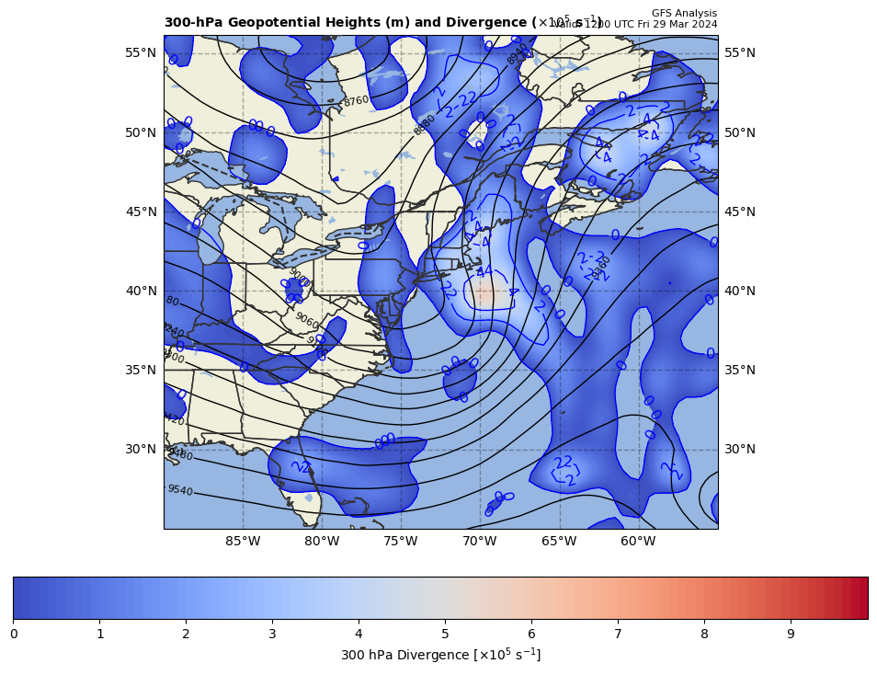
300 hPa Z, Div at t0
+
[∼0]

Slide 12
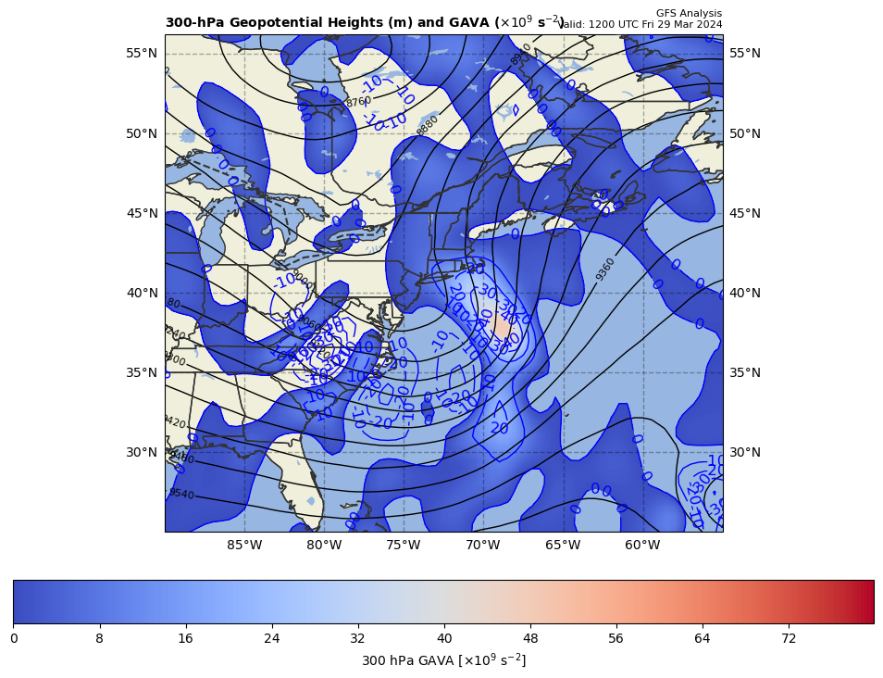
300 hPa Z, GAVA at t0
+
[+]

Slide 13
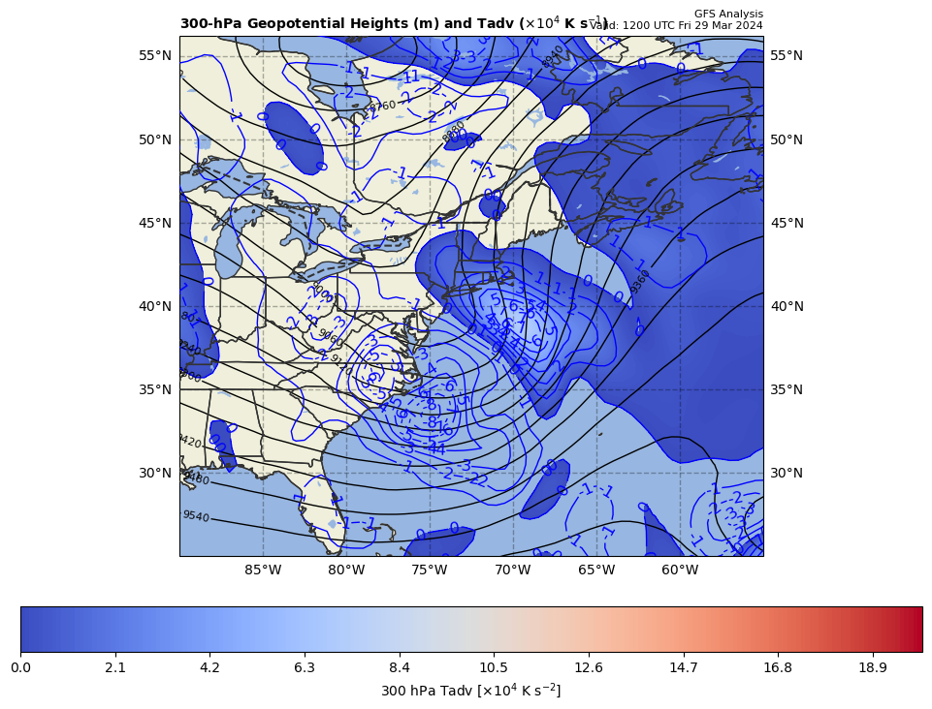
300 hPa Z, Temp Adv at t0
+
[+]

