Slide 1
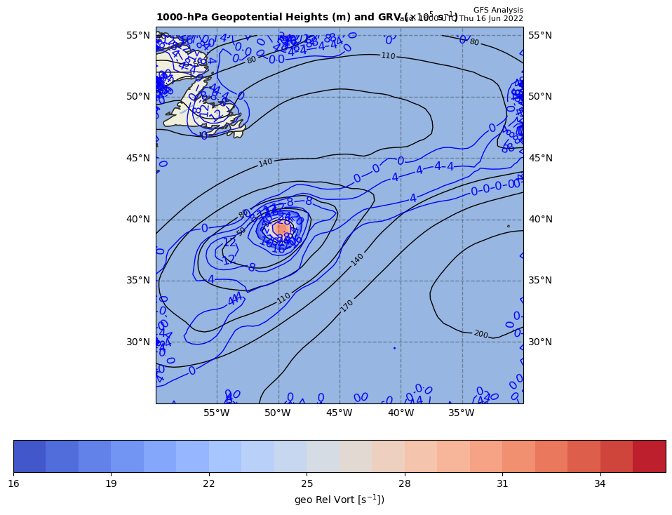
1000 hPa Z/Geo Rel Vort at t0
+

Slide 2
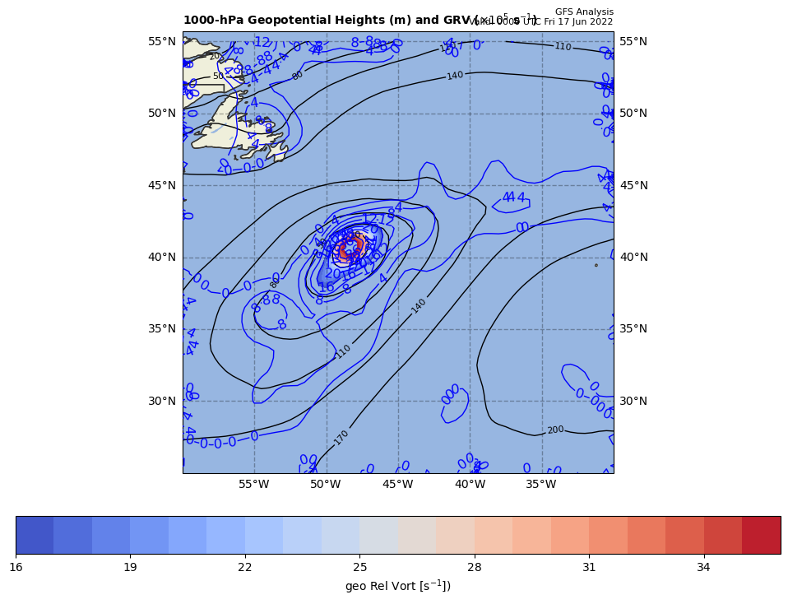
1000 hPa Z/Geo Rel Vort at t1
+
+

Slide 3
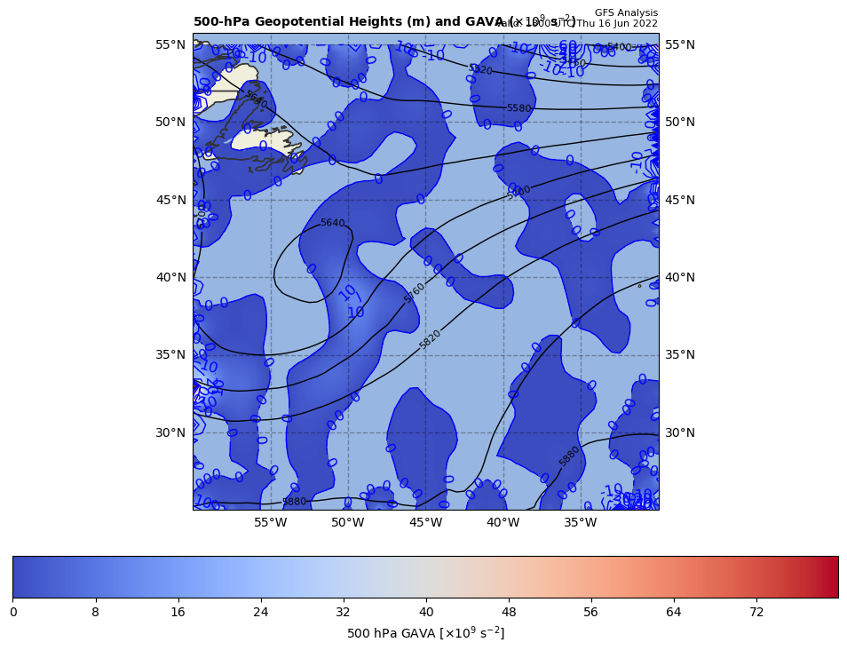
18Z GAVA (x 10⁻⁹ s⁻²); negative at 00Z position
+
−1.00 x 10⁻⁹ s⁻²
Giving a negative GAVA contribution to cyclogenesis

Slide 4
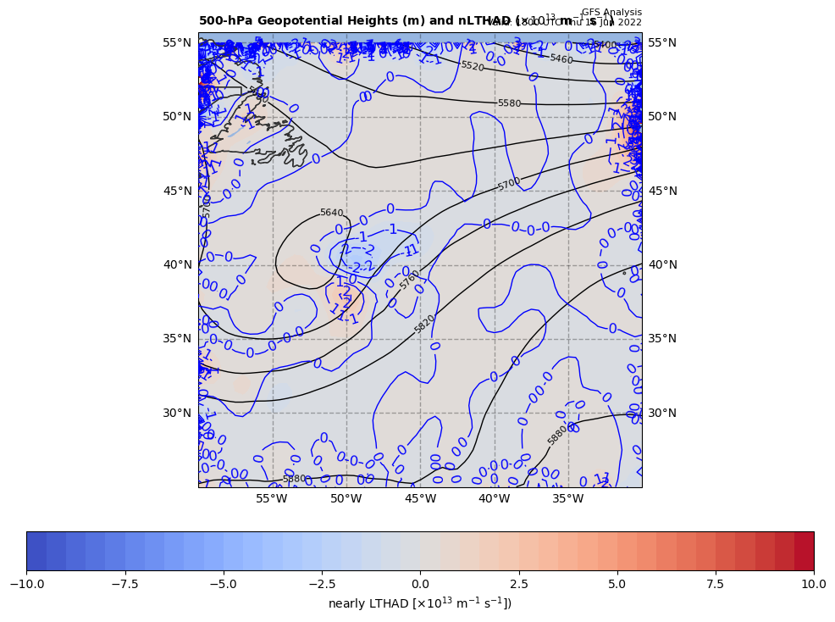
18Z nearly LTHAD (x 10⁻¹³ m⁻¹s⁻¹); negative at 00Z position
OLD WAY!!
+
-[9.81 m s⁻²/ (9.445839x10⁻⁵ s⁻¹)]*(-2.234 x10⁻¹³ m⁻¹s⁻¹) = +2.32016 x 10⁻⁸ s⁻²
So, multiply by –g/f, giving a positive LTHAD contribution to cyclogenesis

Slide 5
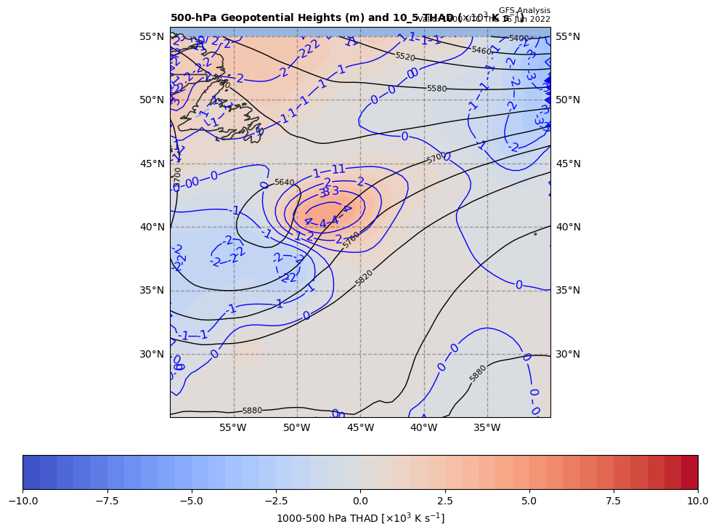
18Z nearly LTHAD (x 10⁻¹³ m⁻¹s⁻¹); negative at 00Z position
THAD field shown
NEW WAY!!
+
-[9.81 m s⁻²/ (9.445839x10⁻⁵ s⁻¹)]*(-2.234 x10⁻¹³ m⁻¹s⁻¹) = +2.32016 x 10⁻⁸ s⁻²
So, multiply by –g/f, giving a positive LTHAD contribution to cyclogenesis

Slide 6
18Z nearly LTHAD (x 10⁻¹³ m⁻¹s⁻¹); negative at 00Z position
+2.91
+
THAD field shown
x 10⁻³ m s⁻¹
NEW WAY!!
0.5º long. = 84.41 km
+
+3.82
+
+
+
+4.32
+
+
+4.18
+
+
+4.16
-[9.81 m s⁻²/ (9.445839x10⁻⁵ s⁻¹)]*(-2.1466x10⁻¹³ m⁻¹s⁻¹) = +2.2293 x 10⁻⁸ s⁻²
So, multiply by –g/f, giving a positive LTHAD contribution to cyclogenesis

Slide 7
Coriolis parameter= 9.445839E-005 for Lat= 40.5
GARP-based LTHAD= 2.320165E-008
finite diff-based LTHAD= 2.229317E-008
d2tdx2, d2tdy2, xnnLTHAD= -8.845564E-014 -1.262005E-013 -2.146562E-013

Slide 8
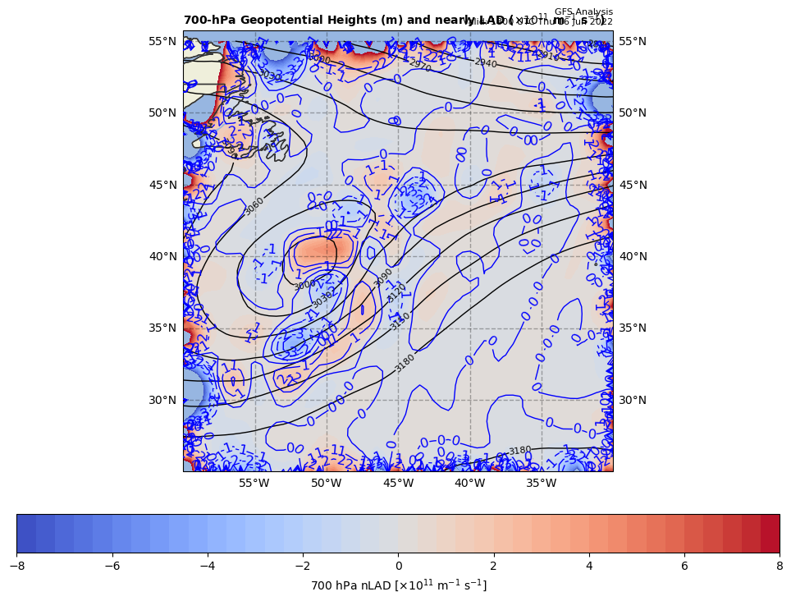
18Z nearly 700 hPa LAD (x 10⁻¹³ units); positive at 00Z position
+
+2.2293 x 10⁻⁹ s⁻² * 85% = −1.89492 x 10⁻⁸ s⁻²
So, multiply by –g/f, giving a negative LAD contribution to cyclogenesis

Slide 9
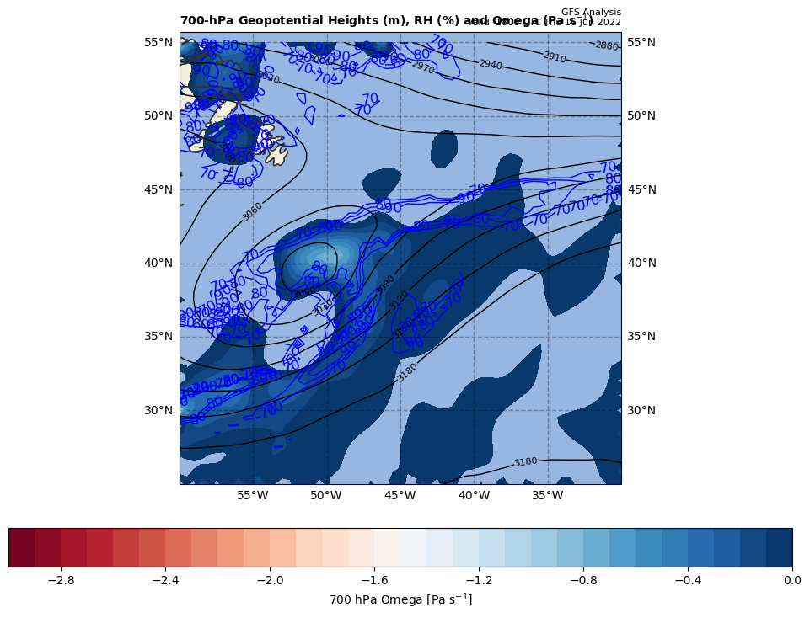
18Z nearly LDIA; latent heat release at 00Z position
+
1.89492 x 10⁻¹⁰ s⁻² * 70% = +1.326444 x 10⁻⁸ s⁻²
ω < 0 mb s⁻¹ & RH > 70%!!!

Slide 10
Calculations
Sum of terms on RHS = GAVA + LTHAD + LAD + LDIA
= +15.6079 x 10⁻⁹ s⁻²
Finite difference approximation of LHS = ∂GRV/∂t
= [(39.00 – {32.01}]) x 10⁻⁵ s⁻¹ ] / [6 h * 60 min/h * 60 s/min]
= +3.23611 x 10⁻⁹ s⁻²
RHS = +4.8230 x LHS

Slide 11
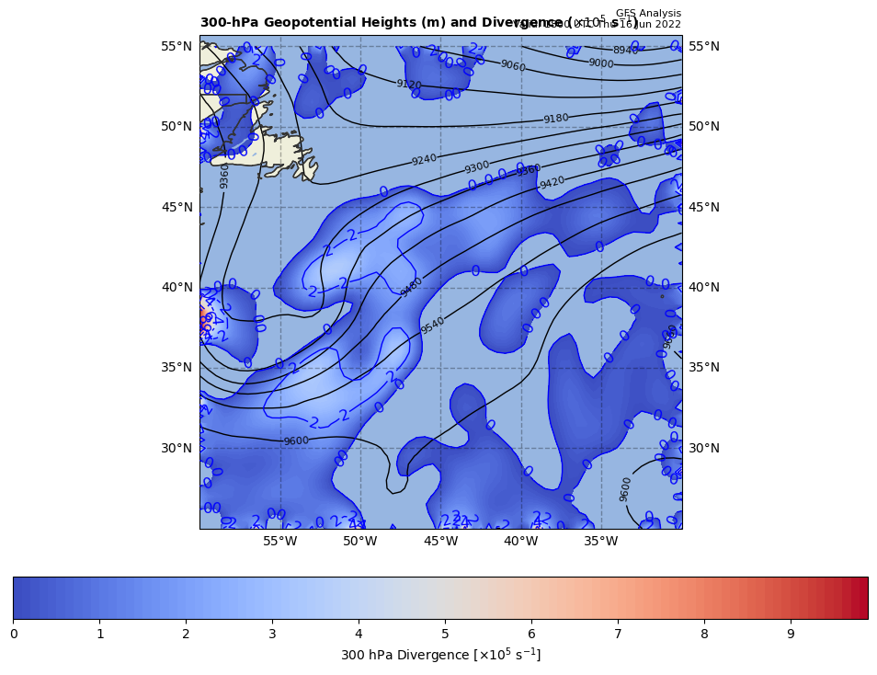
300 hPa Z, Div at t0
+
[+]

Slide 12
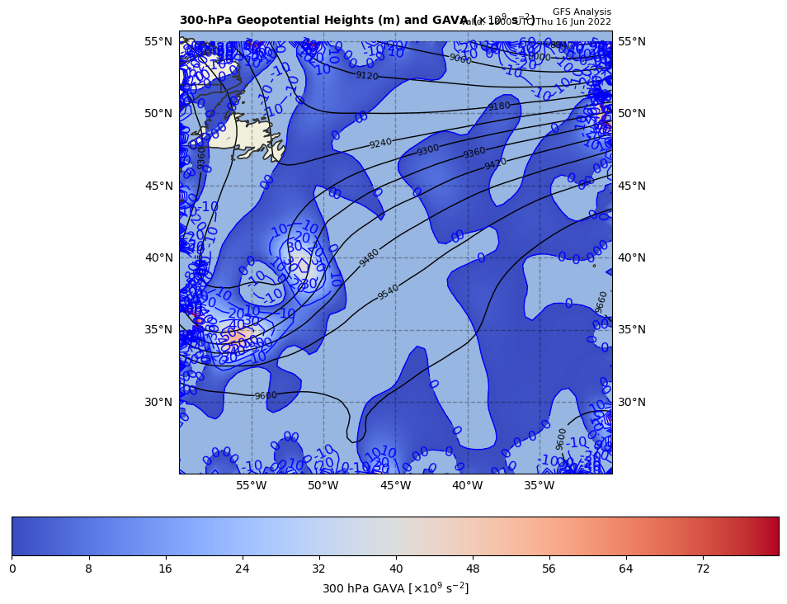
300 hPa Z, GAVA at t0
+
[−]

Slide 13
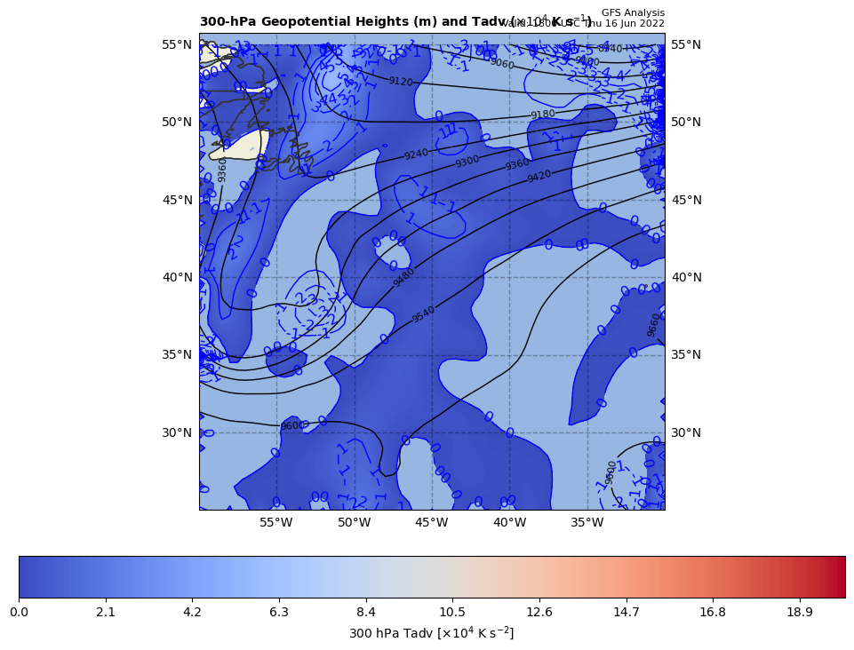
300 hPa Z, Temp Adv at t0
+
[+, ∼0]

