Slide 1
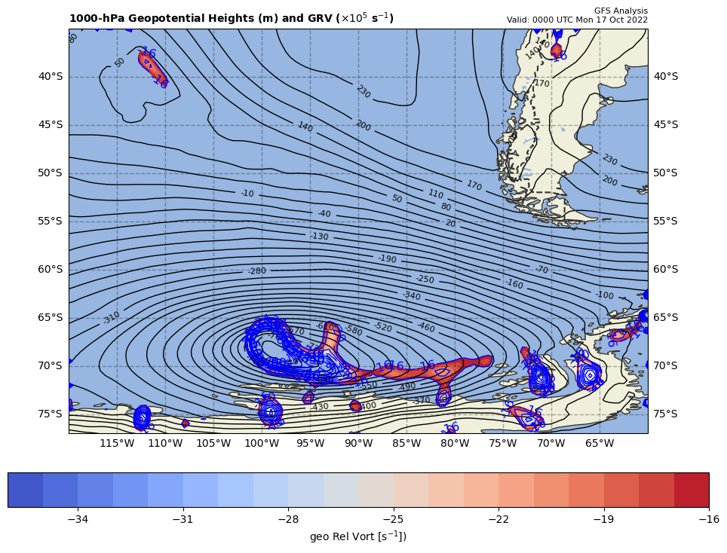
1000 hPa Z/Geo Rel Vort at t0
+

Slide 2
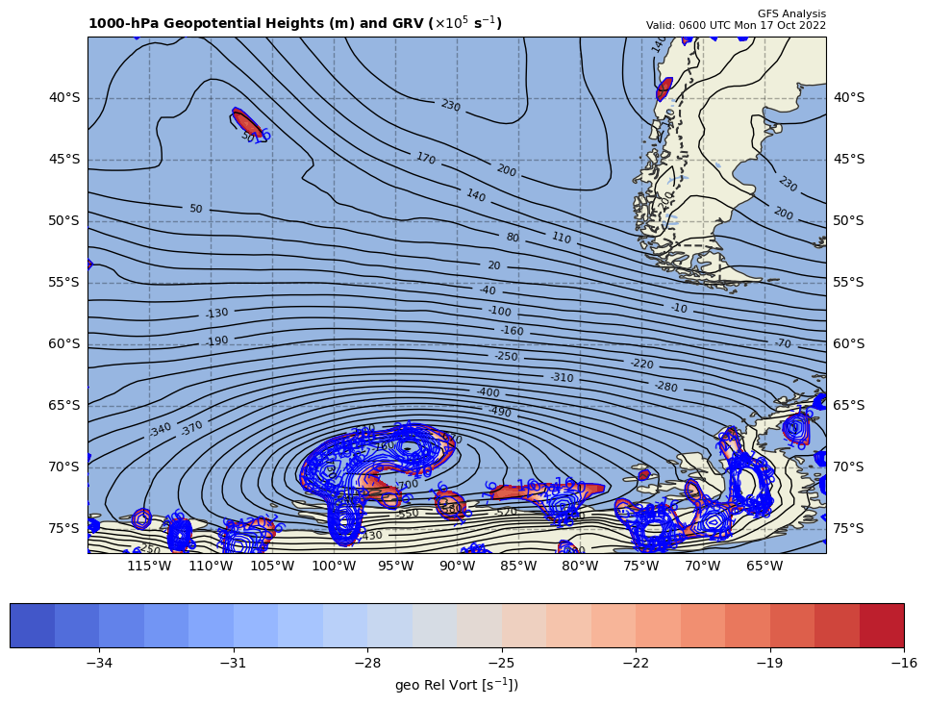
1000 hPa Z/Geo Rel Vort at t1
+
+

Slide 3
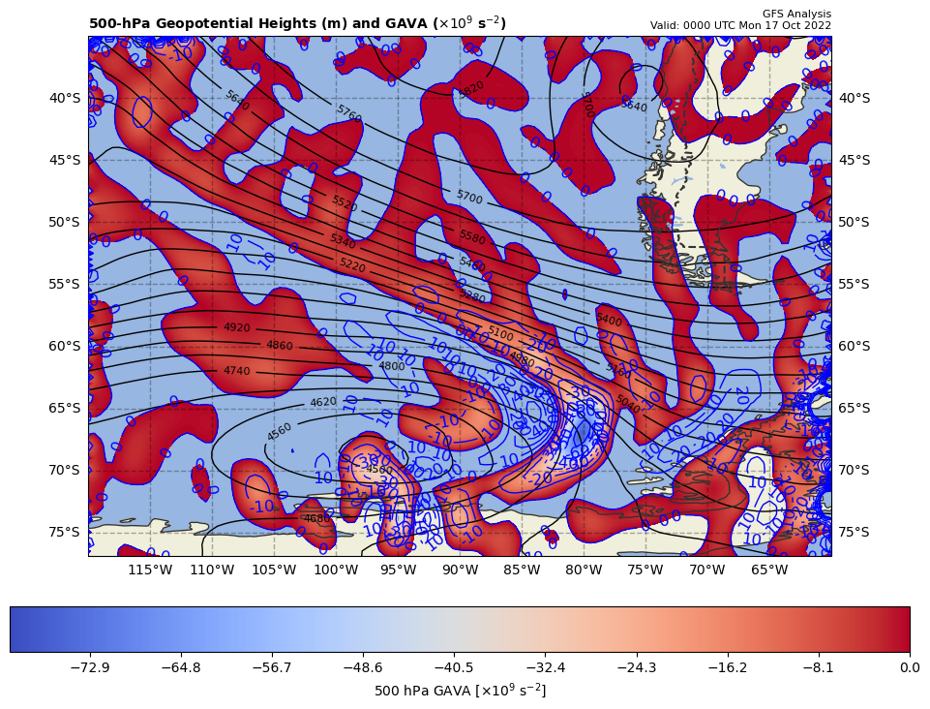
12Z GAVA (x 10⁻⁹ s⁻²); positive at 18Z position
+
+13.67288 x 10⁻⁹ s⁻²
Giving a GAVA contribution to cyclolysis

Slide 4
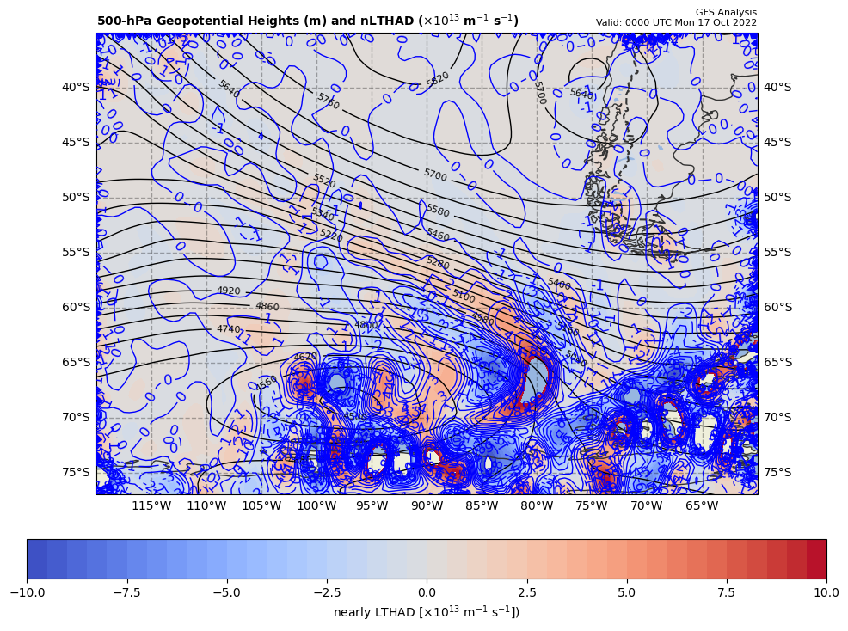
12Z nearly LTHAD (x 10⁻¹³ m⁻¹s⁻¹); positive at 18Z position
+
-[9.81 m s⁻²/ (-13.53238x10⁻⁵ s⁻¹)]*(+5.34973x10⁻¹³ m⁻¹s⁻¹) = +38.7817 x 10⁻⁹ s⁻²
So, multiply by –g/f, giving a LTHAD contribution to cyclolysis

Slide 5
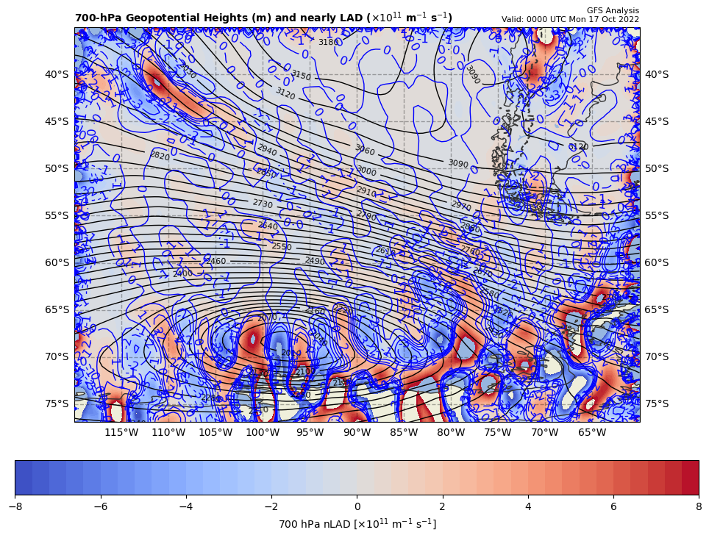
12Z nearly 700 hPa LAD (x 10⁻¹³ units); negative at 18Z position
+
38.7817 x 10⁻⁹ s⁻² * 85% = −32.964445 x 10⁻⁹ s⁻²
So, multiply by –g/f, giving a LAD contribution to cyclogenesis

Slide 6
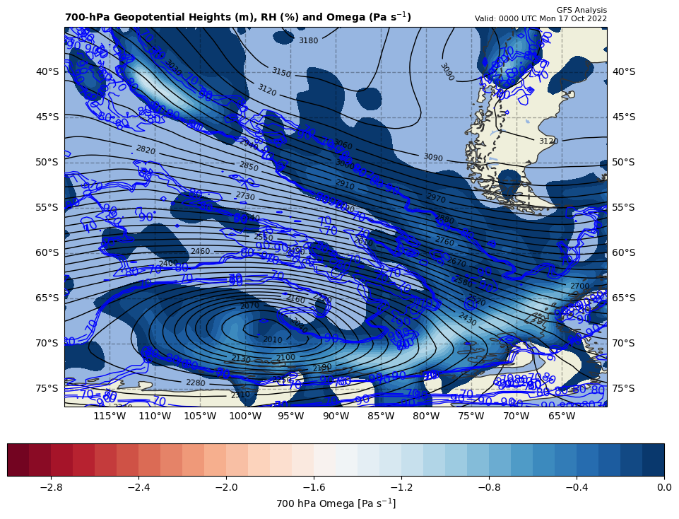
12Z nearly LDIA; latent heat release at 18Z position
+
32.964445 x 10⁻⁹ s⁻² * 70% = −23.075112 x 10⁻⁹ s⁻²
ω < 0 m s⁻¹ & RH ≥ 70%!!!

Slide 7
Calculations
Sum of terms on RHS = GAVA + LTHAD + LAD + LDIA
= -3.58498 x 10⁻⁹ s⁻²
Finite difference approximation of LHS = dGRV/dt
= [(-73.38 – {-22.29}]) x 10⁻⁵ s⁻¹ ] / [6 h * 60 min/h * 60 s/min]
= -24.6528 x 10⁻⁹ s⁻²
RHS = 0.1516 x LHS

Slide 8
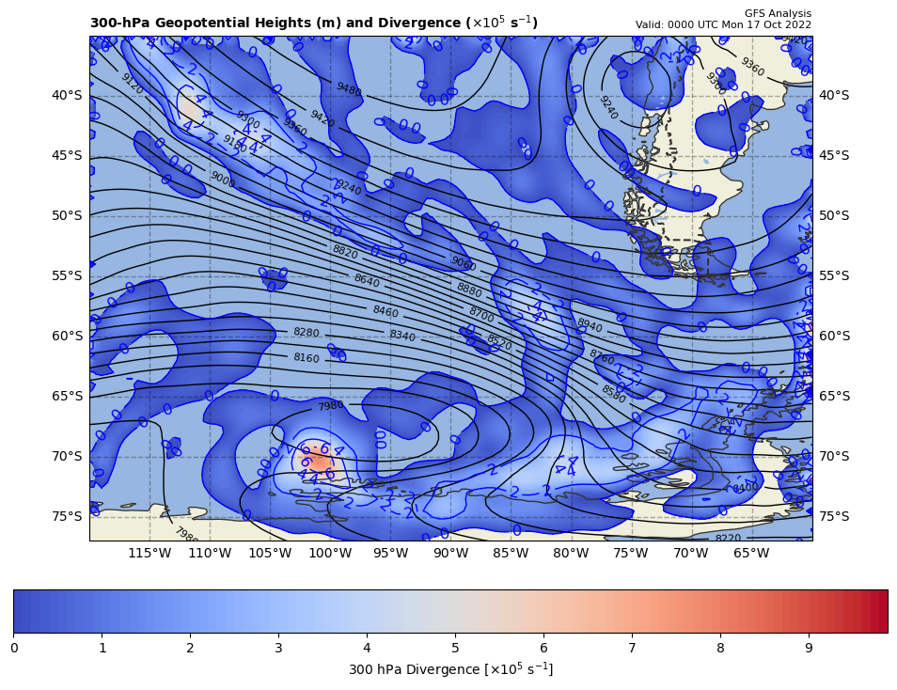
300 hPa Z, Div at t0
+
[∼0]

Slide 9
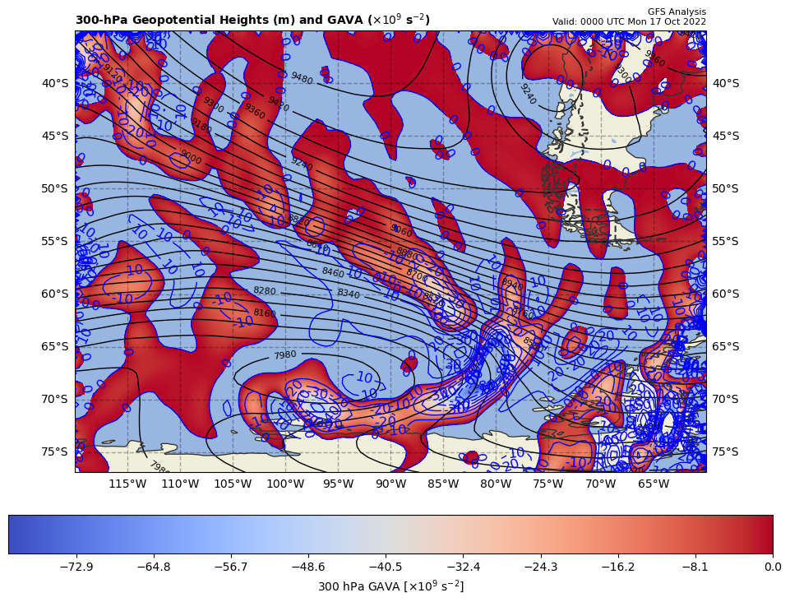
300 hPa Z, GAVA at t0
+
[+]

Slide 10
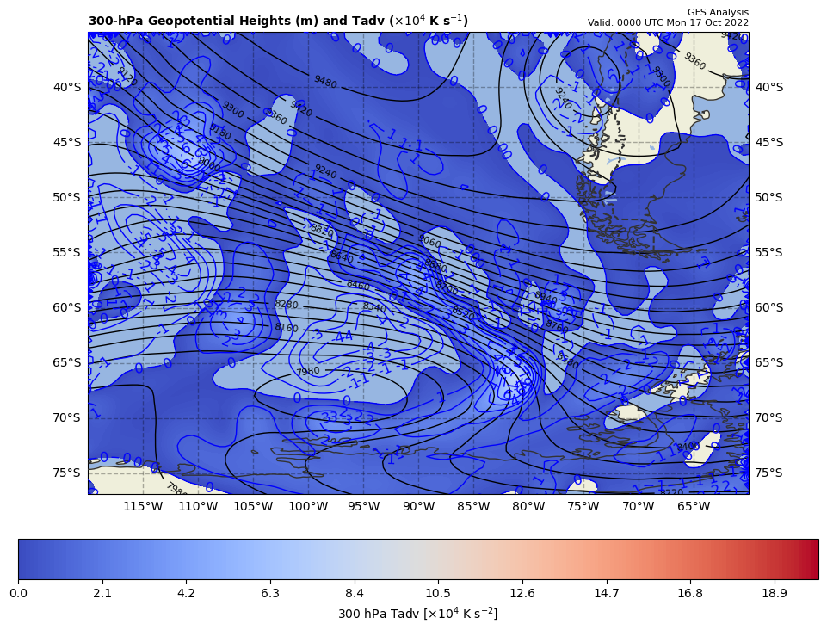
300 hPa Z, Temp Adv at t0
+
[∼0]

