Slide 1
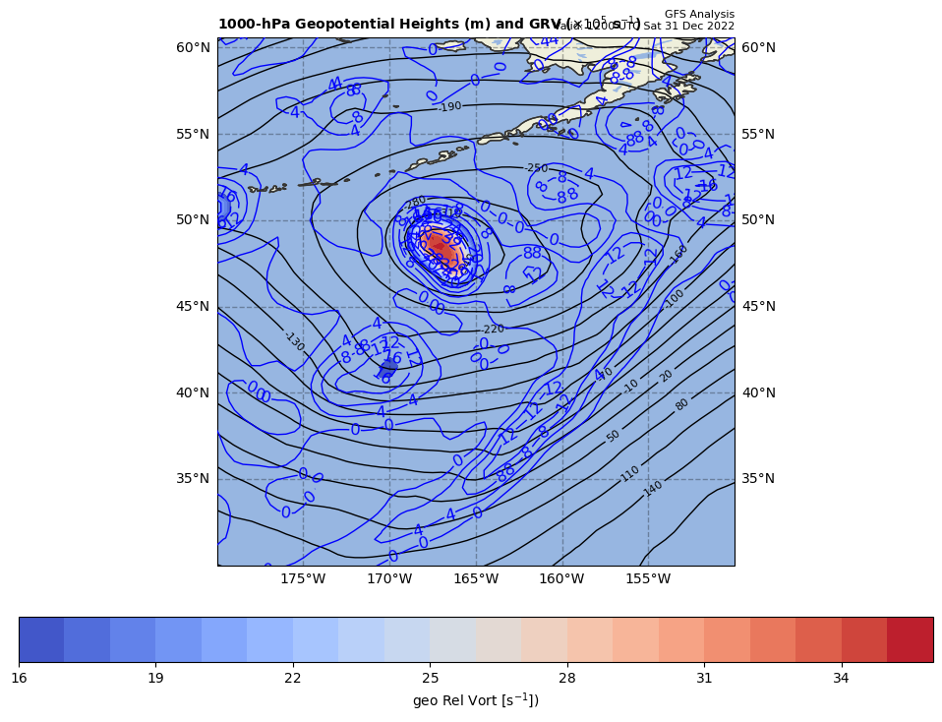
1000 hPa Z/Geo Rel Vort at t0
+
+

Slide 2
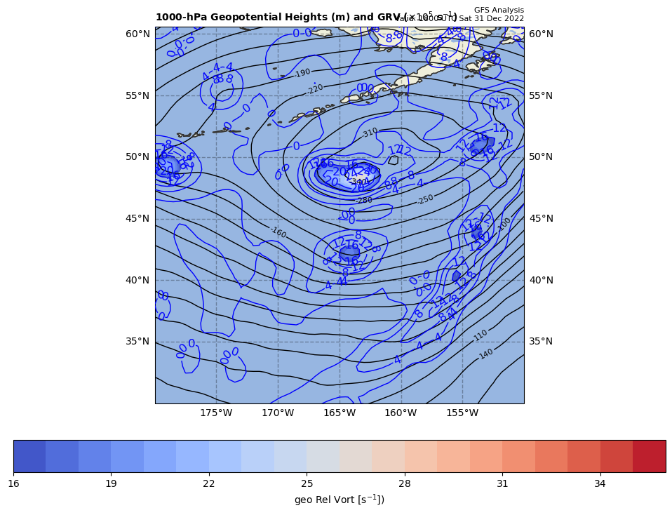
1000 hPa Z/Geo Rel Vort at t1
+

Slide 3
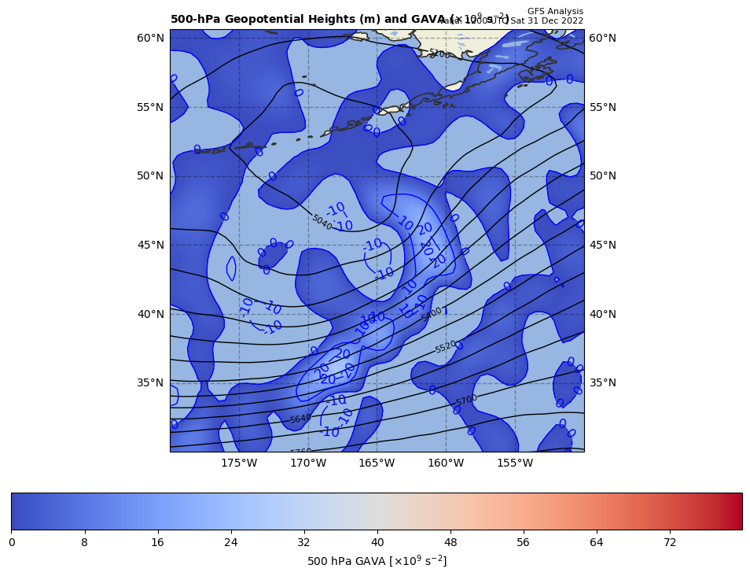
12Z GAVA (x 10⁻⁹ s⁻²); positive at 18Z position
+
+11.5 x 10⁻⁹ s⁻²
Giving a positive GAVA contribution to cyclogenesis

Slide 4
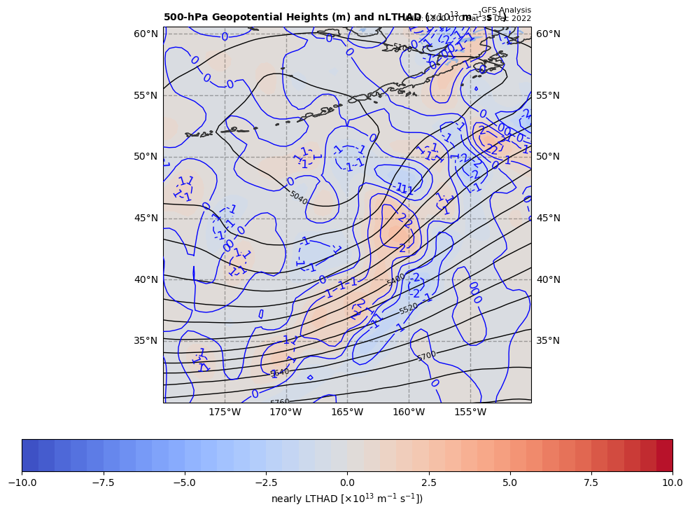
12Z nearly LTHAD (x 10⁻¹³ m⁻¹s⁻¹); negative at 18Z position
+
-[9.81 m s⁻²/ (10.8931x10⁻⁵ s⁻¹)]*(-0.69957x10⁻¹³ m⁻¹s⁻¹) = +6.30011 x 10⁻⁹ s⁻²
So, multiply by –g/f, giving a positive LTHAD contribution to cyclogenesis

Slide 5
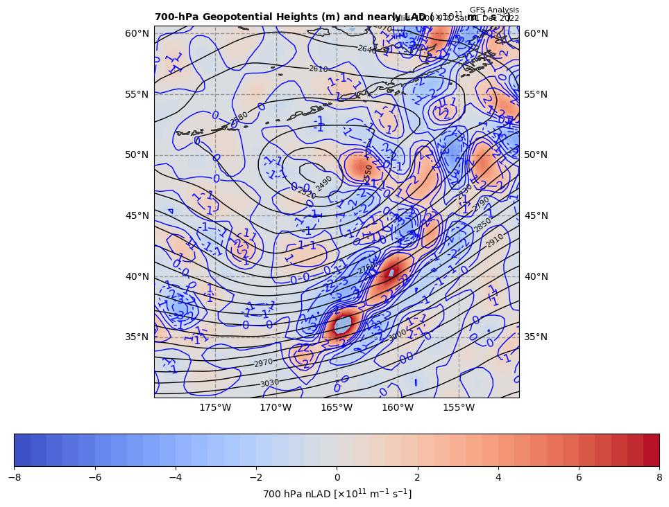
12Z nearly 700 hPa LAD (x 10⁻¹³ units); positive at 18Z position
+
6.30011 x 10⁻⁹ s⁻² * 85% = −5.35509 x 10⁻⁹ s⁻²
So, multiply by –g/f, giving a negative LAD contribution to cyclogenesis

Slide 6
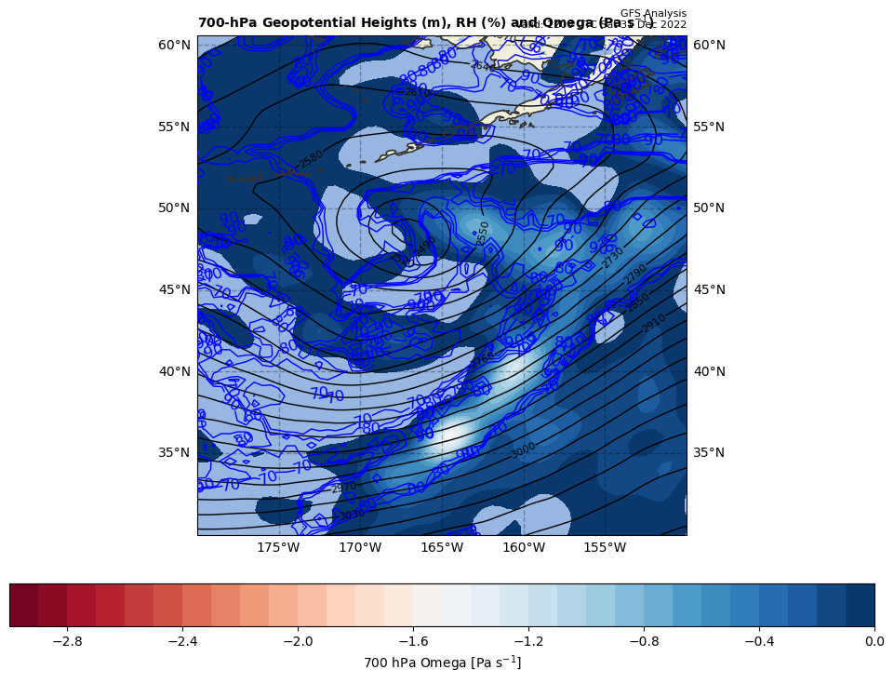
12Z nearly LDIA; latent heat release at 18Z position
+
5.35509 x 10⁻⁹ s⁻² * 70% = +3.74856 x 10⁻⁹ s⁻²
ω < 0 m s⁻¹ & RH ≥ 70%!!!

Slide 7
Calculations
Sum of terms on RHS = GAVA + LTHAD + LAD + LDIA
= +16.1696 x 10⁻⁹ s⁻²
Finite difference approximation of LHS = dGRV/dt
= [(26.1 – {3.8}]) x 10⁻⁵ s⁻¹ ] / [6 h * 60 min/h * 60 s/min]
= +19.9074 x 10⁻⁹ s⁻²
RHS = 1.566 x LHS

Slide 8
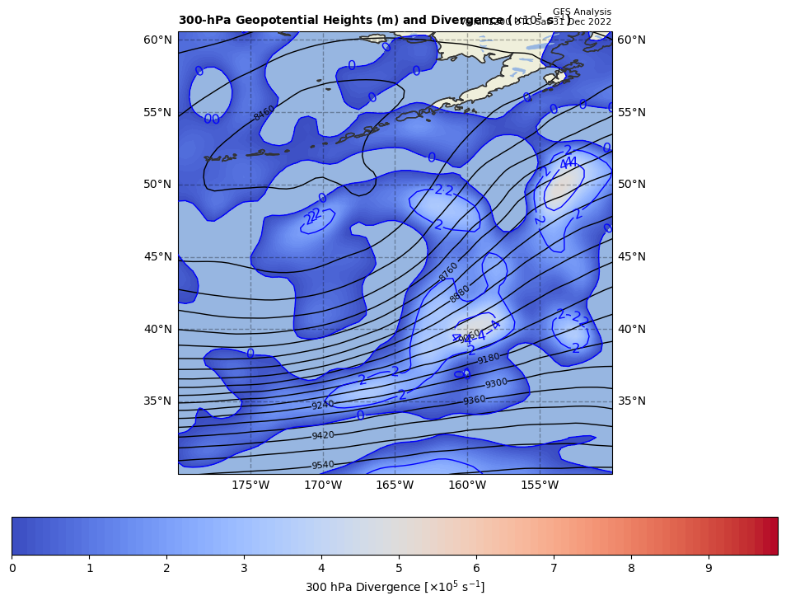
300 hPa Z, Div at t0
+
[+]

Slide 9
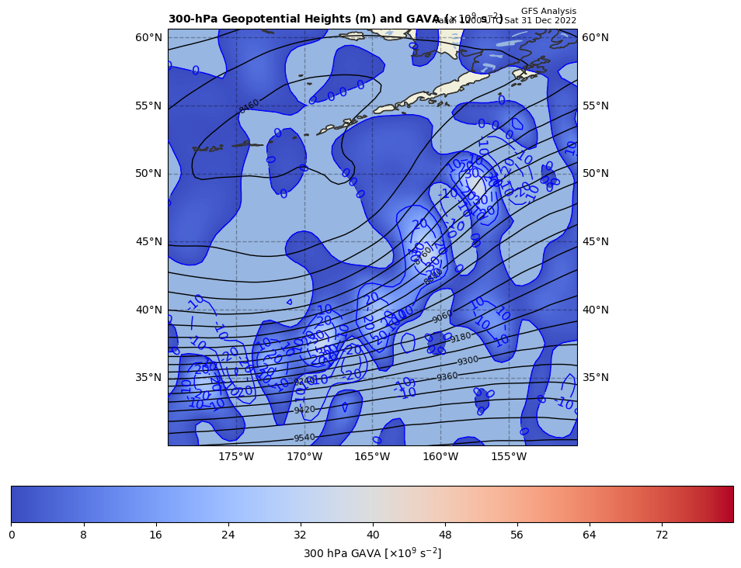
300 hPa Z, GAVA at t0
+
[+]

Slide 10
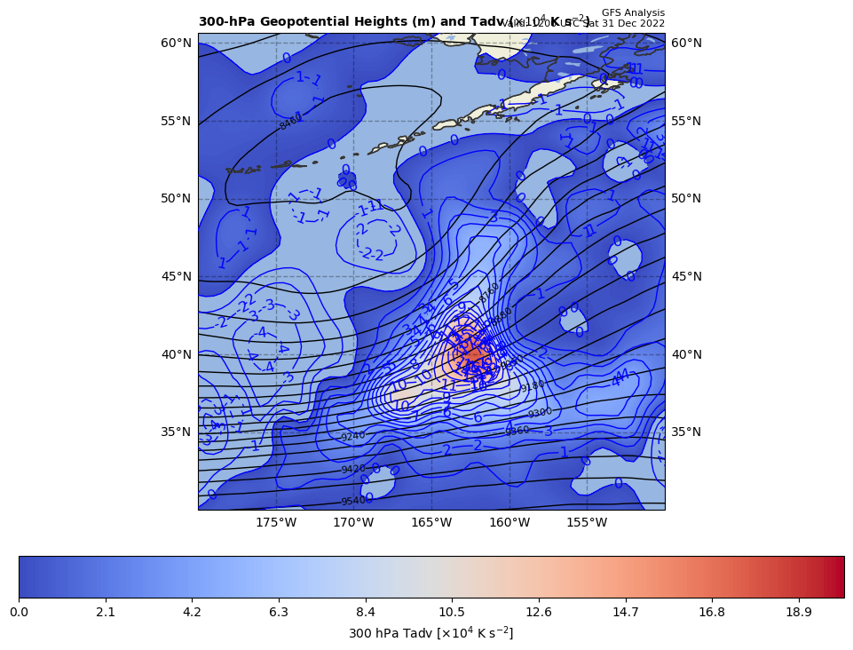
300 hPa Z, Temp Adv at t0
+
[+]

