Slide 1
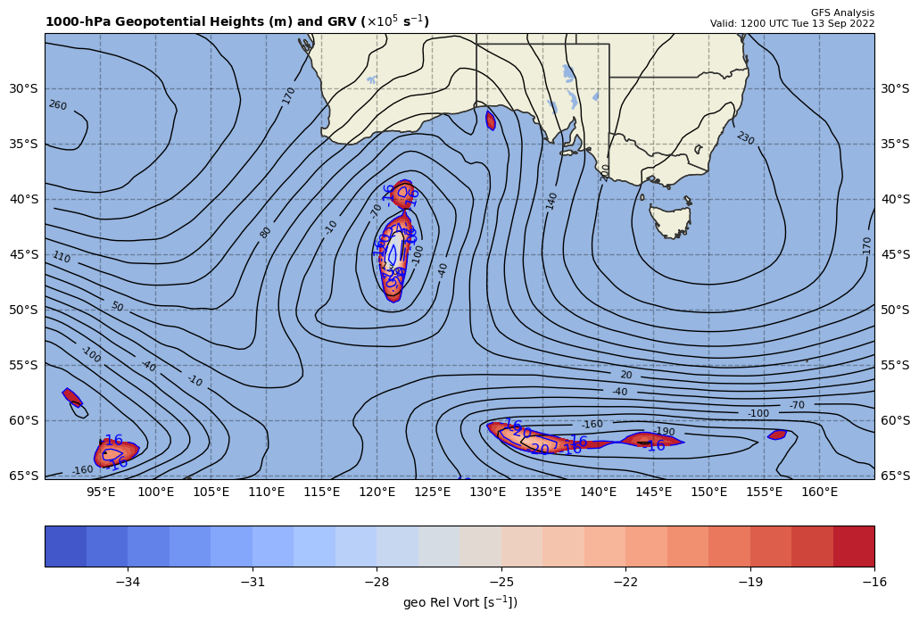
1000 hPa Z/Geo Rel Vort at t0
+
+

Slide 2
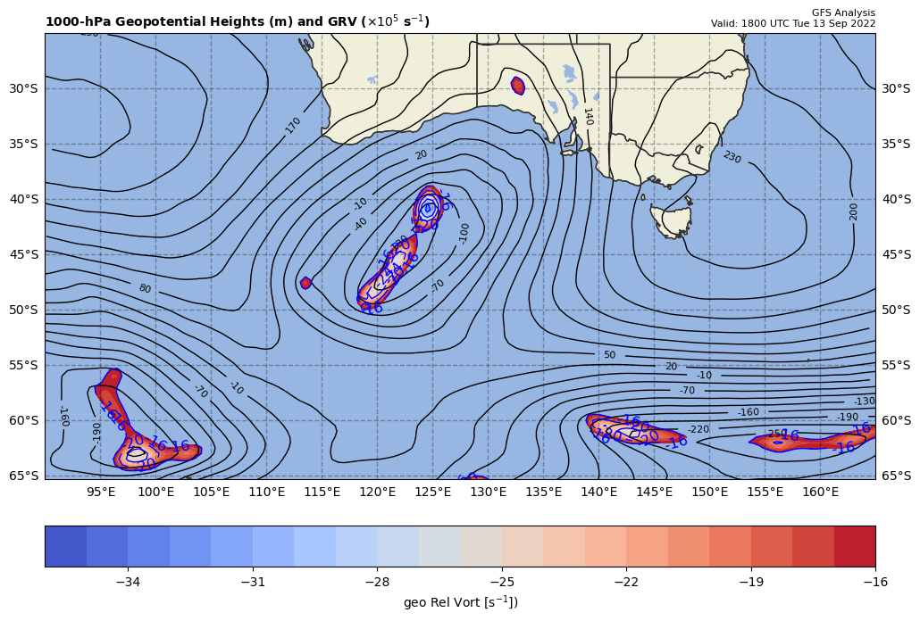
1000 hPa Z/Geo Rel Vort at t1
+

Slide 3
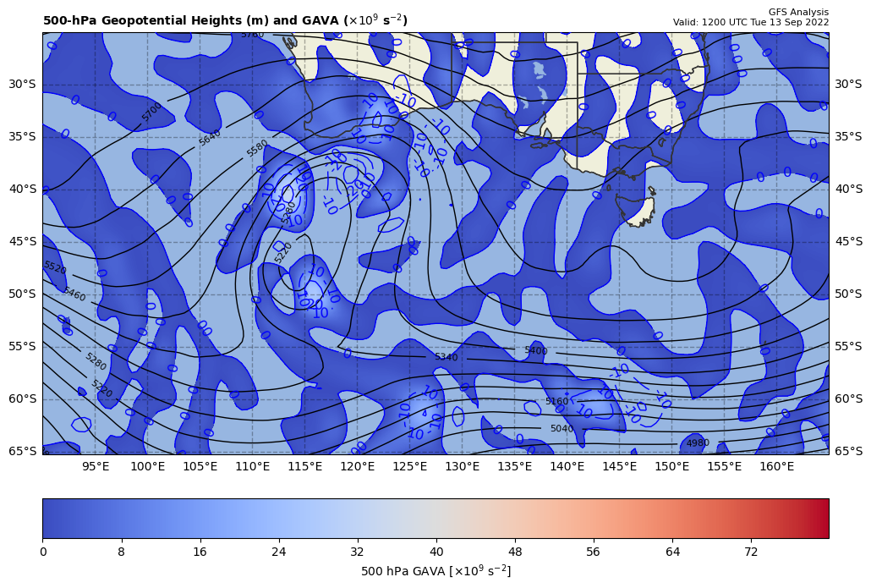
12Z GAVA (x 10⁻⁹ s⁻²); negative at 18Z position
+
−2.08 x 10⁻⁹ s⁻²
Giving a GAVA contribution to cyclogenesis

Slide 4
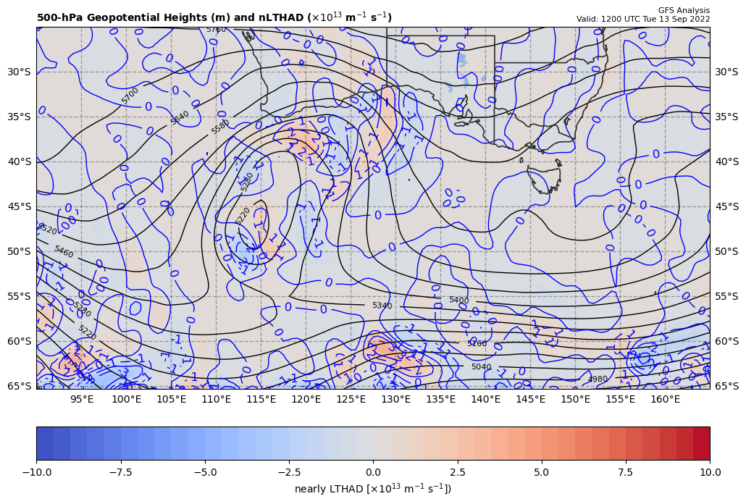
12Z nearly LTHAD (x 10⁻¹³ m⁻¹s⁻¹); positive at 18Z position
+
-[9.81 m s⁻²/ (-10.3738x10⁻⁵ s⁻¹)]*(+0.16284x10⁻¹³ m⁻¹s⁻¹) = +1.53990 x 10⁻⁹ s⁻²
So, multiply by –g/f, giving a LTHAD contribution to cyclolysis

Slide 5
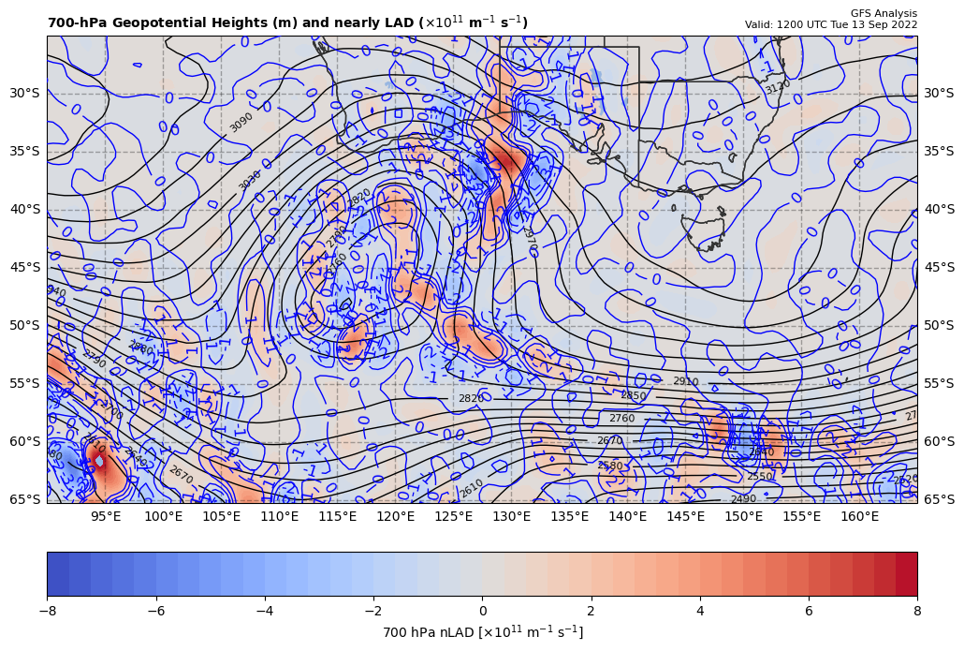
12Z nearly 700 hPa LAD (x 10⁻¹³ units); positive at 18Z position
+
1.53990 x 10⁻⁹ s⁻² * 85% = +1.30891 x 10⁻⁹ s⁻²
So, multiply by –g/f, giving a LAD contribution to cyclolysis

Slide 6
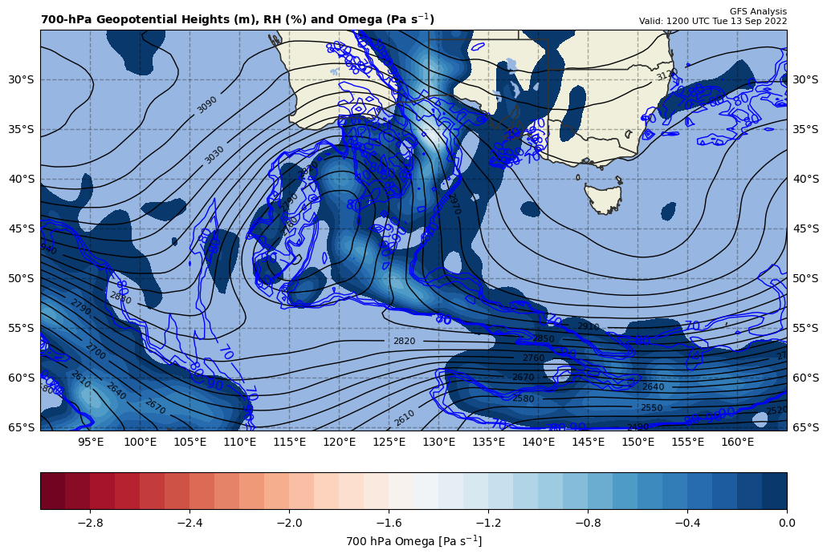
12Z nearly LDIA; latent heat release at 18Z position
+
1.30891 x 10⁻⁹ s⁻² * 70% = −0.91624 x 10⁻⁹ s⁻²
ω < 0 m s⁻¹ & RH ≥ 70%!!!

Slide 7
Calculations
Sum of terms on RHS = GAVA + LTHAD + LAD + LDIA
= -1.47428 x 10⁻¹⁰ s⁻²
Finite difference approximation of LHS = dGRV/dt
= [(-26.7 – {-25.7}]) x 10⁻⁵ s⁻¹ ] / [6 h * 60 min/h * 60 s/min]
= -4.62963 x 10⁻¹⁰ s⁻²
RHS = 0.3184 x LHS

Slide 8
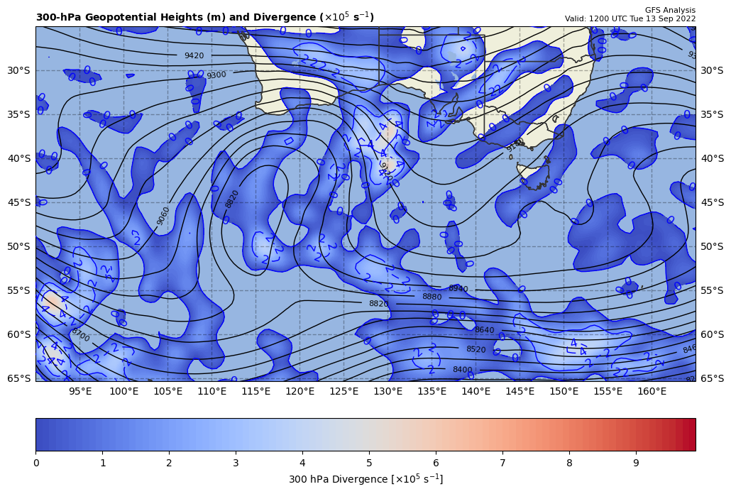
300 hPa Z, Div at t0
+
[+]

Slide 9
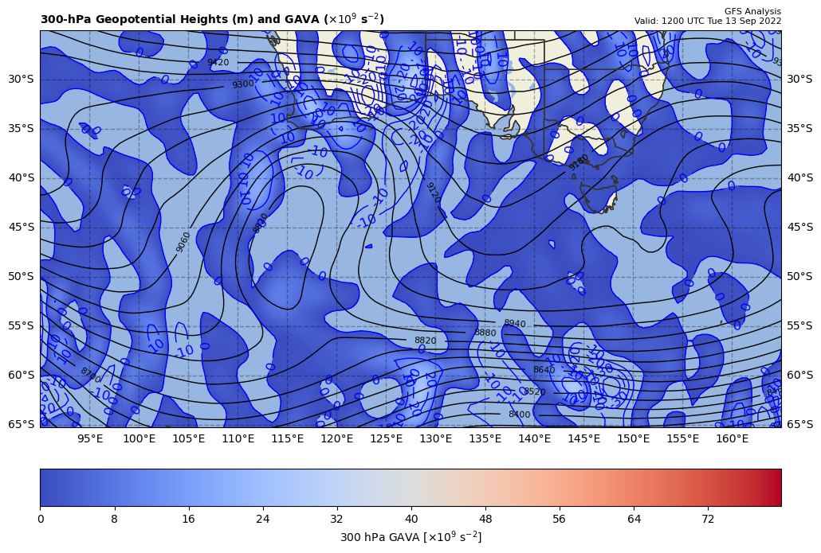
300 hPa Z, GAVA at t0
+
[−]

Slide 10
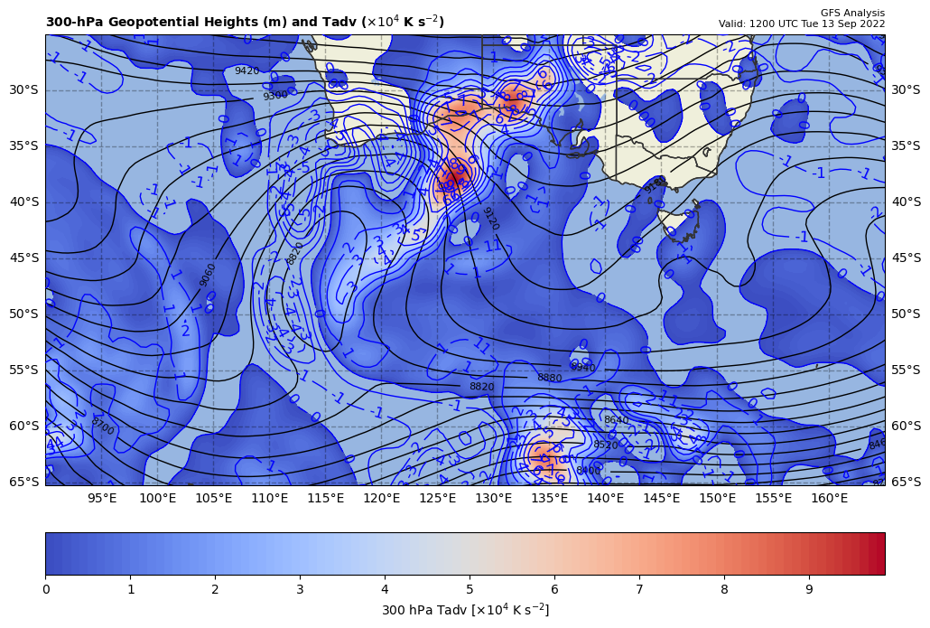
300 hPa Z, Temp Adv at t0
+
[+]

