Slide 1
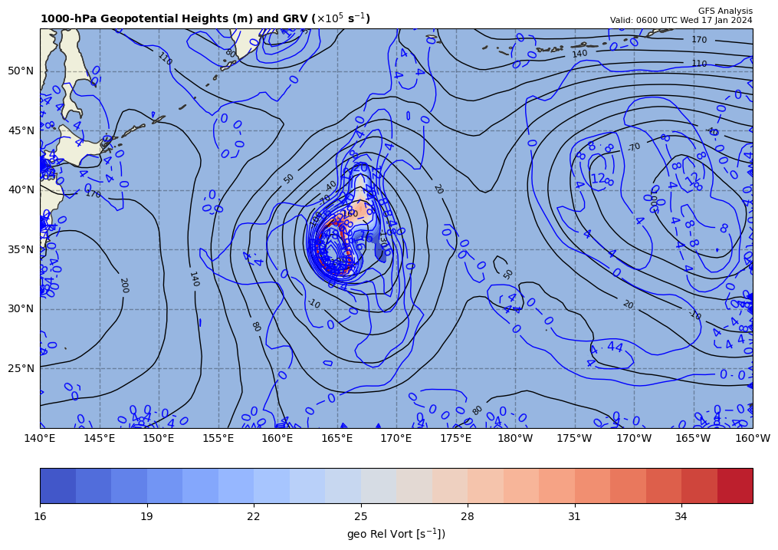
1000 hPa Z/Geo Rel Vort at t0
+

Slide 2
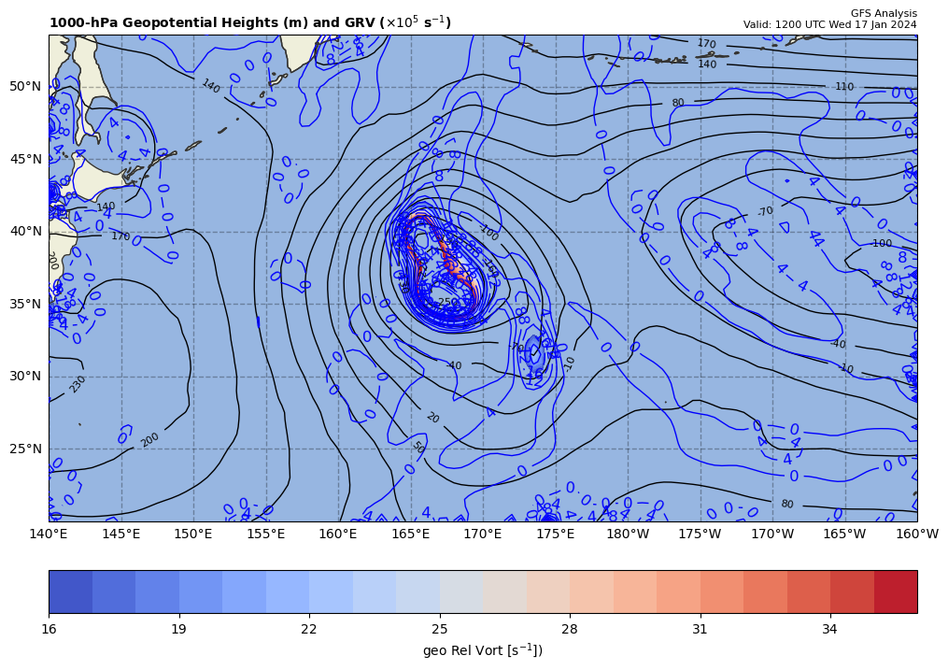
1000 hPa Z/Geo Rel Vort at t1
+
+

Slide 3
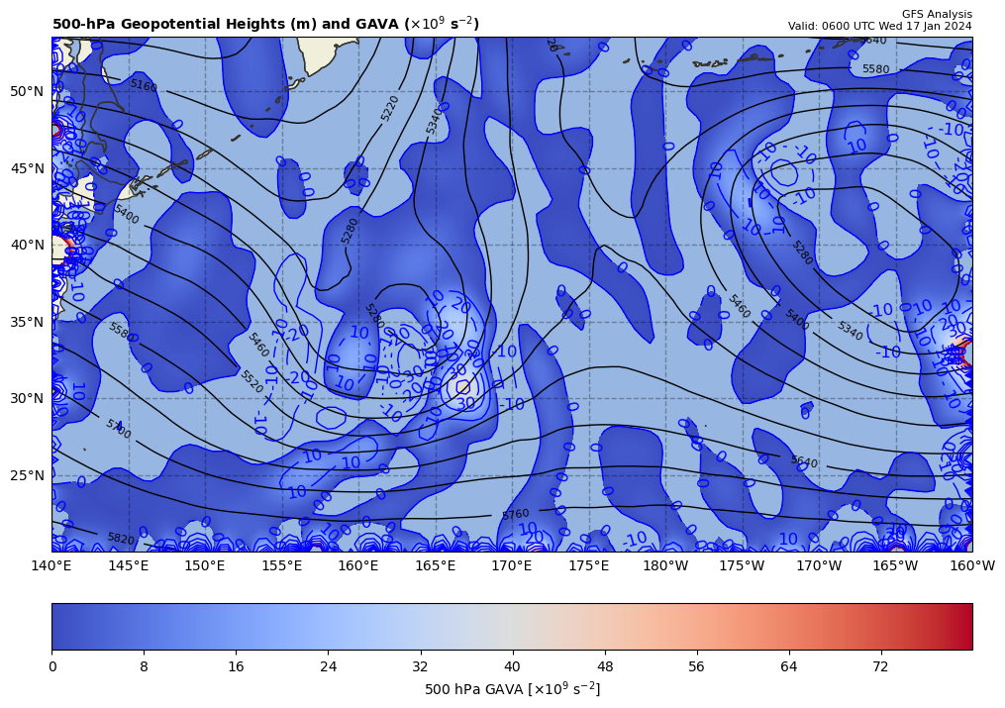
06Z GAVA (x 10⁻⁹ s⁻²); positive at 12Z position
+
+15.94912 x 10⁻⁹ s⁻²
Giving a positive GAVA contribution to cyclogenesis

Slide 4
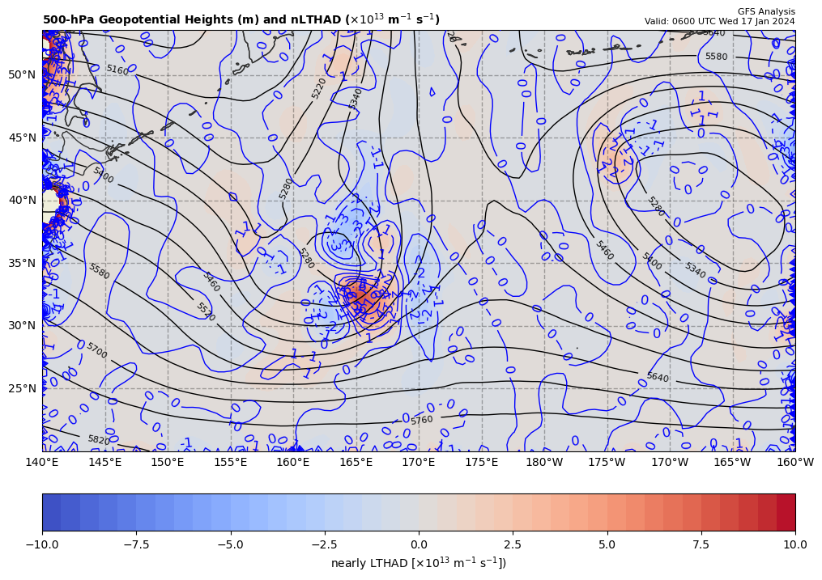
06Z nearly LTHAD (x 10⁻¹³ m⁻¹s⁻¹); positive at 12Z position
OLD WAY!!
+
-[9.81 m s⁻²/ (8.445982x10⁻⁵ s⁻¹)]*(+0.875204x10⁻¹³ m⁻¹s⁻¹) = −10.165480 x 10⁻⁹ s⁻²
So, multiply by –g/f, giving a negative LTHAD contribution to cyclogenesis

Slide 5
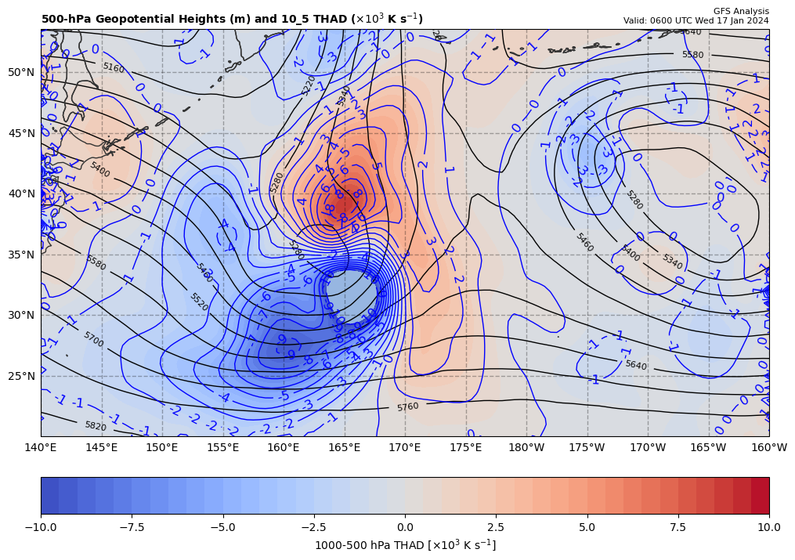
06Z nearly LTHAD (x 10⁻¹³ m⁻¹s⁻¹); negative at 12Z position
THAD field shown
NEW WAY!!
+
-[9.81 m s⁻²/ (8.445982x10⁻⁵ s⁻¹)]*(+0.875204x10⁻¹³ m⁻¹s⁻¹) = −10.165480 x 10⁻⁹ s⁻²
So, multiply by –g/f, giving a positive LTHAD contribution to cyclogenesis

Slide 6
06Z nearly LTHAD (x 10⁻¹³ m⁻¹s⁻¹); negative at 12Z position
+1.48
+
THAD field shown
x 10⁻³ m s⁻¹
NEW WAY!!
0.5º long. = 90.37 km
+
-1.08
+
+
+
-0.64
+
+
+1.08
+
+
-3.66
-[9.81 m s⁻²/ (8.445982x10⁻⁵ s⁻¹)]*(+8.397725x10⁻¹⁴ m⁻¹s⁻¹) = −9.753949 x 10⁻⁹ s⁻²
So, multiply by –g/f, giving a positive LTHAD contribution to cyclogenesis

Slide 7
Coriolis parameter= 8.445982E-005 for Lat= 35.5
GARP-based LTHAD= -1.0165480E-008
finite diff-based LTHAD= -9.753949E-009
d2tdx2, d2tdy2, xnnLTHAD= 1.567566E-013 -7.277936E-014 8.3977246E-014

Slide 8
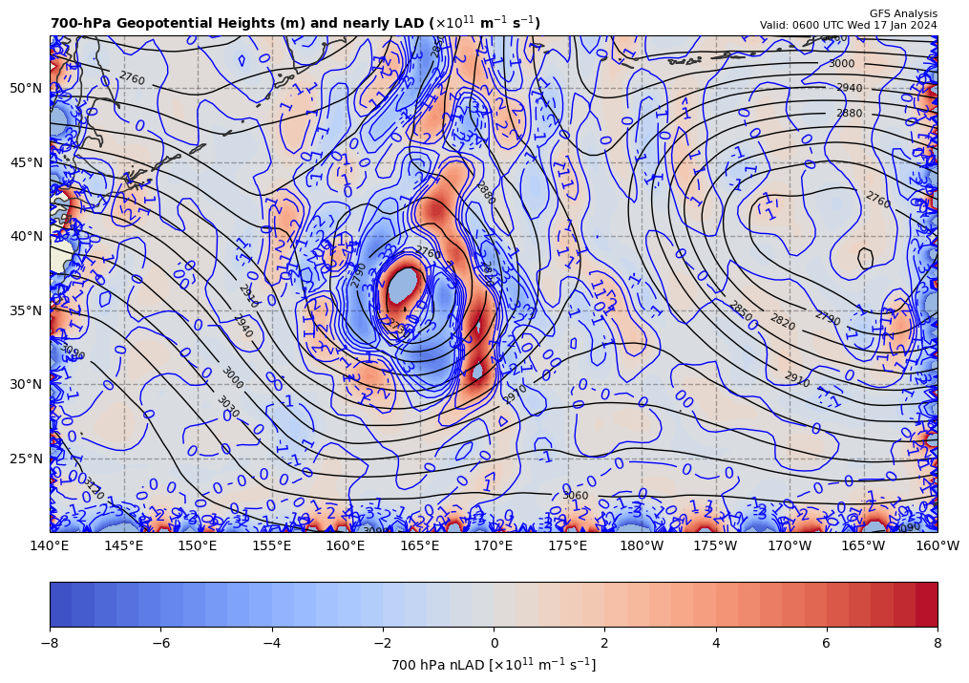
06Z nearly 700 hPa LAD (x 10⁻¹³ units); negative at 12Z position
+
+9.753949 x 10⁻⁹ s⁻² * 85% = +8.290857 x 10⁻⁹ s⁻²
So, multiply by –g/f, giving a positive LAD contribution to cyclogenesis

Slide 9
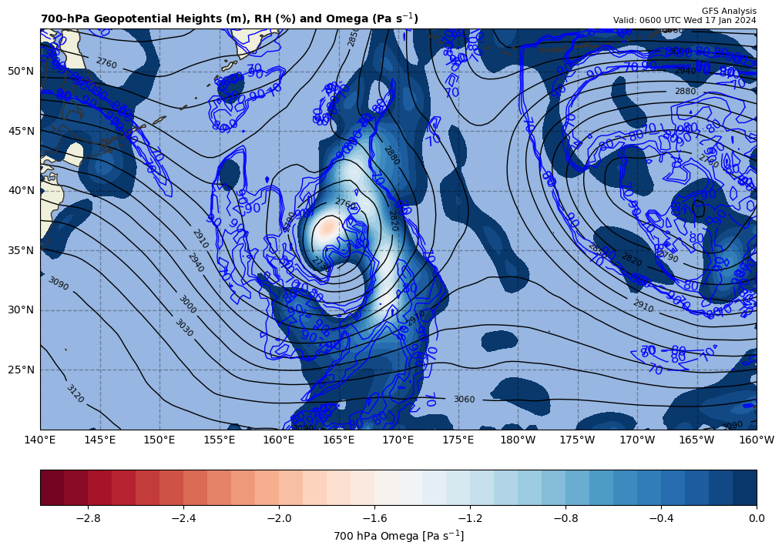
06Z nearly LDIA; latent heat release at 12Z position
+
8.290857 x 10⁻⁹ s⁻² * 70% = +5.803600 x 10⁻⁹ s⁻²
ω < 0 mb s⁻¹ & RH > 70%!!!

Slide 10
Calculations
Sum of terms on RHS = GAVA + LTHAD + LAD + LDIA
= +20.28963 x 10⁻⁹ s⁻²
Finite difference approximation of LHS = ∂GRV/∂t
= [(66.93 – {14.49}]) x 10⁻⁵ s⁻¹ ] / [6 h * 60 min/h * 60 s/min]
= +24.27778 x 10⁻⁹ s⁻²
RHS = +0.8357 x LHS

Slide 11
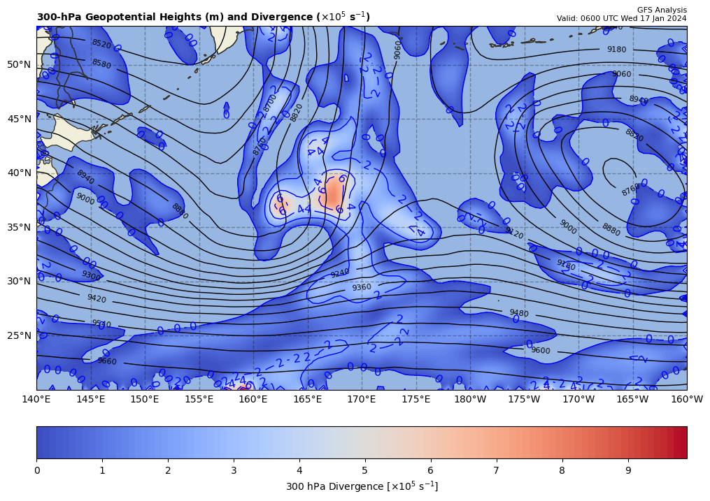
300 hPa Z, Div at t0
+
[+]

Slide 12
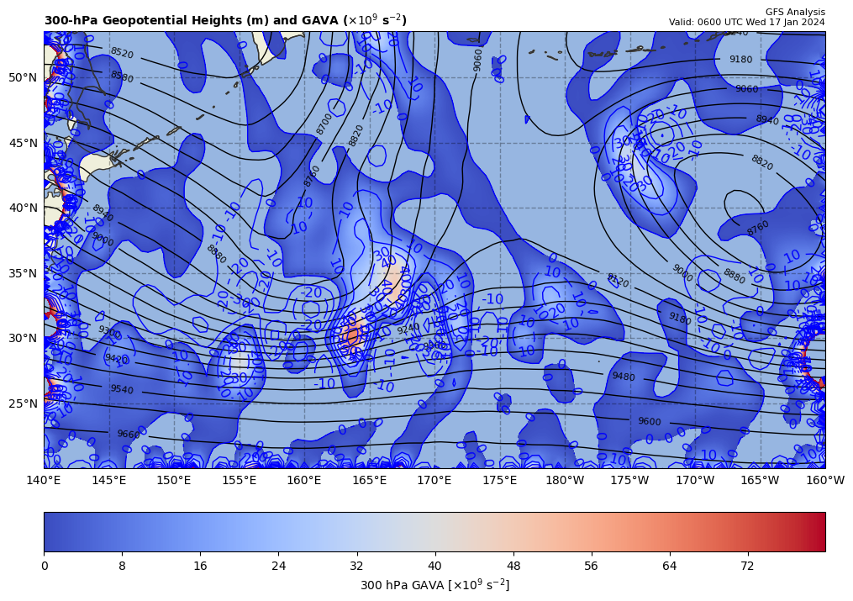
300 hPa Z, GAVA at t0
+
[+]

Slide 13
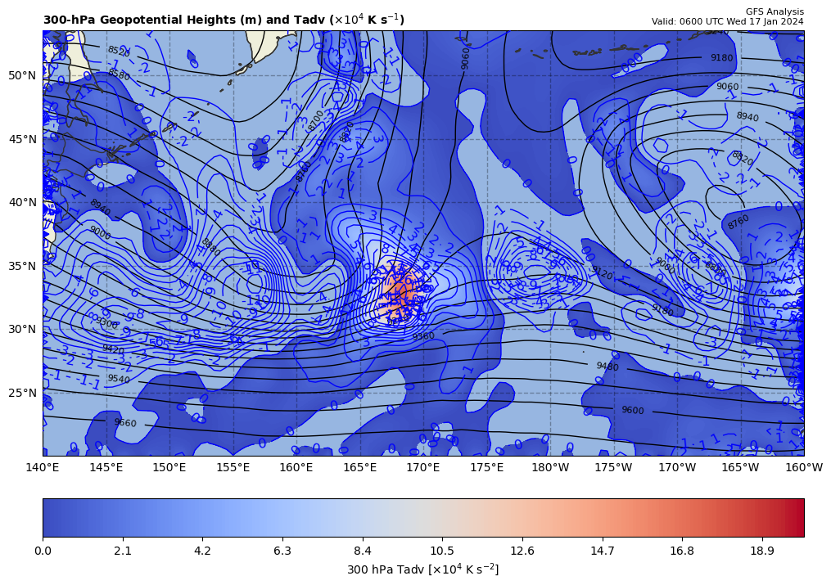
300 hPa Z, Temp Adv at t0
+
[+]

