Slide 1
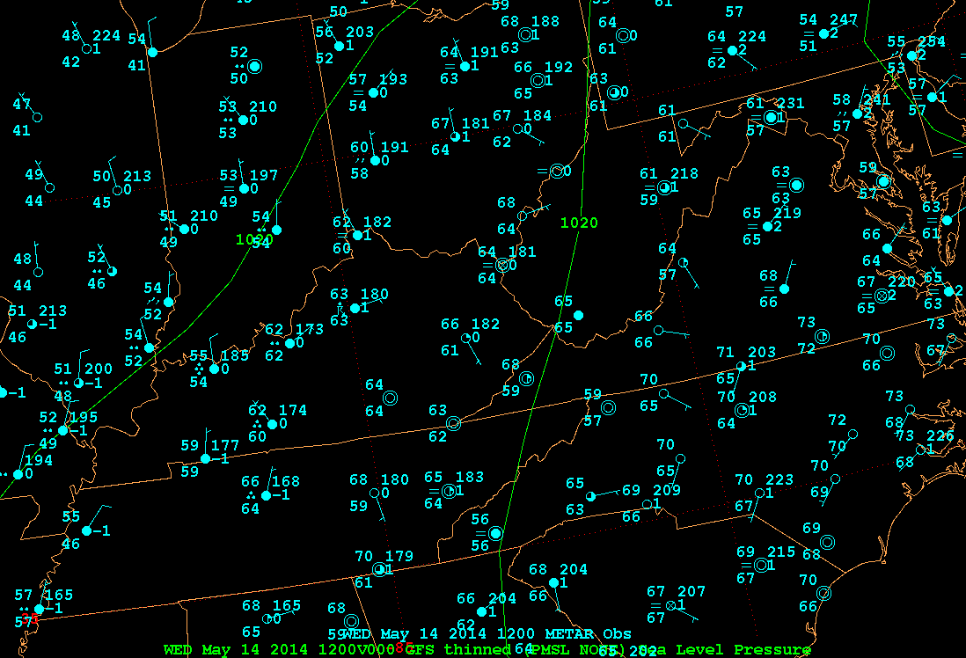
1200 UTC 14 May 2014, 00-h Forecast

Slide 2
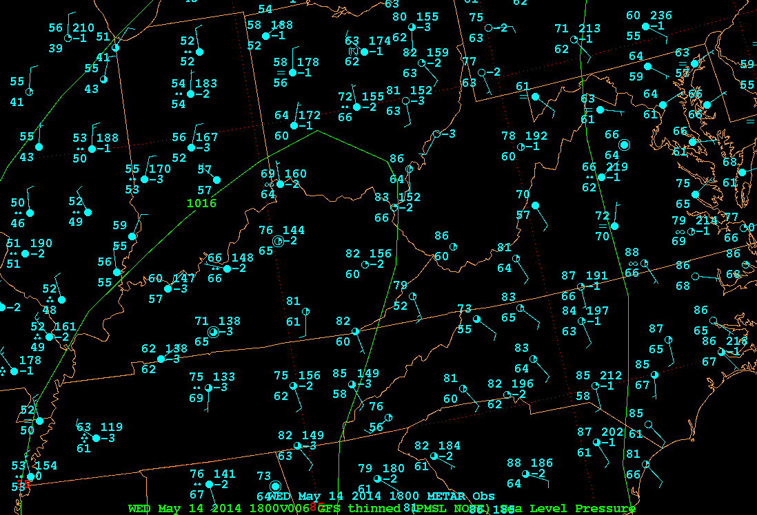
1800 UTC 14 May 2014, 06-h Forecast

Slide 3
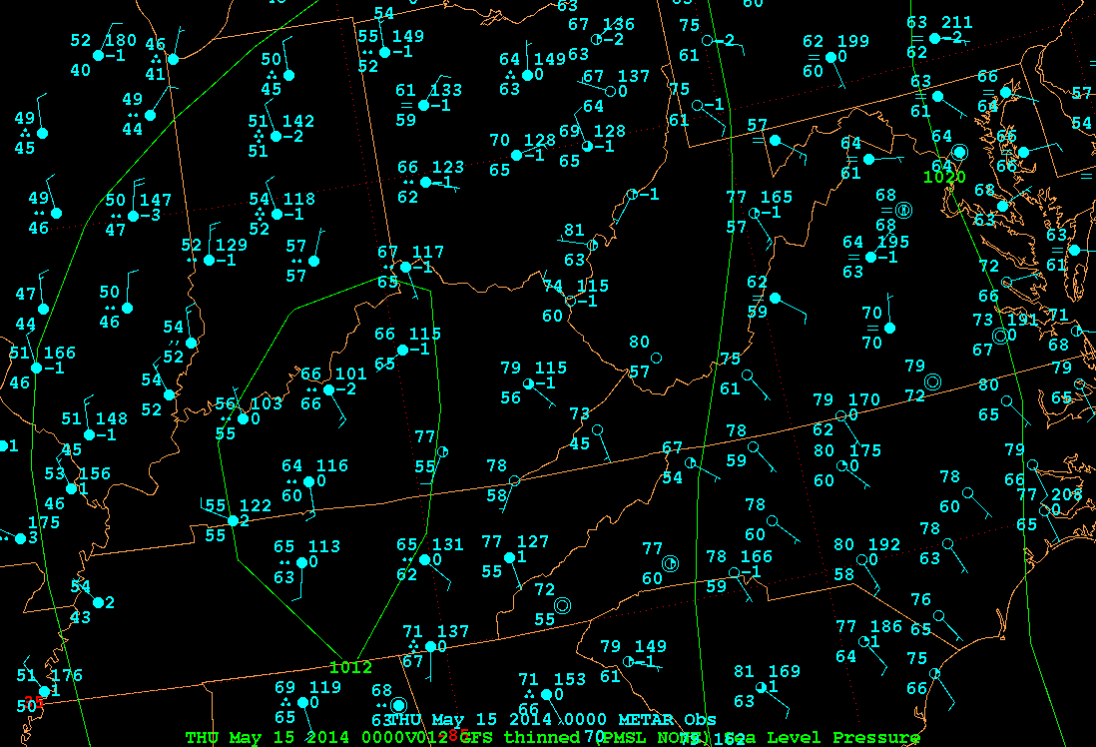
0000 UTC 15 May 2014, 12-h Forecast

Slide 4
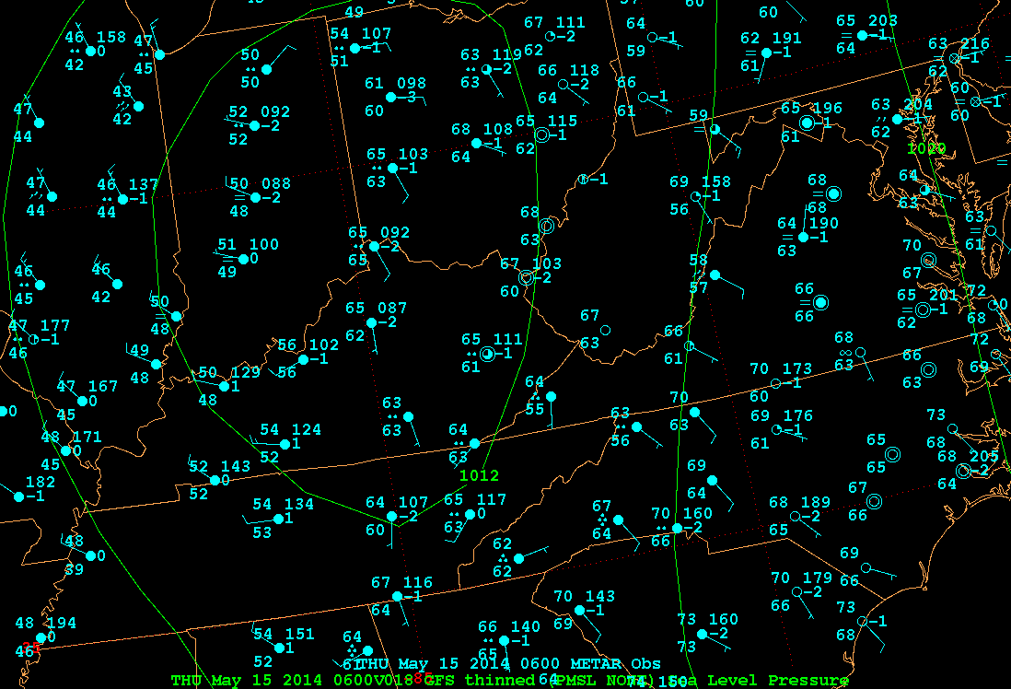
0600 UTC 15 May 2014, 18-h Forecast

Slide 5
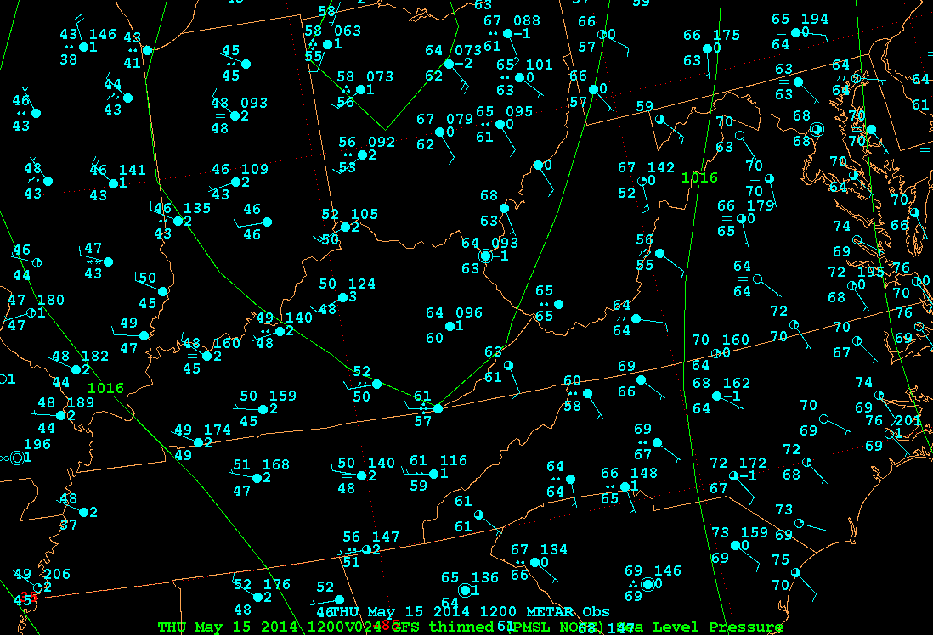
1200 UTC 15 May 2014, 24-h Forecast

Slide 6
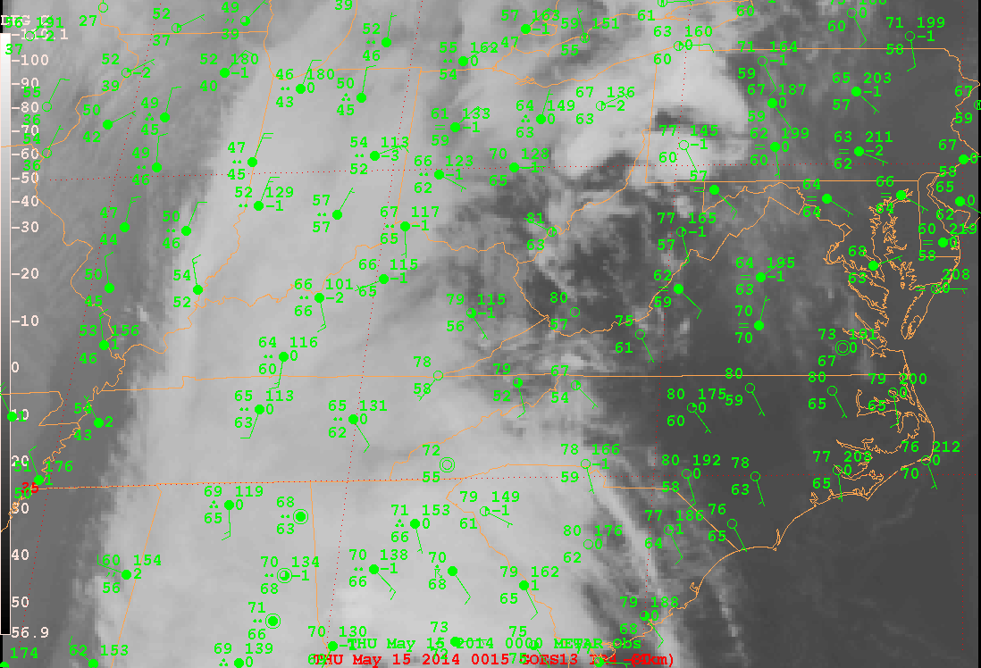
0000 UTC 15 May 2014

Slide 7
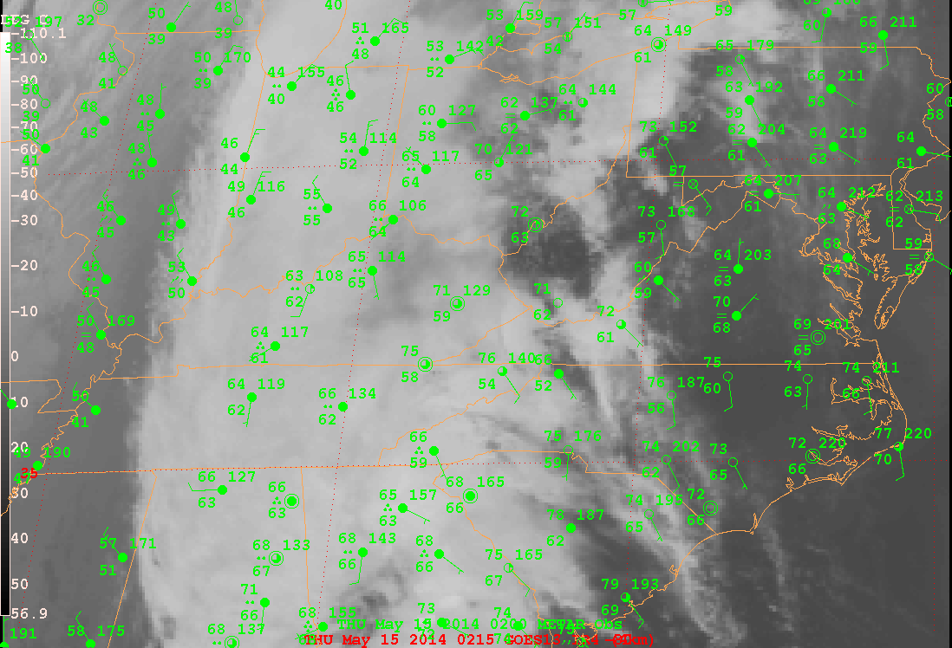
0200 UTC 15 May 2014

Slide 8
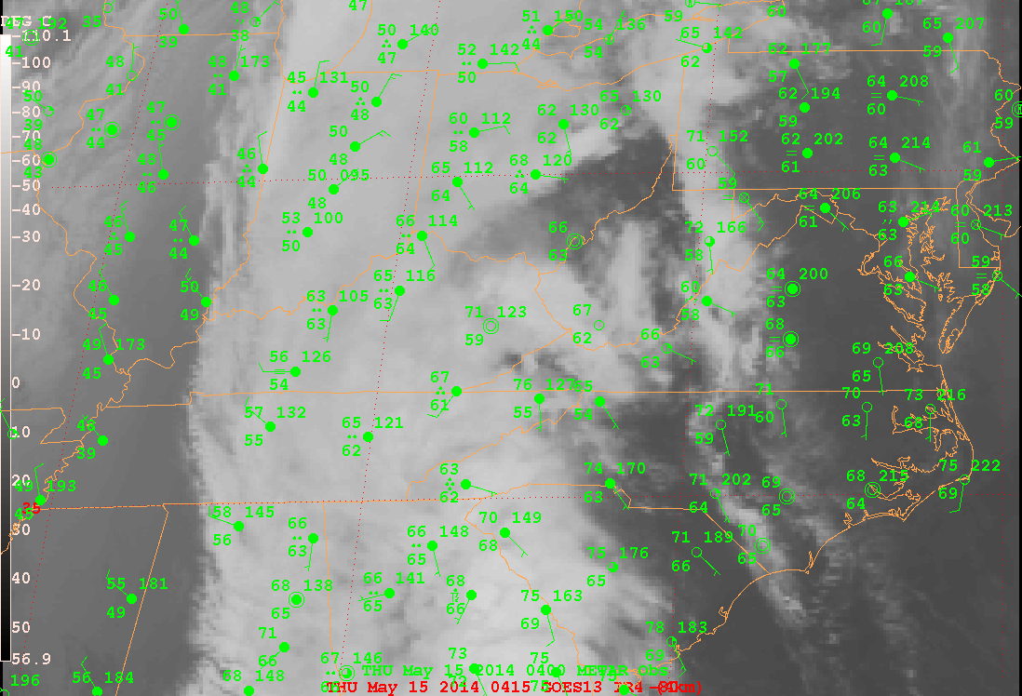
0400 UTC 15 May 2014

Slide 9
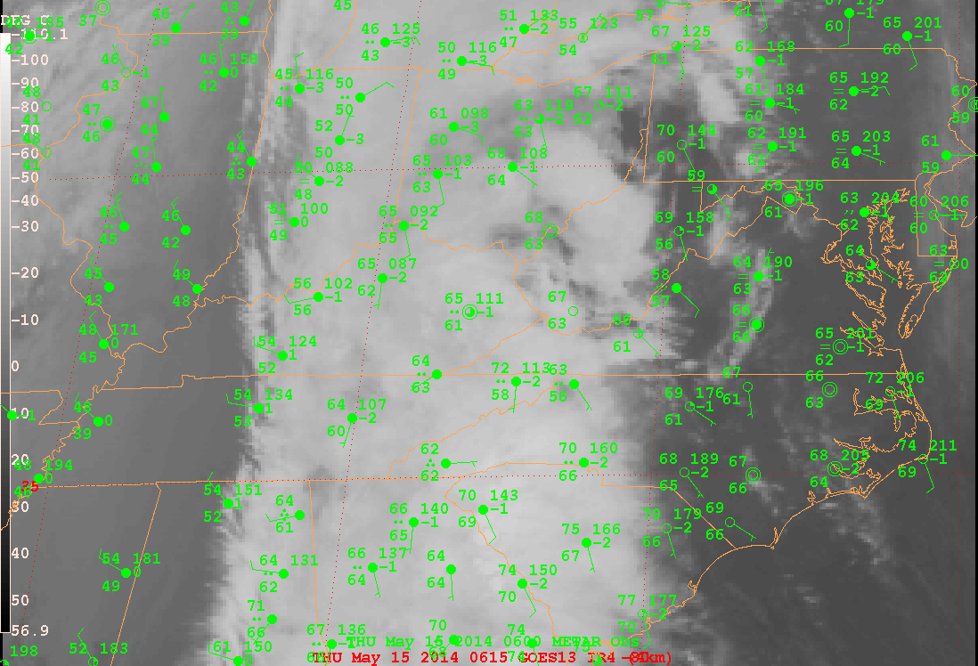
0600 UTC 15 May 2014

Slide 10
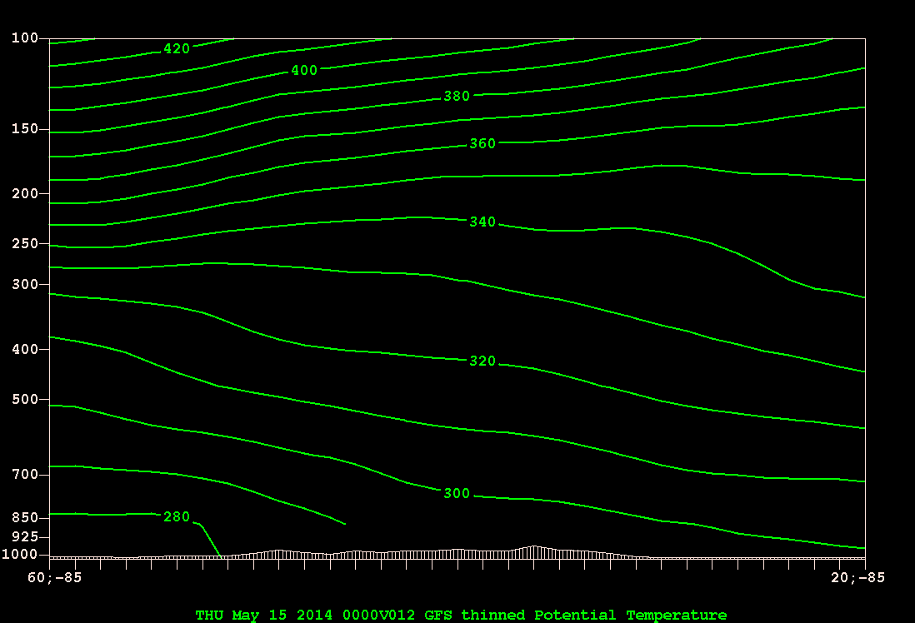
0000 UTC 15 May 2014, 12-h Forecast
XAV( THTA )

Slide 11
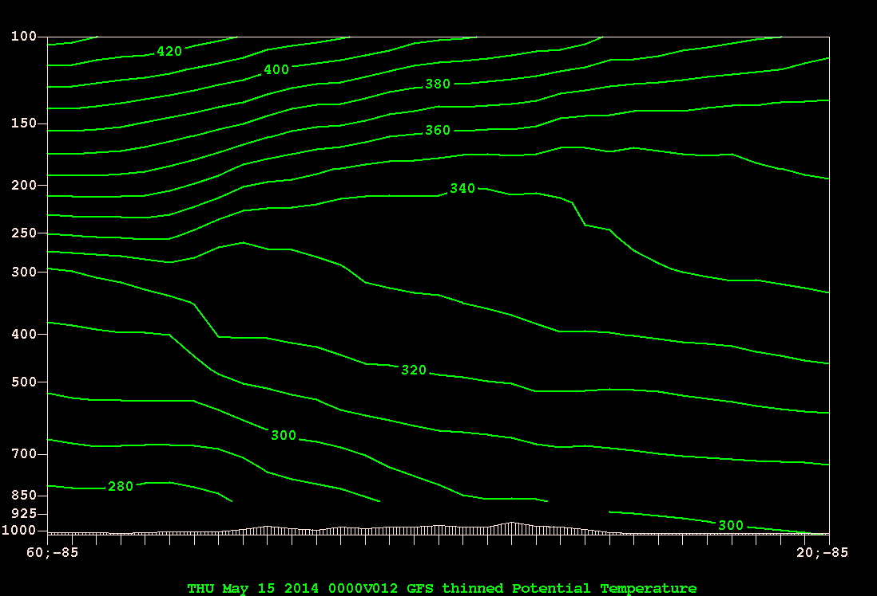
0000 UTC 15 May 2014, 12-h Forecast

Slide 12
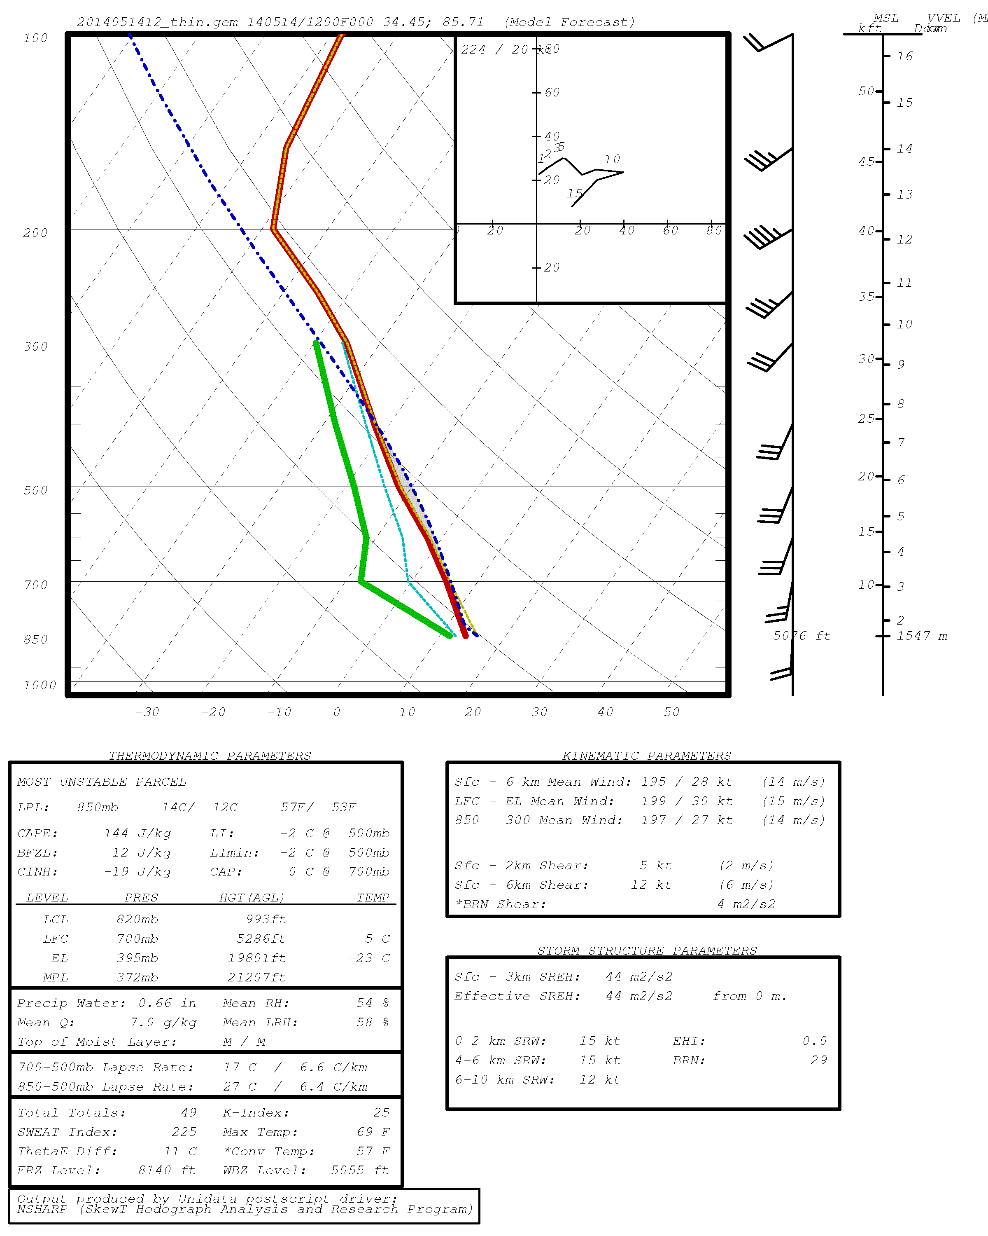
1200 UTC 14 May 2014, 00-h Forecast

Slide 13
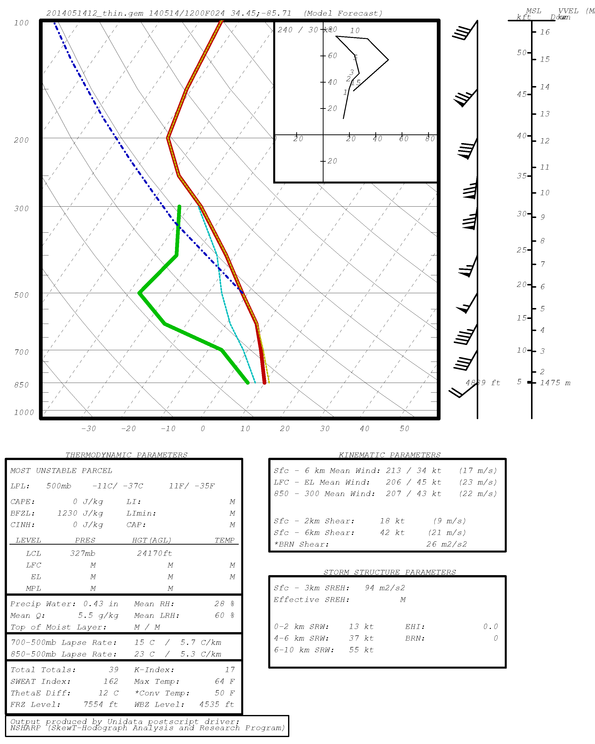
1200 UTC 15 May 2014, 24-h Forecast

