Slide 1
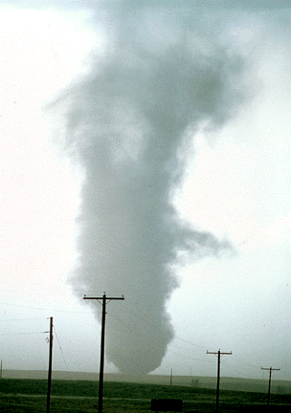
ATMS 316- Mesoscale Meteorology
Packet#2
What is the mesoscale?
http://www.ucar.edu/communications/factsheets/Tornadoes.html

Slide 2
ATMS 316- Mesoscale Meteorology
Outline
Background
Synoptic scale analysis
Mesoscale analysis?
Scaling Parameters
http://www.ucar.edu/communications/factsheets/Tornadoes.html

Slide 3
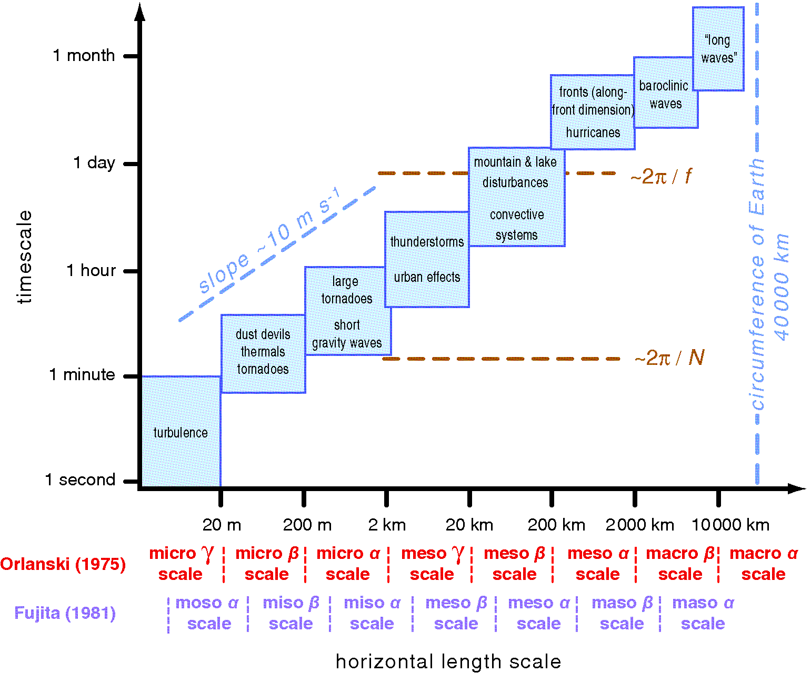
ATMS 316- Background
Relationship between spatial and temporal scales (Fig. 1.1)

Slide 4
ATMS 316- Background
Equations of motion in (x, y, z) coordinates
(C. Hennon)

Slide 5
Scale Analysis
Process to determine which terms in an equation may be neglected
Can usually be neglected if they are much smaller (orders of magnitude smaller) than other terms
Use typical values for parameters in the mid-latitudes:
(C. Hennon)

Slide 6
Synoptic Scale Analysis
Horizontal velocity (U) ≈ 10 m/s (u,v)
Vertical velocity (W) ≈ 10⁻² m/s (w)
Horizontal Length (L) ≈ 10⁶ m ( )
Vertical Height (H) ≈ 10⁴ m ( )
Angular Velocity (Ω) ≈ 10⁻⁴ s⁻¹ (Ω)
Time Scale (T) ≈ 10⁵ s ( )
Frictional Acceleration (Fr) ≈ 10⁻³ ms⁻² (F_{rx}, F_{ry}, F_{rz})
Gravitational Acceleration (G) ≈ 10 m/s (g)
Horizontal Pressure Gradient (∆p) ≈ 10³ Pa ( )
Vertical Pressure Gradient (Po) ≈ 10⁵ Pa ( )
Specific Volume (α) ≈ 1 m³kg⁻¹ (α)
Coriolis Effect (C) ≈ 1 (2sinφ,2cosφ)
(C. Hennon)

Slide 7
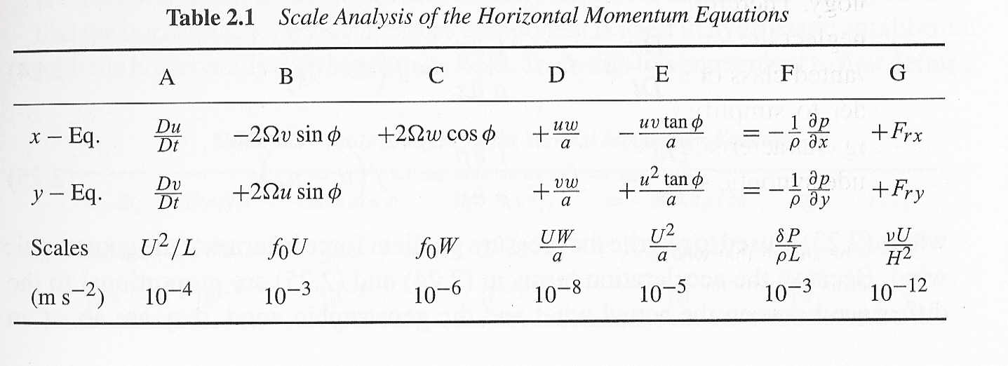
Synoptic Scale Analysis
(Holton)

Slide 8
Synoptic Scale Analysis
(Holton)

Slide 9
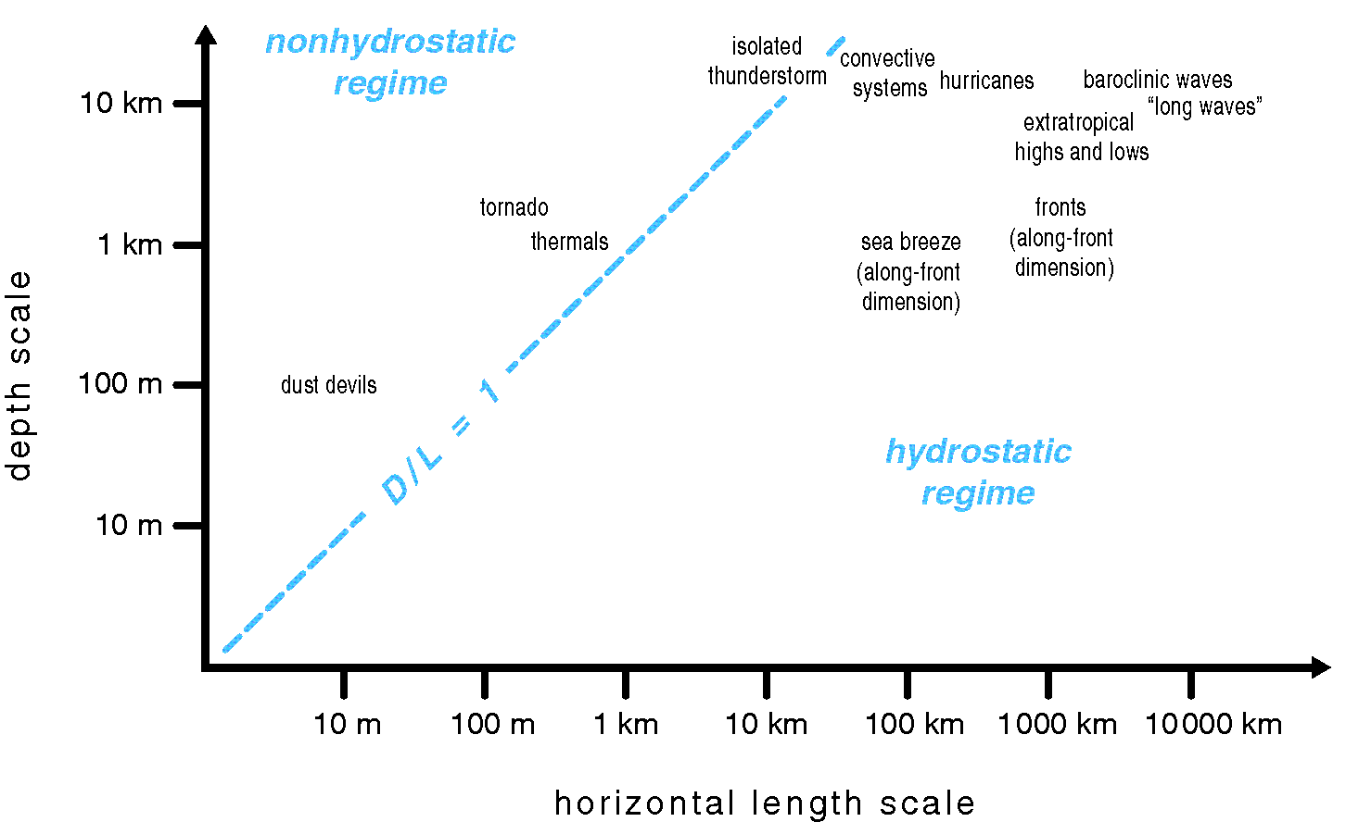
ATMS 316- Background
Hydrostatic balance variation by depth and length scales (Fig. 1.4)

Slide 10
ATMS 316- Synoptic Scale Motion
Approximate equations of motion in (x, y, z) coordinates
(C. Hennon)

Slide 11
ATMS 316- Synoptic Scale Motion
The degree of acceleration of the wind is related to the degree that the actual winds are out of geostrophic balance

Slide 12
ATMS 316- Synoptic Scale Motion
A measure of the validity of the geostrophic approximation is given by the Rossby number*
ratio of the acceleration to the Coriolis force
*a dimensionless fluid scaling parameter {Eq. (1.2)}

Slide 13
ATMS 316- Synoptic Scale Motion
For typical synoptic scale values of f_{o} ~ 10⁻⁴ s, L ~ 10⁶ m, and U ~ 10 m s⁻¹, the Rossby number becomes R_{o} ~ 0.1
The smaller the value of R_{o}, the closer the winds to
geostrophic balance

Slide 14
ATMS 316- Synoptic Scale Motion
For typical synoptic scale values of f_{o} ~ 10⁻⁴ s, L ~ 10⁶ m, and U ~ 10 m s⁻¹, the Rossby number becomes R_{o} ~ 0.1
The smaller the value of R_{o}, the more important the
effects of the earth’s rotation on the winds

Slide 15
ATMS 316- Background
Equations of motion in (x, y, z) coordinates
But what about for mesoscale motions?
(C. Hennon)

Slide 16
ATMS 316- Background
But what about for mesoscale motions?
It depends on the specific type of mesoscale phenomena

Slide 17
ATMS 316- Background
But what about for mesoscale motions?
A measure of the validity of the geostrophic approximation is given by the Rossby number*
ratio of the acceleration to the Coriolis force
R_{o} becomes large for mesoscale motions →
geostrophic approximation becomes less valid

Slide 18
ATMS 316- Background
But what about for mesoscale motions?
A measure of the validity of the geostrophic approximation is given by the Rossby number*

Slide 19
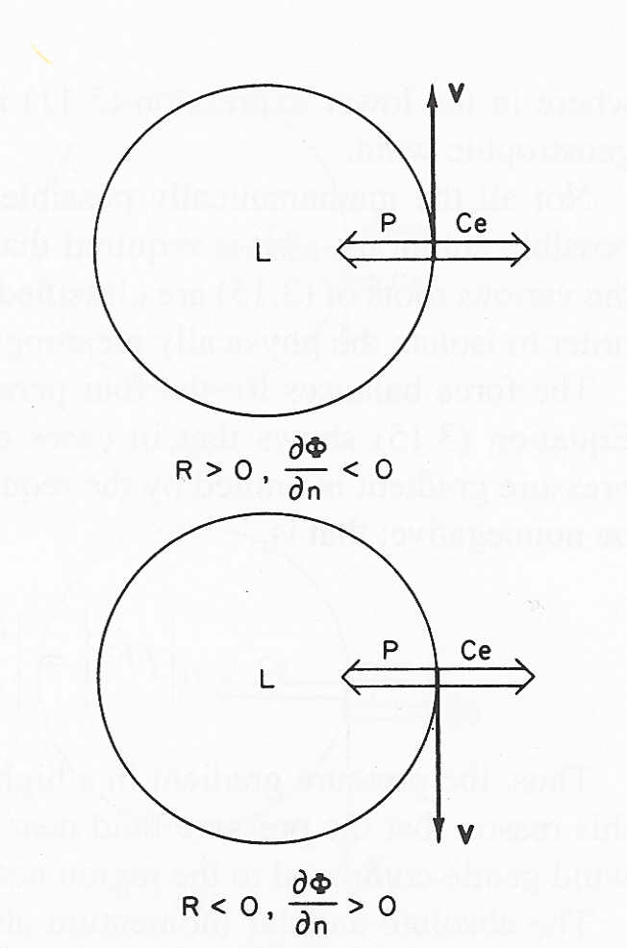
ATMS 316- Background
R_{o} becomes large for mesoscale motions → effects
of earth’s rotation on winds becomes negligible
An example; cyclostrophic flow (Holton, p. 63)…
Balanced flow → centrifugal force = pressure gradient force

Slide 20
ATMS 316- Scaling Parameters
Scaling parameters
e.g. a measure of the validity of the geostrophic approximation is given by the Rossby number*
*a dimensionless fluid scaling parameter

Slide 21
ATMS 316- Scaling Parameters
Scaling parameters
Why?
A useful tool for diagnosing fluid (atmospheric) behavior
Can be a useful prognostic tool if the parameter can be accurately predicted

Slide 22
ATMS 316- Defining Mesoscale
Scale | Synoptic | Meso- | Micro-
temporal/ spatial | days/3000 km | hour – one day/ 2 – 200 km | seconds – minutes/ 1 m – 2 km
momentum equations | geostrophic/ hydrostatic balance | full form | neglect Coriolis force
relevant instability | baroclinic | wide variety | shear, buoyancy
Lagrangian timescale | 1.0+ days | 10 minutes – 17 hours | seconds - minutes

Slide 23
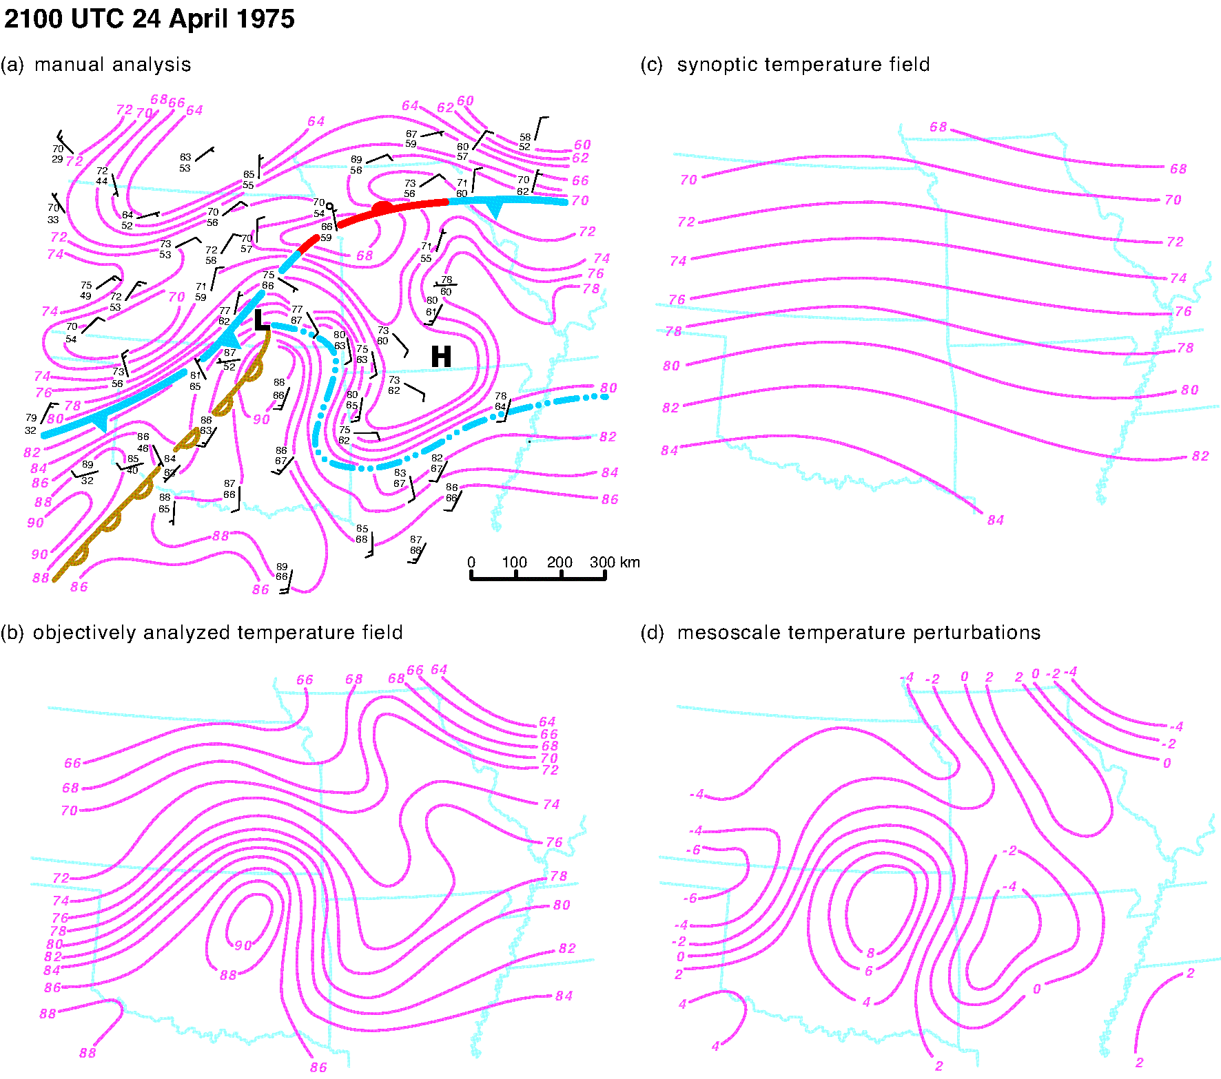
ATMS 316- Scaling Parameters
Multi-scale analyses (Fig. 1.3)

Slide 24
ATMS 316- Scaling Parameters
Other scaling parameters
Rossby radius of deformation
Froude number
Internal
Scorer parameter
Richardson number
Bulk
Gradient

Slide 25
ATMS 316- Scaling Parameters
Rossby radius of deformation (L_{R})
C_{g} = gravity wave speed
f = Coriolis parameter
= 2Ω sinΦ
http://meted.ucar.edu/nwp/pcu1/d_adjust/index.htm

Slide 26
ATMS 316- Scaling Parameters
Rossby radius of deformation (L_{R})
The key to a response to atmospheric forcing is whether the disturbance is much wider, comparable to, or much less than the Rossby radius of deformation. The Rossby radius is related to the distance a gravity wave propagates before the Coriolis effect becomes important.
http://meted.ucar.edu/nwp/pcu1/d_adjust/index.htm

Slide 27
ATMS 316- Scaling Parameters
Ways to conceptualize Rossby radius | Consequences
The scale at which rotation becomes as important as buoyancy | Features smaller in scale are dominated by buoyancy forcing, resulting in gravity waves in a stable environment, so they disperse and have a short lifetime Features larger in scale are rotational in character, dominated by Rossby wave dynamics, and have a longer life
The partitioning of potential vorticity (PV) into vorticity (winds) and static stability (mass). (Remember, PV is conserved if potential temperature is conserved. Thus, ignoring latent heating, radiation, and turbulence for the moment, the disturbance PV would be conserved during adjustment.) | A large-scale disturbance primarily causes height and temperature changes to the pre-disturbance state, resulting in the disturbance PV showing up predominantly in the mass field A small-scale disturbance primarily causes vorticity changes to the pre-disturbance state, resulting in the disturbance PV showing up predominantly in the wind field
Partitioning between potential and kinetic energy | A large-scale disturbance ends up with most of its energy stored as potential energy A small-scale disturbance ends up with most of its energy in the form of kinetic energy

Slide 28
ATMS 316- Scaling Parameters
Rossby radius of deformation (L_{R})
The Rossby radius of deformation marks the scale beyond which rotation is more important than buoyancy, meaning larger features are dominated more by rotation than by divergence, and they tend to be balanced and long-lived.
Features smaller than the Rossby radius tend to be transient, having their energy dispersed by gravity waves.
The Rossby radius increases for thicker disturbances and is longer when the lapse rate is weaker.
http://meted.ucar.edu/nwp/pcu1/d_adjust/index.htm

Slide 29
ATMS 316- Scaling Parameters
Rossby radius of deformation (L_{R})
The Rossby radius is proportional to the inertial period (1/f ), which is longer where the Coriolis parameter is small (lower latitudes) and where the absolute vorticity is small (anticyclones).
The point is that smaller cyclonic vortices can survive longer in midlatitudes than in the tropics, while anticyclones (unless they are fairly large scale) will be transient after their forcing ends.
http://meted.ucar.edu/nwp/pcu1/d_adjust/index.htm

Slide 30
ATMS 316- Scaling Parameters
Froude number (Fr)
U = wind speed normal to mountain
N = Brunt-Väisälä frequency
S = vertical (for some applications, horizontal) scale of the mountain
Wallace & Hobbs (2006), p. 407, 408

Slide 31
ATMS 316- Scaling Parameters
Froude number (Fr)
A measure of whether flow will go over (surmount) a mountain range
Small Fr; low-level airflow is forced to go around the mountain and/or through gaps
Larger Fr; more airflow goes over the mountain crest
Wallace & Hobbs (2006), p. 407, 408

Slide 32
ATMS 316- Scaling Parameters
Froude number (Fr)
Ratio of inertial to gravitational force
Describes the ratio of the flow velocity to the phase speed of gravity waves on the interface of a two-layer fluid (e.g. top of the boundary layer)
Fr < 1; gravity wave phase speed exceeds flow speed, subcritical flow
Fr > 1; flow speed is greater than the gravity wave propagation speed, supercritical flow
Burk & Thompson (1996)

Slide 33
ATMS 316- Scaling Parameters
Froude number (Fr)
In supercritical flow, gravity wave perturbations cannot propagate upstream, and the flow, therefore, does not show an upstream response to the presence of obstacles
Hydraulic jumps; can occur where the flow transitions back from being supercritical to subcritical
Burk & Thompson (1996)

Slide 34
ATMS 316- Scaling Parameters
Scorer parameter (L²)
U = wind speed normal to mountain
N = Brunt-Väisälä frequency

Slide 35
ATMS 316- Scaling Parameters
Scorer parameter (L²)
aL << 1, evanescent waves exist
Decay with height
Have streamlines that satisfy potential flow theory
aL >> 1, vertically propagating waves exist
Under ideal conditions, the amplitude of the waves does not decrease with height
“a” is the half-width of the mountain
Burk & Thompson (1996)

Slide 36
ATMS 316- Scaling Parameters
Richardson number (Ri)
B = buoyant generation or consumption of turbulence, equal to the square of the Brunt-Väisälä frequency
M = mechanical generation of turbulence
Wallace & Hobbs (2006), p. 380

Slide 37
ATMS 316- Scaling Parameters
Richardson number (Ri)
Laminar flow becomes turbulent when Ri drops below a critical value of 0.25
Turbulent flow often stays turbulent, even for Ri numbers as large as 1.0, but becomes laminar at larger values of Ri
Flow in which 0.25 < Ri < 1.0; type of flow depends on the history of the flow
Flow in which Ri < 0.25, dynamically unstable
Wallace & Hobbs (2006), p. 380

Slide 38
ATMS 316- Mesoscale Research
Techniques for mesoscale meteorology research
Laboratory-based research
Fluid experiments
Analytical experiments
Numerical experiments
Observation-based research
Field experiment

Slide 39
ATMS 316- Mesoscale Research
Advantages/disadvantages of mesoscale meteorology research
Laboratory-based research
Fluid experiments – can control parameters and have results related to an actual fluid. How well do our findings scale upward?
Analytical experiments – inexpensive, easy to manipulate, and require modest computational capabilities. Can we find a meaningful application to the real world of our solution to a simplified state or to simplified conditions?
Numerical experiments – inexpensive and easy to manipulate the various parameters. Do we introduce error that overshadows meaningful results in our desire to reduce the number of calculations?
How well do results translate to the real world atmosphere?
Observation-based research – observe directly what we desire to explain. Expensive and a bit of a gamble (are we in the right place at the right time?).

Slide 40
ATMS 316- Textbook
Basic Equations and Tools (Chapter 2), Mesoscale Instabilities (Chapter 3), and The Boundary Layer (Chapter 4, p. 73 – 93) make the book useful as reference and review material for
ATMS 305 (Thermodynamics and Statics)
ATMS 310 (Kinematics and Dynamics)
ATMS 410 (Synoptic Meteorology I)
ATMS 411 (Synoptic Meteorology II)
in addition to the mesoscale phenomena that will be explored in this course (Mesoscale Meteorology).

