Slide 1
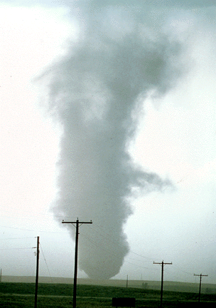
ATMS 316- Mesoscale Meteorology
Packet#4
Interesting things happen at the boundaries, or at the interface…
  Flat, mountainous
http://www.ucar.edu/communications/factsheets/Tornadoes.html

Slide 2
ATMS 316- Mesoscale Meteorology
http://www.erh.noaa.gov/gsp/localdat/NWFS_discussion_group/nwfs_discussion_group.html
Outline
  Background
  Northwest flow snowfall
    Introduction
    Methodology
    Synoptic Conditions
    Results
    Summary

Slide 3
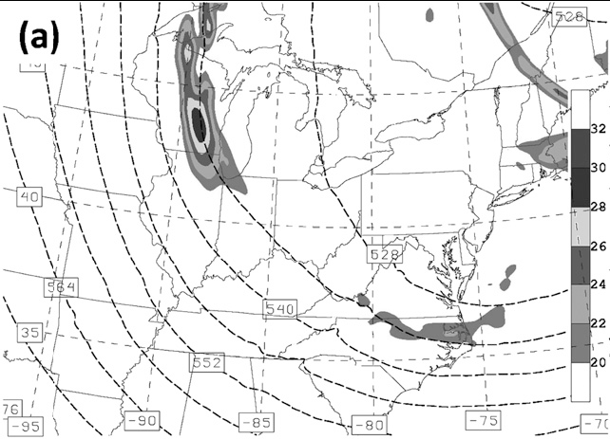
ATMS 316- Background
Cyclonic vorticity advection (CVA) at 500 hPa occurs downstream of a maximum in absolute vorticity (shading) and contributes to rising motion in the lower troposphere

Slide 4
ATMS 316- NW Flow Snowfall
Near-Term Effects of the Lower Atmosphere in Simulated Northwest Flow Snowfall Forced over the Southern Appalachians
  Douglas K. Miller
  Weather and Forecasting, October 2012
  p. 1198-1216

Slide 5
ATMS 316- NW Flow Snowfall
Introduction
  Purpose: numerical simulations are used to investigate the near-term impact of heat and moisture fluxes at the ground directly upstream of the southern region of the Appalachian Mountains (SAMs) on snowfall accumulation

Slide 6
ATMS 316- NW Flow Snowfall
Introduction
  Northwest flow snowfall (NWFS) events can account for 50% of the mean annual snowfall at high altitudes along the windward slopes of the SAMs (Perry 2006; Perry et al. 2010)

Slide 7
ATMS 316- NW Flow Snowfall
Introduction
  These events often occur after the passage of the upper-level trough, when quasigeostrophic forcings are generally unfavorable for precipitation generation

Slide 8
ATMS 316- NW Flow Snowfall
Introduction
  In addition, moist-layer temperatures during passage of the upper-level trough are typically quite cold in the moist layer, in the range –14º to –17ºC, favorable for dendritic snow crystal growth (Ryan et al. 1976; Pruppacher and Klett 1997; Fukuta and Takahashi 1999)

Slide 9
ATMS 316- NW Flow Snowfall
Introduction
  The challenge in predicting snow accumulation with NWFS is that it is highly localized due in part to
    the topographic relief variability of the mountains (Perry and Konrad 2006)
    the mesoscale variability of the low-level atmospheric moisture, temperature, and stratification (Perry and Konrad 2006; Holloway 2007; Keighton et al. 2009)

Slide 10
ATMS 316- NW Flow Snowfall
Introduction
  NWFS is closely related to lake-effect snow events, accumulations sensitive to
    Rapidly varying SLRs
    Shortwaves transiting upper-level trough
    Evolving PBL; influenced by shortwaves & diurnal cycle
    Strength & height of capping inversion

Slide 11
ATMS 316- NW Flow Snowfall
Introduction
  Great Lakes “tap”
    upwind trajectories extend to the Appalachian Mountains southeastward from the Great Lakes (Schmidlin 1992; Sousounis and Fritsch 1994; Holloway 2007; Perry et al. 2007; Keighton et al. 2009)
      Moistens and destabilizes PBL

Slide 12
ATMS 316- NW Flow Snowfall
Introduction
  NWFS convection type sometimes varies with the diurnal cycle
    Cellular – daytime (deeper PBL)
    Banding – nighttime (resembles HCRs)
      Banding could also be a response to a convective mode distinct from HCRs (Kirshbaum and Durran 2005; Kirshbaum et al. 2007a,b)

Slide 13
ATMS 316- NW Flow Snowfall
Introduction
  Hypotheses
    soil moisture conditions upstream of the mountains can contribute to a higher NWFS snowfall accumulation event if the soil contains elevated amounts of groundwater from recent rainfall or snowmelt and no snow covers the ground
    the intensity of cloud and precipitation formation during NWFS events can be significantly influenced by diurnal effects in the PBL

Slide 14
ATMS 316- NW Flow Snowfall
Methodology
  Use WRF-ARW mesoscale model to study 5–8 December 2010 NWFS event
    horizontal grid spacings were defined to be 13.5, 4.5, and 1.5 km for the outer, middle, and innermost nests, respectively
    45 model vertical levels of the three domains extended from the ground to the model top at the 100-hPa level

Slide 15
ATMS 316- NW Flow Snowfall
Methodology
  Use WRF-ARW mesoscale model to study 5–8 December 2010 NWFS event
    Initialized from NARR at 0000 UTC 6 December 2010
    48-h simulations

Slide 16
ATMS 316- NW Flow Snowfall
Methodology
  WRF-ARW orography

Slide 17
ATMS 316- NW Flow Snowfall
Methodology
  Experiments
    Running ‘‘SHoff’’ or ‘‘LHoff’’ during the first 12-h period of the model simulation (P1), during the middle 12-h period of the model simulation (P2), or during the final 24-h period of the model simulation (P34)
    The remainder of the model time integration consisted of using either the ‘‘default,’’ ‘‘50% SH enhancement,’’ or ‘‘50% LH enhancement’’ land surface model

Slide 18
ATMS 316- NW Flow Snowfall
Synoptic Conditions
  Why study the 5–8 December 2010 NWFS event?
    soil conditions upstream of the SAMs had significant moisture content at the time of its onset
    relatively significant impact on the residents of western North Carolina

Slide 19
ATMS 316- NW Flow Snowfall
Synoptic Conditions
  Timing of the 5–8 December 2010 NWFS event
    at 1800 UTC 4 December 2010 [1300 EST 4 December 2010] light rain was observed at the KAVL ASOS station
    cold front passed Asheville at 0000 UTC 5 December
    light snow was reported at KAVL starting at 1400 UTC 5 December, by which time the NWFS event can be defined to have started at Asheville
    Snowfall associated with the NWFS portion of the event was over by 0000 UTC 8 December

Slide 20
ATMS 316- NW Flow Snowfall
Synoptic Conditions
  a southeastward-tracking short wave, marked by a vorticity maximum at the 500-hPa level brings snow to the region via upslope or northwest flow near the surface

Slide 21
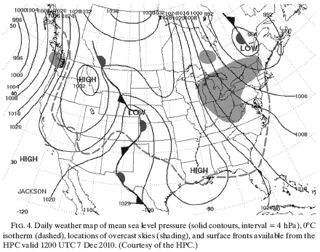
ATMS 316- NW Flow Snowfall
Synoptic Conditions
  a southeastward-tracking short wave, marked by a vorticity maximum at the 500-hPa level brings snow to the region via upslope or northwest flow near the surface

Slide 22
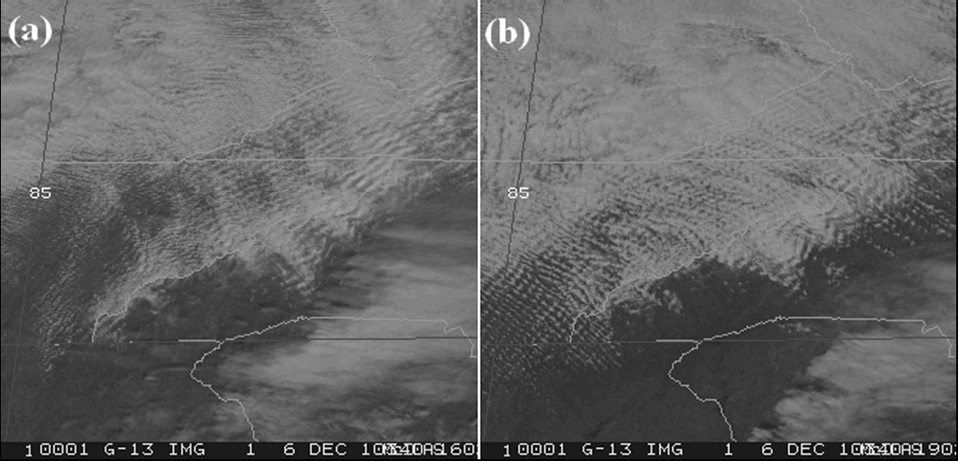
ATMS 316- NW Flow Snowfall
Synoptic Conditions

Slide 23
ATMS 316- NW Flow Snowfall
Synoptic Conditions
  Sky relatively clear at 1602 UTC 6 Dec (a)
    Trapped or resonant lee waves (transverse banding)
  Clouds “fill in” by 1902 UTC 6 Dec (b)
    Transverse and longitudinally oriented banding

Slide 24
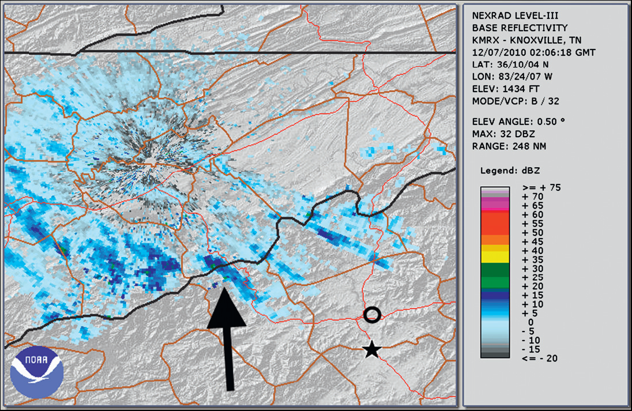
ATMS 316- NW Flow Snowfall
Synoptic Conditions

Slide 25
ATMS 316- NW Flow Snowfall
Synoptic Conditions
  After sunset (0206 UTC 7 Dec), longitudinal banding becomes isolated
    Dominant snowband position highlighted by the arrow

Slide 26
ATMS 316- NW Flow Snowfall
Results
  Default WRF-ARW land surface model 3-h liquid equivalent accumulation at Max Patch
    1.64 cm (0.6 in) total liquid equivalent accumulation
    40:1 SLR translates to a total snowfall accumulation of 65.6 cm (24 in)
Default = Control

Slide 27
ATMS 316- NW Flow Snowfall
Results
  Significant accumulation during nighttime hours
  Lesser accumulations in the daylight hours
    Diurnal implications or coincidence?

Slide 28
ATMS 316- NW Flow Snowfall
Results

Slide 29
ATMS 316- NW Flow Snowfall
Results
  The study region during the period leading up to the 24-h period of interest (P34) is characterized synoptically by large-scale subsidence in the wake of the 500-hPa trough passage
  However, a short wave is evident over Wisconsin at 1200 UTC 6 Dec that contributes to localized ascent due to vertical differential cyclonic vorticity advection

Slide 30
ATMS 316- NW Flow Snowfall
Results

Slide 31
ATMS 316- NW Flow Snowfall
Results
  a well-mixed PBL from the surface to the 850-hPa level
  vapor mixing ratios exceeding 1.4 g kg⁻¹ are confined to a shallow layer below the 850-hPa level
  moist layer is capped by a stable layer associated with large-scale subsidence
  nearly unidirectional northwesterly flow is evident from near the ground through the 100-hPa level

Slide 32
ATMS 316- NW Flow Snowfall
Results

Slide 33
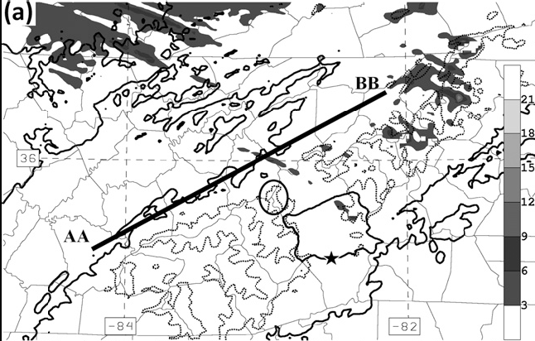

ATMS 316- NW Flow Snowfall
Results

Slide 34
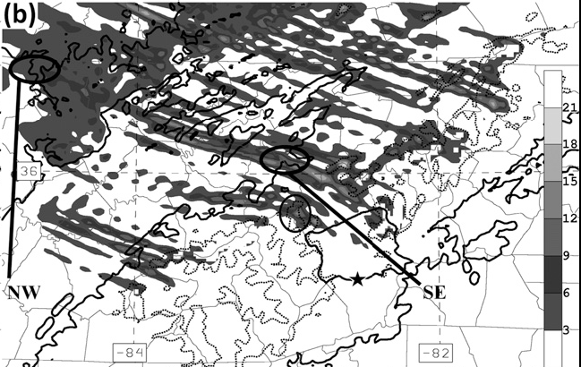
ATMS 316- NW Flow Snowfall
Results

Slide 35
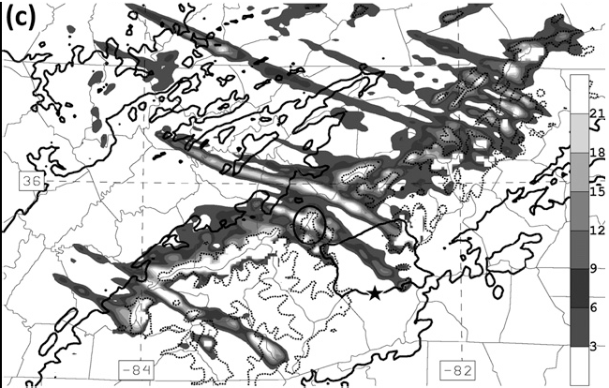
ATMS 316- NW Flow Snowfall
Results

Slide 36
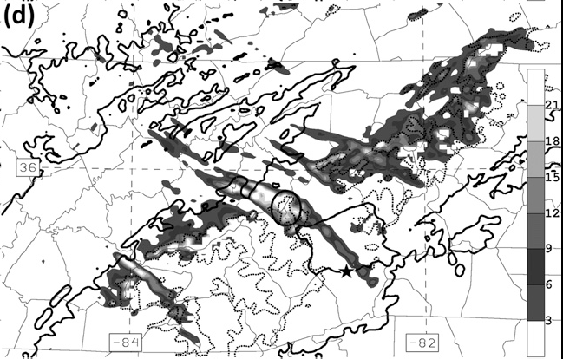
ATMS 316- NW Flow Snowfall
Results

Slide 37
ATMS 316- NW Flow Snowfall
Results
  1800 UTC; bands have reached NW corner of domain, aligned along mean wind and shear vector directions
  2100 UTC; transverse and longitudinally oriented convection bands cover domain
Sunset occurs at 2217 UTC 6 December, PBL cools after sunset

Slide 38
ATMS 316- NW Flow Snowfall
Results
  0000 UTC; bands have shifted to mtns along TN/NC border, large band near Max Patch
  0300 UTC; banding becomes more localized, Max Patch band 15 km NE of observed dominant band (KMRX NEXRAD)
500 hPa vorticity maximum has little or no influence on rising motion at 0000 and 0300 UTC

Slide 39
ATMS 316- NW Flow Snowfall
Results
  no Great Lakes “tap”
  air parcels spend their entire journey within the PBL
  850 hPa = mid-cloud band level

Slide 40
ATMS 316- NW Flow Snowfall
Results
  Periodic vertical motion evident downstream of Cumberland Plateau
    transverse waves
  Calculations confirm transverse waves are trapped or resonant lee waves (later this semester)
  Cloud top corresponds to the bottom of the inversion layer; cloud is entirely contained in the conditionally unstable PBL

Slide 41
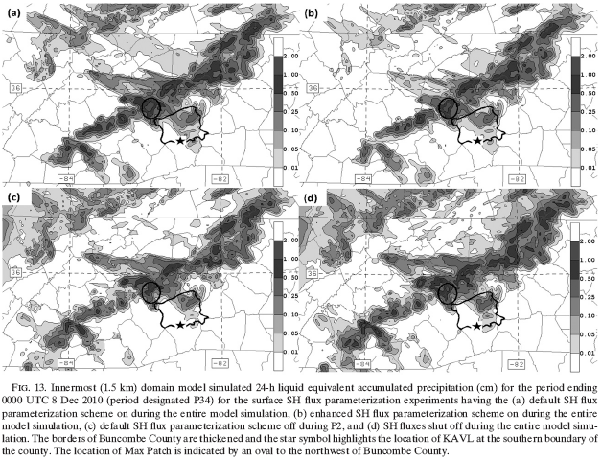
ATMS 316- NW Flow Snowfall
Surface SH Experiments
Results

Slide 42
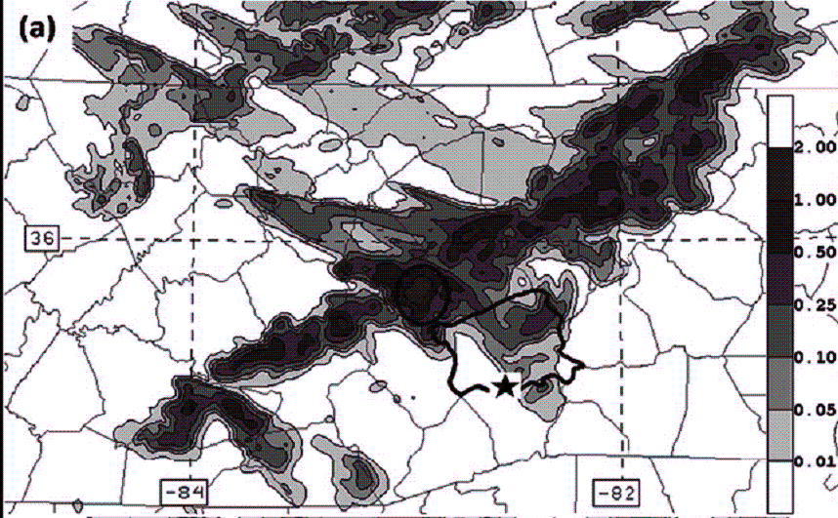
ATMS 316- NW Flow Snowfall
Results

Slide 43
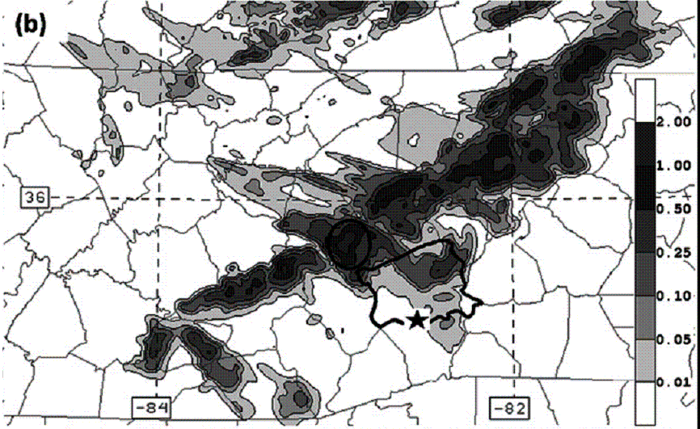
ATMS 316- NW Flow Snowfall
Results

Slide 44
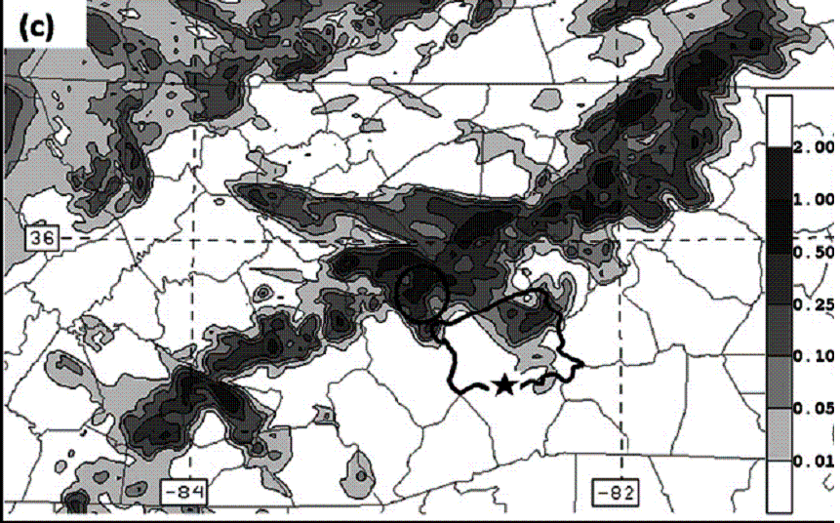
ATMS 316- NW Flow Snowfall
Results

Slide 45
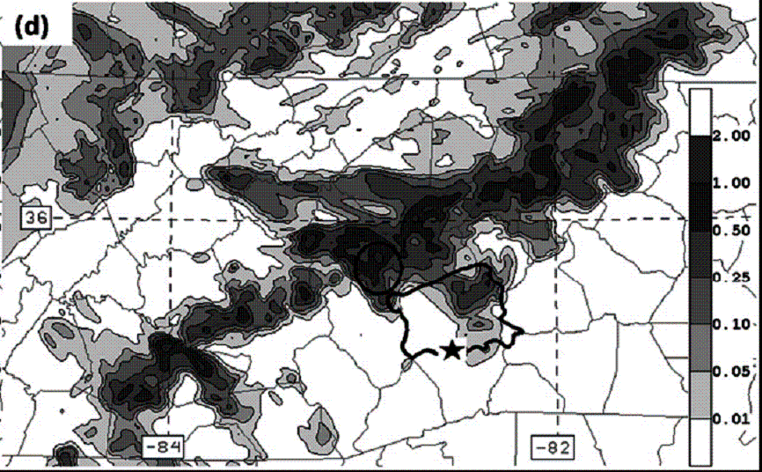
ATMS 316- NW Flow Snowfall
Results

Slide 46
ATMS 316- NW Flow Snowfall
Results
  elongated areas of accumulation oriented normal to the crest of mtns are consistent with the banding nature of the clouds producing the precipitation

Slide 47
ATMS 316- NW Flow Snowfall
Results
  in precipitation over mountainous regions, banding allows precipitation to extend much farther downstream of the mountain crest than if pure upslope was the dominant mode (Yoshizaki et al. 2000)

Slide 48
ATMS 316- NW Flow Snowfall
Results
  no sfc SH flux sim (d) has a systematically higher predicted accumulation amount compared with the default sfc SH flux sim (a)

Slide 49
ATMS 316- NW Flow Snowfall
Results
  enhanced sfc SH flux sim (b) has the systematically lowest predicted accumulation amount compared with all sfc SH flux sims (a, c, d)

Slide 50
ATMS 316- NW Flow Snowfall
Results
  Sims having sfc SH fluxes shut off during daytime hours (P2; c, d) distribute greater amounts of snowfall over the Cumberland Plateau than do the experiments having surface SH fluxes on during daytime hours (a, b)

Slide 51
ATMS 316- NW Flow Snowfall
Results

Slide 52
ATMS 316- NW Flow Snowfall
Results
  enhanced sfc SH flux sim (a) shows a uniformly higher PBL and cloud base and top compared to the default sim
    also has a warmer and slightly less stable PBL

Slide 53
ATMS 316- NW Flow Snowfall
Results
  no sfc SH flux sim (b) reveals the opposite extreme of the default sim with a uniformly shallower PBL and lower cloud base and top

Slide 54
ATMS 316- NW Flow Snowfall
Results
  delayed cloud development in the enhanced sfc SH flux sim (b) due to warmer and deeper PBL and is part of the reason for smaller snowfall accumulations over the Cumberland Plateau

Slide 55
ATMS 316- NW Flow Snowfall
Results
  suppression of surface sensible heat fluxes, particularly during the daylight hours, generally increases the simulated snowfall accumulation amounts

Slide 56
ATMS 316- NW Flow Snowfall
Results
  daytime surface SH fluxes partly oppose cloud development
    resultant heating and thickening of the PBL
  daytime surface SH fluxes partly enhance cloud development
    daytime mixing in the PBL also acts to efficiently transport moisture away from the ground, contributing to the moistening of air parcels in the PBL

Slide 57
ATMS 316- NW Flow Snowfall
Results

Slide 58
ATMS 316- NW Flow Snowfall
Results
  no sfc SH flux sim (b) has a
    wider spacing between bands,
    higher cloud mixing ratios within the bands, and
    wider cloud bands
  than the enhanced sfc SH flux sim (a)

Slide 59
ATMS 316- NW Flow Snowfall
Results
  lack of regular spacing between bands and the wide band spacing for a shallow convective PBL in the no sfc SH flux sim (b)
    doubtful that organizing processes typical of HCRs are responsible for the simulated banding

Slide 60
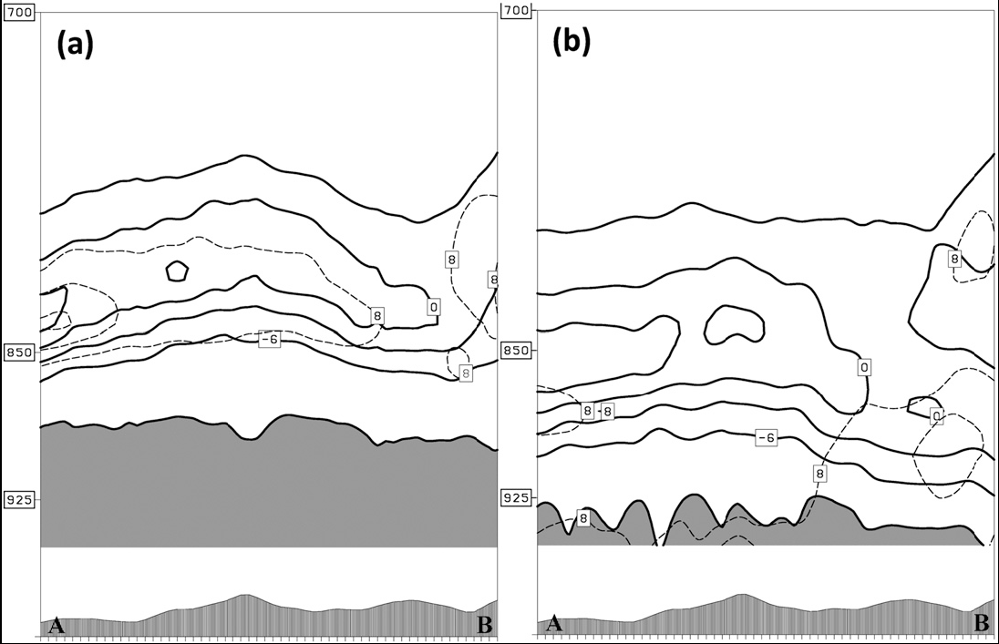
ATMS 316- NW Flow Snowfall
Results

Slide 61
ATMS 316- NW Flow Snowfall
Results
  enhanced sfc SH flux sim (a)
    conditionally unstable layer (shading) extends from the surface to above the 900-hPa level
    layer of strongest unidirectional vertical wind shear (dashed contours) is well elevated above the orography (at about the 825-hPa level) and coincides with the inversion capping the PBL

Slide 62
ATMS 316- NW Flow Snowfall
Results
  no sfc SH flux sim (b)
    conditionally unstable layer (shading) extends from the surface to almost the 925-hPa level
    layer of strongest unidirectional vertical wind shear (dashed contours) is collocated with the most unstable PBL layer next to the ground

Slide 63
ATMS 316- NW Flow Snowfall
Results
  no sfc SH flux sim (b)
    layer of strongest unidirectional vertical wind shear (dashed contours) is collocated with the most unstable PBL layer next to the ground
    allows for the maximum projection of energy forced by underlying terrain features onto the realized convective cloud bands

Slide 64
ATMS 316- NW Flow Snowfall
Results

Slide 65
ATMS 316- NW Flow Snowfall
Results
  enhanced sfc SH flux sim (a)
    only a single “strong” band
      cloud mixing ratio
      cross band convergence/ divergence

Slide 66
ATMS 316- NW Flow Snowfall
Results
  no sfc SH flux sim (b)
    multiple “strong” bands [four]
    wide horizontal spacing between strongest band and the adjacent bands, indicative of strong compensating subsidence

Slide 67
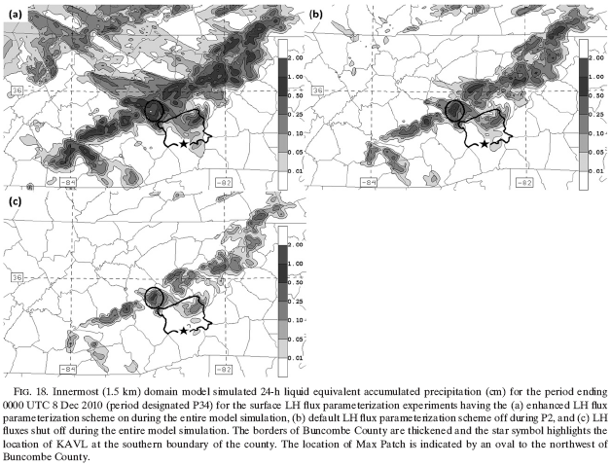
ATMS 316- NW Flow Snowfall
Surface LH Experiments
Results

Slide 68
ATMS 316- NW Flow Snowfall
Results
Default

Slide 69
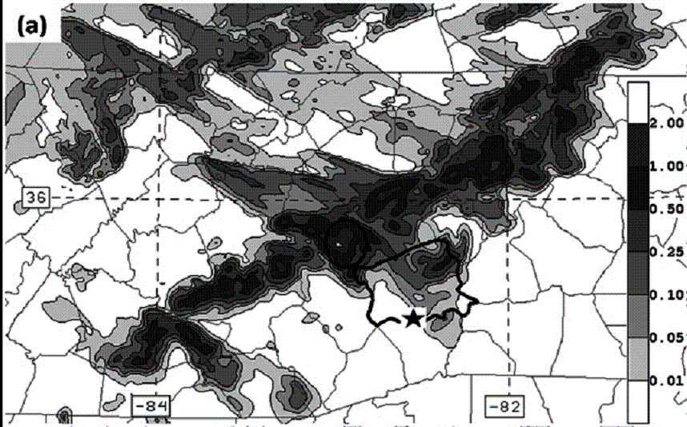

ATMS 316- NW Flow Snowfall
Results

Slide 70
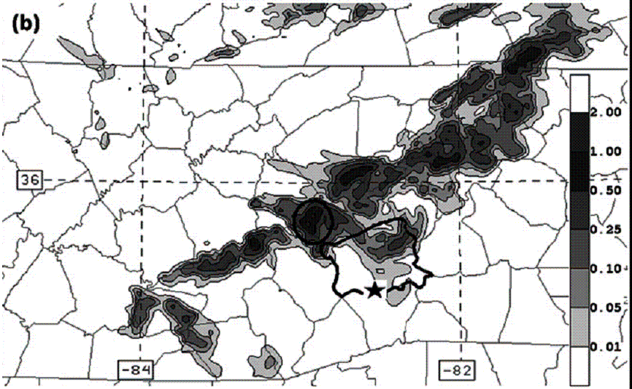
ATMS 316- NW Flow Snowfall
Results

Slide 71
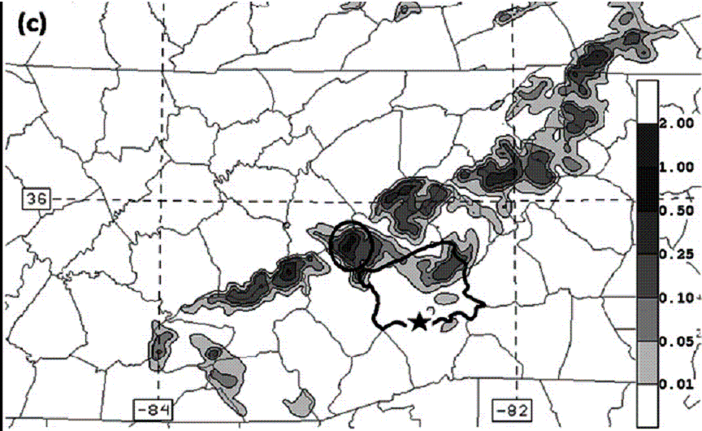
ATMS 316- NW Flow Snowfall
Results

Slide 72
ATMS 316- NW Flow Snowfall
Results
  enhanced LH flux experiments generally increase the specific humidity of the PBL compared to the default simulations
  latent heating denial impacts are comparable to the effects of the enhanced sensible heating experiments described earlier

Slide 73
ATMS 316- NW Flow Snowfall
Results
  enhanced sfc LH flux sim (a) has a systematically higher predicted accumulation amount compared with the default sfc LH flux sim (13a)

Slide 74
ATMS 316- NW Flow Snowfall
Results
  Sim having sfc LH fluxes shut off during daytime hours (P2; b) gives significantly reduced accumulation results across the entire domain
    a significant fraction of the water mass that fell during P34 in the default simulation was evaporated or sublimated from the surface during the daylight hours

Slide 75
ATMS 316- NW Flow Snowfall
Results
  a trajectory analysis (not shown) shows
    the greatest increase in vapor mixing ratio of air parcels in the cloud bands occurred during the second half of the daylight hours (1400 LT), the period when BL mixing would be maximized just before the sun begins to set

Slide 76
ATMS 316- NW Flow Snowfall
Results
  Sim having zero sfc LH fluxes (c) shows the amount of snowfall that can be attributed to moisture packets carried great distances to the SAMs
    a substantial portion of the water mass that accumulates as snow over the mountains in the default simulation is evaporated or sublimated from the surface en route to the southern Appalachians

Slide 77
ATMS 316- NW Flow Snowfall
Summary
  the origin of most of the moisture converted into snowfall accumulation in the southern Appalachians during this event came from the ground as air parcels traveled over the study domain toward the mountains
    air parcels involved in the cloud and precipitation formation received the bulk of their water vapor in the PBL during daytime hours

Slide 78
ATMS 316- NW Flow Snowfall
Summary
  daytime surface sensible heat fluxes and cloud development
    oppose; through the resultant heating and thickening of the PBL
    support; through the enhanced daytime mixing in the PBL, acting to efficiently transport moisture away from the ground

Slide 79
ATMS 316- NW Flow Snowfall
Summary
  strongest convective banding
    occurs under the conditions when the strongest unidirectional vertical wind shear is collocated within a layer having a nearly dry-adiabatic environmental lapse rate next to the ground
    longitudinal banding becomes less sensitive to the underlying topography when the layer of strongest unidirectional vertical wind shear is found near the top of the PBL

Slide 80
ATMS 316- NW Flow Snowfall
Summary
  Operational near-term forecasting implications, optimal condition for creating productive NWFS snow clouds
    cool PBL air
    PBL mixing of moderate strength
    optimal conditions are most likely to occur during nighttime hours

Slide 81
ATMS 316- NW Flow Snowfall
Summary
  Operational near-term forecasting implications, mesoscale model (MM) forecasts
    MM LH underestimates and/or SH overestimates will contribute to suppressed cloud development and an underprediction of snowfall accumulation
      erroneous predictions of high-impact warning areas being too narrowly confined to the primary SAMs crest located along the TN/NC border

Slide 82
ATMS 316- NW Flow Snowfall
http://www.erh.noaa.gov/gsp/localdat/cases/2012/11Feb12_NWFS/The%20Northwest%20Flow%20Snow%20Event%20of%2011%20February%202012.pdf
Which scenario?
  Scenario#1; synoptic scale forcing alone
  Scenario#2; synoptic scale dominates mesoscale forcing
  Scenario#3; weak synoptic scale forcing
11 February 2012
NW Flow Snowfall

