Slide 1
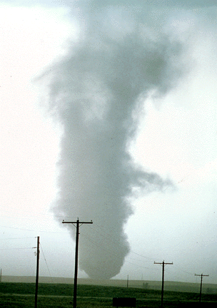
ATMS 316- Mesoscale Meteorology
Packet#12
Interesting things happen at the boundaries, or at the interface…
  Warm air, cold air
  Humid air, dry air
http://www.ucar.edu/communications/factsheets/Tornadoes.html

Slide 2
ATMS 316- Mesoscale Meteorology
http://www.meted.ucar.edu/mesoprim/severe2/print_version/_p_5.0MCCs.htm
Outline
  MCSs
  Hazards associated with deep moist convection

Slide 3
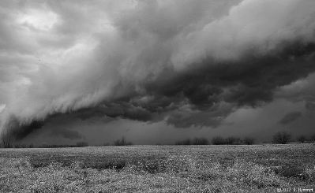
ATMS 316- MCSs and Hazards
Chapter 9, p. 245 – 249
  General characteristics
Chapter 10, p. 273 – 306
  Tornadoes
  Nontornadic, damaging straight-line winds
  Hailstorms
  Flash floods
http://www.crh.noaa.gov/iwx/?n=suncldpics, Photo courtesy Bob Hammitt

Slide 4
ATMS 316- MCSs and Hazards
Mesoscale convective system (MCS)
  Any ensemble of thunderstorms producing a contiguous precipitation area on the order of 100 km or more in horizontal scale in at least one direction
    Scale at which the Coriolis acceleration becomes significant
http://www.crh.noaa.gov/iwx/?n=suncldpics, Photo courtesy Bob Hammitt

Slide 5
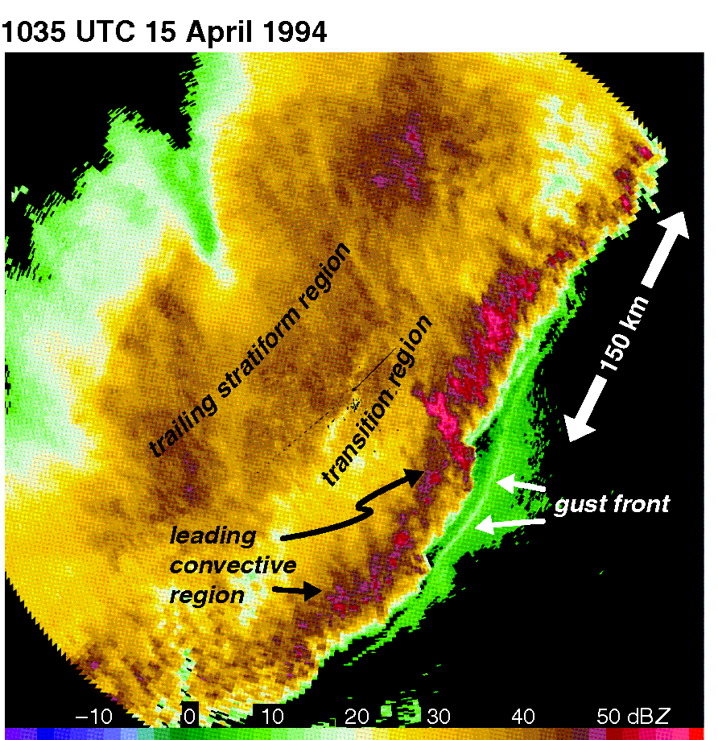
ATMS 316- MCSs and Hazards
Radar reflectivity (dBZ) from the St. Louis, MO radar showing a mesoscale convective system [MCS] (Fig 9.1)

Slide 6
ATMS 316- MCSs and Hazards
MCS formation
  Upscale growth (Type 2)
    Outflows originating from isolated convection merge into a single cold pool capable of initiating new cells
  Immediate development (Type 1)
    Large-scale convection initiation, a result of widespread, strong forcing in a weakly capped environment or as a result of strong isentropic upglide over a synoptic-scale front
http://www.crh.noaa.gov/iwx/?n=suncldpics, Photo courtesy Bob Hammitt
Notes:
6

Slide 7
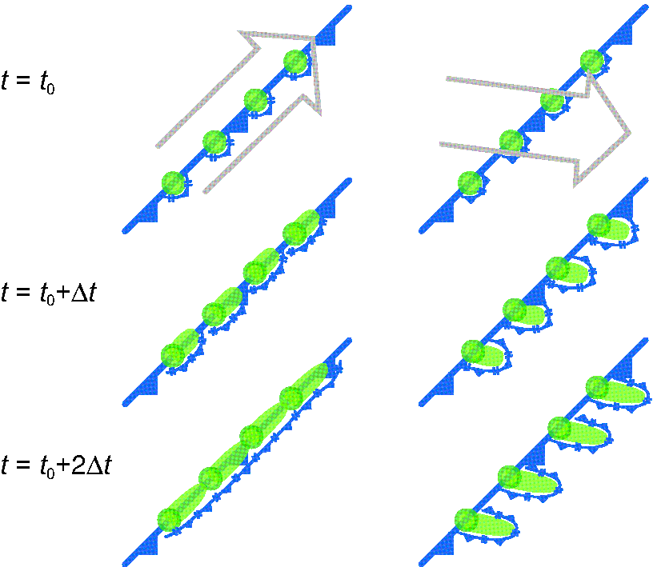
ATMS 316- MCSs and Hazards
Schematic illustrating why the upscale growth of convection is accelerated in environments in which the deep-layer shear has a large component parallel to the convection-initiating boundary [cold front in this case] (Fig 9.2)

Slide 8
ATMS 316- MCSs and Hazards
MCS formation
  MCS Type 1 and 2
    Produce heavy rain
  MCS Type 2
    Most likely to produce severe weather given their greater potential coupling to the boundary layer
http://www.crh.noaa.gov/iwx/?n=suncldpics, Photo courtesy Bob Hammitt
Notes:
8

Slide 9
ATMS 316- MCSs and Hazards
MCS; multicellular convection [see Fig. 8.12b] analogy
  The system of cells (MCS) long outlives the life of any individual cell
http://www.crh.noaa.gov/iwx/?n=suncldpics, Photo courtesy Bob Hammitt
Notes:
9

Slide 10
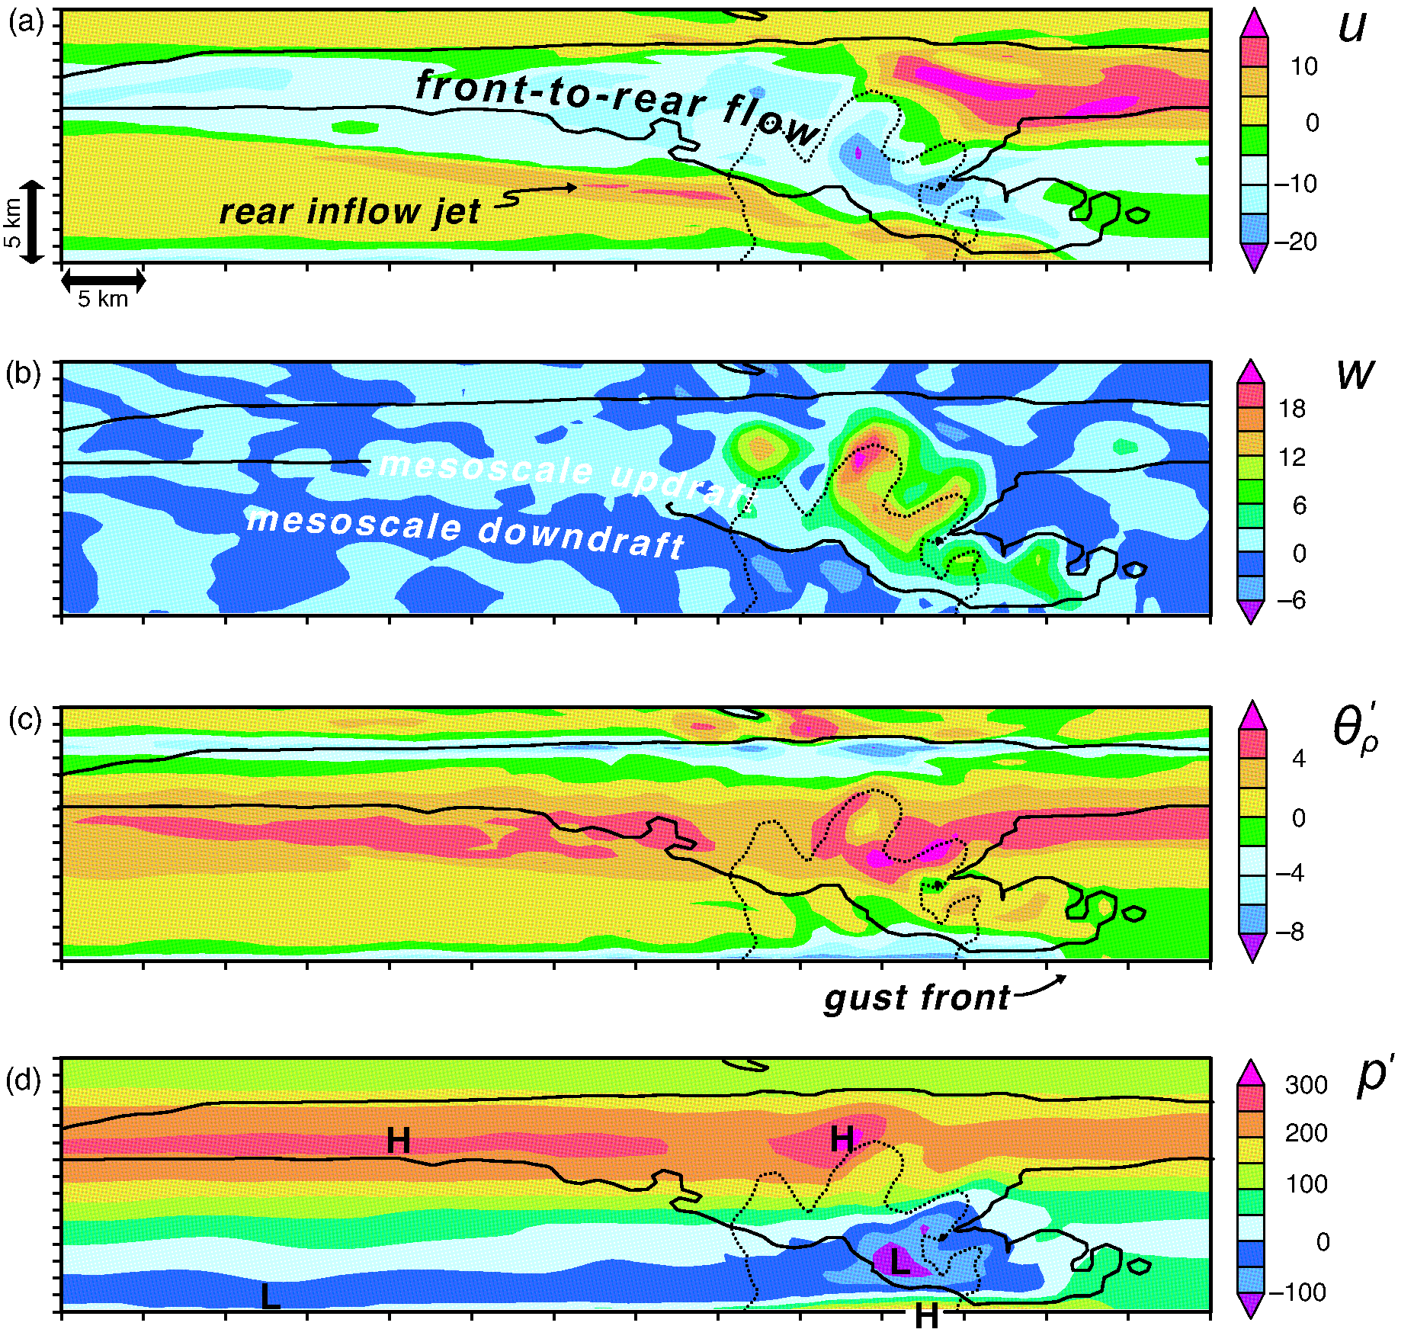
ATMS 316- MCSs and Hazards
Output from a numerical simulation of a squall line shown 2.5 h after initiation (a) storm-relative zonal wind, (b) vertical velocity, (c) density potential temperature pert., and (d) total pressure perturbation (Fig 9.3a)

Slide 11
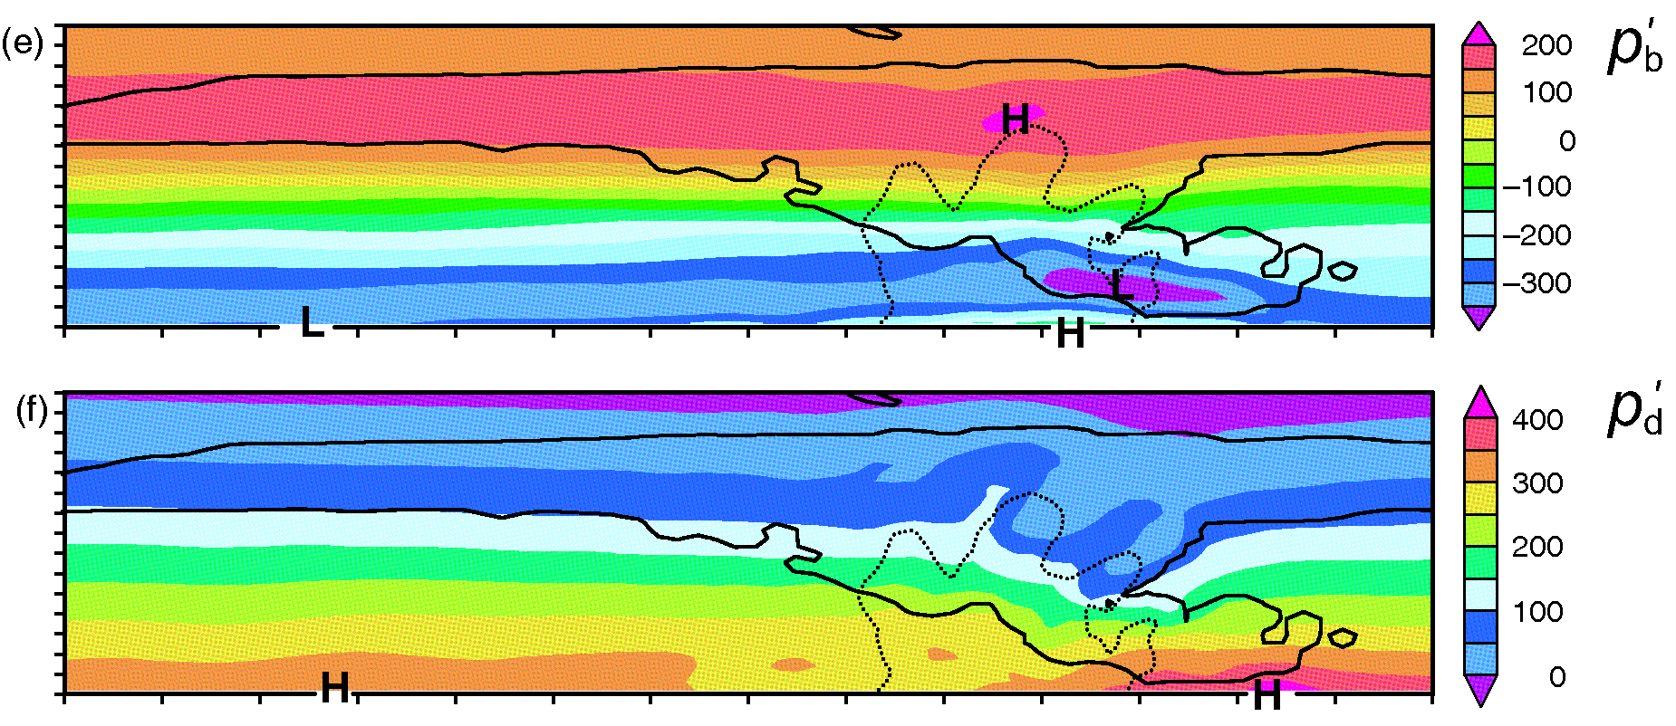
ATMS 316- MCSs and Hazards
Output from a numerical simulation of a squall line shown 2.5 h after initiation (e) buoyancy pert. pressure and (f) dynamic pressure pert. (Fig 9.3b)

Slide 12
ATMS 316- MCSs and Hazards
MCS; supercell mergers
  Deep-layer shear is strong and oriented at roughly 90º angle with respect to the initiating boundary
    Left- and right-movers collide, resulting in a rapid upscale growth into a 2D MCS
  A bow echo can evolve from supercells, particularly HP supercells
http://www.crh.noaa.gov/iwx/?n=suncldpics, Photo courtesy Bob Hammitt
Notes:
12

Slide 13
ATMS 316- MCSs and Hazards
MCSs tend to be more common at night
  Upscale growth requires isolated convection (initiated in the late afternoon or evening) to merge
  Nocturnal low-level wind maximum
http://www.crh.noaa.gov/iwx/?n=suncldpics, Photo courtesy Bob Hammitt
Notes:
13

Slide 14
ATMS 316- MCSs and Hazards
MCS classification
  Squall lines or quasi-linear convective systems (QLCSs)
    Linear radar reflectivity appearance
  Bow echoes
    Arc-shaped or bowing radar reflectivity structures in squall lines
  Line-echo wave pattern (LEWP)
    Multiple bows embedded in a single line
  Mesoscale convective complexes
    Substantial circular anvil
http://www.crh.noaa.gov/iwx/?n=suncldpics, Photo courtesy Bob Hammitt
Notes:
14

Slide 15
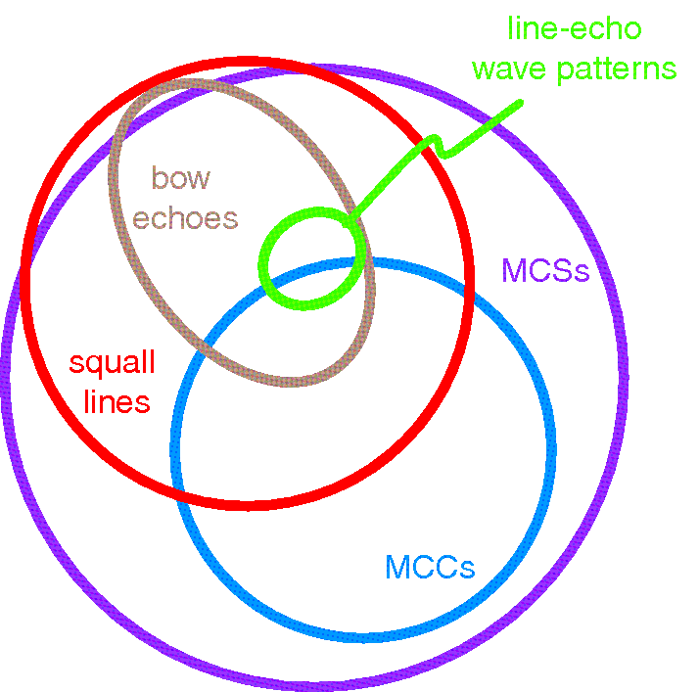
ATMS 316- MCSs and Hazards
Venn diagram of MCS subclassifications (Fig 9.4)

Slide 16
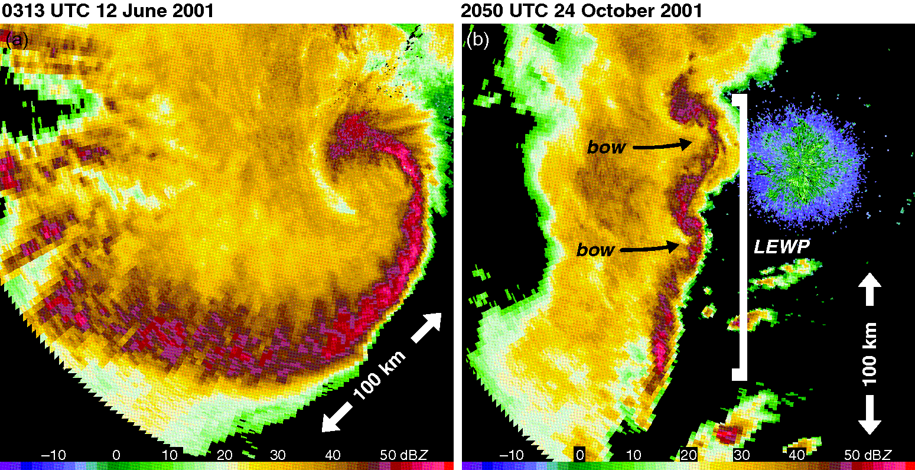
ATMS 316- MCSs and Hazards
Examples of bow echoes (Fig 9.5)

Slide 17
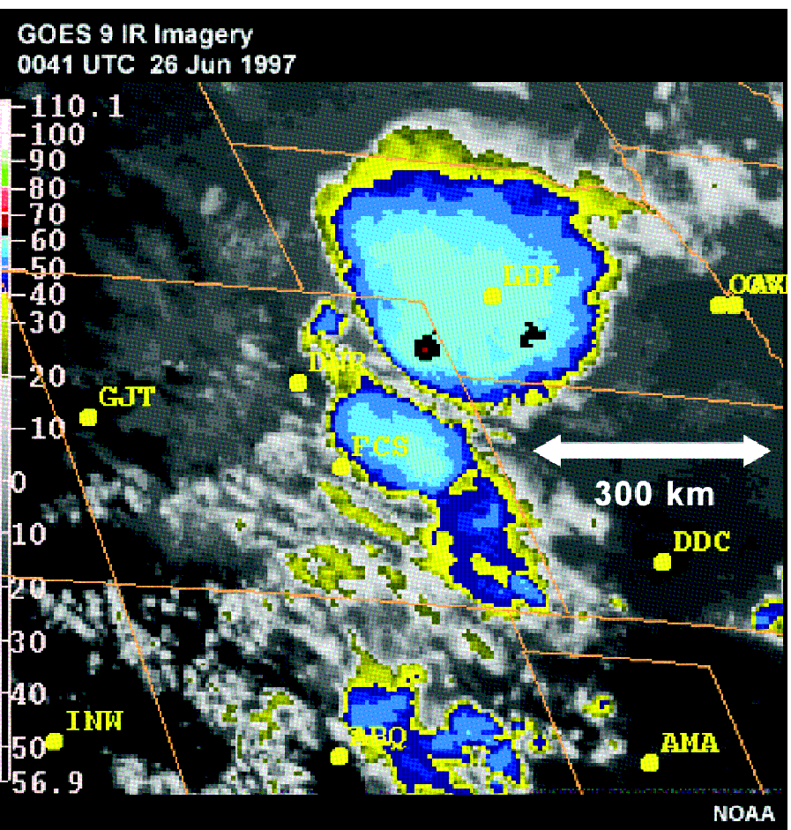
ATMS 316- MCSs and Hazards
IR satellite image of a mesoscale convective complex [MCC] over Nebraska (Fig 9.6)

Slide 18
ATMS 316- MCSs and Hazards
MCSs; vertical wind shear and CAPE
  Observed over a wide range of vertical wind shears
    Bow echoes require strong vertical wind shear (0-6 km shear > 20 m s⁻¹)
  Observed over a wide range of CAPE values
    Less than 500 J kg⁻¹ in cold season squall line environments
    In excess of 5000 J kg⁻¹ in some warm season bow echo events
http://www.crh.noaa.gov/iwx/?n=suncldpics, Photo courtesy Bob Hammitt
Notes:
18

Slide 19
ATMS 316- MCSs and Hazards
Hazards associated with Deep Moist Convection
  Tornadoes
  Nontornadic, damaging straight-line winds
http://www.crh.noaa.gov/iwx/?n=suncldpics, Photo courtesy Bob Hammitt
Notes:
19

Slide 20
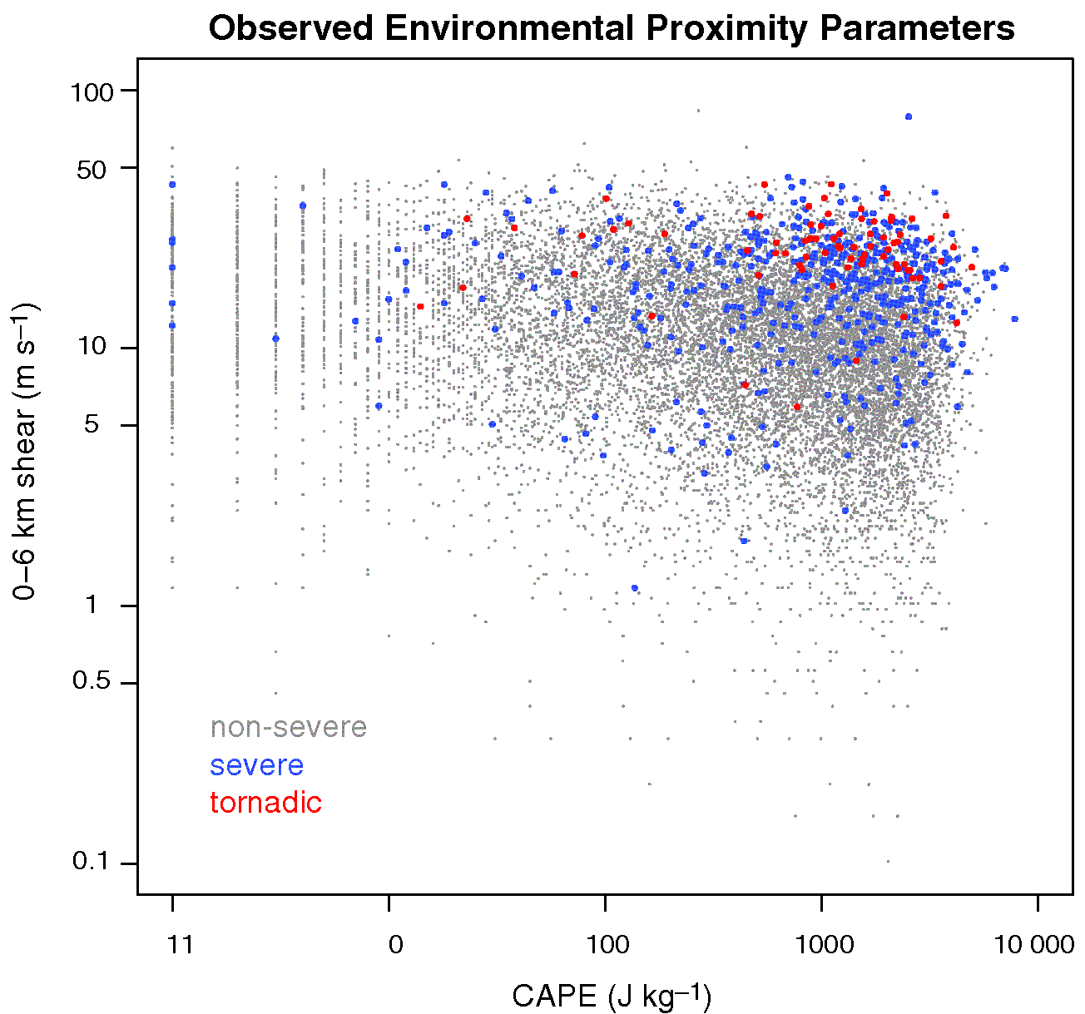
ATMS 316- MCSs and Hazards
Relationship between severity of observed T-storms and the CAPE and vertical wind shear of the environments (Fig 10.1)
Product of CAPE and vertical wind shear magnitude – reasonably good first guess of possibility of severe weather

Slide 21
ATMS 316- MCSs and Hazards
Severe weather (NWS) any or all of
  wind gusts exceeding 25 m s⁻¹
  hail diameter exceeding 1.0 inch (25.4 mm)
  a tornado
Notes:
21

Slide 22
ATMS 316- MCSs and Hazards
Severe weather
  more widespread when large shear accompanies significant CAPE
  single-cell storms with briefly intense updrafts (pulse variety) in high-CAPE, weak shear environments
  → hence, maximum updraft speed is also an important factor
Notes:
22

Slide 23
ATMS 316- MCSs and Hazards
Severe weather threats; annual deaths (30 year mean; 1977-2006)
  Flash floods and flooding; 99
  Lightning; 61
  Tornadoes; 54
  Straight-line winds and hail; 21
Notes:
23

Slide 24
ATMS 316- MCSs and Hazards
Tornadoes (10.1)
  99%; wind speeds of less than 50 m s⁻¹
  Strongest 1%; three-second (3-s) wind gusts exceeding 75 m s⁻¹ (166 mph)
    Enhanced Fujita scale
      EF0; 65-86 mph 3-s gusts
      EF1; 86-110 mph 3-s gusts
      EF2; 111-135 mph 3-s gusts
      EF3; 136-165 mph 3-s gusts
      EF4; 166-200 mph 3-s gusts
      EF5; >200 mph 3-s gusts
Most significant tornadoes (EF2 and stronger) and practically all violent tornadoes (EF4 and EF5) are associated with supercell storms
Notes:
24

Slide 25
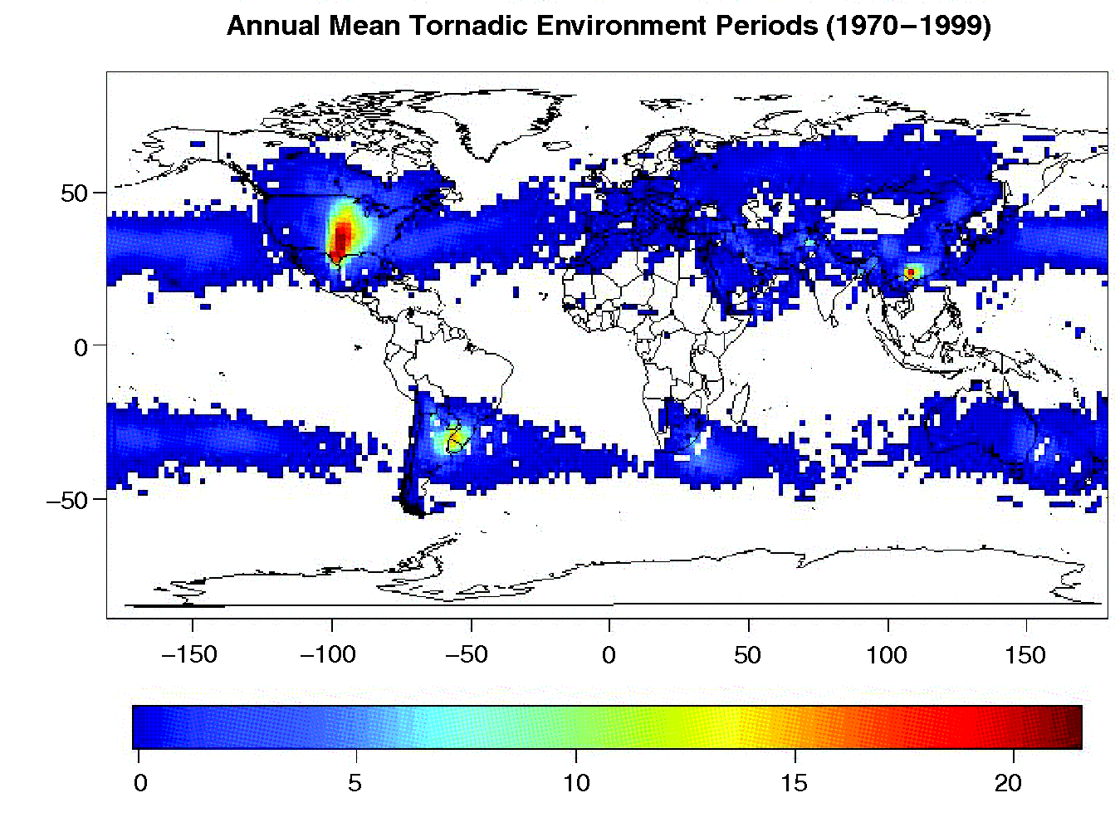
ATMS 316- MCSs and Hazards
Average number of days per year having environments favorable for tornadic supercells were convection to form (Fig 10.2)

Slide 26
ATMS 316- MCSs and Hazards
Tornadoes
  Source of high θe low-level air (GoM)
  Heated elevated terrain to the west produces large lapse rates advected eastward at mid-levels (Term I, Eq. 7.4)
  Superposition of two ingredients gives rise to substantial CAPE
Notes:
26

Slide 27
ATMS 316- MCSs and Hazards
Tornadoes
  No terrain barriers between GoM and North Pole → strong baroclinity available in region → strong vertical wind shear (via the thermal wind relation)
    Lee troughs and drylines form in western Great Plains, result of westerly flow over terrain
    Strong ageostrophic winds and wind shear
Notes:
27

Slide 28
ATMS 316- MCSs and Hazards
Tornadoes
  Favorable locations downstream of major mtn barriers and poleward of warm bodies of water
    southeastern China
    Bangladesh
    southern Brazil
    northern Italy, Slovenia, Croatia
Notes:
28

Slide 29
ATMS 316- MCSs and Hazards
Tornadogenesis
  Pre-existing vertical vorticity near the ground?
    No*
      Tilting of horizontal vorticity
      Advection toward the surface from aloft
* involve the reorientation and generation of vorticity within a downdraft in close proximity to the storm’s main updraft
Notes:
29

Slide 30
ATMS 316- MCSs and Hazards
Tornadogenesis
  Tilting of horizontal vorticity
    updraft + downdraft* involved in the tilting process
      vertical vorticity can be advected to the ground via tilting
*necessary condition when preexisting rotation is absent near the ground
Notes:
30

Slide 31
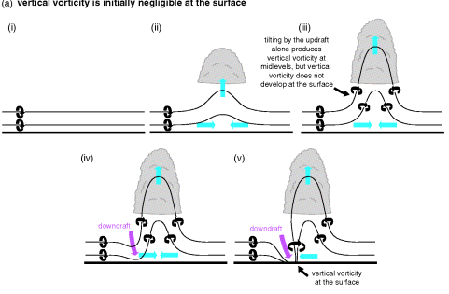
ATMS 316- MCSs and Hazards
(a) Simple vortex line demonstration of why a downdraft is needed in order for significant vertical vorticity to develop at the ground beneath a T-storm in the absence of preexisting vertical vorticity at the surface (Fig 10.3a)

Slide 32
ATMS 316- MCSs and Hazards
Tilt by updraft alone cannot be invoked to explain the amplification of near-ground vertical vorticity that results in tornadogenesis*
*if preexisting vertical vorticity is negligible near the ground
Notes:
32

Slide 33
ATMS 316- MCSs and Hazards
Tornadogenesis
  Importance of downdrafts; mechanism A
    Verified in numerical simulations
    Observations of RFDs, hook echoes, and clear slots in close proximity to tornadoes
Notes:
33

Slide 34
ATMS 316- MCSs and Hazards
←
*if preexisting vertical vorticity is negligible near the ground
Notes:
34

Slide 35
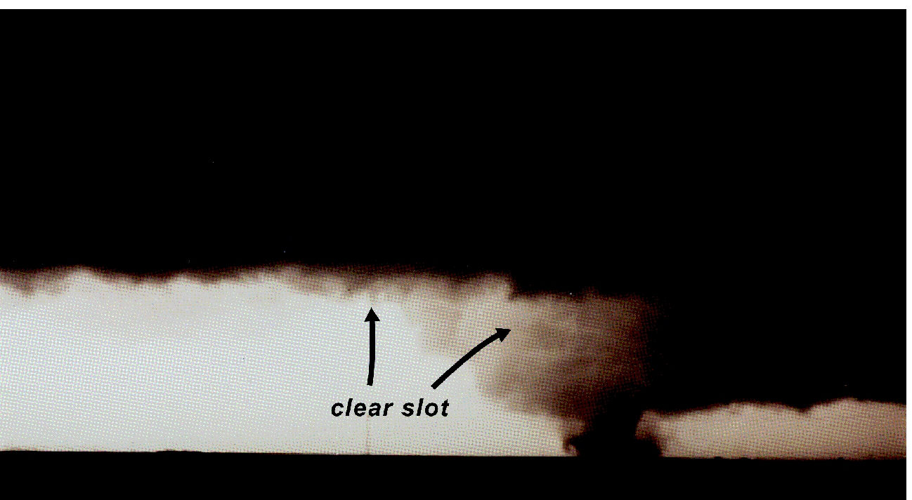
ATMS 316- MCSs and Hazards
A clear slot like that shown above near the Dimmitt, TX, tornado on 2 June 1995 is a visual manifestation of sinking air [occlusion downdraft?] (Fig 10.4)

Slide 36
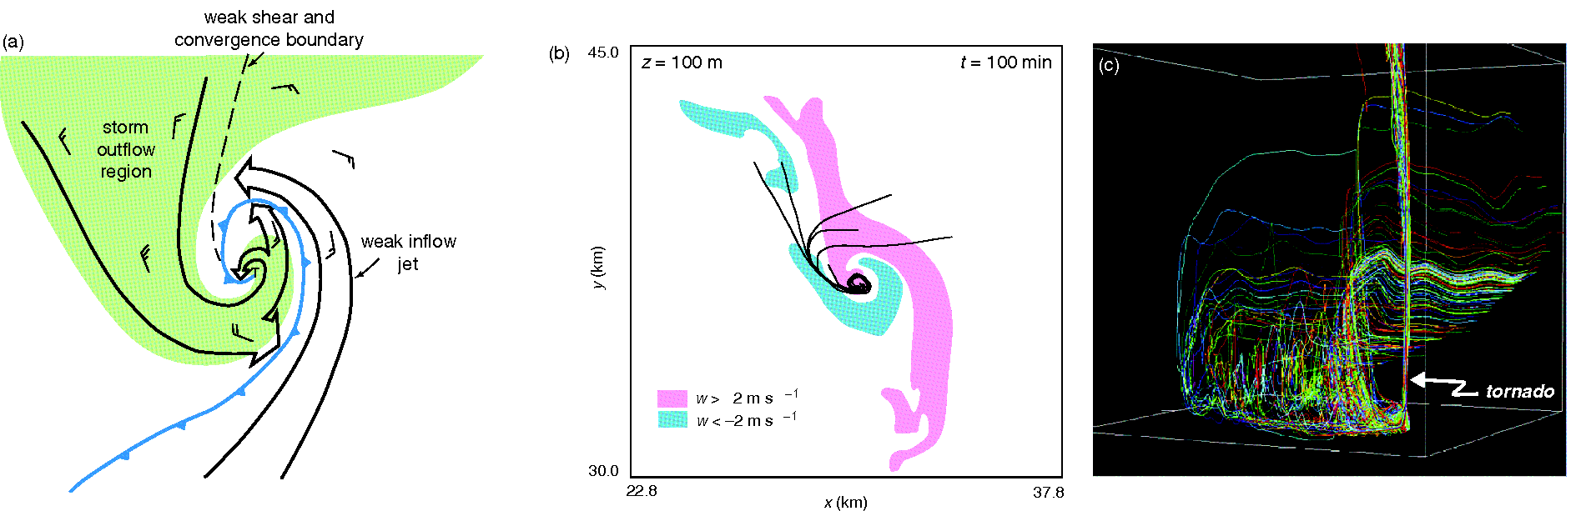
ATMS 316- MCSs and Hazards
Observations and numerical simulations indicate that the air that enters tornadoes, tornado parent circulations, or nontornadic, near-ground circulations in supercells typically enters the circulation from the outflow air mass, rather than directly from the inflow (Fig 10.5)

Slide 37
ATMS 316- MCSs and Hazards
Tornadogenesis
  Importance of downdrafts; mechanism B
    In the vicinity of low-level mesocyclones
      arches joining counter-rotating vortices
        on opposite sides of the RFD
[resemble structure of line-end vortices of bow echoes (Fig. 9.27)]
Notes:
37

Slide 38
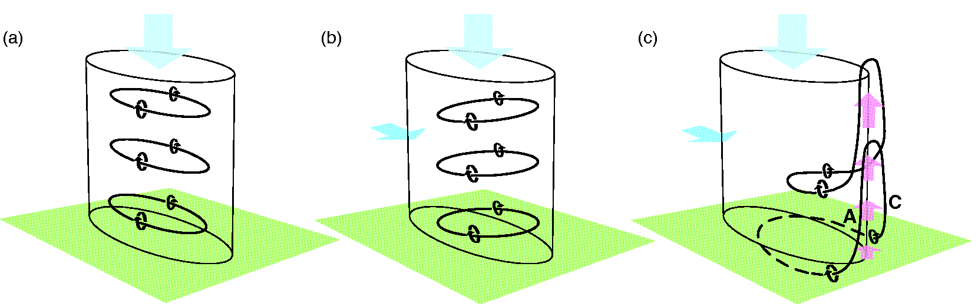
ATMS 316- MCSs and Hazards
One possible way in which vertical vorticity can be produced at the surface by a purely baroclinic* process in an environment containing no preexisting vertical vorticity at the surface (Fig 10.8)
*warm air rising, cold air sinking

Slide 39
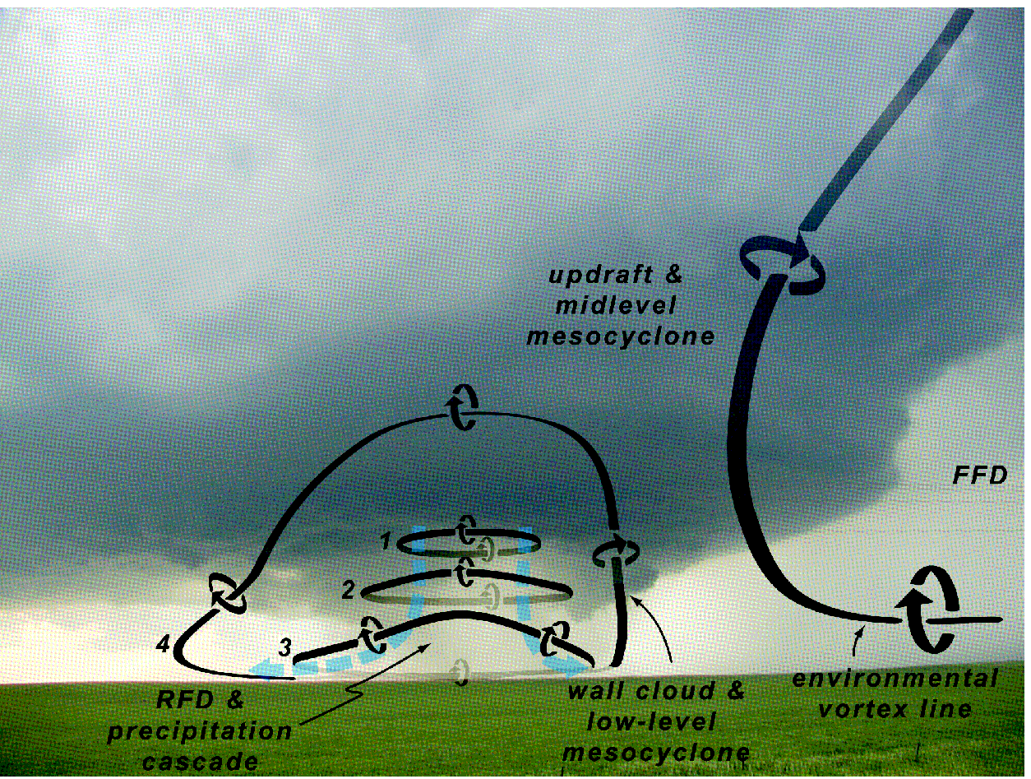
ATMS 316- MCSs and Hazards
Idealized evolution of vortex rings and arches inferred from the sample of supercells analyzed by Markowski et al. [2008] (Fig 10.7)

Slide 40
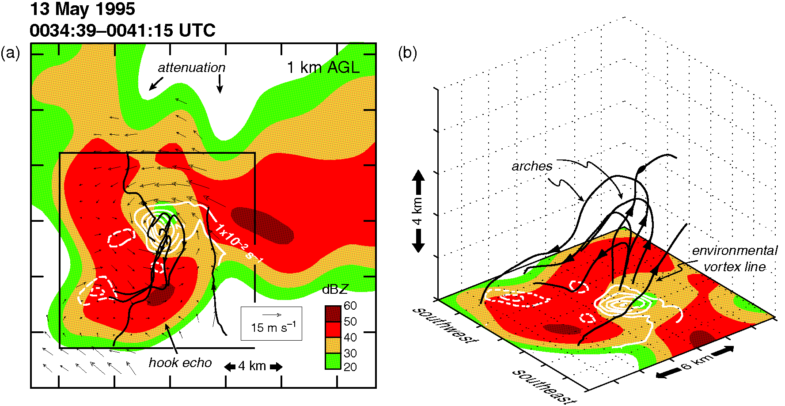
ATMS 316- MCSs and Hazards
Observations…
(a) Radar reflectivity factor (dBZ) at 1 km AGL and (b) a 3D perspective of the vortex lines emanating from the low-level mesocyclone center (Fig 10.6)

Slide 41
ATMS 316- MCSs and Hazards
Tornadogenesis
  Pre-existing vertical vorticity near the ground?
    Yes
      vorticity stretching near the ground*
        downdraft not needed for tornadogenesis
*near-ground convergence alone can amplify vertical vorticity to tornado intensity
Notes:
41

Slide 42
ATMS 316- MCSs and Hazards
Tornadogenesis
  Nonmesocyclonic tornadoes
    most commonly form along air mass boundaries
      large horizontal wind shear
      large vertical vorticity
Notes:
42

Slide 43
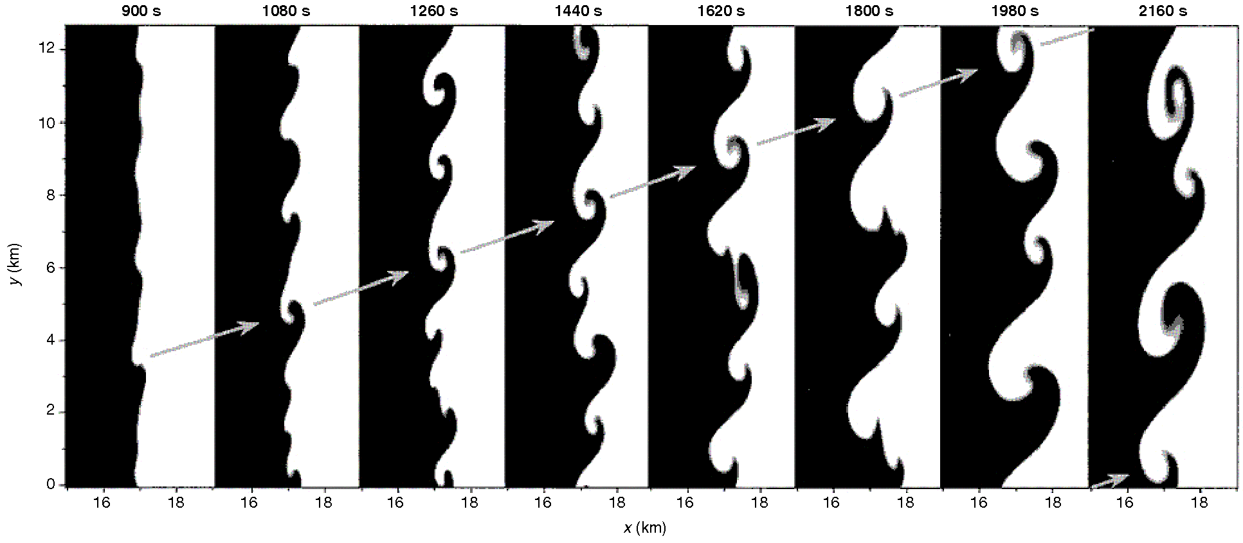
ATMS 316- MCSs and Hazards
Horizontal cross-section through the leading edge of a simulated outflow boundary at z = 0.55 km showing the development of misocyclone circulations as a result of horizontal shear instability (Fig 10.9)

Slide 44
ATMS 316- MCSs and Hazards
Tornadogenesis
  Nonmesocyclonic tornadoes
    anomalously large vertical vorticity breaks down
      discrete patches of vorticity
        result of horizontal shear instability
Notes:
44

Slide 45
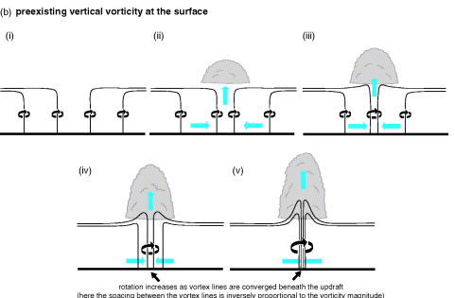
ATMS 316- MCSs and Hazards
(b) how a tornado can arise from convergence alone, in the absence of a downdraft, when preexisting vert. vort. is present at the ground (Fig 10.3b)
Notes:
45

Slide 46
ATMS 316- MCSs and Hazards
Tornadogenesis
  Nonmesocyclonic tornadoes
    if DMC develops of passes over a discrete patch of vorticity
      stretching can amplify the vortex to tornado strength
Notes:
46

Slide 47
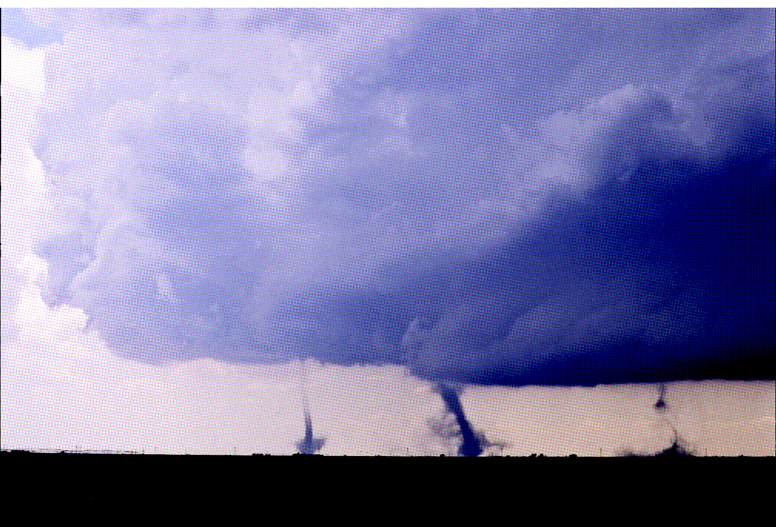
ATMS 316- MCSs and Hazards
Landspouts near Lazbuddie, TX on 4 June 1995 (Fig 10.10)
landspouts and waterspouts form most commonly in environments characterized by weak vertical wind shear (vws)
weak vws maximizes duration that overlying updrafts can remain over misocyclones and intensify them via stretching

Slide 48
ATMS 316- MCSs and Hazards
Tornadogenesis
  Preexisting vertical vorticity
    waterspouts
      land breezes located offshore in late AM
    landspouts
      outflow boundary, colliding bdry, mesoscale eddy
Notes:
48

Slide 49
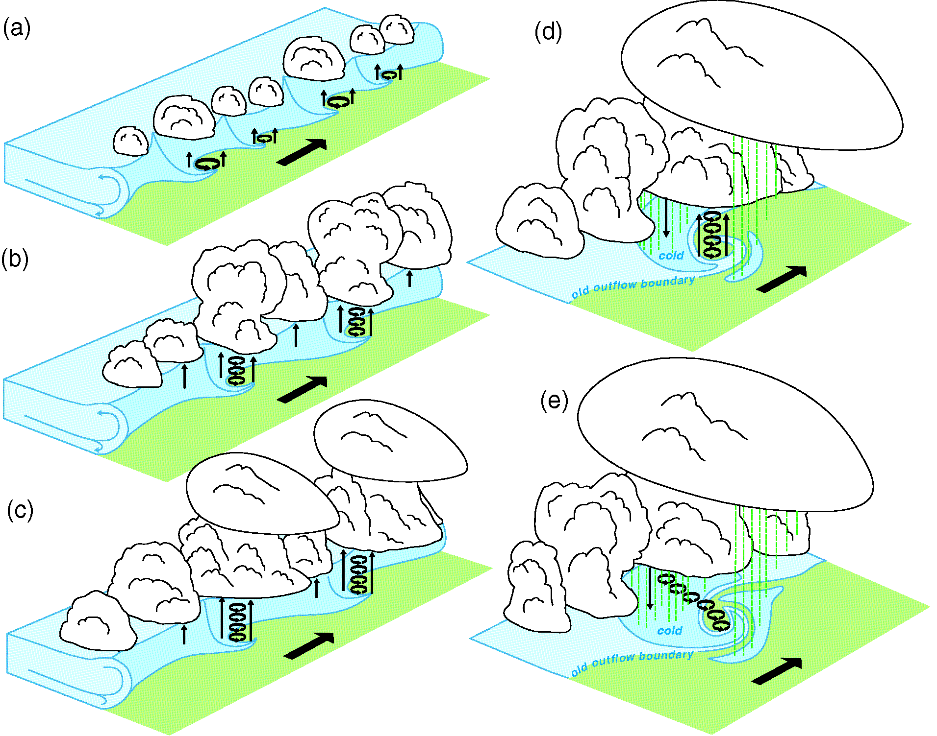
ATMS 316- MCSs and Hazards
Schematic presentation of the lifecycle stages of landspouts, looking northwest (Fig 10.11)

Slide 50
ATMS 316- MCSs and Hazards
Tornadogenesis
  vortex developing stage (i)
    horizontal shear instability → regular spaced vortices
    release of instability
      lobe and cleft
      HCR intersections
      sfc roughness variations
      naturally occuring temperature variations
Notes:
50

Slide 51
ATMS 316- MCSs and Hazards
Tornadogenesis
  misocyclone interaction & merger stage (ii)
    discrete vert. vort. patches induces by horiz. shear instability
    vortex interactions increase spacing between misocyclones and their circulation
Notes:
51

Slide 52
ATMS 316- MCSs and Hazards
Tornadogenesis
  early mature stage (iii)
    vert. vort. is redistributed from BL to storm midlevels
      stretching intensifies misocyclones to tornado intensity
      deep convection induces subcloud convergence and vortex stretching through BL
Notes:
52

Slide 53
ATMS 316- MCSs and Hazards
Landspouts near Lazbuddie, TX on 4 June 1995 (Fig 10.10)
multiple land spouts are often observed during early mature stage
Notes:
53

Slide 54
ATMS 316- MCSs and Hazards
Tornadogenesis
  late mature stage (iv)
    most intense phase
    occurs at same time as precip-induced cold pools develop
    cold air increases low-level convergence, significantly increasing vortex stretching
Notes:
54

Slide 55
ATMS 316- MCSs and Hazards
Tornadogenesis
  dissipation stage (v)
    downdrafts and negatively buoyant air surround the landspout
    tornado may become sharply tilted if lower portion is advected by advancing gust front
Notes:
55

Slide 56
ATMS 316- MCSs and Hazards
Tornadogenesis
  Nonmesocyclonic tornadoes
    can also form within squall lines
      mesovortices (meso-γ-scale vortices)
      rarely form EF2 – EF5 tornadoes
*downdrafts may be key to tornado formation in squall lines
Notes:
56

Slide 57
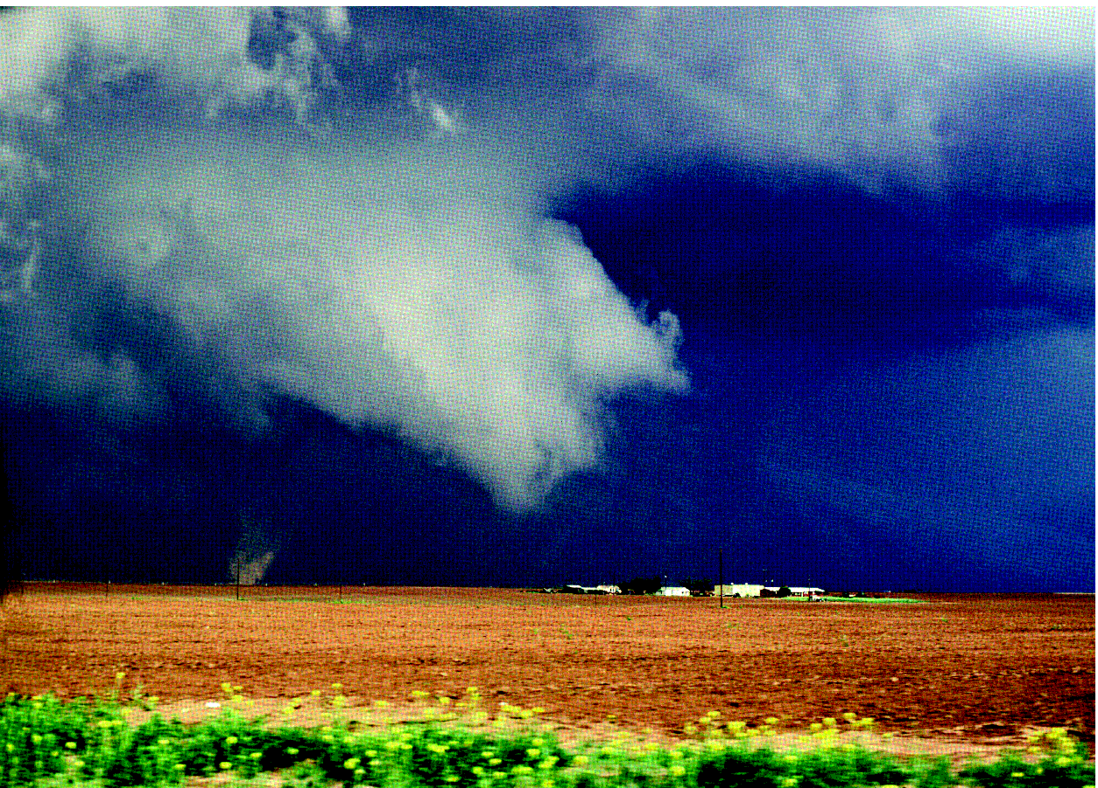
ATMS 316- MCSs and Hazards
Photograph of a gustnado (Fig 10.12)
shallow and transient vortices that occur along T-storm gust fronts
  rarely responsible for significant damage
  weak due to gust front racing ahead of overlying deep updraft (limit vortex stretching)
  rarely connect to the base of a deep convective cloud

Slide 58
ATMS 316- MCSs and Hazards
Forecasting and nowcasting tornadoes
  most strong and virtually all violent tornadoes → supercells
    25% of all radar-detected mesocyclones are associated with tornadoes (as few as 5-10%)
radars cannot resolve tornadic circulations, only parent circulations (mesocyclones)
Notes:
58

Slide 59
ATMS 316- MCSs and Hazards
Forecasting and nowcasting tornadoes
  tornadoes occur over a broad range of midlevel mesocyclone intensities
  promising parameters
    BL relative humidity
    0-1 km vertical wind shear
Notes:
59

Slide 60
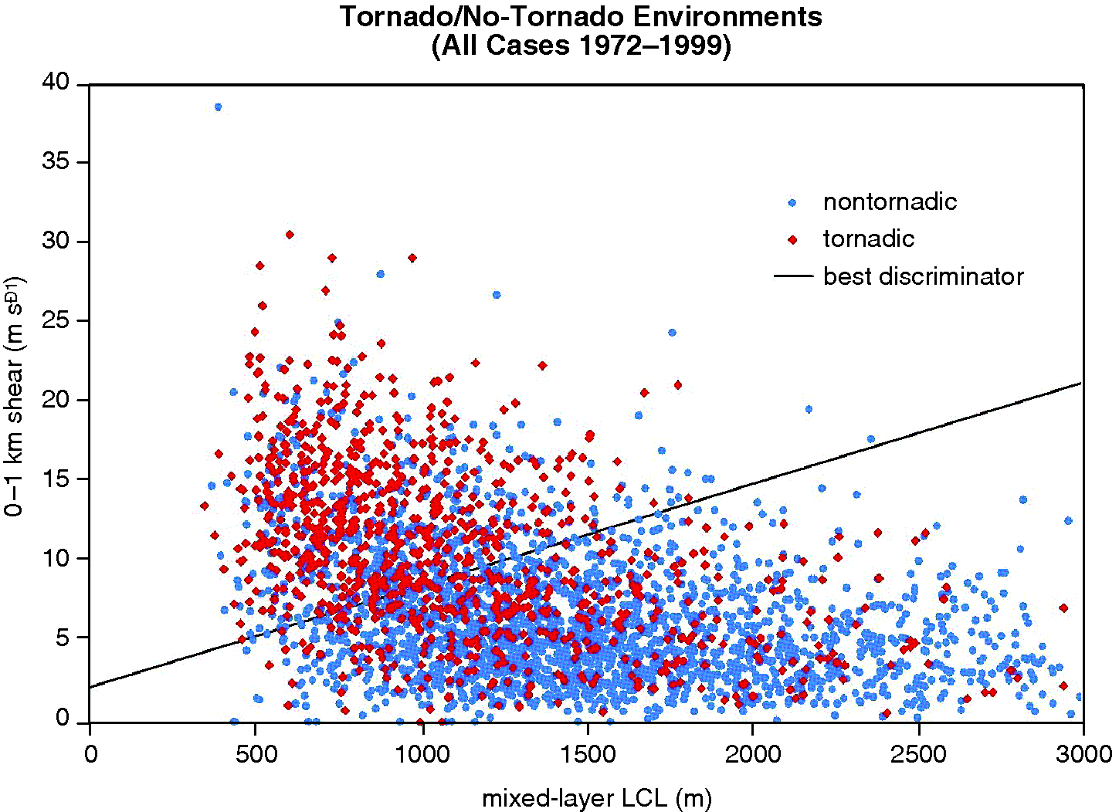
ATMS 316- MCSs and Hazards
Observations of tornadic versus nontornadic supercells as a function of low-level shear and mean BL RH of the environment (Fig 10.13)
  high BL relative humidity and strong 0-1 km vertical wind shear → most favorable for tornadic supercells

Slide 61
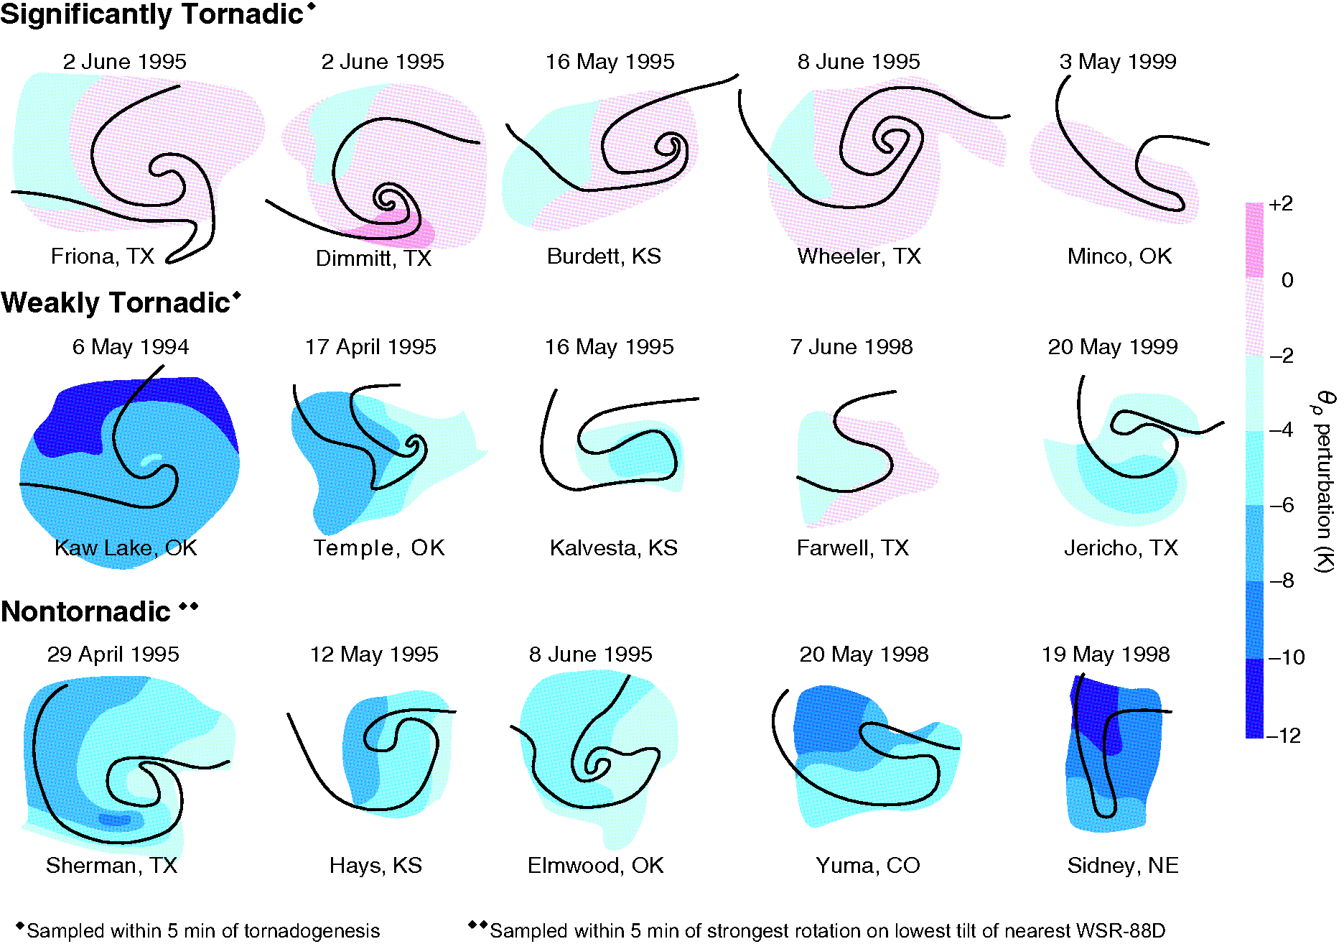
ATMS 316- MCSs and Hazards
Forecasting and nowcasting tornadoes
  strong cold pools
  excessive negative buoyancy
  detrimental to tornadogenesis
large BL relative humidity (low cloud base) can limit the production of exceptionally cold outflow
Notes:
61

Slide 62
ATMS 316- MCSs and Hazards
Surface density potential temperature perturbations measured by mobile mesonets within the hook-echo and RFD regions of supercells (Fig 10.14)

Slide 63
ATMS 316- MCSs and Hazards
Forecasting and nowcasting tornadoes
  supercell and tornado outbreaks
    large-scale (meso-α scale) favorable BL RH and low-level wind shear {‘high risk’ days at SPC}
Notes:
63

Slide 64
ATMS 316- MCSs and Hazards
Forecasting and nowcasting tornadoes
  more commonly, tornadoes occur as ‘mesoscale accidents’ {a strong random element to their formation}
    enhancements of BL RH and/or low-lvl wind shear not detectable by the observation network
Notes:
64

Slide 65
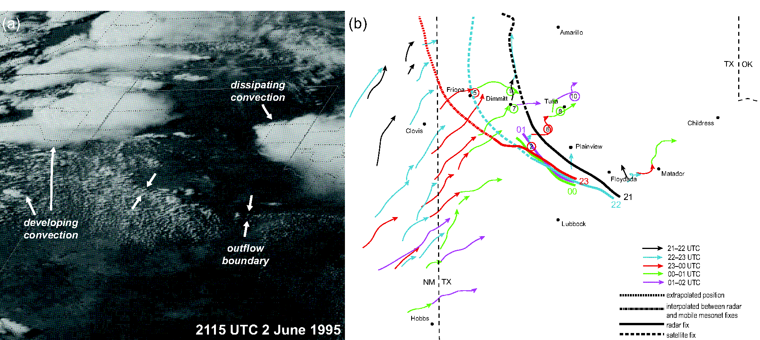
ATMS 316- MCSs and Hazards
(a) Visible satellite image and (b) echo centroid tracks for five 1 h periods on 2 June 1995 (Fig 10.15)

Slide 66
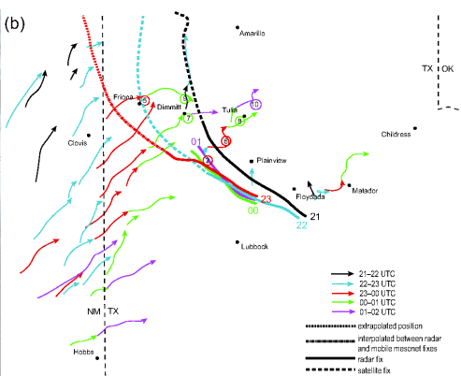
ATMS 316- MCSs and Hazards
Forecasting and nowcasting tornadoes
  enhancements
    often associated with outflow boundaries, warm fronts, inland sea breezes
      augment low-level wind shear
      convergence and attendant deepening of low-level moist layer
Notes:
66

Slide 67
ATMS 316- MCSs and Hazards
Forecasting and nowcasting tornadoes
  not all storm-boundary interactions are favorable
  also, no shortage of examples of
    no tornadoes forming in favorable environments
    tornadoes forming in marginal environments
      what nonlinear impact did small-scale environmental variability have?
Notes:
67

Slide 68
ATMS 316- MCSs and Hazards
Forecasting and nowcasting tornadoes
  nonmesocyclonic tornado prediction – even more difficult!
    non-supercellular convection is much more common*
*a much smaller fraction of non-supercells produces tornadoes compared with supercells
Notes:
68

Slide 69
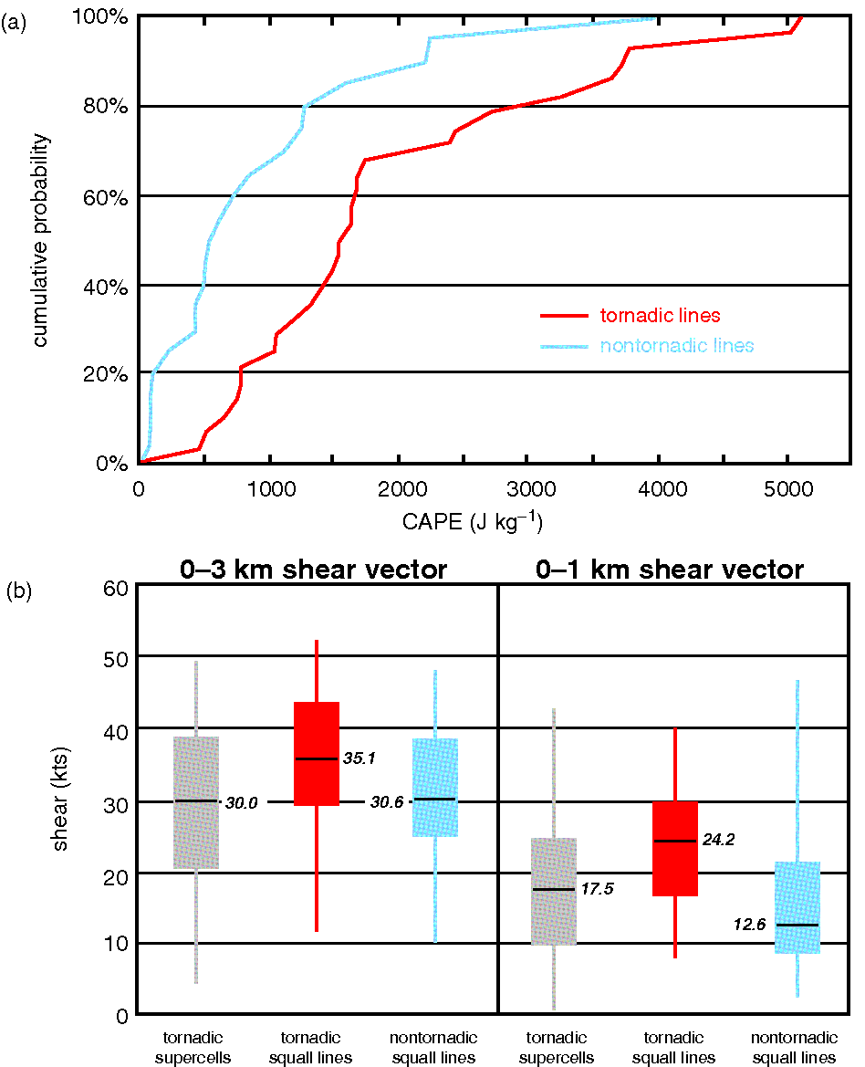
ATMS 316- MCSs and Hazards
Forecasting and nowcasting tornadoes
  nonmesocyclonic tornado prediction – squall lines
    CAPE and shear tend to be larger in environments of tornado-producing squll lines
(a) Cumulative probability distribution of CAPE in squall lines that contain tornadoes and those that do not, (b) box-and-whisker plots of the magnitude of the 0-1 km and 0-3 km vertical wind shear vectors in tornadic environments (Fig 10.16)

Slide 70
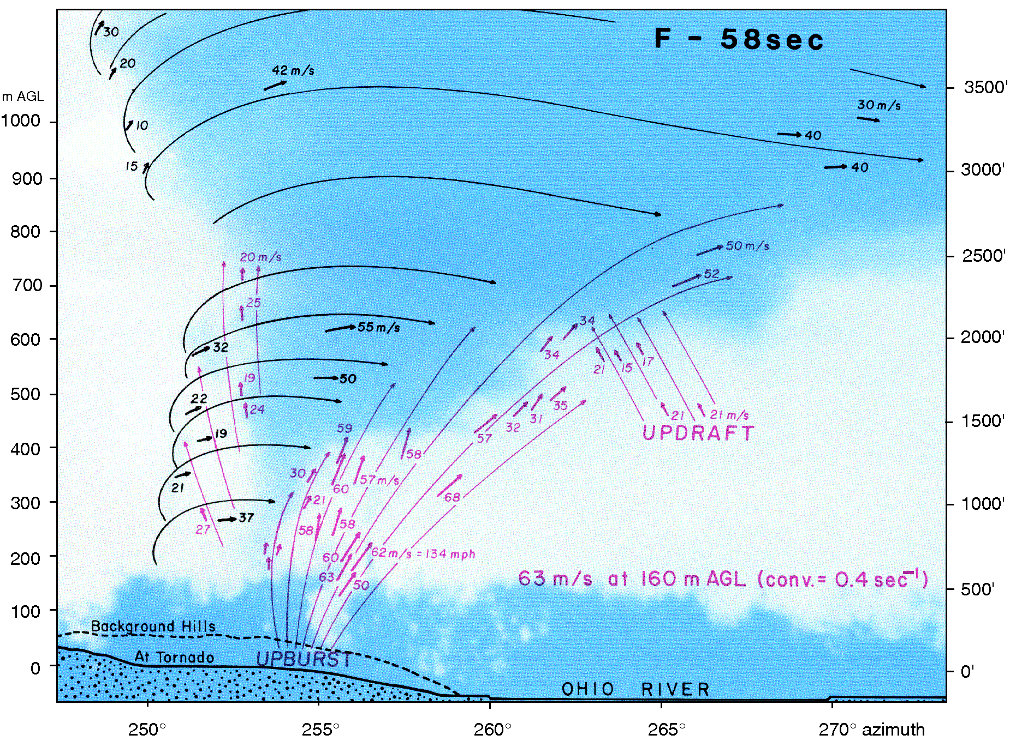
ATMS 316- MCSs and Hazards
Fujita’s photogrammetric analysis of wind velocities in the Sayler Park, OH, tornado of 3 April 1974 (Fig 10.17)

Slide 71
ATMS 316- MCSs and Hazards
Tornado structure and dynamics
  Flow regions
    Outer region (I)
    Core (II)
    Corner (III)
    BL flow (IV)
    Rotating updraft (V)
Notes:
71

Slide 72
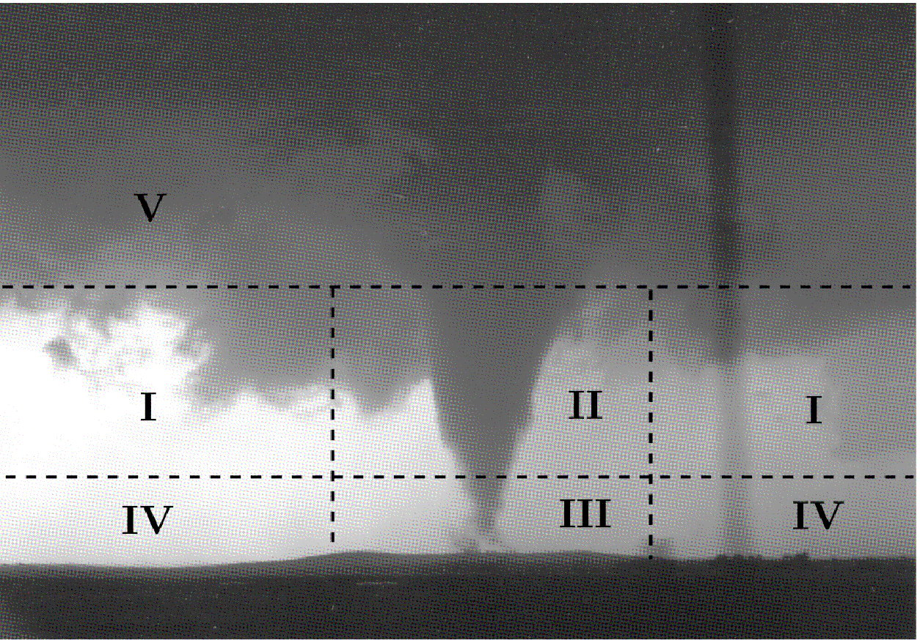
ATMS 316- MCSs and Hazards
The five regions of a tornado vortex (Fig 10.19)

Slide 73
ATMS 316- MCSs and Hazards
Tornado structure and dynamics
  Flow regions
    Outer region (I)
      inward spiraling air ~conserves angular momentum (spins faster as it approaches tornado axis)
Notes:
73

Slide 74
ATMS 316- MCSs and Hazards
Tornado structure and dynamics
  Flow regions
    Core (II)
      air parcels are in ~cyclostrophic balance, above BL
      ~zero entrainment
Notes:
74

Slide 75
ATMS 316- MCSs and Hazards
Tornado structure and dynamics
  Flow regions
    Corner (III)
      flow turns upward from a primarily horizontal to a primarily vertical direction (“turns the corner”)
Notes:
75

Slide 76
ATMS 316- MCSs and Hazards
Tornado structure and dynamics
  Flow regions
    BL flow (IV)
      turbulent
      radial inflow + convergence of ang. momentum → intense wind speeds*
*presence of friction can intensify the vortex
Notes:
76

Slide 77
ATMS 316- MCSs and Hazards
Tornado structure and dynamics
  Flow regions
    Rotating updraft (V)
      larger-scale, parent updraft situated above the tornado
Notes:
77

Slide 78
ATMS 316- MCSs and Hazards
Tornado structure and dynamics
  weak tornado ( v_{max} ~ 25 m s⁻¹)*
    min pressure ~ 6 mb
      short funnel cloud visible aloft (60 m)
*obtained using a simplified vortex model; Rankine vortex
Notes:
78

Slide 79
ATMS 316- MCSs and Hazards
Tornado structure and dynamics
  violent tornado ( v_{max} ~ 100 m s⁻¹)
    min pressure ~ 100 mb
      long funnel cloud visible aloft (~1000 m)
Notes:
79

Slide 80
ATMS 316- MCSs and Hazards
Tornado structure and dynamics
  Burgers-Rott vortex
  Sullivan vortex
Notes:
80

Slide 81

ATMS 316- MCSs and Hazards
Tornado structure and dynamics
  Swirl ratio
    Eq (10.14) here
where C is the circulation about the central axis at a radius of r₀, Q is the rate of volume flow through the top of the tornado chamber, v₀ is the tangential velocity at r₀, and w₀ is the mean vertical velocity at the top of the chamber
Notes:
81

Slide 82
ATMS 316- MCSs and Hazards
Tornado structure and dynamics
  very low swirl ratio (not shown)
    flow is dominated by the updraft rather than by rotation
Notes:
82

Slide 83
ATMS 316- MCSs and Hazards
Tornado structure and dynamics
  low swirl ratio (Figs. 10.18[a-c], 10.20b)
    one-cell vortex – vortex contains an updraft throughout
Notes:
83

Slide 84
ATMS 316- MCSs and Hazards
Tornado structure and dynamics
  high swirl ratio (Figs. 10.18[d-f], 10.20c, d)
    two-celled vortex – a central downdraft forms
      surrounded by updraft
Notes:
84

Slide 85
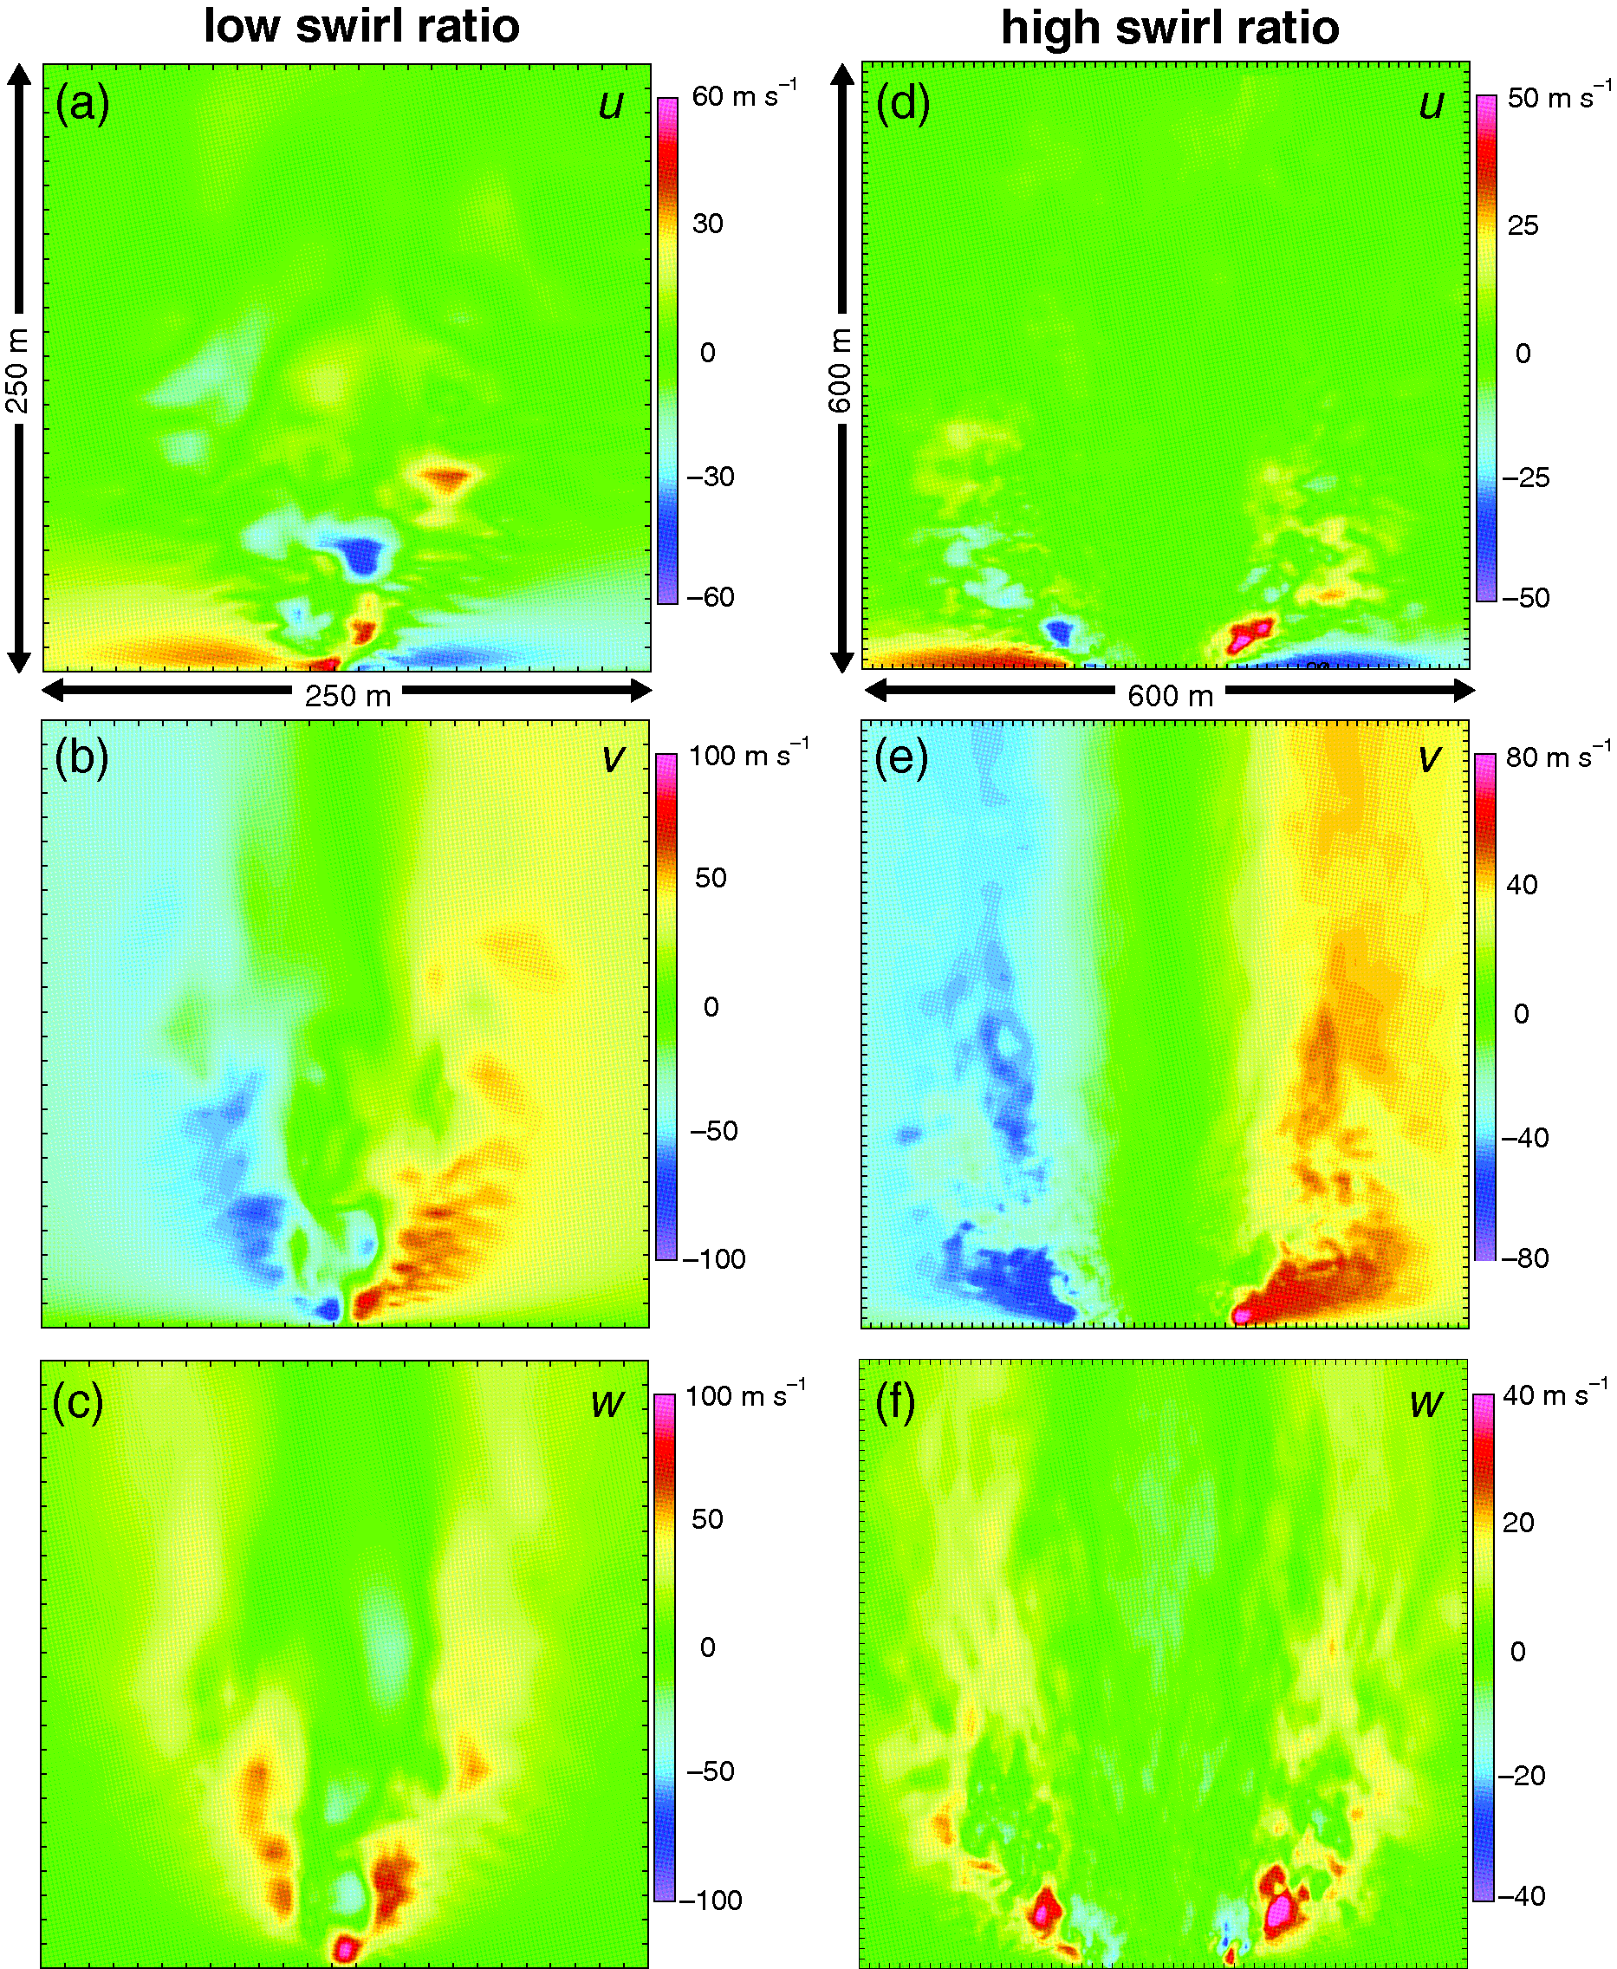
ATMS 316- MCSs and Hazards
(a)-(c) Vertical cross-sections of instantaneous radial (u), tangential (v), and vertical (w) velocities in a 3D numerical simulation of a tornado having a low swirl ratio, (d)-(f) for a tornado having a high swirl ratio (Fig 10.18)

Slide 86
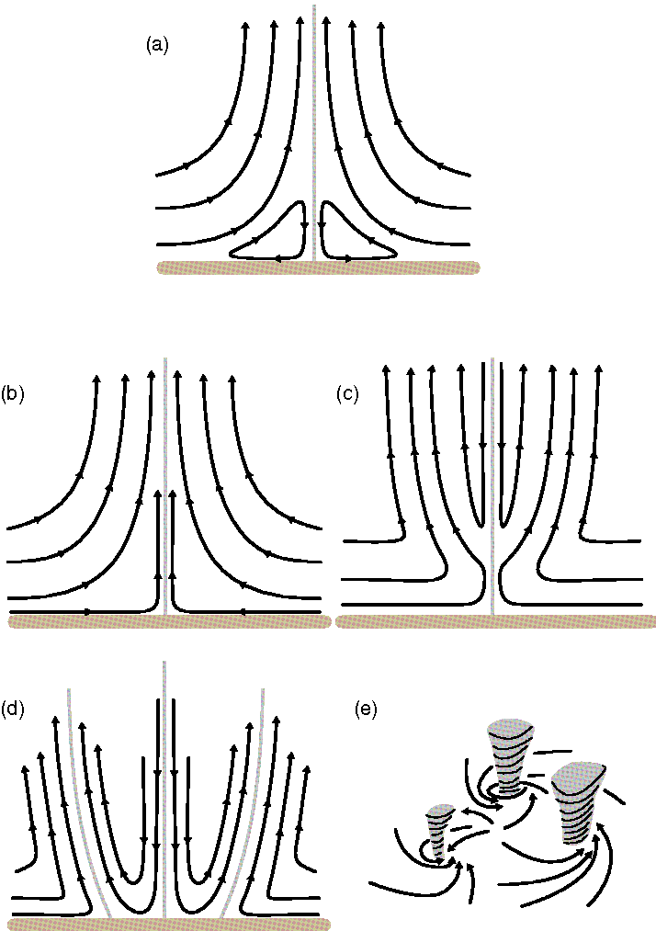
ATMS 316- MCSs and Hazards
Types of vortices produced in a vortex chamber as swirl ratio increases (Fig 10.20)

Slide 87
ATMS 316- MCSs and Hazards
Tornado structure and dynamics
  vortex breakdown
    transition from a one-celled to a two-celled vortex
      multiple vortices are formed
most strong tornadoes are observed to evolve from one-celled to two-celled tornadoes and exhibit vortex breakdown and subvortices
Notes:
87

Slide 88
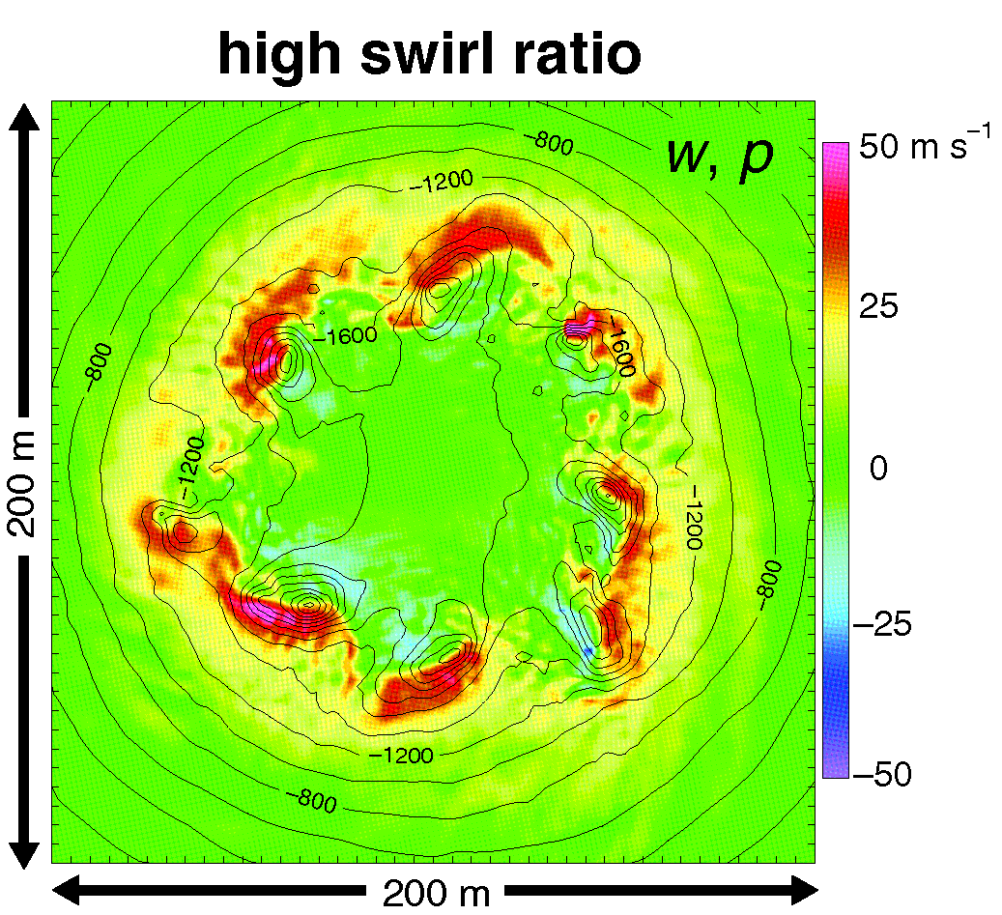
ATMS 316- MCSs and Hazards
Horizontal cross-section at z = 50 m of vertical velocity (shading) and pressure perturbation (contours) in a 3D numerical simulation of a tornado having a high swirl ratio. (Fig 10.21)

Slide 89
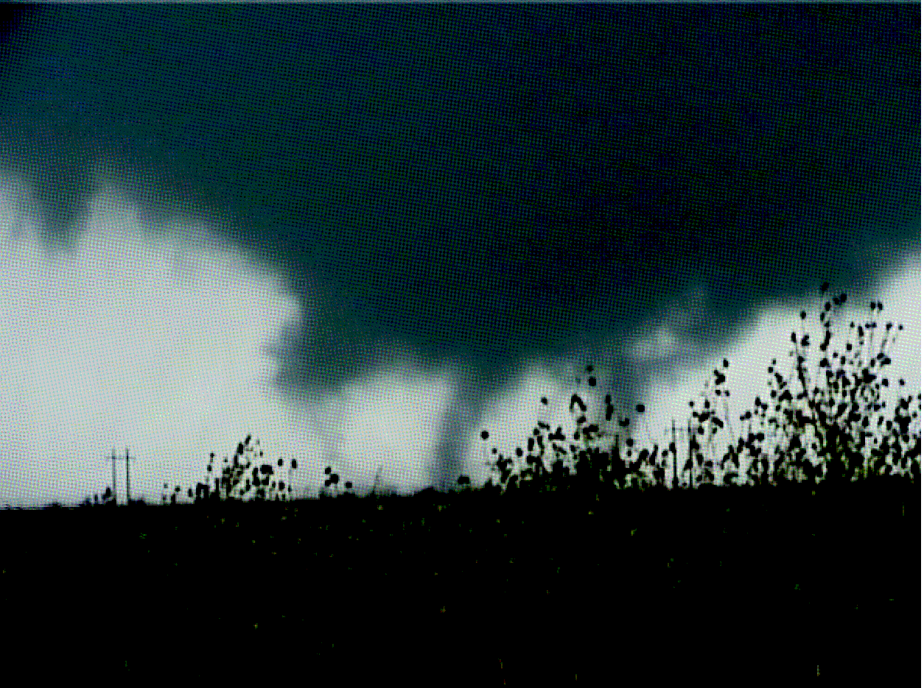
ATMS 316- MCSs and Hazards
Video frame of a multiple-vortex tornado near Mountain View, OK on 9 October 2001 (Fig 10.22)

Slide 90
ATMS 316- MCSs and Hazards
Tornado structure and dynamics
  Numerical simulations
    challenges apply to assessing relationships between observed tornado structure and swirl ratio
Notes:
90

Slide 91
ATMS 316- MCSs and Hazards
Nontornadic, damaging straight-line winds
  Resulting from downdrafts (10.2.1)
    downbursts; dx<10 km
    microbursts; dx< 4 km

Slide 92
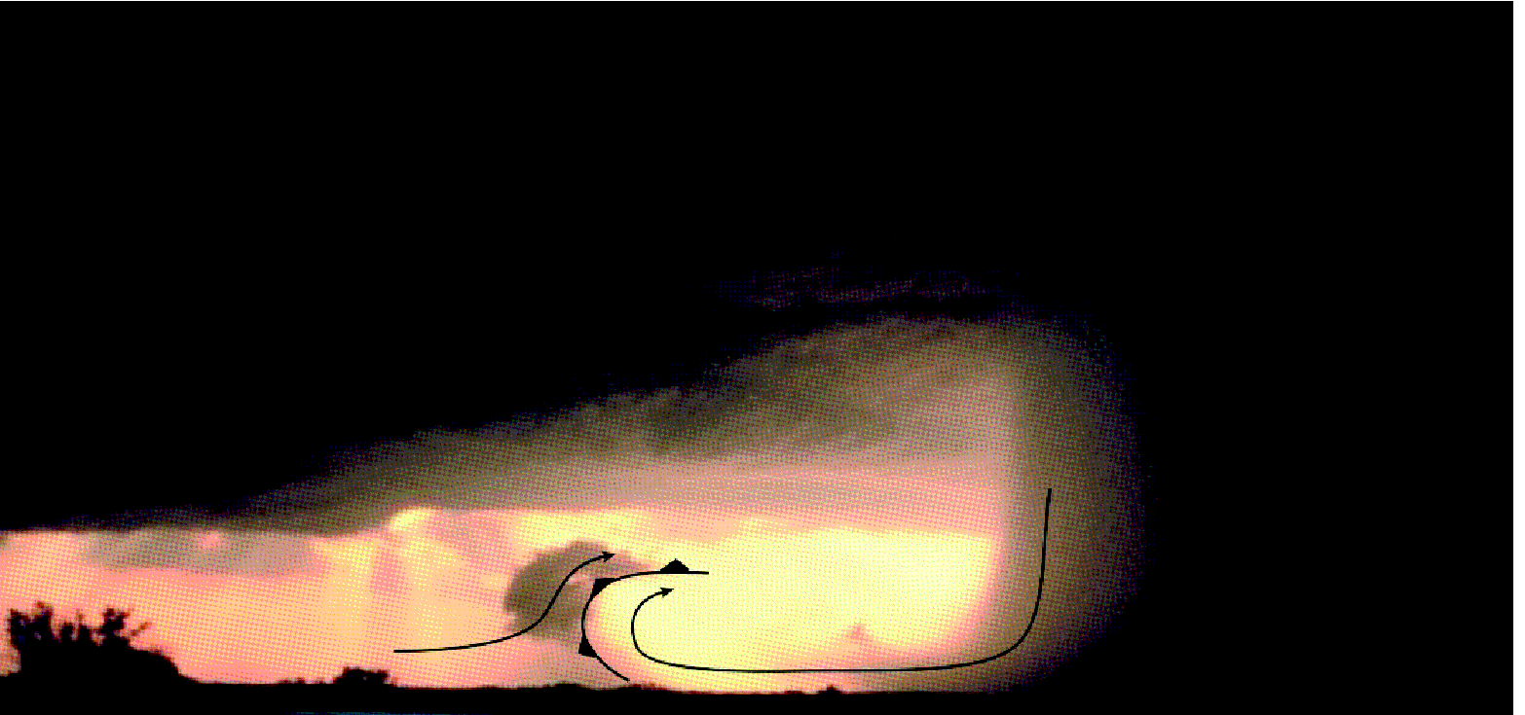
ATMS 316- MCSs and Hazards
Photograph of a wet microburst, with the gust front position and a couple of schematic streamlines drawn (Fig 10.23)

Slide 93
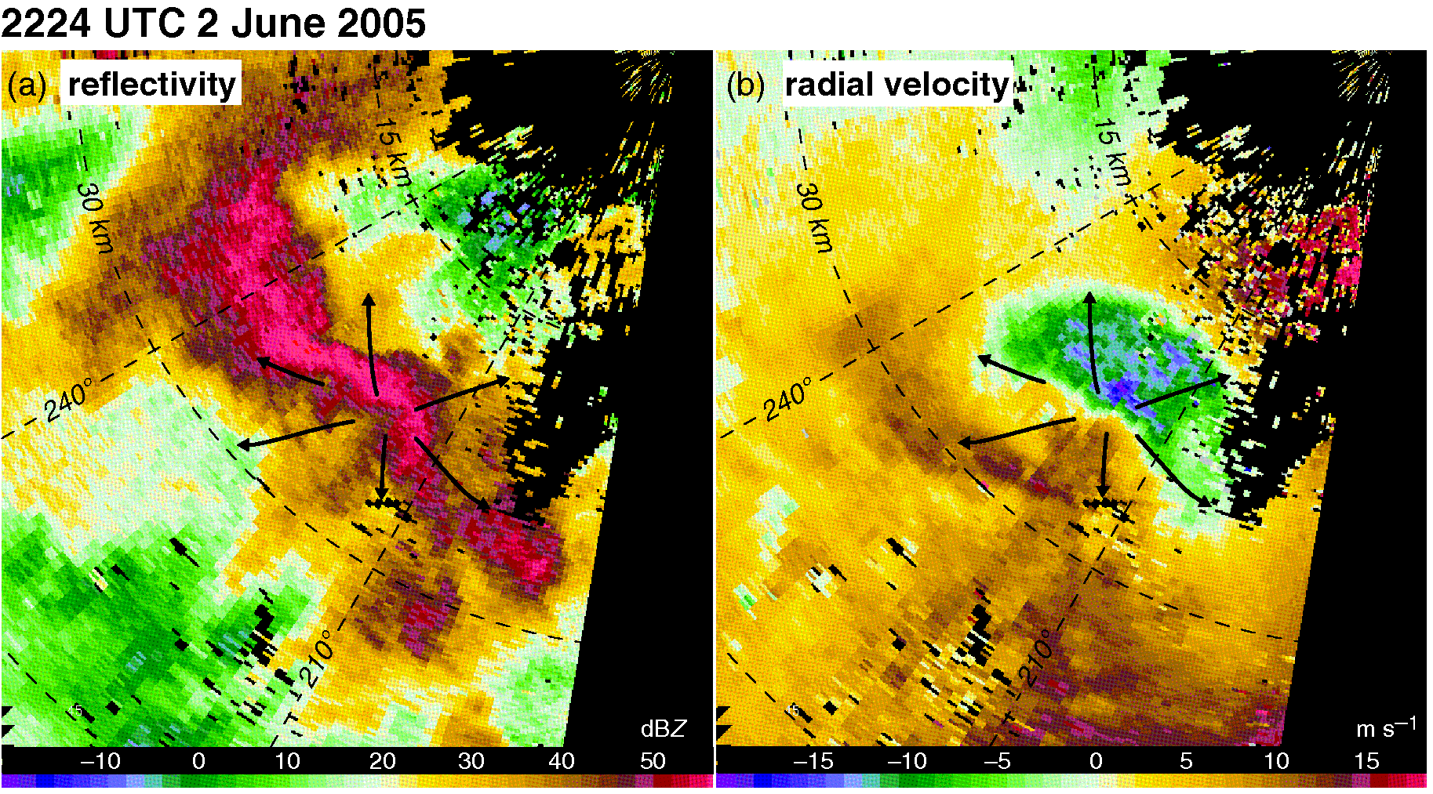
ATMS 316- MCSs and Hazards
A downburst as seen in (a) radar reflectivity (dBZ) and (b) radial velocity (m s⁻¹) imagery obtained by the CSU-CHILL radar in NE CO (0.5º elevation angle) (Fig 10.24)

Slide 94
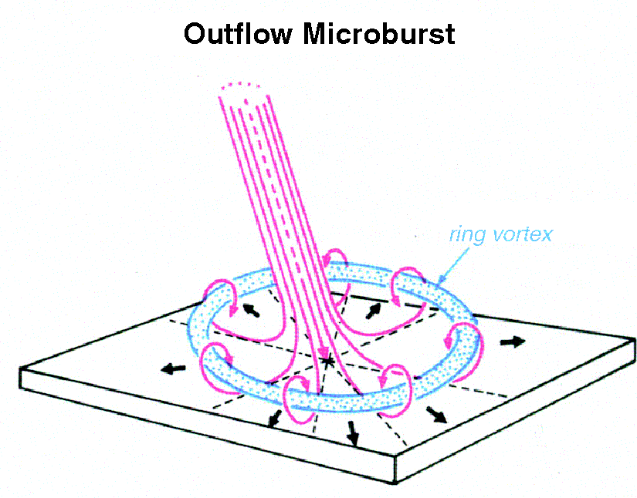
ATMS 316- MCSs and Hazards
Fujita’s conceptual model of a microburst which can be viewed as an intense vortex ring intercepting the ground (Fig 10.25)

Slide 95
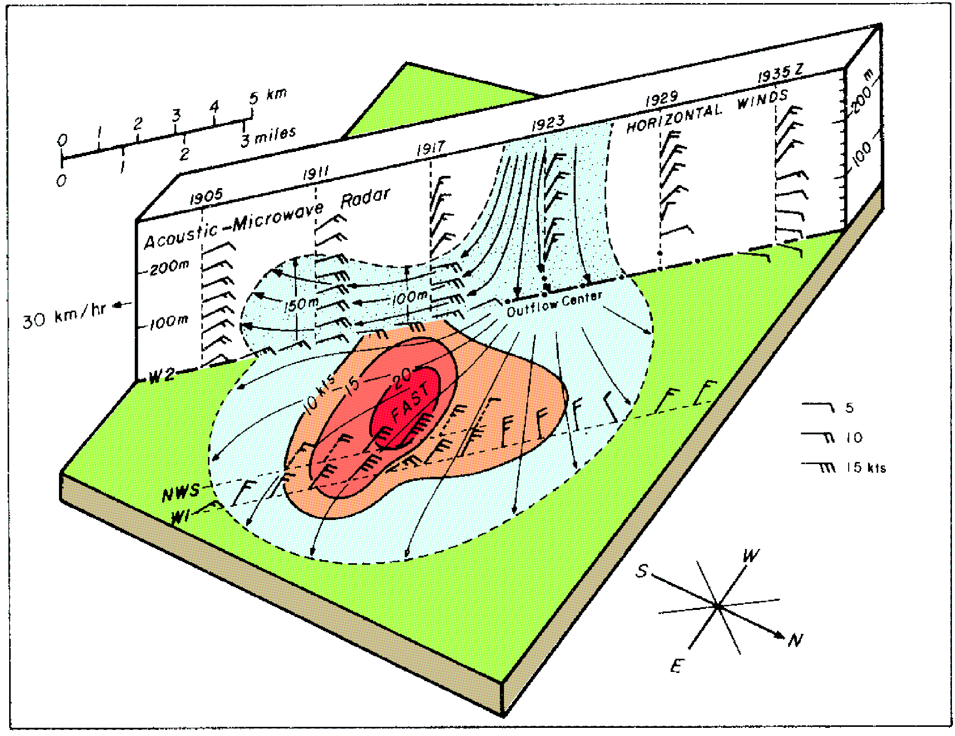
ATMS 316- MCSs and Hazards
Cross-section of a microburst (Fig 10.26)

Slide 96
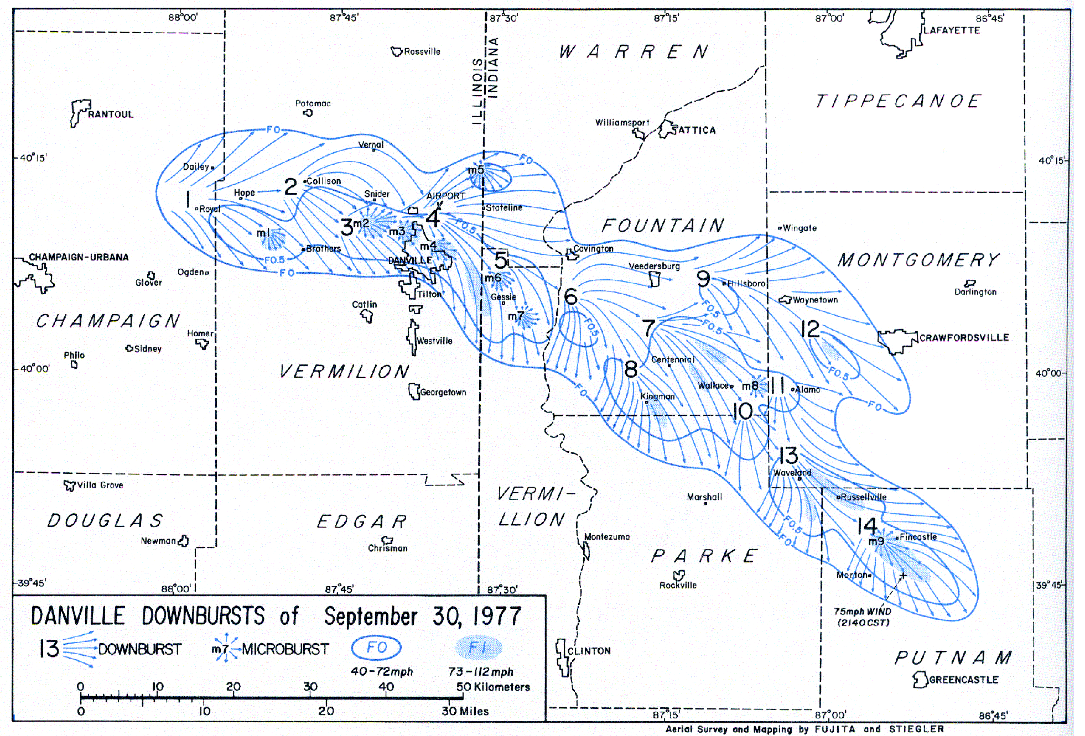
ATMS 316- MCSs and Hazards
Streamline analysis of a series of downbursts and microbursts on 30 September 1977 (Fig 10.27)

Slide 97
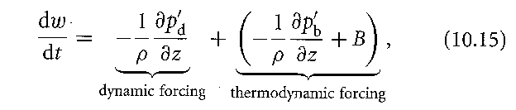
ATMS 316- MCSs and Hazards
Nontornadic, damaging straight-line winds
  development of strong downdrafts
  Eq. (10.15) here
thermodynamic forcing is probably dominant in most downburst cases

Slide 98
ATMS 316- MCSs and Hazards
Nontornadic, damaging straight-line winds
  downdrafts are associated with high pressure
    hydrostatic origins (a)
    nonhydrostatic origins (b)
    (a) air is relatively cool and (b) air must decelerate as it approaches the ground

Slide 99
ATMS 316- MCSs and Hazards
Nontornadic, damaging straight-line winds
  difficulty in approximating maximum downdraft speed as w_{min} = −sqrt(2×DCAPE)
    from what upper level shall DCAPE be integrated?
    at what level does air parcel become unsaturated?
    [see Fig 10.28]

Slide 100
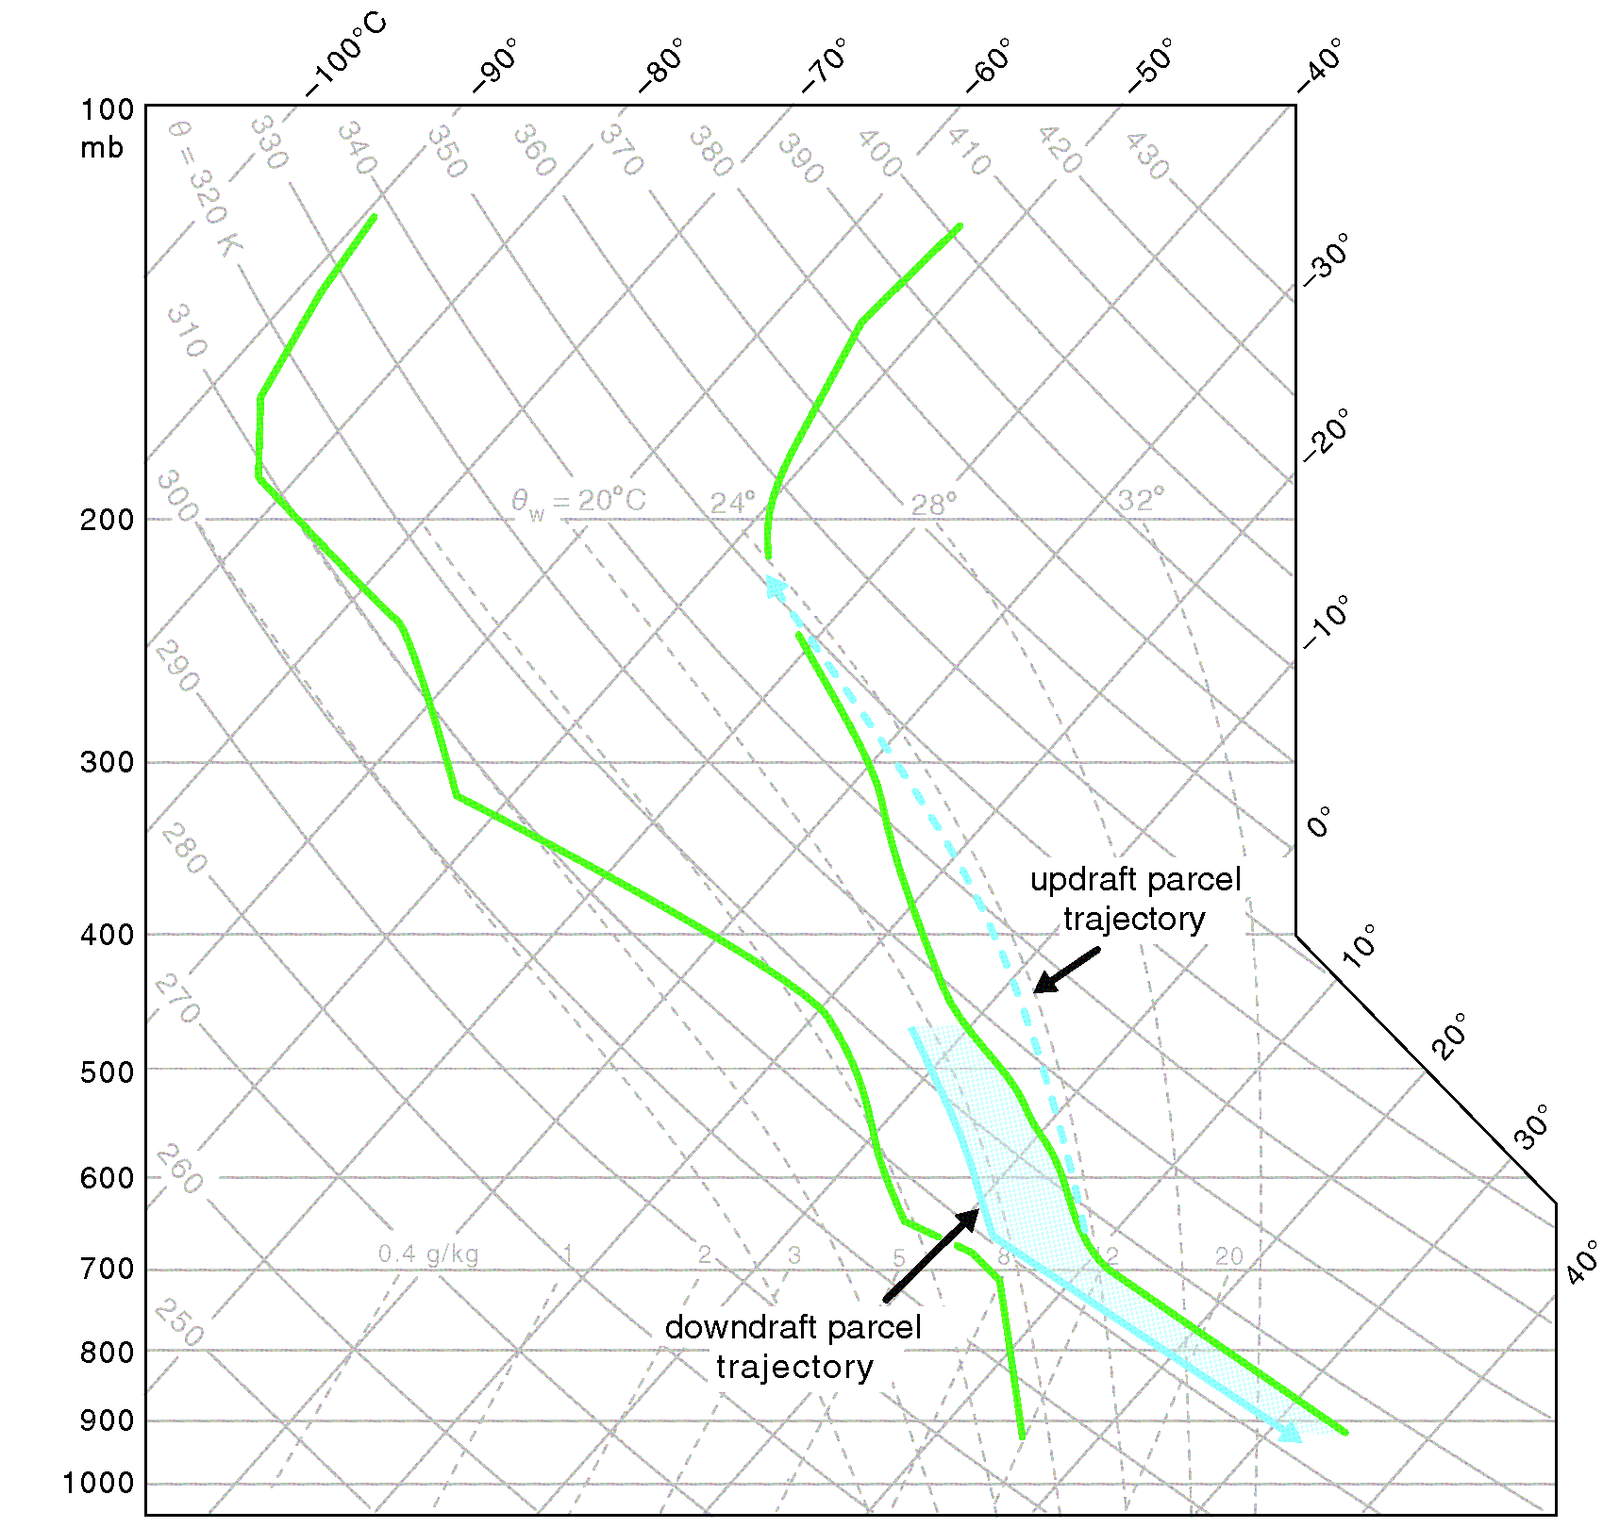
ATMS 316- MCSs and Hazards
Downburst air parcels commonly undergo both moist and dry adiabatic descent en route to the ground (Fig 10.28)

Slide 101
ATMS 316- MCSs and Hazards
Nontornadic, damaging straight-line winds
  downdrafts; thermodynamic effects
    Negative buoyancy
      Latent cooling
      Hydrometeor loading

Slide 102
ATMS 316- MCSs and Hazards
Nontornadic, damaging straight-line winds
  downdrafts; thermodynamic effects
    Latent cooling
      evaporation & melting in lower troposphere
      melting & sublimation in mid- and upper-troposphere

Slide 103
ATMS 316- MCSs and Hazards
Nontornadic, damaging straight-line winds
  downdrafts; thermodynamic effects
    Latent cooling, generating good negative buoyancy
      dry BLs
      entrainment of dry midlevel environmental air
        increases with vertical wind shear and storm-relative winds
increasing environmental dryness does not necessarily lead to increasing downdraft intensity… too dry? No hydrometeors…no latent cooling

Slide 104
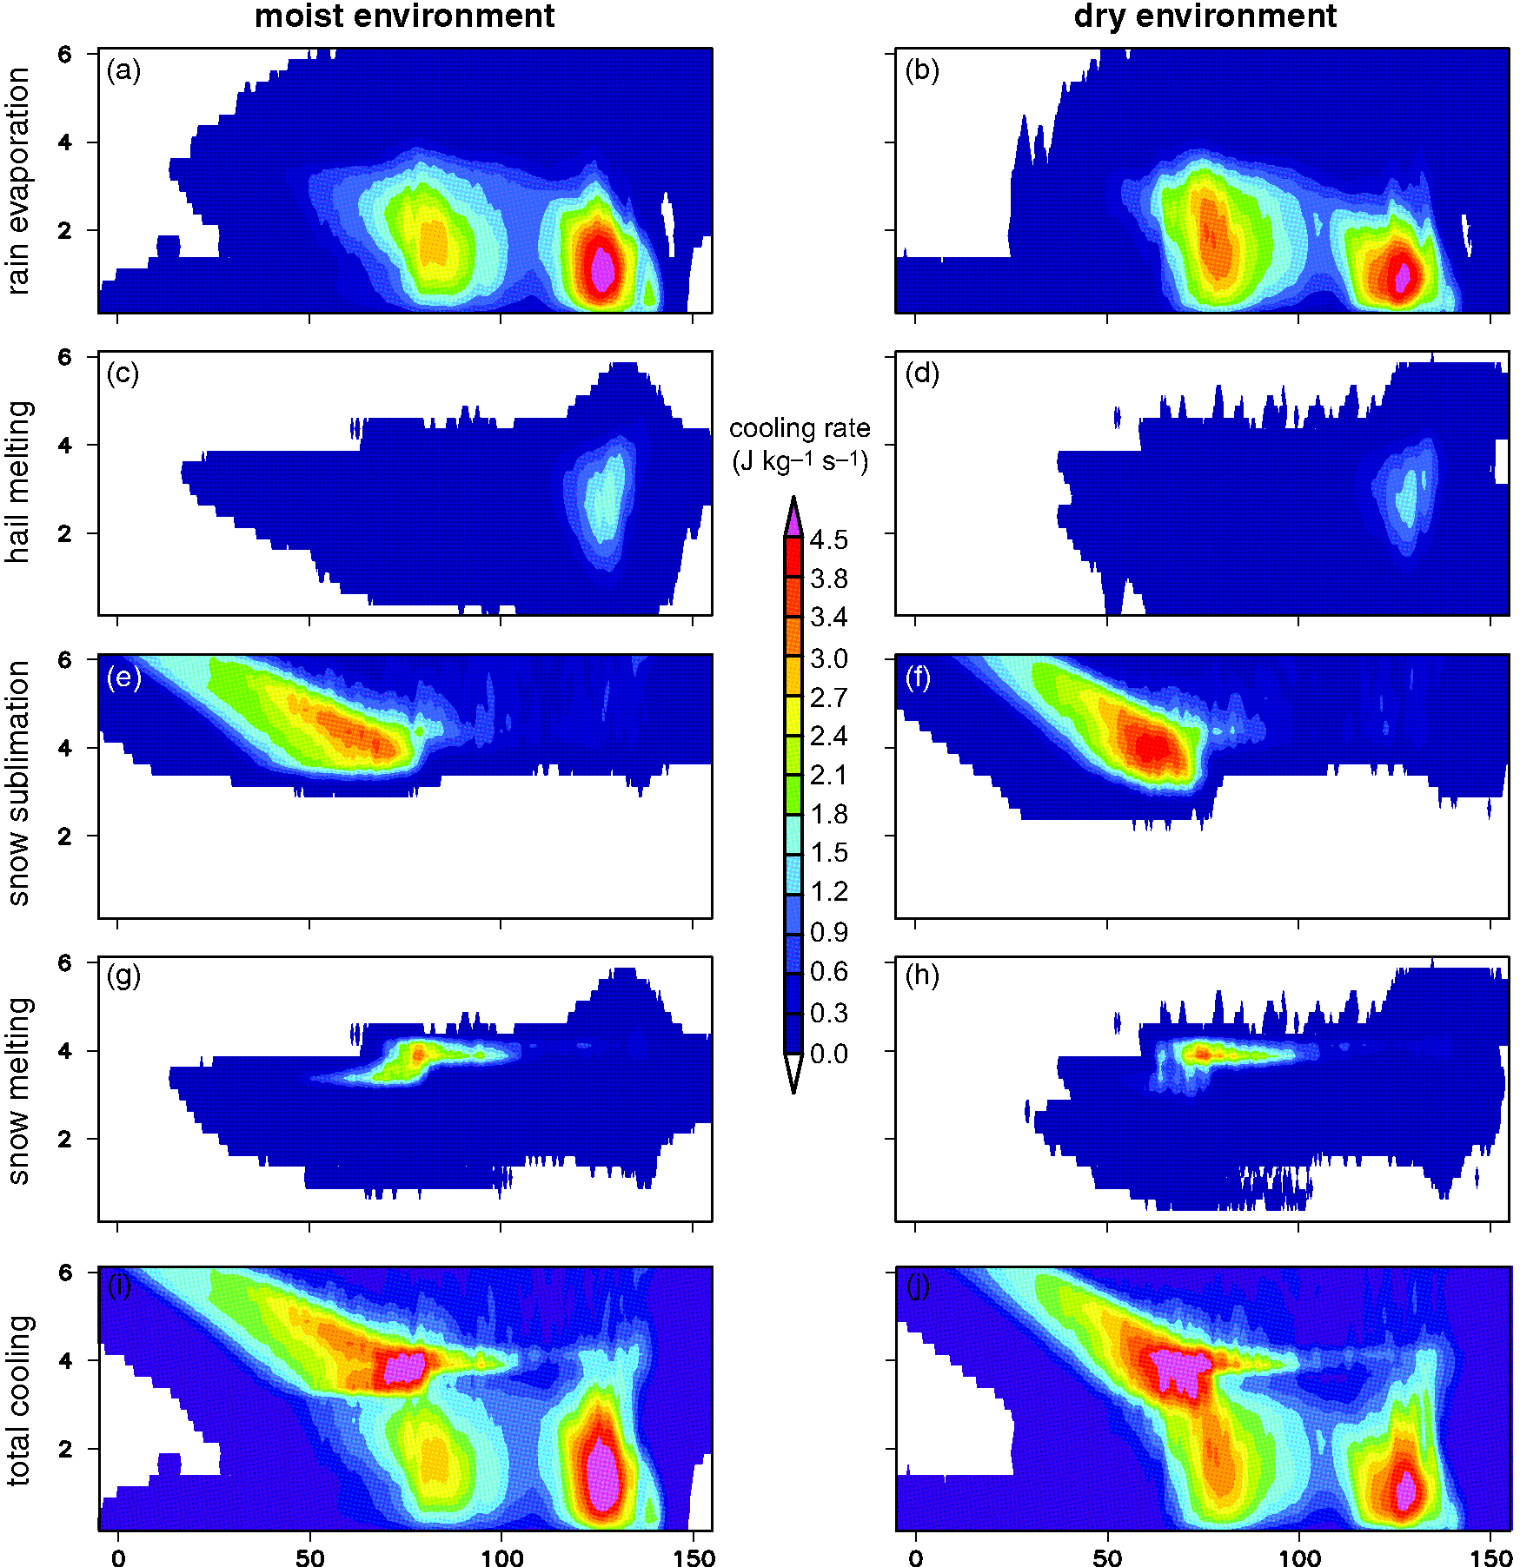
ATMS 316- MCSs and Hazards
Vertical cross-sections of line-averaged latent cooling rates in a pair of numerical simulations of a long-lived MCS (Fig 10.29)

Slide 105
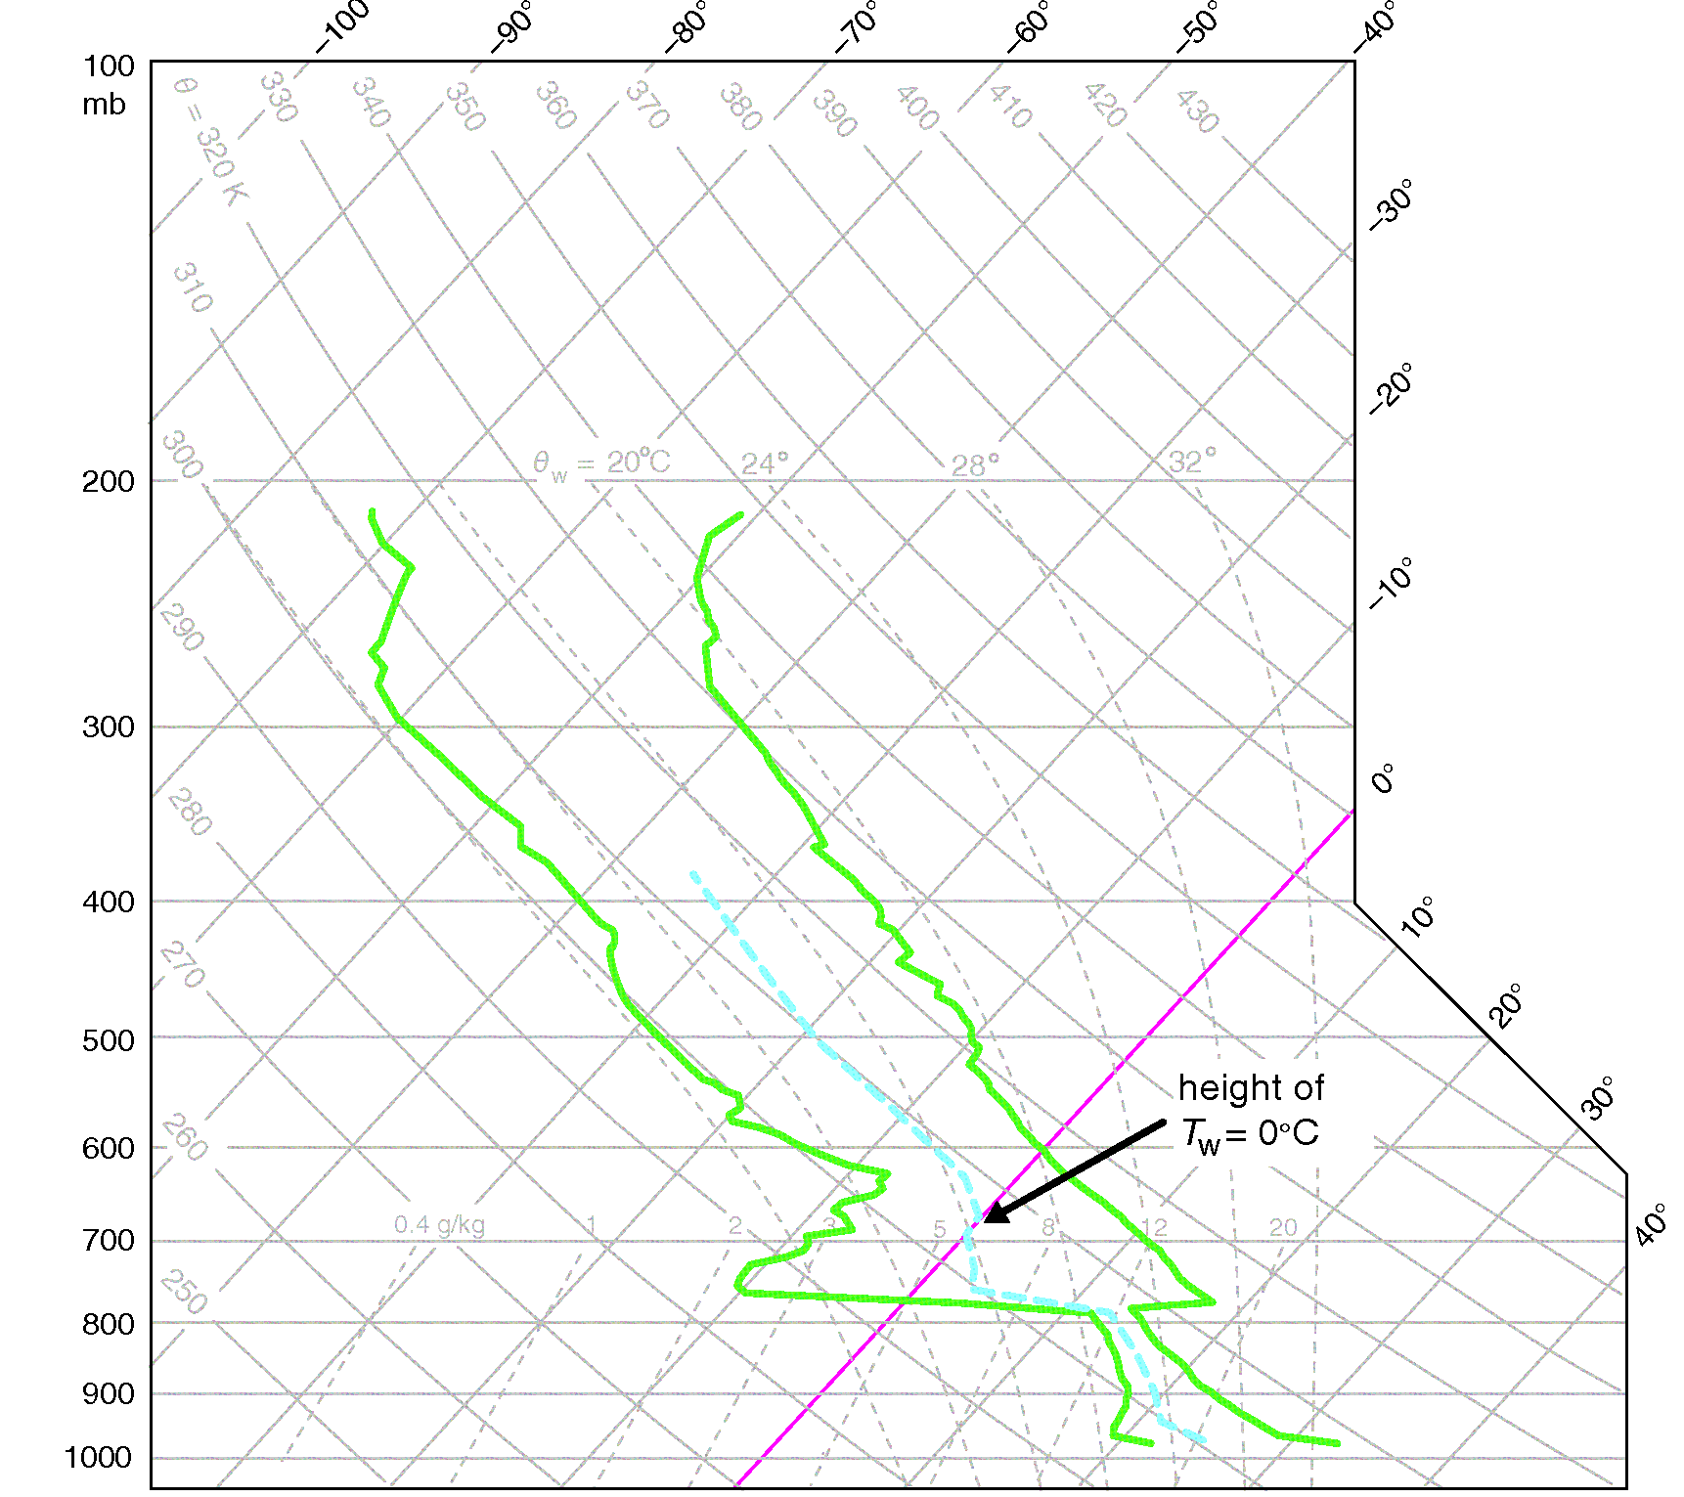
ATMS 316- MCSs and Hazards
melting does not occur until ice encounters wet-bulb temperatures above freezing (wet-bulb zero level)
dry environments…lower wet-bulb zero level…less time for melting by ice
ICE
A typical loaded gun sounding with the vertical profile of wet-bulb temperature (T_{w}) indicated with a dashed blue line (Fig 10.30)

Slide 106
ATMS 316- MCSs and Hazards
Nontornadic, damaging straight-line winds
  downdrafts; thermodynamic effects
    hydrometeor loading*
      air parcel density increase due to the mass of hydrometeors
      hydrometeor mixing ratio = 10 g kg⁻¹ ~ same negative buoyancy as a -3 K θ perturbation
*often crucial in initiating the downdraft

Slide 107
ATMS 316- MCSs and Hazards
Nontornadic, damaging straight-line winds
  downdrafts; dynamic effects
    more significant in environments containing large vertical wind shear
      below level where product of updraft speed and environmental shear is largest
      layer in which vertical vorticity decreases w/ height

Slide 108
ATMS 316- MCSs and Hazards
Nontornadic, damaging straight-line winds
  subclasses of downbursts/ microbursts
    dry microbursts
      a few sprinkles, common in the High Plains; deep BLs and high cloud bases
    wet microbursts

Slide 109
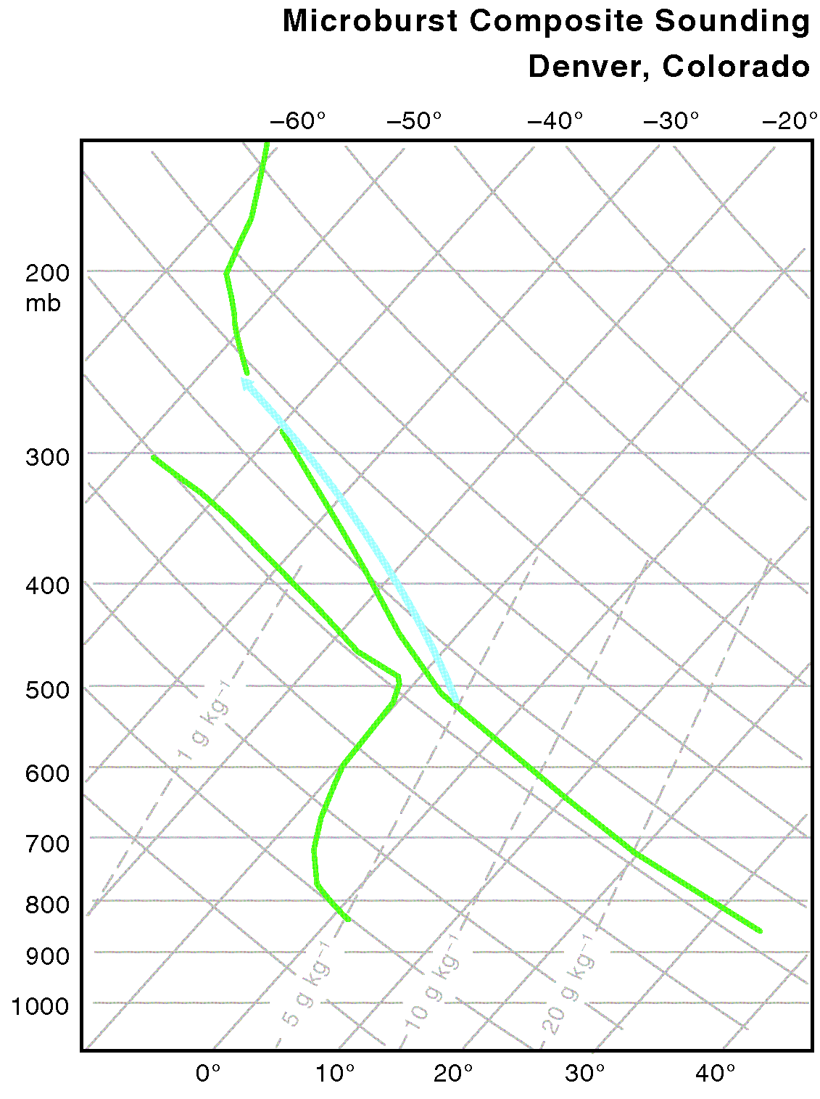
ATMS 316- MCSs and Hazards
Composite skew T – log p diagram for Denver, CO, on dry microburst-producing days (Fig 10.31)

Slide 110
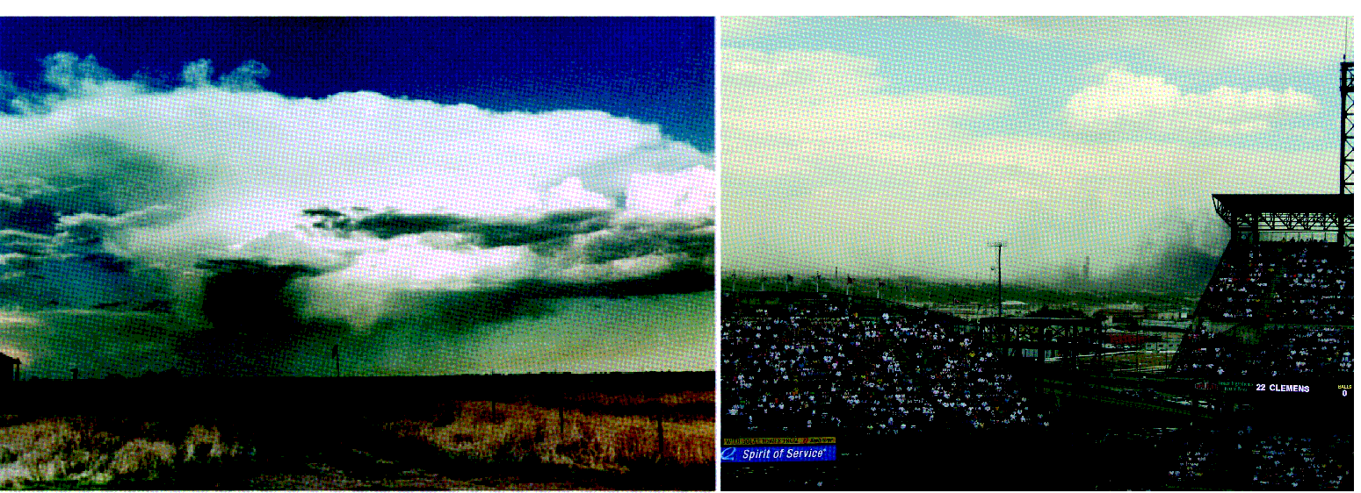
ATMS 316- MCSs and Hazards
Photographs of dry microbursts (Fig 10.32)

Slide 111
ATMS 316- MCSs and Hazards
Nontornadic, damaging straight-line winds
  subclasses of downbursts/ microbursts
    mid-air microbursts
      low-level stable layer prevents penetration to the ground
    heat bursts
      downbursts penetrate through a shallow stable layer near the ground

Slide 112
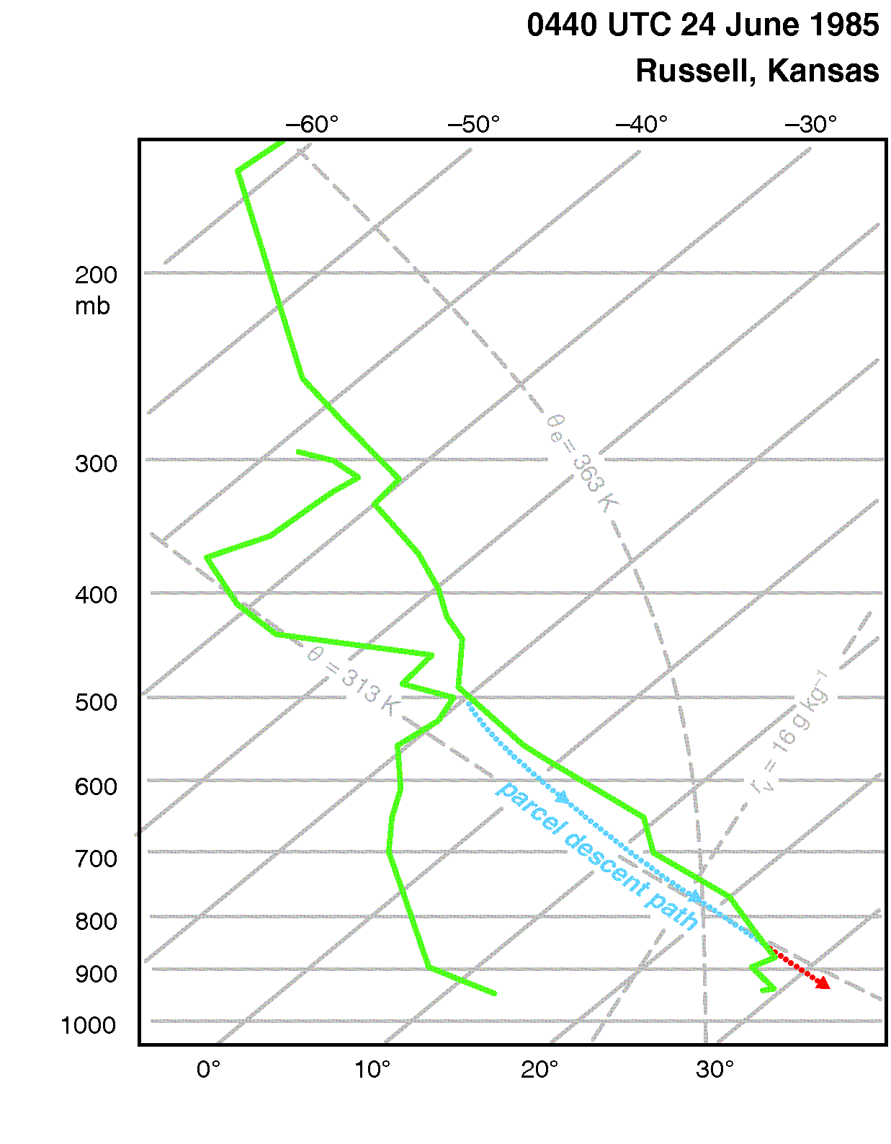
ATMS 316- MCSs and Hazards
Skew T – log p diagram for Russell, KS, at 0440 UTC 24 June 1985. Expected heat burst parcel trajectory is shown and colored blue (red) for the portions of the trajectory that are negatively (positively) buoyant (Fig 10.33)

Slide 113
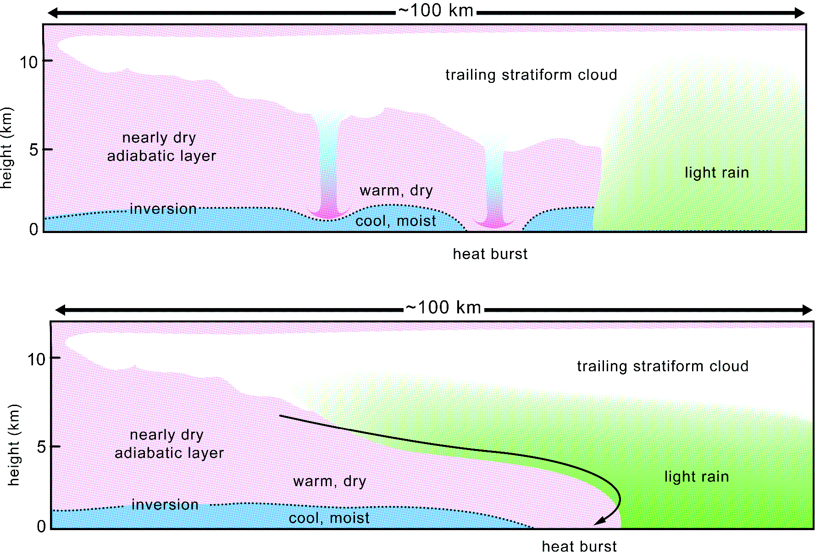
ATMS 316- MCSs and Hazards
Depictions of two possible heat-burst mechanisms associated with the trailing stratiform regions of MCSs (Fig 10.34)

Slide 114
ATMS 316- MCSs and Hazards
Nontornadic, damaging straight-line winds
  absence of a strong downdraft (10.2.2)
    cold pool deep enough to create a strong enough horizontal pressure gradient to support strong winds
    descent of rear-inflow jet to the surface
both mechanisms make the apex of a bow echo a favored location for high winds

Slide 115
ATMS 316- MCSs and Hazards
Nontornadic, damaging straight-line winds
  Squall lines
    wind damage coincides with the tracks of meso-γ-scale vortices embedded within the lines (mesovortices)

Slide 116
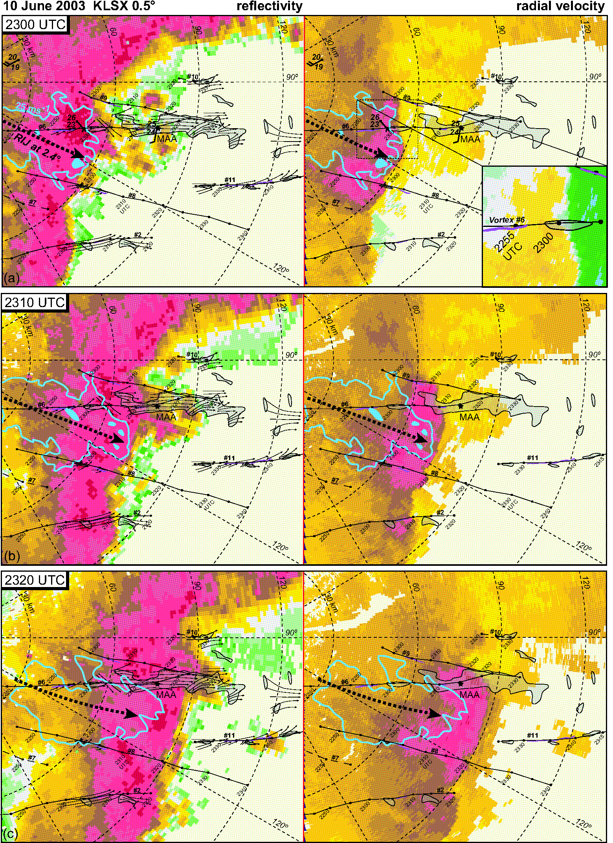
ATMS 316- MCSs and Hazards
Damage survey from 10 June 2003 superimposed on 0.5º radar reflectivity (dBZ) and ground-relative radial velocities (m s⁻¹, cool [warm] colors are flow toward [away] from St. Louis WSR88D site) (Fig 10.35)

Slide 117
ATMS 316- MCSs and Hazards
Nontornadic, damaging straight-line winds
  Squall lines
    mesovortex origins
      lifting of vortex lines generated in cold pool by an updraft
      horizontal shear instability along the gust front

Slide 118
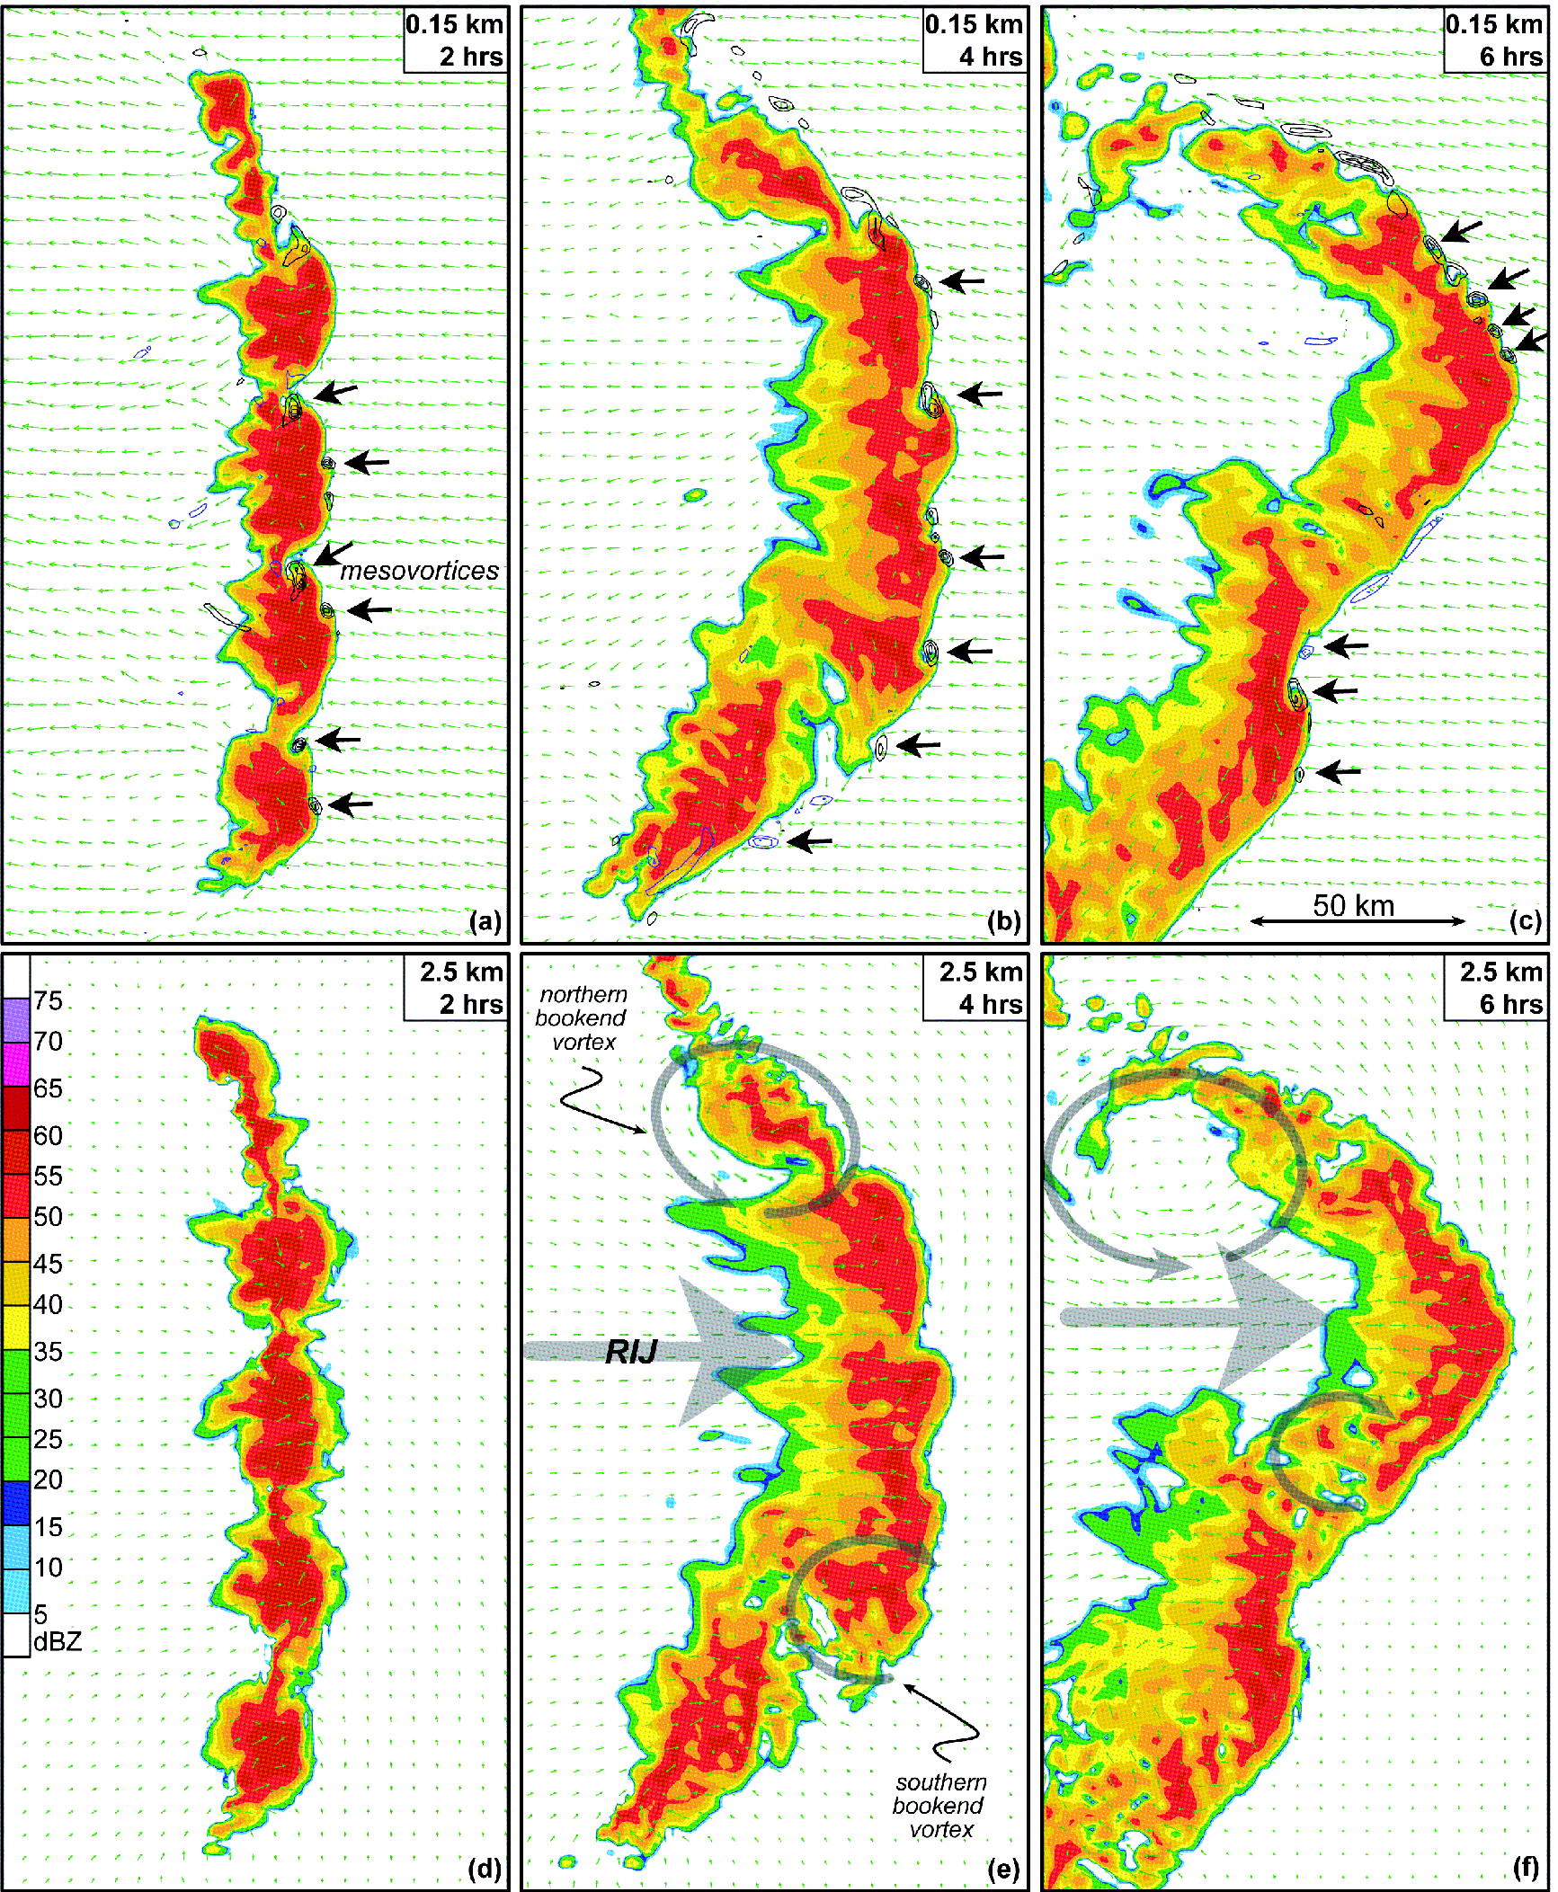
ATMS 316- MCSs and Hazards
Simulation of a bow echo, depicting radar reflectivity (dBZ) in color, along with storm-relative winds (m s⁻¹, green) and vertical vorticity (x10⁻³ s⁻¹, black) (Fig 10.36)

Slide 119
ATMS 316- MCSs and Hazards
Nontornadic, damaging straight-line winds
  Squall lines
    mesovortex origins (cont.)
      downward tilting of vortex lines in the cold pool (Fig. 10.37)
Horizontal winds within the outflow are enhanced by the superpositioning of the wind fields of the mesovortices and the outflow (two winds fields add constructively).

Slide 120
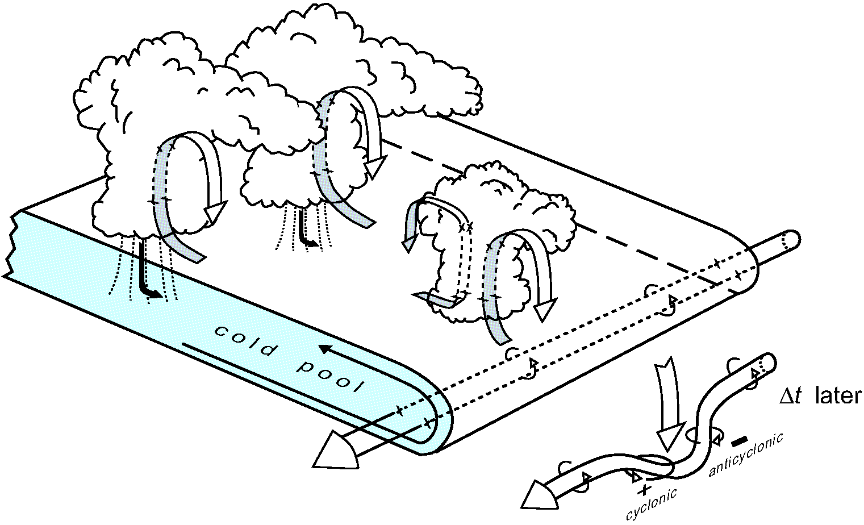
ATMS 316- MCSs and Hazards
Schematic model illustrates the origin of vortex couplets along the outflow boundary of the bow echo studied by Wakimoto et al. [2006b] (Fig 10.37)

