Slide 1
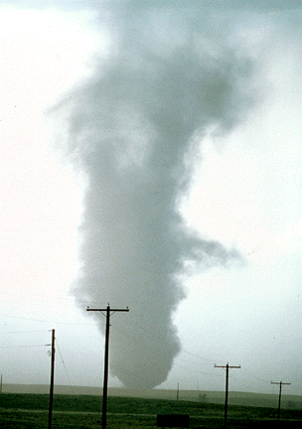
ATMS 316- Mesoscale Meteorology
Packet#1
What is meant by “Mesoscale Meteorology”?
http://www.ucar.edu/communications/factsheets/Tornadoes.html

Slide 2
ATMS 316- Mesoscale Meteorology
Outline
Introduction
Topics
Literature search
http://www.ucar.edu/communications/factsheets/Tornadoes.html

Slide 3
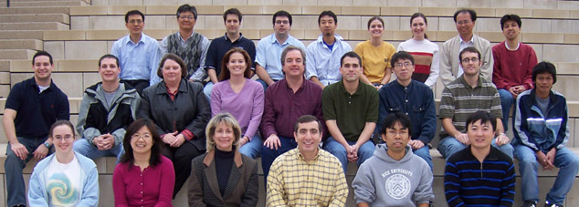
ATMS 316- Introduction
We as humans like to categorize things…
…it helps us find order in nature
http://www.ruf.rice.edu/~kekule/

Slide 4
ATMS 316- Introduction
Mesoscale meteorology
Various attempts at categorizing “mesoscale meteorology”

Slide 5
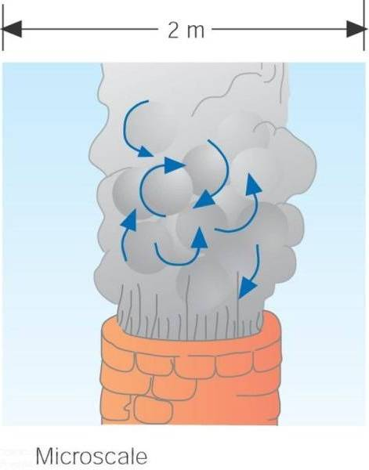
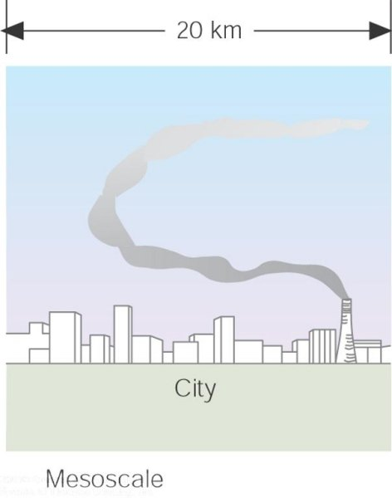
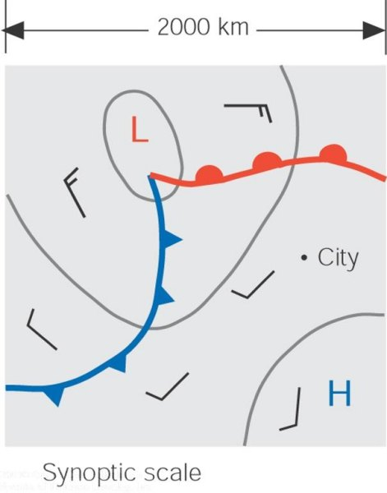
ATMS 316- Introduction
The tiny microscale motions... constitute a part of the larger mesoscale motions... which, in turn, are part of the much larger synoptic scale. Notice that as the scale becomes larger, motions observed at the smaller scale are no longer visible.

Slide 6
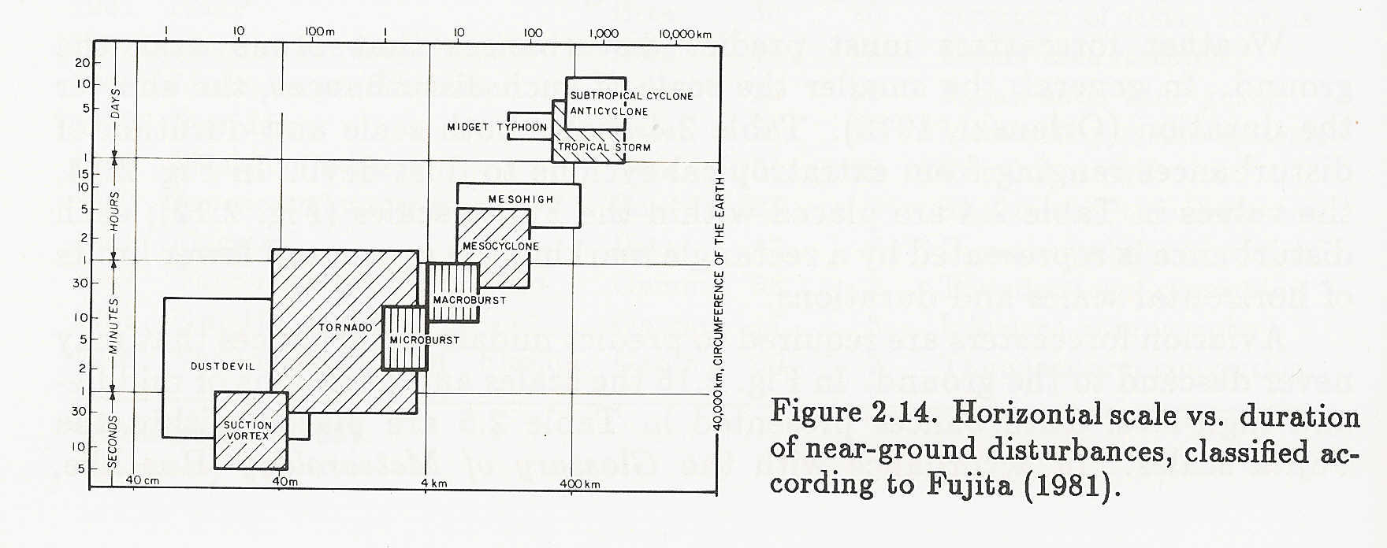
ATMS 316- Introduction
Mesoscale meteorology
near-ground disturbances
Horizontal scale is related to time scale (lifespan)

Slide 7
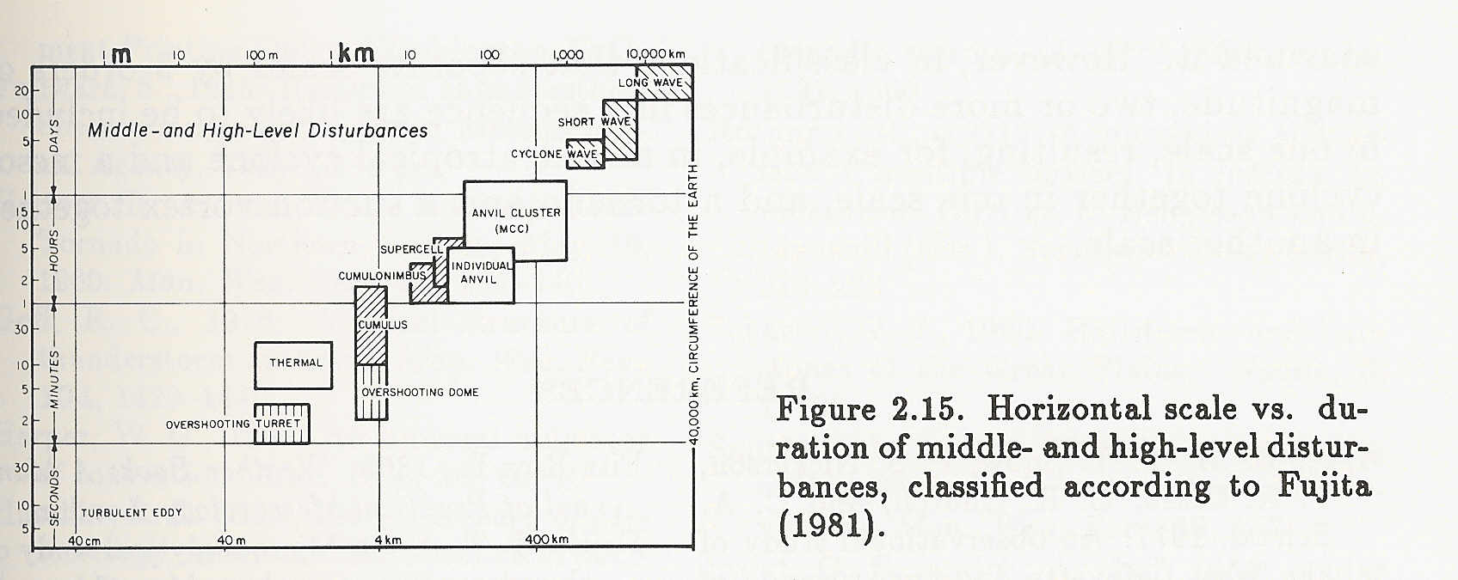
ATMS 316- Introduction
Mesoscale meteorology
upper-air disturbances
Horizontal scale is related to time scale (lifespan)

Slide 8
ATMS 316- Introduction
Which way does the ball roll?
HILL
synoptic scale

Slide 9
ATMS 316- Introduction
Scenario#1
HILL
synoptic scale

Slide 10
ATMS 316- Introduction
HILL
synoptic scale

Slide 11
ATMS 316- Introduction
HILL
synoptic scale
synoptic scale forcing alone

Slide 12
ATMS 316- Introduction
mesoscale
BUMP
Scenario#2
HILL
synoptic scale

Slide 13
ATMS 316- Introduction
mesoscale
BUMP
HILL
synoptic scale

Slide 14
ATMS 316- Introduction
mesoscale
BUMP
HILL
synoptic scale
synoptic scale dominates mesoscale forcing

Slide 15
ATMS 316- Introduction
Scenario#3
mesoscale
PLAIN
BUMP
synoptic-scale

Slide 16
ATMS 316- Introduction
mesoscale
PLAIN
BUMP
synoptic-scale
weak synoptic scale forcing

Slide 17
ATMS 316- Introduction
Interesting things happen at the boundaries, or at the interface…
Land, water (coastline)
Flat, mountainous
Smooth surface, rough surface
Ground, atmosphere
Dry land, moist land
Cold land, warm land
Dry air, moist air
Cold air, warm air

Slide 18
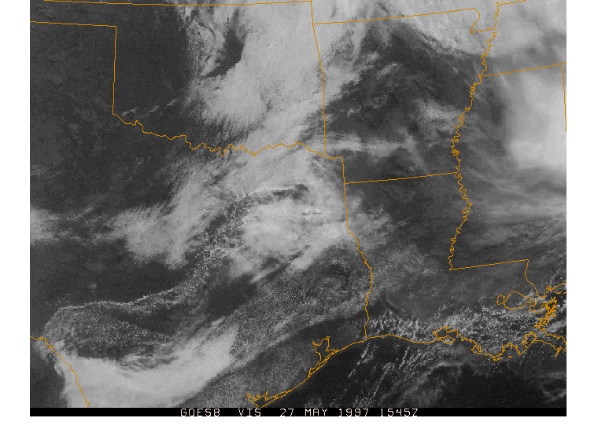
ATMS 316- Introduction
Mesoscale weather events are often initiated at boundaries, or at the interface…

Slide 19
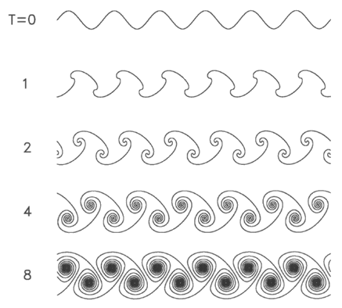
ATMS 316- Introduction
How do mesoscale weather events “fit in” to the big picture?
http://www.nsf.gov/pubs/2002/nsf0120/nsf0120_free1_new.html
Richardson…
“Big whirls have little whirls which feed on their velocity
and little whirls have lesser whirls and so on to viscosity.”

Slide 20
ATMS 316- Introduction
A method for categorizing mesoscale weather events
Internally generated circulations
Events deriving their energy from the atmosphere
Mesoscale convective systems
Cellular convection that has organized into larger-scale structures
Externally forced circulations
Events deriving their energy from a source outside of the atmosphere (e.g. terrain)

Slide 21
ATMS 316- Introduction
A method for categorizing mesoscale weather events
Internally generated circulations
Fronts and jet streaks, instabilities, gravity waves, quasi-stationary convective events, convection in hurricanes
Mesoscale convective systems
Isolated convective storms, squall lines and rainbands, mesoscale convective complexes, tornadoes
Externally forced circulations
Upslope precipitation events, mountain waves, lee cyclogenesis, differential terrain heating, drylines

Slide 22
ATMS 316- Mesoscale Meteorology
Topics
Lake-effect convection [LP#3]
Northwest flow snowfall [LP#4]
Polar lows [LP#5]
Synoptic fronts [LP#6]
Mesoscale Gravity Waves [LP#7]
Mountain Waves and Downslope Windstorms [LP#8]
Drylines and outflow boundaries [LP#9]
Convection Initiation [LP#10]

Slide 23
ATMS 316- Mesoscale Meteorology
Topics (continued)
Organization of Isolated Convection [LP#11]
Mesoscale Convective Systems and Hazards Associated with Deep Moist Convection [LP#12]

Slide 24
ATMS 316- Mesoscale Meteorology
Literature search
UNCA library resource; EBSCO
Link
http://wncln.wncln.org/search/j?SEARCH=#

