Slide 1
21 November 2022 Map Discussion
Asheville, North Carolina
Douglas Miller

Slide 2
Conditions at Asheville, NC
Sunday (pm) – Monday (am) [20 – 21 Nov]
Maximum Temperature = 40ºF
Minimum Temperature = 19ºF
Wind speed & direction (1800 UTC) = 22 mph from the north/northwest
24-h Precipitation = 0.00 inches

Slide 3
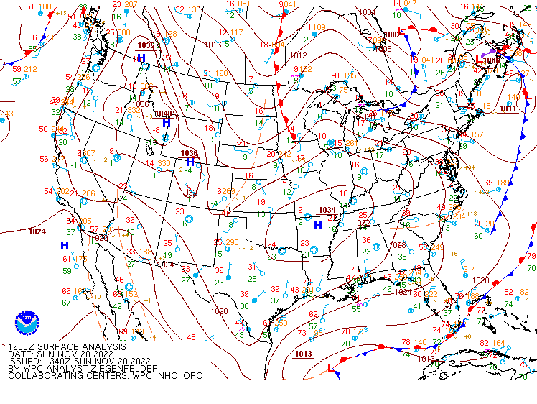
Within the past 24 hours
Sea level pressure – 1200 UTC 20 Nov 2022

Slide 4
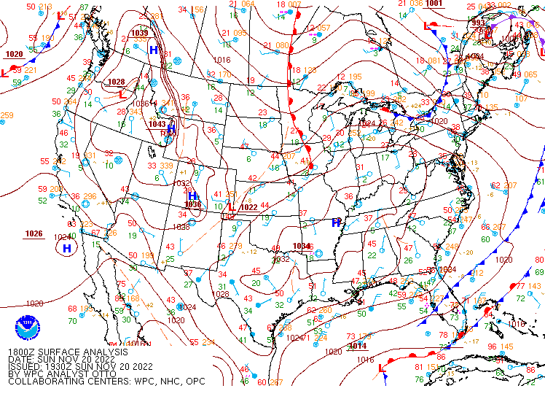
Within the past 24 hours
Sea level pressure – 1800 UTC 20 Nov 2022

Slide 5
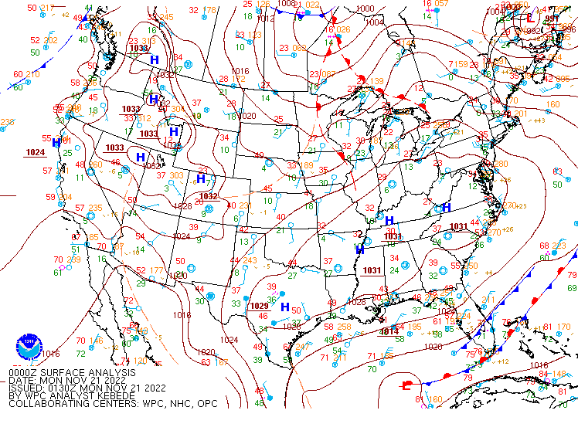
Within the past 24 hours
Sea level pressure – 0000 UTC 21 Nov 2022

Slide 6
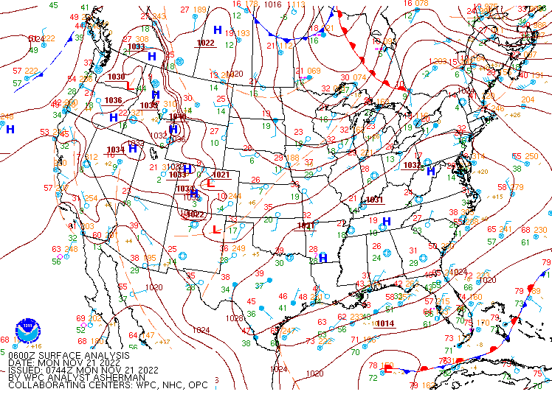
Within the past 24 hours
Sea level pressure – 0600 UTC 21 Nov 2022

Slide 7
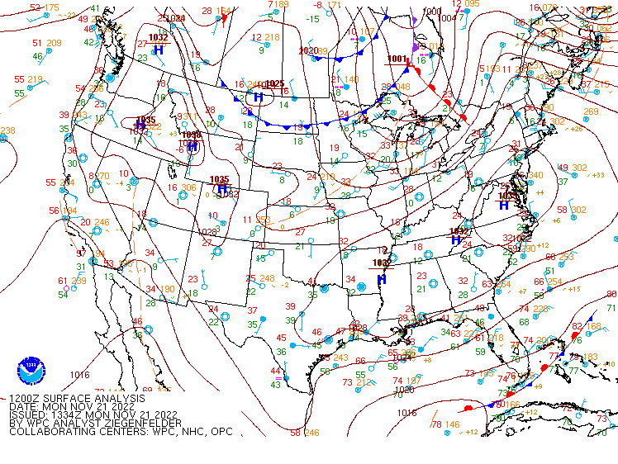
Within the past 24 hours
Sea level pressure – 1200 UTC 21 Nov 2022

Slide 8
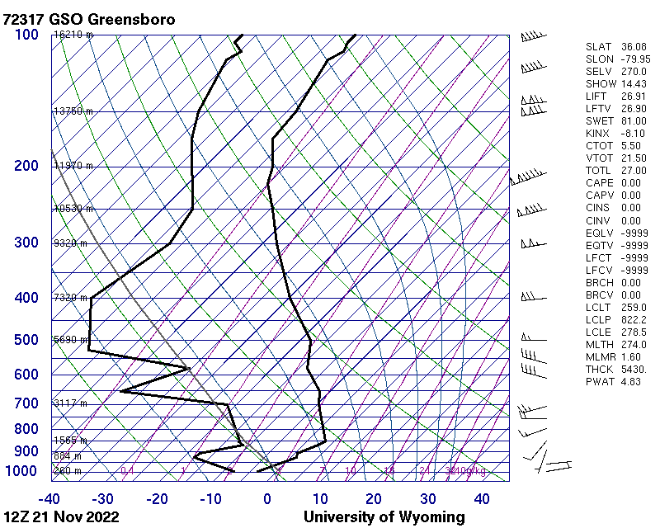
Within the past 24 hours
Greensboro, NC – 1200 UTC 21 Nov 2022

Slide 9
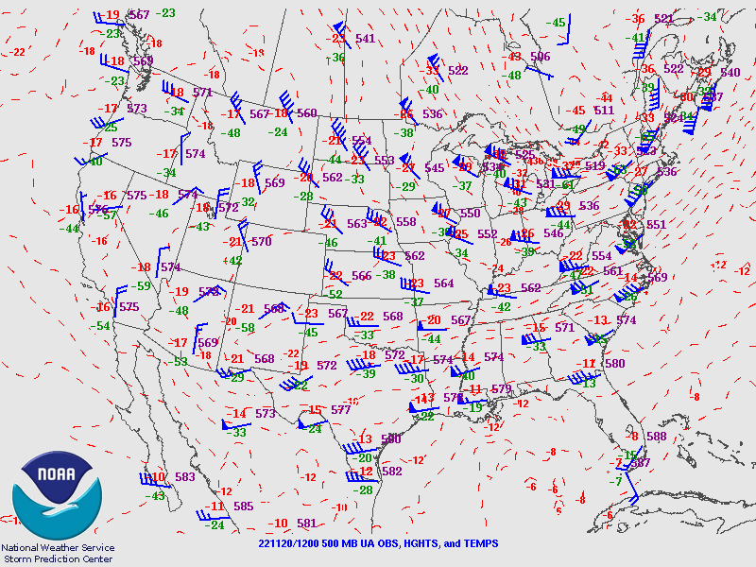
Within the past 24 hours
Halfway up through the troposphere (500 mb)
1200 UTC 20 Nov 2022

Slide 10
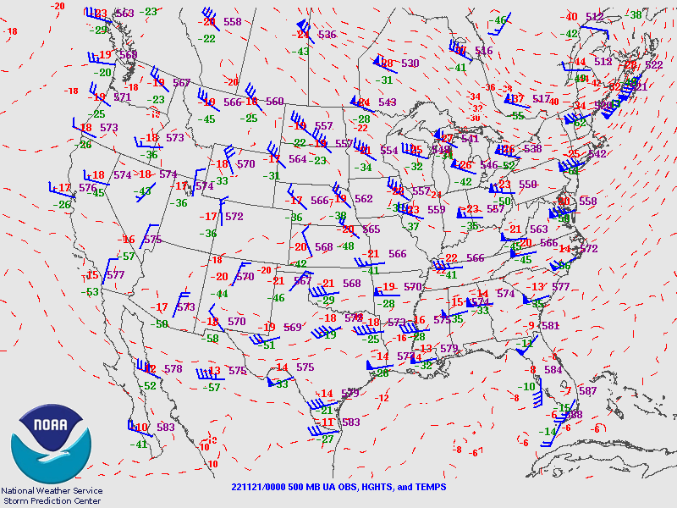
Within the past 24 hours
Halfway up through the troposphere (500 mb)
0000 UTC 21 Nov 2022

Slide 11
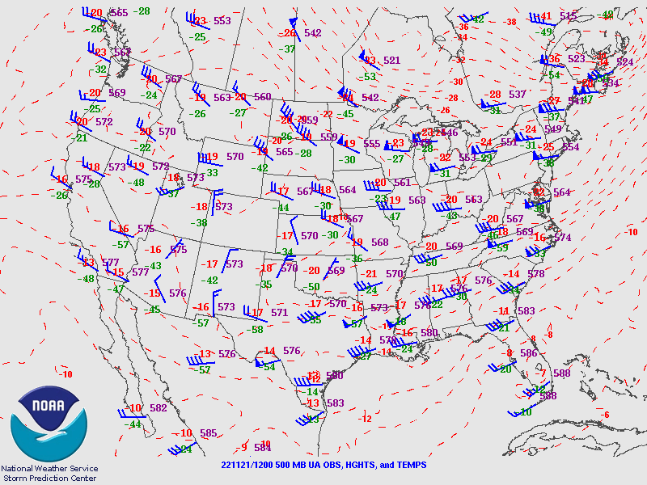
Within the past 24 hours
Halfway up through the troposphere (500 mb)
1200 UTC 21 Nov 2022

Slide 12
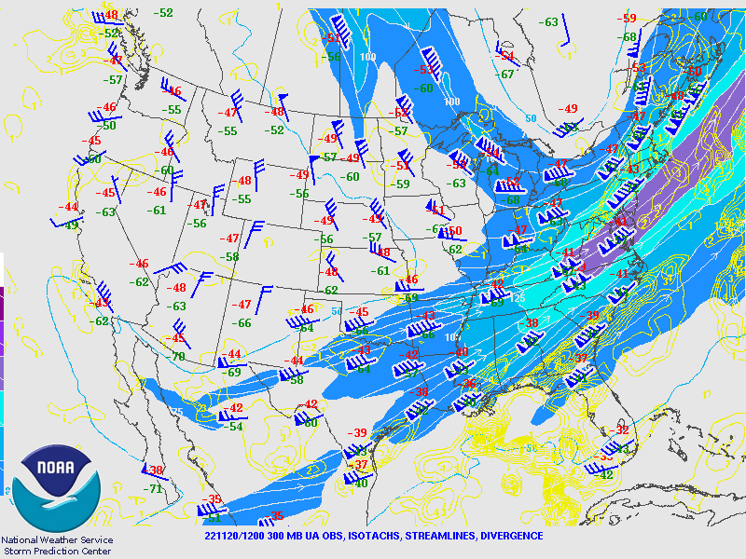
Within the past 24 hours
At the tropopause (300 mb)
1200 UTC 20 Nov 2022

Slide 13
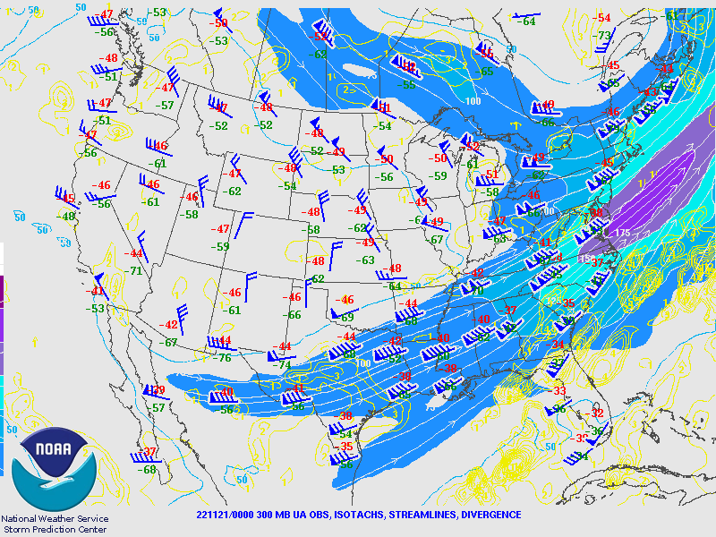
Within the past 24 hours
At the tropopause (300 mb)
0000 UTC 21 Nov 2022

Slide 14
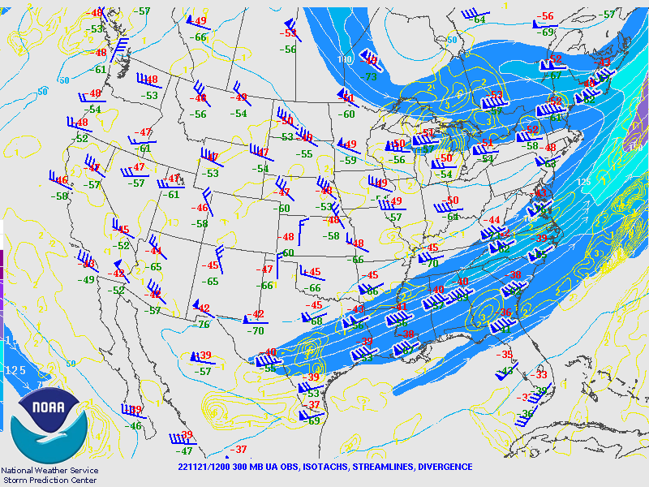
Within the past 24 hours
At the tropopause (300 mb)
1200 UTC 21 Nov 2022

Slide 15
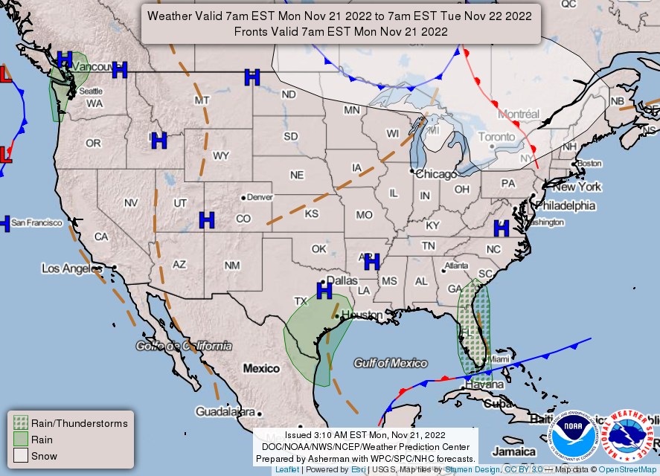
https://www.wpc.ncep.noaa.gov/NationalForecastChart/staticmaps/noaad1.png

Slide 16
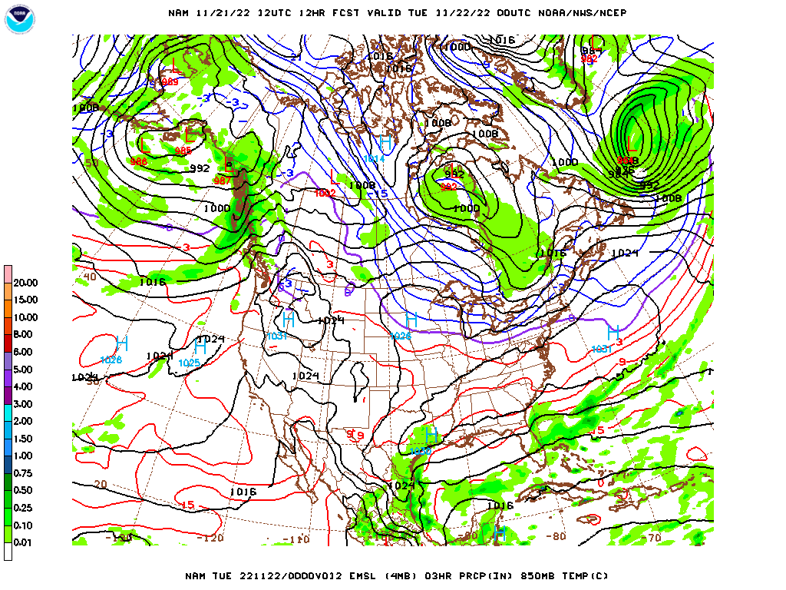
Over the next 48 hours
Sea level pressure
0000 UTC 22 Nov 2022

Slide 17
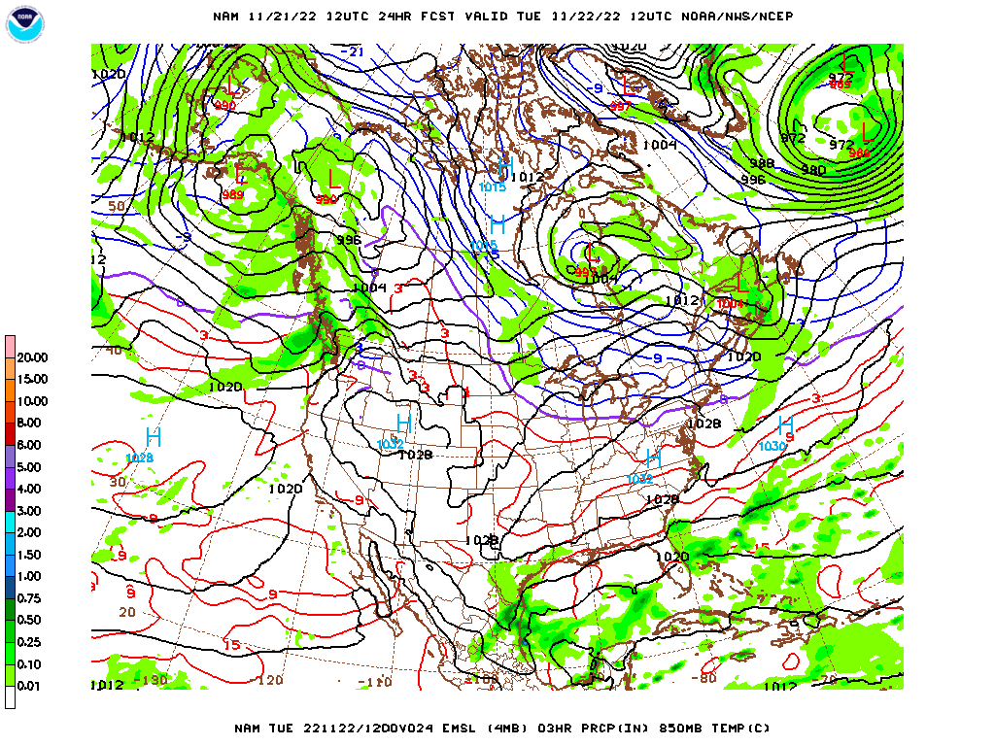
Over the next 48 hours
Sea level pressure
1200 UTC 22 Nov 2022

Slide 18
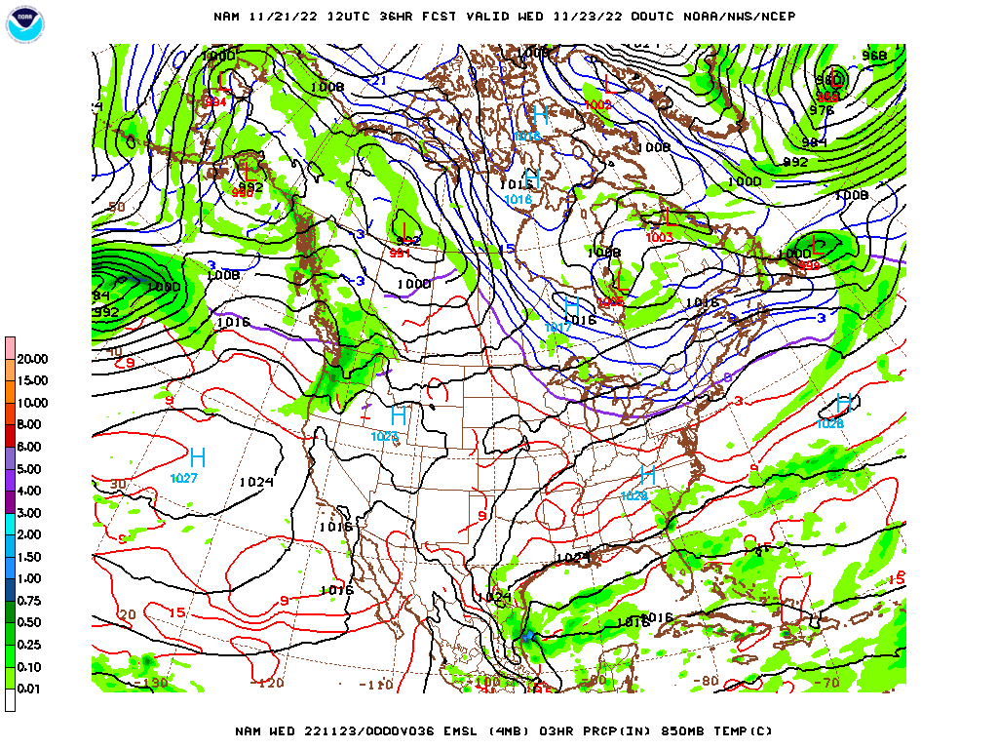
Over the next 48 hours
Sea level pressure
0000 UTC 23 Nov 2022

Slide 19
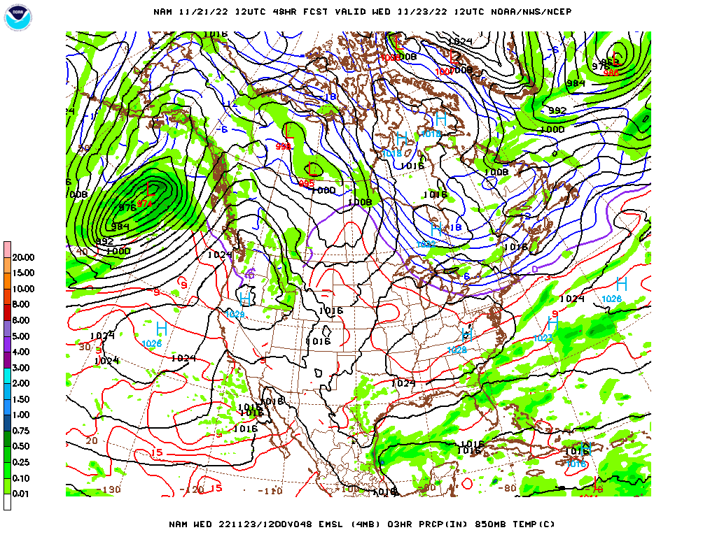
Over the next 48 hours
Sea level pressure
1200 UTC 23 Nov 2022

Slide 20
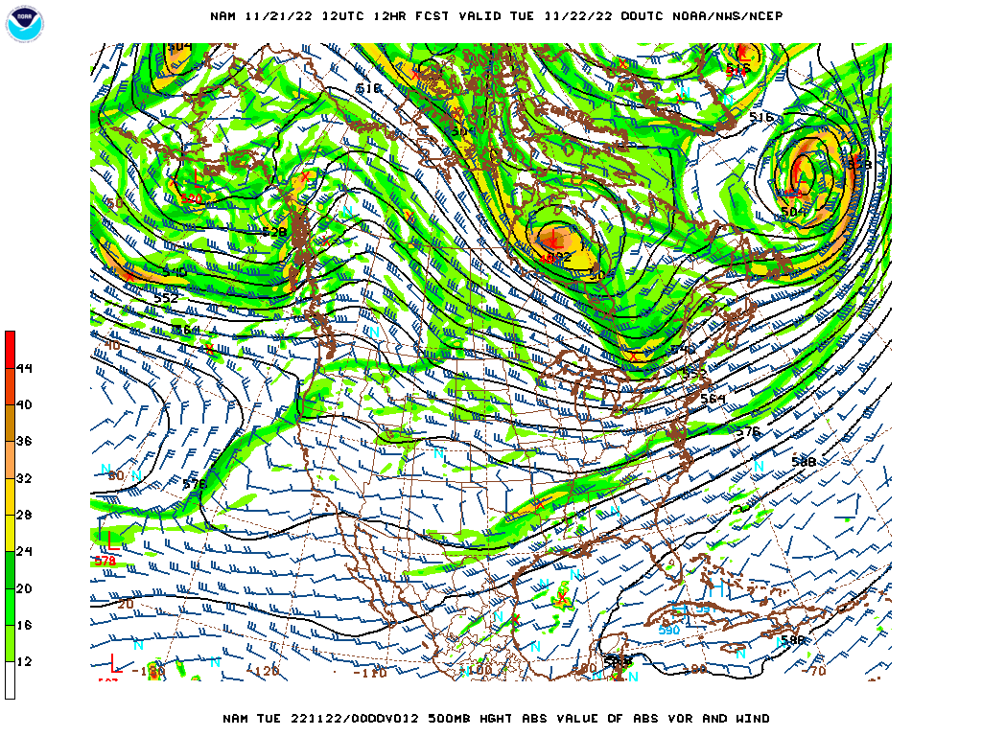
Over the next 48 hours
500 mb level
0000 UTC 22 Nov 2022

Slide 21
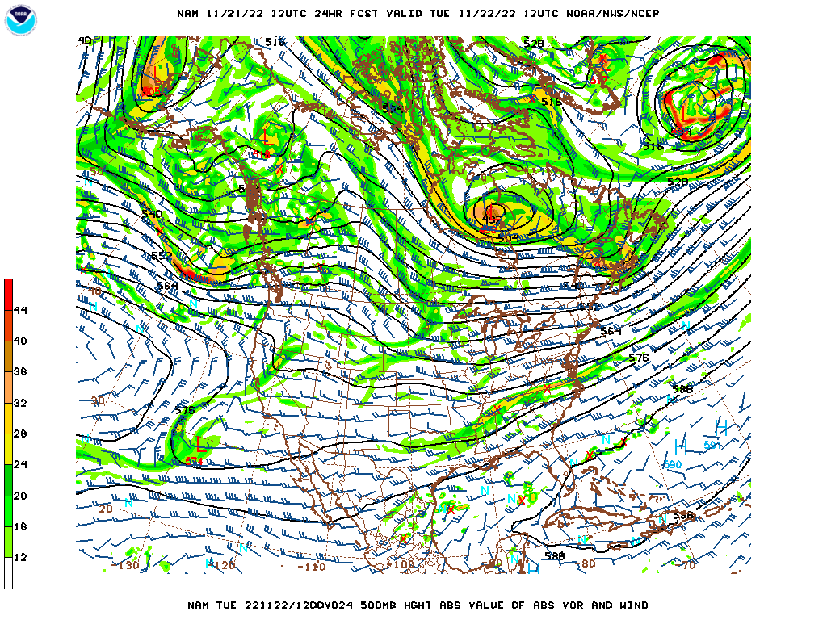
Over the next 48 hours
500 mb level
1200 UTC 22 Nov 2022

Slide 22
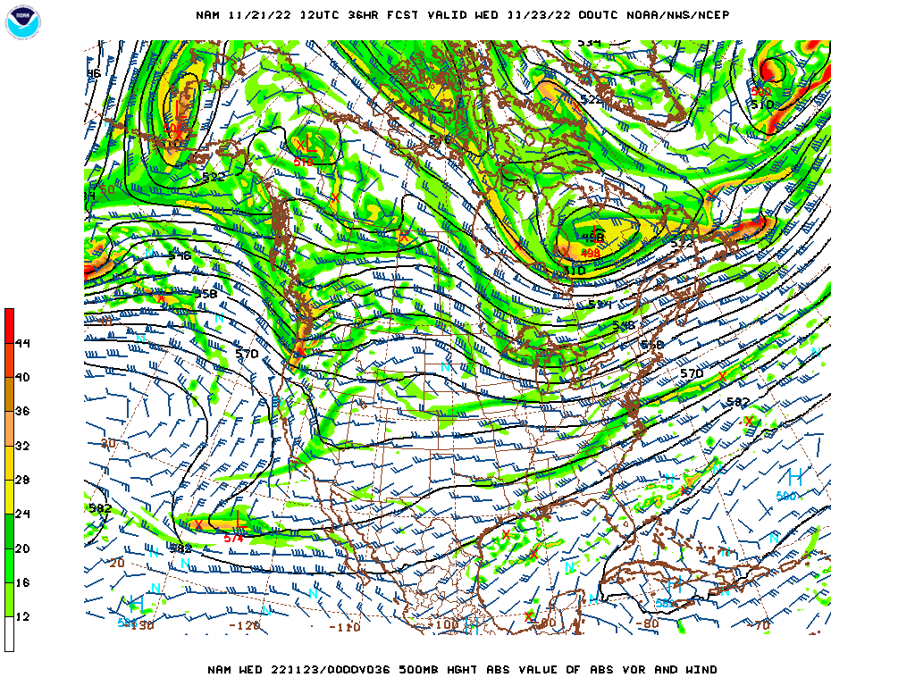
Over the next 48 hours
500 mb level
0000 UTC 23 Nov 2022

Slide 23
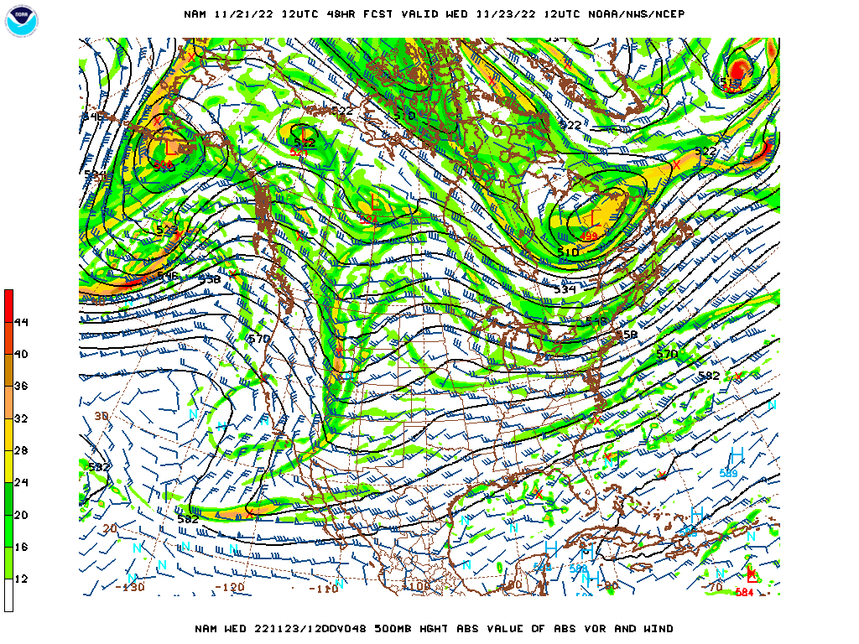
Over the next 48 hours
500 mb level
1200 UTC 23 Nov 2022

Slide 24
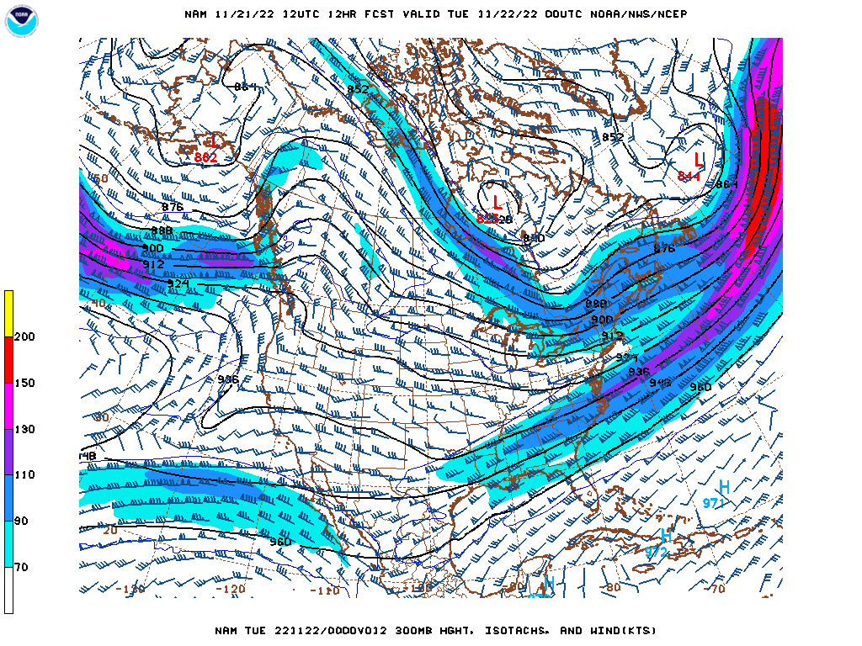
Over the next 48 hours
300 mb level
0000 UTC 22 Nov 2022

Slide 25
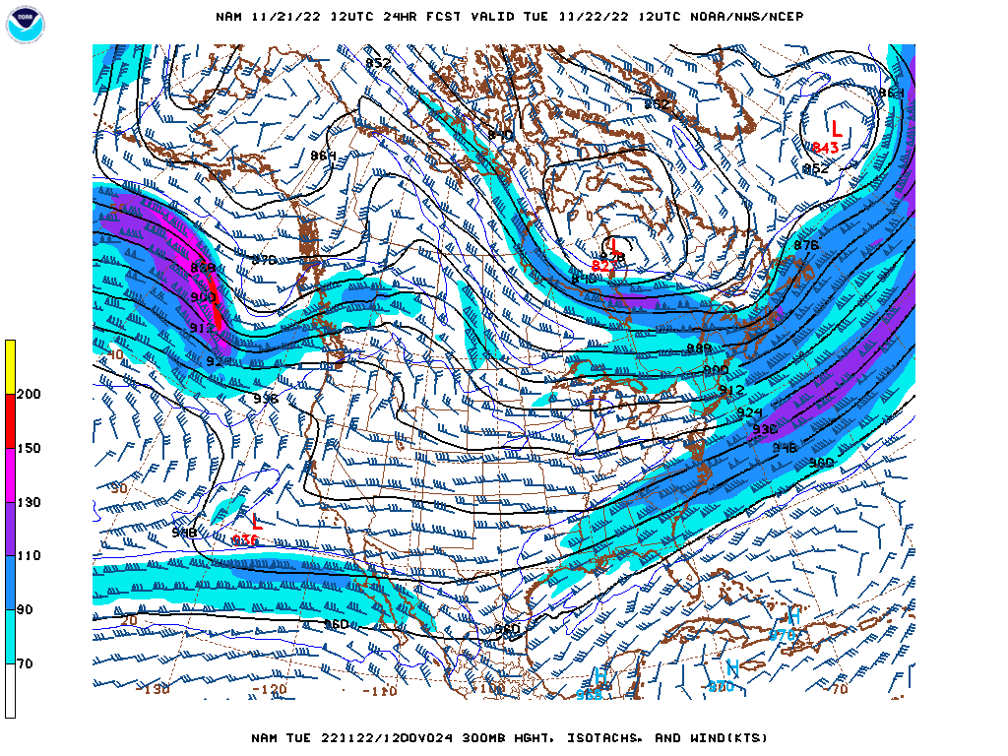
Over the next 48 hours
300 mb level
1200 UTC 22 Nov 2022

Slide 26
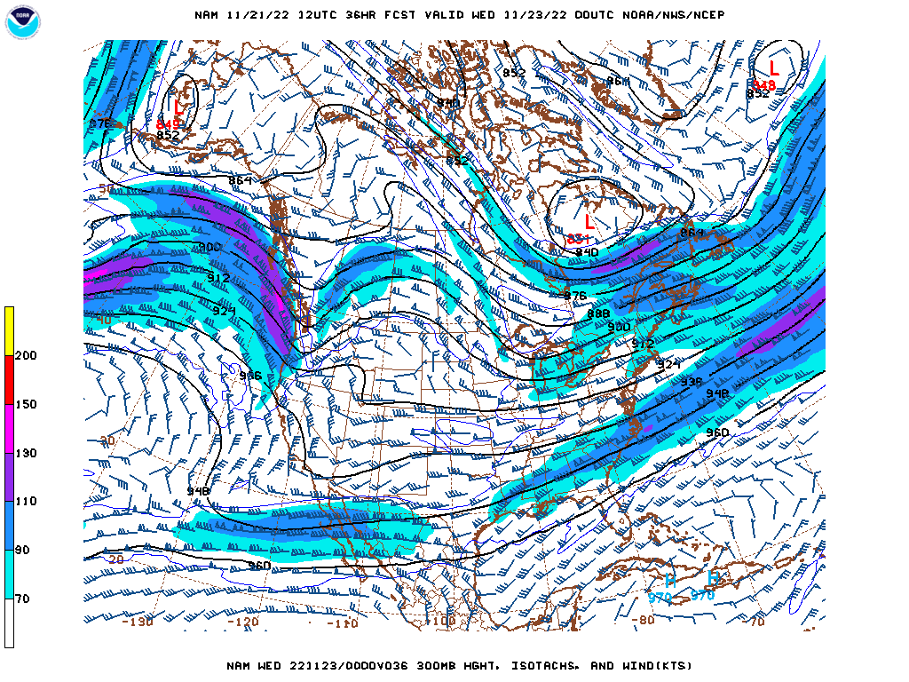
Over the next 48 hours
300 mb level
0000 UTC 23 Nov 2022

Slide 27
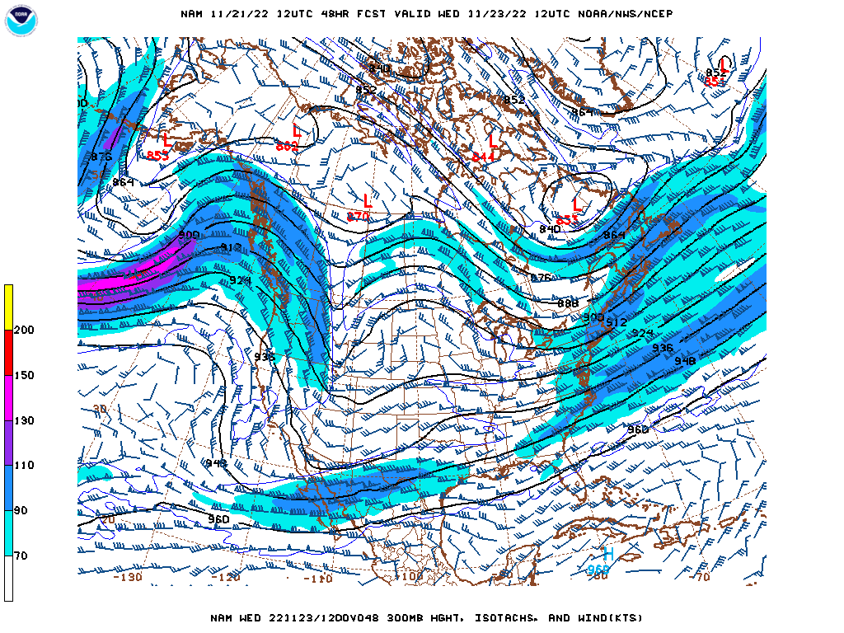
Over the next 48 hours
300 mb level
1200 UTC 23 Nov 2022

Slide 28
Forecast for Asheville, NC
Monday (pm) – Tuesday (am) [21 – 22 Nov]
Maximum Temperature = 53ºF
Minimum Temperature = 29ºF
Wind speed & direction (1800 UTC) = 8 mph from the south
Precipitation = 0.00 inches

Slide 29
Forecast for Asheville, NC
Tuesday (pm) – Wednesday (am) [22 – 23 Nov]
Maximum Temperature = 55ºF
Minimum Temperature = 36ºF
Wind speed & direction (1800 UTC) = 5 mph from the east
Precipitation = 0.00 inches

