Slide 1
22 April 2024 Map Discussion
Asheville, North Carolina
Douglas Miller

Slide 2
Conditions at Asheville, NC
Sun. (pm) – Mon. (am) [21 – 22 Apr]
Maximum Temperature = 49ºF
Minimum Temperature = 40ºF
Wind speed & direction (1800 UTC) = 7 mph from the north
24-h Precipitation = 0.21 inches

Slide 3
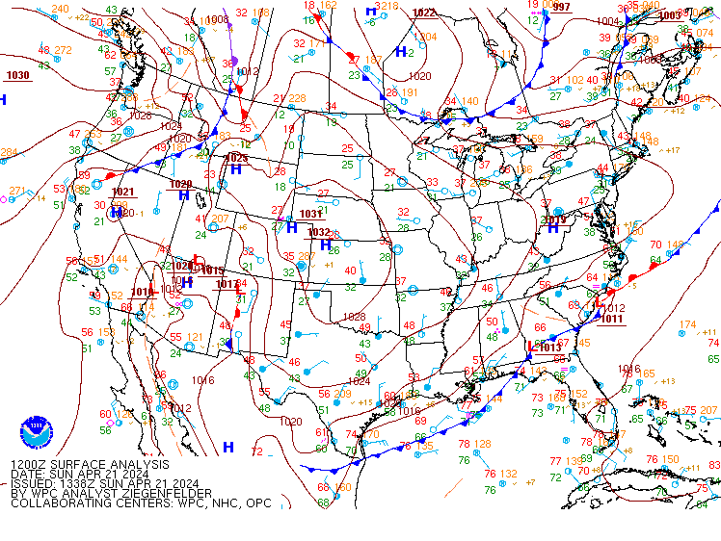
Within the past 24 hours
Sea level pressure – 1200 UTC 21 Apr 2024

Slide 4
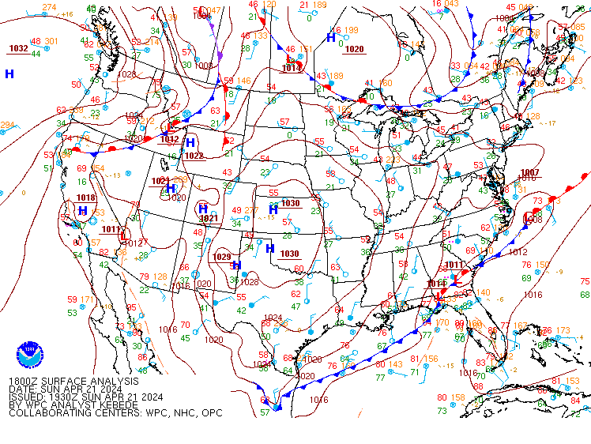
Within the past 24 hours
Sea level pressure – 1800 UTC 21 Apr 2024

Slide 5
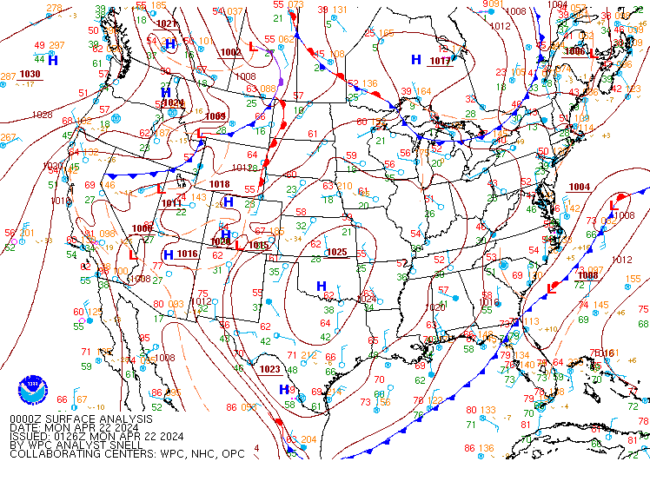
Within the past 24 hours
Sea level pressure – 0000 UTC 22 Apr 2024

Slide 6
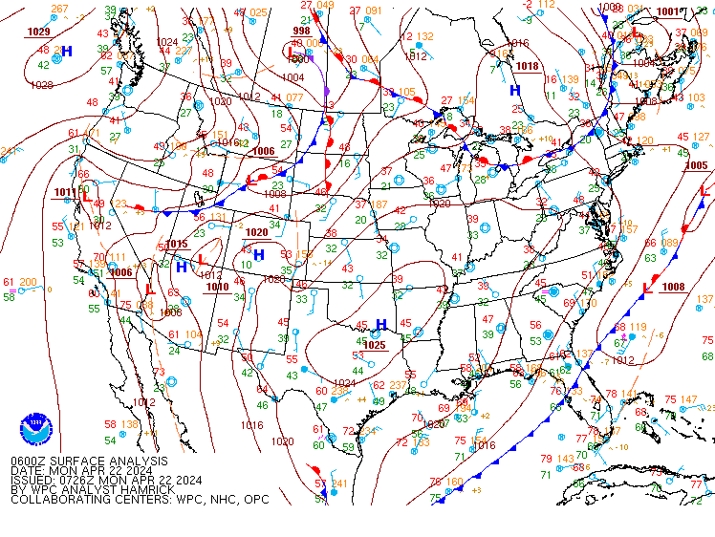
Within the past 24 hours
Sea level pressure – 0600 UTC 22 Apr 2024

Slide 7
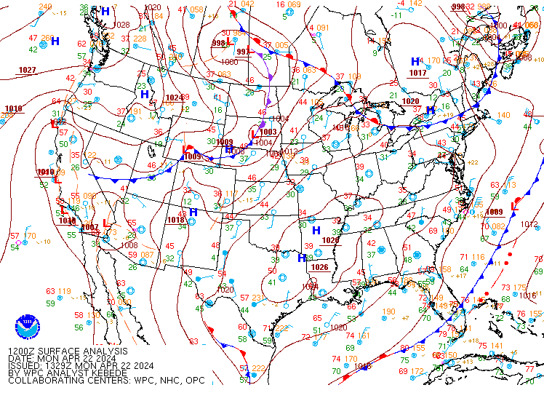
Within the past 24 hours
Sea level pressure – 1200 UTC 22 Apr 2024

Slide 8
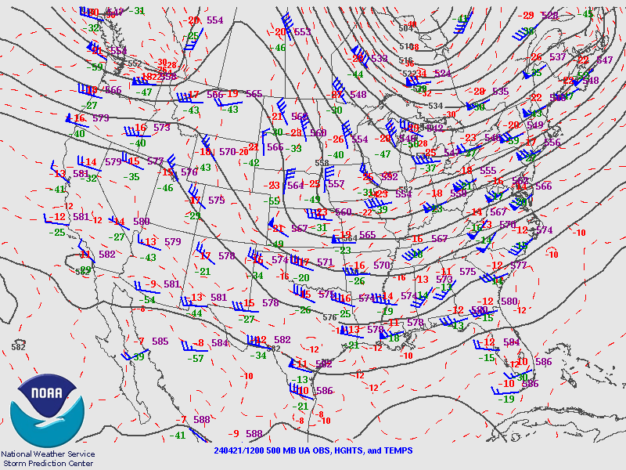
Within the past 24 hours
Halfway up through the troposphere (500 mb)
1200 UTC 21 Apr 2024

Slide 9
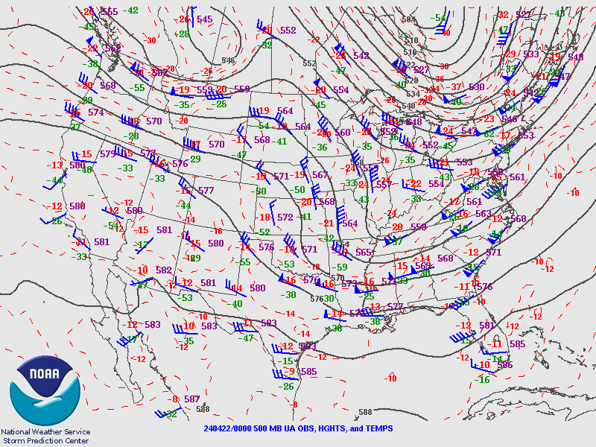
Within the past 24 hours
Halfway up through the troposphere (500 mb)
0000 UTC 22 Apr 2024

Slide 10
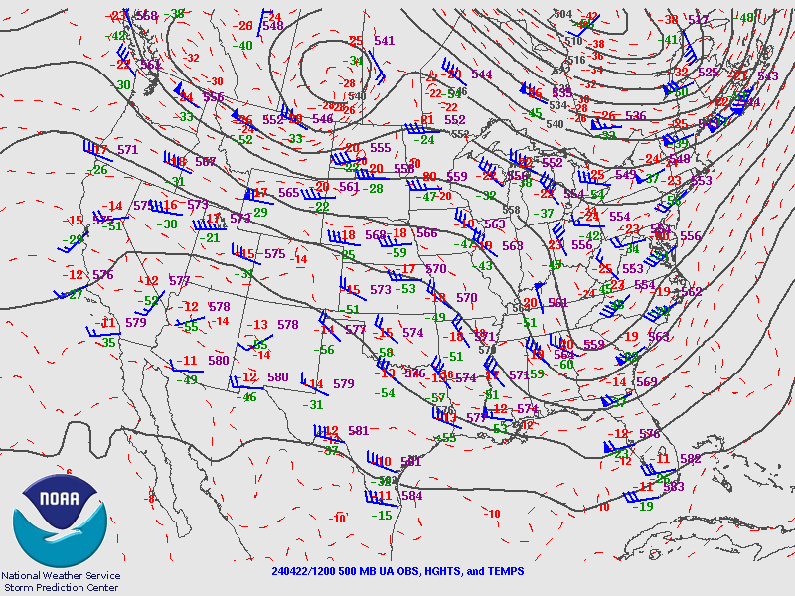
Within the past 24 hours
Halfway up through the troposphere (500 mb)
1200 UTC 22 Apr 2024

Slide 11
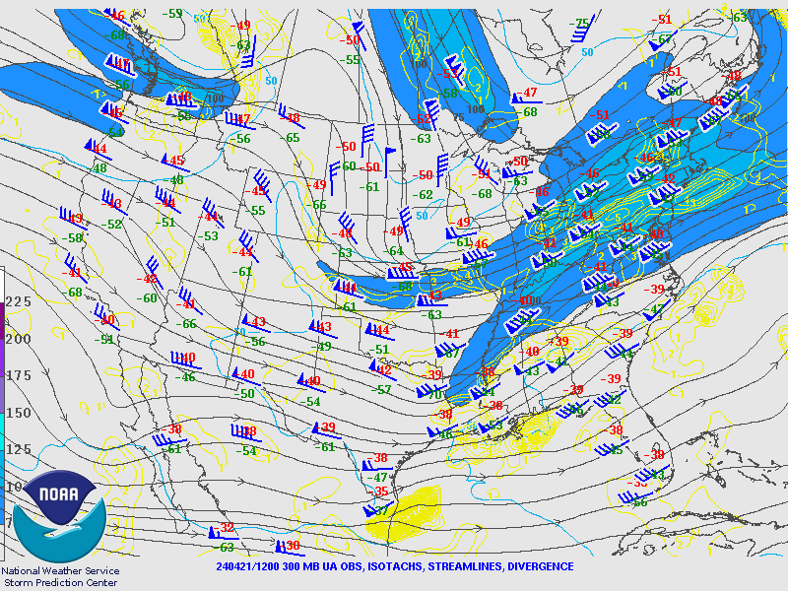
Within the past 24 hours
At the tropopause (300 mb)
1200 UTC 21 Apr 2024

Slide 12
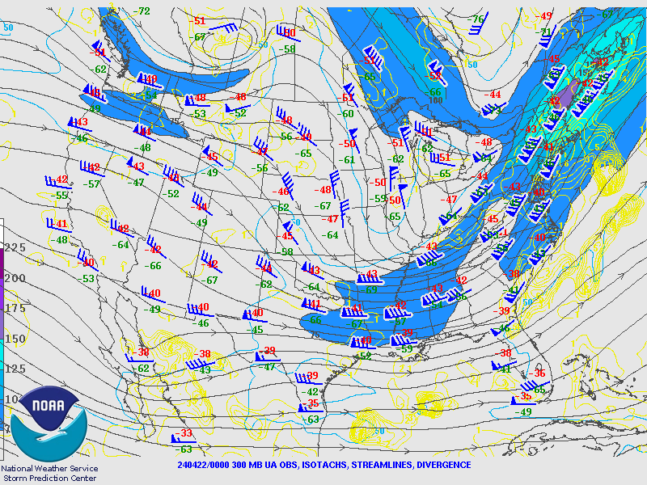
Within the past 24 hours
At the tropopause (300 mb)
0000 UTC 22 Apr 2024

Slide 13
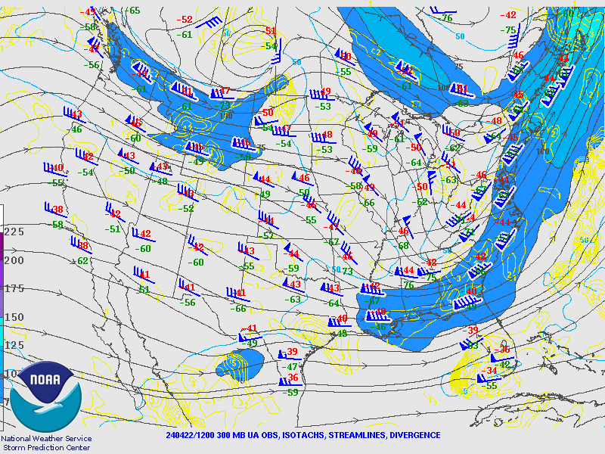
Within the past 24 hours
At the tropopause (300 mb)
1200 UTC 22 Apr 2024

Slide 14
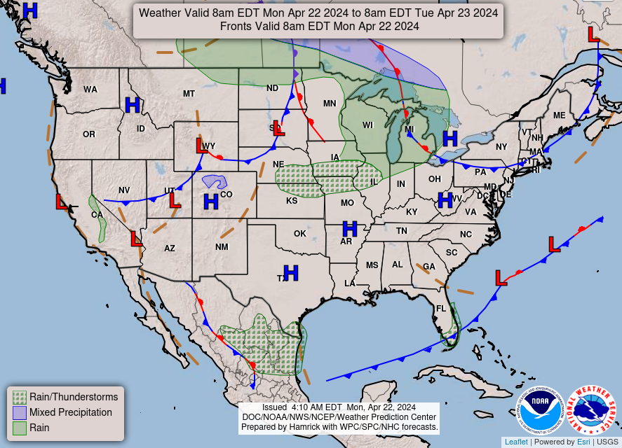
https://www.wpc.ncep.noaa.gov/NationalForecastChart/staticmaps/noaad1.png

Slide 15
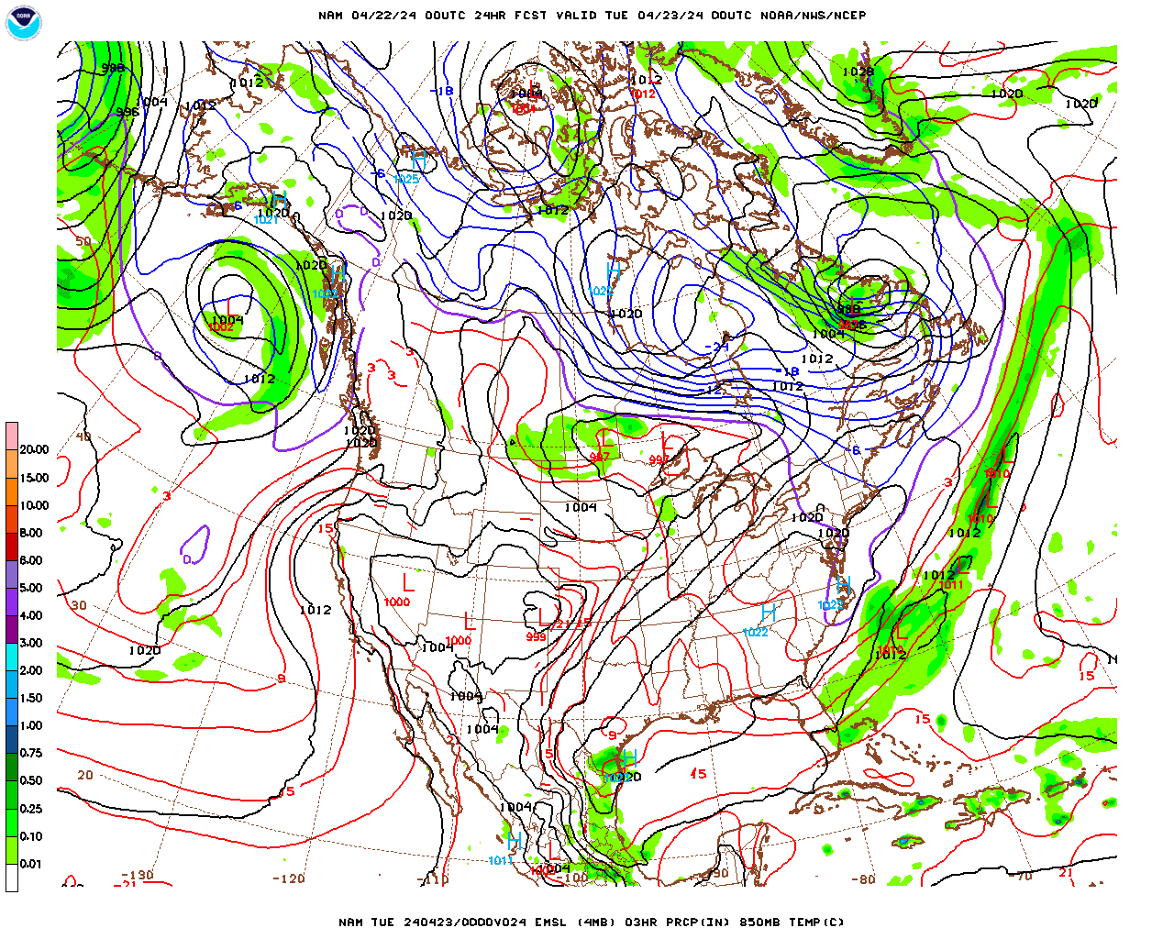
Over the next 48 hours
Sea level pressure
0000 UTC 23 Apr 2024

Slide 16
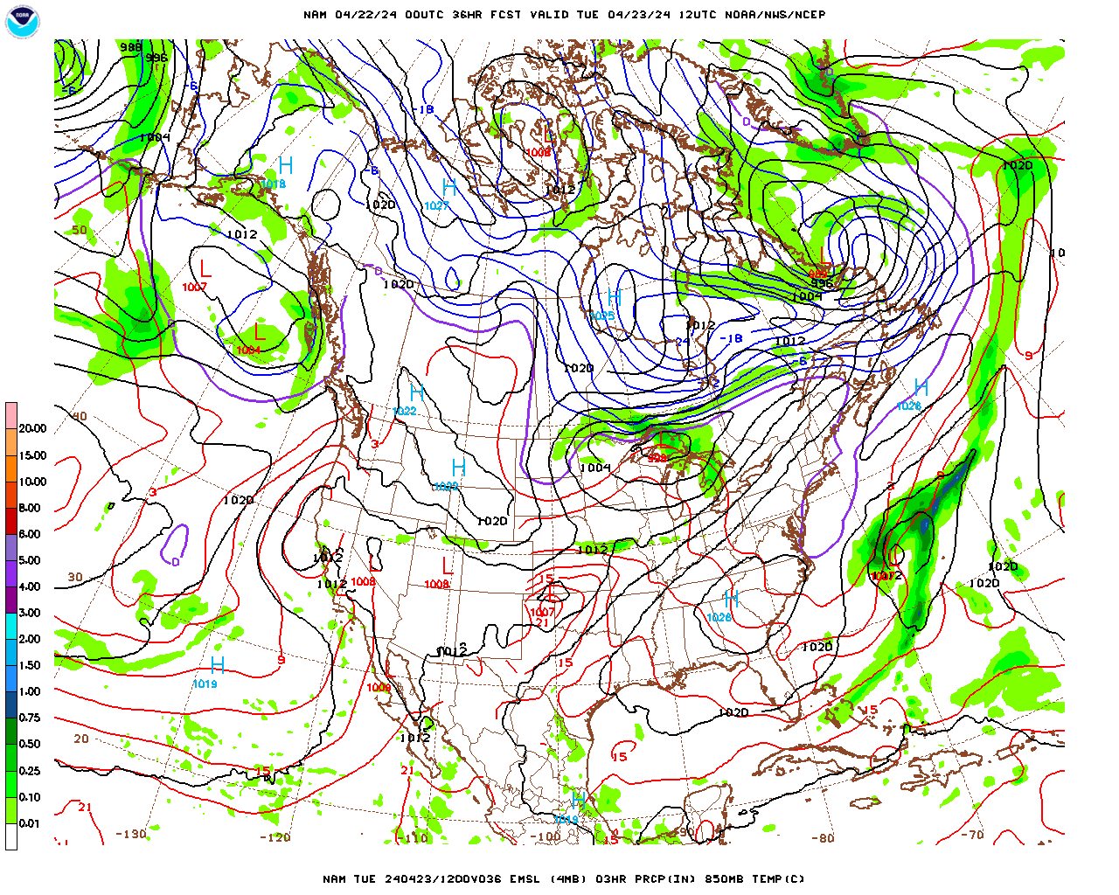
Over the next 48 hours
Sea level pressure
1200 UTC 23 Apr 2024

Slide 17
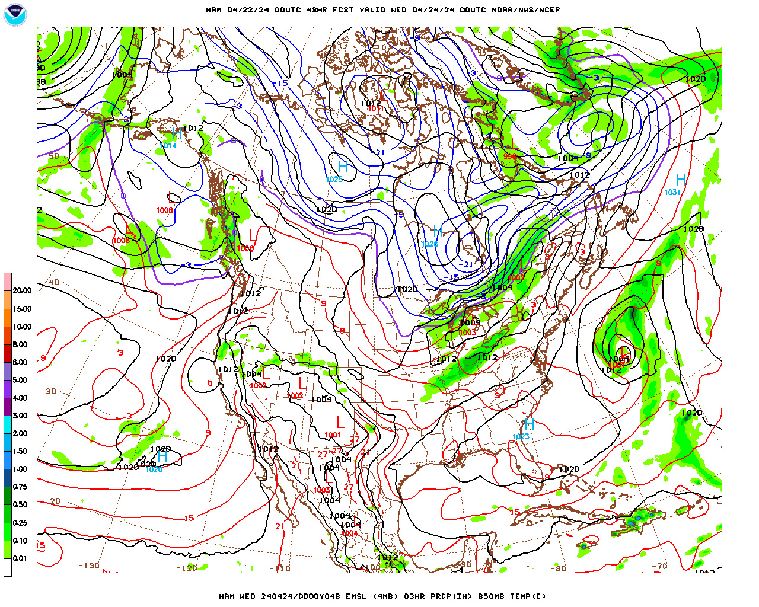
Over the next 48 hours
Sea level pressure
0000 UTC 24 Apr 2024

Slide 18
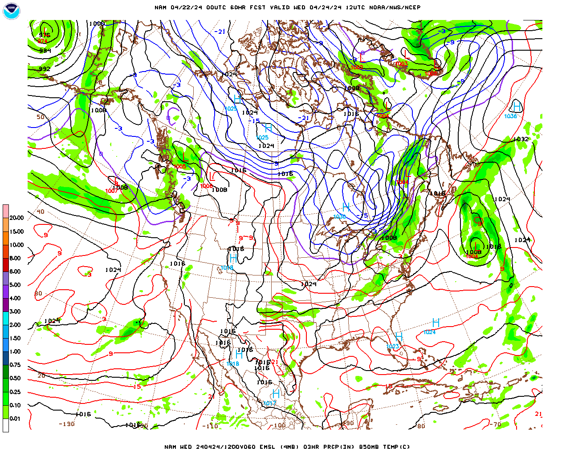
Over the next 48 hours
Sea level pressure
1200 UTC 24 Apr 2024

Slide 19
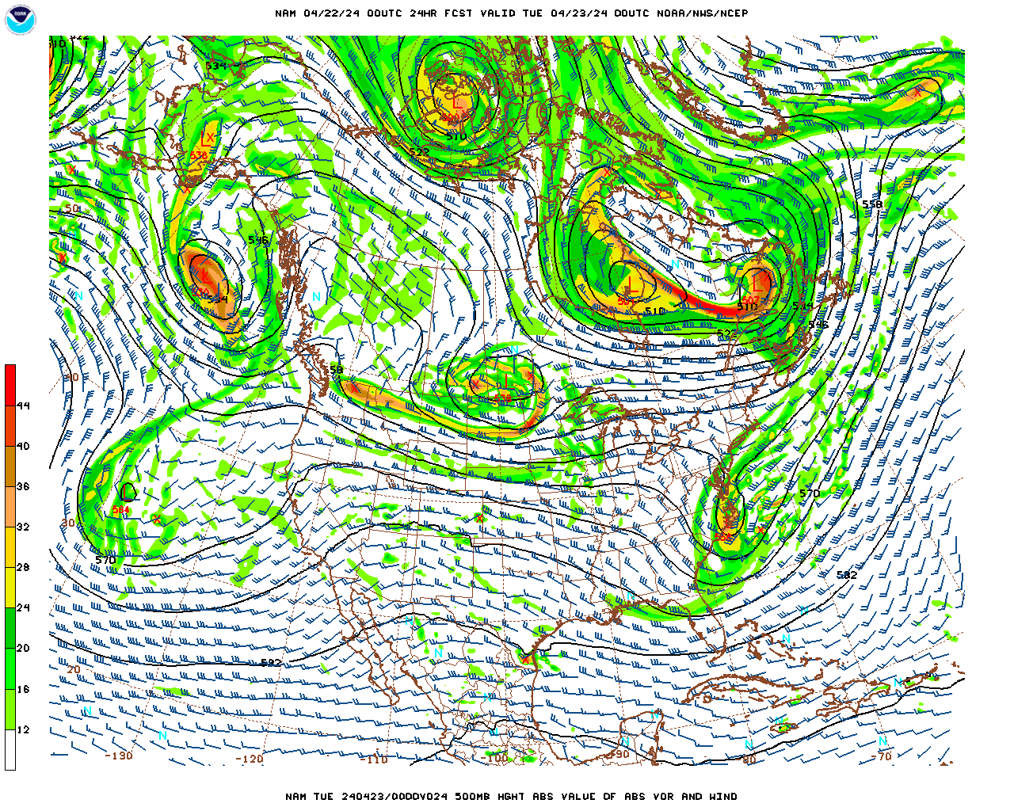
Over the next 48 hours
500 mb level
0000 UTC 23 Apr 2024

Slide 20
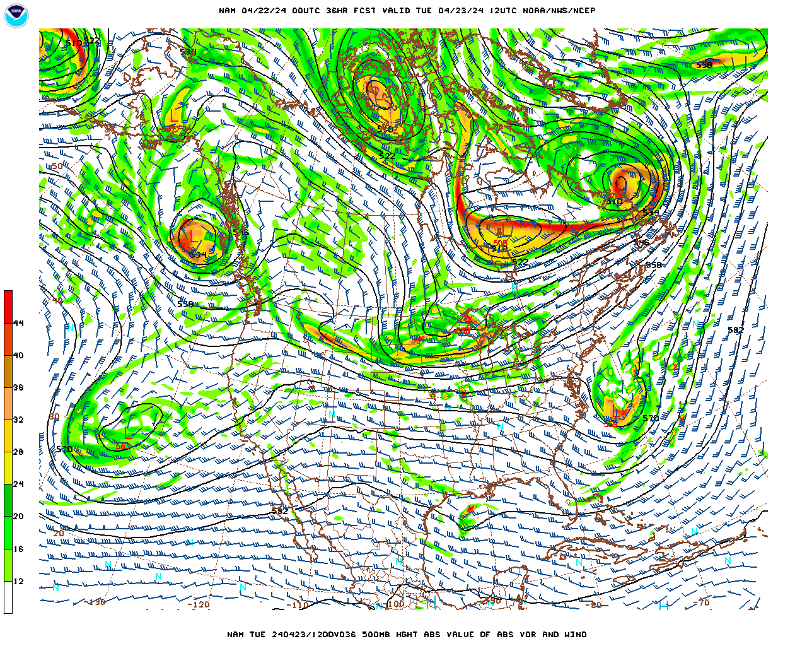
Over the next 48 hours
500 mb level
1200 UTC 23 Apr 2024

Slide 21
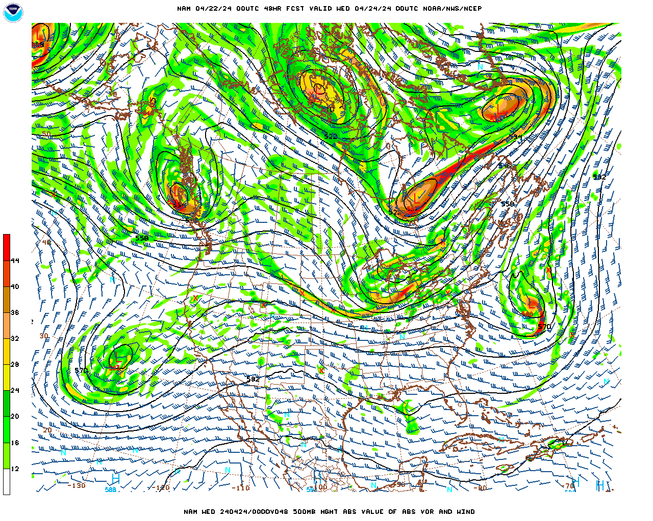
Over the next 48 hours
500 mb level
0000 UTC 24 Apr 2024

Slide 22
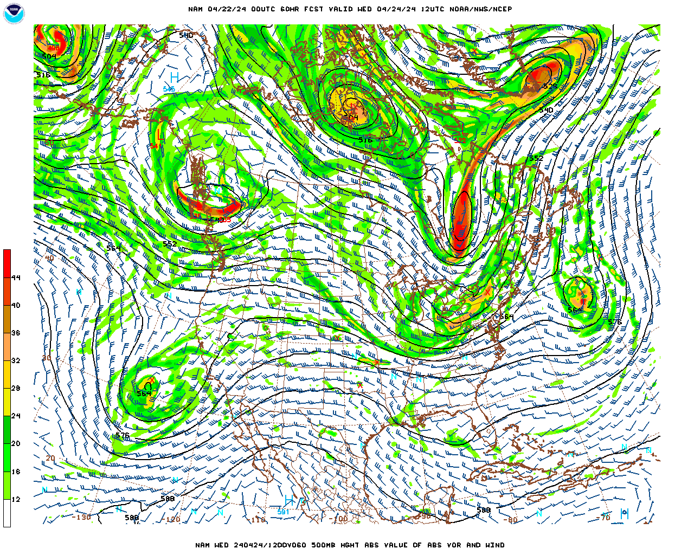
Over the next 48 hours
500 mb level
1200 UTC 24 Apr 2024

Slide 23
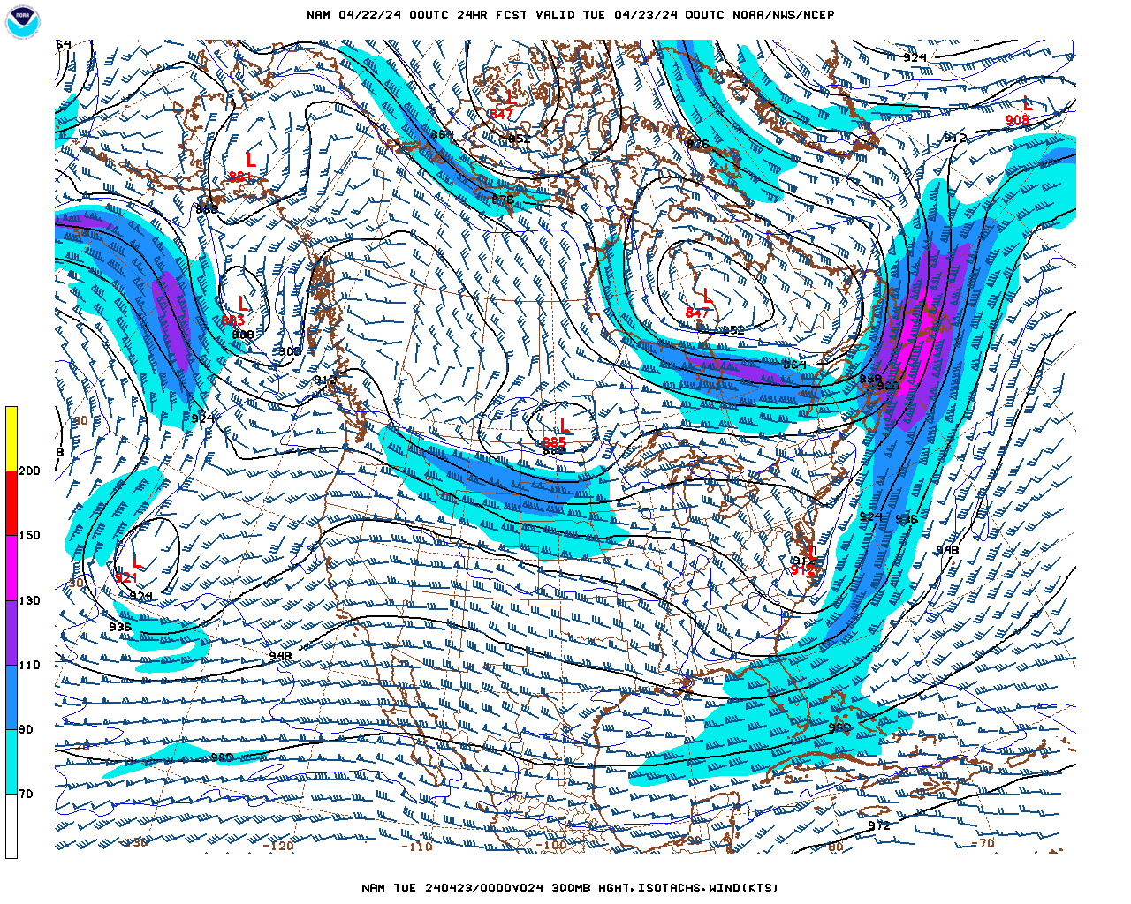
Over the next 48 hours
300 mb level
0000 UTC 23 Apr 2024

Slide 24
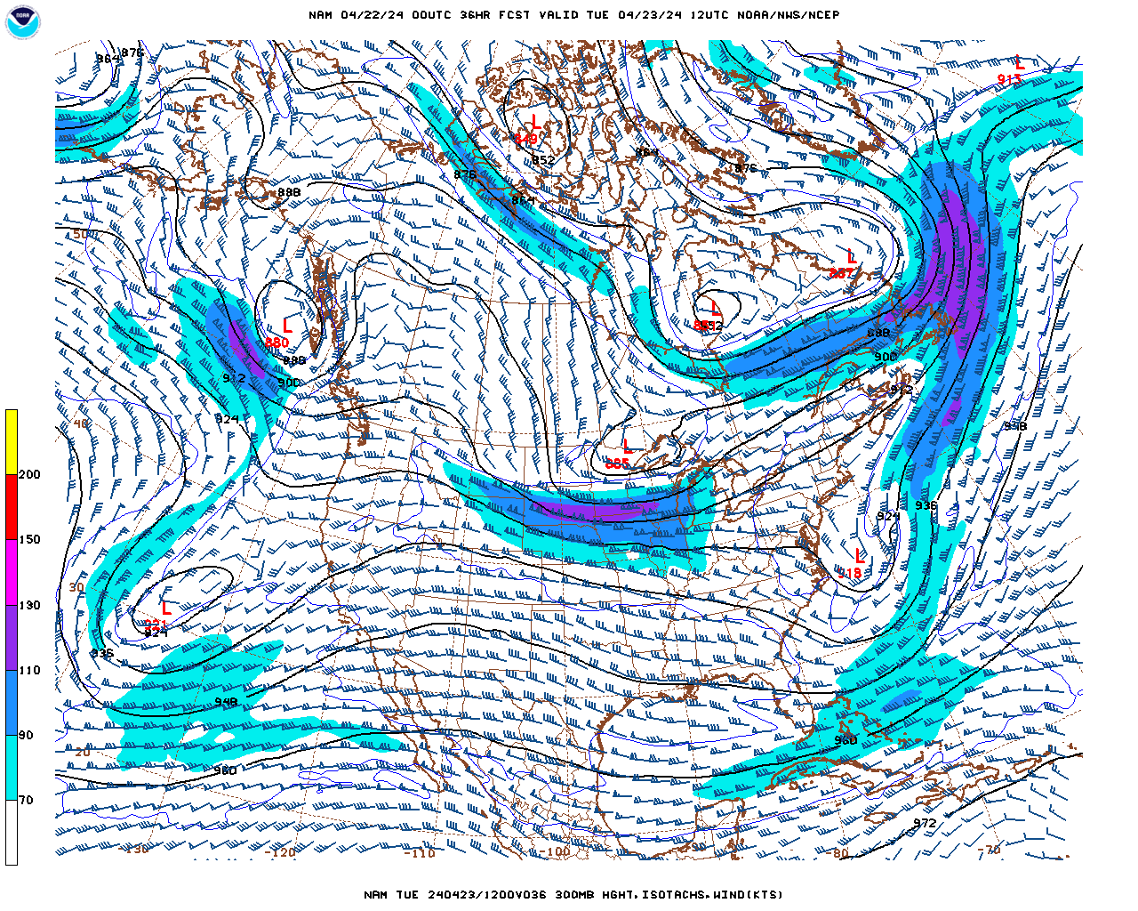
Over the next 48 hours
300 mb level
1200 UTC 23 Apr 2024

Slide 25
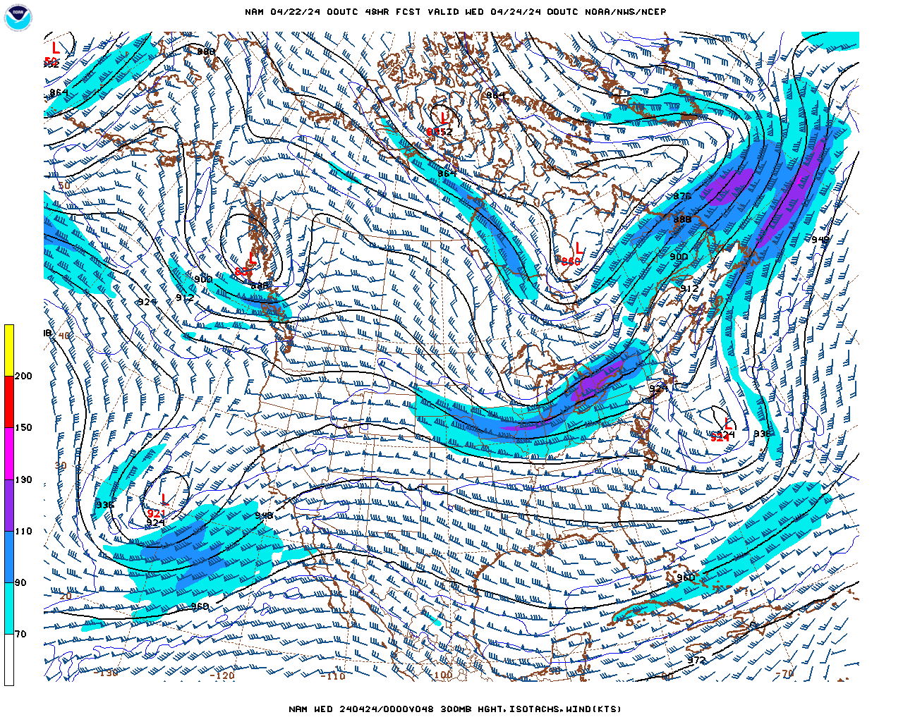
Over the next 48 hours
300 mb level
0000 UTC 24 Apr 2024

Slide 26
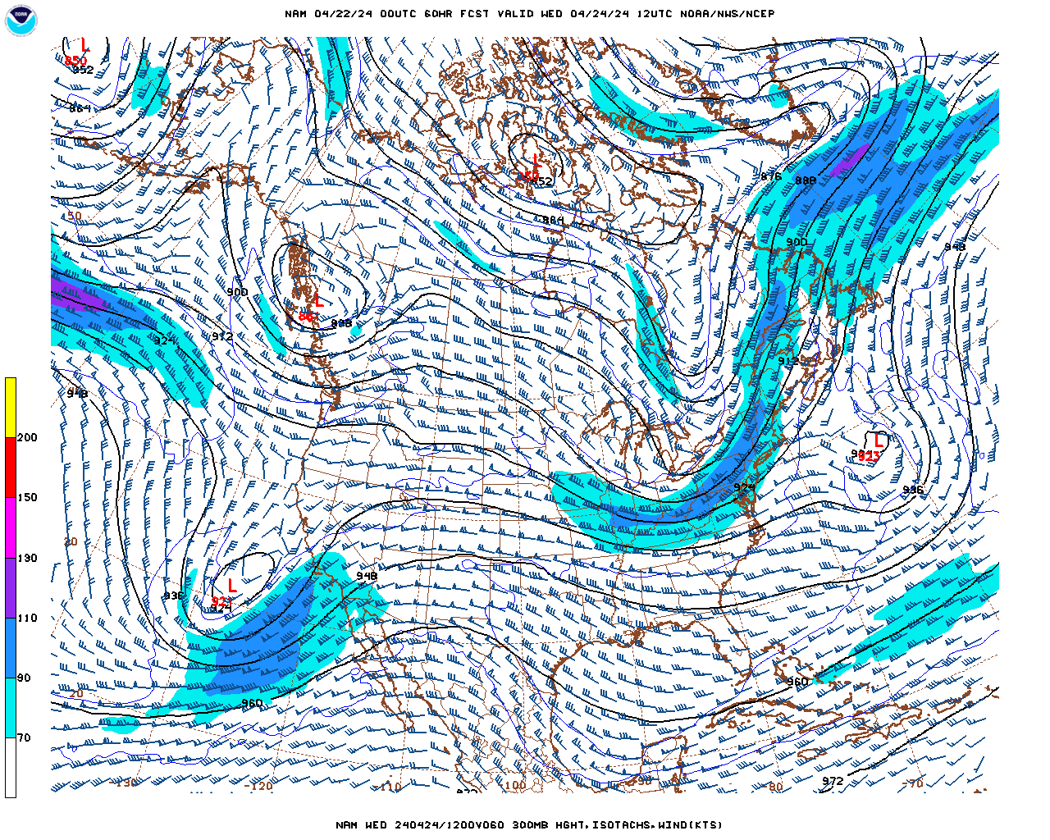
Over the next 48 hours
300 mb level
1200 UTC 24 Apr 2024

Slide 27
Forecast for Asheville, NC
Mon. (pm) – Tues. (am) [22 – 23 Apr]
Maximum Temperature = 60ºF
Minimum Temperature = 37ºF
Wind speed & direction (1800 UTC) = 10 mph from the northwest
Precipitation = 0.00 inches

Slide 28
Forecast for Asheville, NC
Tues. (pm) – Wed. (am) [23 – 24 Apr]
Maximum Temperature = 72ºF
Minimum Temperature = 47ºF
Wind speed & direction (1800 UTC) = 10 mph from the south
Precipitation = 0.00 inches

