Slide 1

Applied NWP
Why should we believe the computer weather forecast model? (D&VK, Chaps. 17-18, Kalnay Chapter 6)
http://www.zerowaste.co.nz/assets/img/Howcanwehelp/PhotoGallery/landfill.jpg

Slide 2
Applied NWP
Why should we believe the computer weather forecast model?
Before becoming operational…
  Verification
When operational…
  Validation
  Enhancement of model output
  Ensembles

Slide 3
Applied NWP
Why should we believe the computer weather forecast model?
Model errors we can’t avoid…
  Representing a continuous medium using a discrete grid
  Numerical approximation of the governing equations
Model errors we can minimize…
  Incomplete ICs and BCs
  Errors in initialization data
  Parameterization of sub-grid processes
Model errors we can eliminate…
  Improper implementation of algorithms, invalid algorithms, or programming ‘bugs’

Slide 4
Applied NWP
Why should we believe the computer weather forecast model?
Model errors we can’t avoid…
  Representing a continuous medium using a discrete grid
  Numerical approximation of the governing equations
Model errors we can minimize…
  Incomplete ICs and BCs
  Errors in initialization data
  Parameterization of sub-grid processes
Model errors we can eliminate…
  Improper implementation of algorithms, invalid algorithms, or programming ‘bugs’
  (Verification)

Slide 5
Applied NWP
Before becoming operational, Verification [17.2]
  Each sub-module is checked and tested separately
  Modeling system is verified in its entirety
  Both steps accomplished using well-established test cases that have known input and output values
  General accuracy of the model is not assessed (Validation)

Slide 6
Applied NWP
Why should we believe the computer weather forecast model?
Before becoming operational…
  Verification
When operational…
  Validation
  Enhancement of model output
  Ensembles

Slide 7
Applied NWP
Why should we believe the computer weather forecast model?
Model errors we can’t avoid…
  Representing a continuous medium using a discrete grid
  Numerical approximation of the governing equations
Model errors we can minimize…
  Incomplete ICs and BCs
  Errors in initialization data
  Parameterization of sub-grid processes
  Assessing the impact of errors we have tried to minimize (validation)

Slide 8
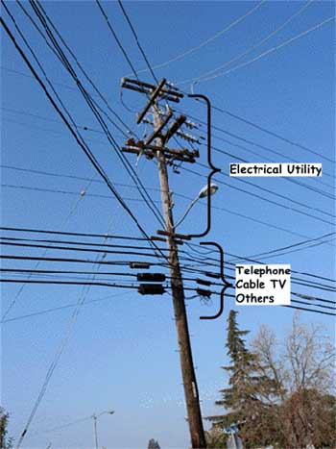
Applied NWP
Before becoming operational, Validation [17.3], assess model
  Accuracy
  Biases
  Reliability
  Skill
  Utility
http://ops.fhwa.dot.gov/publications/telecomm_handbook/images/fig8-5.jpg

Slide 9
Applied NWP
Before becoming operational, Validation [17.3], assess model
  Accuracy – difference between forecast and observed values

Slide 10
Applied NWP
Before becoming operational, Validation [17.3], assess model
  Accuracy – difference between forecast and observed values
    Contingency tables and … [17.3.2]

Slide 11
Applied NWP
Before becoming operational, Validation [17.3], assess model
  Accuracy – difference between forecast and observed values
    Contingency tables and … [17.3.2]

Slide 12
Applied NWP
Before becoming operational, Validation [17.3], assess model
  Accuracy – difference between forecast and observed values
    Skill score [17.3.3]

Slide 13
Applied NWP
Before becoming operational, Validation [17.3], assess model
  Accuracy – difference between forecast and observed values
    Reliability diagrams [17.3.4]

Slide 14
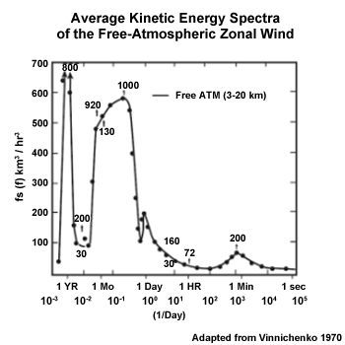
Applied NWP
Before becoming operational, Validation [17.3], assess model
  Accuracy – difference between forecast and observed values
    Kinetic-energy spectra [17.3.5]
    Model kinetic energy spectral decay is compared with the observed wave spectra at the highest resolved wave numbers in the model
http://www.meted.ucar.edu/tropical/textbook_2nd_edition/media/graphics/kinetic_energy_spectra.jpg

Slide 15
Applied NWP
Before becoming operational, Validation [17.3], assess model
  Biases – tendency of a model to over- or under-predict a variable

Slide 16
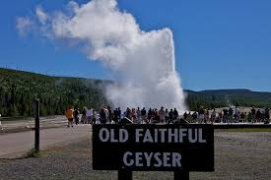
Applied NWP
Before becoming operational, Validation [17.3], assess model
  Reliability – the correlation of the forecast values to the average values for specific observed variables

Slide 17

Applied NWP
Before becoming operational, Validation [17.3], assess model
  Skill – degree of accuracy of the model compared with a forecast using baseline information (e.g., climatology)
http://images.lowes.com/product/converted/039725/039725033154lg.jpg

Slide 18
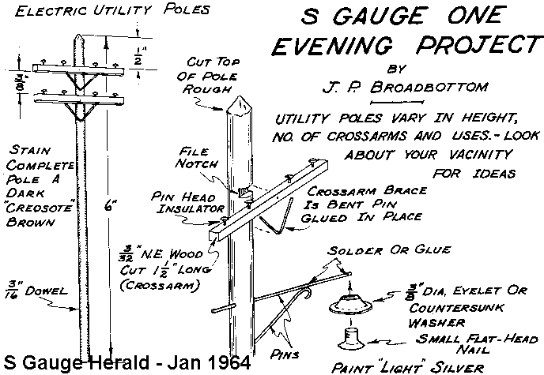
Applied NWP
Before becoming operational, Validation [17.3], assess model
  Utility – how useful a model forecast is for decision making in a specific application or industry
http://www.trainweb.org/s-trains/herald/utility_pole.gif

Slide 19
Applied NWP
Before becoming operational, Validation [17.3], assess model
  Interpretation of validation statistics [17.3.6]
    Errors of random (nonsystematic) events can mimic systematic errors

Slide 20
Applied NWP
Why should we believe the computer weather forecast model?
Before becoming operational…
  Verification
When operational…
  Validation
  Enhancement of model output
  Ensembles

Slide 21
Applied NWP
Post-processing enhancement of model output [D&VK Chap. 18]
  Perfect-prog method [18.2.1]
  Model-output statistics (MOS) [18.2.2]
  Artificial neural networks [18.2.4]
Purpose of post-processing techniques
  not all parameters of interest for a particular model user are produced by the model (e.g., reflectivity) - must be derived
  remove systematic biases and reduce error of the model

Slide 22
Applied NWP
Postprocessing enhancement of model output [D&VK Chap. 18]
  Perfect-prog(nosis) method [18.2.1]
    Uses past observations and climate data to develop a set of regression equations relating two or more meteorological variables
    It is assumed that the model output is completely accurate

Slide 23
Applied NWP
Postprocessing enhancement of model output [D&VK Chap. 18]
  Model-output statistics [18.2.2]
    MOS uses output of the model itself for the predictor values
    MOS regression equations account for model biases

Slide 24
Applied NWP
Model-output statistics approaches [18.2.2]
  Standard MOS – uses long period record as a training set with one set of calculated regression equations using a single model for the entire period
    Problems in transition months
  Dynamic MOS – uses only recent history as training set
  Regime (or stratified) MOS – uses weather regime-specific training set
  Dynamic-regime MOS – uses the regime approach to define the training days and continually recalculates the regression equation; regimes are dynamically redefined each day

Slide 25
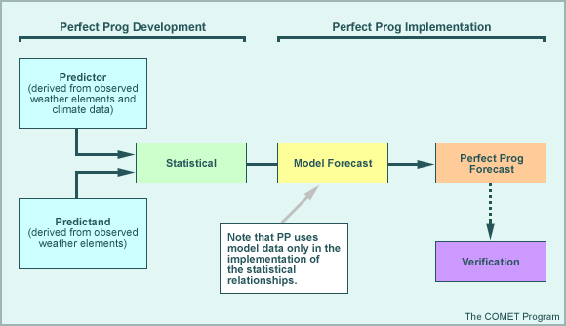
Applied NWP
http://www.met.tamu.edu/class/metr452/models/2001/output.html
Postprocessing enhancement of model output [D&VK Chap. 18]
  Comparison of perfect-prog and MOS [18.2.3]
  Perfect prog advantages
  no need to have a historical record of model forecasts
  if models improve, so will p-p forecast
  correlations between predictors and predictands tend to be high

Slide 26
Applied NWP
http://www.met.tamu.edu/class/metr452/models/2001/output.html
Postprocessing enhancement of model output [D&VK Chap. 18]
  Comparison of perfect-prog and MOS [18.2.3]
  Perfect prog disadvantages
  does not account for model biases
  cannot use model-derived parameters as predictors

Slide 27
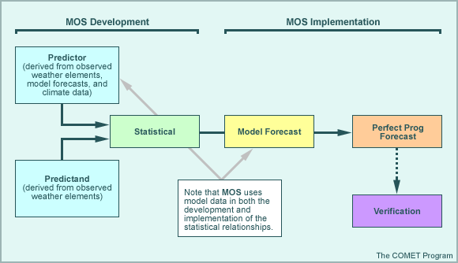
Applied NWP
http://www.met.tamu.edu/class/metr452/models/2001/output.html
Postprocessing enhancement of model output [D&VK Chap. 18]
  Comparison of perfect-prog and MOS [18.2.3]
  MOS advantages
  accounts for systematic model biases and errors
  can use model-derived parameters as predictors
  shows better skill for longer-range forecasts

Slide 28
Applied NWP
http://www.met.tamu.edu/class/metr452/models/2001/output.html
Postprocessing enhancement of model output [D&VK Chap. 18]
  Comparison of perfect-prog and MOS [18.2.3]
  MOS disadvantages
  requires a long period of historical model data
  any changes in the model require new regression equations to be developed
  relationship between predictors and predictand weaken with time as the model error increases

Slide 29
Applied NWP
Why should we believe the computer weather forecast model?
Before becoming operational…
  Verification
When operational…
  Validation
  Enhancement of model output
  Ensembles

Slide 30
Applied NWP
Why should we believe the computer weather forecast model?
Model errors we can’t avoid…
  Representing a continuous medium using a discrete grid
  Numerical approximation of the governing equations
Model errors we can minimize…
  Incomplete ICs and BCs
  Errors in initialization data
  Parameterization of sub-grid processes
  Assessing the impact of errors we have tried to minimize (ensembles)

Slide 31
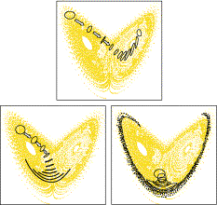
Applied NWP
We’re going to examine the repercussions of something called the “strange attractor”…(Kalnay Chapter 6)
http://www.ecmwf.int/research/predictability/background/Lorenz.html
Online site: http://www.meted.ucar.edu/nwp/pcu1/ensemble_webcast/
Online site: http://www.meted.ucar.edu/nwp/pcu1/ensemble/index.htm
Online site:http://www.ecmwf.int/sites/default/files/Chaos%20and%20weather%20prediction.pdf

Slide 32
Applied NWP
REVIEW…
Data assimilation
  Combine a first guess at each model grid point (e.g. “old” model forecast) with observations to create a new estimate of the structure of the atmosphere
Model simulation
  Use the new estimate of the structure of the atmosphere to initialize our computer weather forecast model
Create meaningful forecast products (model post-processing)
  Convert model output into forecasts useful to customers

Slide 33
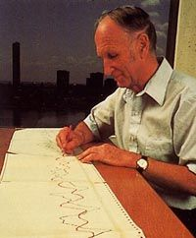

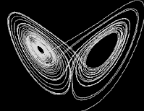
Applied NWP
BACKGROUND
An accidental discovery...and a coffee cup is involved…
  Ran a simple computer weather model, got a forecast (fcst1)
  Re-ran portion of integration
  Coffee break
  New forecast was completely different from the original forecast, fcst1
Edward Lorenz
http://en.wikipedia.org/wiki/Edward_Lorenz
“Initial round-off errors were the culprit”
http://www.exploratorium.edu/complexity/CompLexicon/lorenz.html
TRY THIS→ http://www.exploratorium.edu/complexity/java/lorenz.html

Slide 34


Applied NWP
BACKGROUND
Read Ray Bradbury’s A Sound of Thunder for the first mention of the “butterfly effect”
http://www.vision.caltech.edu/feifeili/101_ObjectCategories/butterfly/
http://en.wikipedia.org/wiki/Image:Raybradbury.gif

Slide 35
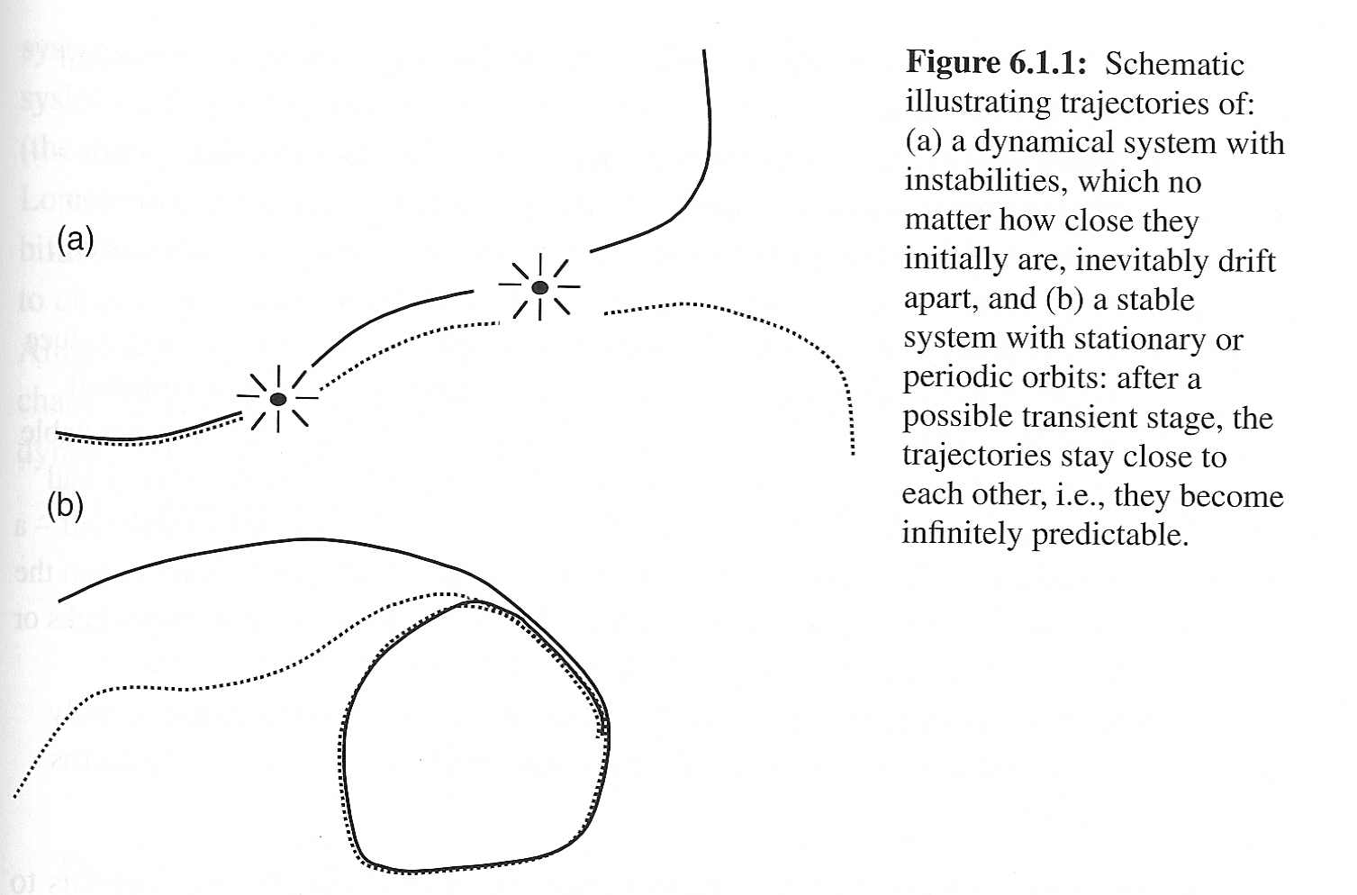

Applied NWP
Fundamental theorem of predictability
  Unstable systems (a) have a finite limit of predictability, and conversely, stable systems (b) are infinitely predictable
Kalnay (2003)
http://www.gumballs.com/vortex.html

Slide 36
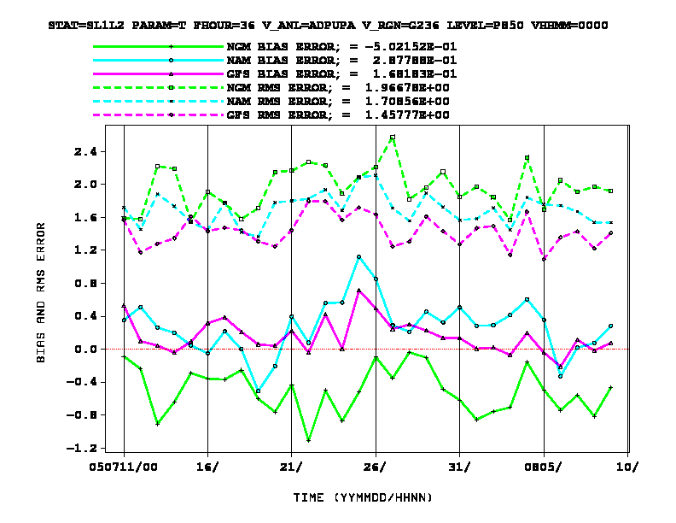
Applied NWP
Fundamental theorem of predictability; as a result…
  Even if the computer weather forecast model is perfect, and even if the initial conditions are known almost perfectly, the atmosphere has a finite limit of predictability
http://wwwt.emc.ncep.noaa.gov/mmb/mmbpll/mmbverif/

Slide 37
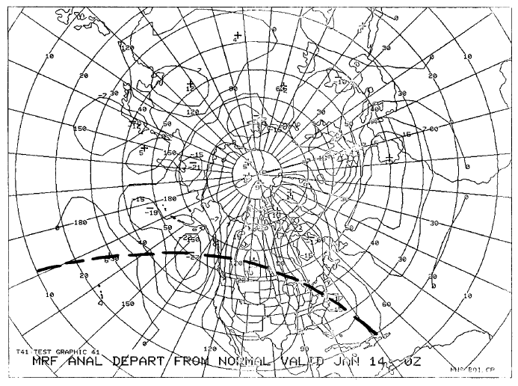
Applied NWP
Fundamental theorem of predictability; implications
  Small errors in the coarser (resolvable) structure of the weather pattern tend to double in about 2-3 days
http://www.nws.noaa.gov/im/pub/wrta8604.pdf

Slide 38
Applied NWP
Fundamental theorem of predictability; implications
  Small errors in the coarser structure;
    Every time we cut obs error in half, we extend the range of acceptable prediction by three days
    Could make good forecasts several weeks in advance
http://www.nws.noaa.gov/im/pub/wrta8604.pdf

Slide 39
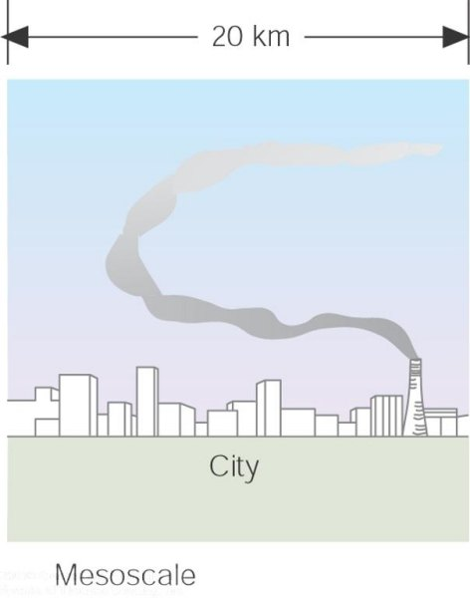
Applied NWP
Fundamental theorem of predictability; implications
  Small errors in the finer (unresolvable) structure of the weather pattern tend to double in hours or less
Ahrens (2005)

Slide 40
Applied NWP
Fundamental theorem of predictability; implications
  Small errors in the finer structure;
    Wouldn’t alone be cause for reduction in hopes of extended-range forecasting
    We do not forecast the finer structure at all
Ahrens (2005)

Slide 41
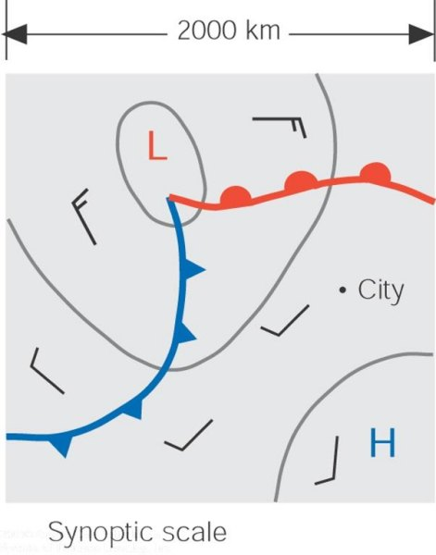
Applied NWP
Fundamental theorem of predictability; implications
  Errors in the finer structure of the weather pattern tend to produce errors in the coarser structure
    After a day or so, coarser structure will have appreciable error
Ahrens (2005)

Slide 42
Applied NWP
Fundamental theorem of predictability; implications
  Errors in the finer structure of the weather pattern tend to produce errors in the coarser structure
    This appreciable error in the coarse structure will grow and inhibit extended range forecasting
Ahrens (2005)

Slide 43
Applied NWP
Fundamental theorem of predictability; implications
  Errors in the finer structure of the weather pattern tend to produce errors in the coarser structure
    Cutting obs error of fine structure in half would extend coarse structure forecasts only by hours or less
Ahrens (2005)
hopes for predicting two weeks or more in advance are greatly diminished.

Slide 44
Applied NWP
Fundamental theorem of predictability; implications
  Certain meteorological quantities (e.g. weekly ave. temperatures or weekly total rainfall) may be predictable at a range at which entire weather patterns are not
http://wwwt.emc.ncep.noaa.gov/mmb/mmbpll/mmbverif/

Slide 45
Applied NWP
(stable)
Predictable state
  small errors in the starting conditions will not affect the forecast
Less predictable state
  the points stay together only for a limited time before diverging
(unstable)
Unpredictable state
  have little confidence in the outcome even a short period ahead
http://www.ecmwf.int/research/predictability/background/Lorenz.html

Slide 46
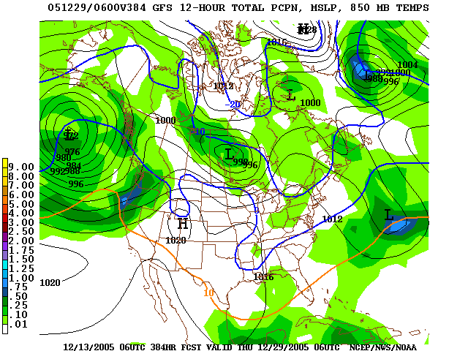
Applied NWP
Ensemble forecasting
  Forecast skill depends on
    Accuracy of initial conditions
    Realism of the model
    Instabilities of the flow itself
http://www.nco.ncep.noaa.gov/pmb/nwprod/analysis/
A result of all three components will inevitably lead to a total loss of skill in the weather forecasts after a finite forecast length [limit of predictability]. Lorenz estimated the limit of predictability to be two weeks; varies by atmospheric flow [weather regime] type.

Slide 47
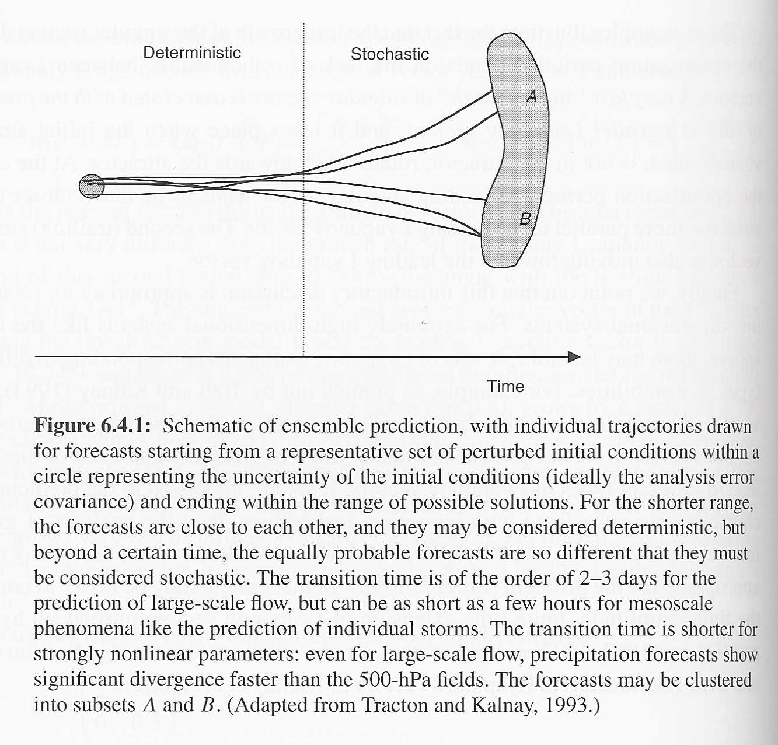
Applied NWP
Stochastic forecast
  Trajectories from several sets of similar initial conditions diverge
Deterministic forecast
  Trajectories from several sets of similar initial conditions follow each other
Kalnay (2003)

Slide 48
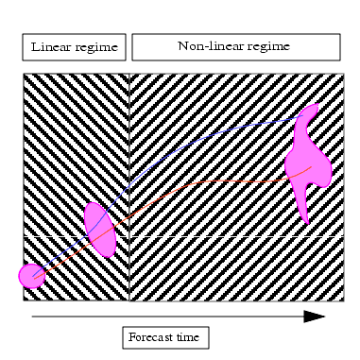
Applied NWP
Non-linear regime
  Trajectories from several sets of similar initial conditions diverge
Linear regime
  Trajectories from several sets of similar initial conditions follow each other
ECMWF
http://www.ecmwf.int/newsevents/training/rcourse_notes/GENERAL_CIRCULATION/CHAOS/Chaos2.html

Slide 49
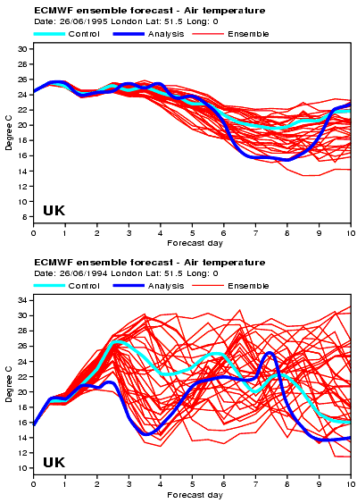
Applied NWP
Operational NWP needs to account for the stochastic nature of the evolution of the atmosphere
ECMWF
http://www.ecmwf.int/newsevents/training/rcourse_notes/GENERAL_CIRCULATION/CHAOS/Chaos3.html

Slide 50
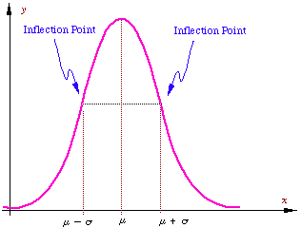

Applied NWP
Ensemble forecasting; stochastic-dynamic forcing [Epstein (1969)]
  First forecasting method attempted to account for uncertainty in atmospheric fields
  Based on continuity equation for the probability density of a model solution of a dynamical model
  Completely unfeasible for a modern model, having millions of degrees of freedom
f(x) =
http://people.hofstra.edu/faculty/Stefan_Waner/cprob/cprob2.html

Slide 51
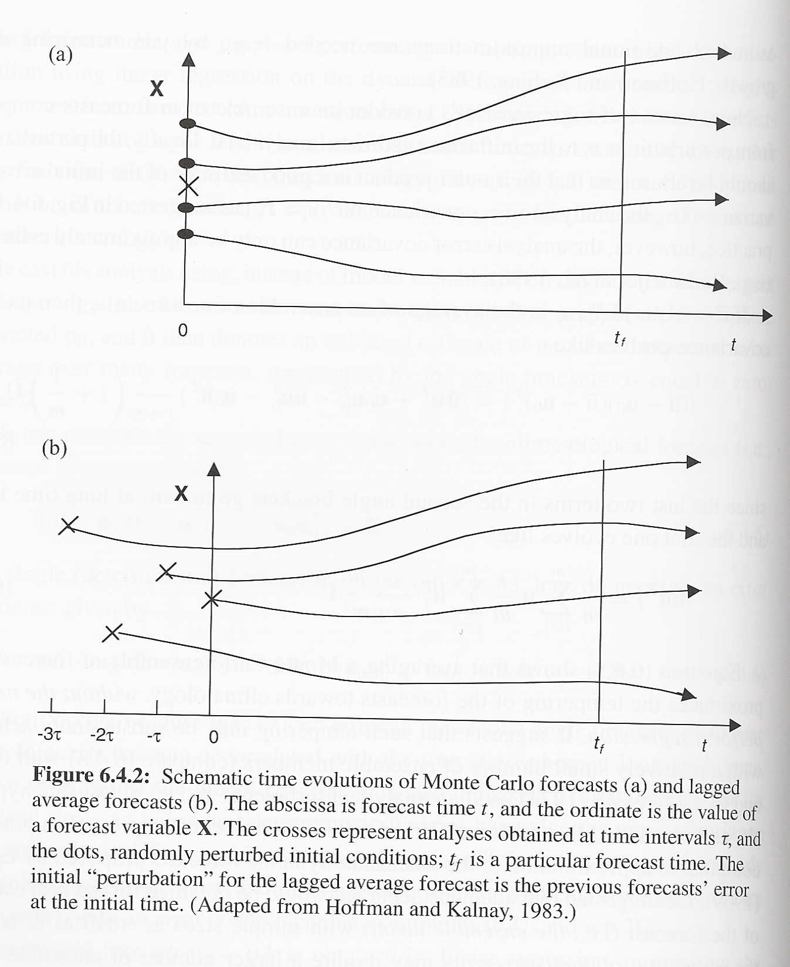
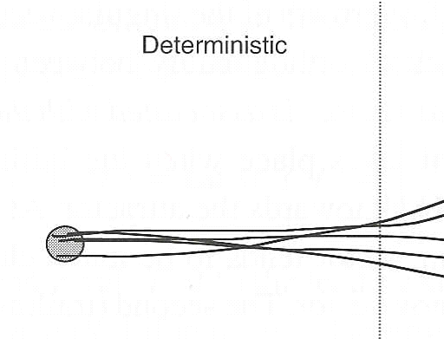
Applied NWP
Ensemble forecasting; Monte Carlo forecasting [Leith (1974)]
  Initializes deviation of model variables from climatology
  Perturbs deviations randomly about climatology so that the initial conditions of all the members is “reasonable”
  Adequate accuracy from 8 to ∞ ensemble members
Kalnay (2003)

Slide 52
Applied NWP
Kalnay (2003)
Ensemble forecasting; Lagged average forecasting [Hoffman and Kalnay (1983)]
  Forecasts initialized at the current initial time as well as previous times are combined to form an ensemble
  Paremeterized the observed error (covariance) growth to account for using members of different “age”

Slide 53
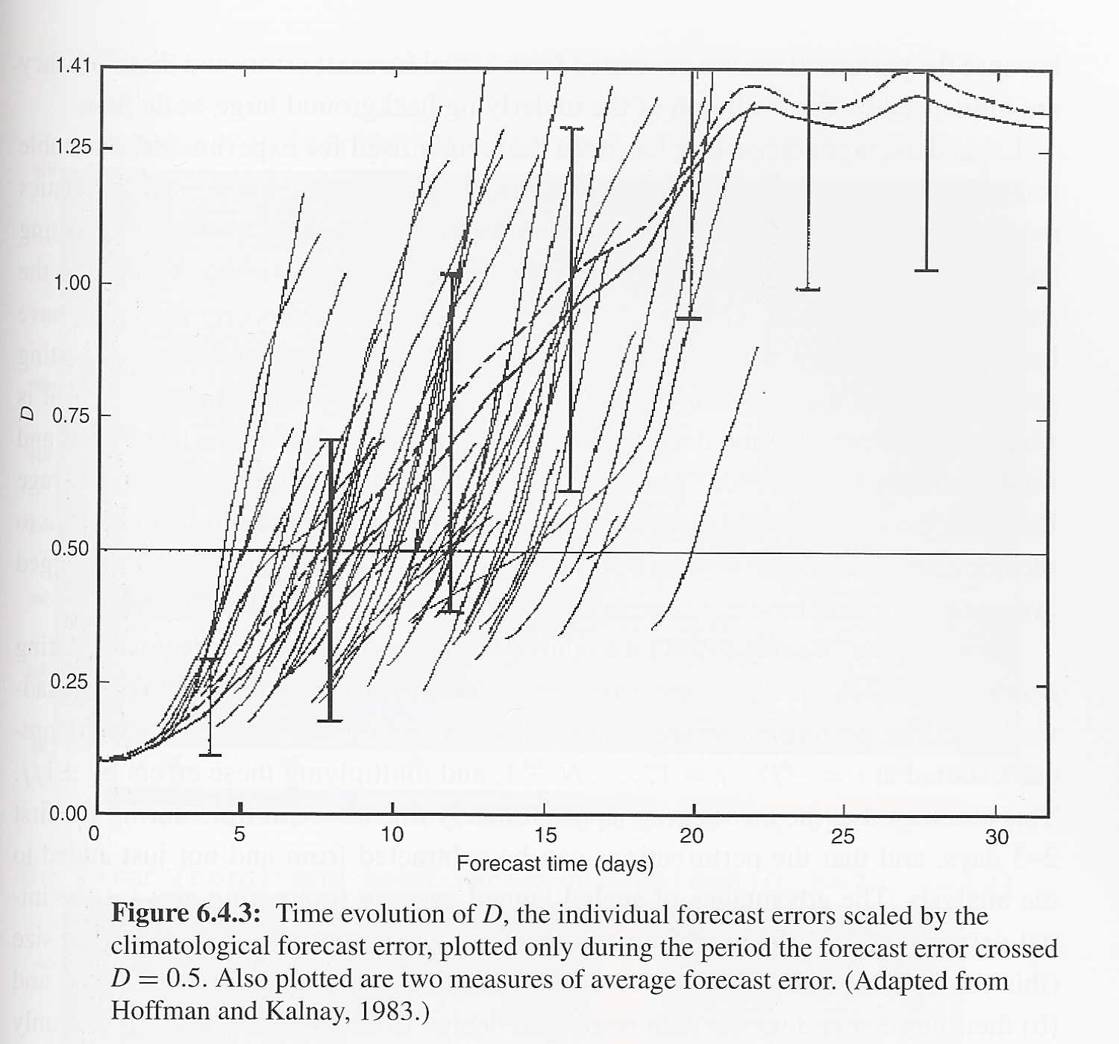
Applied NWP
Ensemble forecasting; Lagged average forecasting [(continued)]
  Experiment
    Primitive equations model = nature (truth)
    Quasi-geostrophic model = forecast model (guess)
  Findings
    Slow initial error growth
    Rapid growth- takes place at a time that varies from 5 to 20 days
Kalnay (2003)

Slide 54
Applied NWP
Ensemble forecasting; Lagged average forecasting [(continued)]
  Findings (cont.)
    Lagged Average Forecast (LAF) method was better than Monte Carlo method for predicting forecast skill
    Superiority linked to LAF perturbations in the initial conditions containing “errors of the day” [influenced by the evolution of the underlying background large-scale flow]

Slide 55
Applied NWP
Ensemble forecasting; Lagged average forecasting [(continued)]
  Advantages
    Easily implemented in operational centers
    Simple to perform; perturbation generation is straightforward
    Perturbations contain “errors of the day” (Lyapunov vectors)
  Disadvantages
    A large LAF ensemble would have to include VERY old forecasts
    Without weighing more recent forecasts more heavily, the LAF ensemble average may be tainted by the VERY old forecasts

Slide 56
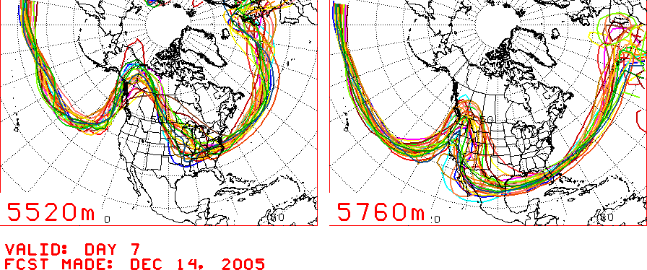
Applied NWP
Operational ensemble forecasting methods
http://www.cpc.ncep.noaa.gov/products/predictions/threats/briefs/hgtP1.html

Slide 57
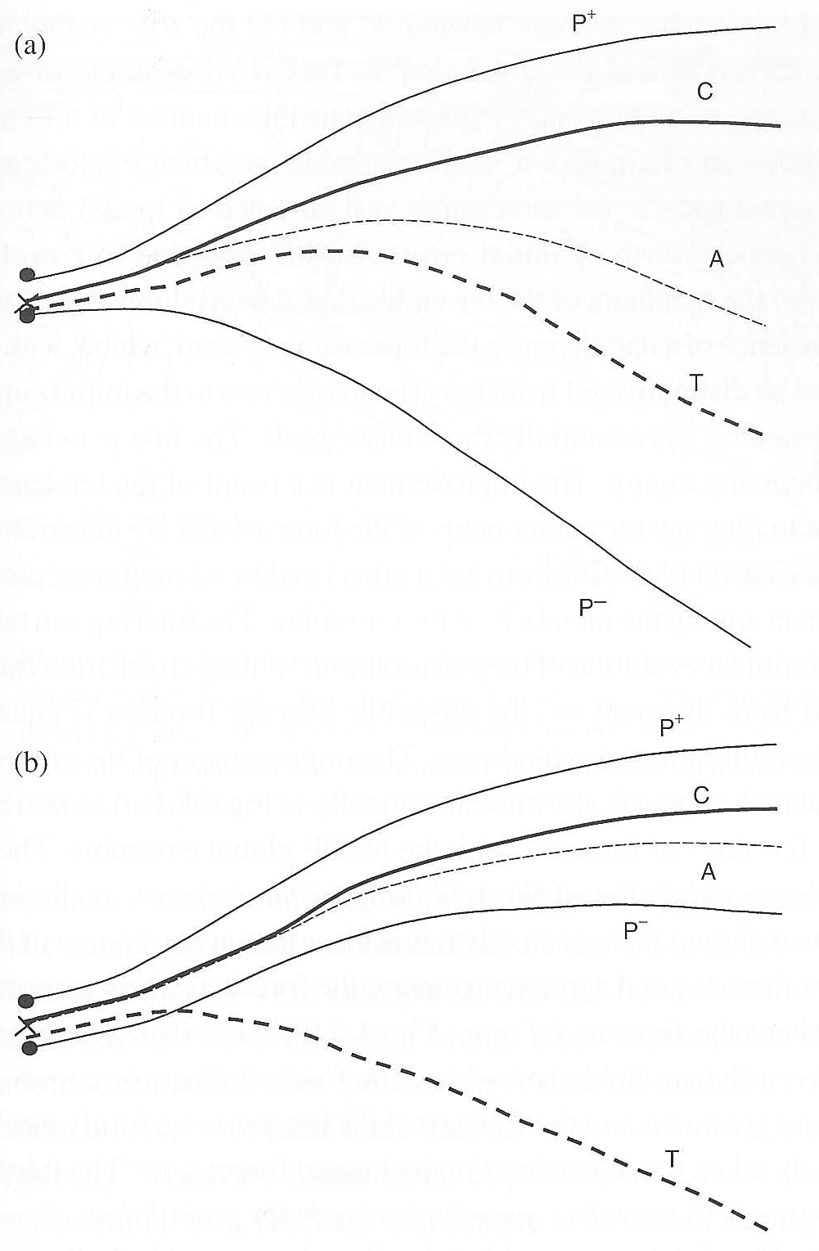
Applied NWP
Operational ensemble forecasting methods; some examples
  “good” ensemble
    True evolution (T) is a plausible member of the ensemble since its trajectory falls between the trajectories of the extreme members (P+ and P-)
Kalnay (2003)

Slide 58
Applied NWP
Operational ensemble forecasting methods; some examples (cont.)
  “bad” ensemble
    True evolution (T) is NOT a plausible member of the ensemble since its trajectory falls outside the trajectories of the extreme members (P+ and P-)
Kalnay (2003)

Slide 59
Applied NWP
Operational ensemble forecasting methods; some examples (cont.)
  “bad” ensemble
    Suggests problems in the forecasting system (e.g., model physics deficiencies)
    Forecast errors are dominated by forecast problems rather than by chaotic growth of initial errors

Slide 60
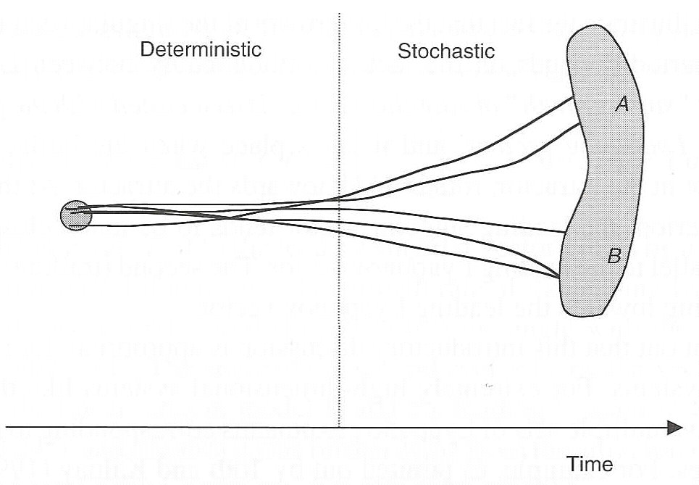
Applied NWP
Kalnay (2003)
Goals of ensemble forecasting;
  improve the forecast by ensemble averaging
  provide an indication of the reliability of the forecast
  provide a quantitative basis for probabilistic forecasting
Example
40% probability of cluster A
60% probability of cluster B

Slide 61
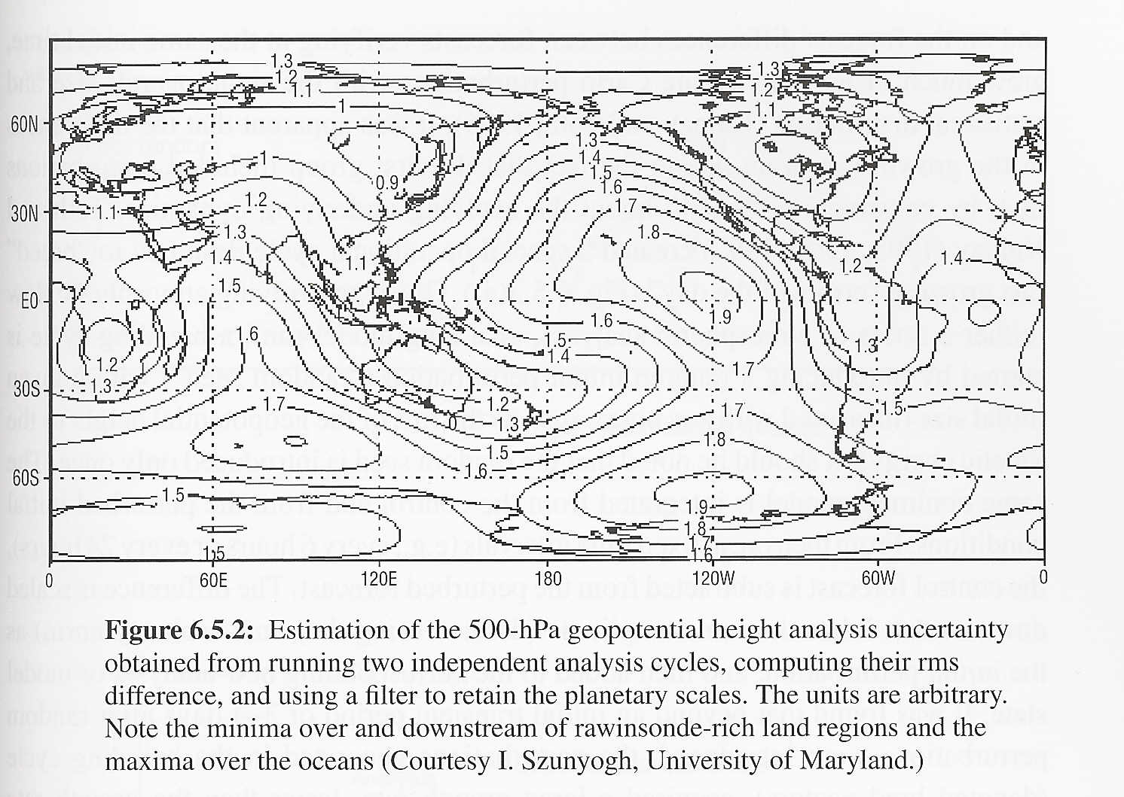
Applied NWP
Ensemble forecast system, how to perturb the initial conditions?
  Where to perturb*
    Horizontal structure
    Vertical structure
  Amplitude*
    Depends on distribution of the observations
Kalnay (2003)
*Perturbation position and amplitude is determined by how confident we feel in our “guess” of the atmospheric structure.

Slide 62
Applied NWP
*Perturbation position and amplitude is determined by how confident we feel in our “guess” of the atmospheric structure.
Our analysis error is estimated from the analysis error covariance (matrix B in LP #8)
  Accuracy of statistical assumptions
  RMS differences between independent analysis cycles

Slide 63
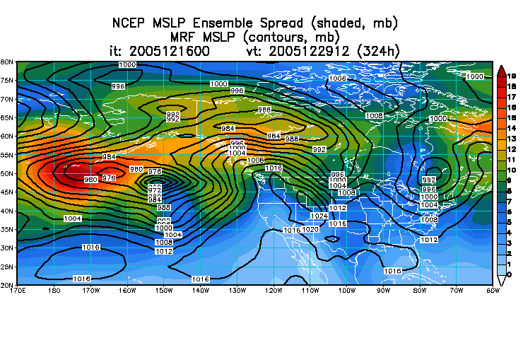
Applied NWP
Ensemble forecast systems, differ mostly in the ways that the initial perturbations (IPs) are generated, two classes;
  random (Monte Carlo)
  depend on dynamics of underlying flow
http://www.emc.ncep.noaa.gov/gmb/ens/targ/hgtmenu.html

Slide 64
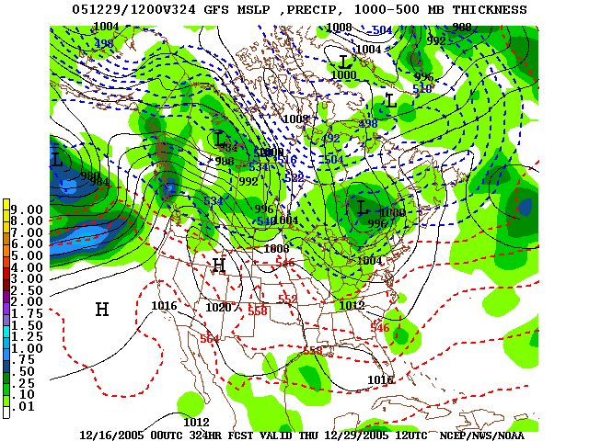
Applied NWP
Ensemble forecast systems, random (Monte Carlo)
  IP amplitudes chosen to be compatible with average estimated analysis error
  IP positions are chosen randomly
http://www.nco.ncep.noaa.gov/pmb/nwprod/analysis/

Slide 65
Applied NWP
Ensemble forecast systems, random (Monte Carlo)
  Studies suggest that random initial perturbations do not grow as fast as the real analysis errors
http://www.nco.ncep.noaa.gov/pmb/nwprod/analysis/

Slide 66
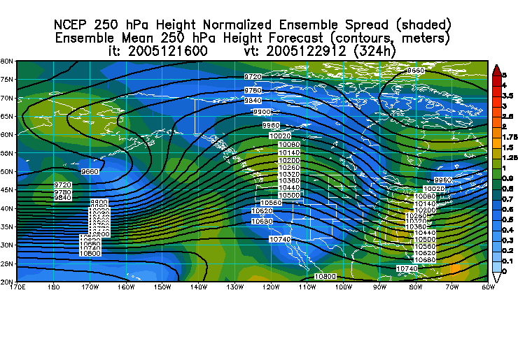
Applied NWP
Ensemble forecast systems, depend on dynamics of underlying flow
  “breeding”
  “singular vector”
http://www.emc.ncep.noaa.gov/gmb/ens/targ/hgtmenu.html

Slide 67
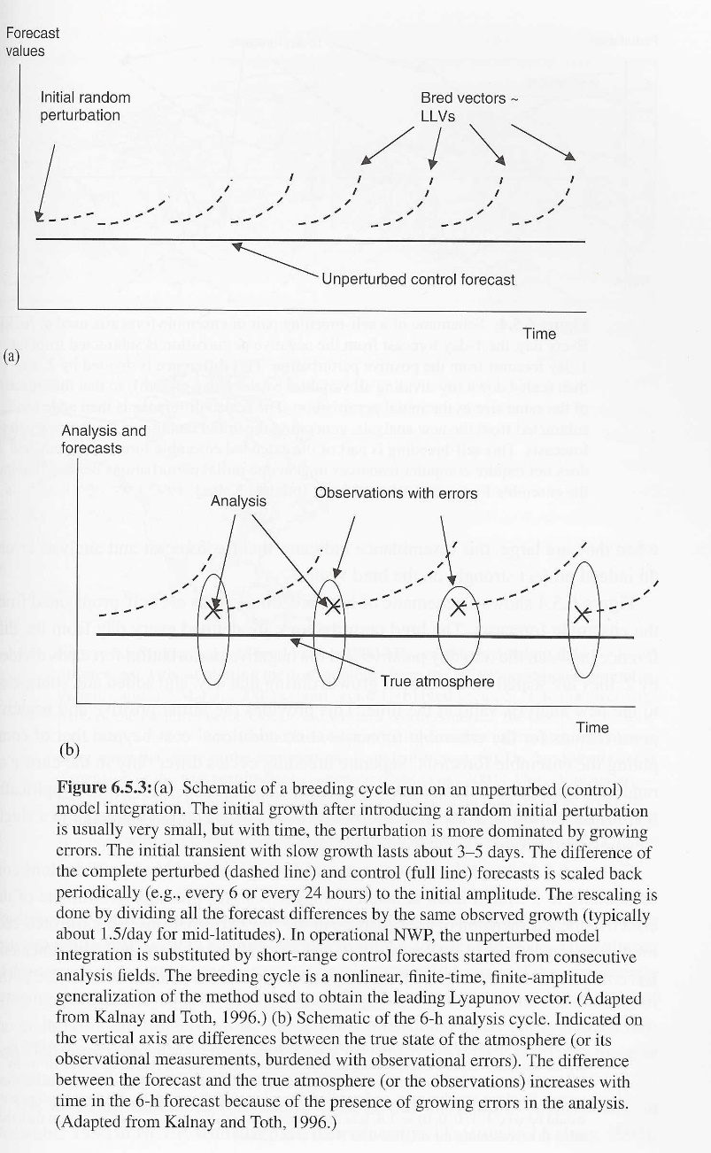
Applied NWP
Kalnay (2003)
Operational ensemble forecasting methods; breeding
  Start with a random initial perturbation
  Run control and perturbed forecasts
  Subtract the control from the perturbed forecast at fixed time intervals
  Scale difference and add to the corresponding new analysis

Slide 68
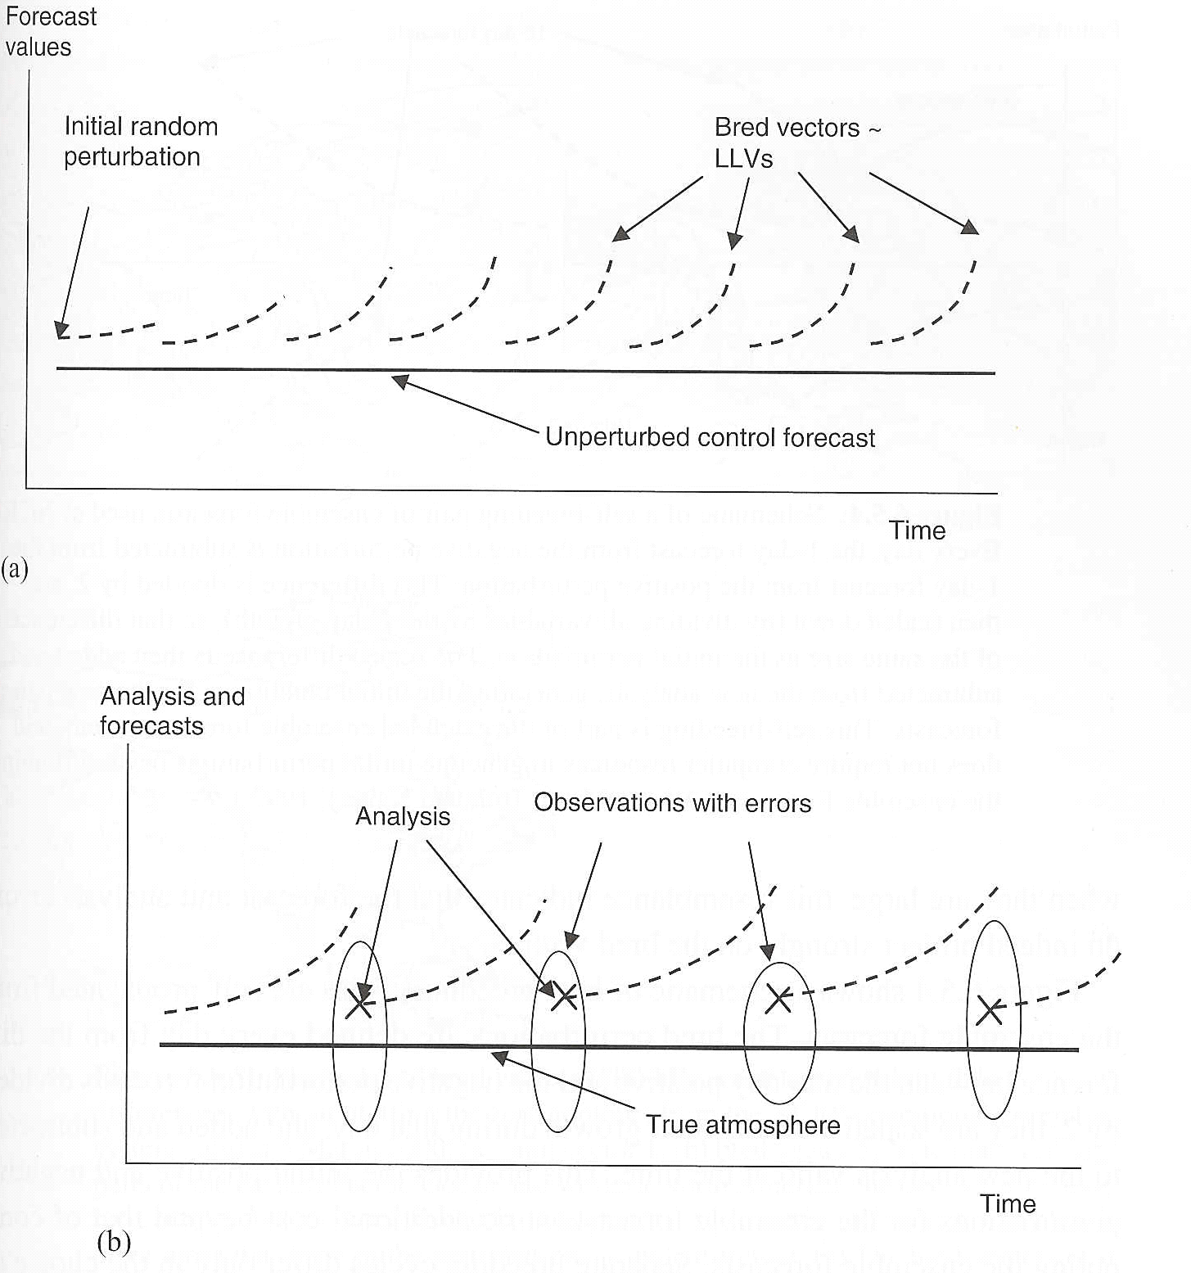
Applied NWP
Operational ensemble forecasting methods; breeding, after transient period (3-4 days), perturbations…
  generated in breeding cycle (bred vectors) acquired a large growth rate
  did not depend on the norm or on the scaling period
norm
scaling period

Slide 69
Applied NWP
Operational ensemble forecasting methods; breeding
  a nonlinear, finite-time, finite-amplitude generalization of the method used to obtain the leading Lyapunov vector
  similar to the analysis cycle

Slide 70
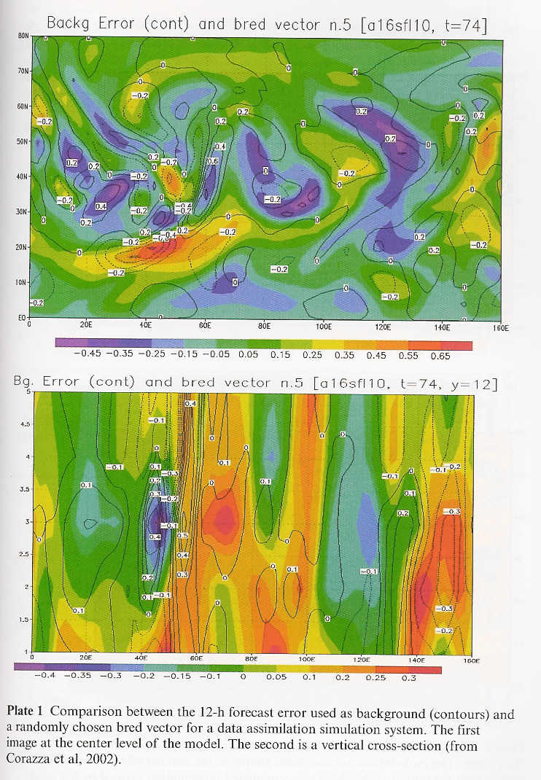
Applied NWP
Kalnay (2003)
Operational ensemble forecasting methods; breeding; similar to the analysis cycle
  Strong resemblance between the structure of the errors of the forecast used as a first guess (contours) and the bred vectors (shading)

Slide 71
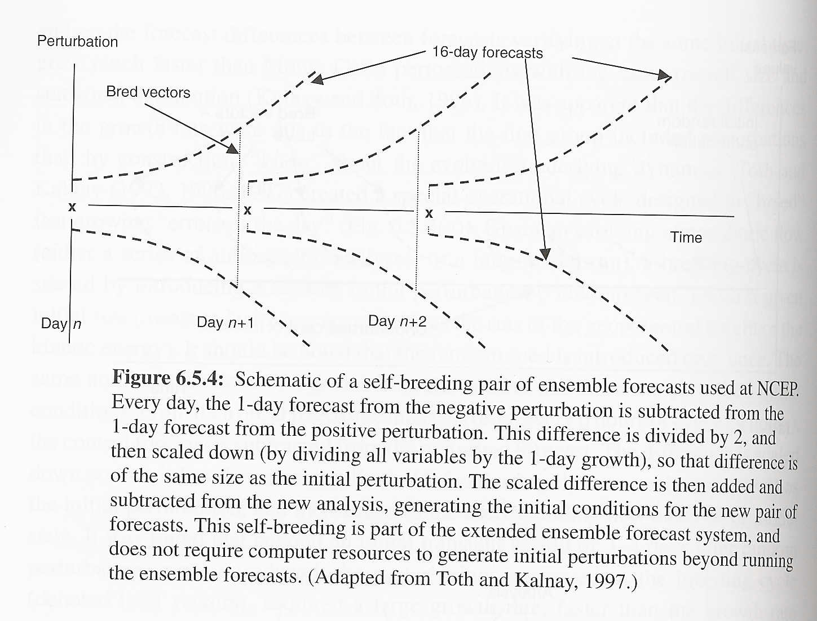
Applied NWP
Kalnay (2003)
Operational ensemble forecasting methods; breeding- a schematic
  bred perturbations are defined every day
    difference between the one-day + and the – perturbation forecasts divided by 2
    scaled down
    added and subtracted to the new analysis valid at the time
Finite amplitude bred vectors do not converge to a single “leading bred vector”.

Slide 72
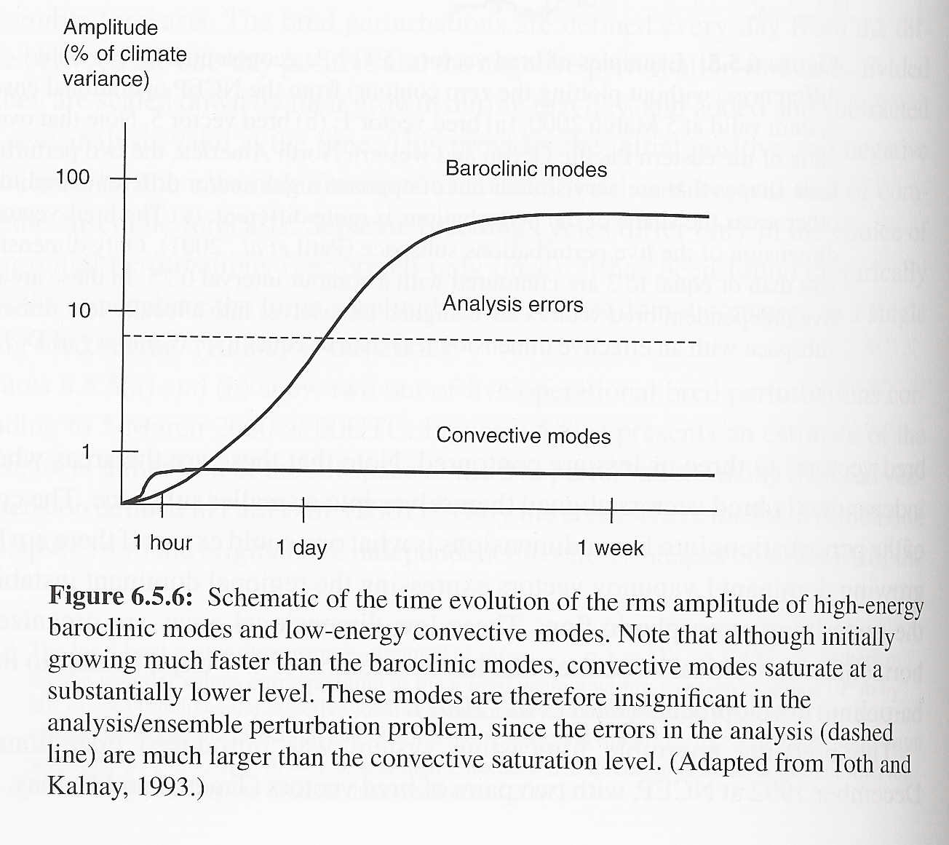
Applied NWP
Operational ensemble forecasting methods; breeding- findings
  bred vectors developed quickly in strong baroclinic areas
    Saturate at levels above typical analysis error magnitudes
  bred vectors developed very quickly in regions of convective instabilities
    Saturate at levels below typical analysis error magnitudes
Kalnay (2003)

Slide 73
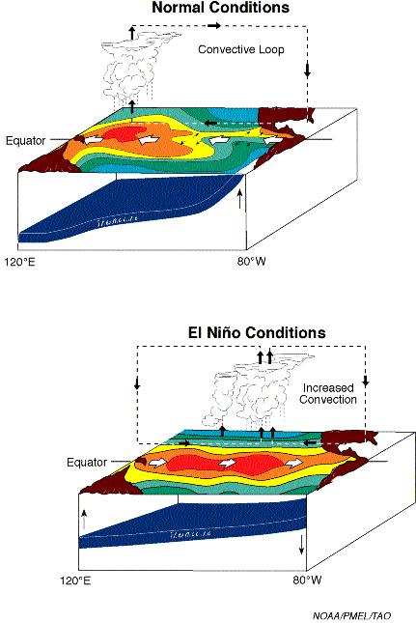
Applied NWP
Operational ensemble forecasting methods; breeding- advantages
  filters irrelevant instabilities
  could be used for seasonal and interannual forecasting to capture slower growing large amplitude instabilities (e.g. El Niño) in a coupled ocean-atmosphere model
http://www.pmel.noaa.gov/tao/elnino/gif/ElNino.gif

Slide 74
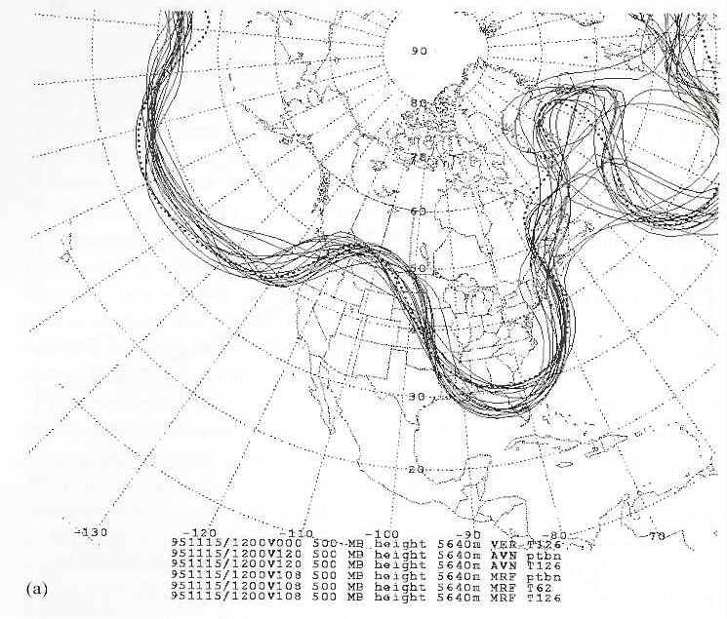
Applied NWP
Kalnay (2003)
Operational ensemble forecasting methods; breeding- an example
  500 mb “spaghetti” plot
    Predictable snowstorm
November 15, 1995

Slide 75
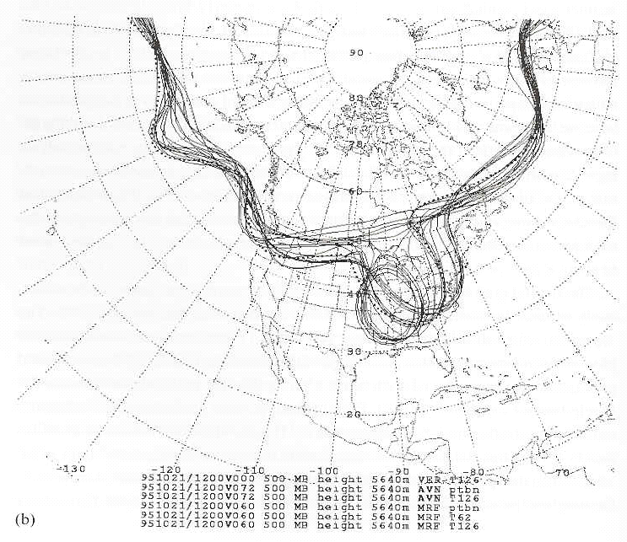
Applied NWP
Kalnay (2003)
Operational ensemble forecasting methods; breeding- an example
  500 mb “spaghetti” plot
    Divergence in ensemble members – less predictable situation
    Potential value for targeted observations
    Find area that originated this region of uncertainty – launch new observations in area
October 21, 1995

Slide 76
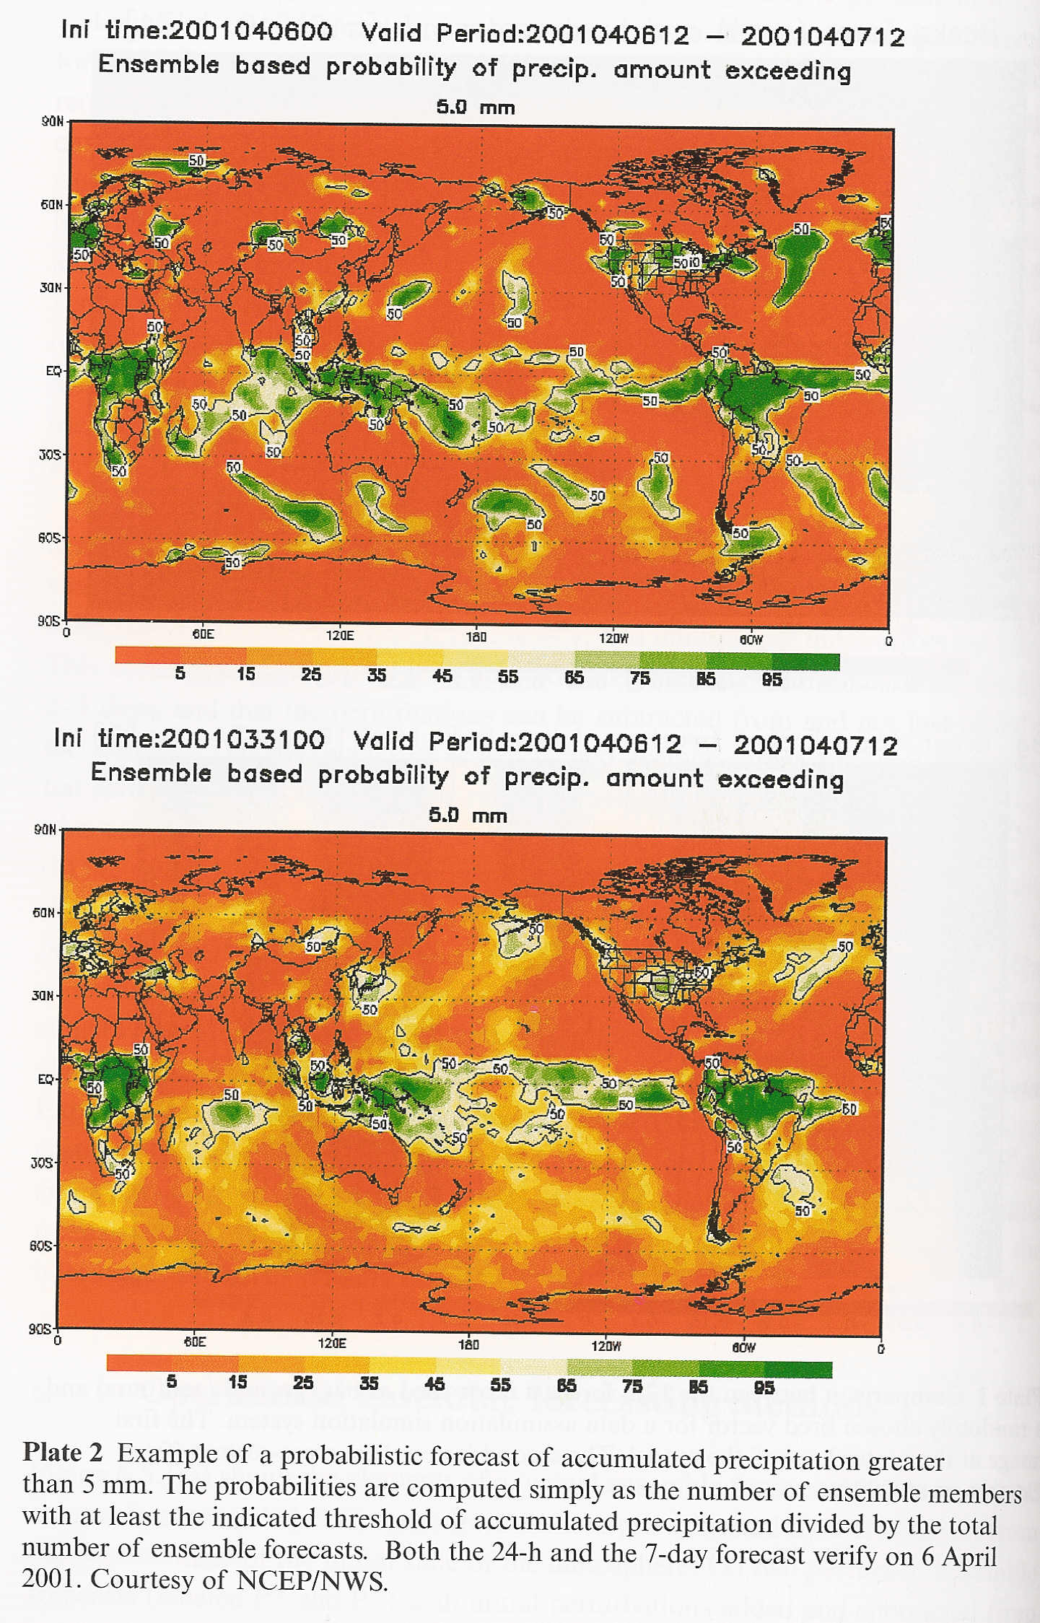
Applied NWP
Kalnay (2003)
Operational ensemble forecasting methods; breeding- an example
  Probabilistic forecast of precipitation exceeding 5 mm over a 24-h period
  Percentage of ensemble members exceeding the accumulated precipitation threshold
1 Day Fcst
7 Day Fcst

Slide 77
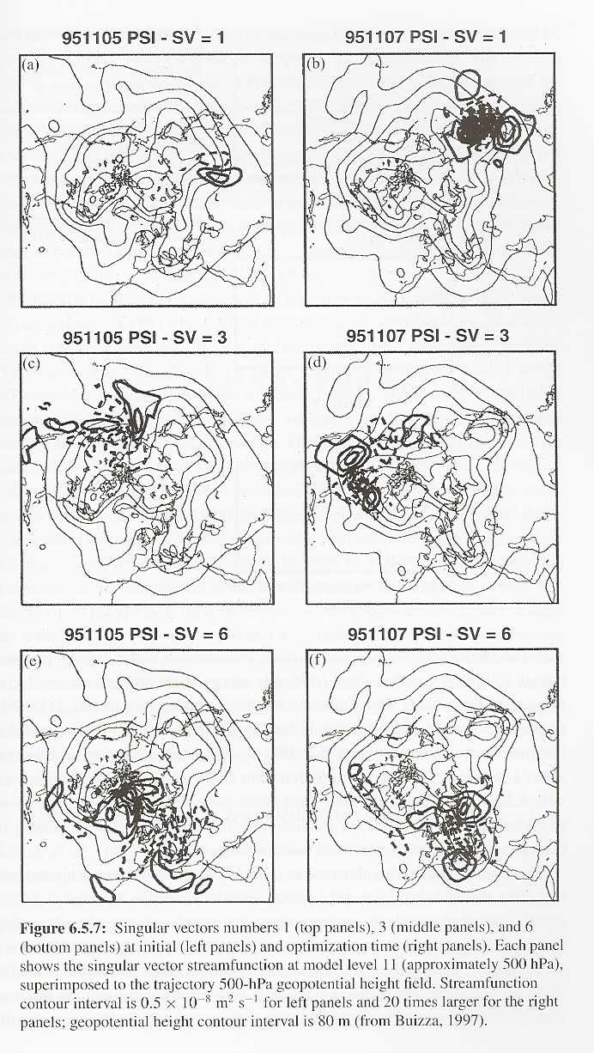
Applied NWP
Kalnay (2003)
Operational ensemble forecasting methods; singular vectors
  Implemented by ECMWF in Dec 1992
    Initial singular vectors are the perturbations with maximum energy growth north of 30ºN, for the time interval 0-48 h
    Requires forward TLM (L) integration for 48 h and backward with LT (adjoint model)
    Forward-backward integration performed three times # of desired singular vectors
      3 x 48 x 2 x 38 [for 38 singular vectors] = total # of daily integrations

Slide 78
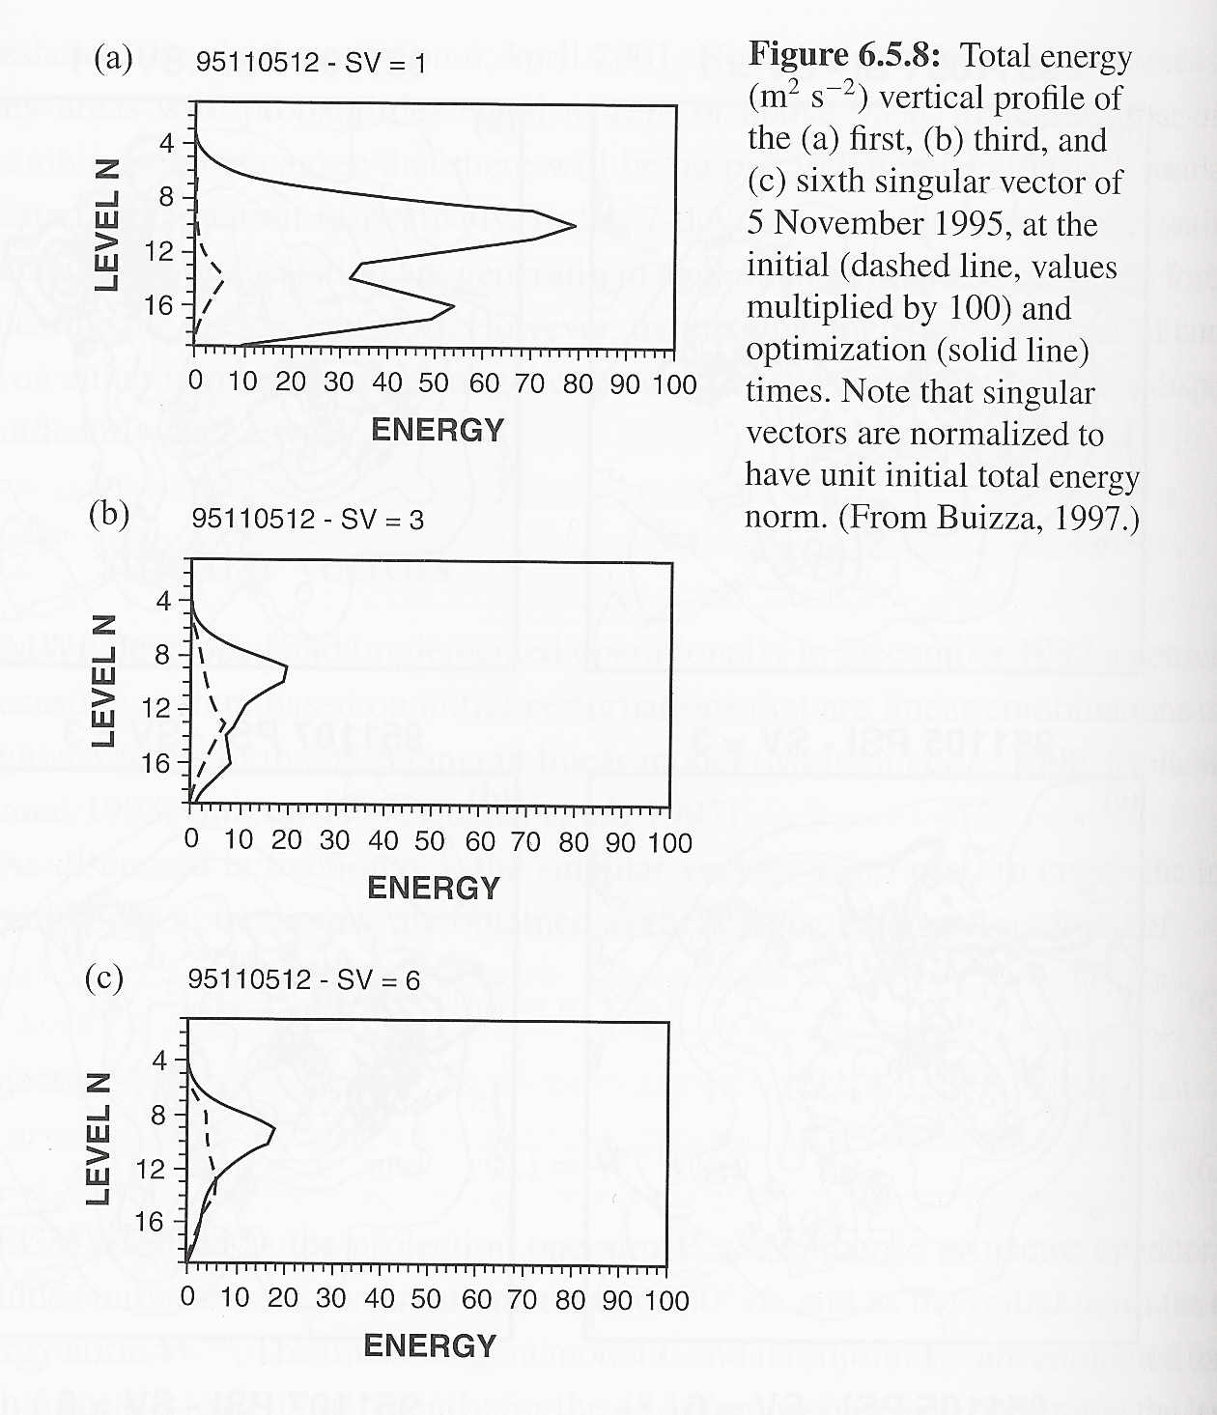
Applied NWP
Kalnay (2003)
Operational ensemble forecasting methods; singular vectors; ECMWF (cont.)
  a maximum in initial energy (dashed) exists at ~ 700 hPa
  final (evolved, solid) energy maximum exists at the tropopause level

Slide 79
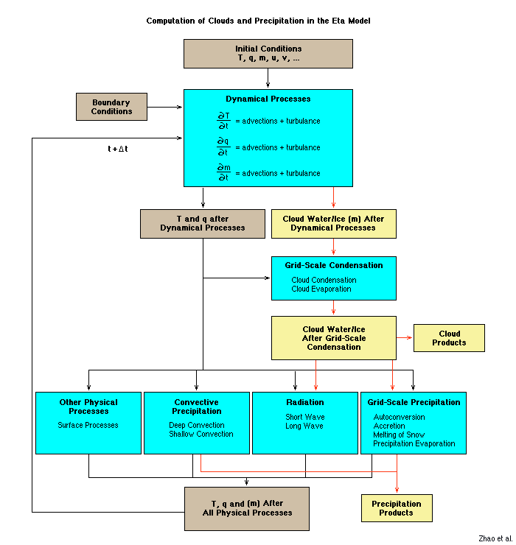
Applied NWP
http://www.comet.ucar.edu/nwplessons/etalesson2/etaphysicsbackground.htm
Operational ensemble forecasting methods; randomness in model physics
  Accounts for deficiencies in model physics
  Time derivatives of physical parameterizations are multiplied by Gaussian random numbers
  Increased ensemble spread to levels similar to those of the control simulation forecast error

Slide 80
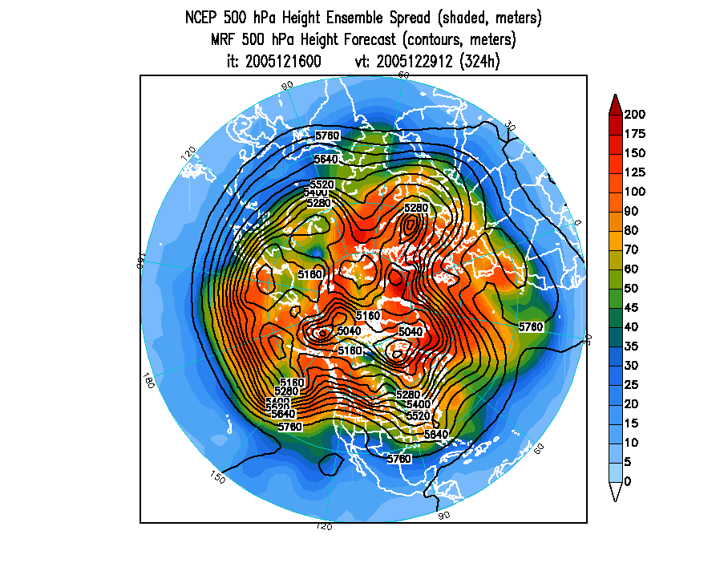
Applied NWP
Ensemble forecast systems, depend on dynamics of underlying flow
  Ensembles of data assimilation (multiple data assimilation [DA])
  Ensembles of different DA and modeling systems (multisystem approach)
http://www.emc.ncep.noaa.gov/gmb/ens/targ/hgtmenu.html

Slide 81
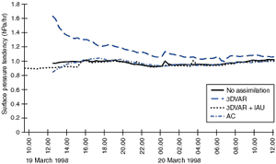
Applied NWP
Operational ensemble forecasting methods; multiple data assimilation
  Use different data assimilation schemes and add random errors to the observations
  Use different model physics as part of the ensembles during analysis step
  Can use ensemble forecasts to isolate the impact of particular parameterizations
http://www.metoffice.com/research/nwp/publications/nwp_gazette/sept99/new_data.html
Hamill et al. (2000) have shown that the multiple data assimilation ensemble system performs better than singular vector or breeding approaches.

Slide 82

Applied NWP
http://images.nfl.com/photos/img8106274.jpg
Operational ensemble forecasting methods; problems with previous approaches…
  Ensemble approach should replicate the statistical uncertainty in the initial conditions (related to the leading eigenvectors of the analysis error covariance)
  Should also replicate model imperfections and our uncertainty about model deficiencies
  However, perturbed ensemble forecasts are usually less skillful than the control and the perturbed model is worse than the control model→ ensemble mean at times is less skillful than the control model forecast

Slide 83

Applied NWP
http://www.cnn.com/2003/SHOWBIZ/books/12/11/review.mythology/story.superman.jpg
Operational ensemble forecasting methods; multisystem (“superensemble”) approach
  Takes the best (control) initial conditions and the best (control) model estimated at different operational centers
  Samples the true uncertainty in both the initial conditions and the models
  Quality of multisystem approach is optimized if systematic errors (bias) have first been corrected by regression

Slide 84
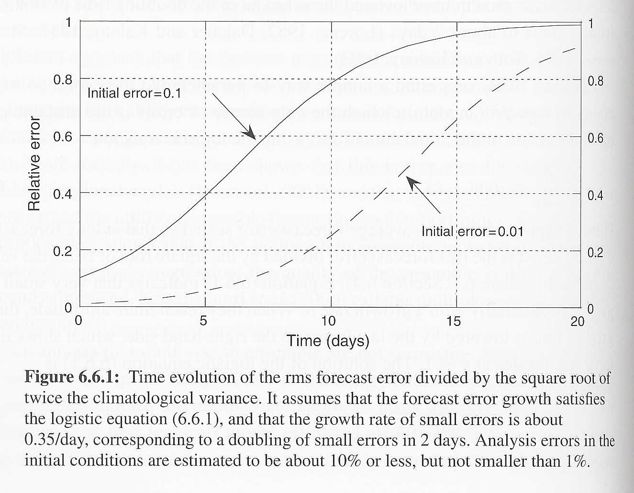
Applied NWP
Kalnay (2003)
Limits of predictability in mid-latitudes and tropics
  Lorenz (1963) estimated the limit of deterministic predictability ~ 2 weeks
  Lorenz (1982) parameterized the error evolution in a perfect model:
, where ε₀ is the initial error

Slide 85
Applied NWP
10%
Limits of predictability in mid-latitudes and tropics
  Current error ~ 10%
  Best error we can hope for ~ 1% [growth of unresolved scales and non-liner interactions with large scales]
1%
, where ε₀ is the initial error

Slide 86
Applied NWP
Limits of predictability in mid-latitudes and tropics
  Average predictability in a perfect model ~ 2 weeks
  Actual predictability with today’s models can extend beyond 2 week limit [Dec 1995]
    Can also be much lower than 2 weeks
  Ensembles provide day-to-day estimates of actual predictability

Slide 87
Applied NWP
Limits of predictability in mid-latitudes and tropics
  Time scales of error growth (“a”) are related to their spatial scales
  Short synoptic waves are typically less predictable than longer waves
Ahrens (2005)
, where ε₀ is the initial error

Slide 88
Applied NWP
Limits of predictability in mid-latitudes and tropics
where ε₀ is the initial error
Ahrens (2005)

Slide 89
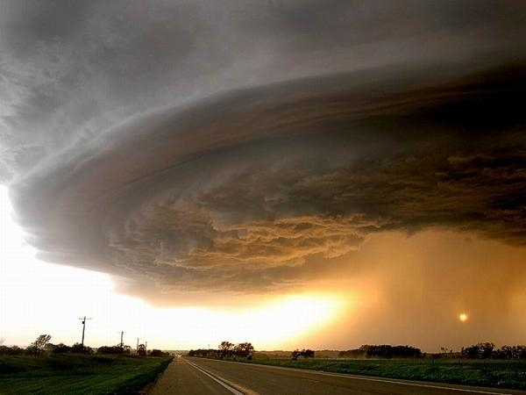
Applied NWP
Limits of predictability in mid-latitudes and tropics
  Mesoscale phenomena (fronts, squall lines, MCSs) are predictable on the order of a day or less
  Precipitation associated with a thunderstorm cannot be predicted with skill beyond ~1 hour

Slide 90
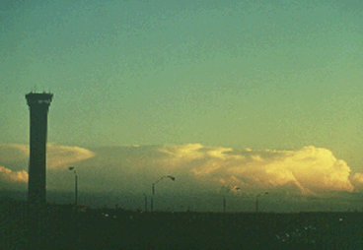
Applied NWP
Limits of predictability in mid-latitudes and tropics
  If small scale weather is organized or forced by larger scales, it can be predictable for much longer than for individual events
    Summer convective precipitation v. squall line associated with passage of a cold front
http://ww2010.atmos.uiuc.edu/guides/mtr/svr/type/mline/gifs/rtr2.gif

Slide 91
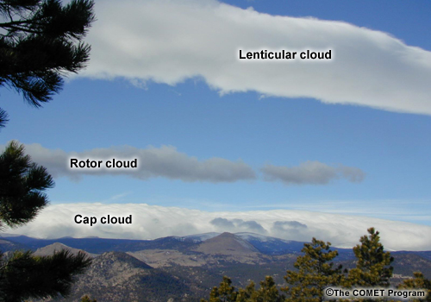
Applied NWP
Limits of predictability in mid-latitudes and tropics
  Mesoscale phenomena forced by the interaction of synoptic scales with surface topography have much longer predictability than when they occur in isolation
http://meted.ucar.edu/mesoprim/mtnwave/media/graphics/waveclouds.jpg

Slide 92
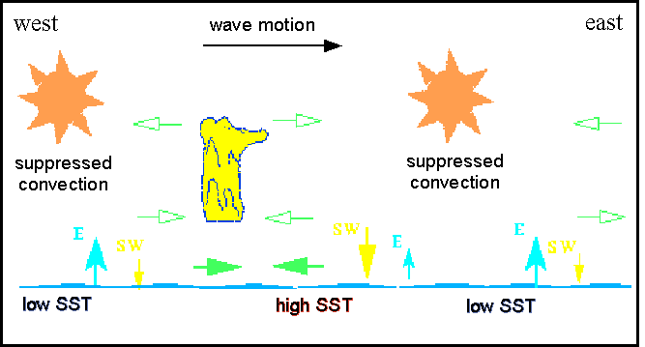
Applied NWP
MJO
Limits of predictability in mid-latitudes and tropics
  “regular” propagation of convection
    Unforced convective activity of Carbone et al. (2000) – 1-2 predictability?
    MJO (Weickman et al. 1985) – 1 month predictability?
http://www-das.uwyo.edu/~geerts/cwx/notes/chap12/mjo1.gif

Slide 93

Applied NWP
Limits of predictability in mid-latitudes and tropics
  Mid-latitudes;
    dominated by synoptic-scale baroclinic instabilities
  Tropics;
    dominated by barotropic and convective instabilities and their interactions
http://www.acclaimimages.com/_gallery/_SM/0001-0302-0301-4148_SM.jpg

Slide 94

Applied NWP
Limits of predictability in mid-latitudes and tropics
  Tropics
    Waves modulated strongly by convection
    Global atmospheric models less accurate
      Imperfect convective parameterization
      Perfect model assumption is poor
http://www.phangan.info/files/photographs/210.jpg

Slide 95
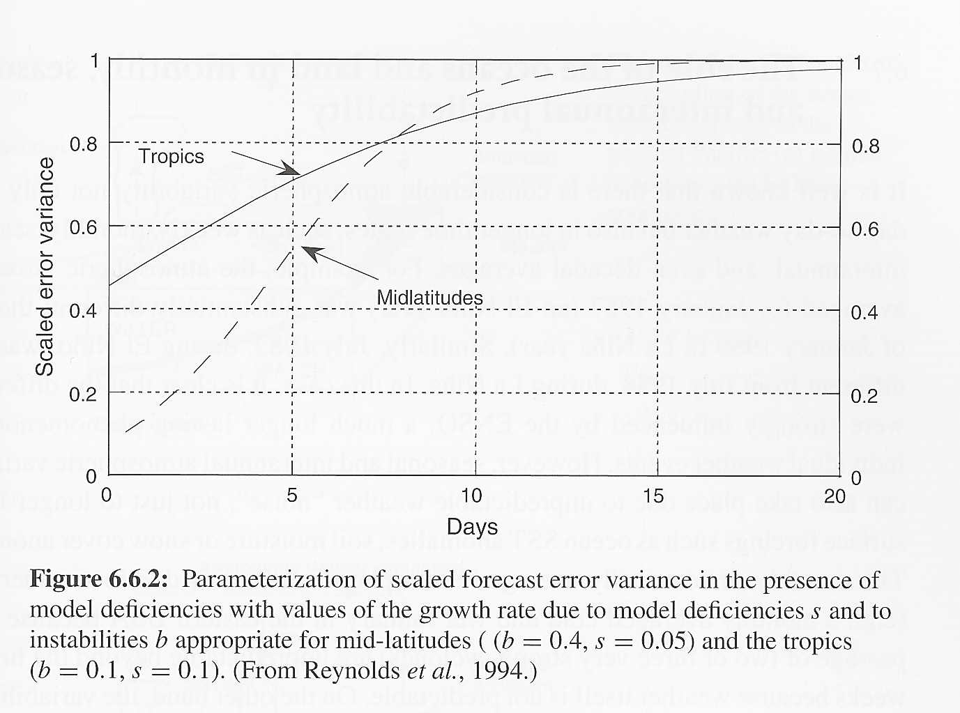
Applied NWP
Kalnay (2003)
Limits of predictability in mid-latitudes and tropics
where
Growth rate of an imperfect model where “b” is the error growth rate due to the presence of errors in the initial conditions and “s” is the error grow rate due to model deficiencies.

Slide 96
Applied NWP
Limits of predictability in mid-latitudes and tropics
  ‘b’ ~ 0.4/day; mid-lats
  ‘b’ ~ 0.1/day; tropics
  ‘s’ ~ 0.05/day; mid-lats
  ‘s’ ~ 0.2/day; tropics
Suggests that if convection didn’t play such a dominant role in the tropics, tropical weather forecasts would be skillful for longer periods than mid-latitude predictions

Slide 97

Applied NWP
Limits of predictability in mid-latitudes and tropics
  On average…
    Tropical forecasts maintain useful skill for about 3-5 days
    Extratropical forecasts maintain useful skill for about 7 days
http://www.fotosearch.com/comp/csk/CSK146/KS5058.jpg

Slide 98
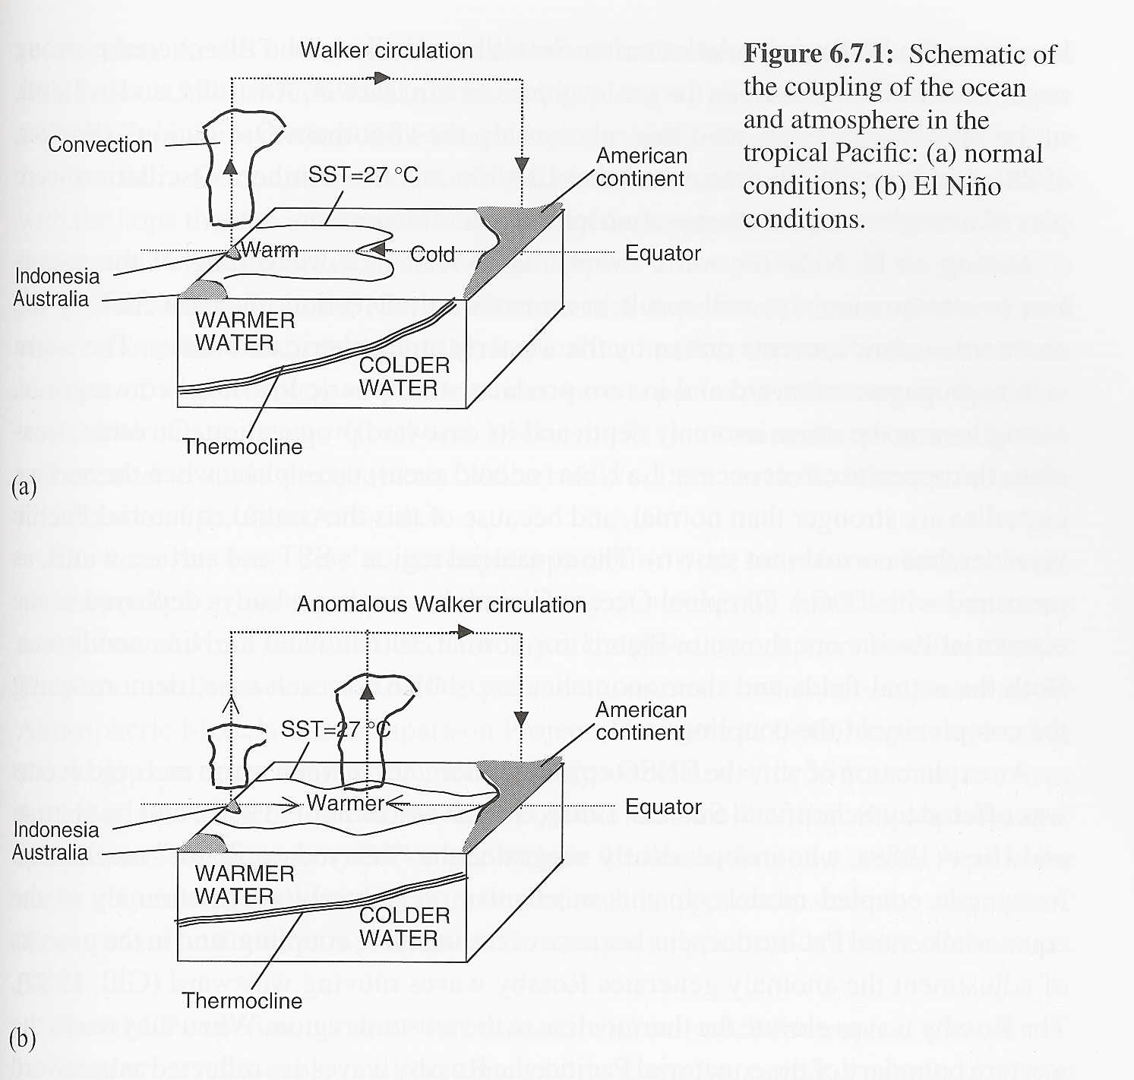
Applied NWP
Kalnay (2003)
Role of the underlying surface in monthly, seasonal, and interannual predictability
  Long-term variability causes…
    Long-lasting weather phenomenon (e.g. El Niño, La Niña)
    SST, soil moisture, or snow cover anomalies

Slide 99

Applied NWP
Long-term variability caused by long-lasting surface anomalies
  Predictable
  Potential predictability
    definition
  “predictability of the second kind”
http://www.ecotrust.org/copperriver/crks_cd/content/pages/photographs/images/glacier.jpg

Slide 100

Applied NWP
Long-term variability caused by long-lasting surface anomalies
  Charney and Shukla
    Tropics are more responsive to long-lasting ocean SST anomalies than mid-lats
    Potential predictability for the tropics at long time scales is much larger than that of mid-lats due to long-lasting ocean anomalies
http://www.acclaimimages.com/_gallery/_SM/0027-0406-1806-0900_SM.jpg

Slide 101

Applied NWP
Long-term variability caused by long-lasting surface anomalies; ENSO
  Normal conditions

Slide 102

Applied NWP
Long-term variability caused by long-lasting surface anomalies; ENSO
  El Niño conditions

Slide 103

Applied NWP
Long-term variability caused by long-lasting surface anomalies; ENSO
  Several ways El Niño (and La Niña) can form
  Coupled oscillations have time scales of 3-7 years
  Could be predictable for seasons through years in advance
Scientific program TOGA was created to study ENSO (see Wallace et al. [1998])

Slide 104
Applied NWP
Long-term variability caused by long-lasting surface anomalies; Cai et al. (2002) ENSO study
  Transitions between episodes are least predictable
  Most predictable during the maxima of the episode

Slide 105

Applied NWP
Long-term variability caused by long-lasting surface anomalies; during ENSO…
  Regions in mid-lats (Europe) that are less predictable
  Regions in mid-lats (Pacific and North America) that have higher predictability
http://www.nctimes.com/content/articles/2005/02/22/news/top_stories/22105201706.jpg
See Vol 126, No 567 of QJRMS and Vol 107, Issue C7 (1998) of JGR for more info

Slide 106

Applied NWP
Long-term variability caused by long-lasting surface anomalies; land surface
  Positive feedback potential quite large
    low precip→low soil moisture→reduced evap→reduced precip
  Regions having strong gradients in precip can lead to long-lasting surface anomalies
    e.g., subtropical regions
http://www.phototravels.net/namibia/ndv1/namib-desert-v-35.2.jpg

Slide 107

Applied NWP
Decadal variability and climate change
  Variations of earth’s sfc temperature over the last 140 years (a) and over the last millennium (b)

Slide 108

Applied NWP
Kalnay (2003)
Decadal variability and climate change
  Rapid climate changes associated with transitions into ice ages may be completely unpredictable since they may be the result of unpredictable small changes
    e.g., volcanic activity

Slide 109
Applied NWP
Decadal variability and climate change
  Climate change of human origin should be predictable
    “external” forcing (increase in greenhouse gases) is known, forced response of climate change can be predicted well
    impacts on regional scales is much more difficult to predict
      influence of chaotic weather

