Slide 1
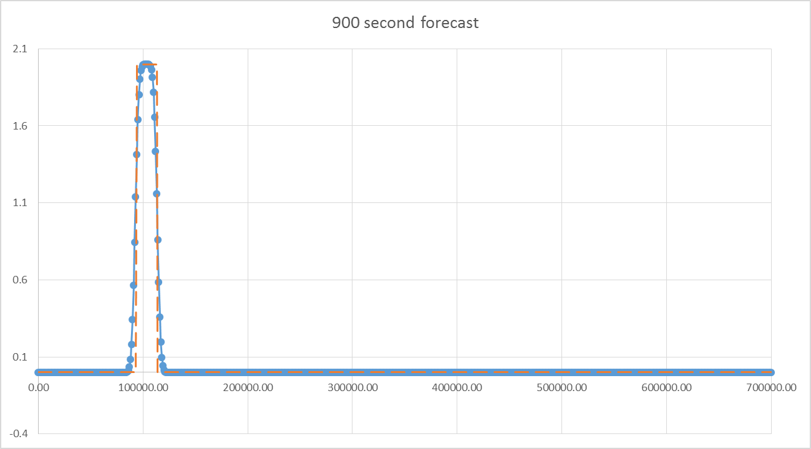
u (m s⁻¹)
x (meters)
$μ=c\frac{Δt}{Δx}$ = 0.45
Δx= 1 km, Δt = 30 s, c = 15 m s⁻¹

Slide 2
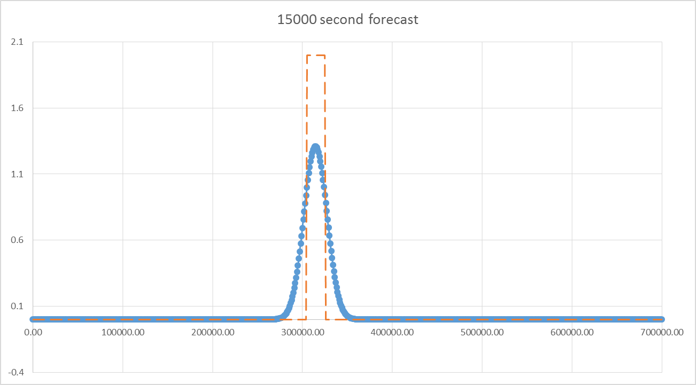
u (m s⁻¹)
x (meters)
Δx= 1 km, Δt = 30 s, c = 15 m s⁻¹

Slide 3
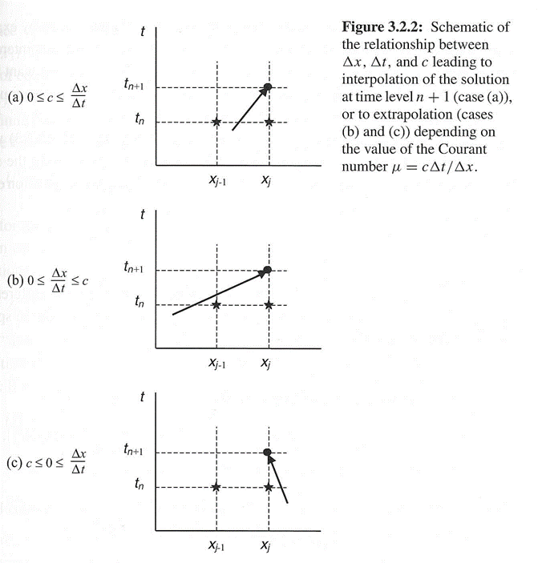
$μ=c\frac{Δt}{Δx}$ = 1.05
Δx= 1 km, Δt = 30 s, c = 35 m s⁻¹

Slide 4
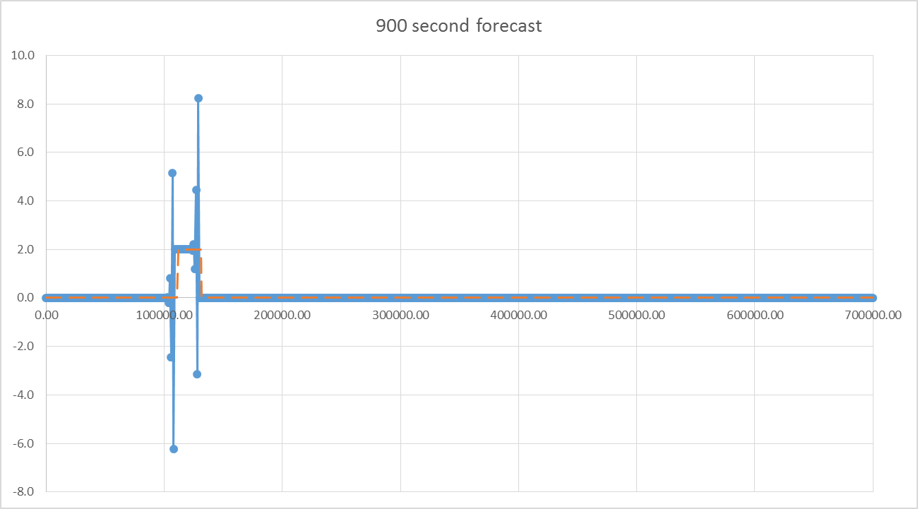
u (m s⁻¹)
x (meters)
Δx= 1 km, Δt = 30 s, c = 35 m s⁻¹

Slide 5
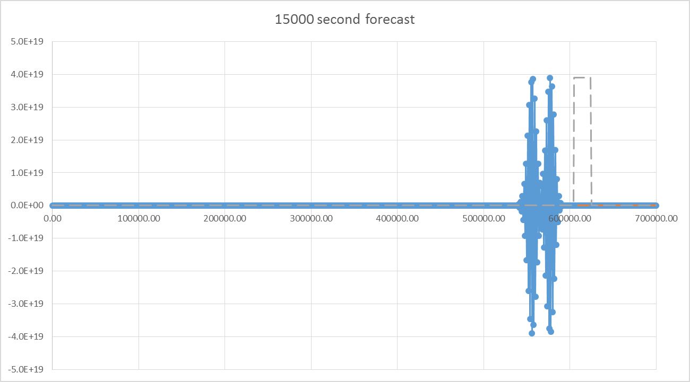
u (m s⁻¹)
x (meters)
Δx= 1 km, Δt = 30 s, c = 35 m s⁻¹

Slide 6
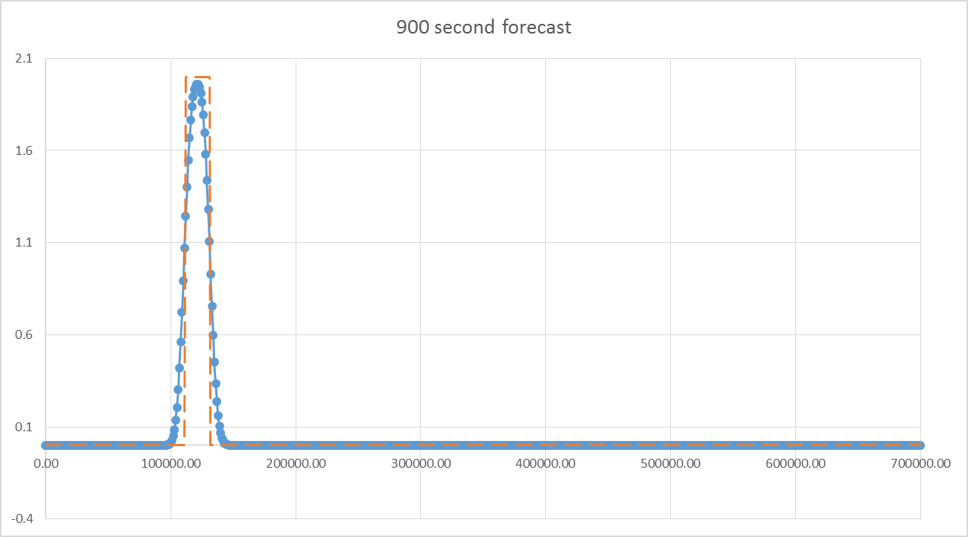
u (m s⁻¹)
x (meters)
$μ=c\frac{Δt}{Δx}$ = 0.35
Δx= 1 km, Δt = 10 s, c = 35 m s⁻¹

Slide 7
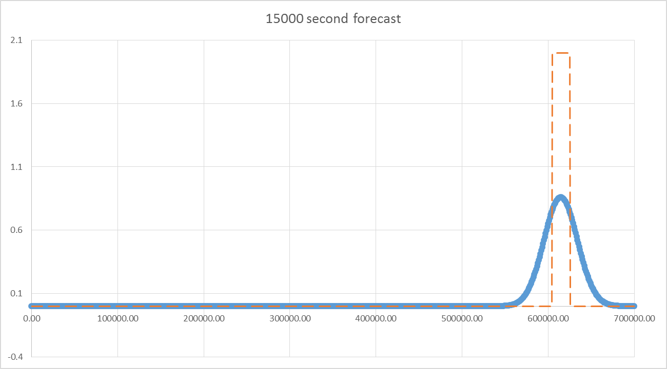
u (m s⁻¹)
x (meters)
Δx= 1 km, Δt = 10 s, c = 35 m s⁻¹

